Slide 1
Benchmarking Object Detectors on
Under-Sampled Marine Biodiversity Imagery
FathomNet CLEF 2026 | Project Review 2
Charan Rasineni
B.Tech CSE | SCOPE, VIT-AP University, Amaravati
Mentor: Dr. Rajesh Duvvuru

Slide 2
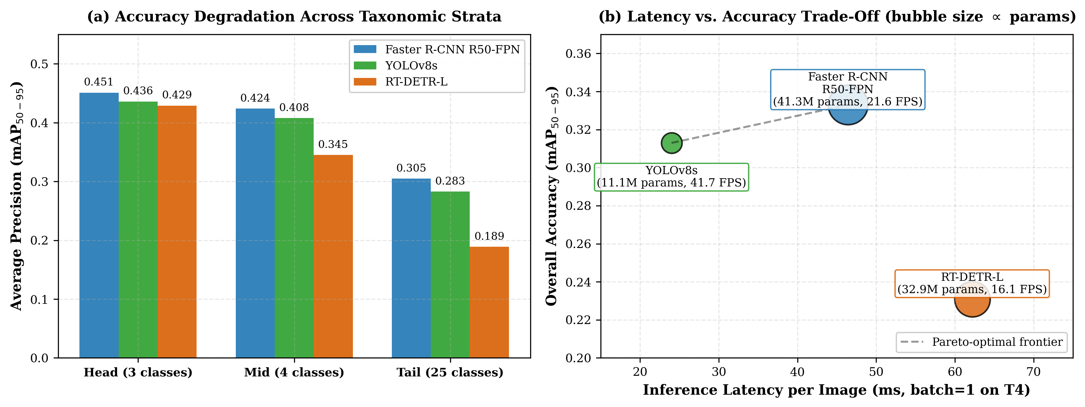
Recap: Models & Protocol
Three detector families:
• Faster R-CNN R50-FPN — two-stage
• YOLOv8s — one-stage
• RT-DETR-L — transformer-based
Identical evaluation protocol:
• Stratified 90/10 split, seed 42
• 640 x 640 px input, 30 epochs
• COCO mAP via pycocotools
• Conf thr 0.001, max det 300

Slide 3
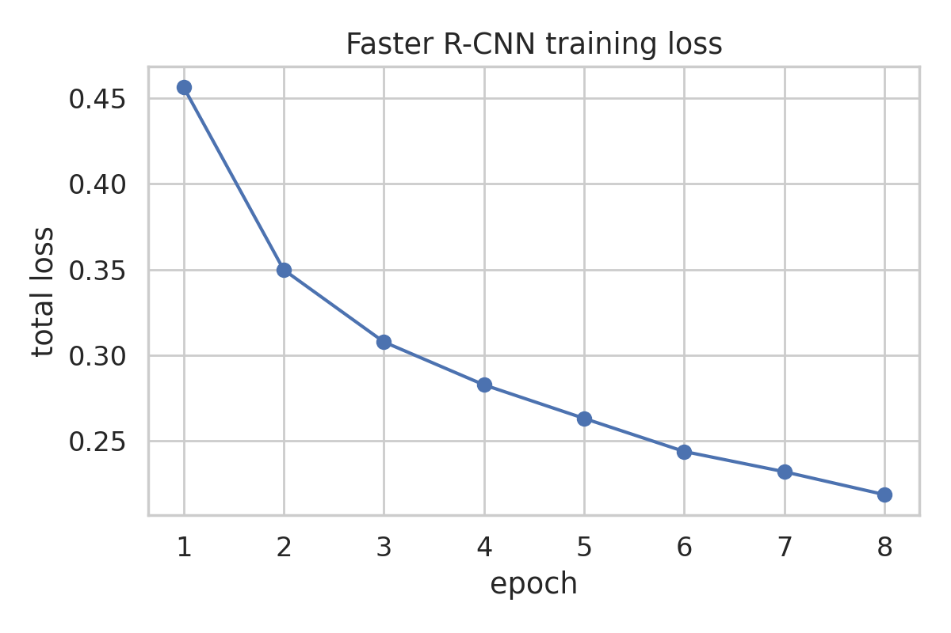
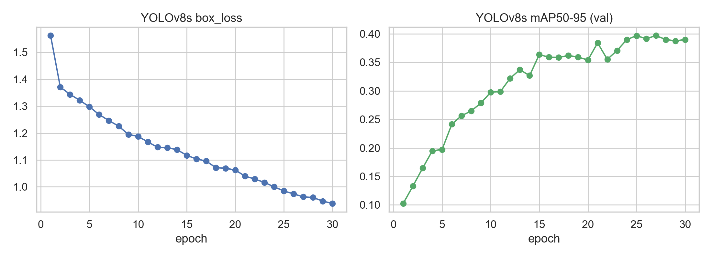
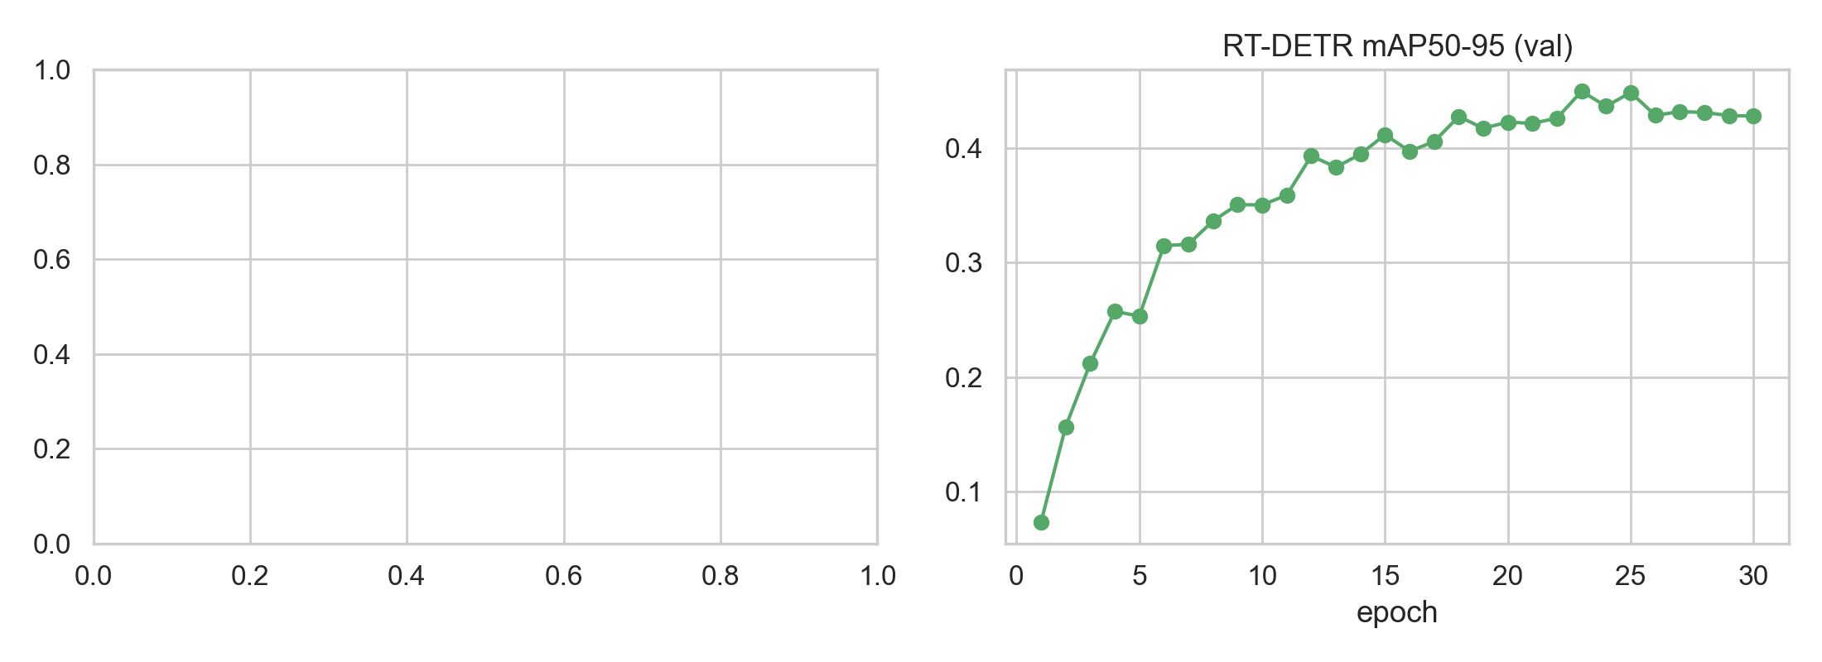
Training Curves — Validation mAP@[.50:.95]
Observations:
• Faster R-CNN and YOLOv8s converge steadily over 30 epochs.
• RT-DETR-L shows a slower, noisier learning curve (transformer data-hunger).
• All models share the identical data split, isolating architectural differences.

Slide 4
Overall Detection Performance
mAP@[.50:.95] | mAP@0.50 | Latency
Faster R-CNN: 0.333 | 0.483 | 46.4 ms
YOLOv8s: 0.313 | 0.428 | 24.0 ms
RT-DETR-L: 0.231 | 0.323 | 62.2 ms
Faster R-CNN is the accuracy leader.

Slide 5
Per-Class Analysis (Faster R-CNN)
Easy classes (AP > 0.55): pyrosome 0.925, larvacean 0.718, hydroid 0.653, urchin 0.592, stony coral 0.586
Medium classes (0.2–0.4): anemone 0.309, sea fan 0.405, sponge 0.397, crab 0.517
Hard tail classes (~0.0): amphipod, bivalve, sea slug, sea squirt, barnacle
Same ordering holds for YOLOv8s & RT-DETR-L — difficulty driven by data distribution, not architecture.
Head / Mid / Tail AP@[.50:.95]:
FRCNN: 0.451 | 0.424 | 0.305
YOLOv8s: 0.436 | 0.408 | 0.283
RT-DETR-L: 0.429 | 0.345 | 0.189
Consistent head-to-tail degradation across all three.

Slide 6
Object-Size Stratified AP@[.50:.95]
Detector | Small | Medium | Large
Faster R-CNN | 0.007 | 0.059 | 0.377
YOLOv8s | 0.000 | 0.063 | 0.350
RT-DETR-L | 0.000 | 0.075 | 0.254
Small objects effectively undetected at 640 px.
Large objects: moderate accuracy (0.25–0.38)
Medium objects: poor (0.06–0.08)
Small objects: ~0.00–0.01 — tiny marine invertebrates occupy only a few pixels after resizing
Future: higher-resolution inputs, test-time tiling, small-object augmentation

Slide 7
Discussion So Far
Ranking: two-stage > one-stage > transformer (this config); read with config caveats (resizing, optimiser, checkpoint rules differ).
YOLOv8s: best accuracy–cost balance — 94% of FRCNN mAP at ~52% latency & ~1/4 parameters.
Faster R-CNN: accuracy ceiling; RT-DETR-L: neither most accurate nor fastest here — transformer baseline.
Head-to-tail degradation generalises to long-tailed underwater datasets (annotation frequency + object scale).
Small-object blind spot at 640 px transfers across architectures.
Review 3 target: qualitative results, Grad-CAM, full discussion, limitations, conclusion.

