Slide 1
Benchmarking Object Detectors on
Under-Sampled Marine Biodiversity Imagery
FathomNet CLEF 2026 | Project Review 3 (Final)
Charan Rasineni
B.Tech CSE | SCOPE, VIT-AP University, Amaravati
Mentor: Dr. Rajesh Duvvuru

Slide 2
Executive Summary
Benchmark of Faster R-CNN R50-FPN, YOLOv8s, RT-DETR-L on FathomNet CLEF 2026 underwater imagery.
Faster R-CNN: best accuracy (mAP 0.333 / 0.483); YOLOv8s: best accuracy–latency trade-off (0.313 / 0.428 at 24 ms).
RT-DETR-L: lowest accuracy (0.231 / 0.323) and slowest (62 ms) in this config.
All detectors show strong head-to-tail degradation; small objects undetected at 640 px.
Recommendation: YOLOv8s for AUV/ROV deployment; Faster R-CNN when latency is secondary.

Slide 3
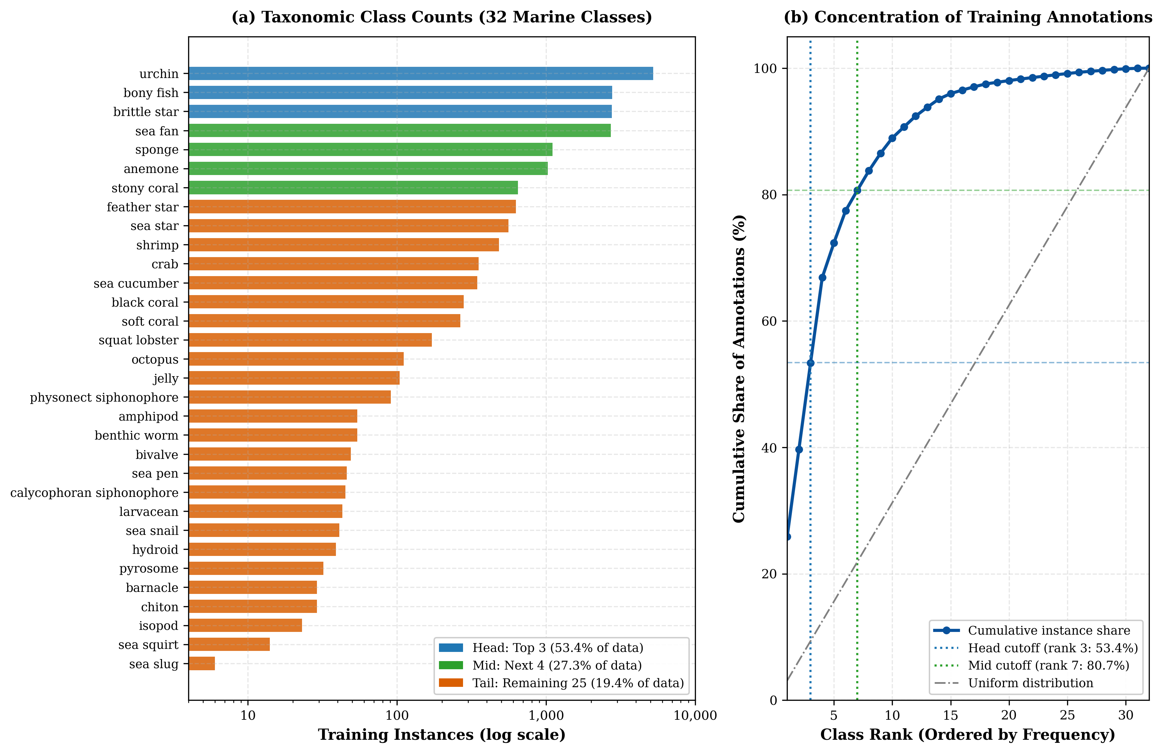
Dataset & Protocol
5,817 train / 646 val images, 32 classes
Long-tailed: top-3 classes ~53% of annotations; rarest has 6 instances
Head: bony fish, brittle star, urchin | Mid: anemone, sea fan, sponge, stony coral | Tail: 25 classes
Stratified 90/10 split, seed 42
640 x 640 px input, 30 epochs
COCO mAP, thr 0.001, max det 300
NVIDIA T4 GPU, 15 GiB

Slide 4
Full Results — mAP & Latency
Detector mAP[.50:.95] mAP@0.50 mAP@0.75 Latency
Faster R-CNN 0.333 0.483 0.354 46.4 ms
YOLOv8s 0.313 0.428 0.356 24.0 ms
RT-DETR-L 0.231 0.323 0.252 62.2 ms
YOLOv8s = 94% of FRCNN mAP at ~52% of latency & ~1/4 parameters.
Head / Mid / Tail AP@[.50:.95] — FRCNN: 0.451 / 0.424 / 0.305; YOLOv8s: 0.436 / 0.408 / 0.283; RT-DETR-L: 0.429 / 0.345 / 0.189
Size AP@[.50:.95] (S / M / L) — FRCNN: 0.007 / 0.059 / 0.377; YOLOv8s: 0.000 / 0.063 / 0.350; RT-DETR-L: 0.000 / 0.075 / 0.254

Slide 5
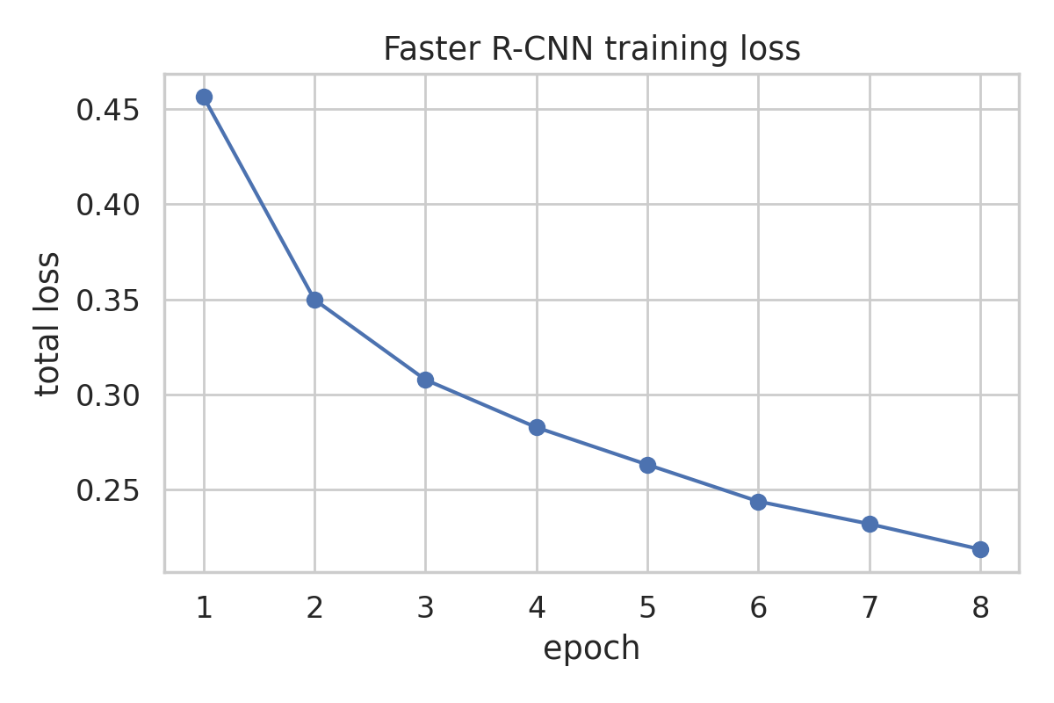
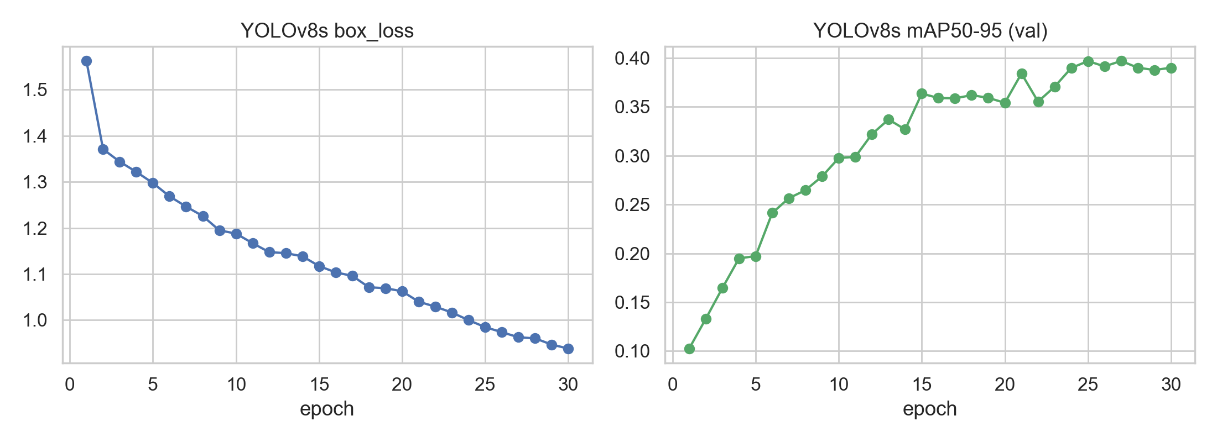
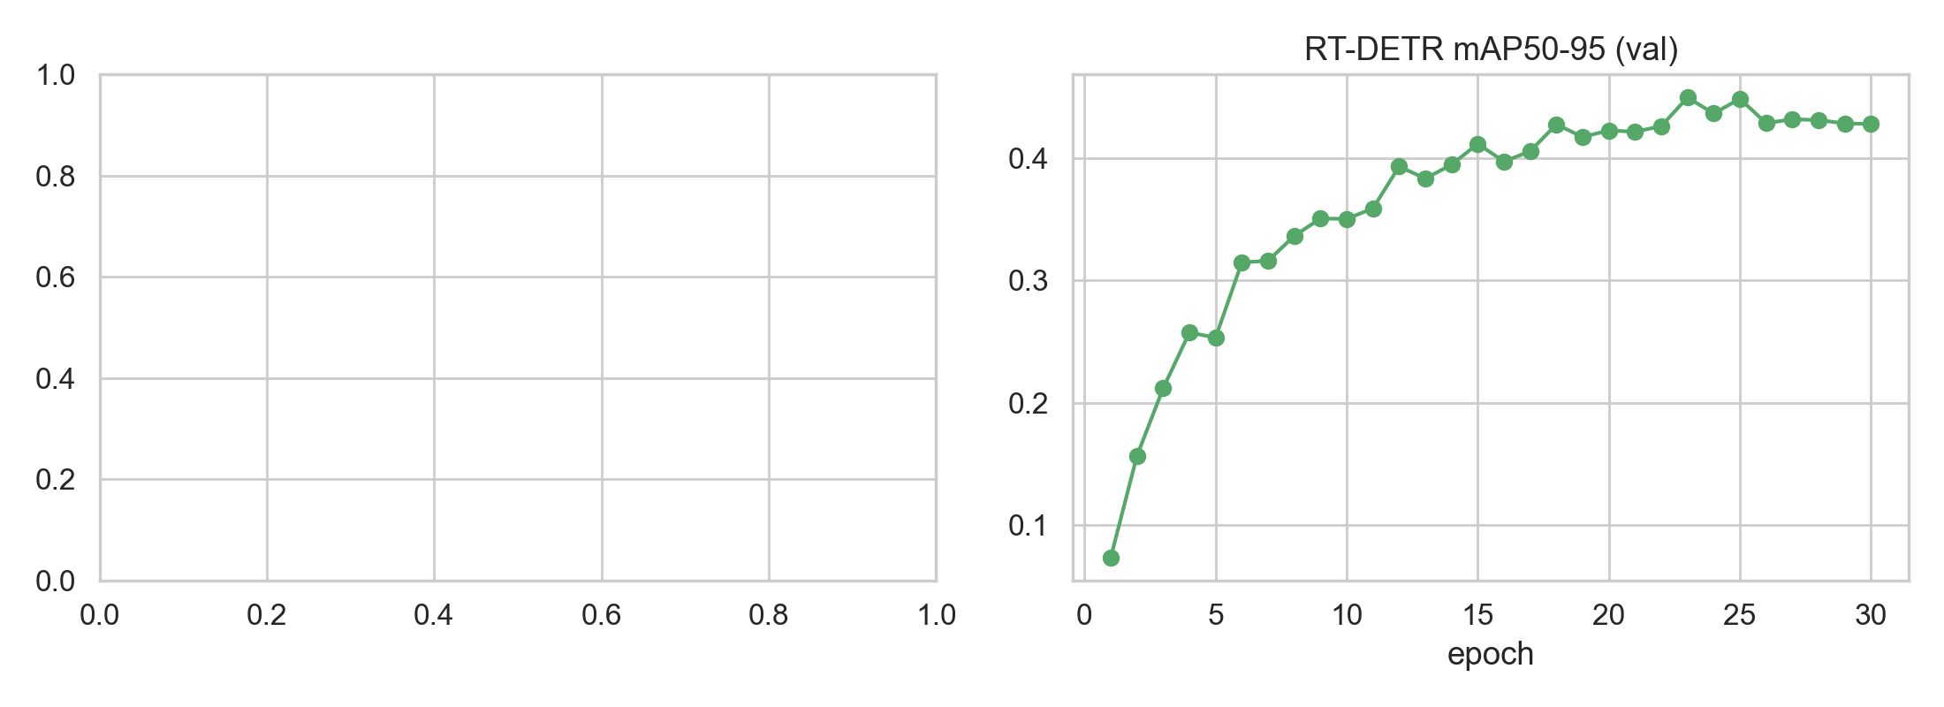
Validation mAP@[.50:.95] Training Curves
FRCNN & YOLOv8s converge steadily; RT-DETR-L slower & noisier (transformer data-hunger / convergence challenge).

Slide 6
Per-Class AP@[.50:.95] (Faster R-CNN)
Easy (>0.55): pyrosome 0.925, larvacean 0.718, hydroid 0.653, urchin 0.592, stony coral 0.586
Medium (0.2–0.4): anemone, sea fan, sponge, crab, octopus
Hard (~0.0): amphipod, bivalve, sea slug, sea squirt, barnacle
Ordering consistent across all three detectors — driven by annotation count & object size.
Head / Mid / Tail AP@[.50:.95]:
FRCNN: 0.451 / 0.424 / 0.305
YOLOv8s: 0.436 / 0.408 / 0.283
RT-DETR-L: 0.429 / 0.345 / 0.189

Slide 7
Inference Cost — NVIDIA T4 (batch 1, FP32, 640 px)
YOLOv8s: 24.0 ms/img (fastest)
FRCNN: 46.4 ms/img
RT-DETR-L: 62.2 ms/img (slowest)
Memory: Ultralytics (YOLOv8s/RT-DETR-L) AMP batch 4; FRCNN FP32 batch 2.
Deployment trade-off:
• YOLOv8s: best accuracy–cost fit for embedded AUV/ROV
• FRCNN: accuracy ceiling when latency is secondary
• RT-DETR-L: high memory, not recommended from these runs

Slide 8
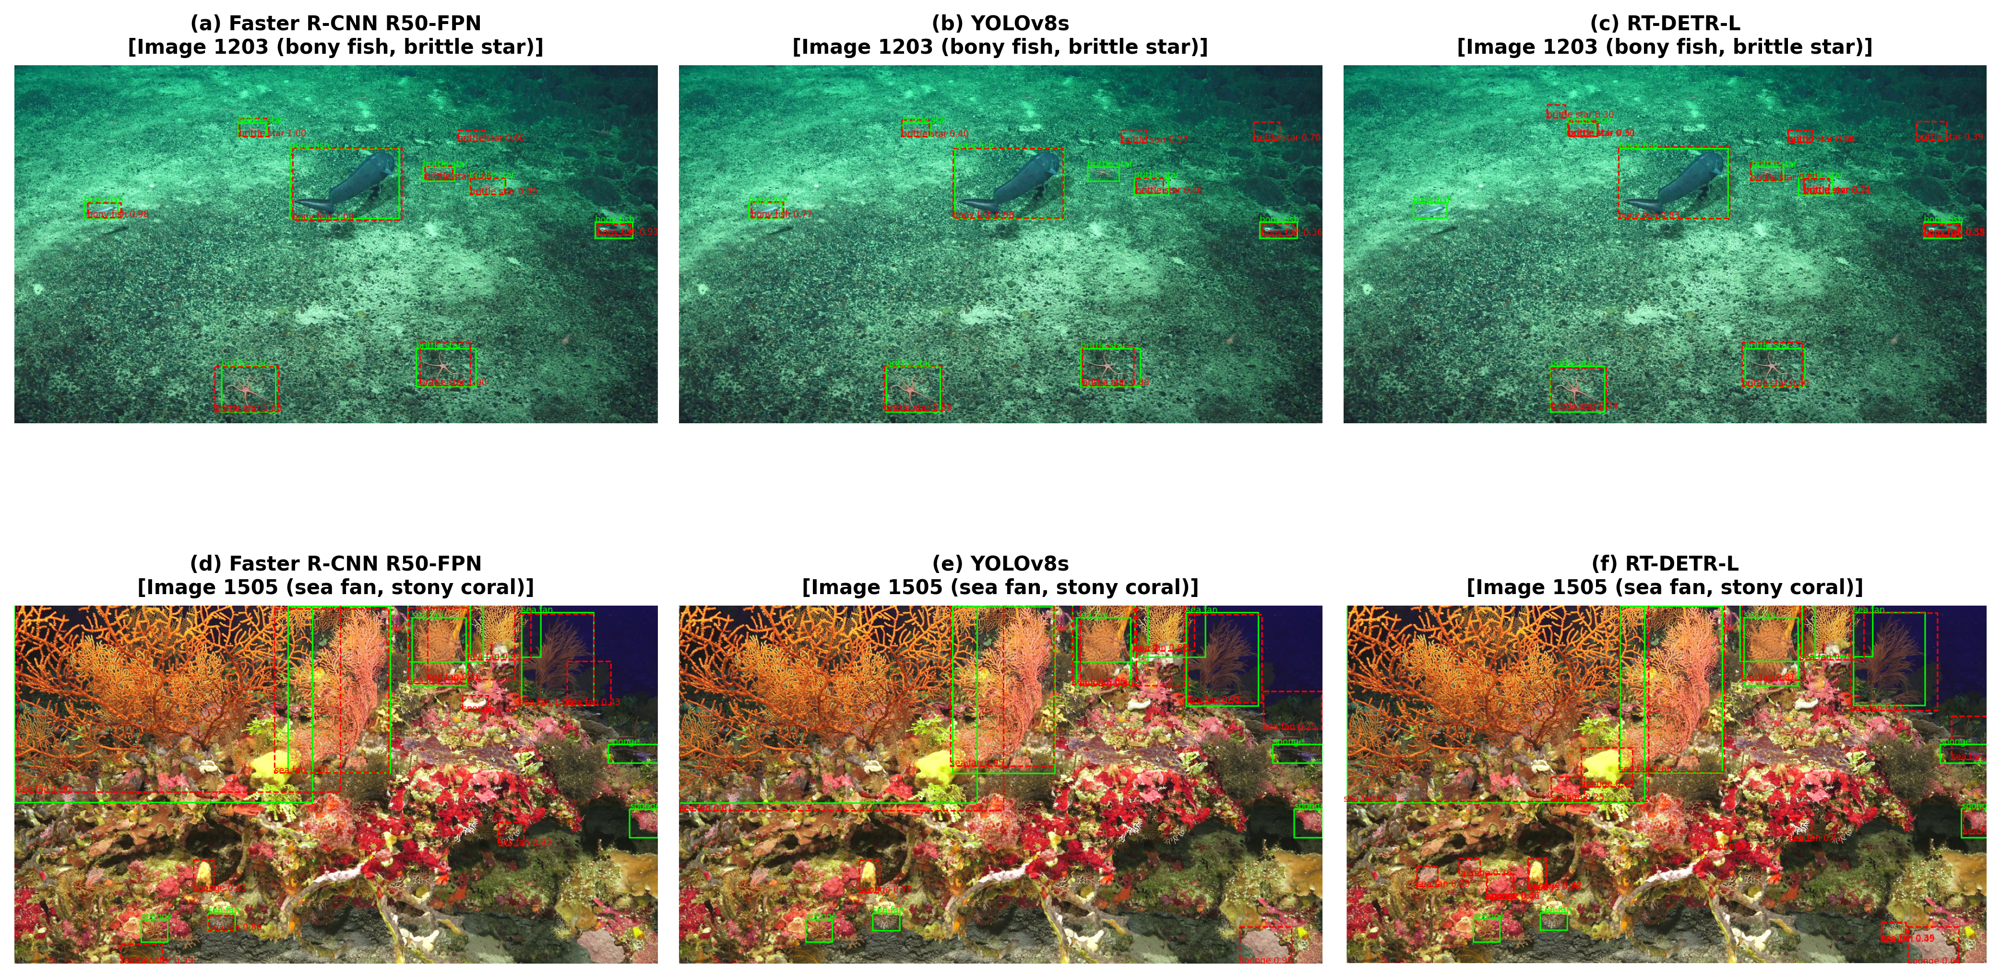
Qualitative Detection Examples
Matched detections across Faster R-CNN, YOLOv8s, RT-DETR-L (GT overlaid, score thr 0.25). Easy classes detected consistently; rare/small/camouflaged taxa missed.

Slide 9
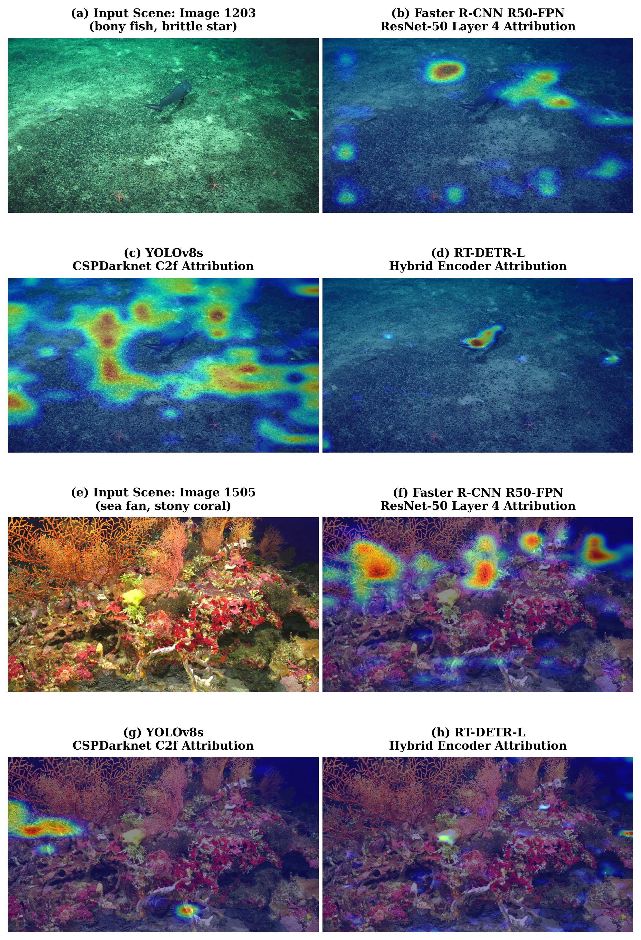
Grad-CAM Visual Attributions
Feature-activation comparison across deep layers — detectors attend to salient foreground on easy classes; diffuse/absent on hard tail classes.

Slide 10
Discussion
Ranking must be read with config caveats — results compare representative default setups, not strictly equal compute.
Head-to-tail degradation is inherited from the data distribution and transfers across long-tailed underwater datasets.
Small-object blind spot at 640 px transfers across architectures.
YOLOv8s sits at the accuracy–cost sweet spot; FRCNN is the accuracy ceiling; RT-DETR-L is the transformer baseline.

Slide 11
Limitations
Single split & seed; validation-only evaluation (no blind test set)
Nominally equal, not identical, compute across frameworks
Single hardware (NVIDIA T4); modest 30-epoch budget
No long-tailed algorithmic intervention (standard cross-entropy only)

Slide 12
Conclusion & Future Work
FRCNN best accuracy; YOLOv8s best accuracy–latency trade-off; RT-DETR-L trails in this config.
Deploy YOLOv8s on AUV/ROV; use FRCNN when latency is secondary.
Future work:
• Longer schedules, multi-seed evaluation, blind test-set submission
• Test-time tiling / higher resolution for small objects
• Long-tailed losses & resampling; model compression (quantisation/distillation)

Slide 13
References
FathomNet (Scientific Reports, 2022); FathomNet CLEF 2026 (ImageCLEF LifeCLEF track)
Faster R-CNN (NeurIPS 2015); FPN (CVPR 2017); Mask R-CNN (ICCV 2017)
YOLOv8 / Ultralytics (2023)
DETR (ECCV 2020); Deformable DETR (ICLR 2021); RT-DETR (CVPR 2024)
PyTorch (NeurIPS 2019); pycocotools; Kaggle

