Slide 1
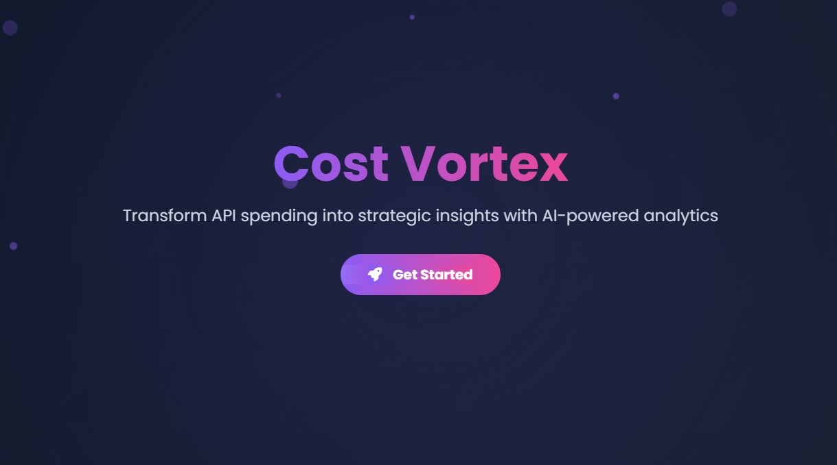
By:
Sahithi Vesangi
sahithivesangi.ms@gmail.com

Slide 2
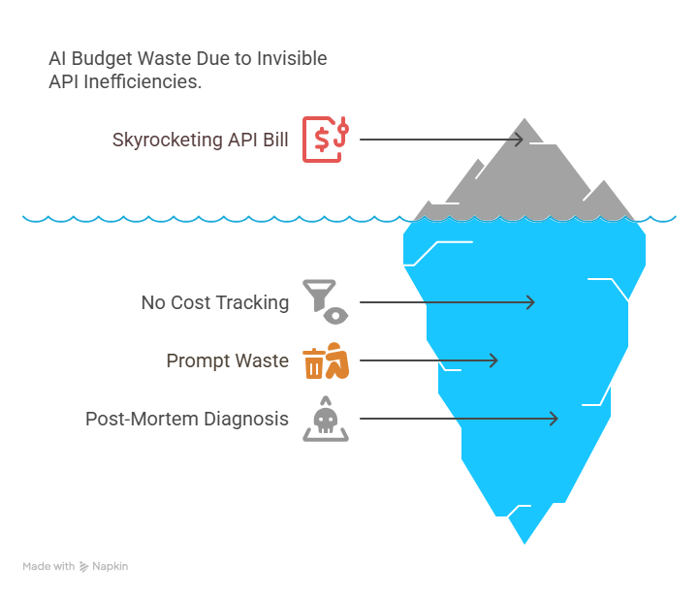
The 1B+ Blind Spot - Problem
Companies waste 37% of AI budgets on invisible API inefficiencies.
Meet - Sarah - Her engineering team shipped groundbreaking AI features… until they got $8400 monthly API bill.

Slide 3
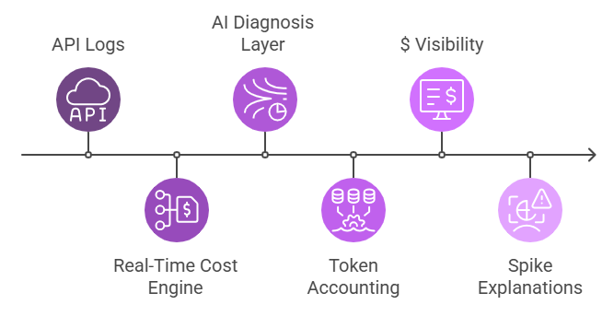
The Solution - Cost Vortex
Cost Vortex - The AI economist for your API stack
Value Proposition:

Slide 4
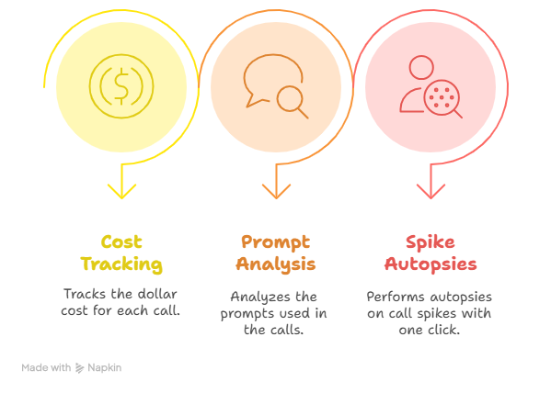
Key Features

Slide 5
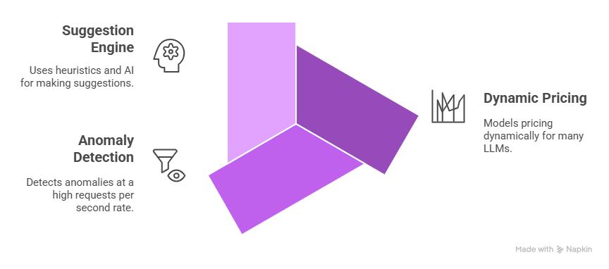
The Techstack
Frontend: Vue.js, Three.js, Tailwind CSS, HTML
Algorithms: Token optimizer, Time Series Analysis
AI blend: GPT-4o Summary prediction

Slide 6
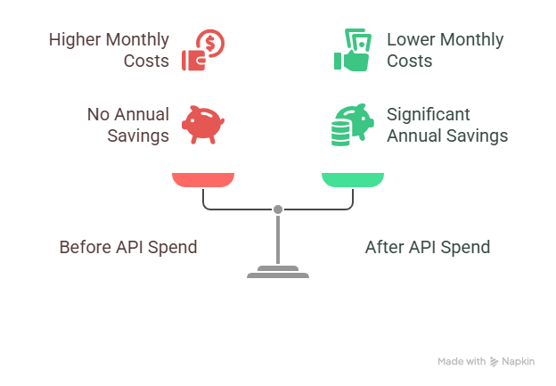
Real World Impact
42% Cost Reduction in the first 14 days.

Slide 7
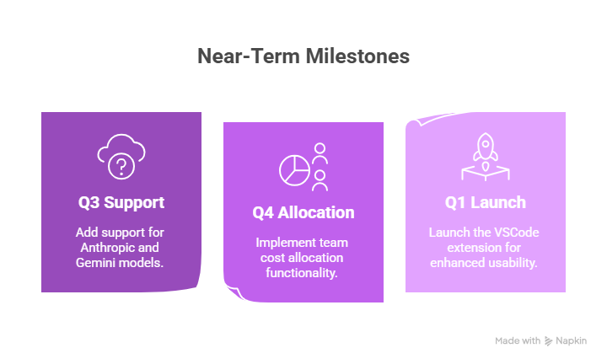
Market Opportunity and The future
$17B enterprise LLM spend by 2025 (Gartner Insights)
0 Competitors with AI powered cost ops

Slide 8
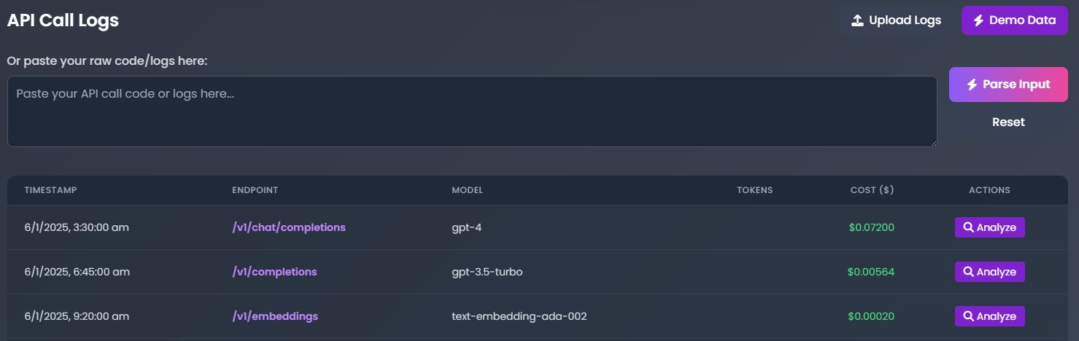
The Demo Snapshots
Upload Files or Code/logs

Slide 9
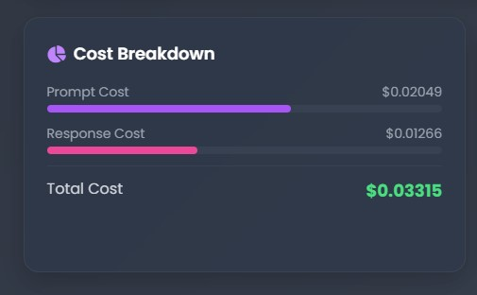
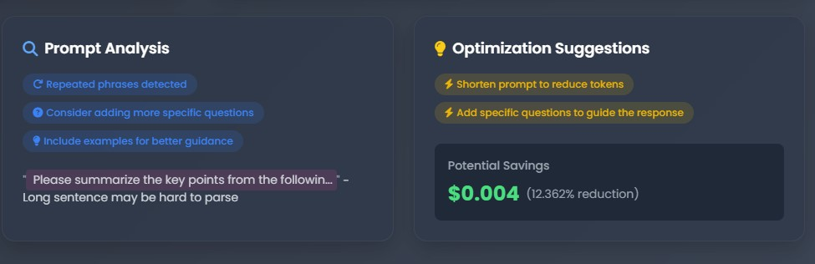
The Demo Snapshots

Slide 10
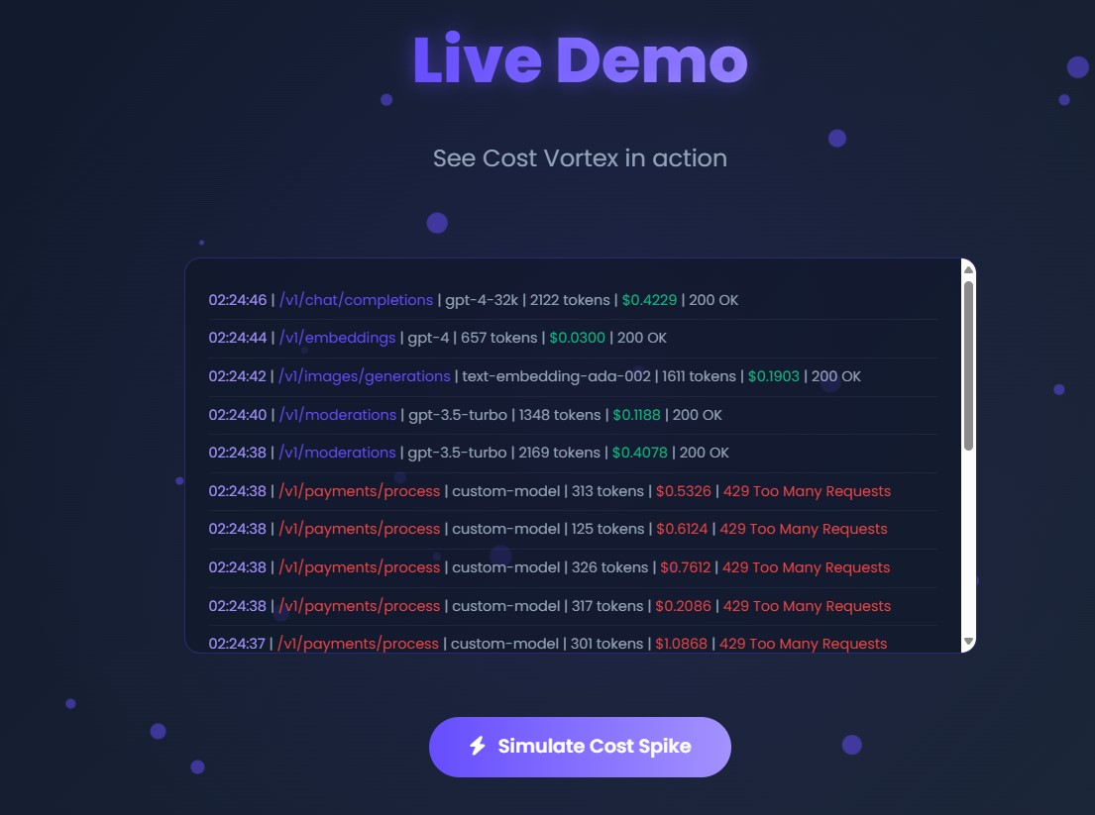
The Demo Snapshots
Cost Spike Simulation

Slide 11
ThankYou

