Slide 1

Data Vizualization Final Project
Analyzing Traffic Collision Data: Enhancing Road Safety in Montgomery County

Slide 2

Objective
The objective of the project is to analyze the Montgomery County Traffic Collision Dataset to:
Identifying accident hotspots
Enhancing road safety measuresEncourage new ideas to stop accidents from happening.
Notes:
The goal of our analysis is to utilize the Montgomery County Traffic Collision Dataset to gain insights into traffic accidents within the region and develop actionable strategies to improve road safety. By identifying patterns, trends, and contributing factors to collisions, By identifying patterns, trends, and contributing factors to collisions, our aim is to reduce the frequency and severity of accidents, ultimately saving lives and enhancing the overall safety of road users in Montgomery County.

Slide 3
Overview
Our project has 172,105 records across 43 columns.

Slide 4
Data Cleaning
We have selected 17,210 rows in the dataset.
Missing values in 'Collision Type' were replaced with the most common value.
Missing values in 'Weather' and 'Surface Condition' were replaced with their respective modes.
Missing values in 'Traffic Control' were replaced with 'Unknown' or 'Not Specified'.
Missing values in 'Municipality' were replaced with a placeholder value like 'Unknown'.
Missing values in 'Vehicle Model' were replaced with the most common value.
'Crash Date/Time' column was converted to a datetime format for easier manipulation.
Object-type columns were converted to strings to ensure uniform data type across the dataset.
Notes:
Missing values in 'Collision Type' were replaced with the most common value.
Missing values in 'Weather' and 'Surface Condition' were replaced with their respective modes.
Missing values in 'Traffic Control' were replaced with 'Unknown' or 'Not Specified'.
Missing values in 'Municipality' were replaced with a placeholder value like 'Unknown'.
Missing values in 'Vehicle Model' were replaced with the most common value.
'Crash Date/Time' column was converted to a datetime format for easier manipulation.
Object-type columns were converted to strings to ensure uniform data type across the dataset.

Slide 5
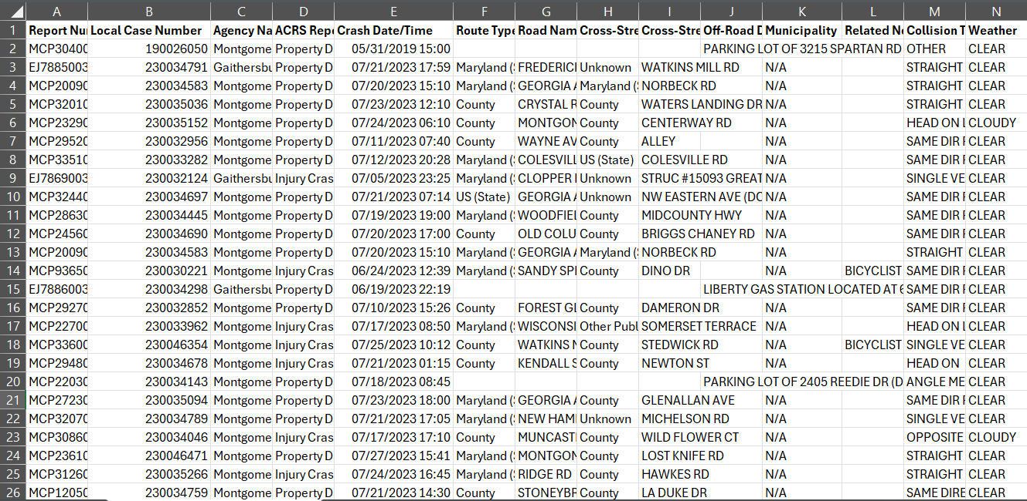
Route Type
Latitude
Longitude
Location
Crash Date/Time
Injury Severity
Speed Limit
Vehicle Year
Weather
Light
Driver At Fault
Related Non-motorist
Driver Distracted By
Driver Substance Abuse
Vehicle make
Variables

Slide 6
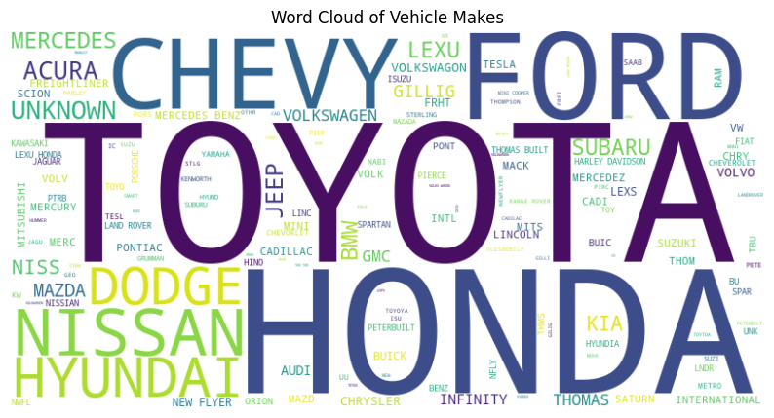

Slide 7
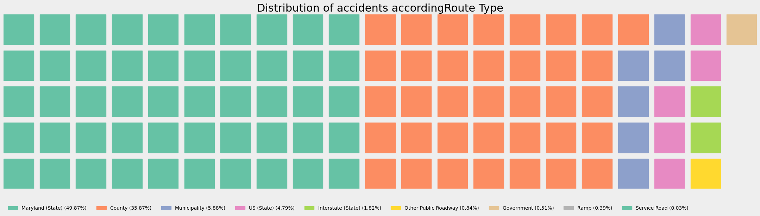

Slide 8
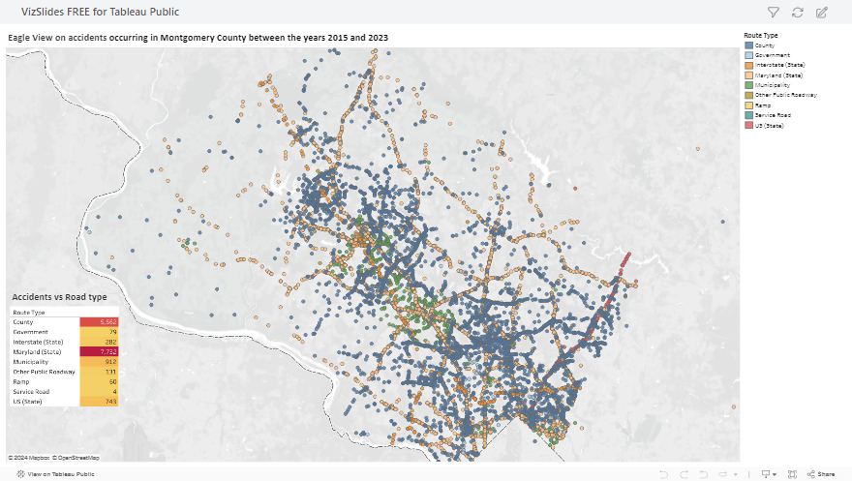

Slide 9
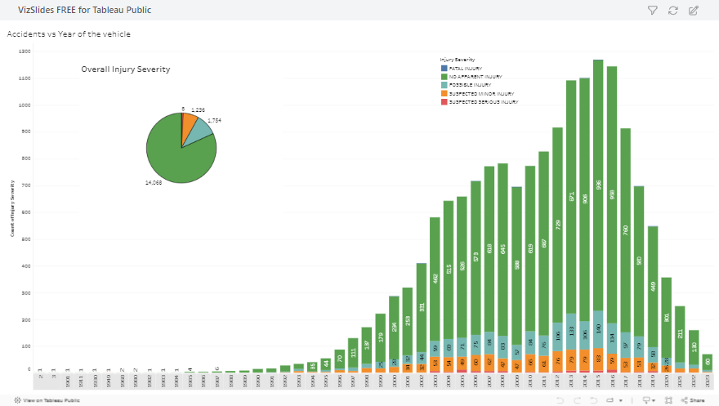

Slide 10

Smart Questions
How many accidents does Montgomery County account for every year and how severe are they?
Are drivers responsible for accidents?
Is there a third party involvement in the accidents?
Is there any reason behind the accident’s occurrence?
Does speed affect the severity of the accident?
Are accidents based on weather conditions/age of the vehicle?
Does the speed limit on the road affect the injury?

Slide 11
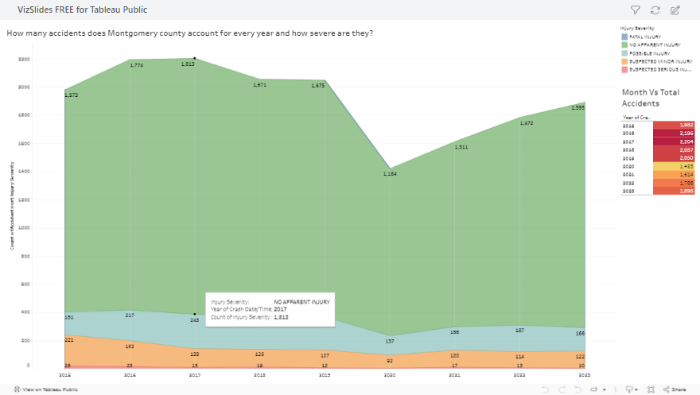

Slide 12
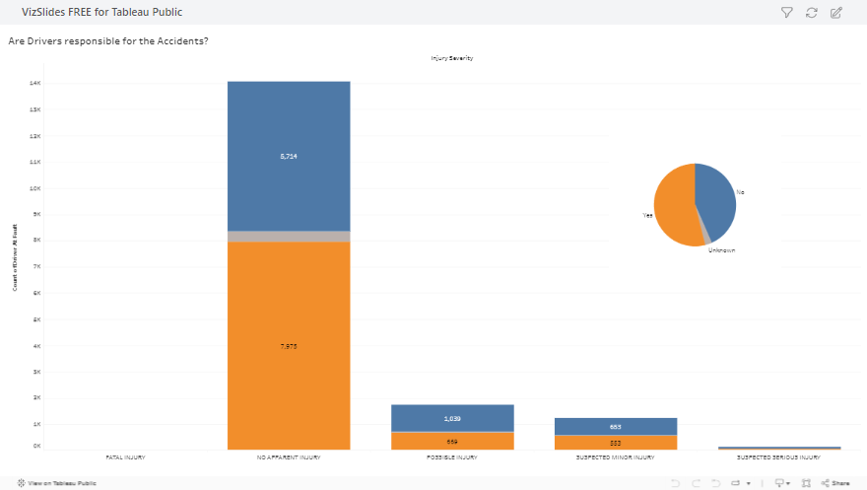

Slide 13
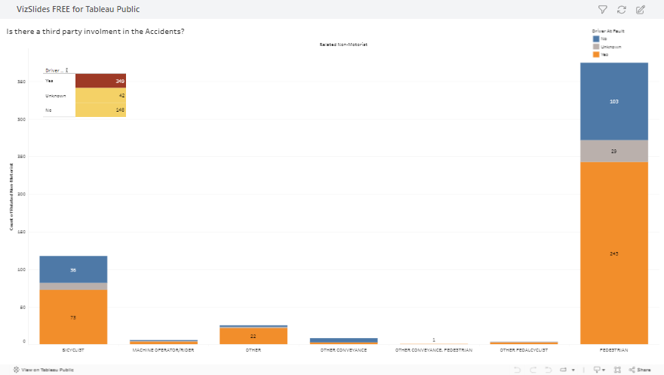

Slide 14
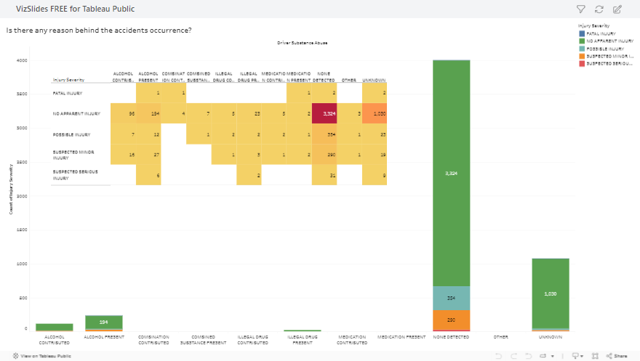

Slide 15
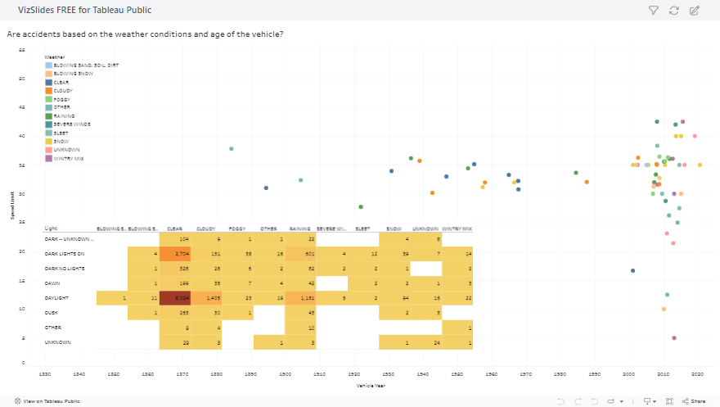

Slide 16
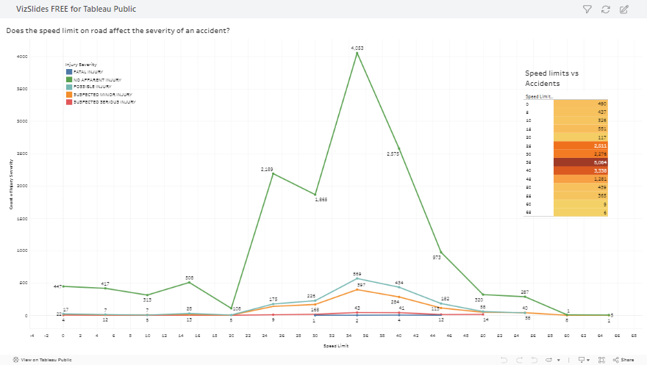

Slide 17
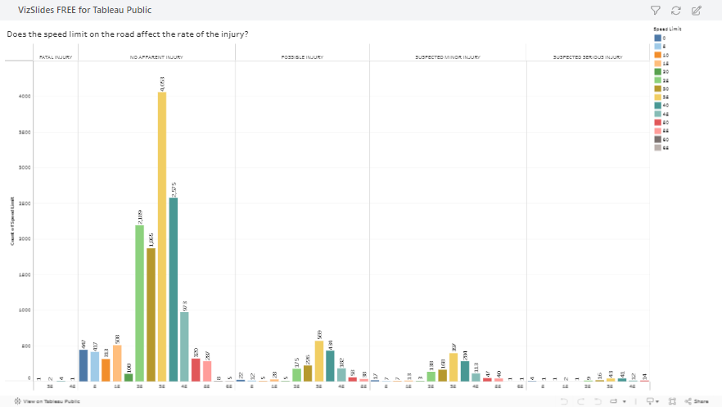

Slide 18
Challenges:
Limited utilization of available data rows.
Presence of numerous null values hindering analysis depth.
Future Directions:
Integration of Machine Learning:
Opportunity to leverage predictive capabilities for forecasting and anomaly detection.
Potential for deeper insights and more flexible analysis.
Lessons Learned:
Importance of effective data preprocessing.

Slide 19
Conclusion
In conclusion, our analysis reveals that the accidents are attributed to 3rd parties, particularly pedestrians. Furthermore, these accidents predominantly occur during daylight hours and within speed limits of 35. Notably, 2017 emerges as the year with the highest frequency of accidents. Additionally, it's notable that most accidents result in no apparent injuries.

Slide 20

Thank you

