Slide 1
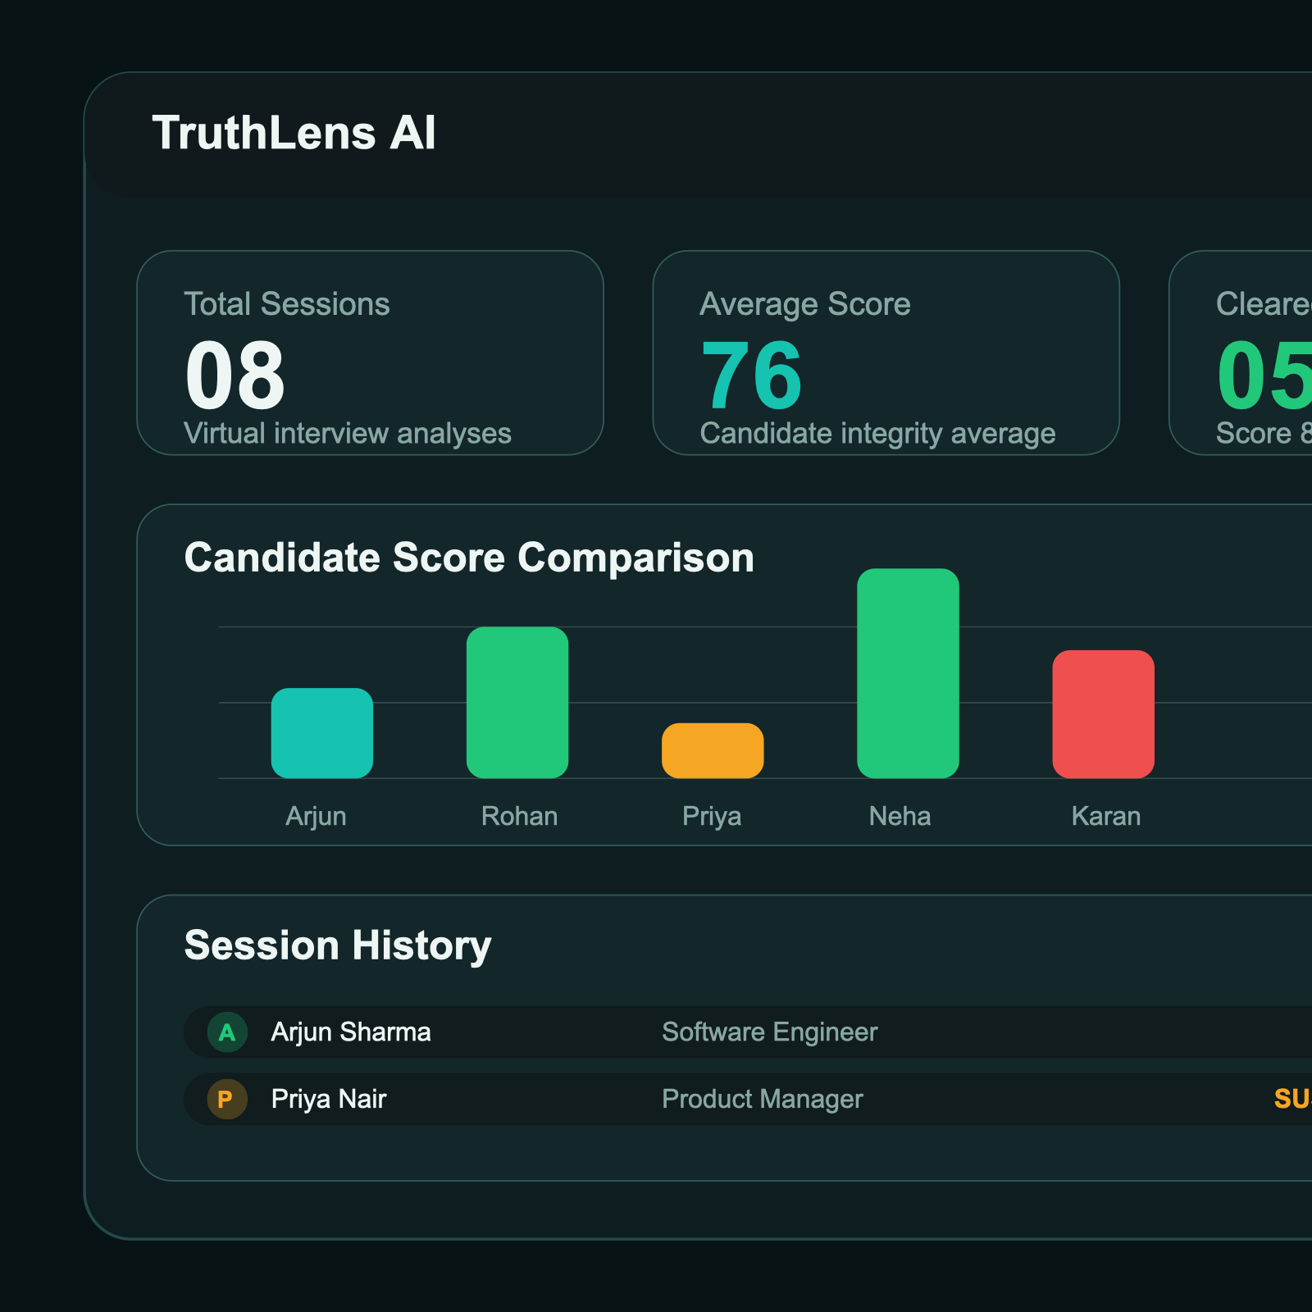
PITCH DECK
TruthLens AI
Turning remote interviews into a measurable, multimodal, and evidence-backed recruiting experience.
Problem
Subjective
Recruiters lack objective behavioral cues in virtual interviews.
Solution
Real-Time
Face, voice, behavior, and environment analysis in one screen.
Outcome
Actionable
Integrity score, live flags, and a downloadable final report.
One-line pitch
TruthLens AI brings facial cues, voice stress, behavioral integrity, and environment monitoring into one recruiter-ready interview platform.
TruthLens AI
Slide 1

Slide 2
THE PROBLEM
Remote interviews are harder to trust
Recruiters depend on human judgement
Confidence, stress, or suspicious behavior are often inferred manually and inconsistently.
No single system fuses all signals
Most platforms stop at video calling and do not combine face, voice, movement, and scene intelligence.
Behavioral red flags are missed in real time
Looking away, phone use, multiple people in frame, or stress spikes are difficult to track live.
Little evidence remains after the interview
Recruiters need structured summaries to support better decisions and reduce bias.
Impact
Lower confidence in remote hiring decisions
Inconsistent evaluation standards across sessions
Limited explainability after interviews end
TruthLens AI
Slide 2

Slide 3
THE SOLUTION
TruthLens AI is an interview intelligence co-pilot
A live recruiter dashboard that turns interview media streams into a clear integrity score, behavior flags, and review-ready evidence.
Capture
Webcam, microphone, and environment cues are collected from the browser.
Analyze
OpenCV, DeepFace, Librosa, and YOLO-ready pipelines interpret candidate signals.
Score
Signals are weighted into a live integrity score with flags and risk labels.
Report
Recruiters receive analytics, verdicts, and a branded PDF summary.
Why this matters
Moves interviews from intuition-only decisions to evidence-backed review
Creates one workflow for observation, scoring, and reporting
TruthLens AI
Slide 3

Slide 4
CORE PRODUCT
Four modules. One recruiter workflow.
Facial authenticity analysis
Confidence, stress, nervousness, and dominant expressions from live video frames.
Voice stress monitoring
Calmness, pacing, pitch variation, and tremor patterns from interview audio.
Behavior tracking
Eye contact, looking-away events, head turning, and movement stability.
Environment integrity checks
Phone detection, extra-person detection, and suspicious object monitoring.
TruthLens AI
Slide 4

Slide 5
ARCHITECTURE
Built for demo today, ready for AI integration tomorrow
Frontend
React.js, Vite, Chart.js, and jsPDF power the recruiter UI, analytics views, and report downloads.
Vision + Audio
OpenCV, DeepFace, and Librosa fit naturally into the current response schema for live model upgrades.
Backend
FastAPI and Python handle session orchestration, scoring, dashboards, and data contracts.
Environment AI
YOLO-style object detection supports suspicious-object and extra-person monitoring inside interview frames.
Production path
Preserve the current UI contract while swapping simulated signals for live inference outputs
TruthLens AI
Slide 5

Slide 6
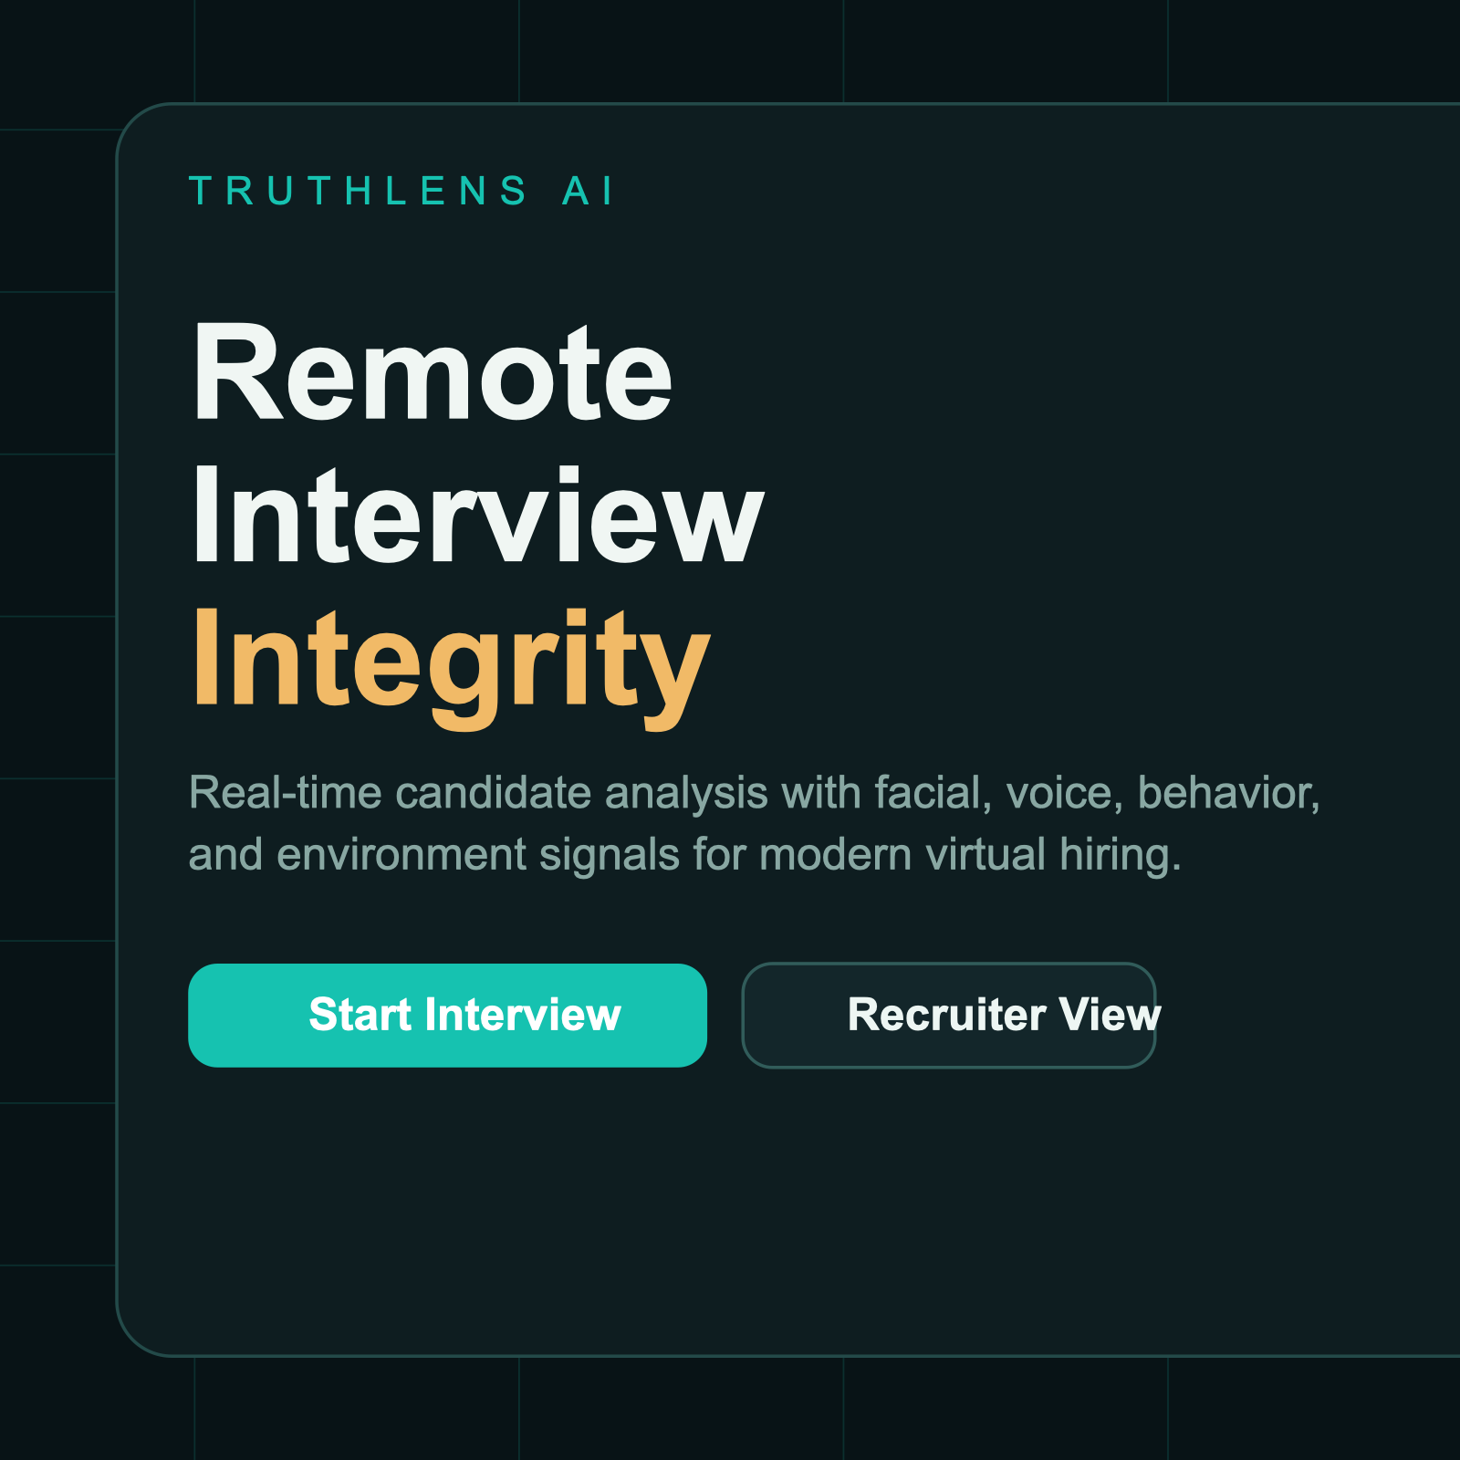
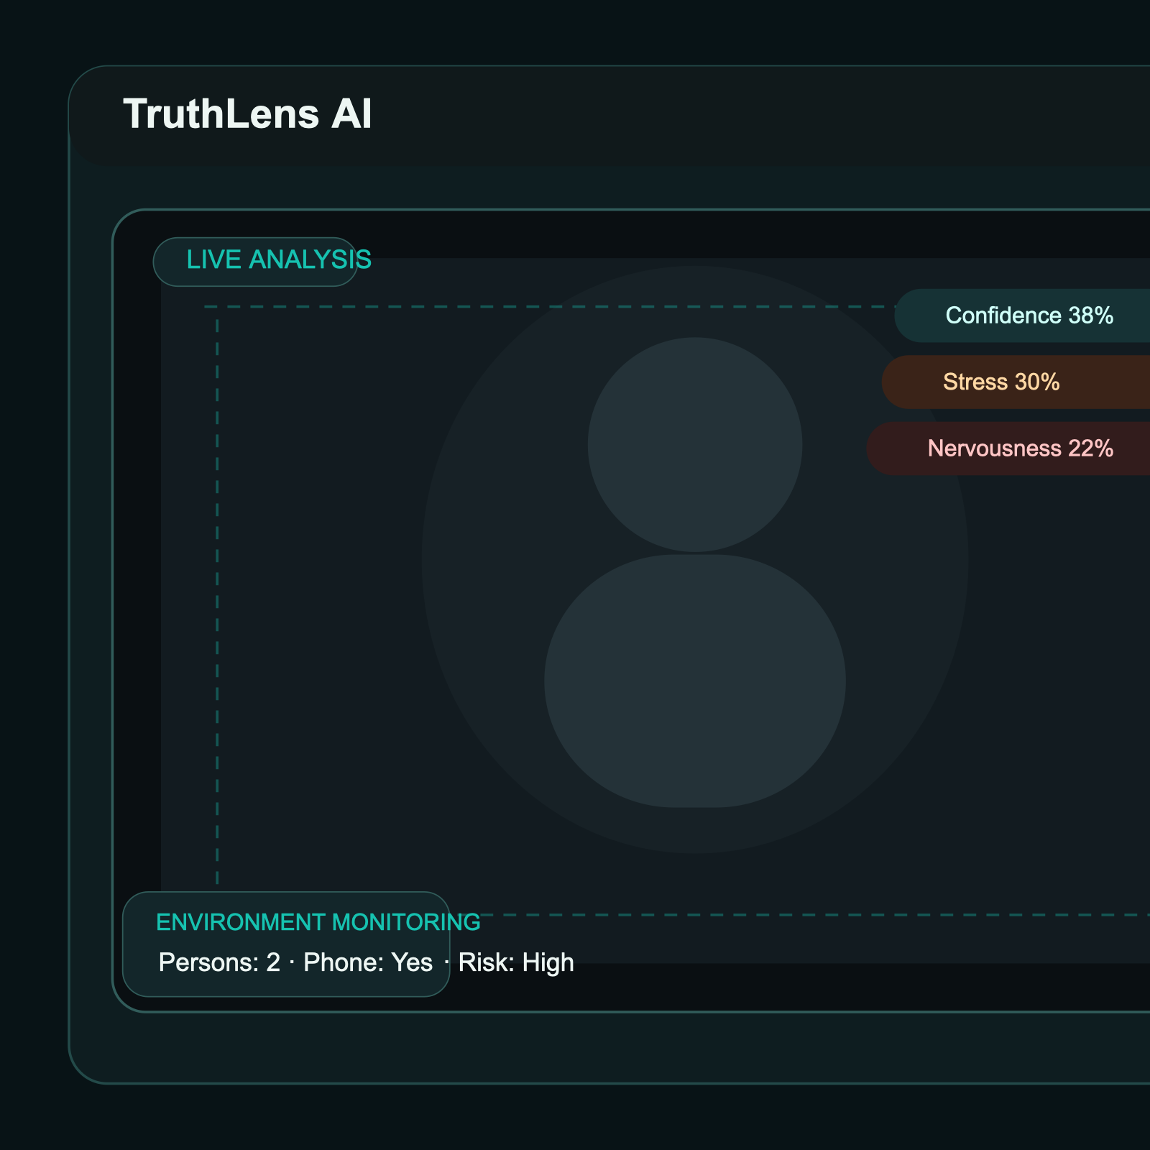
UI SHOWCASE
Landing page, recruiter dashboard, and live interview monitor
Landing page
Product-first positioning and feature-led onboarding.
Dashboard
Verdicts, score distribution, history, and analytics.
Interview screen
Live signal overlays, flags, and recruiter-side monitoring.
TruthLens AI
Slide 6

Slide 7
USE CASES
Where this can create immediate value
Campus Placements
Screen large candidate pools with more consistent remote evaluation criteria.
Recruitment Agencies
Support faster shortlisting and stronger hiring documentation for client interviews.
Enterprise Hiring
Add structured behavioral visibility to remote hiring pipelines without redesigning recruiter workflows.
Assessment Platforms
Extend into interview-based evaluations, proctored oral tests, and trust-sensitive screening processes.
TruthLens AI
Slide 7

Slide 8
ROADMAP
From product demo to deployable platform
Phase 1
Complete live model wiring for facial, voice, and environment analysis while preserving the current UI contract.
Phase 2
Add historical analytics, interviewer review workflows, and recruiter calibration dashboards.
Phase 3
Integrate ATS platforms, fairness guardrails, and enterprise authentication for production rollout.
TruthLens AI
Slide 8

Slide 9
CLOSING
TruthLens AI makes remote interviews more visible, measurable, and reviewable.
We are building a recruiter-facing intelligence layer that helps teams move from intuition-only decisions to evidence-supported remote hiring.
Final takeaway
TruthLens AI combines facial cues, voice stress, behavioral integrity, and environment monitoring in one platform
Designed as a demo-ready product with a clear path to live AI deployment
TruthLens AI
Slide 9

