Slide 1

Project Title –Agriculture Data Analysis
Student Name- CHARAN TEJA RAIPALLY
College Name- SIR PADAMPAT SINGHANIA UNIVERSITY
AICTE STU ID : STU69e68716cff881776715542

Slide 2

PROBLEM STATEMENT
(Agricultural activities are influenced by seasonal variations in environmental conditions, farming practices, resource availability and market conditions. As a result, agricultural performance may differ from one season to another. However, raw agricultural data does not clearly explain how agricultural performance changes across seasons or what patterns can be observed in different seasonal conditions. The problem is to analyze the given agricultural dataset and investigate seasonal differences in agricultural performance by identifying meaningful patterns, trends, relationships and variations within the available data.

Slide 3
Project Description
This project analyses seasonal agricultural performance using a dataset of 4,000 farm records collected across 8 Indian states, covering 8 crops and 3 farming seasons (Kharif, Rabi, Zaid). The dataset includes environmental factors (rainfall, temperature, humidity, soil conditions), resource usage (water, fertilizer, pesticide), and economic outcomes (cost, revenue, profit).
The goal was to clean the raw data, explore it, and find out how farming performance actually changes from one season to another — and whether those differences are big enough to matter, not just visually but statistically. The analysis covers data cleaning (handling missing values and unrealistic outliers), exploratory data analysis, correlation analysis.

Slide 4

WHO ARE THE END USERS?
Farmers and farmer groups — to understand which season works best for which crop and plan accordingly
Agricultural officers / extension workers — to identify which regions or seasons need more support
Policy makers / government agriculture departments — to plan subsidies, irrigation schemes, or crop insurance around season-wise risk
Agri-business and supply chain companies — to plan procurement and pricing around seasonal yield patterns
Students and researchers — as a reference dataset/analysis for further agricultural data studies

Slide 5

Technology Used
Python 3 — core programming language
Pandas, NumPy — data cleaning and manipulation
Matplotlib, Seaborn — data visualization (bar charts, box plots, heatmaps, scatter plots)
SciPy — statistical testing
Google Colab— development and presentation environment

Slide 6
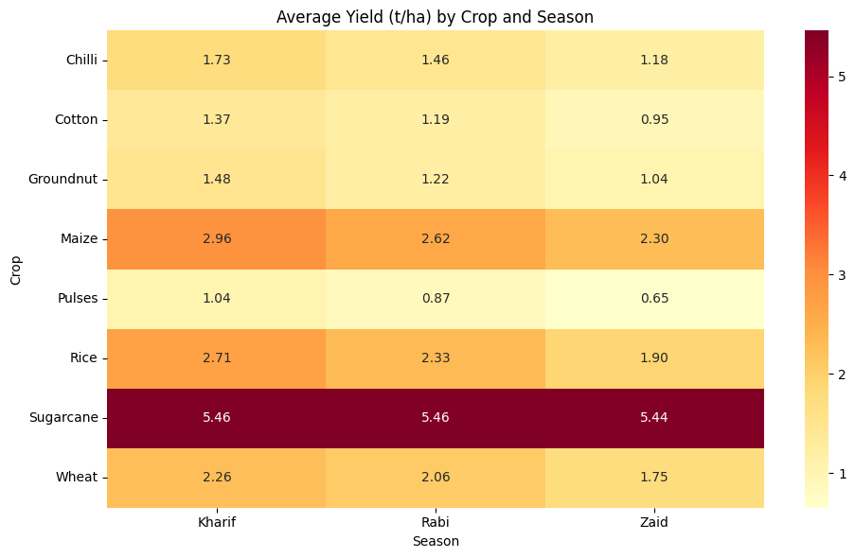
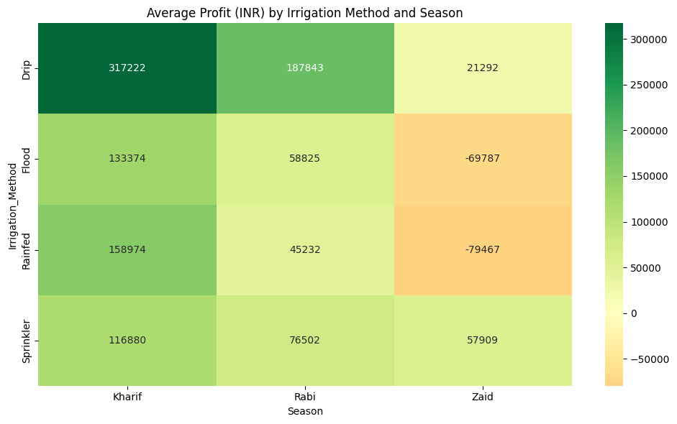
RESULTS
Seasonal Comparison
Compares the average yield of different crops across Kharif, Rabi, and Zaid seasons, along with the profitability of different irrigation methods across seasons. The results highlight seasonal variations in crop performance and the financial benefits associated with irrigation choices.

Slide 7
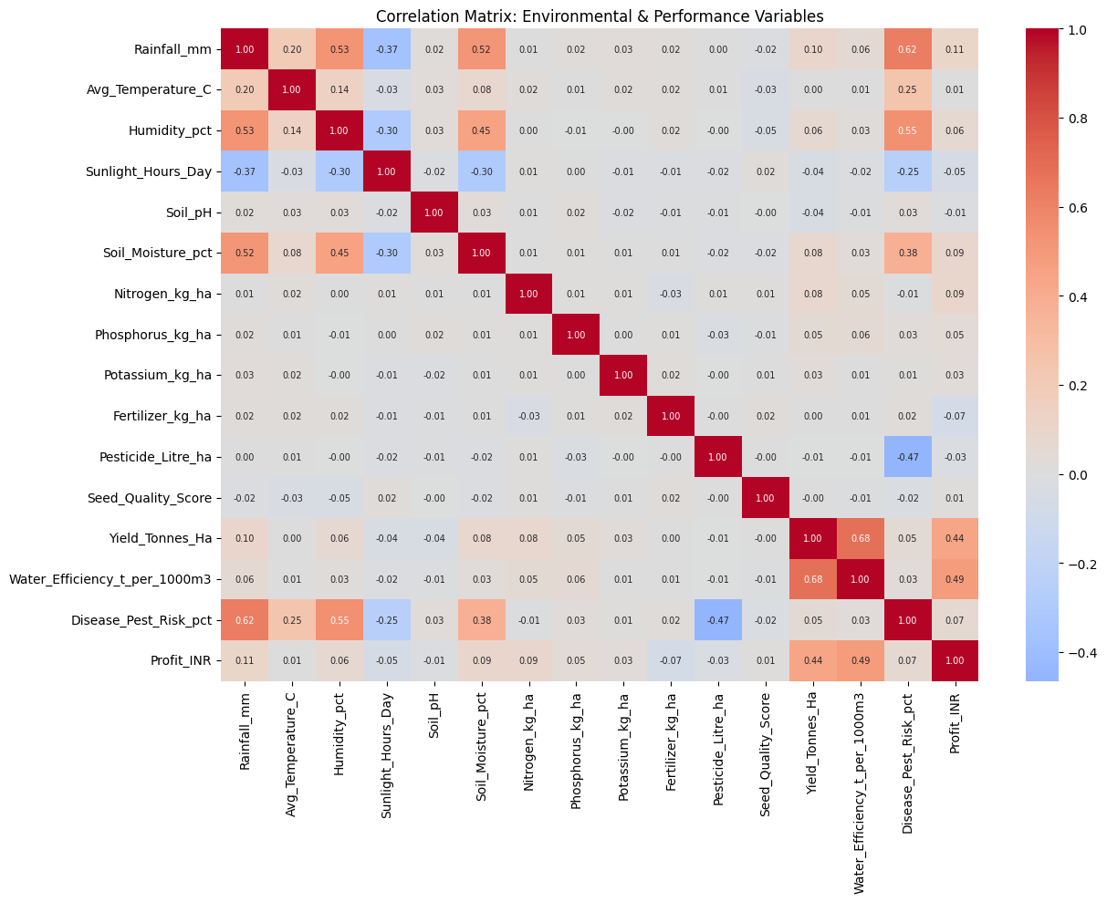
RESULTS
Environmental Factors and Their Impact on Crop Performance
Analyses the relationships between environmental conditions, agricultural inputs, crop yield, water efficiency, disease risk, and profit. The correlation patterns help identify the factors that are most closely associated with overall agricultural performance

Slide 8
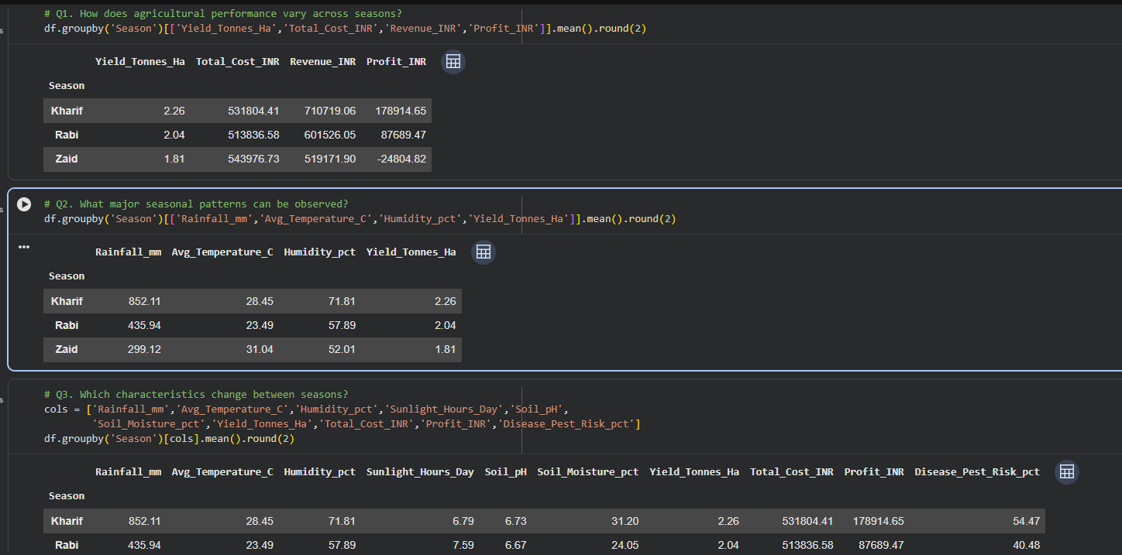
RESULTS

Slide 9
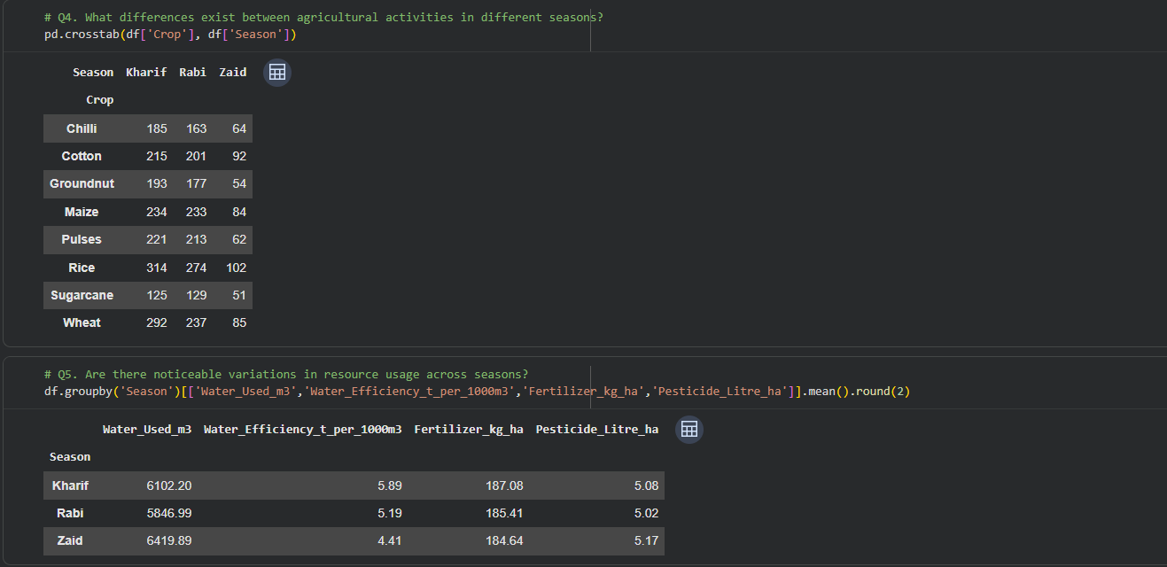
RESULTS

Slide 10
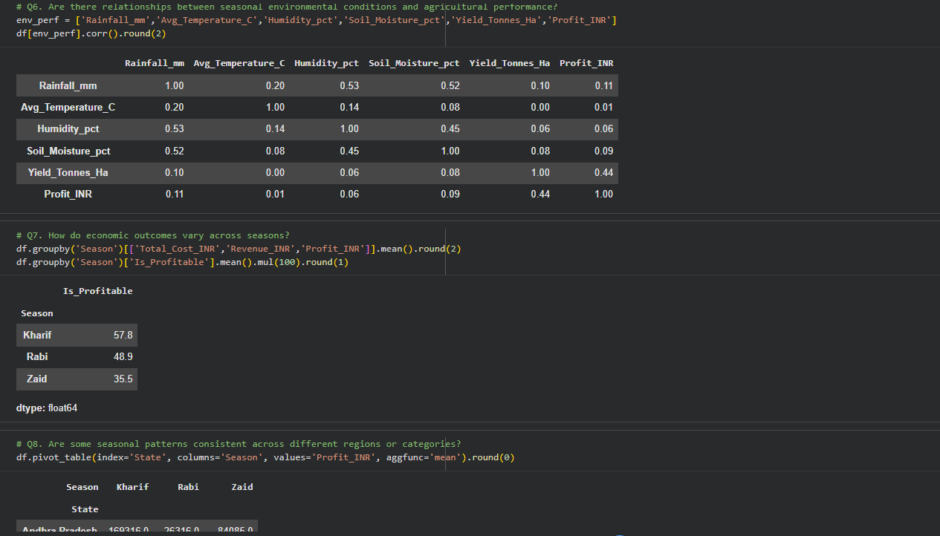
RESULTS
[Add screen shots of your code ]

Slide 11
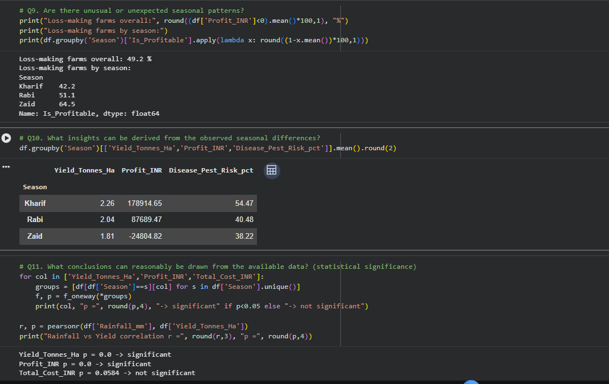
RESULTS

Slide 12
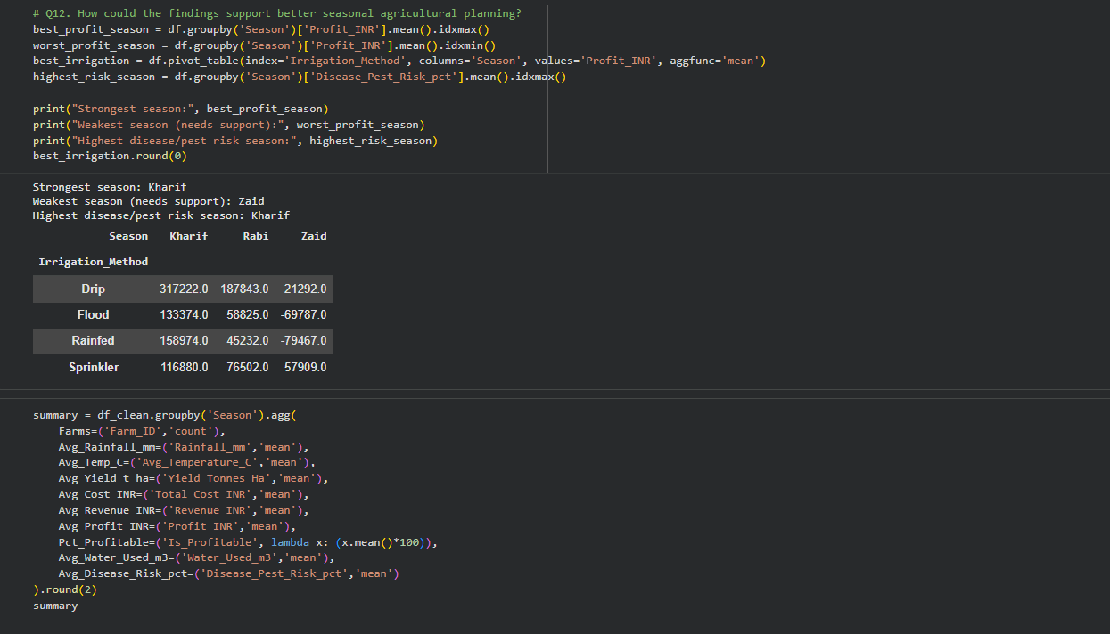
RESULTS

Slide 13
Future scope
Build a predictive model (e.g. regression) to forecast yield or profit based on season and environmental inputs
Add real-time weather API integration to make the analysis dynamic instead of static
Extend the dataset to more states/districts for wider geographic coverage
Build an interactive dashboard) so non-technical users like farmers or officers can explore the data themselves
Include soil health and satellite/remote-sensing data for deeper environmental analysis
Study the profitability problem found in the data (nearly half the farms operate at a loss) as its own separate project

Slide 14
GitHub Link
https://github.com/CharanTeja-06/agriculture-data-analysis

Slide 15
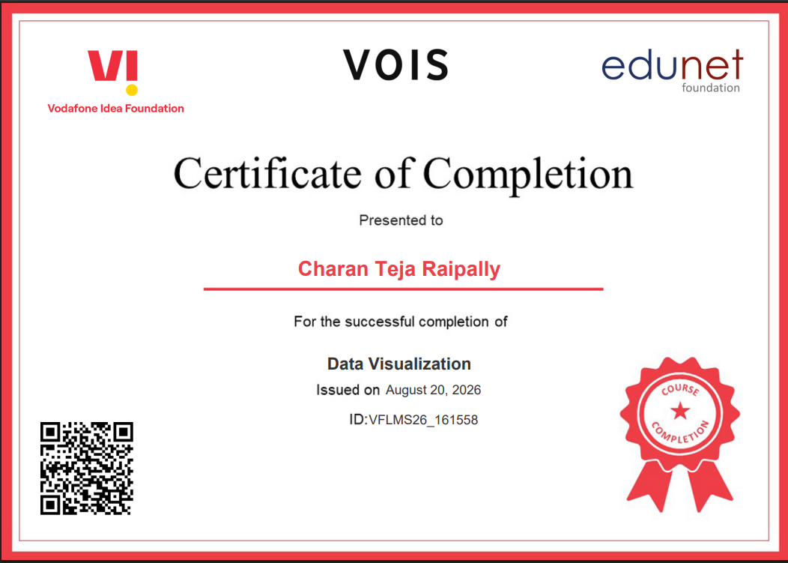
VOIS Course completion certificate - Course name- Data Visualization

Slide 16
Thank you
.
.

