Slide 1
ARTIFICIAL INTELLIGENCE & MACHINE LEARNING 23AD2001O ​ Bayesian Belief Networks, DECISION TREES, KNN
CO3 SESSION 19

Slide 2




AIM OF THE SESSION
To familiarize students with the basic concept of Bayesian Networks,Decision Trees and KNN
INSTRUCTIONAL OBJECTIVES
This Session is designed to:
1. Bayesian belief network
2. Decision Trees
3. What is KNN?
LEARNING OUTCOMES
At the end of this session, you should be able to:
Define Bayesian Network
Describe Decision Tree
Apply KNN

Slide 3
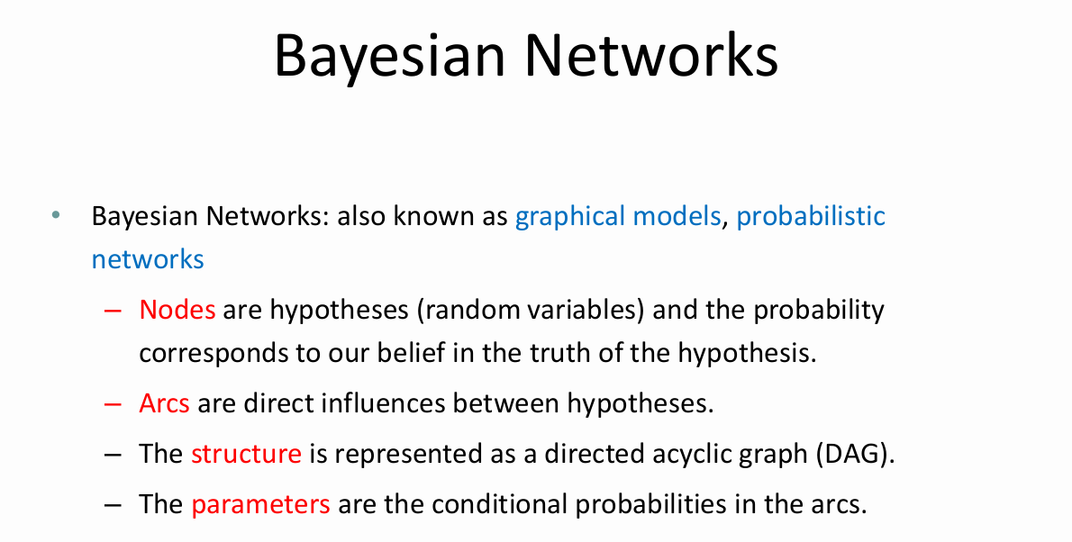

Slide 4
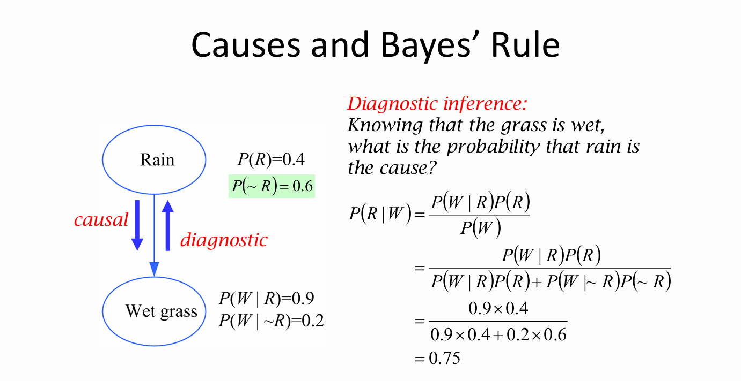

Slide 5
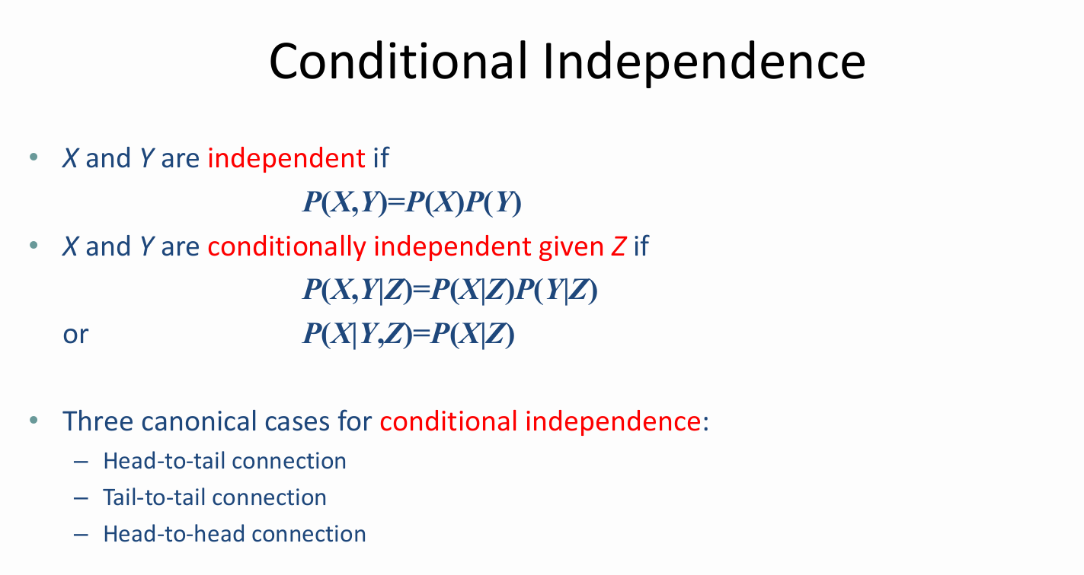

Slide 6
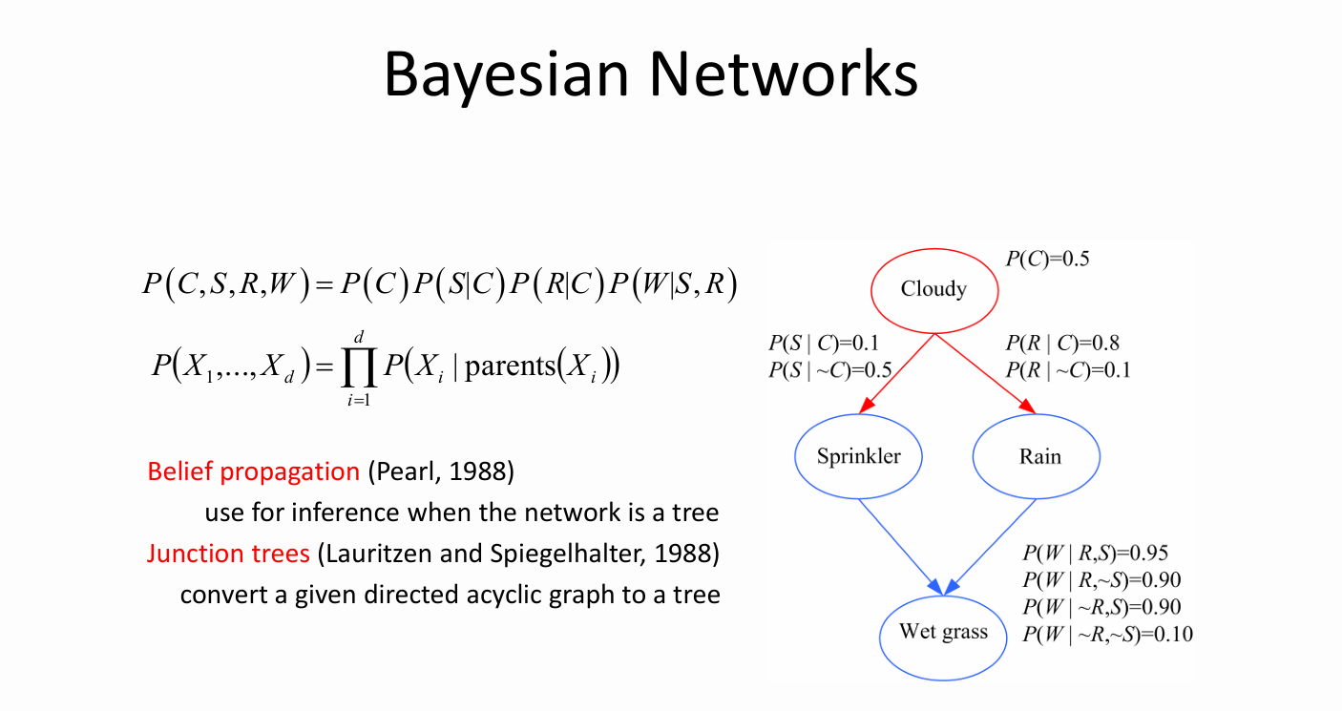

Slide 7
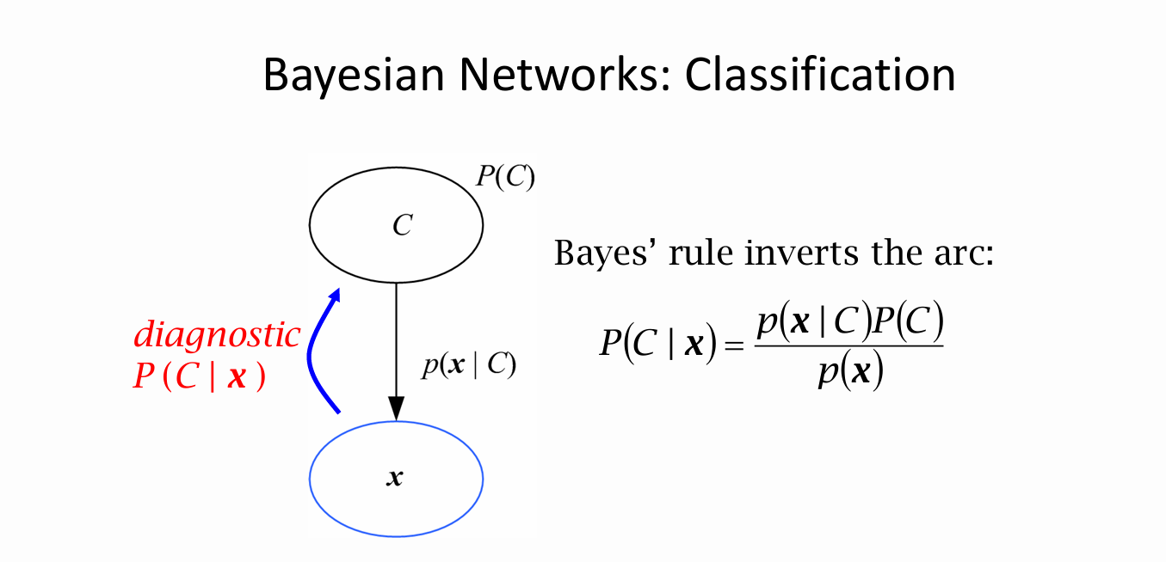

Slide 8
Decision Tree Learning
Decision tree learning is a method for approximating discrete-valued target functions.
The learned function is represented by a decision tree.
A learned decision tree can also be re-represented as a set of if-then rules.
Decision tree learning is one of the most widely used and practical methods for inductive inference.
It is robust to noisy data and capable of learning disjunctive expressions.
8

Slide 9
Decision Tree Learning
Decision tree learning method searches a completely expressive hypothesis.
Avoids the difficulties of restricted hypothesis spaces.
Its inductive bias is a preference for small trees over large trees.
The decision tree algorithms such as ID3, C4.5 – (CART) are very popular inductive inference algorithms, and they are successfully applied to many leaning tasks.

Slide 10
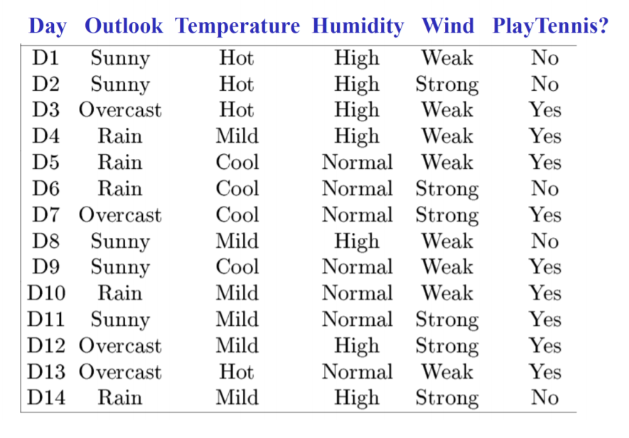
Training dataset(Play Tennis)

Slide 11
Decision Tree
Decision trees represent a disjunction of conjunctions of constraints on the attribute values of instances.
Each path from the tree root to a leaf corresponds to a conjunction of attribute tests, and
The tree itself is a disjunction of these conjunctions.
Outlook
Sunny
Overcast
Rain
Humidity
High Normal
Yes
Wind
Strong
Weak
(Outlook = Sunny ∧ Humidity = Normal)
(Outlook = Overcast)
(Outlook = Rain ∧ Wind = Weak)
No
Yes
No
Yes

Slide 12
Decision Tree
Decision trees classify instances by sorting them down the tree from the root to some leaf node, which provides the classification of the instance.
Each node in the tree specifies a test of some attribute of the instance.
Each branch descending from a node corresponds to one of the possible values for the attribute.
Each leaf node assigns a classification.
The instance
(Outlook=Sunny, Temperature=Hot, Humidity=High, Wind=Strong) is classified as a negative instance.

Slide 13
When to Consider Decision Trees
Instances are represented by attribute-value pairs.
Fixed set of attributes, and the attributes take a small number of disjoint possible values.
The target function has discrete output values.
Decision tree learning is appropriate for a boolean classification, but it easily extends to learning functions with more than two possible output values.
Disjunctive descriptions may be required.
decision trees naturally represent disjunctive expressions.

Slide 14
The training data may contain errors.
Decision tree learning methods are robust to errors, both errors in classifications of the training examples and errors in the attribute values that describe these examples.
The training data may contain missing attribute values.
Decision tree methods can be used even when some training examples have unknown values.
Decision tree learning has been applied to problems such as learning to classify
medical patients by their disease,
equipment malfunctions by their cause, and
loan applicants by their likelihood of defaulting on payments.

Slide 15
ID3 Algorithm
ID3(Examples, TargetAttribute, Attributes)
Create a Root node for the tree
If all Examples are positive, Return the single-node tree Root, with label = +
If all Examples are negative, Return the single-node tree Root, with label = -
If Attributes is empty, Return the single-node tree Root, with label = most common value of TargetAttribute in Examples
Otherwise Begin
A ← the attribute from Attributes that best classifies Examples
The decision attribute for Root ←A
For each possible value, vi, of A,
Add a new tree branch below Root, corresponding to the test A = vi
Let Examples_{vi} be the subset of Examples that have value vi for A
If Examples_{vi} is empty
Then below this new branch add a leaf node with label = most common value of TargetAttribute in Examples
Else below this new branch add the subtree ID3(Examples_{vi} , TargetAttribute, Attributes – {A})
End
Return Root

Slide 16
Top-Down Induction of Decision Trees -- ID3
A ← the “best” decision attribute for next node
Assign A as decision attribute for node
For each value of A create new descendant node
Sort training examples to leaf node according to the attribute value of the branch
If all training examples are perfectly classified (same value of target attribute) STOP,
else iterate over new leaf nodes.

Slide 17
Information Gain
entropy is a measure of the impurity in a collection of training examples
information gain is a measure of the effectiveness of an attribute in classifying the training data.
information gain measures the expected reduction in entropy by partitioning the examples according to an attribute.
Gain(S,A) = Entropy(S) - ∑
( |S_{v}| / |S| ) Entropy(S_{v})
v∈Values(A)
S – a collection of examples
A – an attribute
Values(A) – possible values of attribute A
S_{v} – the subset of S for which attribute A has value v

Slide 18
Entropy
Given a collection S, containing positive and negative examples of some target concept, the entropy of S relative to this boolean classification is:
Entropy(S) = -p₊ log₂p₊ - p₋
S is a sample of training examples
p₊ is the proportion of positive examples
p₋ is the proportion of negative examples
log₂p₋

Slide 19
ID3 - Training Examples
Day | Outlook | Temp. | Humidity | Wind | Play Tennis
D1 | Sunny | Hot | High | Weak | No
D2 | Sunny | Hot | High | Strong | No
D3 | Overcast | Hot | High | Weak | Yes
D4 | Rain | Mild | High | Weak | Yes
D5 | Rain | Cool | Normal | Weak | Yes
D6 | Rain | Cool | Normal | Strong | No
D7 | Overcast | Cool | Normal | Weak | Yes
D8 | Sunny | Mild | High | Weak | No
D9 | Sunny | Cold | Normal | Weak | Yes
D10 | Rain | Mild | Normal | Strong | Yes
D11 | Sunny | Mild | Normal | Strong | Yes
D12 | Overcast | Mild | High | Strong | Yes
D13 | Overcast | Hot | Normal | Weak | Yes
D14 | Rain | Mild | High | Strong | No

Slide 20
Entropy
Entropy([9+,5-] = | – (9/14) log₂(9/14) – (5/14) log₂(5/14) = |  | = | 0.940
Entropy([12+,4-] = | – (12/16) log₂(12/16) – (4/16) log₂(4/16) = |  |  |  | 0.811
Entropy([12+,5-] = | – (12/17) log₂(12/17) – (5/17) log₂(5/17) = |  |  |  | 0.874
Entropy([8+,8-] = | – (8/16) log₂(8/16) – (8/16) log₂(8/16) = |  |  | 1.0
Entropy([8+,0-] = – (8/8) log₂(8/8) – (0/8) log₂(0/8) = 0.0
Entropy([0+,8-] = – (0/8) log₂(0/8) - (8/8) log₂(8/8) = 0.0
It is assumed that log₂(0) is 0

Slide 21
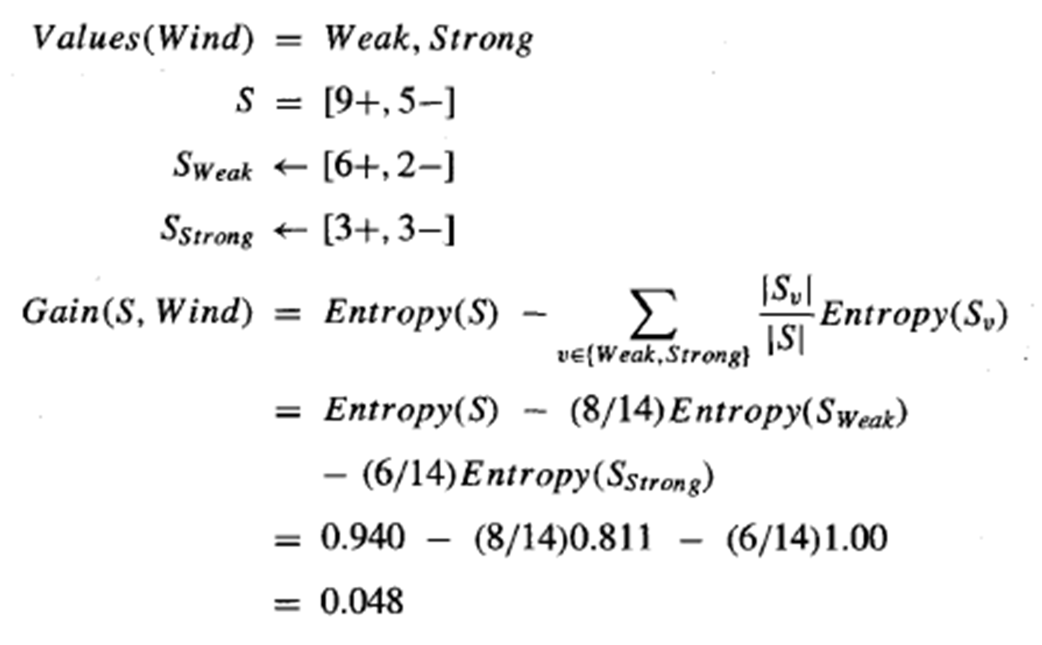
Information Gain

Slide 22
ID3 – Selecting Next Attribute
Entropy([9+,5-] = – (9/14) log₂(9/14) – (5/14) log₂(5/14) = 0.940
S=[9+,5-] E=0.940
S=[9+,5-] E=0.940
Humidity
Wind
High
Normal
Weak
Strong
[3+, 4-] [6+, 1-]
[6+, 2-]
[3+, 3-]
E=0.985
Gain(S,Humidity) =
0.940-(7/14)*0.985-(7/14)*0.592= 0.151
E=0.592
Gain(S,Wind) =
0.940-(8/14)*0.811-(6/14)*1.0
= 0.048

Slide 23
ID3 - S_{sunny}
Gain(S_{sunny} , Humidity) = 0.970-(3/5)0.0 – 2/5(0.0) = 0.970
Gain(S_{sunny} , Temp.) = 0.970-(2/5)0.0 –2/5(1.0)-(1/5)0.0 = 0.570 Gain(S_{sunny} , Wind) = 0.970= -(2/5)1.0 – 3/5(0.918) = 0.019
So, Hummudity will be selected

Slide 24
ID3 - Result
Outlook
Sunny
Overcast
Rain
Yes [D3,D7,D12,D13]
Humidity
High Normal
Wind
Strong
Weak
No [D1,D2]
Yes [D8,D9,D11]
No [D6,D14]
Yes [D4,D5,D10]

Slide 25
K-Nearest Neighbor
Features
All instances correspond to points in an n-dimensional Euclidean space
Classification is delayed till a new instance arrives
Classification done by comparing feature vectors of the different points
Target function may be discrete or real-valued

Slide 26
1-Nearest Neighbor

Slide 27
3-Nearest Neighbor

Slide 28
K-Nearest Neighbor
An arbitrary instance is represented by (a₁(x), a₂(x), a₃(x),.., a_{n}(x))
a_{i}(x) denotes features
Euclidean distance between two instances
d(x_{i}, x_{j})=sqrt (sum for r=1 to n (a_{r}(x_{i}) - a_{r}(x_{j}))²)
Continuous valued target function
mean value of the k nearest training examples

Slide 29
Distance-Weighted Nearest Neighbor Algorithm
Assign weights to the neighbors based on their ‘distance’ from the query point
Weight ‘may’ be inverse square of the distances
All training points may influence a particular instance
Shepard’s method

Slide 30
Merits and demerits
+Highly effective inductive inference method for noisy training data and complex target functions
+Target function for a whole space may be described as a combination of less complex local approximations
+Learning is very simple
- Classification is time consuming

Slide 31
Self-Assessment Questions
1. In a Bayesian belief network, what do nodes represent?
Data instances
Decision boundaries
Random variables
Class labels
2. In decision trees, what is used to split the data at each node?
Gini impurity
Entropy
Information gain
Chi-square test

Slide 32
TERMINAL QUESTIONS
Define Bayesian Belief Networks (BBNs) and explain their significance in probabilistic reasoning.
What are the components of a Bayesian Belief Network?
Discuss the difference between conditional probability and joint probability in the context of Bayesian Belief Networks.
Define Decision Trees and explain their structure.
What are the advantages of using Decision Trees for classification and regression?
Explain the working principle of the k-Nearest Neighbors algorithm.
What is the importance of choosing the right value for 'k' in KNN?

Slide 33
Reference books and web links
Text Books:
Russel and Norvig, ‘Artificial Intelligence’, third edition, Pearson Education, PHI, (2015)
Tom M. Mitchell, Machine Learning, WCB McGraw-Hill, Boston, 1997.
Elaine Rich & Kevin Knight, ‘Artificial Intelligence’, 3nd Edition, Tata McGraw Hill Edition, Reprint (2008)
Web links:
https://www.geeksforgeeks.org/agents-artificial-intelligence/
https://www.simplilearn.com/what-is-intelligent-agent-in-ai-types-function-article
https://www.javatpoint.com/turing-test-in-ai
https://www.geeksforgeeks.org/turing-test-artificial-intelligence/
https://www.section.io/engineering-education/turing-test-in-ai/

Slide 34
THANK YOU

