Slide 1
SESSION INTRODUCTION
In this session we are going to learn about basic concept of Performance metrics: Confusion matrix, Accuracy, F-score, Precession and Recall.
Discussion about Numerical Formula based on above topic.

Slide 2
SESSION DESCRIPTION
A confusion matrix is a table that is used to define the performance of a classification algorithm.
A confusion matrix visualizes and summarizes the performance of a classification algorithm.
Confusion matrix is a very popular measure used while solving classification problems.
It can be applied to binary classification as well as for multiclass classification problems.
The confusion matrix was utilized for the performance evaluations of the methods used after the classification. For binary classification.
It is NxN Matrix used for evaluating the performance of a given model .

Slide 3
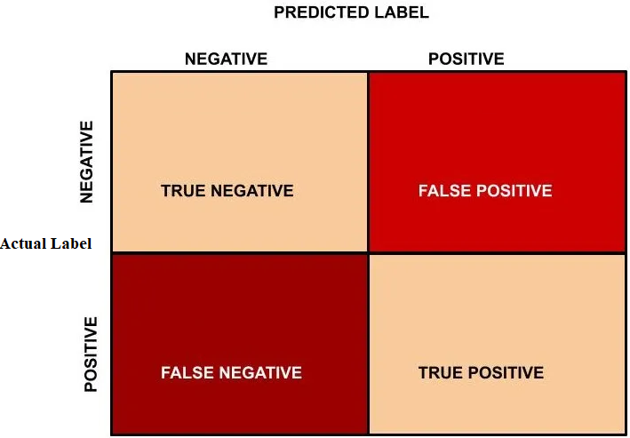
Confusion Matrix

Slide 4
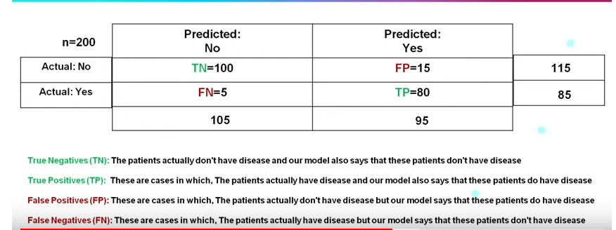
Example-

Slide 5
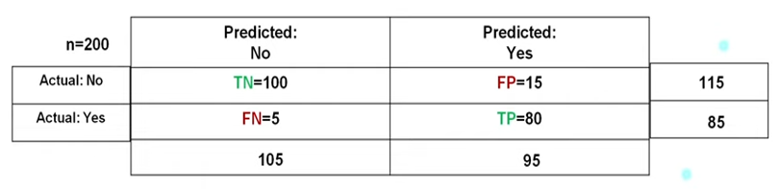
It is one of the important parameters to determine the accuracy of the classification problems. It defines how often the model predicts the correct output. It can be calculated as the ratio of the number of correct predictions made by the classifier to all number of predictions made by the classifiers. The formula is given below.
Accuracy=(80+100)/(80+15+5+100)
Accuracy=0.9
Accuracy

Slide 6
Precision: It can be defined as the number of correct outputs provided by the model or out of all positive classes that have predicted correctly by the model, how many of them were actually true. It can be calculated using the below formula:
Precision=80/(80+15)
Precision=0.84
Precision

Slide 7
Recall: It is defined as the out of total positive classes, how our model predicted correctly. The recall must be as high as possible.
Recall=80/(80+5)
Recall=0.94
Recall

Slide 8
If two models have low precision and high recall or vice versa, it is difficult to compare these models. So, for this purpose, we can use F-score. This score helps us to evaluate the recall and precision at the same time. The F-score is maximum if the recall is equal to the precision. It can be calculated using the below formula:
F-Score=(2*0.94*0.84)/(0.94+0.84)
F-Score=0.8871
F-Score

Slide 9
It offers a thorough analysis of true positive, true negative, false positive, and false negative predictions, facilitating a more profound comprehension of a model’s recall, accuracy, precision, and overall effectiveness in class distinction. When there is an uneven class distribution in a dataset, this matrix is especially helpful in evaluating a model’s performance beyond basic accuracy metrics.
Summary

