Slide 1
ARTIFICIAL INTELLIGENCE AND MACHINE LEARNING
Introduction to Data Preprocessing
CO - 3
Session - 15

Slide 2



AIM
To familiarize the students with the concept of data preprocessing and various data preprocessing techniques.
INSTRUCTIONAL OBJECTIVES
This session is designed to:
1. Demonstrate the importance of data preprocessing.
2. Demonstrate various data preprocessing techniques.
LEARNING OUTCOMES
At the end of this session, students will be able to:
Learn the importance of data preprocessing.
Learn various data preprocessing techniques.

Slide 3
OUTLINE
Why preprocess data?
Why data are dirty?
Why data preprocessing is important in the machine learning context?
Major tasks in data preprocessing
Data cleaning
Data integration
Data transformation
Data reduction
Data splitting, batching, and shuffling
Overfitting and underfitting
Summary

Slide 4
Why preprocess data?
Data in the real world is dirty
incomplete: lacking attribute values, lacking certain attributes of interest, or containing only aggregate data
e.g., occupation=“ ”
noisy: containing errors or outliers
e.g., Salary=“-10”
inconsistent: containing discrepancies in codes or names
e.g., Age=“42” Birthday=“03/07/1997”
e.g., Was rating “1,2,3”, now rating “A, B, C”
e.g., discrepancy between duplicate records

Slide 5
Why data are dirty?
Incomplete data may come from
“Not applicable” data value when collected
Different considerations between the time when the data was collected and when it is analyzed.
Human/hardware/software problems
Noisy data (incorrect values) may come from
Faulty data collection instruments
Human or computer error at data entry
Errors in data transmission
Inconsistent data may come from
Different data sources
Functional dependency violation (e.g., modify some linked data)
Duplicate records also need data cleaning

Slide 6
Why data preprocessing is important in machine learning context?
No quality data, no quality results!
Quality decisions must be based on quality data
e.g., duplicate or missing data may cause incorrect or even misleading statistics.
In machine learning, preprocessing is a crucial step to ensure that the data is in a format that the algorithm can understand and that it is free of errors or outliers that can negatively impact the model's performance.

Slide 7
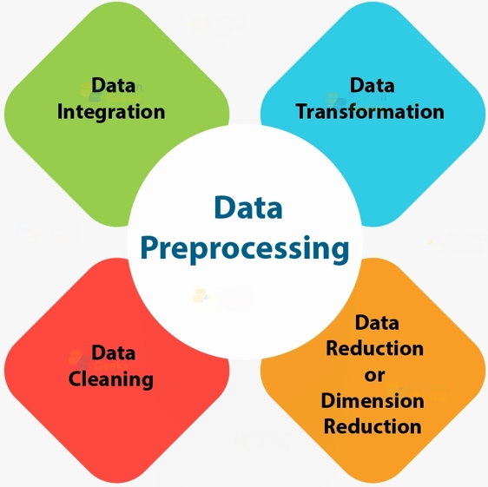
Major tasks in data preprocessing

Slide 8
Major tasks in data preprocessing
Data cleaning
Fill in missing values, smooth noisy data, identify or remove outliers, and resolve inconsistencies
Data integration
Integration of multiple databases, data cubes, or files
Data transformation
Normalization and aggregation
Data reduction
Obtains reduced representation in volume but produces the same or similar analytical results

Slide 9
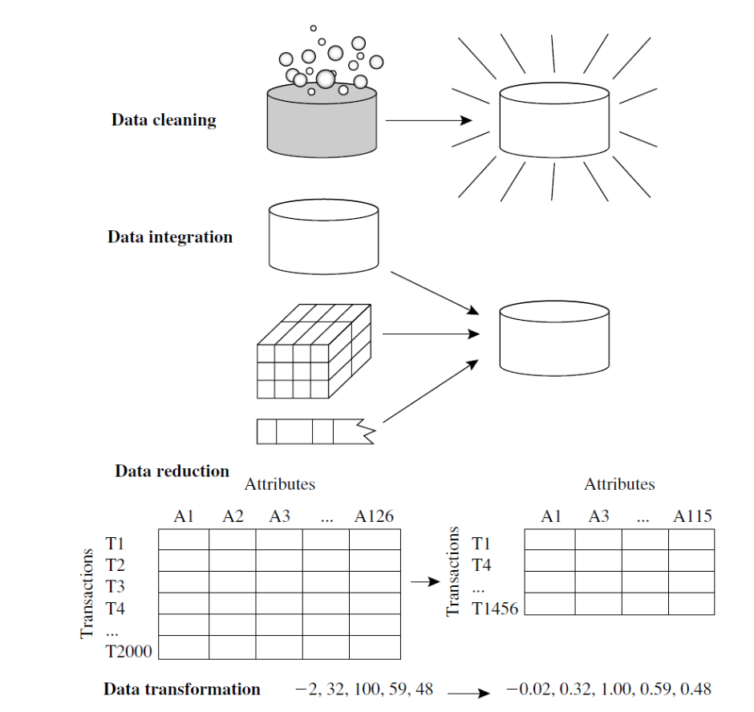
ILLUSTRATION OF Major tasks in data preprocessing

Slide 10
DATA CLEANING
Data cleaning tasks
Fill in missing values
Identify outliers and smooth out noisy data
Correct inconsistent data
Resolve redundancy caused by data integration

Slide 11
MISSING DATA
Data is not always available
E.g., many tuples have no recorded value for several attributes, such as customer income in sales data
Missing data may be due to
equipment malfunction
inconsistent with other recorded data and thus deleted
data not entered due to misunderstanding
certain data may not be considered important at the time of entry
Name | Age | Sex | Income | Class
Mike | 40 | Male | 150k | Big spender
Jenny | 20 | Female | ? | Regular

Slide 12
HOW TO HANDLE MISSING DATA?
Ignore the tuple: usually done when class label is missing (assuming the tasks in classification—not effective when the percentage of missing values per attribute varies considerably.
Fill in the missing value manually: tedious + infeasible?
Fill in it automatically with
a global constant : e.g., “unknown”, a new class?!
the attribute mean
the attribute mean for all samples belonging to the same class: smarter
the most probable value

Slide 13
HOW TO HANDLE NOISY DATA?
Binning: This method is to smooth or handle noisy data. First, the data is sorted, and then the sorted values are separated and stored in the form of bins. There are three methods for smoothing data in the bin.
Smoothing by bin mean method: In this method, the values in the bin are replaced by the mean value of the bin;
Smoothing by bin median: In this method, the values in the bin are replaced by the median value;
Smoothing by bin boundary: In this method, the using minimum and maximum values of the bin values are taken, and the closest boundary value replaces the values.
Regression: This is used to smooth the data and will help to handle data when unnecessary data is present. For the analysis, purpose regression helps to decide the variable that is suitable for our analysis.
Clustering: This is used for finding the outliers and also in grouping the data. Clustering is generally used in unsupervised learning.

Slide 14
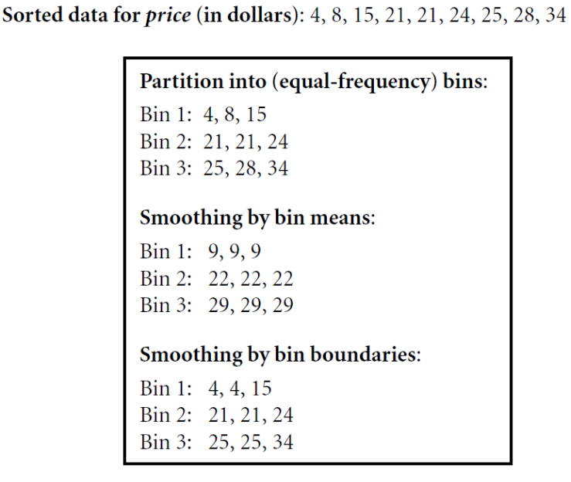
Data transformation: binning

Slide 15
Data integration
Data integration:
Combines data from multiple sources into a coherent store
Schema integration: e.g., A.cust-id ≡ B.cust-#
Integrate metadata from different sources
Entity identification problem:
Identify real-world entities from multiple data sources, e.g., Bill Clinton = William Clinton
Detecting and resolving data value conflicts
For the same real-world entity, attribute values from different sources are different
Possible reasons: different representations, different scales, e.g., metric vs. British units (e.g., GPA in US and China)

Slide 16
Data transformation
Smoothing: remove noise from data
Aggregation: summarization
Generalization: concept hierarchy climbing
Normalization: scaled to fall within a small, specified range
min-max normalization
z-score normalization
normalization by decimal scaling
Attribute/feature construction
New attributes constructed from the given ones

Slide 17
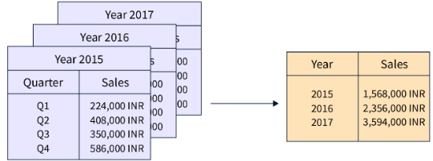
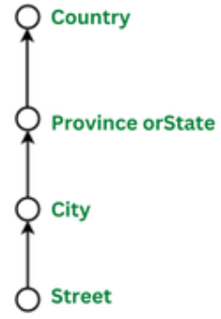
Data transformation
Smoothing:
With the help of algorithms, we can remove noise from the dataset, which helps in knowing the important features of the dataset. By smoothing, we can find even a simple change that helps in prediction.
Aggregation:
In this method, the data is stored and presented in the form of a summary.
Discretization:
The continuous data here is split into intervals.
Discretization reduces the data size. For example, rather than specifying the class time, we can set an interval like (3 pm-5 pm or 6 pm-8 pm).
Concept Hierarchy Generation:
Here attributes are converted from lower level to higher level in the hierarchy. For Example-The attribute “street” can be converted to “country”.
Normalization:
It is the method of scaling the data so that it can be represented in a smaller range. Example ranging from -1.0 to 1.0.
Aggregated Data

Slide 18
Data transformation: Normalization
Min-max normalization: to [new_min_{A}, new_max_{A}]
The min-max normalization method converts a dataset into a scale ranging from 0 to 1.
Ex. Let income range $12,000 to $98,000 normalized to [0.0, 1.0]. Then $73,000 is mapped to
Z-score normalization (μ: mean, σ: standard deviation):
Ex. Let μ = 54,000, σ = 16,000. Then

Slide 19
Data transformation: Normalization
Normalization by Decimal Scaling:
Let the input data be: -10, 201, 301, -401, 501, 601, 701
To normalize the above data,
Step 1: Maximum absolute value in given data (m): 701
Step 2: Divide the given data by 1000 (i.e., j=3)
Why j=3? We will count total numbers in our maximum value and then put 1 and after 1 we
can put zeros equal to the length of the maximum value
Result: The normalized data is: -0.01, 0.201, 0.301, -0.401, 0.501, 0.601, 0.701
Where j is the smallest integer such that Max(|ν’|) < 1

Slide 20
Data reduction
Dimensionality reduction:
In this method, irrelevant features are removed
Avoid the curse of dimensionality
Reduce time and space required during the learning process
Allow easier visualization
Techniques for dimensionality reduction are principal component analysis, feature selection, and wavelet transforms
Numerosity reduction:
In this method, the data representation is made smaller by reducing the volume. There will not be any loss of data in this reduction
Techniques for numerosity reduction are parametric (regression, log-linear models) and non-parametric methods (histograms, clustering, sampling)
Data compression:
The compressed form of data is called data compression
This compression can be lossless or lossy. When there is no loss of information during compression, it is called lossless compression. Whereas lossy compression reduces information, but it removes only the unnecessary information

Slide 21
Data reduction
Problem: Feature selection (i.e., attribute subset selection):
Select a minimum set of features such that the probability distribution of different classes given the values for those features is as close as possible to the original distribution given the values of all features
Nice side-effect: reduces # of attributes in the discovered patterns (which are now easier to understand)
Solution: Heuristic methods (due to the exponential # of choices) are usually greedy:
step-wise forward selection
step-wise backward elimination
combining forward selection and backward elimination
decision-tree induction

Slide 22
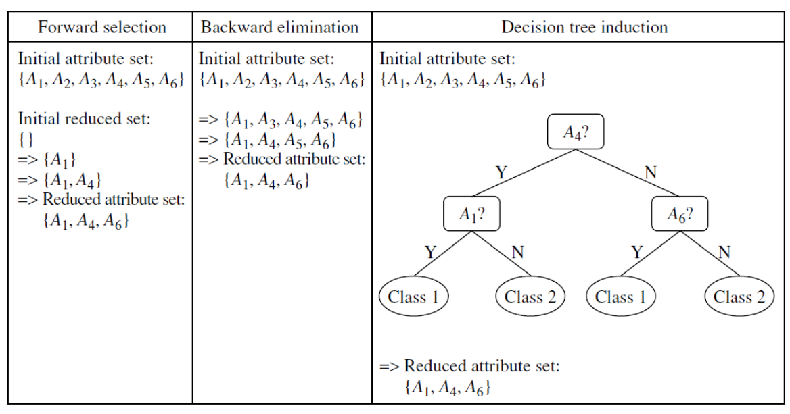
Data reduction: FEATURE SELECTION
Stepwise forward selection:
The procedure starts with an empty set of attributes as the reduced set. The best of the original attributes is determined and added to the reduced set. At each subsequent iteration or step, the best of the remaining original attributes is added to the set.
Stepwise backward elimination:
The procedure starts with the full set of attributes. At each step, it removes the worst attribute remaining in the set.
Combination of forward selection and backward elimination:
The stepwise forward selection and backward elimination methods can be combined so that, at each step, the procedure selects the best attribute and removes the worst from among the remaining attributes.

Slide 23
DATA REDUCTION: Principal component analysis (PCA)
Principal Component Analysis
Principal component analysis or PCA is a dimensionality reduction method that is often used to reduce the dimensionality of large data sets, by transforming a large set of variables into a smaller one
How do you do a principal component analysis?
Standardize the range of continuous initial variables
Compute the covariance matrix to identify correlations
Compute the eigenvectors and eigenvalues of the covariance matrix to identify the principal components
Create a feature vector to decide which principal components to keep
Recast the data along the axes of the principal component that still contains most of the information in the large set.

Slide 24
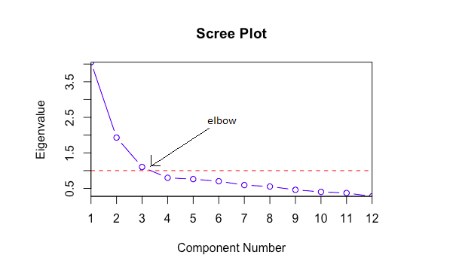
Pca – scree plot
A common method for determining the number of PCs to be retained is a graphical representation known as a scree plot.
A Scree Plot is a simple line segment plot that shows the eigenvalues for each PC. It shows the eigenvalues on the y-axis and the number of factors on the x-axis.
It always displays a downward curve. Most scree plots look broadly similar in shape, starting high on the left, falling rather quickly, and then flattening out at some point.
This is because the first component usually explains much of the variability, the next few components explain a moderate amount, and the latter components only explain a small fraction of the overall variability.
The scree plot criterion looks for the “elbow” in the curve and selects all components just before the line flattens out.

Slide 25
Pca – APPLICATIONS, CONSIDERATIONS, and limitations
Applications of PCA
Dimensionality reduction and feature extraction: PCA can simplify complex datasets by reducing the number of variables while retaining meaningful information.
Data preprocessing: PCA can be used to preprocess data before applying other machine learning algorithms to improve their performance.
Noise reduction: PCA can remove noise and extract signals from data.
Visualization: PCA can help visualize high-dimensional data in a lower-dimensional space.
Considerations and Limitations
PCA assumes linearity and normality in the data.
Outliers can affect the results of PCA.
Scaling and standardization of variables are important to avoid the dominance of certain features.
PCA is a linear technique and may not capture nonlinear relationships in the data.

Slide 26
Data splitting
Data splitting is a crucial step in the machine learning workflow. It involves dividing the dataset into separate subsets for training, validation, and testing to ensure that the model generalizes well to new, unseen data. The following are the types of splitting.
Train-Test Split
Purpose: To evaluate the model’s performance on unseen data.
Method:
The dataset is split into two parts: a training set and a testing set.
Common split ratio is 80% for training and 20% for testing, but this can vary (e.g., 70-30, 60-40).
Train-Validation-Test Split
Purpose: To tune the model’s hyperparameters and evaluate its performance.
Method:
The dataset is split into three parts: training set, validation set, and testing set.
Common split ratio is 60% for training, 20% for validation, and 20% for testing.

Slide 27
Data splitting
Cross-Validation
Purpose: To ensure the model performs well on different subsets of the data.
Method:
The dataset is split into k equally sized folds.
The model is trained on k-1 folds and tested on the remaining fold.
This process is repeated k times with each fold used exactly once as the test data.
Common values for k are 5 or 10.
Stratified Splitting
Purpose: To maintain the same proportion of classes in each subset as in the original dataset, particularly useful for imbalanced datasets.
Method:
Similar to train-test split but ensures the distribution of classes is consistent across training and testing sets.

Slide 28
Data batching
Data batching is a technique in machine learning where data is divided into smaller subsets, or batches, for processing. This is particularly useful for training models on large datasets, as it allows for more efficient memory usage and can speed up the training process. The following are the data batching practices.
Mini-Batch Gradient Descent
Purpose: To update model parameters more frequently compared to batch gradient descent while maintaining computational efficiency.
Data Batching with PyTorch
Purpose: To efficiently handle batching during model training with automatic handling of data loading and shuffling.
Data Batching with TensorFlow/Keras
Purpose: To handle data batching using built-in functions for model training.
Custom Data Batching
Purpose: To implement custom batching logic when built-in libraries are not sufficient.

Slide 29
Data shuffling
Data shuffling is an important preprocessing step in machine learning that helps ensure that the data is randomly distributed. This reduces the risk of bias in the training process, especially in scenarios where the data may have inherent order or patterns.
Basic Data Shuffling
Purpose: To randomly shuffle the dataset to ensure that the training and testing subsets are representative of the overall dataset.
Shuffling Before Train-Test Split
Purpose: To ensure that the training and testing sets are not biased by any inherent order in the data.
Shuffling During Cross-Validation
Purpose: To ensure that the folds in cross-validation are representative of the entire dataset.
Shuffling in Stratified Cross-Validation
Purpose: To maintain class distribution while ensuring random distribution of samples across folds.

Slide 30
Overfitting and underfitting
Overfitting occurs when a model learns the training data too well, capturing noise and details that are not relevant to the general problem. This leads to a model that performs exceptionally well on training data but poorly on new, unseen data.
Causes of Overfitting:
Complex Models: Models with too many parameters relative to the number of training samples.
Insufficient Data: Too little training data can cause the model to learn the noise and random fluctuations.
Too Many Features: Using too many irrelevant features can lead to overfitting.
Indicators of Overfitting:
High accuracy on training data.
Low accuracy on validation/testing data.
Large gap between training and validation/testing performance.

Slide 31
Overfitting and underfitting
Solutions to Overfitting:
Simplify the Model: Use fewer parameters or features.
Regularization: Techniques like L1 (Lasso) or L2 (Ridge) regularization add a penalty for large coefficients.
Cross-Validation: Use techniques like k-fold cross-validation to ensure the model generalizes well.
Pruning (for Decision Trees): Reduce the size of the tree by removing sections that provide little power.
Early Stopping (for Neural Networks): Stop training when the performance on a validation set starts to degrade.

Slide 32
Overfitting and underfitting
Underfitting happens when a model is too simple to capture the underlying patterns in the data. This results in poor performance on both the training data and new data.
Causes of Underfitting:
Too Simple Models: Models that are not complex enough to capture the data's underlying structure.
Insufficient Training: Not training the model for enough epochs or iterations.
Poor Feature Selection: Using features that do not capture the underlying patterns.
Indicators of Underfitting:
Low accuracy on both training and validation/testing data.
Minimal gap between training and validation/testing performance.

Slide 33
Overfitting and underfitting
Solutions to Underfitting:
Increase Model Complexity: Use a more complex model with more parameters.
Train Longer: Train the model for more epochs or iterations.
Feature Engineering: Create better features or use more relevant data.
Reduce Regularization: If using regularization techniques, reduce the penalty to allow the model to better fit the data.

Slide 34
summary
Data preprocessing techniques are responsible for converting raw data into a format understandable by the machine learning algorithms.
Data cleaning, data transformation, data integration, data reduction, data splitting, data batching, and data shuffling are the major steps in data preprocessing.
It is essential to find the balance between overfitting and underfitting to create a model that generalizes well to new, unseen data. Techniques like cross-validation, proper feature selection, and regularization help in achieving this balance.

Slide 35
books
Textbooks:
Best Practices in Data Cleaning:A Complete Guide to Everything You Need to Do Before and After Collecting Your Data, 1st Edition, Jason W. Osborne, 2012
Data Cleaning, 1st Edition, Ihab F Ilyas and Xu Chu, 2019
Data mining concepts and techniques, 3rd Edition, Jiawei Han, Micheline Kamber, and Jian Pei
Reference Books :
Bad Data Handbook, 1st Edition, Q. E McCallum, 2012
Feature Engineering for Machine Learning: Principles and Techniques for Data Scientists, 1st Edition, Alice Zheng and Amanda Casari, 2018
Introduction to data mining, Pang-Ning Tan and Michael Steinbach

Slide 36
Weblinks
https://www.scaler.com/topics/data-science/data-preprocessing/
https://neptune.ai/blog/data-preprocessing-guide
https://www.analyticsvidhya.com/blog/2021/08/data-preprocessing-in-data-mining-a-hands-on-guide/#:~:text=Data%20preprocessing%20is%20the%20process,learning%20or%20data%20mining%20algorithms.
https://wikidocs.net/185539
https://www.turing.com/kb/guide-to-principal-component-analysis

Slide 37
Self-Assessment Questions
To remove noise and inconsistent data ____ is needed.
Data cleaning
Data transformation
Data integration
Data reduction
2. Normalization by ______ normalizes by moving the decimal point of values of attributes.
Z-score
Z-index
Decimal scaling
Min-max normalization

Slide 38
TERMINAL QUESTIONS
You are given a dataset with several missing values scattered across different features. How would you decide on the best strategy to handle these missing values? Discuss the considerations and techniques you would use.
What techniques would you use to reduce noise in your data? Explain how these techniques can improve model performance with an example.
How would you preprocess data that needs to be aggregated over certain periods or categories? Provide an example where data aggregation is necessary before modeling.
Why is it important to normalize your data before applying machine learning algorithms? Describe a scenario where normalization significantly improves the model performance.
Explain the difference between standard scaling and min-max scaling. Provide an example where one might be preferred over the other.
Discuss the importance of dimensionality reduction in data preprocessing. How would you apply PCA (Principal Component Analysis) to a high-dimensional dataset? What are the potential pitfalls of using PCA?
What considerations would you consider when splitting your data into training and testing sets?

Slide 39

THANK YOU
Team – ARTIFICIAL INTELLIGENCE AND MACHINE LEARNING

