Slide 1
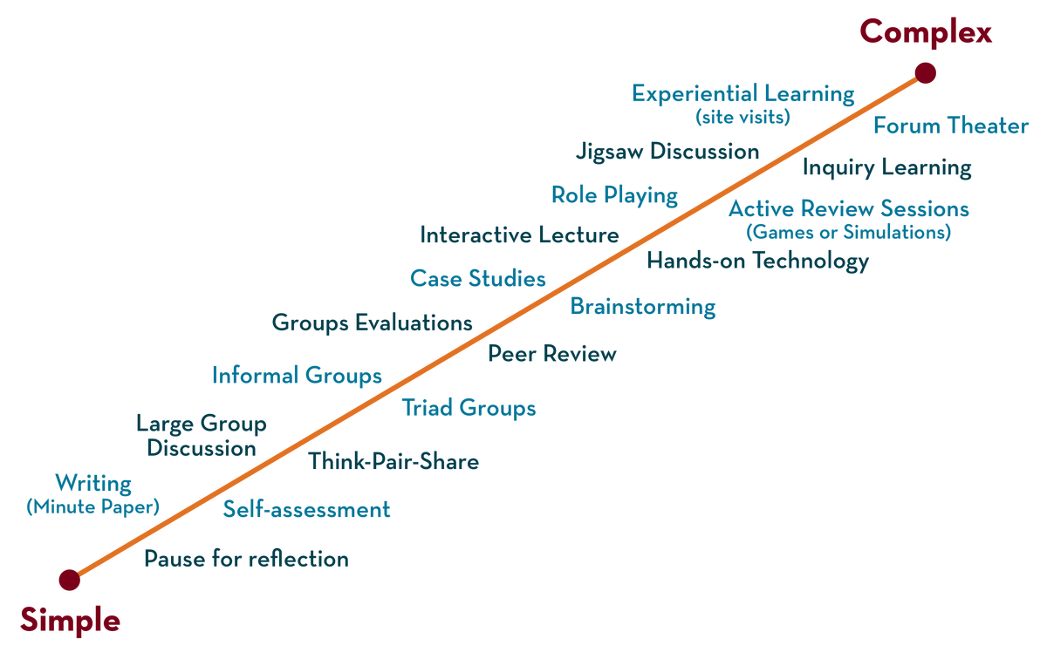
COURSE NAME: Operating Systems COURSE CODE: 23CS2104R/a
CO3
Session - 1
Inter Process Communication, Threads & Thread API

Slide 2
AIM OF THE SESSION
To familiarize students with the basic concept of Threads.
INSTRUCTIONAL OBJECTIVES
This Session is designed to:
Demonstrate what is meant by Inter-Process Communication.
Demonstrate what is meant by a Thread.
Describe the types of Threads.
Describe the Thread Models.
LEARNING OUTCOMES
At the end of this session, you should be able to:
Defines what inter-process communication is.
Describe Thread Models.
Summarize the Role of Thread.

Slide 3
Inter process Communication
Processes within a system may be independent or cooperating
Cooperating process can affect or be affected by other processes, including sharing data
Reasons for cooperating processes:
Information sharing
Computation speedup
Modularity
Convenience
Cooperating processes need inter process communication (IPC)
Two models of IPC
Shared memory
Message Passing

Slide 4
Communications Models
(a) Message passing. (b) shared memory.

Slide 5
Cooperating Processes
Independent process cannot affect or be affected by the execution of another process
The cooperating process can affect or be affected by the execution of another process
Advantages of process cooperation
Information sharing
Computation speed-up
Modularity
Convenience

Slide 6
Thread
Thread is an execution unit that consists of its program counter, a stack, and a set of registers where the program counter mainly keeps track of which instruction to execute next, a set of registers mainly holds its current working variables, and a stack mainly contains the history of execution
Threads are also known as Lightweight processes. Threads are a popular way to improve the performance of an application through parallelism.

Slide 7
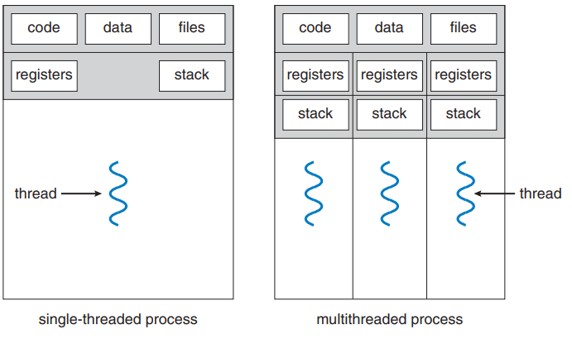
Single-thread and multi-thread process

Slide 8
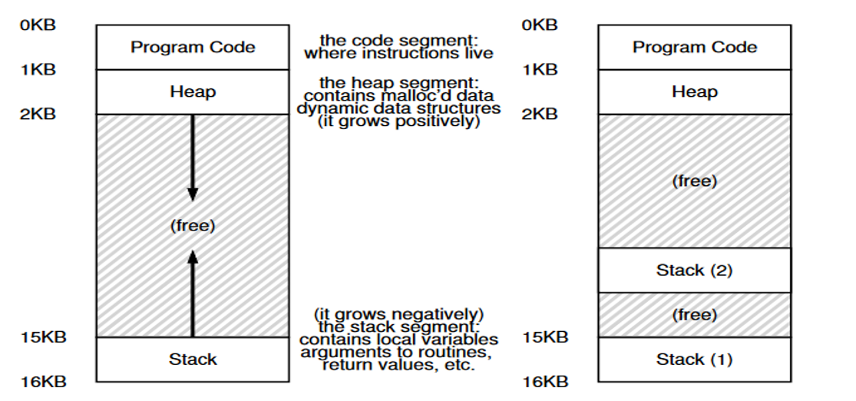
Single-thread and multi-thread process

Slide 9
Why Do We Need Thread?
Threads run in parallel improving the application performance.
Each such thread has its own CPU state and stack, but they share the address space of the process and the environment.
Threads can share common data so they do not need to use inter-process communication. Like the processes, threads also have states like ready, executing, blocked, etc.
Priority can be assigned to the threads just like the process, and the highest priority thread is scheduled first.
Each thread has its own Thread Control Block (TCB). Like the process, a context switch occurs for the thread, and register contents are saved in (TCB).

Slide 10
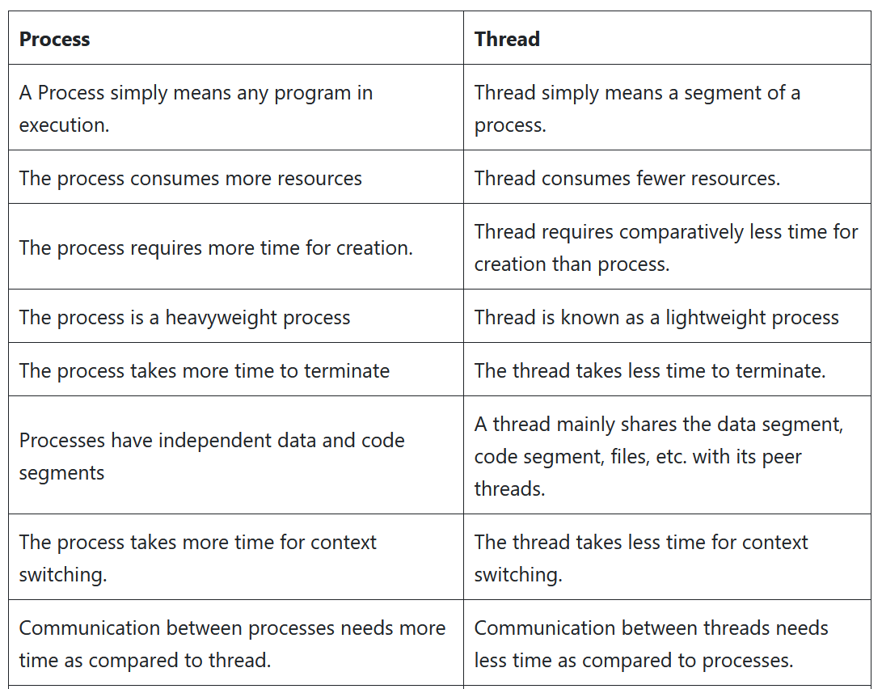
Differences between process and thread

Slide 11
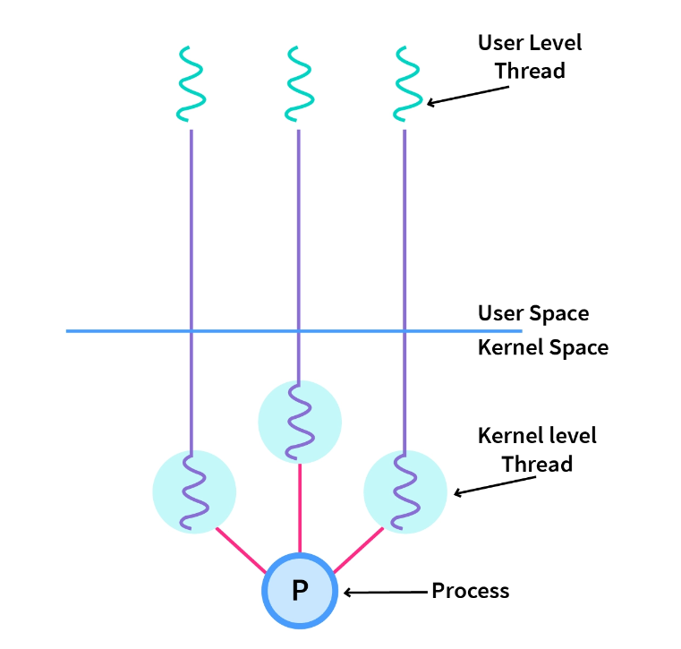
Types of threads
In the operating systems, there are two types of threads.
Kernel-level thread.
User-level threads.

Slide 12
Context switch between threads
Each thread has its own program counter and set of registers.
if there are two Threads that are running on a single processor, when switching from T1 to T2, a context switch must take place.
The context switch between threads is quite similar to the context switch between processes, as the register state of T1 must be saved and the register state of T2 restored before running T2.
With processes, we saved the state to a process control block (PCB); now, we’ll need one or more thread control blocks (TCBs) to store the state of each thread of a process.
There is one major difference, though, in the context switch we perform between threads as compared to processes: the address space remains the same (i.e., there is no need to switch which page table we are using).

Slide 13
Context switch between threads
In our simple model of the address space of a classic process (which we can now call a single-threaded process), there is a single stack, usually residing at the bottom of the address space.
In a multi-threaded process, each thread runs independently.
Thus, any stack-allocated variables, parameters, return values, and other things that we put on the stack will be placed in what is sometimes called thread-local storage, i.e., the stack of the relevant thread.

Slide 14
Multithreading Models
The user threads must be mapped to kernel threads, by one of the following strategies:
1)Many to One Model
2)One to One Model
3)Many to Many Model

Slide 15
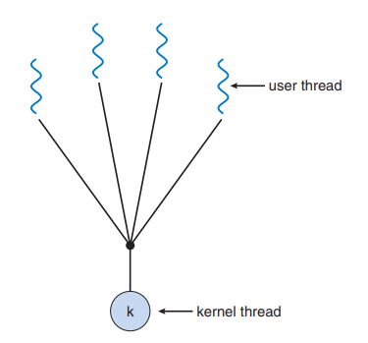
Many-to-One Model
Many user-level threads mapped to a single kernel thread
Thread library is in user space
Drawback: The Entire process will block if a thread makes a blocking system call
Examples:
Solaris Green Threads
GNU Portable Threads

Slide 16
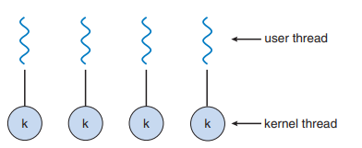
One to One Model
The one-to-one model creates a separate kernel thread to handle every user thread.
Most implementations of this model limit how many threads can be created.
Linux and Windows from 95 to XP implement the one-to-one model for threads.
This model provides more concurrency than that of the many-to-one Model.

Slide 17
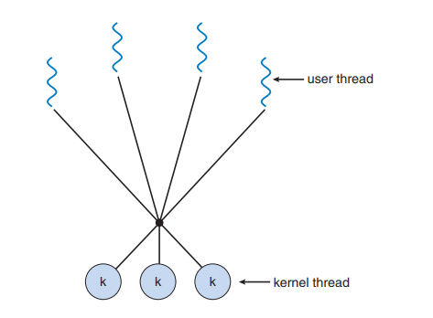
Many to Many Model
The many to many model multiplexes any number of user threads onto an equal or smaller number of kernel threads, combining the best features of the one-to-one and many-to-one models.
Users can create any number of threads.
Example: Solaris prior to version 9

Slide 18
Benefits of threads
Responsiveness
Resource Sharing
Economy
Scalability

Slide 19
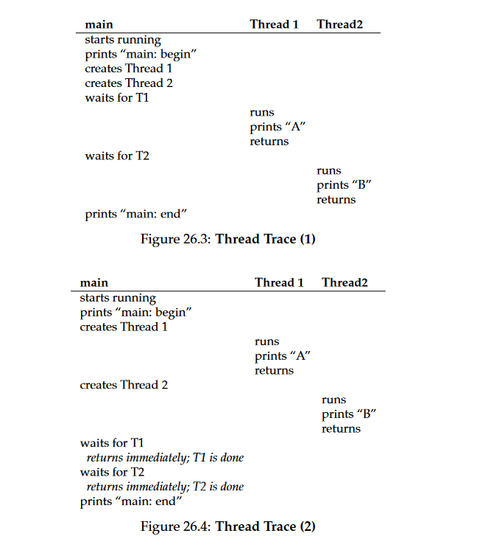
THREAD TRACE

Slide 20
Thread API
int pthread_create (pthread_t* thread, const pthread_attr_t * attr, void* (*start_routine)(void*), void* arg)
int pthread_join(pthread_t thread, (void *)*value_ptr)
int pthread_mutex_lock(pthread_mutex_t *mutex)
int pthread_mutex_unlock(pthread_mutex_t *mutex)
int pthread_mutex_trylock(pthread_mutex_t *mutex)
int pthread_mutex_timelock(pthread_mutex_t *mutex, struct timespec *abs_timeout);
int pthread_cond_wait(pthread_cond_t *cond, pthread_mutex_t *mutex)
int pthread_cond_signal(pthread_cond_t *cond)

Slide 21
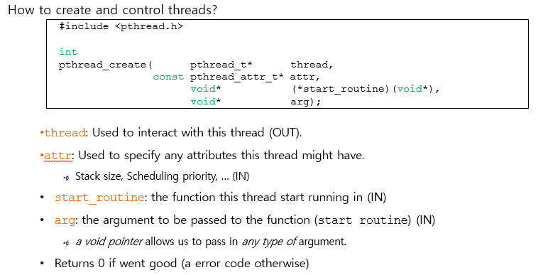
Thread Creation

Slide 22
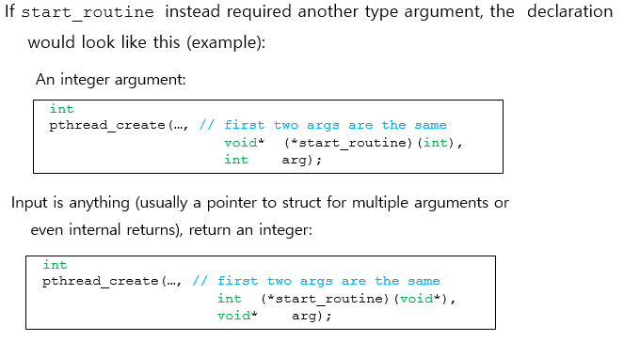

Slide 23
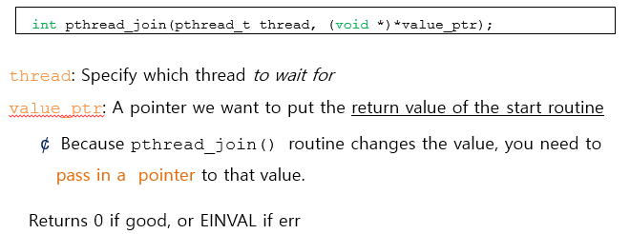
Wait for a thread to complete

Slide 24
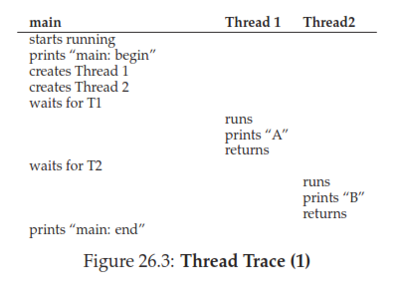
Possible outcomes

Slide 25
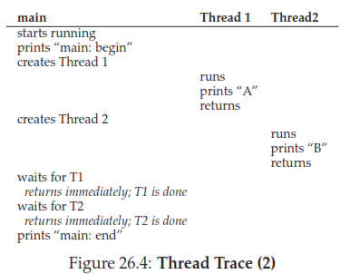
Possible outcomes

Slide 26
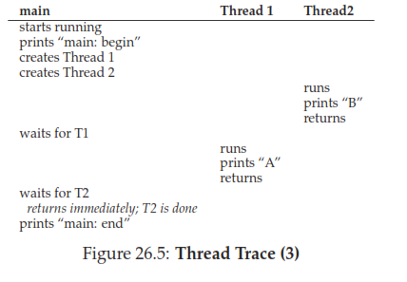
Possible outcomes

Slide 27
Threads in different environments
POSIX:(UNIX OS): The POSIX thread libraries are a C/C++ thread API based on standards. It enables the creation of a new concurrent process flow.
Win32(WINDOWS OS): These Threads are provided as a kernel-level library on Windows systems.
Java Threads(Platform Independent): Since Java generally runs on a Java Virtual Machine, implementing threads is based upon whatever OS and hardware the JVM is running on, i.e., Pitheads or Win32 threads depending on the system.

Slide 28
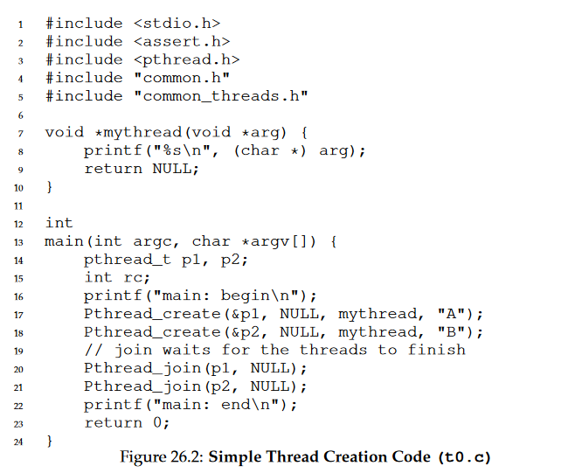
Simple Thread Creation

Slide 29

THANK YOU
Team – Operating System

