Slide 1
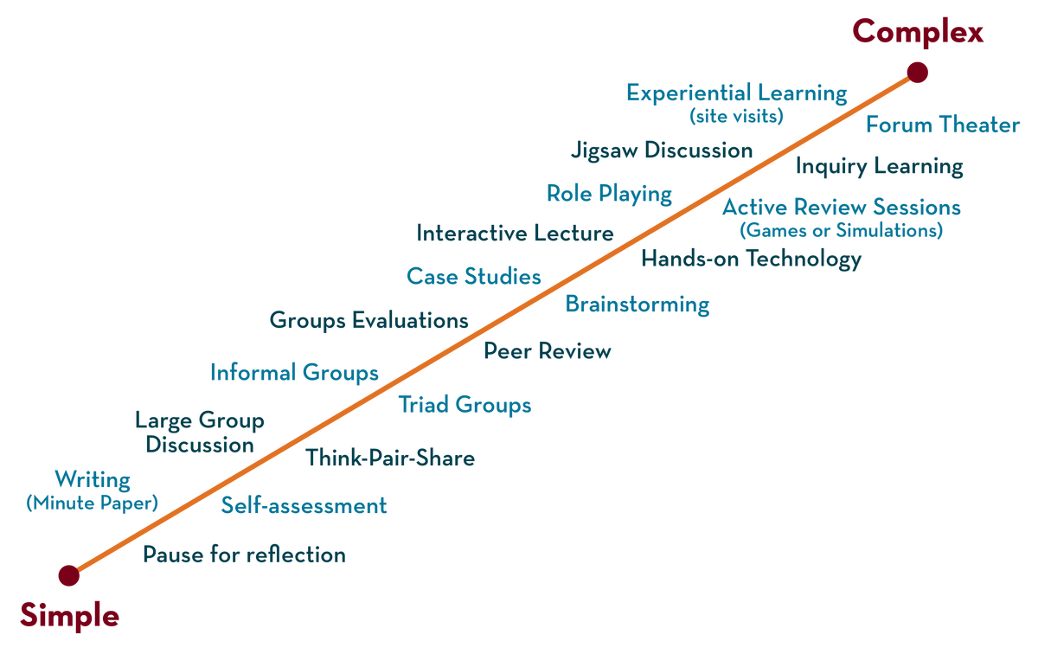
COURSE NAME: Operating Systems COURSE CODE: 23CS2104R/A
CO3
Session - 2
Concurrency and Process Synchronization

Slide 2
AIM OF THE SESSION
To familiarize students with the basic concept of Concurrency and Process Synchronization.
INSTRUCTIONAL OBJECTIVES
This Session is designed to:
Demonstrate what is meant by Concurrency.
Demonstrate what is meant by a Process Synchronization.
Describe the need for Process Synchronization.
LEARNING OUTCOMES
At the end of this session, you should be able to:
Defines what Describe Concurrency and Process Synchronization.

Slide 3
Concurrency in OS
Concurrency in operating systems refers to the ability of an operating system to handle multiple tasks or processes simultaneously.
With the increasing demand for high-performance computing, concurrency has become a critical aspect of modern computing systems.
Concurrency is essential in modern operating systems due to the increasing demand for multitasking, real-time processing, and parallel computing.
Operating systems that support concurrency can execute multiple tasks simultaneously, leading to better resource utilization, improved responsiveness, and enhanced user experience.

Slide 4
Principles of Concurrency
The principles of concurrency in operating systems are designed to ensure that multiple processes or threads can execute efficiently and effectively
INTERLEAVING
Interleaving refers to the interleaved execution of multiple processes or threads.
SYNCHRONIZATION
Synchronization refers to the coordination of multiple processes or threads to ensure they do not interfere.

Slide 5
Principles of Concurrency
MUTUAL EXCLUSION
Mutual exclusion refers to ensuring that only one process or thread can access a shared resource at a time.
DEADLOCK AVOIDANCE
Deadlock is a situation in which two or more processes or threads are waiting for each other to release a resource, resulting in a deadlock.
PROCESS OR THREAD COORDINATION
Processes or threads may need to coordinate their activities to achieve a common goal.
RESOURCE ALLOCATION
Operating systems must allocate resources such as memory, CPU time, and I/O devices to multiple processes or threads fairly and efficiently.

Slide 6
Concurrency Mechanisms
These concurrency mechanisms are essential for managing concurrency in operating systems and are used to ensure safe and efficient access to system resources.
Process vs Threads: An operating system can support concurrency using processes or threads.
Synchronization Primitives: Operating systems provide synchronization primitives to coordinate access to shared resources between multiple processes or threads.
Scheduling Algorithms: Operating systems use scheduling algorithms to determine which process or thread should execute next.
Message Passing: Message passing is a mechanism used to communicate between processes or threads.
Memory Management: Operating systems provide memory management mechanisms to allocate and manage memory resources.
Interrupt Handlings: Interrupts are signals sent by hardware devices to the operating system, indicating that they require attention.

Slide 7
Advantages of concurrency
Concurrency provides several advantages in operating systems, including
Improved Performance: Concurrency allows multiple tasks to be executed simultaneously, improving the overall performance of the system.
Resource Utilization: Concurrency allows better utilization of system resources, such as CPU, memory, and I/O devices.
Responsiveness: Concurrency can improve system responsiveness by allowing multiple tasks to be executed concurrently.
Scalability: Concurrency can improve the scalability of the system by allowing it to handle an increasing number of tasks and users without degrading performance.
Fault Tolerance: Concurrency can improve the fault tolerance of the system by allowing tasks to be executed independently. If one task fails, it does not affect the execution of other tasks.

Slide 8
Problems in Concurrency
These problems can be difficult to debug and diagnose and often require careful design and implementation of concurrency mechanisms to avoid.
Sharing global resources Sharing of global resources safely is difficult. If two processes both make use of a global variable and both perform read and write on that variable.
Optimal allocation of resources It is difficult for the operating system to manage the allocation of resources optimally.
Locating programming errors It is very difficult to locate a programming error because reports are usually not reproducible.
Locking the channel It may be inefficient for the operating system to simply lock the channel and prevents its use by other processes.

Slide 9
COMMUNICATION IN Concurrency
Concurrency is the execution of multiple instruction sequences at the same time. It happens in the operating system when several process threads are running in parallel. The running process threads always communicate with each other through shared memory or message passing.

Slide 10
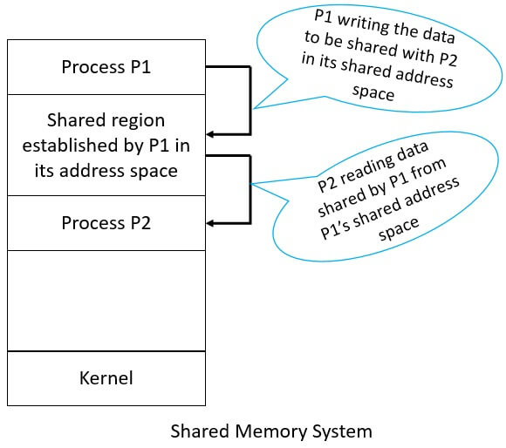
Shared memory systems
Inter process Communication using shared memory requires communicating processes to establish a region of shared memory.
Typically a shared memory region resides in the address space of the process creating the shared memory segment.
Other processes that wish to communicate using this shared memory segment must attach it to their address space.
Normally, the operating system tries to prevent one process from accessing another process’s memory.
Shared memory requires that two or more processes agree to remove this restriction.

Slide 11
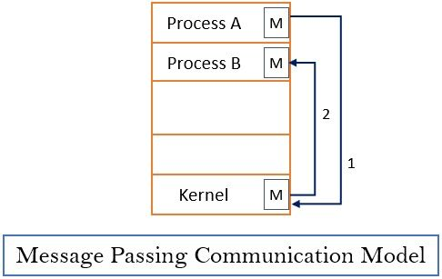
Message-passing systems
Message passing provides a mechanism to allow processes to communicate and synchronize their actions without sharing the same address space and is particularly useful in a distributed environment, where the communicating processes may reside on different computers connected by a network.

Slide 12
Process Synchronization
Process Synchronization is the coordination of execution of multiple processes in a multi-process system to ensure that they access shared resources in a controlled and predictable manner. It aims to resolve the problem of race conditions and other synchronization issues in a concurrent system.
The main objective of process synchronization is to ensure that multiple processes access shared resources without interfering with each other and to prevent the possibility of inconsistent data due to concurrent access. To achieve this, various synchronization techniques such as semaphores, monitors, and critical sections are used.
In a multi-process system, synchronization is necessary to ensure data consistency and integrity, and to avoid the risk of deadlocks and other synchronization problems. Process synchronization is an important aspect of modern operating systems, and it plays a crucial role in ensuring the correct and efficient functioning of multi-process systems.

Slide 13
Process Synchronization
What is Process?
A process is a program that is currently running or a program under execution is called a process. It includes the program’s code and all the activity it needs to perform its tasks, such as using the CPU, memory, and other resources.
The process is categorized into two types on the basis of synchronization and these are given below:
1. Independent Process
2. Cooperative Process
1. Independent Processes
Two processes are said to be independent if the execution of one process does not affect the execution of another process.
2. Cooperative Processes
Two processes are said to be cooperative if the execution of one process affects the execution of another process. These processes need to be synchronized so that the order of execution can be guaranteed.

Slide 14
Background
Processes can execute concurrently
May be interrupted at any time, partially completing execution
Concurrent access to shared data may result in data inconsistency
Maintaining data consistency requires mechanisms to ensure the orderly execution of cooperating processes
Illustration of the problem: Suppose that we wanted to provide a solution to the producer-consumer problem that fills all the buffers. We can do so by having an integer counter that keeps track of the number of full buffers. Initially, counter is set to 0. It is incremented by the producer after it produces a new buffer and is decremented by the consumer after it consumes a buffer.

Slide 15
Producer-Consumer problem
The Producer-Consumer problem is a classical multi-process synchronization problem, that is we are trying to achieve synchronization between more than one process.
There is one Producer in the producer-consumer problem, the Producer is producing some items, whereas there is one Consumer that is consuming the items produced by the Producer. The same memory buffer is shared by both producers and consumers which is of fixed size.

Slide 16
Producer-Consumer problem or bounded buffer problem
Producer
while (true) { /* produce an item in next produced */
while (counter == BUFFER SIZE) ;
/* do nothing */
buffer[in] = next produced;
in = (in + 1) % BUFFER SIZE; counter++;
}
Consumer
while (true) {
while (counter == 0) ; /* do nothing */
next consumed = buffer[out];
out = (out + 1) % BUFFER SIZE;
counter--; /* consume the item in next consumed */
}

Slide 17
Producer-Consumer problem
Before Starting an explanation of code, first, understand the few terms used in the above code:
“in" used in a producer code represents the next empty buffer
"out" used in consumer code represents a first filled buffer
Count keeps the count number of elements in the buffer.
Count is further divided into 3 lines of code represented in the block in both the producer and consumer code.

Slide 18
Producer-Consumer problem
The producer should produce data only when the buffer is not full.
In case it is found that the buffer is full, the producer is not allowed to store any data into the memory buffer.
Data can only be consumed by the consumer if and only if the memory buffer is not empty. In case it is found that the buffer is empty, the consumer is not allowed to use any data from the memory buffer.
Accessing memory buffer should not be allowed to producer and consumer at the same time.

Slide 19


Need for process synchronization
Race condition
A race condition occurs when two or more processes access and manipulate a shared resource simultaneously, leading to unexpected results. In this example, we will use a shared variable "counter" and two processes, "Process A" and "Process B".
Process A:
Read the value of the counter
Increment the value of the counter by 1
Save the new value of the counter
Process B:
Read the value of the counter
Decrement the value of the counter by 1
Save the new value of the counter

Slide 20
Example of Race Condition
counter++ could be implemented as register1 = counter register1 = register1 + 1 counter = register1
counter-- could be implemented as register2 = counter register2 = register2 - 1 counter = register2
Consider this execution interleaving with “count = 5” initially:
S0: producer execute register1 = counter {register1 = 5} S1: producer execute register1 = register1 + 1 {register1 = 6} S2: consumer execute register2 = counter {register2 = 5} S3: consumer execute register2 = register2 – 1 {register2 = 4} S4: producer execute counter = register1 {counter = 6 } S5: consumer execute counter = register2 {counter = 4}

Slide 21
Race Condition
We would arrive at this incorrect state because we allowed both processes to manipulate the variable counter concurrently.
A situation like this, where several processes access and manipulate the same data concurrently and the outcome of the execution depends on the particular order in which the access takes place, is called a race condition.
To guard against the race condition above, we need to ensure that only one process at a time can be manipulating the variable counter. To make such a guarantee, we require that the processes be synchronized in some way.

Slide 22
Critical Section Problem
Consider system of n processes {p₀, p₁, … p_{n-1}}
Each process has a critical section segment of code
Process may be changing common variables, updating the table, writing a file, etc
When one process in the critical section, no other may be in its critical section
The critical section problem is to design a protocol to solve this
Each process must ask permission to enter the critical section in the entry section, may follow the critical section with the exit section, then the remainder section

Slide 23
Critical-Section Problem
do {
Entry section
Critical section
Exit section
Remainder section
}
while (true);
The general structure of a typical process Pi with Critical Section.

Slide 24
Algorithm for Process P_{i}
do {
while (turn == j);
critical section
turn = j;
remainder section
} while (true);

Slide 25
solution to the critical section problem
A solution to the critical-section problem must satisfy the following three requirements:
1. Mutual exclusion: If process Pi is executing in its critical section, then no other processes can be executing in their critical sections.
2. Progress: If no process is executing in its critical section and some processes wish to enter their critical sections, then only those processes that are not executing in their remainder sections can participate in deciding which will enter its critical section next, and this selection cannot be postponed indefinitely.
3. Bounded waiting:There exists a bound, or limit, on the number of times that other processes are allowed to enter their critical sections after a process has made a request to enter its critical section and before that request is granted

Slide 26
Peterson’s Solution
Good algorithmic description of solving the problem
Two process solution
Assume that the load and store machine-language instructions are atomic; that is, cannot be interrupted
The two processes share two variables:
int turn;
Boolean flag[2]
The variable turn indicates whose turn it is to enter the critical section
The flag array is used to indicate if a process is ready to enter the critical section. flag[i] = true implies that process P_{i} is ready!

Slide 27
Algorithm for Process P_{i}
do {
flag[i] = true;
turn = j;
while (flag[j] && turn = = j);
critical section
flag[i] = false;
remainder section
} while (true);

Slide 28
Peterson’s Solution (Cont.)
Provable that the three CS requirements are met:
1. Mutual exclusion is preserved
P_{i} enters CS only if:
either flag[j] = false or turn = i
2. Progress requirement is satisfied
3. Bounded-waiting requirement is met

Slide 29

THANK YOU
Team – Operating System

