Slide 1
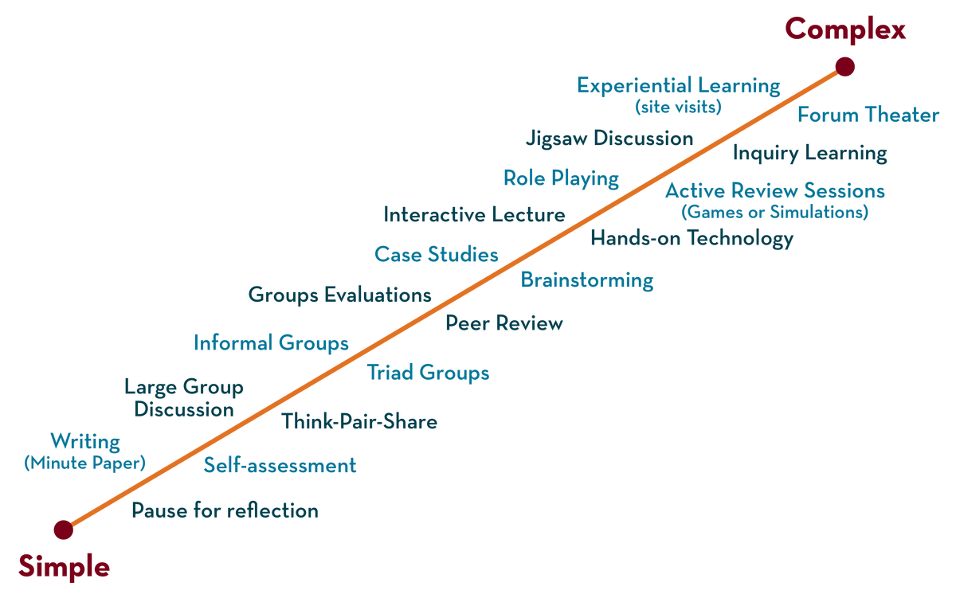
COURSE NAME: Operating Systems COURSE CODE: 23CS2104R/A
CO3
Session - 3
LOCKS, LOCKED DATA STRUCTURES, CONDITION VARIABLES, MUTEX.

Slide 2
AIM OF THE SESSION
To familiarize students with the basic concept of locks.
INSTRUCTIONAL OBJECTIVES
This Session is designed to:
Demonstrate what is meant by Lock.
Describe the types of Locks.
Describe the Locked Data Structures.
Describe the Concurrent Counters with Locks.
LEARNING OUTCOMES
At the end of this session, you should be able to:
Defines what is a lock.
Describe Test and Set and Compare and Swap.
Summarize the Role of Mutex Locks.

Slide 3
Synchronization Hardware
Many systems provide hardware support for critical section code
Uniprocessors – could disable interrupts
Currently running code would execute without preemption
Generally too inefficient on multiprocessor systems
Operating systems using this not broadly scalable
Modern machines provide special atomic hardware instructions
Atomic = non-interruptible
Either test memory word and set value
Or swap contents of two memory words

Slide 4
Locks: The Basic Idea
Ensure that any critical section executes as if it were a single atomic instruction.
An example: the canonical update of a shared variable
Add some code around the critical section
balance = balance + 1;
lock_t mutex; // some globally-allocated lock ‘mutex’
…
lock(&mutex);
balance = balance + 1; unlock(&mutex);

Slide 5
Contd..
Lock variable holds the state of the lock.
available (or unlocked or free)
No thread holds the lock.
acquired (or locked or held)
Exactly one thread holds the lock and presumably is in a critical section.

Slide 6
The semantics of the lock()
lock()
Try to acquire the lock.
If no other thread holds the lock, the thread will acquire the lock.
Enter the critical section.
This thread is said to be the owner of the lock.
Other threads are prevented from entering the critical section while the first thread that holds the lock is in there.

Slide 7
Evaluating locks – Basic criteria
Mutual exclusion
Does the lock work, preventing multiple threads from entering a critical section?
Fairness
Does each thread contending for the lock get a fair shot at acquiring it once it is free? (Starvation)
Performance
The time overheads added by using the lock

Slide 8
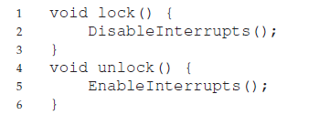
Controlling Interrupts
Disable Interrupts for critical sections
One of the earliest solutions used to provide mutual exclusion
Invented for single-processor systems.

Slide 9
Locks
Test and Set
Compare and Swap
Load-Linked and Store-Conditional
Fetch-And-Add
Ticket Lock
Futex Lock

Slide 10
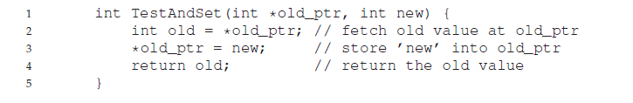
Test And Set (Atomic Exchange)
An instruction to support the creation of simple locks
return(testing) old value pointed to by the ptr.
Simultaneously update(setting) said value to new.
This sequence of operations is performed atomically.

Slide 11
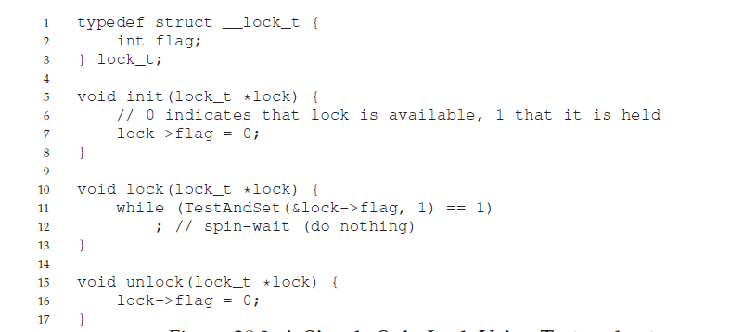
A Simple Spin Lock using test-and-set

Slide 12
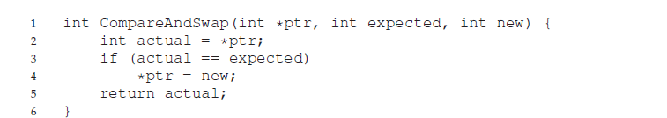
Compare-And-Swap
Test whether the value at the address(ptr) is equal to expected.
If so, update the memory location pointed to by ptr with the new value.
In either case, return the actual value at that memory location.

Slide 13

Compare-And-Swap
Compare-and-Swap hardware atomic instruction (C-style)
Spin lock with compare-and-swap

Slide 14
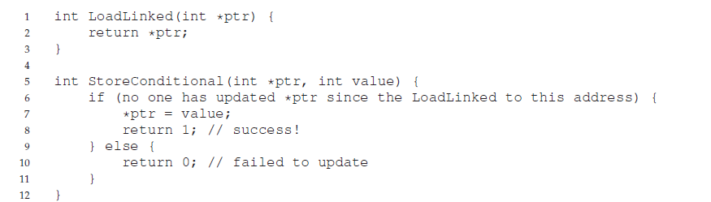
Load-Linked and Store-Conditional
The store-conditional only succeeds if no intermittent store to the address has taken place.
success: return 1 and update the value at ptr to value.
fail: the value at ptr is not updated and 0 is returned.

Slide 15
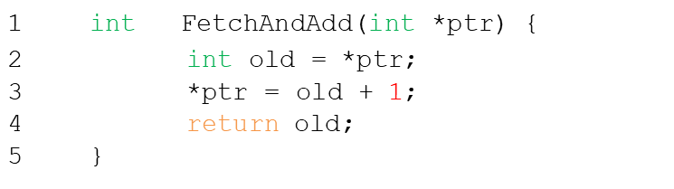
Fetch-And-Add
Atomically increment a value while returning the old value at a particular address.
Fetch-And-Add Hardware atomic instruction (C-style)

Slide 16
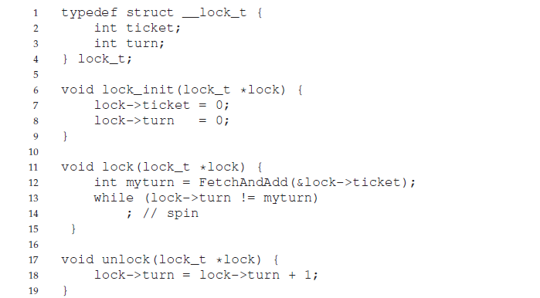
Ticket Lock
Ticket lock can be built with fetch-and add.
Ensure progress for all threads. à fairness

Slide 17
Using Queues: Sleeping Instead of Spinning
Queue to keep track of which threads are waiting to enter the lock.
park()
Put a calling thread to sleep
unpark(threadID)
Wake a particular thread as designated by threadID.

Slide 18
Wakeup/waiting race
In case of releasing the lock (thread A) just before the call to park(
(thread B) à Thread B would sleep forever (potentially).
Solaris solves this problem by adding a third system call: setpark().
By calling this routine, a thread can indicate it is about to park.
If it happens to be interrupted and another thread calls unpark before park is actually called, the subsequent park returns immediately instead of sleeping.

Slide 19
Futex
Linux provides a futex (is similar to Solaris’s park and unpark). More functionality goes into the kernel.
futex_wait(address, expected)
Put the calling thread to sleep
If the value at address is not equal to expected, the call returns immediately.
futex_wake(address)
¢ Wake one thread that is waiting on the queue.

Slide 20
Two-Phase Locks
A two-phase lock realizes that spinning can be useful if the lock is about to be released.
First phase
The lock spins for a while, hoping that it can acquire the lock.
If the lock is not acquired during the first spin phase, a second phase is entered,
Second phase
The caller is put to sleep.
The caller is only woken up when the lock becomes free later.

Slide 21
Lock-based Concurrent Data Structures
Adding locks to a data structure makes the structure thread safe.
How locks are added determine both the correctness and performance of the data structure.

Slide 22
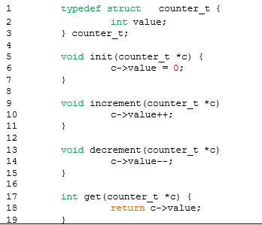
Example: Concurrent Counters without Locks

Slide 23
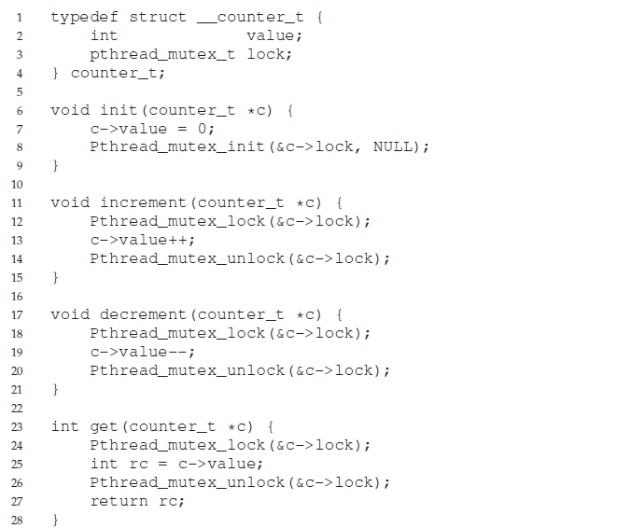
Example: Concurrent Counters with Locks

Slide 24
Sloppy counter
The sloppy counter works by representing …
A single logical counter via numerous local physical counters, on per CPU core
A single global counter
There are locks:
One for each local counter and one for the global counter
Example: on a machine with four CPUs
Four local counters
One global counter

Slide 25
The basic idea of sloppy counting
When a thread running on a core wishes to increment the counter.
It increments its local counter.
Each CPU has its local counter:
Threads across CPUs can update local counters without contention.
Thus counter updates are scalable.
The local values are periodically transferred to the global counter.
Acquire the global lock
Increment it by the local counter’s value
The local counter is then reset to zero.

Slide 26
Sloppy counter example
Tracing the Sloppy Counters
The threshold S is set to 5.
There are threads on each of four CPUs
Each thread updates their local counters 𝐿"… 𝐿#.
Time | 𝐋_{𝟏} | 𝐋_{𝟐} | 𝐋_{𝟑} | 𝐋_{𝟒} | G
0 | 0 | 0 | 0 | 0 | 0
1 | 0 | 0 | 1 | 1 | 0
2 | 1 | 0 | 2 | 1 | 0
3 | 2 | 0 | 3 | 1 | 0
4 | 3 | 0 | 3 | 2 | 0
5 | 4 | 1 | 3 | 3 | 0
6 | 5 | 1 | 3 | 4 | 5 (from 𝐿")
7 | 0 | 2 | 4 | 5 | 10 (from 𝐿#)

Slide 27
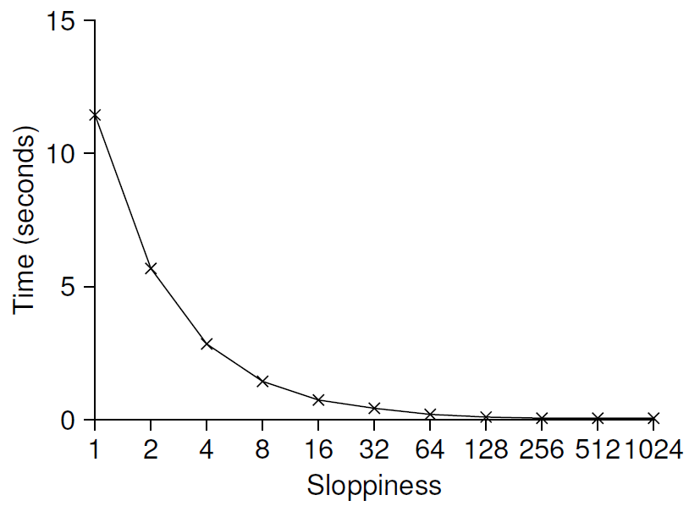
Importance of the threshold value S
Each four threads increments a counter 1 million times on four CPUs.
Low S, Performance is poor, The global count is always quite accurate.
High S, Performance is excellent, The global count lags.

Slide 28
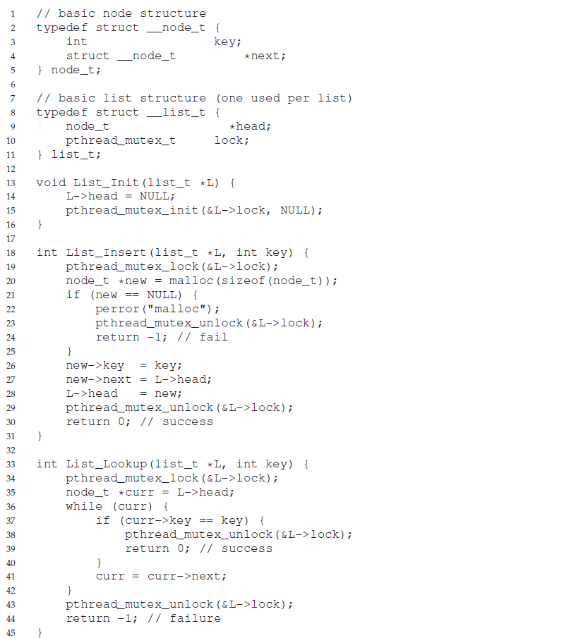
Concurrent Linked List:

Slide 29
Concurrent Linked Lists (Cont.)
The code acquires a lock in the insert routine upon entry.
The code releases the lock upon exit.
If malloc() happens to fail, the code must also release the lock before failing the insert.
This kind of exceptional control flow has been shown to be quite error prone.
Solution: The lock and release only surround the actual critical section in the insert code

Slide 30
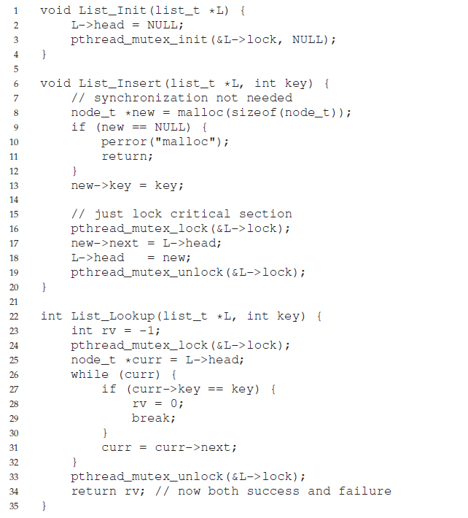
Concurrent Linked List: Refactored Insert

Slide 31
Scaling Linked List
Hand-over-hand locking (lock coupling)
Add a lock per node of the list instead of having a single lock for the entire list.
When traversing the list,
First grab the next node’s lock.
And then releases the current node’s lock.
Enable a high degree of concurrency in list operations.
However, in practice, the overheads of acquiring and releasing locks for each node of a list traversal can be prohibitive.
Perhaps a hybrid (where you grab a new lock every so many nodes) approach?

Slide 32
Michael and Scott Concurrent Queues
Queues uses enqueue / dequeue operations only
There are two locks.
One for the head of the queue.
One for the tail.
The goal of these two locks is to enable concurrency of enqueue and
dequeue operations.
Add a dummy node
Allocated in the queue initialization code
Enable the separation of head and tail operations

Slide 33
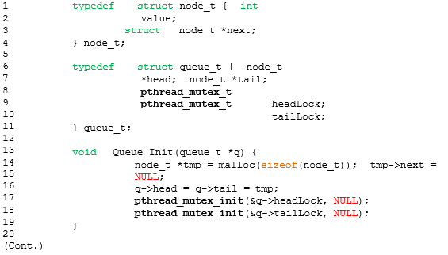
Concurrent Queues (Cont.)

Slide 34
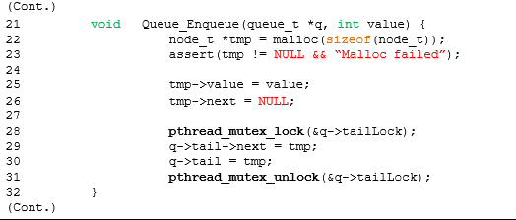
Concurrent Queues (Cont.)

Slide 35
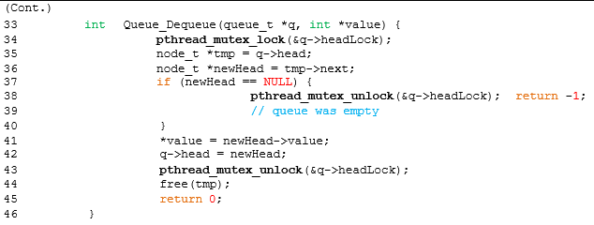
Concurrent Queues (Cont.)

Slide 36
Concurrent Hash Table
Focus on a simple hash table
The hash table does not resize, simplest hash, slow searches
Built using the concurrent lists
It uses a lock per hash bucket each of which is represented by a list.

Slide 37
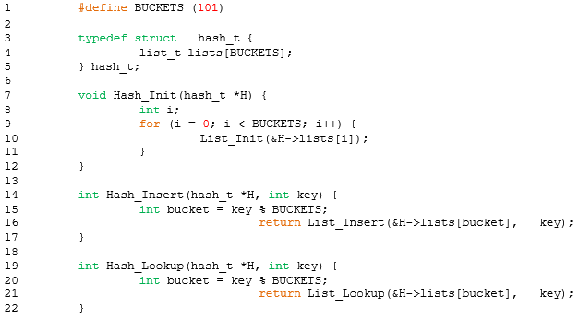
Concurrent Hash Table

Slide 38
Condition Variables
There are many cases where a thread wishes to check whether a
condition is true before continuing its execution.
Example: A parent thread might wish to check whether a child thread has completed.
This is often called a join().

Slide 39
How to wait for a condition
Condition variable
Waiting on the condition
An explicit queue that threads can put themselves on when some state of execution is not as desired.
Signaling on the condition
Some other thread, when it changes said state, can wake one of those waiting threads and allow them to continue.

Slide 40
Definition and Routines
Declare condition variable
pthread cond t c;
Proper initialization is required.
Operation (the POSIX calls)
pthread_cond_wait(pthread_cond_t *c, pthread_mutex_t *m); pthread_cond_signal(pthread_cond_t *c);

Slide 41
Definition and Routines
The wait() call takes a mutex as a parameter.
¢ The wait() call release the lock and put the calling thread to sleep.
¢ When the thread wakes up, it must re-acquire the lock.

Slide 42
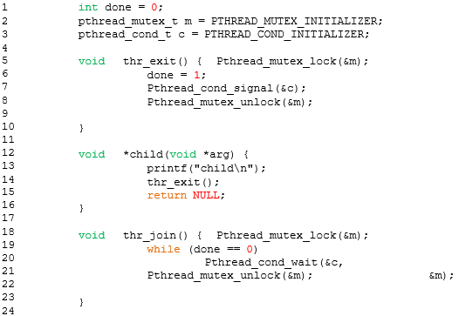
Parent waiting for the Child

Slide 43
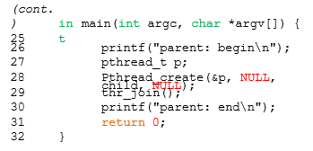
Parent waiting for Child: Use a condition variable

Slide 44
Parent waiting for Child: Use a condition variable
Parent:
Create the child thread and continue running itself.
Call into thr_join() to wait for the child thread to complete.
¢ Acquire the lock
¢ Check if the child is done
¢ Put itself to sleep by calling wait()
¢ Release the lock

Slide 45
Parent waiting for Child: Use a condition variable
Child:
Print the message “child”
Call thr_exit() to wake the parent thread
¢ Grab the lock
¢ Set the state variable done
¢ Signal the parent thus waking it.

Slide 46
The Producer / Consumer (Bound Buffer) Problem
Producer
Produce data items
Wish to place data items in a buffer
Consumer
Grab data items out of the buffer consume them in some way
Example: Multi-threaded web server
A producer puts HTTP requests in to a work queue
Consumer threads take requests out of this queue and process them

Slide 47
Bounded buffer
A bounded buffer is used when you pipe the output of one program into another.
Example: grep foo file.txt | wc –l
¢ The grep process is the producer.
¢ The wc process is the consumer.
¢ Between them is an in-kernel bounded buffer.
Bounded buffer is a Shared resource à Synchronized access is required.

Slide 48
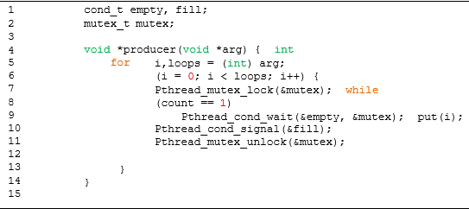
The single Buffer Producer/Consumer Solution
Use two condition variables and while
Producer threads wait on the condition empty, and signals fill.
Consumer threads wait on fill and signal empty.

Slide 49
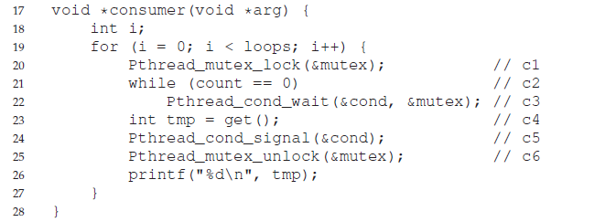
The single Buffer Producer/Consumer Solution

Slide 50
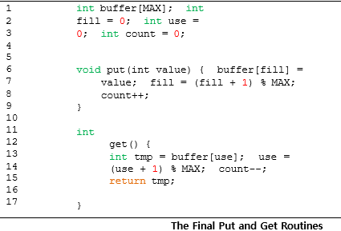
The Final Producer/Consumer Solution(Multiple Buffers)
More concurrency and efficiency à Add more buffer slots.
Allow concurrent production or consuming to take place.
Reduce context switches.

Slide 51
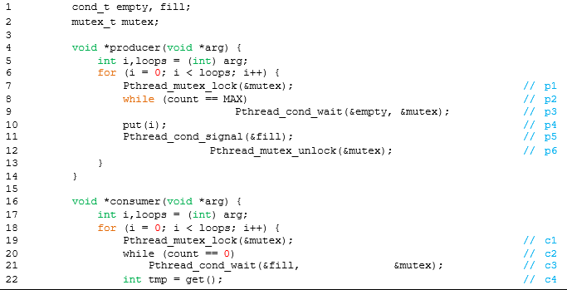
The Final Producer/Consumer Solution (Cont.)

Slide 52

The Final Producer/Consumer Solution (Cont.)
The Final Working Solution (Cont.)
p2: A producer only sleeps if all buffers are currently filled.
c2: A consumer only sleeps if all buffers are currently empty.
Note: The Producer Consumer Problem with Multiple Buffer Slots is practically demonstrated in the next Chapter using semaphores and mutex.

Slide 53
Mutex Lock
A lock variable provides the simplest synchronization mechanism for processes.
Its a software mechanism implemented in user mode, i.e. no support required from the Operating System.
Its a busy waiting solution (keeps the CPU busy even when its technically waiting).
It can be used for more than two processes.
When Lock = 0 implies critical section is vacant (initial value ) and Lock = 1 implies critical section occupied.

Slide 54
Basic operations on a lock:
acquire: mark the lock as owned by the current thread; if some other thread already owns the lock then first wait until the lock is free.
release: mark the lock as free (it must currently be owned by the calling thread).
do {
acquire lock
critical section
release lock
remainder section
} while

Slide 55
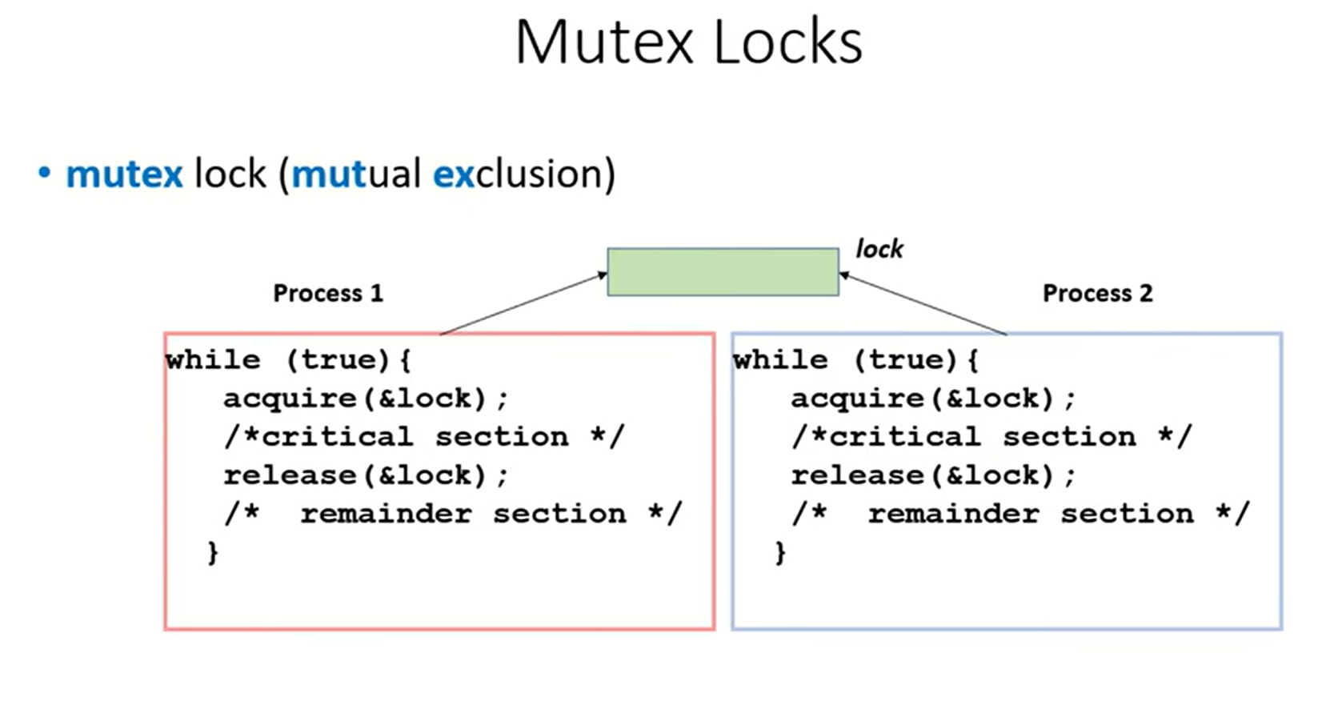

Slide 56
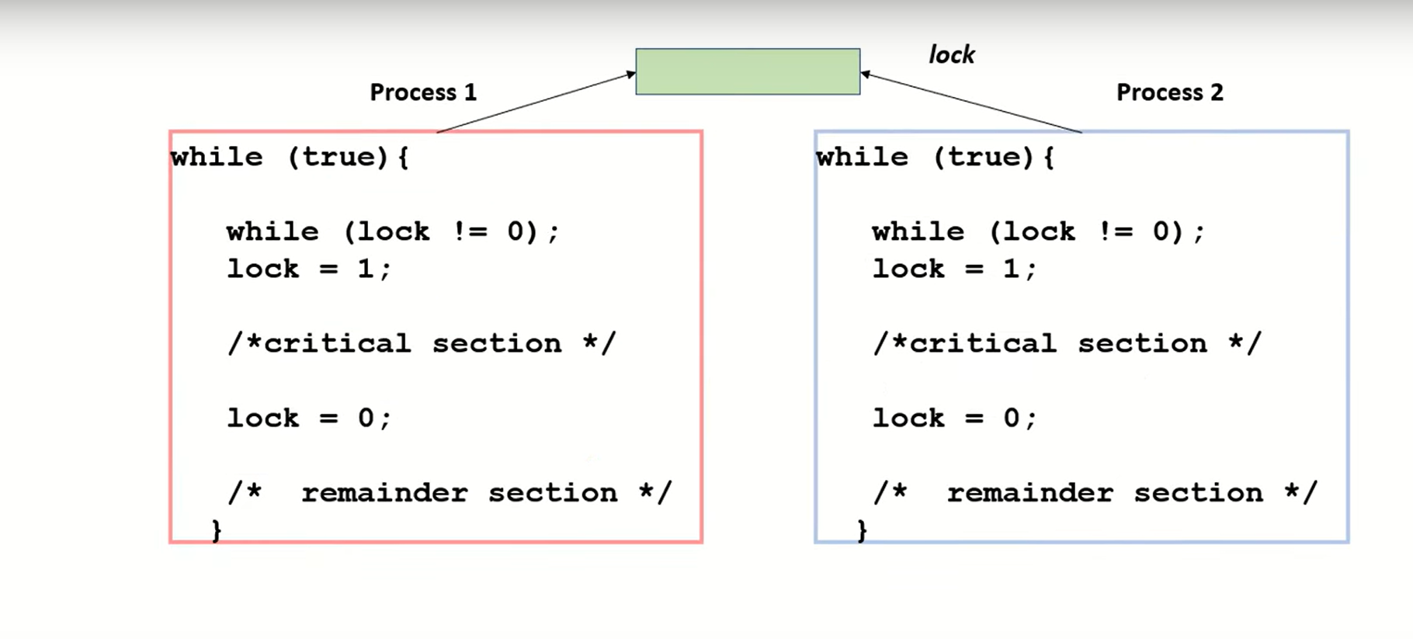

Slide 57

THANK YOU
Team – Operating System

