Slide 1
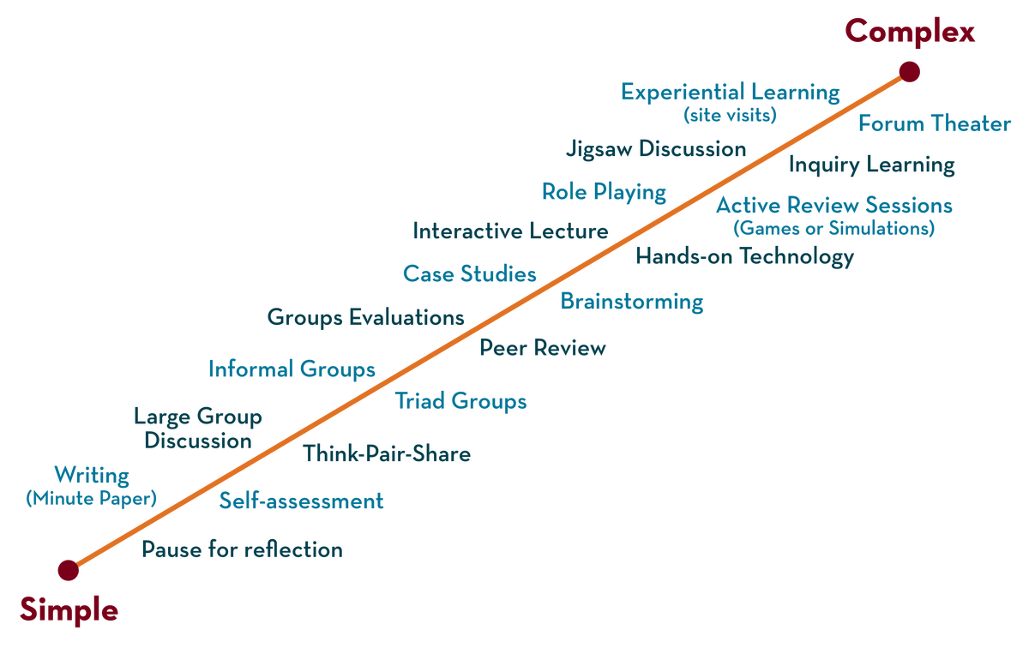
COURSE NAME: Operating Systems COURSE CODE: 23CS2104RA
CO3
Session - 4
SEMAPHORES, CLASSICAL CONCURRENCY PROBLEMS, MONITORS.

Slide 2
AIM OF THE SESSION
To familiarize students with the basic concept of semaphores, Monitors, Inter Process Communication.
INSTRUCTIONAL OBJECTIVES
This Session is designed to:
Demonstrate what is meant by semaphore.
Describe the types of semaphores.
List out the differences between mutex and semaphore .
Describe the role of semaphores in solving critical section problems.
A Case Study of classical synchronization problems using semaphores.
Describe the role of Monitors.
Describe the role of Inter Process Communication.
LEARNING OUTCOMES
At the end of this session, you should be able to:
Defines what is semaphore.
Describe binary semaphore and counting semaphore.
Summarize the Role of semaphores in solving critical section problems.
A Comparative Study of Classical Synchronization Problems.
Defines what is Monitors.

Slide 3
Semaphores
Semaphore proposed by Edsger Dijkstra, is a technique to manage concurrent processes by using integer value, which is known as Semaphore.
Synchronization tool that provides more sophisticated ways (than Mutex locks) for processes to synchronize their activities.
Semaphore S is an integer variable which is used in mutual exclusive manner used by concurrent cooperative processes in order to achieve synchronization.
A semaphore is an integer variable, shared among multiple processes. The main aim of using a semaphore is process synchronization and access control for a common resource in a concurrent environment.

Slide 4
Interact with semaphore
Semaphore S can only be accessed and modified via two indivisible (atomic) operations
Sem_wait () or P() -→ Proberen → ”to test”.
Sem_signal () or sem_post() or V() → Verhogen → ”to increment”.
Definition of the sem_wait() or P() operation
int sem_wait(sem_t *s)
{
while (S <= 0); /* busy wait */
S--;
/*decrement the value of
semaphore S by one.
wait if value semaphore S is negative */
}
Definition of the sem_post() or V() operation
Int sem_post(sem_t *s)
{
S++; /*increment the value
of semaphore s by one
if there are one or more threads waiting wake one*/
}

Slide 5
Initialization of semaphore
#include <semaphore.h>
sem_t s ;
sem_init (&s, 0, 1);
/*Declare a semaphore s and initialize it to the value . The second argument, 0, indicates that the semaphore is shared between threads in the same process.*/

Slide 6
types of Semaphore
Counting semaphore – integer value can range over an unrestricted domain
Binary semaphore – integer value can range only between 0 and 1 Same as a mutex lock.
Can solve various synchronization problems.
Consider P₁ and P₂ that require S₁ to happen before S₂
Create a semaphore “synch” initialized to 0
P1:
S₁;
signal(synch);
P2:
wait(synch);
S₂;
Can implement a counting semaphore S as a binary semaphore

Slide 7
Semaphore Implementation
Must guarantee that no two processes can execute the sem_wait() and sem_signal() on the same semaphore at the same time.
Thus, the implementation becomes the critical section problem where the sem_wait and sem_signal code are placed in the critical section.
Could now have busy waiting in critical section implementation
But the implementation code is short
Little busy waiting if critical section rarely occupied
Note that applications may spend lots of time in critical sections and therefore this is not a good solution

Slide 8
Semaphore Implementation with no Busy waiting
With each semaphore there is an associated waiting queue
Each entry in a waiting queue has two data items:
value (of type integer)
pointer to the next record in the list
Two operations:
Block – place the process invoking the operation on the appropriate waiting queue
Wakeup – remove one of the processes in the waiting queue and place it in the ready queue.
typedef struct{
int value;
struct process *list;
} semaphore;

Slide 9
Implementation with no Busy waiting (Cont.)
Sem_wait(semaphore *S)
{
S->value--;
if (S->value < 0) { add this process to S->list;
block();
}
}
Sem_signal(semaphore *S)
{
S->value++;
if (S->value <= 0)
{ remove a process P from S->list;
wakeup(P);
}
}

Slide 10
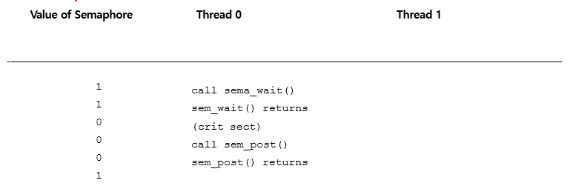
Thread Trace: Single Thread Using A Semaphore

Slide 11
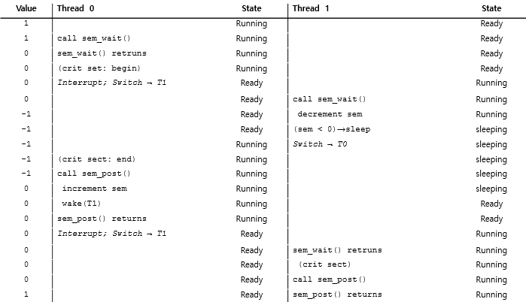
Thread Trace: Two Threads Using A Semaphore (1 CPU)

Slide 12
Deadlock and Starvation
Deadlock – two or more processes are waiting indefinitely for an event that can be caused by only one of the waiting processes
Let S and Q be two semaphores initialized to 1
P₀ P₁
sem_wait(S); sem_wait(Q);
sem_wait(Q); sem_wait(S);
... ...
sem_signal(S); sem_signal(Q);
sem_signal(Q); sem_signal(S);
Starvation – indefinite blocking
A process may never be removed from the semaphore queue in which it is suspended
Priority Inversion – Scheduling problem when a lower-priority process holds a lock needed by a higher-priority process
Solved via priority-inheritance protocol

Slide 13
Classical Problems of Synchronization
Classical problems used to test newly proposed synchronization schemes
Bounded-Buffer Producer Consumer Problem
Readers and Writers Problem
Dining-Philosophers Problem
Sleeping Barber Problem

Slide 14
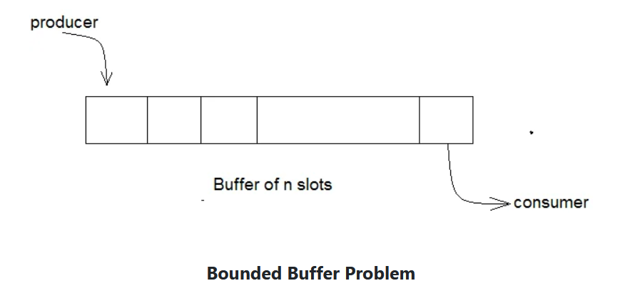
Bounded-Buffer Problem
Buffer with n slots , each can hold one item
Semaphore mutex initialized to the value 1
Semaphore full initialized to the value 0
Semaphore empty initialized to the value n

Slide 15
Bounded Buffer Problem (Cont.)
The structure of the producer process
do {
...*/ produce an item in next_produced */
...
sem_wait(empty);
sem_wait(mutex);
... /* add next produced to the buffer */
...
sem_signal(mutex);
sem_signal(full);
} while (true);
The structure of the consumer process
Do {
sem_wait(full);
sem_wait(mutex);
/* remove an item from buffer to next_consumed */
...
sem_signal(mutex);
sem_signal(empty);
... /* consume the item in next consumed */
... } while (true);

Slide 16
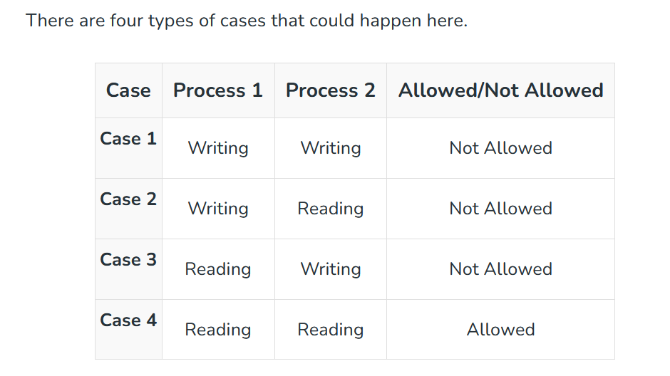
Readers-Writers Problem
A data set is shared among a number of concurrent processes
Readers – only read the data set; they do not perform any updates
Writers – can both read and write
Problem – allow multiple readers to read at the same time
Only one single writer can access the shared data at the same time
Several variations of how readers and writers are considered – all involve some form of priorities

Slide 17
Readers-Writers Problem
Three variables are used: mutex, wrt, readcount to implement solution
Semaphore mutex, wrt;
// semaphore mutex is used to ensure mutual exclusion when readcount is updated i.e. when any reader enters or exit from the critical section. semaphore wrt is used by both readers and writers.
int readcount;
// readcount tells the number of processes performing read in the critical section, initially 0
3. Initial values mutex=1,readcount=0,wrt=1

Slide 18
WRITER PROCESS
Writer requests the entry to critical section.
If allowed i.e. wait() gives a true value, it enters and performs the write. If not allowed, it keeps on waiting.
It exits the critical section.

Slide 19
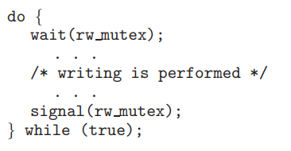
WRITER PROCESS
The structure of a writer process.

Slide 20
Reader process
Reader requests the entry to critical section.
If allowed:
it increments the count of number of readers inside the critical section. If this reader is the first reader entering, it locks the wrt semaphore to restrict the entry of writers if any reader is inside.
It then, signals mutex as any other reader is allowed to enter while others are already reading.
After performing reading, it exits the critical section. When exiting, it checks if no more reader is inside, it signals the semaphore “wrt” as now, writer can enter the critical section.
If not allowed, it keeps on waiting.

Slide 21
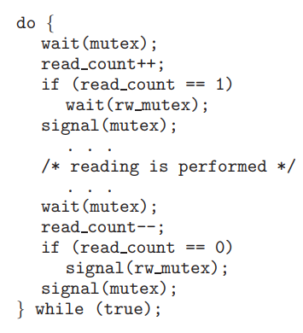
Reader process
The structure of a reader process

Slide 22
Readers-Writers Problem (Cont.)
The structure of a writer process
do { sem_wait(rw_mutex);
... /* writing is performed*/
...
sem_signal(rw_mutex);
} while (true);
The structure of a reader process
do { wait(mutex); read_count++; if (read_count == 1)
wait(rw_mutex);
signal(mutex);
... /* reading is performed */ ...
wait(mutex); read count--; if (read_count == 0)
signal(rw_mutex);
signal(mutex);
} while (true);

Slide 23
Dining Philosopher Problem
The dining philosopher's problem is the classical problem of synchronization which says that Five philosophers are sitting around a circular table and their job is to think and eat alternatively.
A bowl of noodles is placed at the center of the table along with five chopsticks for each of the philosophers. To eat a philosopher needs both their right and a left chopstick. A philosopher can only eat if both immediate left and right chopsticks of the philosopher is available. In case if both immediate left and right chopsticks of the philosopher are not available then the philosopher puts down their (either left or right) chopstick and starts thinking again.

Slide 24
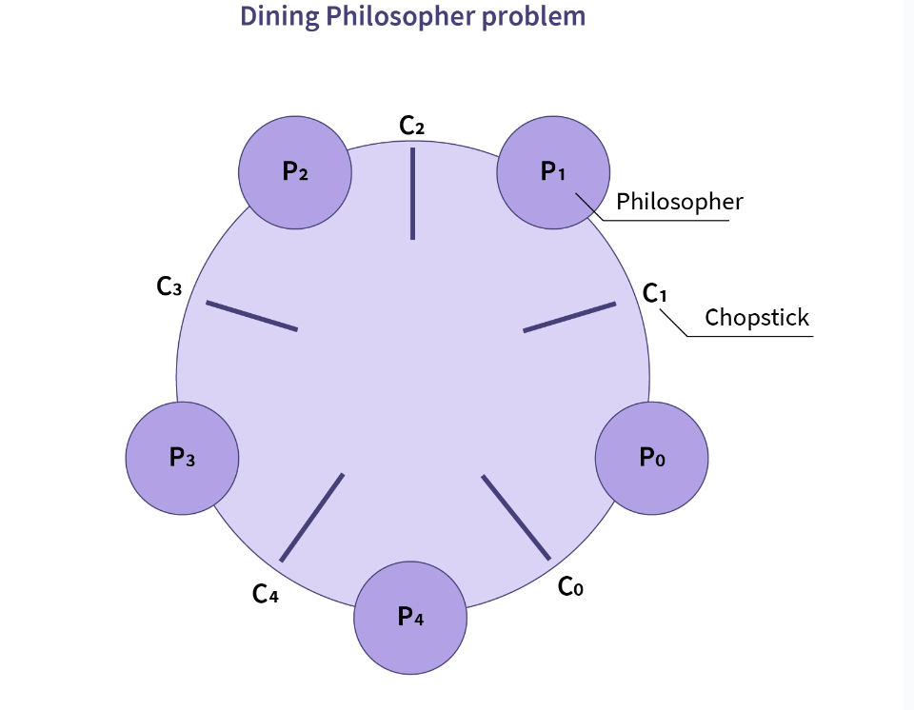
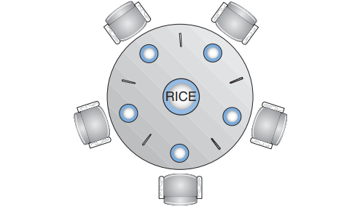

Slide 25
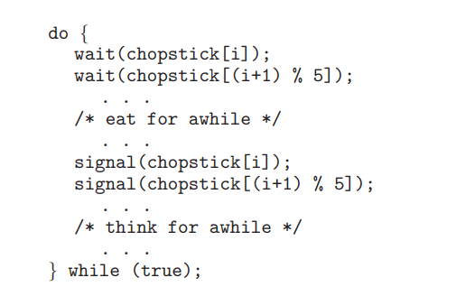
The structure of philosopher i:
semaphore chopstick[5];

Slide 26
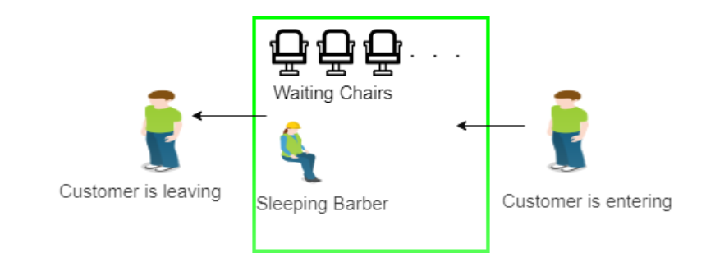
Sleeping Barber problem
The Sleeping Barber problem is a classic problem in process synchronization that is used to illustrate synchronization issues that can arise in a concurrent system. The problem is as follows:
There is a barber shop with one barber and several chairs for waiting customers. Customers arrive at random times and if there is an available chair, they take a seat and wait for the barber to become available. If there are no chairs available, the customer leaves. When the barber finishes with a customer, he checks if there are any waiting customers. If there are, he begins cutting the hair of the next customer in the queue. If no customers are waiting, he goes to sleep.

Slide 27
Semaphore Customers = 0;
Semaphore Barber = 0;
Mutex Seats = 1;
int FreeSeats = N;
Sleeping Barber problem
Barber {
while(true) {
/* waits for a customer (sleeps). */
down(Customers);
/* mutex to protect the number of available seats.*/
down(Seats);
/* a chair gets free.*/
FreeSeats++;
/* bring customer for haircut.*/
up(Barber);
/* release the mutex on the chair.*/
up(Seats);
/* barber is cutting hair.*/
}
}
Shared variables:

Slide 28
Sleeping Barber problem
Customer {
while(true) {
/* protects seats so only 1 customer tries to sit
in a chair if that's the case.*/
down(Seats); //This line should not be here.
if(FreeSeats > 0) {
/* sitting down.*/
FreeSeats--;
/* notify the barber. */
up(Customers);
/* release the lock */
up(Seats);
/* wait in the waiting room if barber is busy. */
down(Barber);
// customer is having hair cut
} else {
/* release the lock */}}}.

Slide 29
Problems with Semaphores
Incorrect use of semaphore operations:
signal (mutex) …. wait (mutex)
wait (mutex) … wait (mutex)
Omitting of wait (mutex) or signal (mutex) (or both)
Deadlock and starvation are possible.

Slide 30
Monitors
A high-level abstraction that provides a convenient and effective mechanism for process synchronization
Abstract data type, internal variables only accessible by code within the procedure
Only one process may be active within the monitor at a time
But not powerful enough to model some synchronization schemes
monitor monitor-name
{
// shared variable declarations
procedure P1 (…) { …. }
procedure Pn (…) {……}
Initialization code (…) { … }
}
}

Slide 31
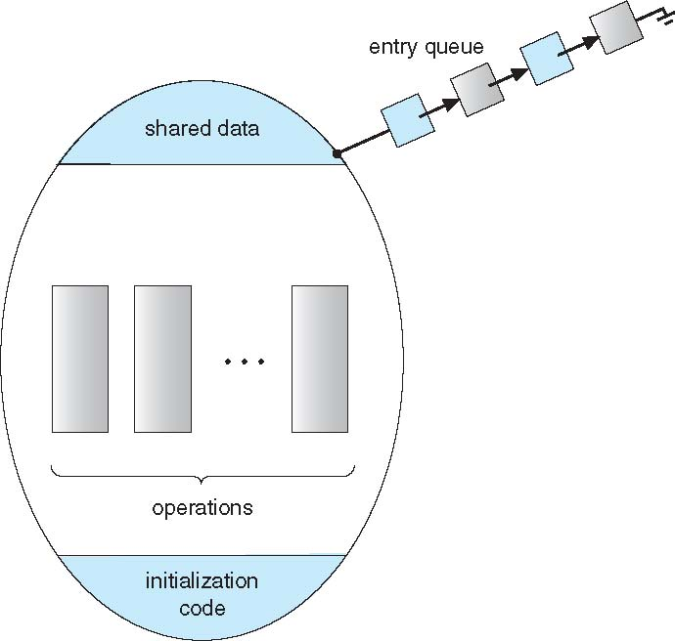
Schematic view of a Monitor

Slide 32
Condition Variables
condition x, y;
Two operations on a condition variable:
x.wait() – a process that invokes the operation is suspended until x.signal()
x.signal() – resumes one of the processes (if any) that invoked x.wait()
If no x.wait() on the variable, then it does not affect the variable

Slide 33
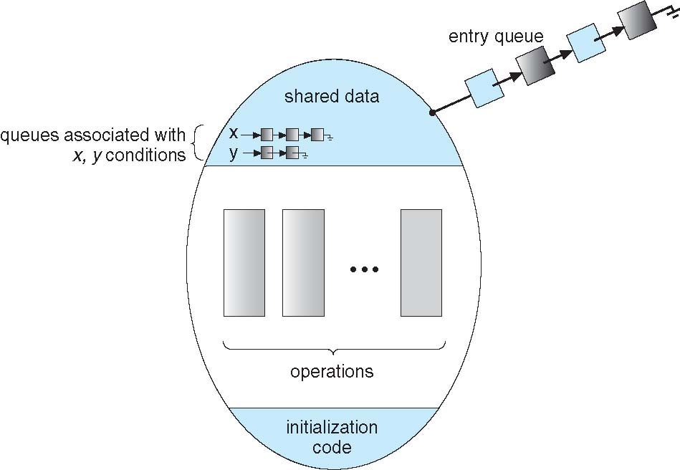
Monitor with Condition Variables

Slide 34
Condition Variables Choices
If process P invokes x.signal(), with Q in x.wait() state, what should happen next?
If Q is resumed, then P must wait
Options include
Signal and wait – P waits until Q leaves the monitor or waits for another condition
Signal and continue – Q waits until P leaves the monitor or waits for another condition
Both have pros and cons – language implementers can decide
Monitors implemented in Concurrent Pascal compromise
P executing signal immediately leaves the monitor, Q is resumed
Implemented in other languages including Mesa, C#, Java

Slide 35
Solution to Dining Philosophers
monitor DiningPhilosophers
{
enum { THINKING; HUNGRY, EATING) state [5] ;
condition self [5];
void pickup (int i) {
state[i] = HUNGRY;
test(i);
if (state[i] != EATING) self [i].wait;
}
void putdown (int i) {
state[i] = THINKING;
// test left and right neighbors
test((i + 4) % 5);
test((i + 1) % 5);
}

Slide 36
Solution to Dining Philosophers (Cont.)
void test (int i) {
if ( (state[(i + 4) % 5] != EATING) &&
(state[i] == HUNGRY) &&
(state[(i + 1) % 5] != EATING) ) {
state[i] = EATING ;
self[i].signal () ;
}
}
initialization_code() {
for (int i = 0; i < 5; i++)
state[i] = THINKING;
}
}

Slide 37
Solution to Dining Philosophers (Cont.)
Each philosopher i invokes the operations pickup() and putdown() in the following sequence:
DiningPhilosophers.pickup(i);
EAT
DiningPhilosophers.putdown(i);
No deadlock, but starvation is possible

Slide 38
Monitor Implementation Using Semaphores
Variables
semaphore mutex; // (initially = 1)
semaphore next; // (initially = 0)
int next_count = 0;
Each procedure F will be replaced by
wait(mutex);
…
body of F;
…
if (next_count > 0)
signal(next)
else
signal(mutex);
Mutual exclusion within a monitor is ensured

Slide 39
Monitor Implementation – Condition Variables
For each condition variable x, we have:
semaphore x_sem; // (initially = 0)
int x_count = 0;
The operation x.wait can be implemented as:
x_count++;
if (next_count > 0)
signal(next);
else
signal(mutex);
wait(x_sem);
x_count--;

Slide 40
Monitor Implementation (Cont.)
The operation x.signal can be implemented as:
if (x_count > 0) {
next_count++;
signal(x_sem);
wait(next);
next_count--;
}

Slide 41
Resuming Processes within a Monitor
If several processes queued on condition x, and x.signal() executed, which should be resumed?
FCFS frequently not adequate
conditional-wait construct of the form x.wait(c)
Where c is the priority number
Process with lowest number (highest priority) is scheduled next

Slide 42
A Monitor to Allocate Single Resource
monitor ResourceAllocator
{
boolean busy;
condition x;
void acquire(int time) {
if (busy)
x.wait(time);
busy = TRUE; }
void release() {
busy = FALSE;
x.signal(); }
initialization code() {
busy = FALSE; }}

Slide 43
SELF-ASSESSMENT QUESTIONS
What is a semaphore, and why is it used in concurrent programming?
2. Differentiate between binary semaphores and counting semaphores. Provide examples of situations where each type might be more appropriate.
3.What is a deadlock, and how can semaphores be involved in deadlock situations? How can you prevent or avoid deadlocks when using semaphores?
4. What is a Monitor, and how it used in concurrent programming?
5. What is meant by Inter-Process Communication?

Slide 44
TERMINAL QUESTIONS
What is the primary purpose of using semaphores in concurrent programming, and how do they help in achieving synchronization?
How do you create and initialize a semaphore in a typical Unix-based terminal environment using system calls or command-line tools?
Explain the fundamental semaphore operations, "wait" (P) and "signal" (V). How are these operations used to control access to shared resources?
In a Unix-based terminal, how can you check the current value of a semaphore and its associated resources using command-line tools?
Describe a scenario where semaphores are useful in a multi-process environment. Provide an example of how you could use semaphores to address a synchronization problem in the terminal.
Can you explain how to handle errors or exceptions when working with semaphores in a terminal-based environment?

Slide 45
REFERENCES FOR FURTHER LEARNING OF THE SESSION
Reference Books:
Arpaci-Dusseau, Remzi H., and Andrea C. Arpaci-Dusseau. Operating systems: Three easy pieces. Boston: Arpaci-Dusseau Books LLC, 2018. http://pages.cs.wisc.edu/~remzi/OSTEP/
Silberschatz, Abraham, Peter B. Galvin, and Greg Gagne. Operating system concepts. 10th edition, John Wiley & Sons, 2018.
Tanenbaum, Andrew. Modern operating systems. Pearson Education, Inc., 2009.
Sites and Web links:
https://www.cse.iitb.ac.in/~mythili/os/
https://cse.iitkgp.ac.in/~sumantra/courses/os/os_pg.html
https://www.cse.iitd.ernet.in/os-lectures

Slide 46
THANK YOU
Team – Operating System

