Slide 1
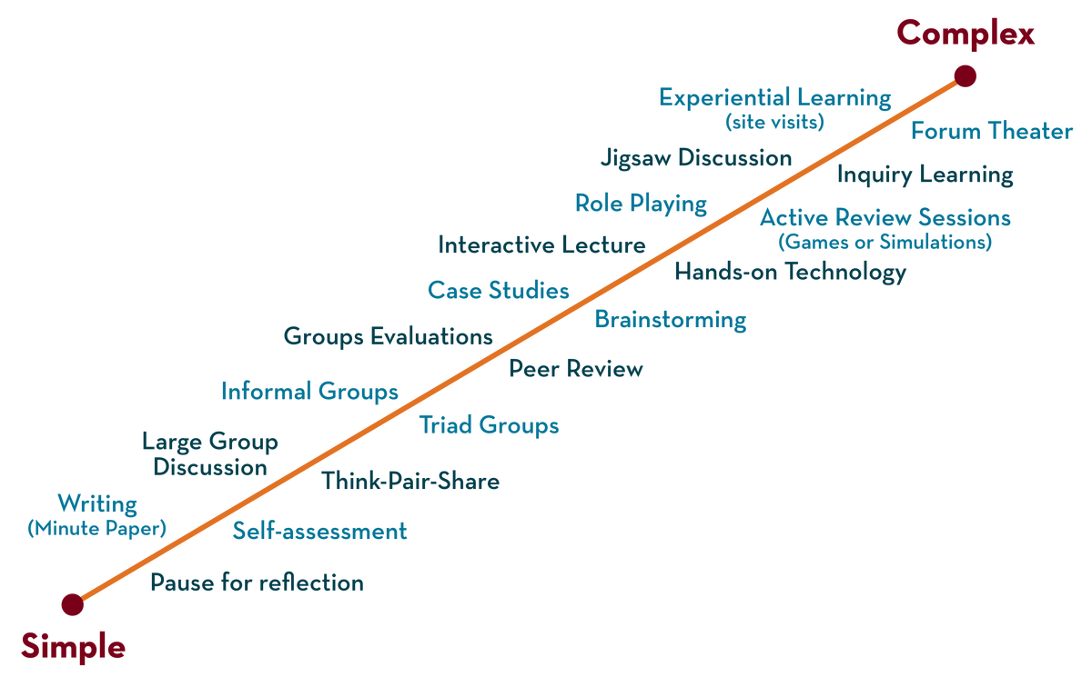
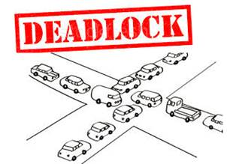
COURSE NAME: Operating Systems COURSE CODE: 23CS2104R/A
CO3
Session - 5
Deadlock: Characterisation, Prevention, Avoidance.

Slide 2
AIM OF THE SESSION
To familiarize students with the basic concept of Deadlocks.
INSTRUCTIONAL OBJECTIVES
This Session is designed to:
Demonstrate what is meant by Deadlock.
Demonstrate what is meant by a Characterisation of A deadlock.
Describe the Methods of Handling Deadlocks .
Describe the banker’s Algorithm.
LEARNING OUTCOMES
At the end of this session, you should be able to:
Defines what Deadlock is.
Defines Resource Allocation Graph.
Summarize the Concept of Deadlock.

Slide 3
Deadlock
All the processes in a system require some resources such as central processing unit(CPU), file storage, input/output devices, etc to execute it.
Once the execution is finished, the process releases the resource it was holding. However, when many processes run on a system they also compete for these resources they require for execution. This may arise a deadlock situation.
Definition :A deadlock is a situation in which more than one process is blocked because it is holding a resource and also requires some resource that is acquired by some other waiting process . Therefore, none of the processes gets executed.

Slide 4
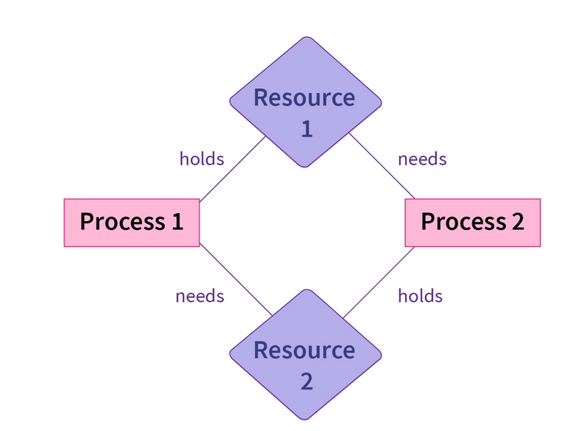
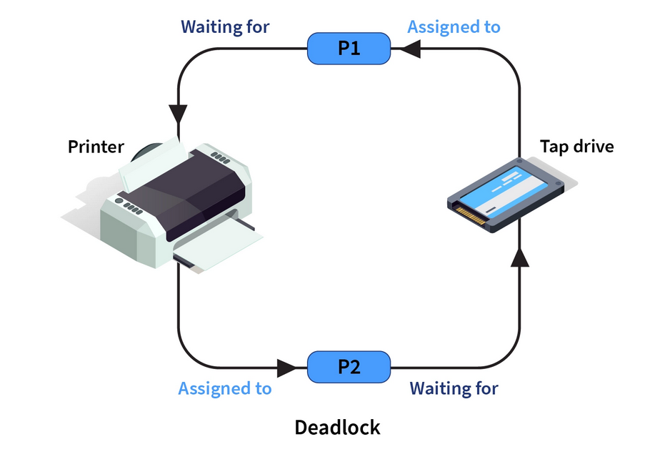
Deadlock Example

Slide 5
System Model
System consists of resources
Resource types R₁, R₂, . . ., R_{m}
CPU cycles, memory space, I/O devices
Each resource type R_{i} has W_{i} instances.
Each process utilizes a resource as follows:
A process in operating system uses resources in the following way.
Requests a resource
Use the resource
Releases the resource

Slide 6
Characterisation of A deadlock
Necessary Conditions :
The four necessary conditions for a deadlock to arise are as follows.
Mutual Exclusion: Only one process can use a resource at any given time i.e. the resources are non-sharable.
Hold and wait: A process is holding at least one resource at a time and is waiting to acquire other resources held by some other process.
No preemption: A resource cannot be taken from a process unless the process releases the resource.
Circular Wait: A set of processes are waiting for each other in a circular fashion.
For example, lets say there are a set of processes {P0,P1​,P2​,P3​} such that P0​ depends on P1​, P1​ depends on P2​, P2​ depends on P3​ and P3​ depends on P0​. This creates a circular relation between all these processes and they have to wait forever to be executed.

Slide 7
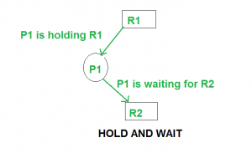
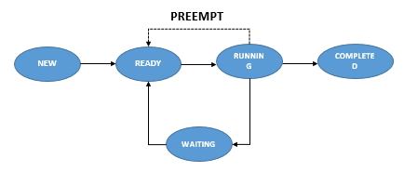
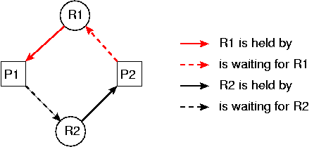
Characterisation of A deadlock

Slide 8
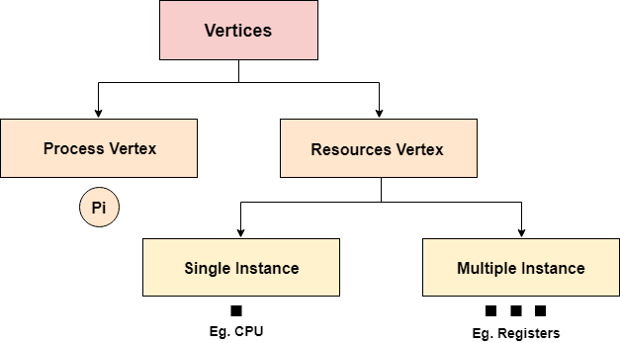
DEADLOCK CHARACTERIZATION(CONTINUES)
Resource-Allocation Graph:
The resource allocation graph is the pictorial representation of the state of a system.
As its name suggests, the resource allocation graph is the complete information about all the processes which are holding some resources or waiting for some resources.
In Resource allocation graph, the process is represented by a Circle while the Resource is represented by a rectangle. Let's see the types of vertices and edges in detail.
A set of vertices V and a set of edges E.
V is partitioned into two types:
P = {P₁, P₂, …, P_{n}}, the set consisting of all the processes in
the system R = {R₁, R₂, …, R_{m}}, the set consisting of all resource types in the system

Slide 9
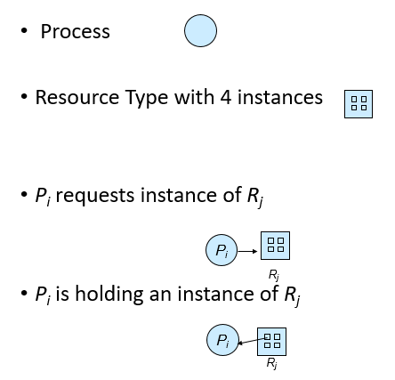

Slide 10
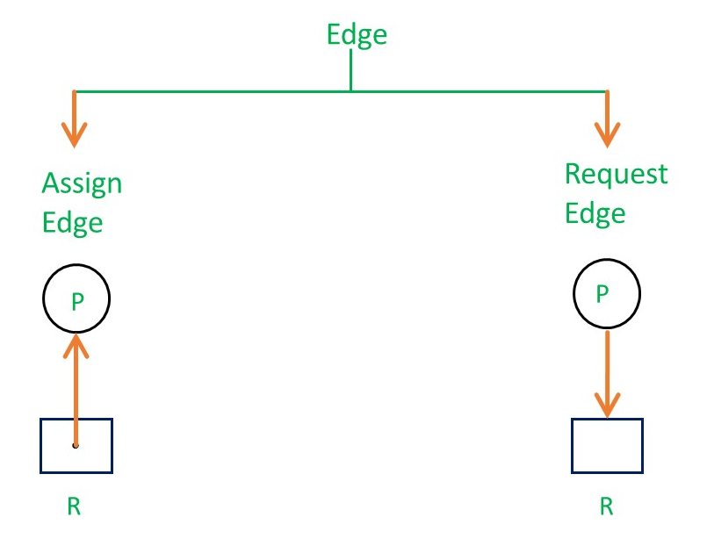
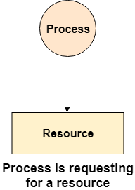
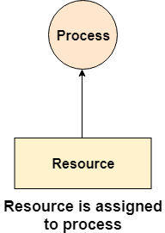
Edges in RAG are also of two types, one represents assignment and other represents the wait of a process for a resource.
A resource is shown as assigned to a process if the tail of the arrow is attached to an instance to the resource and the head is attached to a process.
A process is shown as waiting for a resource if the tail of an arrow is attached to the process while the head is pointing towards the resource.
Request edge – directed edge P_{i} → R_{j}
Assignment edge – directed edge R_{j} → P_{i}

Slide 11
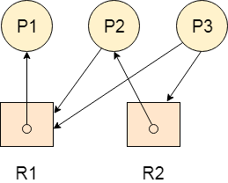
Example
Let’s consider 3 processes P1, P2 and P3, and two types of resources R1 and R2.
The resources are having 1 instance each.
According to the graph, R1 is being used by P1, P2 is holding R2 and waiting for R1, P3 is waiting for R1 as well as R2.
The graph is deadlock free since no cycle is being formed in the graph.

Slide 12
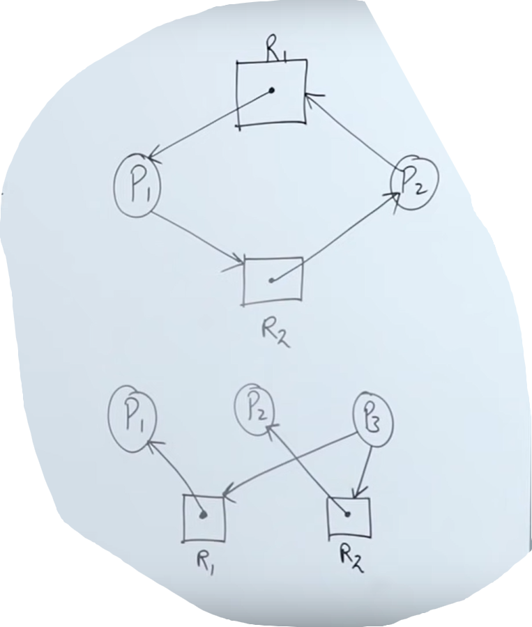
Single instance RAG

Slide 13
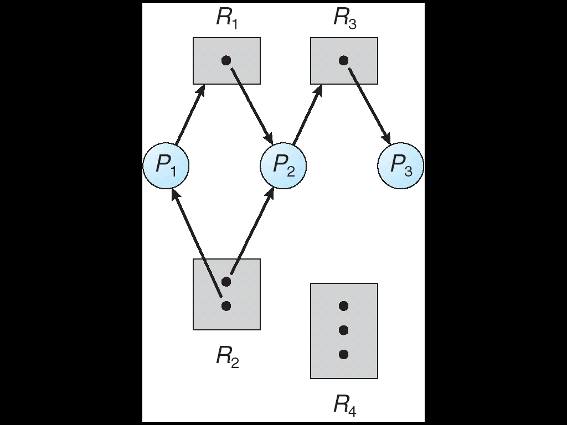
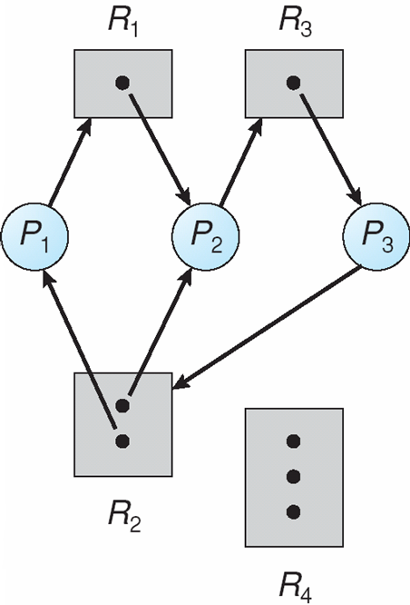
Resource Allocation Graph
RESOURCE ALLOCATION GRAPH WITH A DEADLOCK

Slide 14
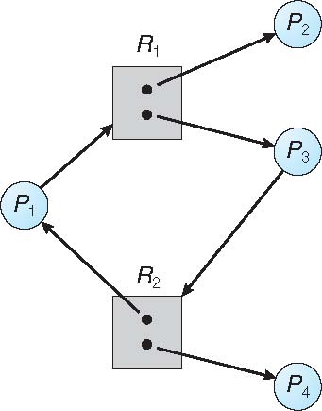
Graph With A Cycle But No Deadlock

Slide 15
If graph contains no cycles ⇒ no deadlock
If graph contains a cycle ⇒
if only one instance per resource type, then deadlock.
if several instances per resource type, possibility of deadlock.

Slide 16
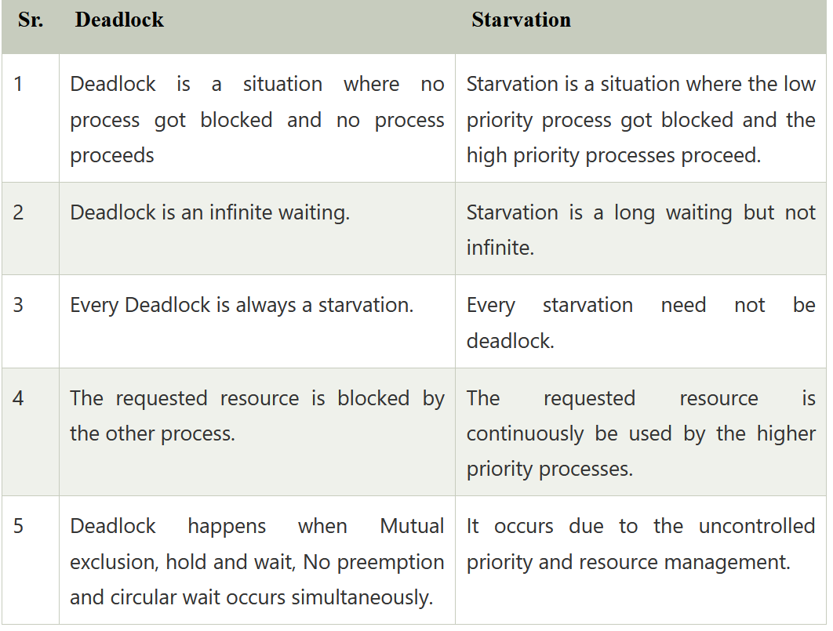
Difference between Starvation and Deadlock

Slide 17
Methods of Handling Deadlocks
Deadlock Prevention
Deadlock Avoidance
Deadlock Detection
Recover from Deadlock

Slide 18
Deadlock Prevention
The possibility of deadlock is excluded before making requests, by eliminating one of the necessary conditions for deadlock.
1.Mutual Exclusion
The mutual exclusion must be hold. That is , atleast one resource must be non sharable.
Some resources are inherently non shareable, for example, Printers. For non shareable resources, processes require exclusive control of the resources.
A mutual exclusion means that unshareable resources cannot be accessed simultaneously by processes.
Sharable resources (Read Only Files) do not require mutual exclusion so don’t cause deadlock but some resources can't be shared among processes, leading to a deadlock.

Slide 19
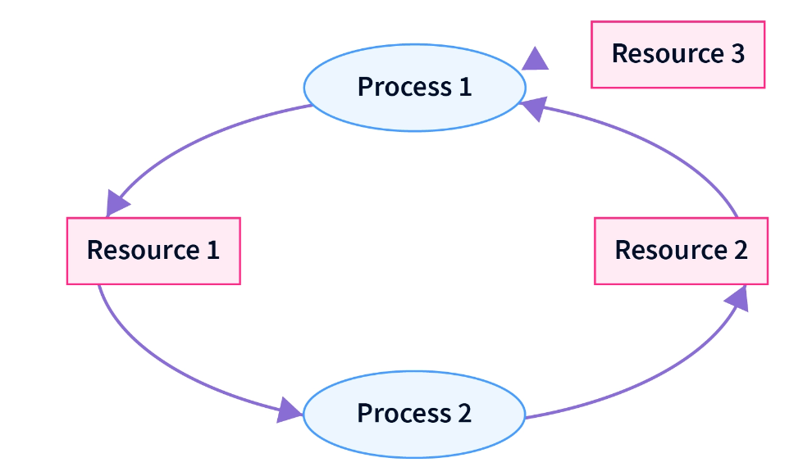
2. Hold and Wait
Hold and wait is a condition in which a process is holding one resource while simultaneously waiting for another resource being held by another process. The process cannot continue till it gets all the required resources.
Resource 1 is allocated to Process 2
Resource 2 is allocated to Process 1
Resource 3 is allocated to Process 1
Process 1 is waiting for Resource 1 and holding Resource 2 and Resource 3
Process 2 is waiting for Resource 2 and holding Resource 1

Slide 20
There are two ways to eliminate hold and wait:-
By eliminating wait:
The process specifies the resources it requires in advance so that it does not have to wait for allocation after execution starts.
For Example: Process1 declares in advance that it requires both Resource1 and Resource2
2. By eliminating hold:
The process has to release all resources it is currently holding before making a new request.
For Example :Process1 has to release Resource2 and Resource3 before requesting Resource1.
3.No preemption
Preemption is temporarily interrupting an executing task and later resuming it.
For example, if process P1 uses a resource and a high-priority process P2 requests for the resource, process P1 is stopped and the resources are allocated to P2.

Slide 21
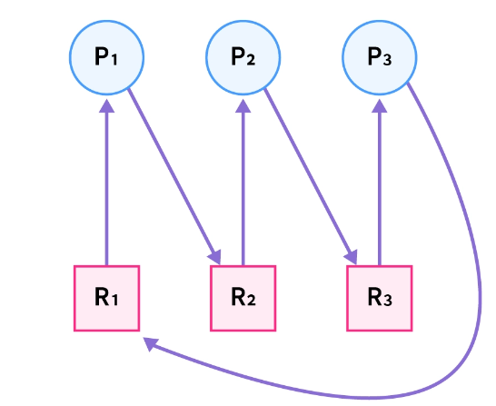
4. Circular Wait: In circular wait, two or more processes wait for resources in a circular order. We can understand this better by the diagram given below:
To eliminate circular wait, we assign a priority to each resource. A process can only request resources in increasing order of priority.
In the example process P3 is requesting resource R1, which has a number lower than resource R3 which is already allocated to process P3. So this request is invalid and cannot be made, as R1 is already allocated to process P1.

Slide 22
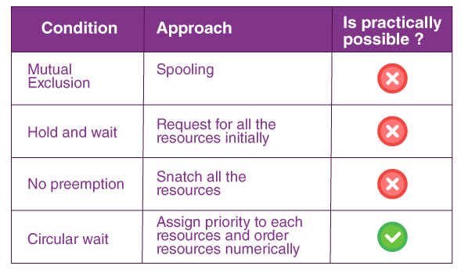

Slide 23
Deadlock Avoidance
In deadlock avoidance, the request for any resource will be granted if the resulting state of the system doesn't cause a deadlock in the system.
The state of the system will continuously be checked for safe and unsafe states.
In order to avoid deadlocks, the process must tell OS, the maximum number of resources a process can request to complete its execution.
Resource Allocation Graph
Banker’s Algorithm(Multiple instances of a resource type)

Slide 24
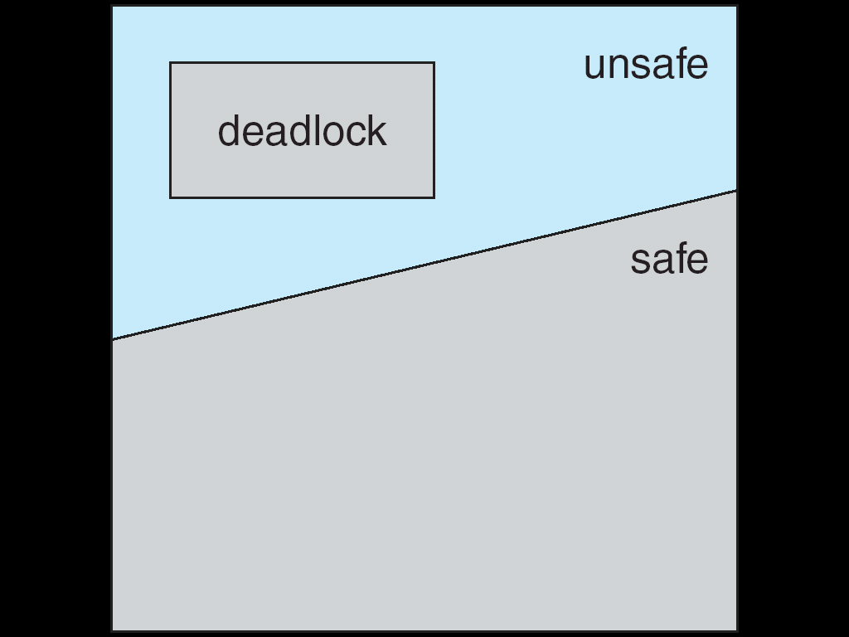
Safe, Unsafe, Deadlock State
If a system is in safe state ⇒ no deadlocks
If a system is in unsafe state ⇒ possibility of deadlock
Avoidance ⇒ ensure that a system will never enter an unsafe state.

Slide 25
Resource-Allocation Graph Scheme
Claim edge P_{i} ---→ R_{j} indicated that process P_{i} may request resource R_{j}; represented by a dashed line.
Claim edge converts to request edge when a process requests a resource.
Request edge converted to an assignment edge when the resource is allocated to the process.
When a resource is released by a process, assignment edge reconverts to a claim edge.
Resources must be claimed a priori in the system.

Slide 26
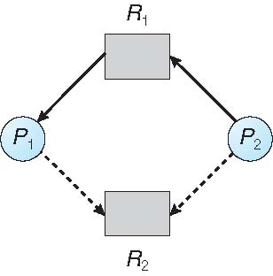
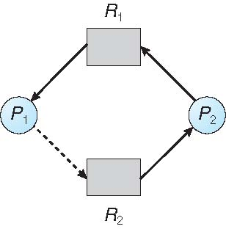
Resource-Allocation Graph

Slide 27
Resource-Allocation Graph Algorithm
Suppose that process P_{i} requests a resource R_{j}
The request can be granted only if converting the request edge to an assignment edge does not result in the formation of a cycle in the resource allocation graph.

Slide 28
Resource-Allocation Graph
Unsafe State

Slide 29
Banker’s Algorithm
Multiple instances
Each process must a priori claim maximum use
When a process requests a resource it may have to wait
When a process gets all its resources it must return them in a finite amount of time

Slide 30
Data Structures for the Banker’s Algorithm
Let n = number of processes, and m = number of resources types
Available: Vector of length m. If available [j] = k, there are k instances of resource type R_{j} available
Max: n x m matrix. If Max [i,j] = k, then process P_{i} may request at most k instances of resource type R_{j}
Allocation: n x m matrix. If Allocation[i,j] = k then P_{i} is currently allocated k instances of R_{j}
Need: n x m matrix. If Need[i,j] = k, then P_{i} may need k more instances of R_{j} to complete its task
Need [i,j] = Max[i,j] – Allocation [i,j]

Slide 31
Safety Algorithm
1. Let Work and Finish be vectors of length m and n, respectively. Initialize:
Work = Available
Finish [i] = false for i = 0, 1, …, n- 1
2. Find an i such that both:
(a) Finish [i] = false
(b) Need_{i} ≤ Work
If no such i exists, go to step 4
3. Work = Work + Allocation_{i} Finish[i] = true go to step 2
4. If Finish [i] == true for all i, then the system is in a safe state

Slide 32
Resource-Request Algorithm for Process P_{i}
Request_{i} = request vector for process P_{i}. If Request_{i} [j] = k then process P_{i} wants k instances of resource type R_{j}
1. If Request_{i} ≤ Need_{i} go to step 2. Otherwise, raise error condition, since process has exceeded its maximum claim
2. If Request_{i} ≤ Available, go to step 3. Otherwise P_{i} must wait, since resources are not available
3. Pretend to allocate requested resources to P_{i} by modifying the state as follows:
Available = Available – Request_{i};
Allocation_{i} = Allocation_{i} + Request_{i};
Need_{i} = Need_{i} – Request_{i};
If safe ⇒ the resources are allocated to P_{i}
If unsafe ⇒ P_{i} must wait, and the old resource-allocation state is restored

Slide 33

THANK YOU
Team – Operating System

