Slide 1


COURSE NAME: Operating Systems COURSE CODE: 23CS2104R/A
CO3
Session - 6
Deadlock: Detection and
Recovery

Slide 2
AIM OF THE SESSION
To familiarize students with the basic concept of Deadlocks.
INSTRUCTIONAL OBJECTIVES
This Session is designed to:
Demonstrate what is meant by Banker’s Algorithm.
Demonstrate problems on Banker’s Algorithm.
Describe the Methods for Deadlock Detection and Recovery .
LEARNING OUTCOMES
At the end of this session, you should be able to:
Defines what Deadlock is.
Defines Wait-for Graph .
Summarize the Concept of Deadlock.

Slide 3
Example of Banker’s Algorithm for Avoidance
5 processes P₀ through P₄;
3 resource types:
A (10 instances), B (5instances), and C (7 instances)
Snapshot at time T₀:
Allocation Max Available
A B C A B C A B C
P₀ 0 1 0 7 5 3 3 3 2
P₁ 2 0 0 3 2 2
P₂ 3 0 2 9 0 2
P₃ 2 1 1 2 2 2
P₄ 0 0 2 4 3 3

Slide 4
The content of the matrix Need is defined to be Max – Allocation
Need
A B C
P₀ 7 4 3
P₁ 1 2 2
P₂ 6 0 0
P₃ 0 1 1
P₄ 4 3 1
The system is in a safe state since the sequence < P₁, P₃, P₄, P₀, P₂> satisfies safety criteria

Slide 5
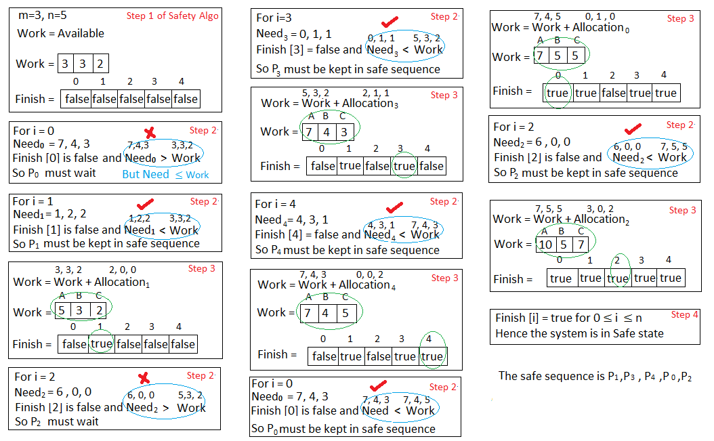

Slide 6
Consider P₁ Request (1,0,2)
Check that Request ≤ Available (that is, (1,0,2) ≤ (3,3,2) ⇒ true
Allocation Need Available
A B C A B C A B C
P₀ 0 1 0 7 4 3 2 3 0
P₁ 3 0 2 0 2 0
P₂ 3 0 2 6 0 0
P₃ 2 1 1 0 1 1
P₄ 0 0 2 4 3 1
Executing safety algorithm shows that sequence < P₁, P₃, P₄, P₀, P₂> satisfies safety requirement
Can request for (3,3,0) by P₄ be granted?
Can request for (0,2,0) by P₀ be granted?

Slide 7
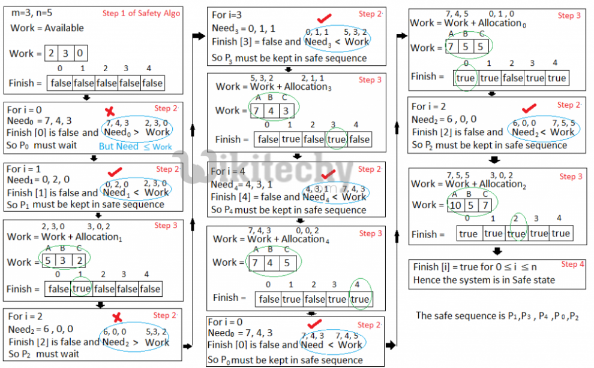

Slide 8
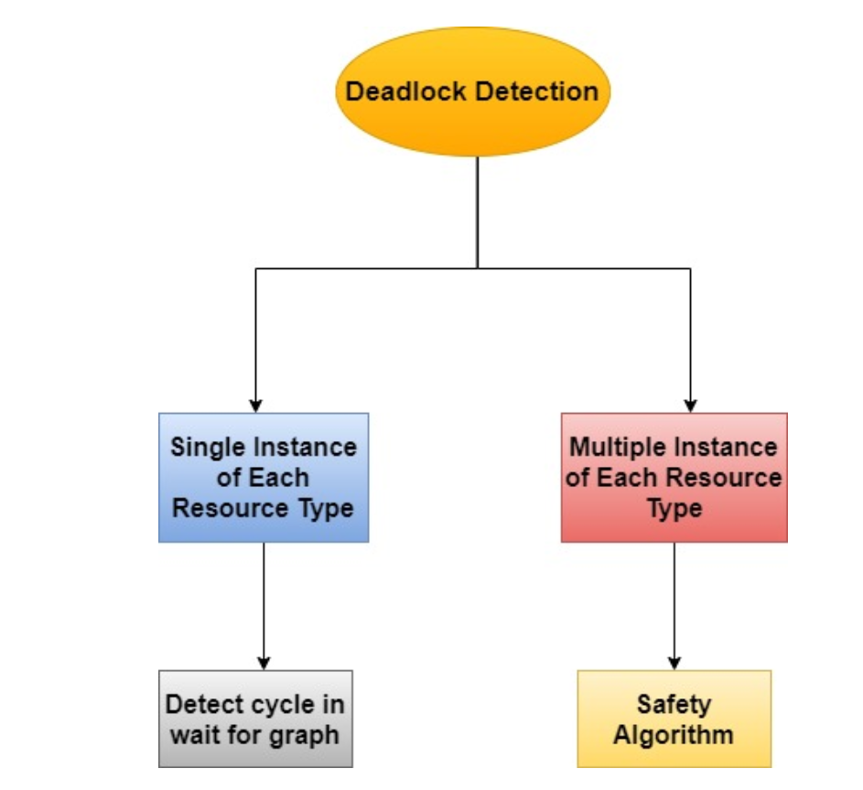
Deadlock Detection
Allow system to enter deadlock state
Detection algorithm
Recovery scheme

Slide 9
Single Instance of Each Resource Type
Maintain wait-for graph
Nodes are processes
P_{i} → P_{j} if P_{i} is waiting for P_{j}
Periodically invoke an algorithm that searches for a cycle in the graph. If there is a cycle, there exists a deadlock.
An algorithm to detect a cycle in a graph requires an order of n² operations, where n is the number of vertices in the graph.

Slide 10
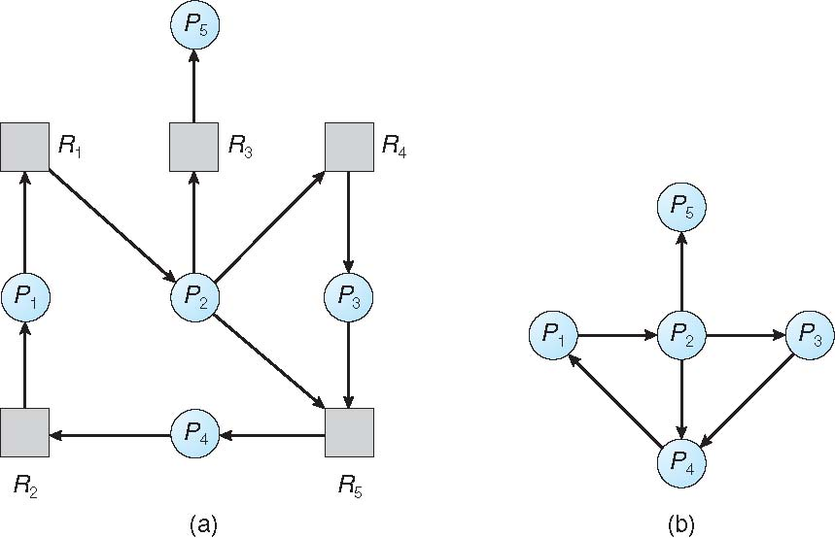
Resource-Allocation Graph and Wait-for Graph
Resource-Allocation Graph
Corresponding wait-for graph

Slide 11
Several Instances of a Resource Type
Available: A vector of length m indicates the number of available resources of each type
Allocation: An n x m matrix defines the number of resources of each type currently allocated to each process
Request: An n x m matrix indicates the current request of each process. If Request [i][j] = k, then process P_{i} is requesting k more instances of resource type R_{j}.

Slide 12
Detection Algorithm
1. Let Work and Finish be vectors of length m and n, respectively Initialize:
(a) Work = Available
For i = 1,2, …, n, if Allocation_{i} ≠ 0, then Finish[i] = false; otherwise, Finish[i] = true
2. Find an index i such that both:
(a) Finish[i] == false
(b) Request_{i} ≤ Work If no such i exists, go to step 4
3. Work = Work + Allocation_{i} Finish[i] = true go to step 2
If Finish[i] == false, for some i, 1 ≤ i ≤ n, then the system is in deadlock state. Moreover, if Finish[i] == false, then P_{i} is deadlocked.
Algorithm requires an order of O(m x n²) operations to detect whether the system is in deadlocked state

Slide 13
Example of Detection Algorithm
Five processes P₀ through P₄; Three Resources A,B,C : A has 7 , B has 2 , and C has 6 instances
Snapshot at time T₀:
Allocation Request Available
A B C A B C A B C
P₀ 0 1 0 0 0 0 0 0 0
P₁ 2 0 0 2 0 2
P₂ 3 0 3 0 0 0
P₃ 2 1 1 1 0 0
P₄ 0 0 2 0 0 2
Sequence <P₀, P₂, P₃, P₁, P₄> OR <P0,P2,P3,P4,P1> will result in Finish[i] = true for all i.

Slide 14
P₂ requests an additional instance of type C
Request
A B C
P₀ 0 0 0
P₁ 2 0 2
P₂ 0 0 1
P₃ 1 0 0
P₄ 0 0 2
State of the system?
Can reclaim resources held by process P₀, but insufficient resources to fulfill other processes; requests
Deadlock exists, consisting of processes P₁, P₂, P₃, and P₄

Slide 15
Recovery From Deadlock
When a detection algorithm determines that a deadlock exists then there are several available alternatives. There one possibility and that is to inform the operator about the deadlock and let him deal with this problem manually.
Another possibility is to let the system recover from the deadlock automatically. These are two options that are mainly used to break the deadlock.

Slide 16
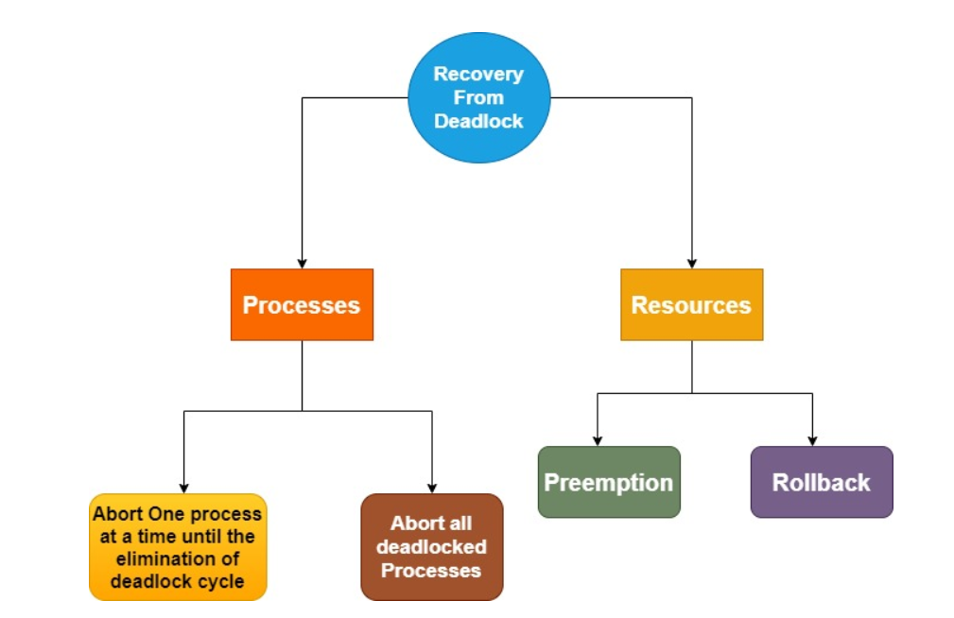
Recovery From Deadlock

Slide 17
Recovery From Deadlock
Approaches To Breaking a Deadlock
1.Process Termination
To eliminate the deadlock, we can simply kill one or more processes. For this, we use two methods:
Abort all the Deadlocked Processes: Aborting all the processes will certainly break the deadlock but at a great expense. The deadlocked processes may have been computed for a long time,.
Abort one process at a time until the deadlock is eliminated: Abort one deadlocked process at a time, until the deadlock cycle is eliminated from the system.

Slide 18
Recovery from Deadlock: Resource Preemption
Selecting a victim – minimize cost
Rollback – return to some safe state, restart process from that state
Starvation – The same process may always be picked as a victim, including the number of rollbacks in the cost factor.

Slide 19
Recovery from Deadlock: Process Termination
Abort all deadlocked processes Abort one process at a time until the deadlock cycle is eliminated In which order should we choose to abort?
Priority of the process
How long process has computed, and how much longer to completion
Resources the process has used
Resources process needs to complete
How many processes will need to be terminated
Is the process interactive or batch?

Slide 20

THANK YOU
Team – Operating System

