Slide 1
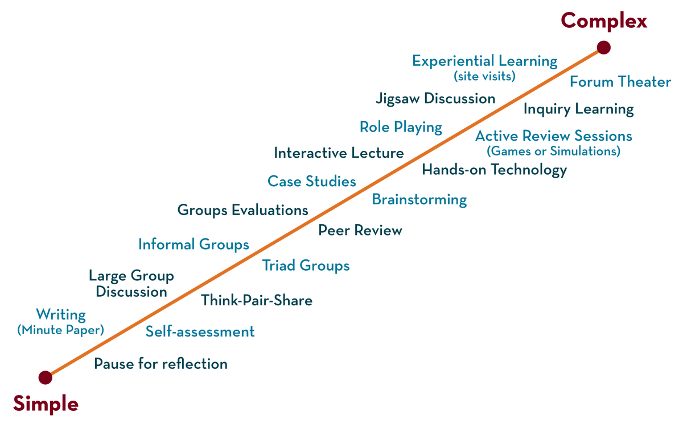
COURSE NAME: Operating Systems COURSE CODE: 23CS2104R/a
CO4
Session - 1
Persistent I/O Devices, Device Management Techniques

Slide 2
AIM OF THE SESSION
To familiarize students with the basic concept of Threads.
INSTRUCTIONAL OBJECTIVES
This Session is designed to:
Demonstrate what is meant by I/O Devices.
Demonstrate what is meant by Interrupts and Polling.
Describe the types of Device Interaction.
Describe the Cananicol Devices
LEARNING OUTCOMES
At the end of this session, you should be able to:
Defines what Interrupts and Polling.
Describe Device Interaction.
Summarize the Role of DMA.

Slide 3
Techniques for Device Management
Three major techniques are used for managing and allocating devices:
Dedicated
Shared
Virtual.

Slide 4
DEDICATED DEVICES
Such devices in the operating system's device management are dedicated or assigned to only one job at a time until that job releases them.
Devices like printers, tape drivers, plotters etc. demand such allocation scheme since it would be awkward if several users share them at the same point of time.
The disadvantage is the inefficiency resulting from the allocation of the device to a single user for the entire duration of job execution even though the device is not used 100% of the time.

Slide 5
Shared Devices
Some devices such as disks, drums, and most other Direct Access Storage Devices (DASD) may be shared concurrently by several processes.
Essentially, several processes can read from a single disk at the same time.
Process request is to be satisfied first based on (1) a priority list or (2) the objective of achieving improved system output.

Slide 6
VIRTUAL DEVICES
These devices are a combination of the first two types and they are dedicated devices which are transformed into shared devices.
For example, a printer converted into a shareable device via a spooling program which re-routes all the print requests to a disk. A print job is not sent straight to the printer, instead, it goes to the disk(spool)until it is fully prepared with all the necessary sequences and formatting, and then it goes to the printers. This technique can transform one printer into several virtual printers which leads to better performance and use.

Slide 7
DEVICE CHARACTERISTICS
Hardware considerations
Input or output devices
Storage devices

Slide 8
I/O DEVICES
The three main jobs of a computer are Input, Output, and Processing.
In most of the cases, the most important job is Input / Output, and the processing is simply incidental.
For an example, when we browse a web page or edit any file, our immediate attention is to read or enter some information, not for computing an answer.
The fundamental role of the operating system in computer Input / Output is to manage and organize I/O operations and all I/O devices.
The various devices that are connected to the computer need to be controlled and it is a key concern of operating-system designers.

Slide 9
I/O HARDWARE
Computers operate many kinds of devices. General categories of devices are input or output devices and storage devices.
A device that communicates with the operating system of a computer by transferring signals over cable or even through the air.
The Peripheral devices that communicate with the machine through a connection point also called ports- (one example is a serial port).
A bus is a collection of wires and a firmly defined protocol that describes a set of messages that can be sent on the wires.
An I/O port usually contains four different registers −
(1) control, (2) status, (3) data-in, and (4) data-out registers

Slide 10
STORAGE DEVICES
Magnetic Disks / Serial Access Devices
Magnetic Drums / Completely Or Random Access Devices
Optical Disks / DASD – Direct Access Storage Devices

Slide 11
Magnetic Disks / Serial Access Devices
It is a sequential access storage device.
Magnetic disks provides a bulk of secondary storage in modern computer systems.
Each disk platter has a flat circular shape like a CD.
Common platter size ranges from 1.8 to 3.5 inches.
The two surfaces of a platter are covered with a magnetic material.
We store information by recording it magnetically on the platters.

Slide 12
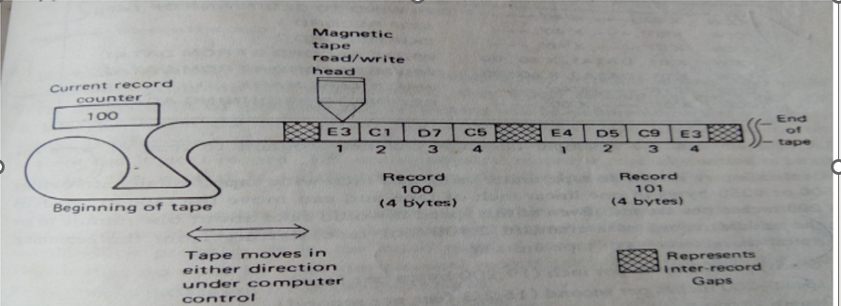
Several kinds of buses are available like
ATA - Advanced Technology Attachment
SATA – Serial ATA
USB – Universal Serial Bus
FC – Fiber Channel

Slide 13
DIRECT ACCESS DEVICES
It is a Direct access, or random-access, storage device.
A magnetic drum, also referred to as drum, is a metal cylinder coated with magnetic iron-oxide material on which data and programs can be stored.
Magnetic drums were once used as a primary storage device but have since been implemented as auxiliary storage devices.
The tracks on a magnetic drum are assigned to channels located around the circumference of the drum, forming adjacent circular bands that wind around the drum.
A single drum can have up to 200 tracks.

Slide 14
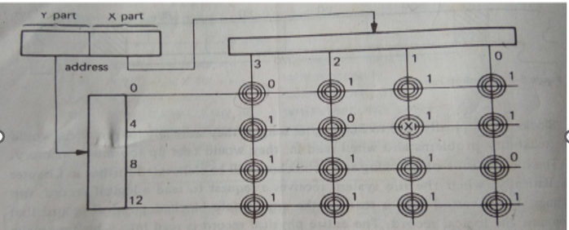
In Figure the circles represent magnetic each core having two selection wires through it.One property of a magnetic core is that when it changes magnetic state it induces a current. A third sensing wire is passed through all the cores.

Slide 15
DIRECT ACCESS STORAGE DEVICES
A device access device is one that is characterized by small variances in the access time Tij.
These have been called Direct Access Storage Devices. Although they do not offer completely direct access, the name persists in the field.
Two examples of DASD are fixed-head and moving-head devices.

Slide 16
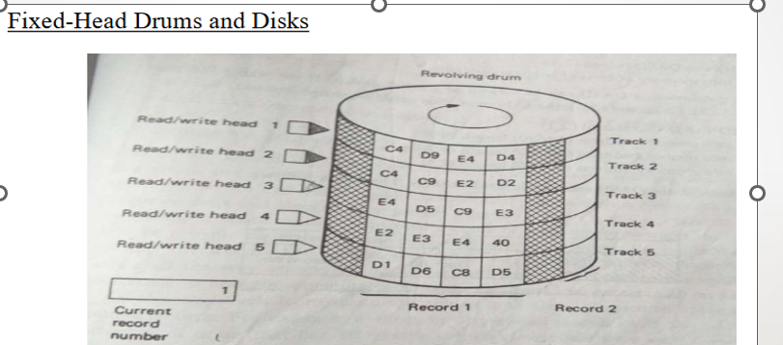
Figure depicts a DASD storage device similar to a magnetic drum. A magnetic drum can be simplistically viewed as several adjacent strips of magnetic tape wrapped around a drum so that the ends of each tape strip join. Each tape strip, called a track, has a separate head/write head.

Slide 17
Moving-Head Disks and Drums
Both drums and fixed head disks are expensive because of the requirement of one head (and associated electronics) per recording track.
Moving head disks vary considerably in performance, from low-speed, low-capacity floppy disks, with only one or two recording surfaces, to high speed units with multiple disk platters all mounted on a common recording surface.
The original moving head disk was developed under the direction of Reynold B. Johnson at IBM's lab.

Slide 18
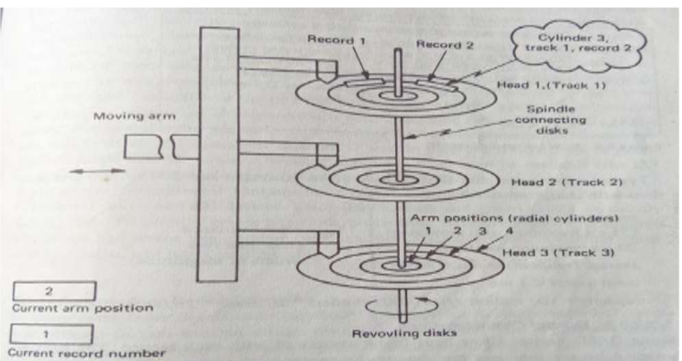

Slide 19
OPTICAL DISKS
Optical disk is an electronic storage medium that can be written to or read from a low powered laser beam.
It was developed by James T. Russel in the year 1960.
It stores data as micron wide dots of light and dark.
First, optical storage system uses a powerful backlight to read the dots through a transparent sheet of material on which the dots were encoded.
In later optical systems, the laser read the dots and data was converted to an electrical signal.
An optical disk could store much more data than magnetic disk.

Slide 20
I/O Devices
I/O is critical to computer systems to interact with systems.
I/O is quite critical to computer systems. imagine a program without any input (it produces the same result each time); now imagine a program with no output (what was the purpose of it running?). For computer systems to be interesting, both input and output are required.
Issue :
How should I/O be integrated into systems?
What are the general mechanisms?
How can we make it efficient?

Slide 21
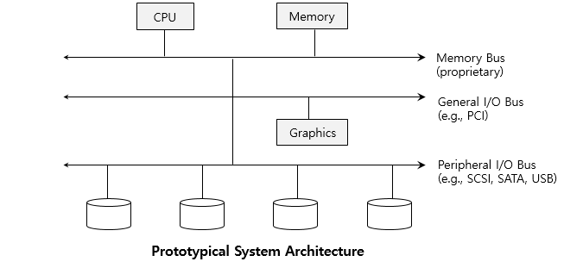
Structure of input/output (I/O) device
CPU is attached to the system’s main memory via some kind of memory bus. Some devices(higher-performance I/O devices are connected to the system via a general I/O bus and a peripheral bus connects the slowest devices to the system, including disks, and mice.

Slide 22
I/O Architecture
Buses
Data paths that provided to enable information between CPU(s), RAM, and I/O devices.
I/O bus
Data path that connects a CPU to an I/O device.
I/O bus is connected to I/O device by three hardware components: I/O ports, interfaces and device controllers.

Slide 23
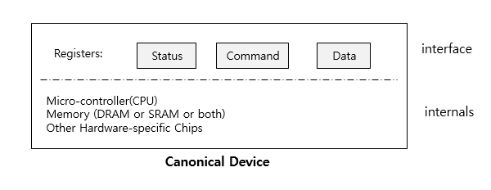
Canonical Device
canonical device (not a real one), and use this device to drive our understanding of some of the machinery required to make device interaction efficient.
Canonical Devices have two important components.
Hardware interface allows the system software to control its operation.
Internals which is implementation-specific.

Slide 24
Hardware interface of Canonical Device
status register
See the current status of the device
command register
Tell the device to perform a certain task
data register
Pass data to the device, or get data from the device
By reading and writing these registers, the operating system can control device behavior.

Slide 25
Hardware interface of Canonical Device (Cont.)
Typical interaction example that OS might have with the device in order to get the device to do something on its behalf. The protocol is as follows:
while ( STATUS == BUSY) ; //wait until the device is not busy
Write data to the data register
Write a command to command register
Doing so starts the device and executes the command
While ( STATUS == BUSY);//wait until the device is done with your request

Slide 26
PROTOCOL OF CANONICAL DEVICE
The protocol has four steps.
In the first, the OS waits until the device is ready to receive a command by repeatedly reading the status register; we call this polling the device.
Second, the OS sends some data down to the data register; When the main CPU is involved with the data movement we refer to it as programmed I/O (PIO).
Third, the OS writes a command to the command register; doing so implicitly lets the device know that both the data is present and that it should begin working on the command.
Finally, the OS waits for the device to finish by again polling it in a loop, waiting to see if it is finished

Slide 27
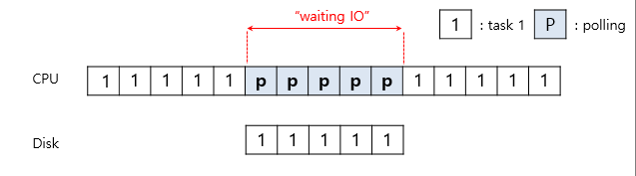
Polling
The operating system waits until the device is ready by repeatedly reading the status register.
Positive aspect is simple and working.
However, it wastes CPU time just waiting for the device.
Switching to another ready process is better utilizing the CPU.
Diagram of CPU utilization by polling

Slide 28
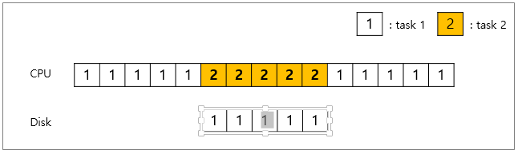
Interrupts
Put the I/O request process to sleep and context switch to another.
When the device is finished, wake the process waiting for the I/O by interrupt.
The positive aspect is allowed to the CPU and the disk is properly utilized.
Diagram of CPU utilization by interrupt

Slide 29
Polling vs interrupts
However, “interrupts is not always the best solution”
If the device performs very quickly, an interrupt will “slow down” the system.
Because context switch is expensive (switching to another process)
If a device is fast → poll is best.
If it is slow → interrupts is better.

Slide 30
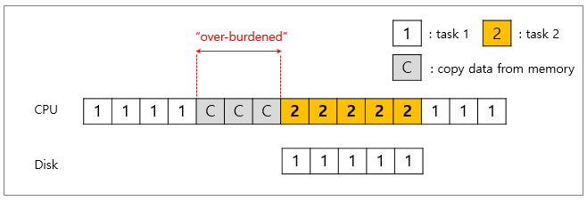
CPU is once again over-burdened
CPU wastes a lot of time to copy the a large chunk of data from memory to the device.
Diagram of CPU utilization

Slide 31
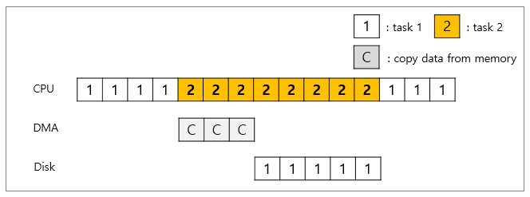
DMA (Direct Memory Access)
OS would program the data engine by telling it “where the data lives in memory, how much data to copy and which device to send it to.”
When completed, DMA raises an interrupt, I/O begins on Disk.
Diagram of CPU utilization by DMA

Slide 32
Methods of Device Interaction
How the OS communicate with the device?
Solutions
I/O instructions: a way for the OS to send data to specific device registers.
Ex) in and out instructions on x86
memory-mapped I/O
Hardware makes Device registers available as if they were memory locations.
To access a particular register the OS issues a load (to read) or store (to write) the address, the hardware then routes the load/store to the device instead of main memory.

Slide 33
Device interaction (Cont.)
How the OS interact with different specific interfaces?
Ex) We’d like to build a file system that worked on top of SCSI disks, IDE disks, USB keychain drivers, and so on.
Solutions: Abstraction
Abstraction encapsulates any specifics of device interaction.

Slide 34
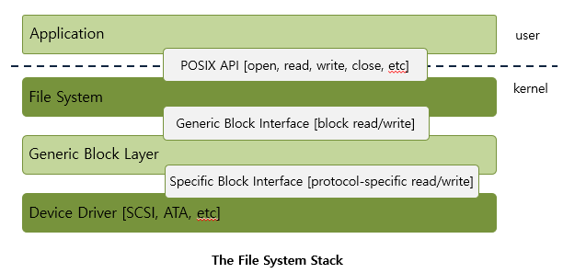
File system Abstraction
File system specifics of which disk class it is using.
Ex) It issues block read and write request to the generic block layer.

Slide 35
Problem of File System Abstraction
If there is a device having many special capabilities, these capabilities will go unused in the generic interface layer.
Over 70% of OS code is found in device drivers.
Any device drivers are needed because you might plug it to your system.
They are primary contributor to kernel crashes, making more bugs.

Slide 36
A Simple IDE Disk Driver
Four types of register
Control, command block, status, and error
Memory-mapped IO
in and out I/O instruction

Slide 37
A Simple IDE Disk Driver
Control Register:
Address 0x3F6 = 0x80 (0000 1RE0): R=reset, E=0 means "enable interrupt”
Command Block Registers:
Address 0x1F0 = Data Port
Address 0x1F1 = Error
Address 0x1F2 = Sector Count
Address 0x1F3 = LBA low byte
Address 0x1F4 = LBA mid byte
Address 0x1F5 = LBA hi byte
Address 0x1F6 = 1B1D TOP4LBA: B=LBA, D=drive
Address 0x1F7 = Command/status

Slide 38
A Simple IDE Disk Driver
Status Register (Address 0x1F7):
7 6 5 4 3 2 1 0
BUSY READY FAULT SEEK DRQ CORR IDDEX ERROR
Error Register (Address 0x1F1): (check when Status ERROR==1)
7 6 5 4 3 2 1 0
BBK UNC MC IDNF MCR ABRT T0NF AMNF
BBK = Bad Block
UNC = Uncorrectable data error
MC = Media Changed
IDNF = ID mark Not Found
MCR = Media Change Requested
ABRT = Command aborted
T0NF = Track 0 Not Found
AMNF = Address Mark Not Found

Slide 39
The basic protocol to interact with the device is as follows
assuming it has already been initialized:
Wait for the drive to be ready. Read Status Register (0x1F7) until the drive is not busy and READY.
Write parameters to command registers. Write the sector count, logical block address (LBA) of the sectors to be accessed, and drive number (master=0x00 or slave=0x10, as IDE permits just two drives) to command registers (0x1F2-0x1F6).
Start the I/O. by issuing read/write to the command register. Write READ—WRITE command to command register (0x1F7).
Data transfer (for writes): Wait until the drive status is READY and DRQ (drive request for data); write data to the data port.
Handle interrupts. In the simplest case, handle an interrupt for each sector transferred; more complex approaches allow batching and thus one final interrupt when the entire transfer is complete.
Error handling. After each operation, read the status register. If the ERROR bit is on, read the error register for details.

Slide 40
The xv6 IDE Disk Driver (Simplified)
void ide_intr() {
struct buf *b;
acquire(&ide_lock);
if (!(b->flags & B_DIRTY) && ide_wait_ready(1) >= 0)
insl(0x1f0, b->data, 512/4); // if READ: get data
b->flags |= B_VALID;
b->flags &= ˜B_DIRTY;
wakeup(b); // wake waiting process
if ((ide_queue = b->qnext) != 0) // start next request
ide_start_request(ide_queue); // (if one exists)
release(&ide_lock);
}
static int ide_wait_ready() {
while (((int r = inb(0x1f7)) & IDE_BSY) ||
!(r & IDE_DRDY))
; // loop until the drive isn’t busy
}

Slide 41
void ide_rw(struct buf *b) {
acquire(&ide_lock);
for (struct buf **pp = &ide_queue; *pp; pp=&(*pp)->qnext)
; // walk queue
*pp = b; // add request to end
if (ide_queue == b) // if q is empty
ide_start_request(b); // send req to disk
while ((b->flags & (B_VALID|B_DIRTY)) != B_VALID)
sleep(b, &ide_lock); // wait for completion
release(&ide_lock);
}
void ide_intr() {
struct buf *b;
acquire(&ide_lock);
if (!(b->flags & B_DIRTY) && ide_wait_ready(1) >= 0)
insl(0x1f0, b->data, 512/4); // if READ: get data
b->flags |= B_VALID;
b->flags &= ˜B_DIRTY;
wakeup(b); // wake waiting process
if ((ide_queue = b->qnext) != 0) // start next request
ide_start_request(ide_queue); // (if one exists)
release(&ide_lock);
}

Slide 42

THANK YOU
Team – Operating System

