Slide 1
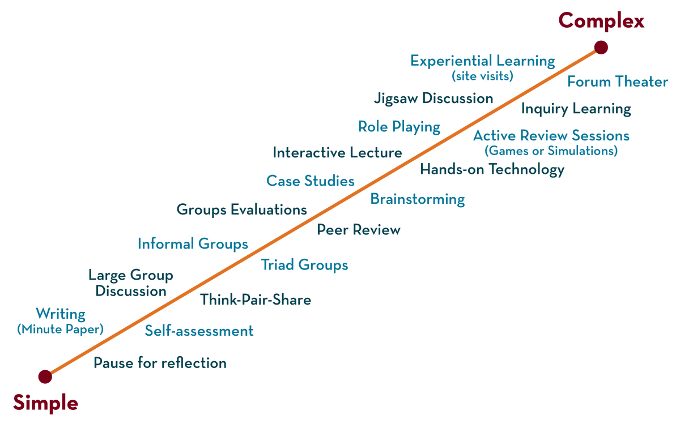
COURSE NAME: Operating Systems COURSE CODE: 23CS2104R/a
CO4
Session - 3
RAID (Redundant Array of Independent/
Inexpensive Disks)

Slide 2
AIM OF THE SESSION
To familiarize students with the basic concept of RAID.
INSTRUCTIONAL OBJECTIVES
This Session is designed to:
Demonstrate what is meant by RAID.
Demonstrate what is meant by MTBF.
Describe the types of RAID Levels.
Describe the Performance of RAID Levels.
LEARNING OUTCOMES
At the end of this session, you should be able to:
Defines what. Is RAID.
Describe RAID Levels.
Summarize the Role of RAID.

Slide 3
RAID
What is RAID?
RAID configurations used.
Performance of each configuration.
Implementations.
Way forward with RAID.

Slide 4
RAID
RAID (redundant array of independent disks) is a setup consisting of multiple disks for data storage. They are linked together to prevent data loss and/or speed up performance. Having multiple disks allows the employment of various techniques like disk striping, disk mirroring, and parity.

Slide 5
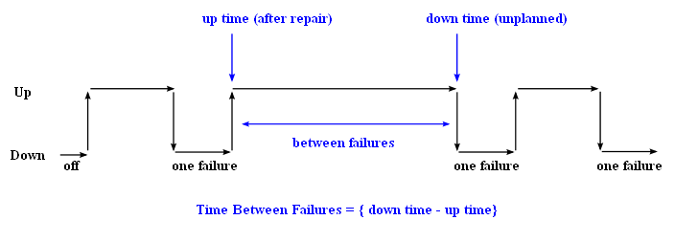
Mean Time Between Failures (MTBF)

Slide 6
RAID flavors
The following list explains the standard RAID levels (0, 1, 2, 3, 4, 5, 6) and popular hybrid or Nested options (RAID 10).
RAID 0: (Non-Redundant Striping)
RAID 1: (Mirrored Disks)
RAID 2: (Memory-Style Error Correcting Codes)
RAID 3: (Bit-Interleaved Parity)
RAID 4: (Block-Interleaved Parity)
RAID 5: (Block-Interleaved Distributed Parity)
RAID 6: (P+Q Redundancy(Double Parity))
RAID 10

Slide 7
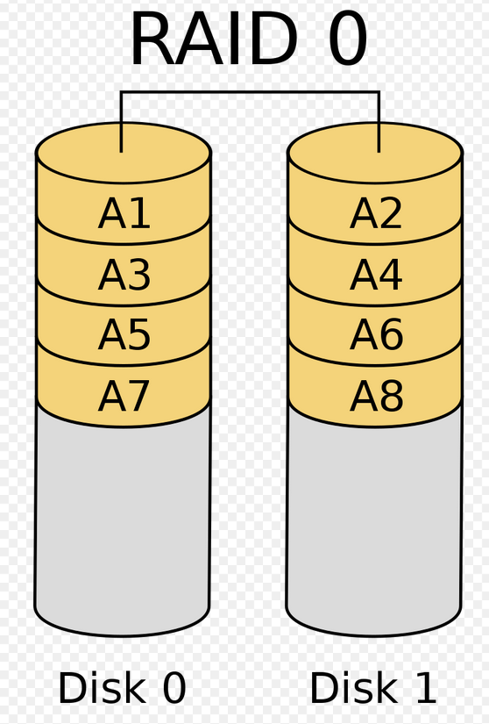
RAID 0: Striping
Under a RAID 0 system, all data is divided into blocks, and the blocks are written across multiple drives. This is known as striping.
Advantages
The advantage of striping is that both read and write speeds greatly increase. This goal is also achieved without any duplication, so the entire storage capacity of each drive is used efficiently.
Disadvantages
The downside of RAID 0 is that it doesn't offer much protection against data loss. If any of the drives fail, the data on that drive cannot be recovered.

Slide 8
RAID 0 analysis
Failure Rate:
MTBF of RAID0 is roughly proportional to the number of disks in the array.
Pr(disk fail) = 5%, then
Pr(atleastonefails) = 1 – Pr(nonefails) = 1 – [1-0.05]² = 9.75%
Performance:
The fragments are written to their respective disks simultaneously on the same sector.
This allows smaller sections of the entire chunk of data to be read off the drive in parallel, hence good performance.

Slide 9
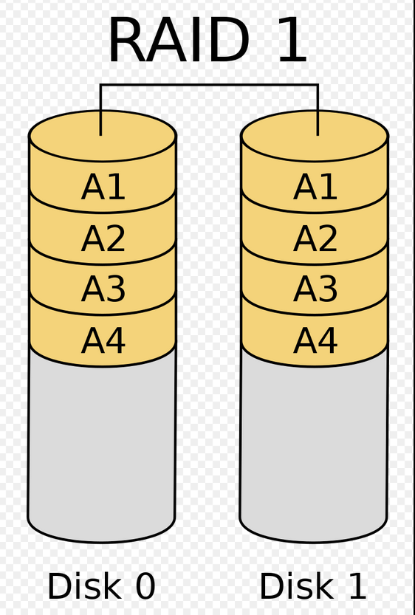
RAID 1:(mirrored disks)
All data is stored twice. First, it's stored on a data drive or drives. Then it's stored again on a mirror drive or drives.
Advantages
RAID 1 is used to prevent data loss. If one drive fails, the data can be recovered because there's already a copy of it.
Disadvantages
RAID 1 requires that half the storage capacity be used on duplicated data.. RAID 1 is only as fast as the slowest drive.

Slide 10
RAID 1 analysis
Failure Rate:
If Pr(disk fail) = 5%, then the probability of both the drives failing in a 2 disk array is P(both fail) = (0.05)² = 0.25%.
Performance:
If we use independent disk controllers for each disk, then we can increase the read or write speeds by doing operations in parallel.

Slide 11
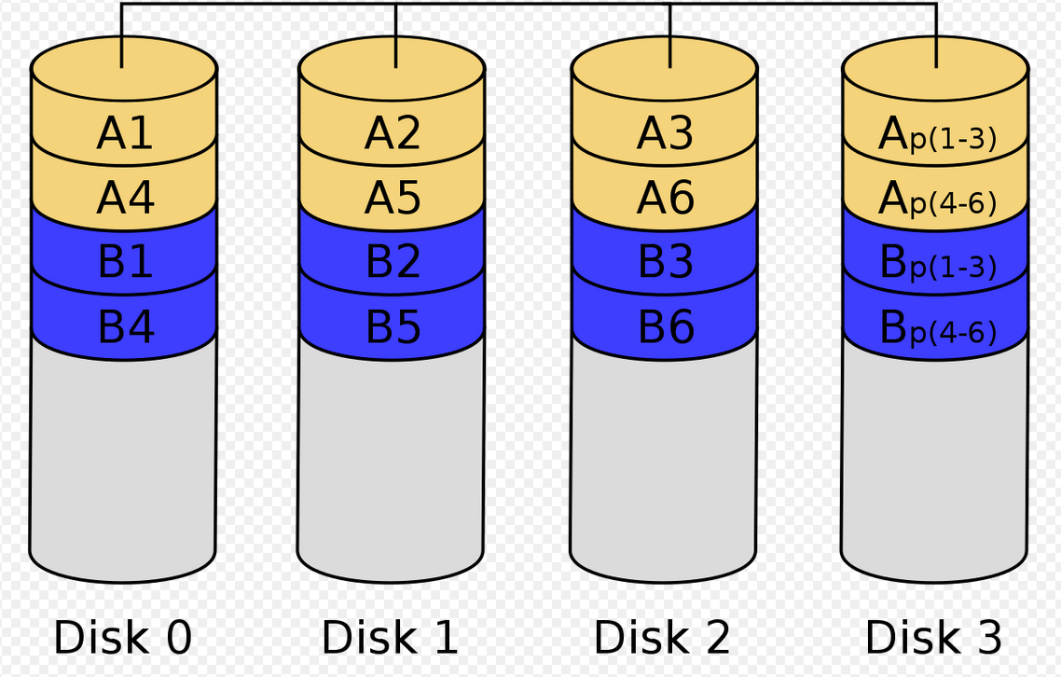
RAID-2 (Memory style error-correcting codes )
In Raid-2, the data error is checked at every bit level. Here, we use Hamming Code Parity Method to find the error in the data.
It uses one designated drive to store parity.
The structure of Raid-2 is very complex as we use two disks in this technique.
One word is used to store bits of each word and another word is used to store error code correction.

Slide 12
RAID-2
Advantages
In case of Error Correction, it uses hamming code.
It Uses one designated drive to store parity.
Disadvantages
It has a complex structure and high cost due to extra drive.
It requires an extra drive for error detection.

Slide 13
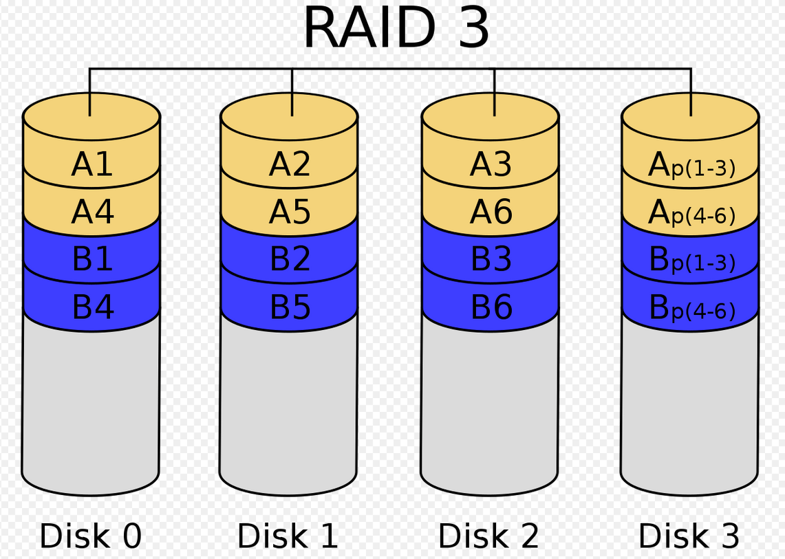
RAID-3 (Bit- Interleaved Parity)
It consists of byte-level striping with dedicated parity striping.
At this level, we store parity information in a disc section and write to a dedicated parity drive.
Whenever failure of the drive occurs, it helps in accessing the parity drive, through which we can reconstruct the data.

Slide 14
RAID-3
Advantages
Data can be transferred in bulk.
Data can be accessed in parallel.
Disadvantages
It requires an additional drive for parity.
In the case of small-size files, it performs slowly.

Slide 15
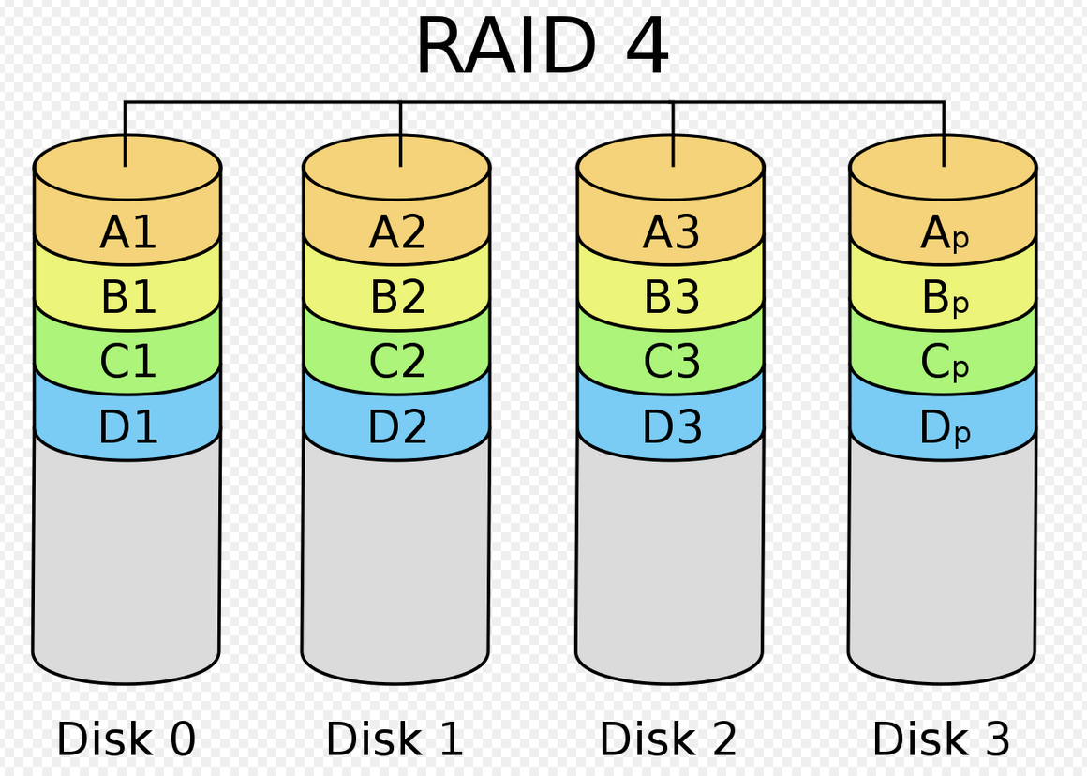
RAID-4 (Block-interleaved Parity)
RAID 4 consists of block-level striping with a dedicated parity disk. As a result of its layout, RAID 4 provides good performance of random reads.

Slide 16
RAID-4
Advantages of RAID 4
Fast read operations.
Low storage overhead.
Simultaneous I/O requests.
Disadvantages of RAID 4
Bottlenecks that have a big effect on overall performance.
Slow write operations.
Redundancy is lost if the parity disk fails.

Slide 17
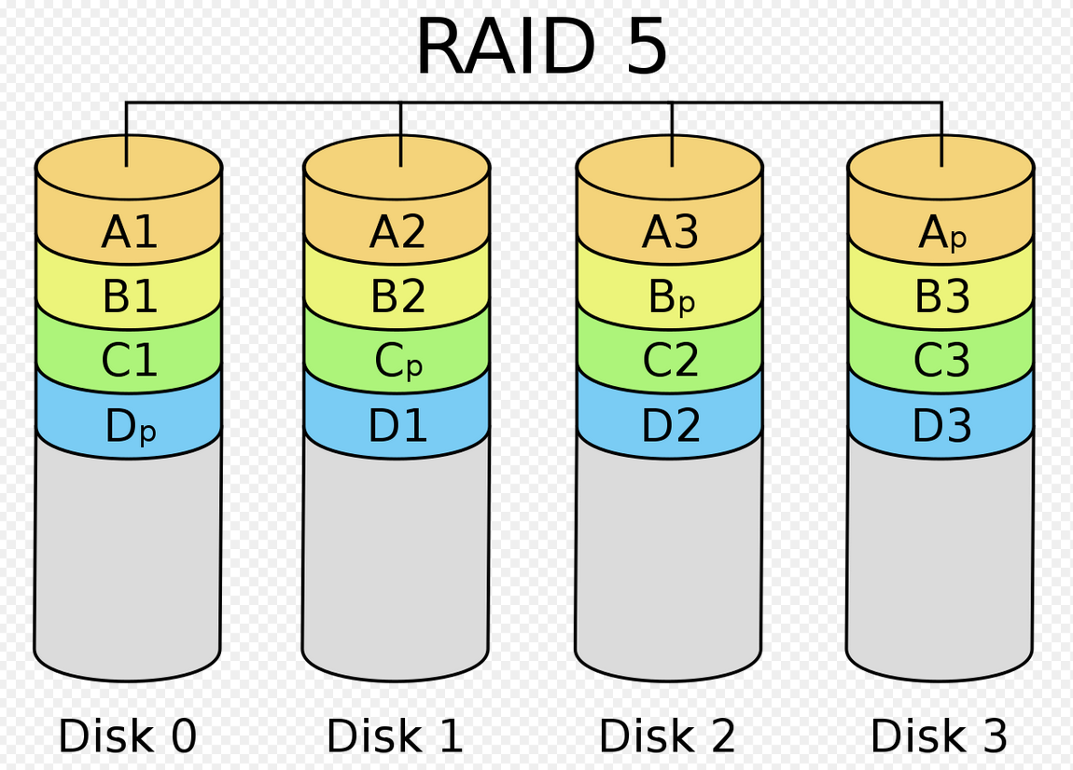
RAID 5:(Block-Interleaved distributed parity)
RAID 5 requires at least three drives. A checksum parity is created. This is a calculated value that can be used to rebuild data mathematically.
The data and the checksum parity of the data are then written across all drives. If any one of the drives fail, the missing data can then be recovered using the checksum.

Slide 18
RAID 5 analysis
MTBF is slightly better than RAID 0. This is because the failure of one disk is not quite a harm. We need more time if 2 or more disks fail.
Performance is also as good as RAID 0, if not better. We can read and write parallel blocks of data.
One of the drawbacks is that the write involves heavy parity calculations by the RAID controller. Write operations are slower compared to RAID 0.
Pretty useful for general purpose uses where ‘read’s’ are more frequent the ‘write’s’.

Slide 19
RAID 5
Advantages
RAID 5 offers fast read speeds but is slower at writing. It protects against drive failure without requiring data duplication.
Disadvantages
Repairing a failed drive is a complicated process that takes time. In addition, if more than one drive fails, data will be lost. This makes a RAID 5 system vulnerable to data loss during the time it takes to replace a failed drive.

Slide 20
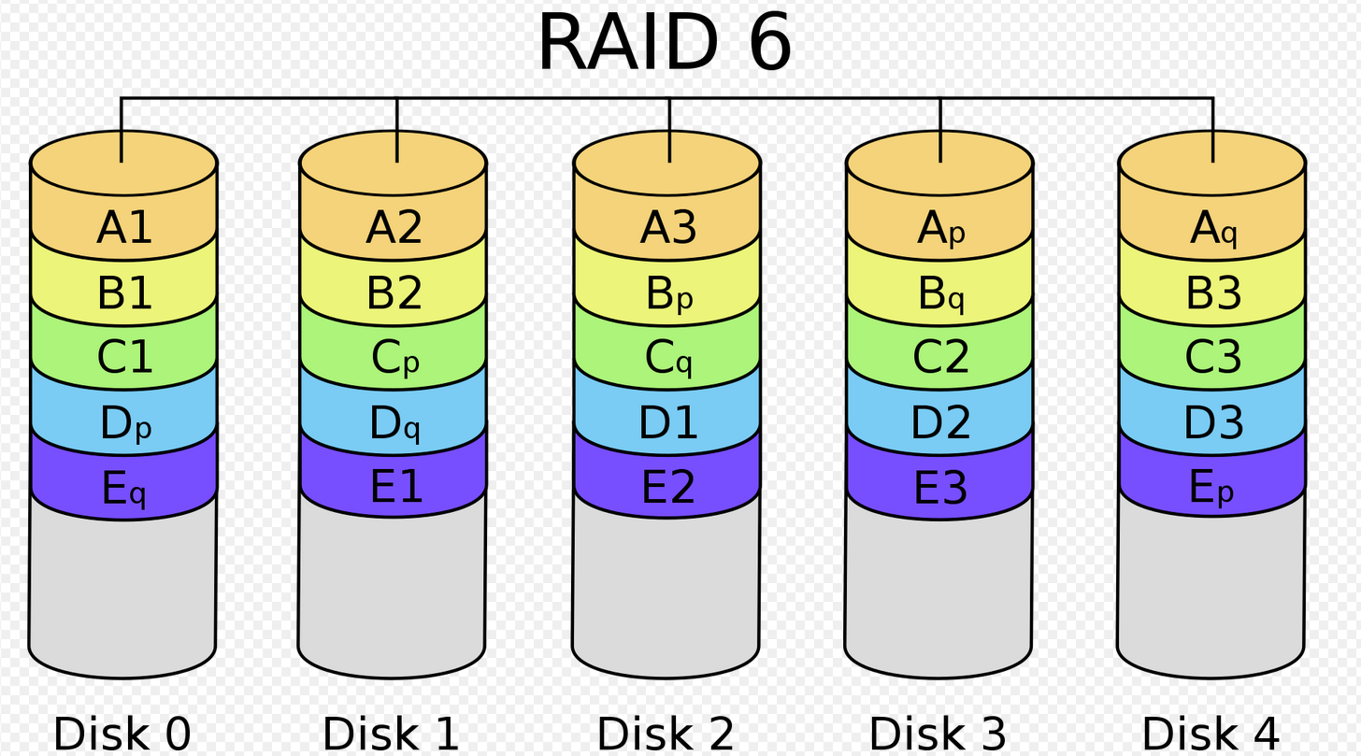
RAID 6(P+Q Redundancy ( Double Parity))
RAID 6 is identical to RAID 5, except parity data is written on two drives instead of one. This requires a minimum of four drives, but the advantage is that two drives can now fail without data loss.
This means that by accounting for a situation where two drives have failed simultaneously, data is protected in almost all cases.

Slide 21
RAID 6
Advantages
RAID 6 is just as fast at reading as RAID 5 but it is much better at protecting against data loss.
Disadvantages
RAID 6 is slower at writing than RAID 5. The process for replacing a drive is still time-intensive.

Slide 22
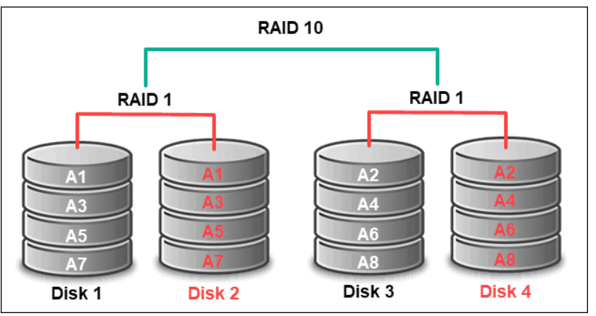
RAID 10(1+0)
RAID 10 combines RAID 1 and RAID 0. Data is mirrored across multiple drives to protect against data loss, and striping is added to increase read speeds.
Advantages
RAID 10 allows the data from a failed drive to be recovered faster than in a comparable RAID 5 or RAID 6 system.
Disadvantages
RAID 10 requires the same amount of data duplication as RAID 1. This means that it requires far more storage space than RAID 5 or RAID 6.

Slide 23
Implementations
Software based RAID:
Software implementations are provided by many Operating Systems.
A software layer sits above the disk device drivers and provides an abstraction layer between the logical drives(RAIDs) and physical drives.
Server's processor is used to run the RAID software.
Used for simpler configurations like RAID0 and RAID1.

Slide 24
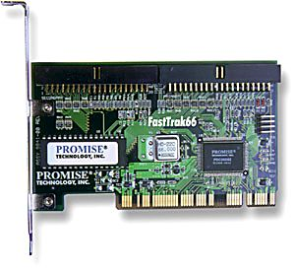
Implementations (contd…)
Hardware based RAID:
A hardware implementation of RAID requires at least a special-purpose RAID controller.
On a desktop system this may be built into the motherboard.
Processor is not used for RAID calculations as a separate controller is present.
A PCI-bus-based, IDE/ATA hard disk RAID controller, supporting levels 0, 1, and 01.

Slide 25
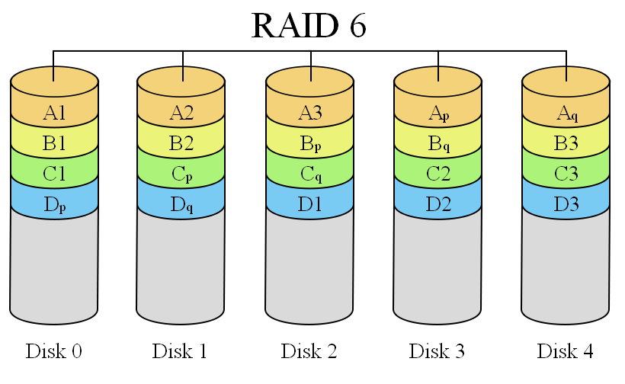
What’s happening present day?
RAID 6:
It is seen as the best way to guarantee data integrity as it uses double parity.
Lesser MTBF compared to RAID5.
It has a drawback though of longer write time.

Slide 26

THANK YOU
Team – Operating System

