Slide 1
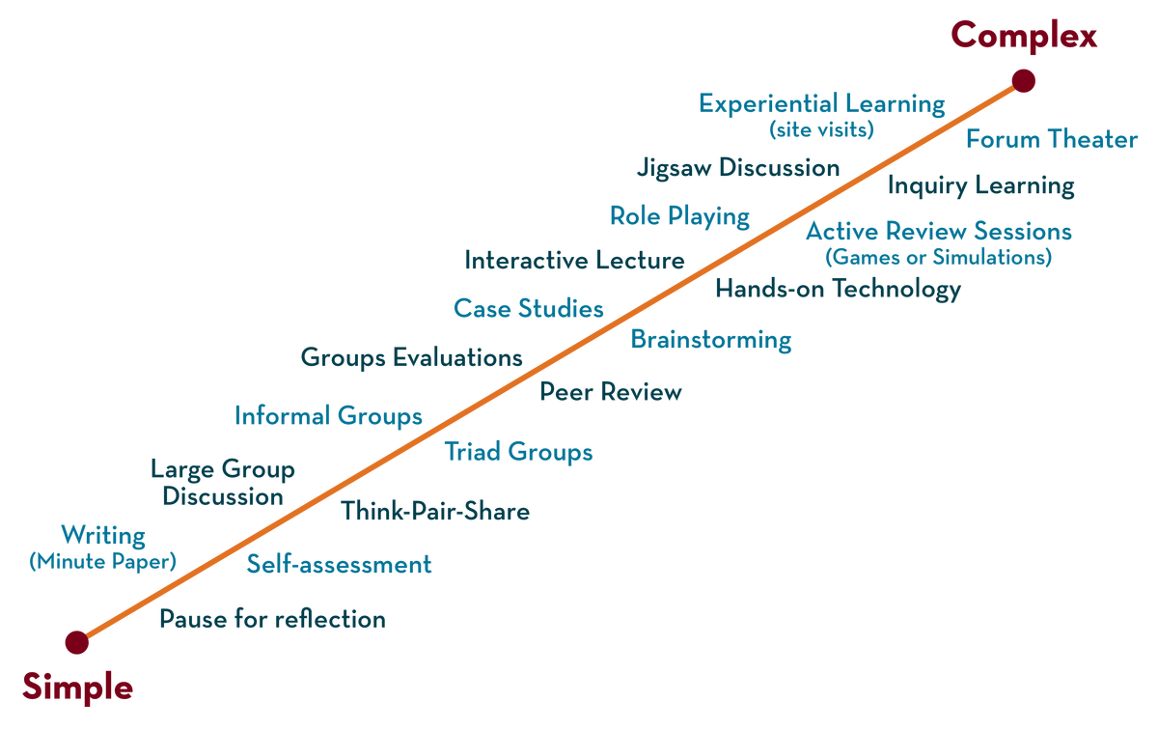
COURSE NAME: Operating Systems COURSE CODE: 23CS2104R/a
CO4
Session - 4
Files and directories

Slide 2
AIM OF THE SESSION
To familiarize students with the basic concept of files and directories.
.
INSTRUCTIONAL OBJECTIVES
This Session is designed to:
Demonstrate what is meant by Files.
Demonstrate what is meant by Directories.
Describes the types of File Allocation Method.
Describes the File System Implementation.
LEARNING OUTCOMES
At the end of this session, you should be able to:
Defines what is meant by Files.
Defines the File System Implementation.
Summarizes the Role of files and directories.

Slide 3
Persistence STORAGE
Keep data intact even if there is a power loss.
Hard disk drive
Solid-state storage device
Two key abstractions in the virtualization of storage
File
Directory

Slide 4
FILE
A file is a named collection of related information recorded on secondary storage. From a user's perspective, a file is the smallest allotment of logical secondary storage
In general, A linear array of bytes OR sequences of bits, bytes, lines, or records, the meaning of which is defined by the file's creator and user. Each file has a low-level name as an inode number The user is unaware of this name.
The filesystem has a responsibility to store data persistently on disks.

Slide 5
DIRECTORY
Directory is like a file and also has a low-level name.
It contains a list of (user-readable name, low-level name) pairs.
Each entry in a directory refers to either files or other directories.
Example)
A directory has an entry (“f1”, “10”)
A file “f1” with the low-level name “10”

Slide 6
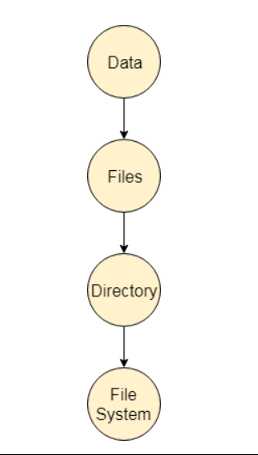

Slide 7
FILE ATTRIBUTES
1. Name
Every file carries a name by which the file is recognized in the file system. One directory cannot have two files with the same name.
2. Identifier
Along with the name, Each File has its extension which identifies the type of the file. For example, a text file has the extension .txt, and A video file can have the extension .mp4.
3. Type
In a File System, the Files are classified in different types such as video files, audio files, text files, executable files, etc.
4. Location
In the File System, there are several locations in which, the files can be stored. Each file carries its location as its attribute.

Slide 8
5. Size:
The Size of the File is one of its most important attributes. By size of the file, we mean the number of bytes acquired by the file in the memory.
6. Protection:
The Admin of the computer may want the different protections for the different files. Therefore each file carries its own set of permissions to the different groups of Users.
7. Time and Date:
Every file carries a time stamp which contains the time and date on which the file is last modified.

Slide 9
FILE OPERATIONS
1. Create: This operation is used to create a file in the file system.
2. Open: This operation is the common operation performed on the file. Once the file is created, it must be opened before performing the file processing operations.
3. Write: This operation is used to write the information into a file. A system call write() is issued that specifies the name of the file and the length of the data that has to be written to the file
4. Read operation: This operation reads the contents from a file. A Read pointer is maintained by the OS, pointing to the position up to which the data has been read.

Slide 10
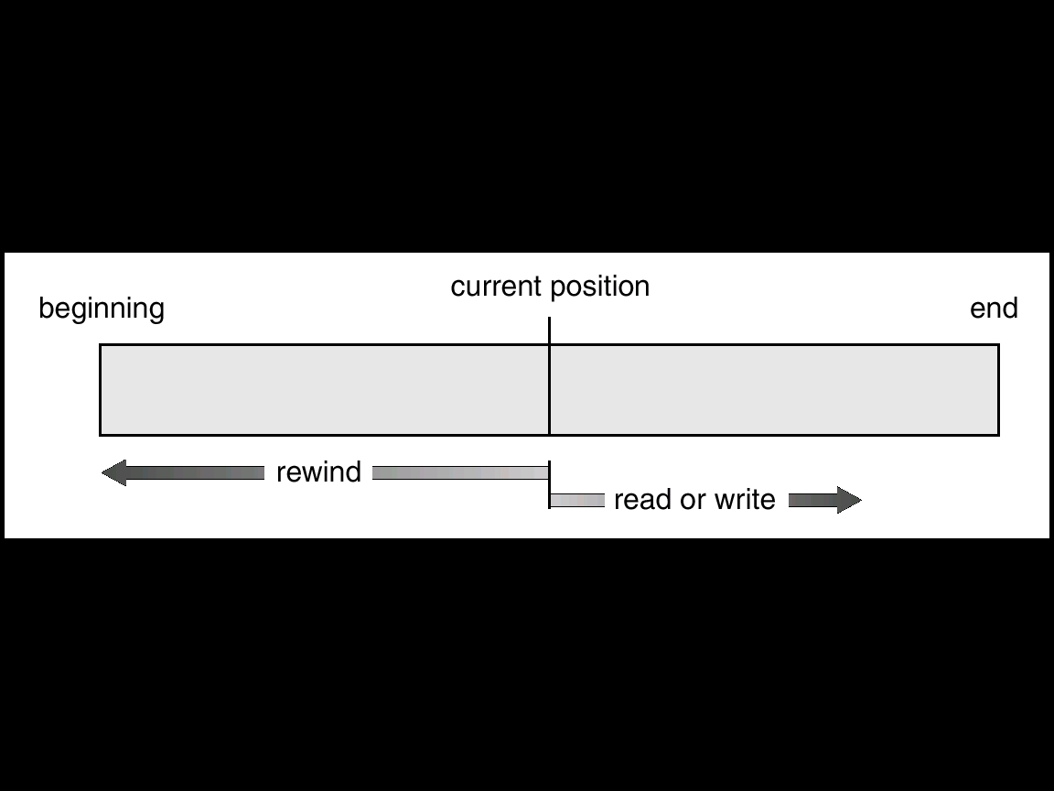
5. Re-position or Seek :
The seek system calls re-positions the file pointers from the current position to a specific place in the file i.e. forward or backward depending upon the user's requirement.
fseek(FILE *filePtr, long offset, int origin);
The origin can have the following three values:
SEEK_SET: It denotes the beginning or starting of the file.
SEEK_CUR: It denotes the current position of the file pointer.
SEEK_END: It denotes the end of the file.

Slide 11
6. Delete: Deleting the file will not only delete all the data stored inside the file it is also used so that disk space occupied by it is freed.
7. Truncate: Truncating is simply deleting the file except for deleting attributes. The file is not completely deleted although the information stored inside the file gets replaced.
8. Close: When the processing of the file is complete, it should be closed so that all the changes made permanent and all the resources occupied should be released. On closing it deallocates all the internal descriptors that were created when the file was opened.
9. Append operation: This operation adds data to the end of the file.
10. Rename operation: This operation is used to rename the existing file

Slide 12
HOW TO MANAGE FILES
Several pieces of data are needed to manage open file
Open-file table: Tracks open files.
File pointer: pointer to last read/write location, per process that has the file open.
File-open count: counter of the number of times a file is open – to allow removal of data from the open-file table when the last process closes it.
Disk location of the file: Cache of data access information.
Access rights: Per-process access mode information.

Slide 13
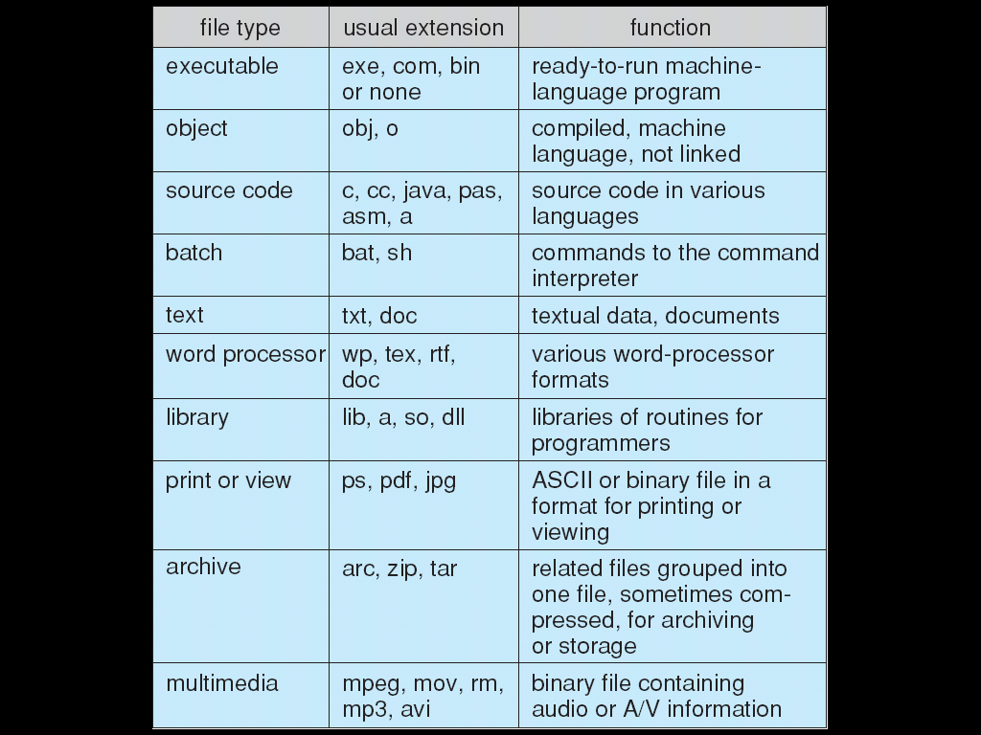
FILE TYPES

Slide 14
Allocation Method
An allocation method refers to how disk blocks are allocated for files:
Contiguous Allocation
Linked Allocation
Indexed Allocation

Slide 15
Contiguous Allocation Method
An allocation method refers to how disk blocks are allocated for files:
Each file occupies a set of contiguous blocks
Best performance in most cases
Simple – only starting location (block #) and length (number of blocks) are required
Problems include:
Finding space on the disk for a file,
Knowing file size,
External fragmentation, need for compaction off-line (downtime) or on-line

Slide 16
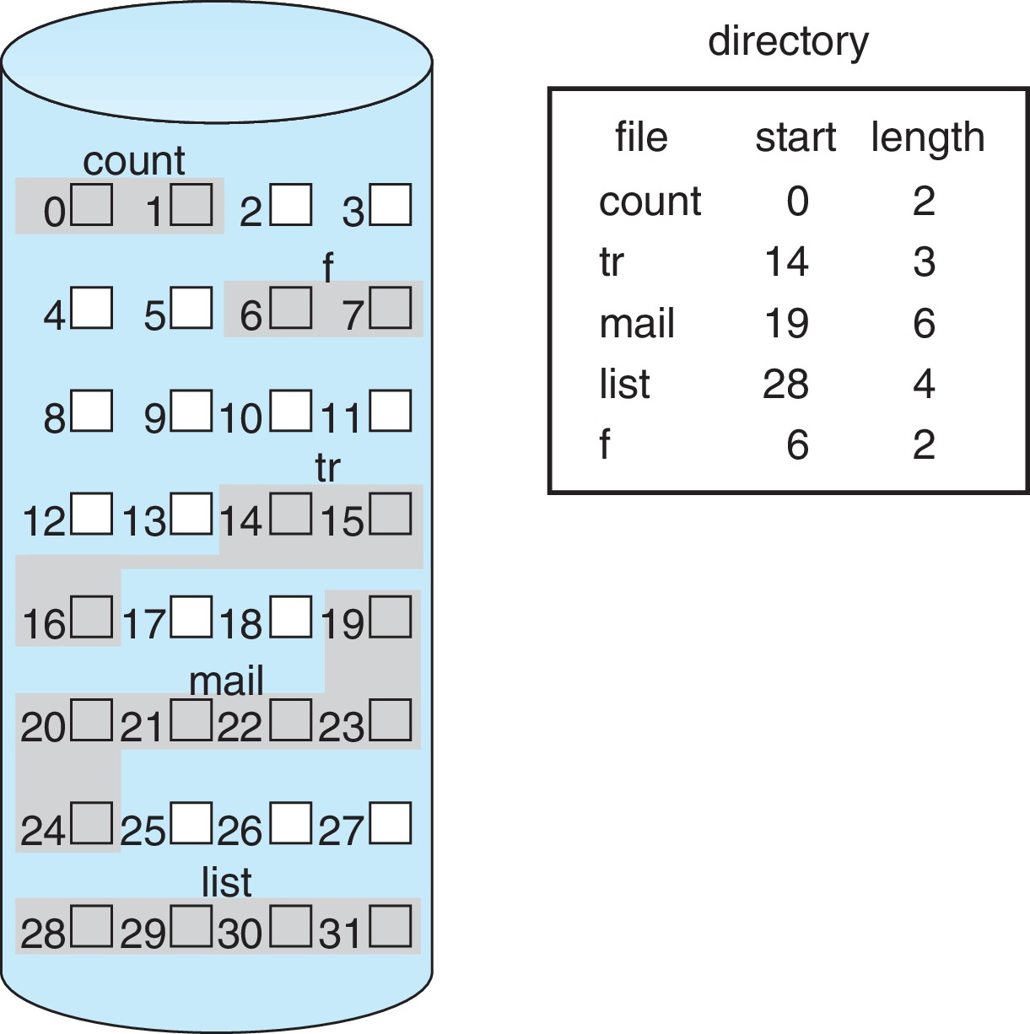
Contiguous Allocation (Cont.)
Mapping from logical to physical (block size =512 bytes)
Block to be accessed = starting address + Q
Displacement into block = R
Q
LA/512
R

Slide 17
Extent-Based Systems
Many newer file systems (i.e., Veritas File System) use a modified contiguous allocation scheme
Extent-based file systems allocate disk blocks in extent
An extent is a contiguous block of disks
Extents are allocated for file allocation
A file consists of one or more extents

Slide 18
Linked Allocation
Each file is a linked list of blocks
File ends at nil pointer
No external fragmentation
Each block contains a pointer to the next block
No compaction, external fragmentation
Free space management system called when a new block needed
Improve efficiency by clustering blocks into groups but increases internal fragmentation
Reliability can be a problem
Locating a block can take many I/Os and disk seeks

Slide 19
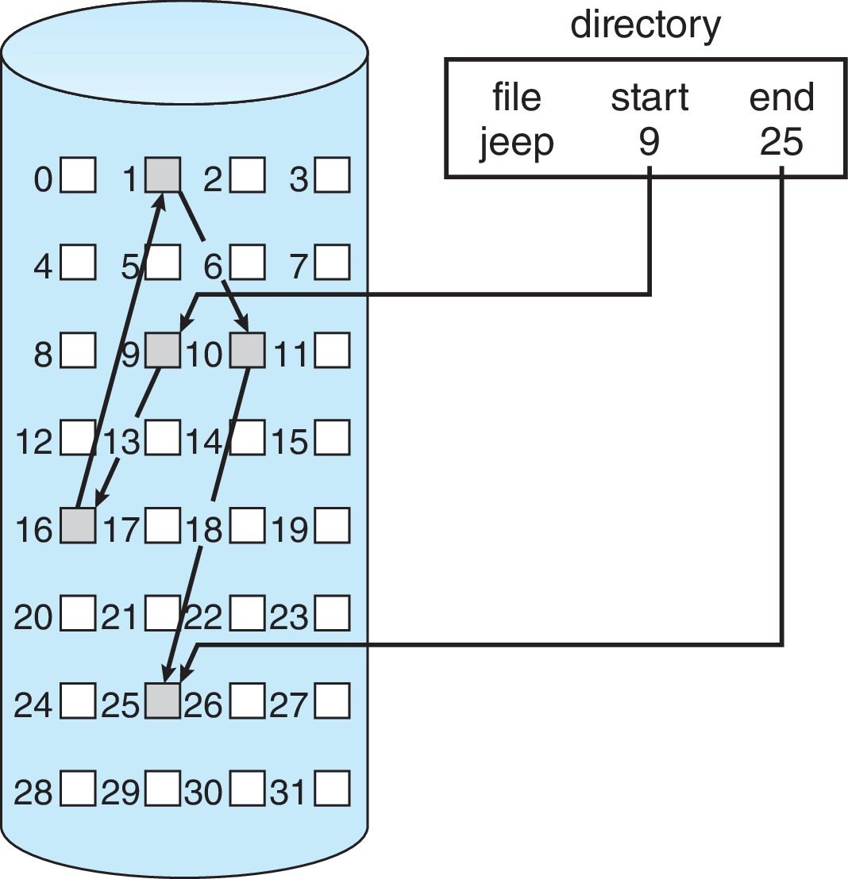
Linked Allocation Example
Each file is a linked list of disk blocks.
blocks may be scattered anywhere on the disk.
Mapping
Block to be accessed is the Q^{th} block in the linked chain of blocks representing the file.
Displacement into block = R + 1
Q
LA/511
R

Slide 20
FAT Allocation Method
The beginning of volume has a table, indexed by block number
Much like a linked list, but faster on disk and cacheable
New block allocation simple.
Used by DOS Operating System

Slide 21
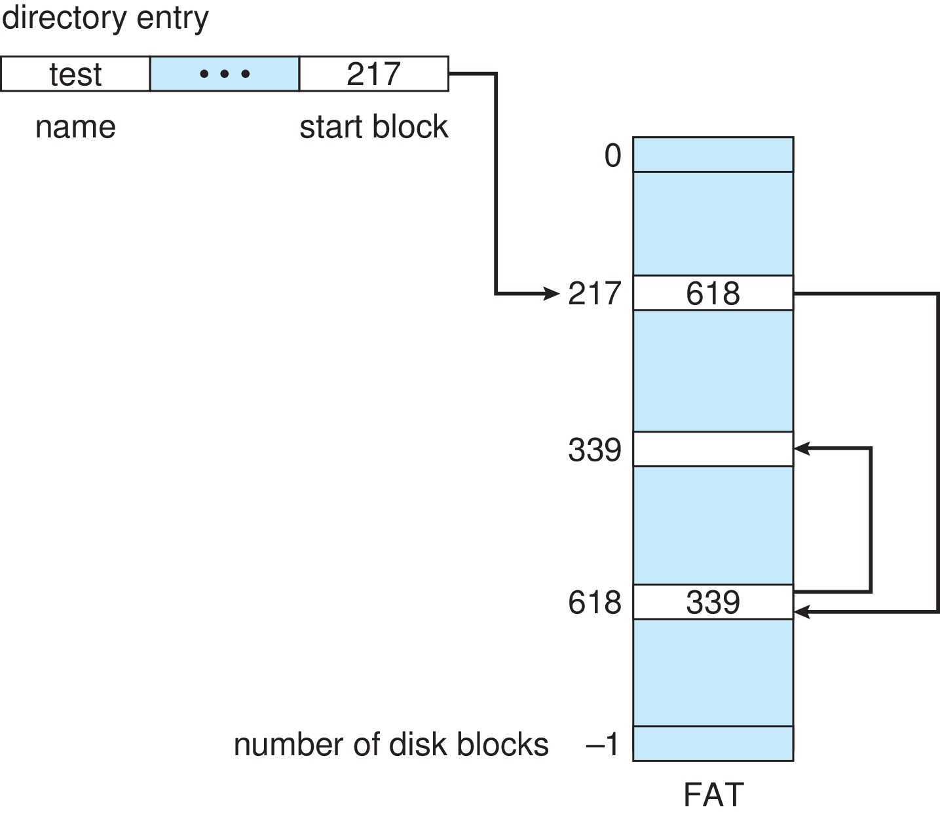
File-Allocation Table

Slide 22
Indexed Allocation Method
Each file has its own index block(s) of pointers to its data blocks
Logical view

Slide 23
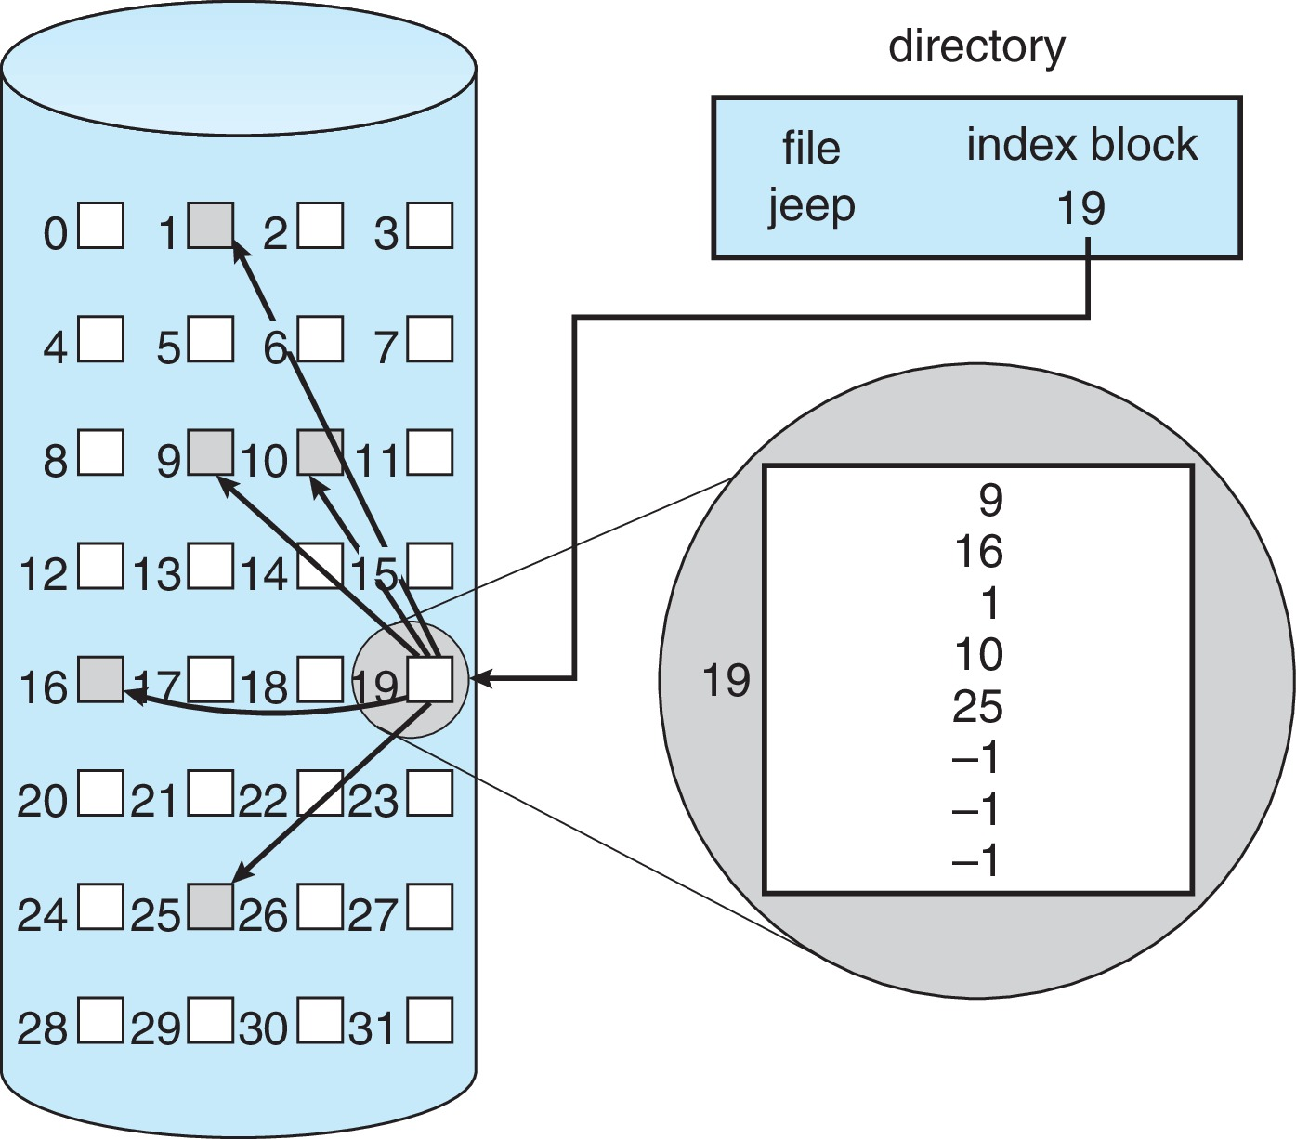
Example of Indexed Allocation

Slide 24
Indexed Allocation – Small Files
Need index table
Random access
Dynamic access without external fragmentation, but have the overhead of index block
Mapping from logical to physical in a file of maximum size of 256K bytes and block size of 512 bytes. We need only 1 block for index table
Calculation:
Q = displacement into index table
R = displacement into block
Q
LA/512
R

Slide 25
Indexed Allocation – Large Files
Mapping from logical to physical in a file of unbounded length (block size of 512 words)
Linked scheme – Link blocks of index table (no limit on size)
Multi-level indexing

Slide 26
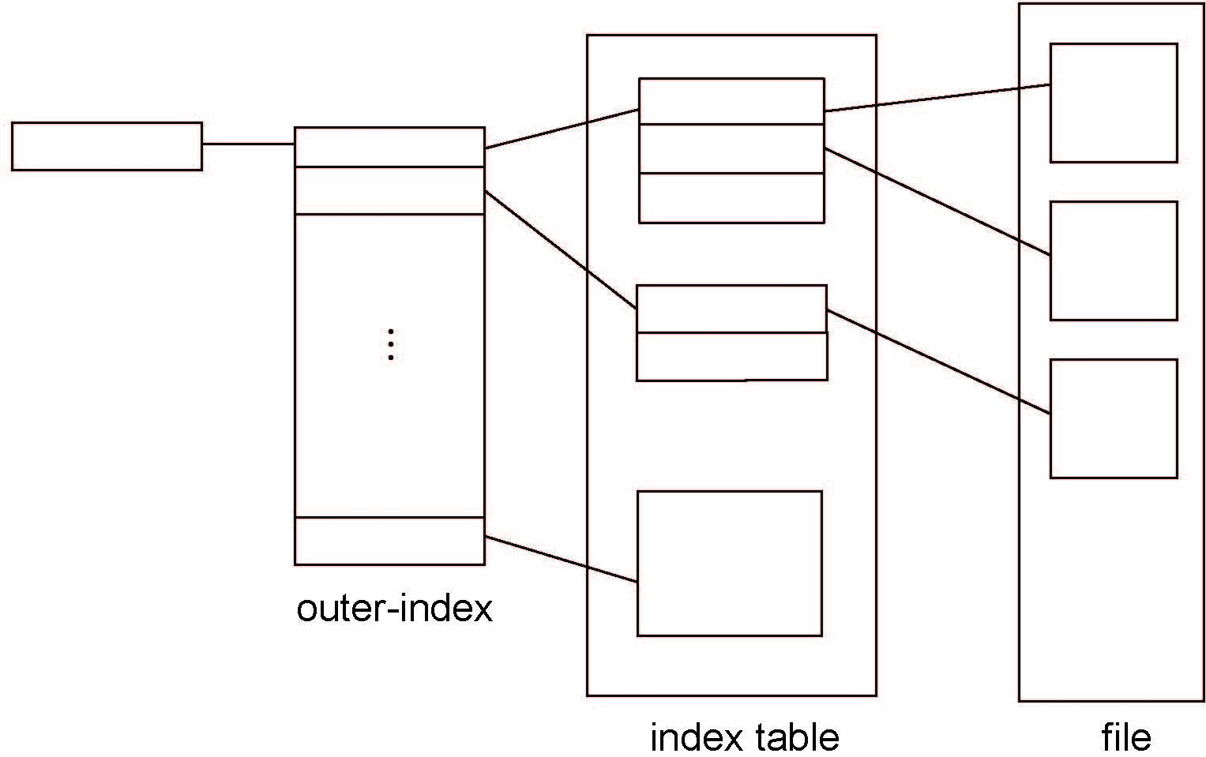
Indexed Allocation – Two-Level Scheme

Slide 27
FILE ACCESS METHODS
SEQUENTIAL ACCESS
RANDOM/DIRECT ACCESS
INDEXED ACCESS

Slide 28
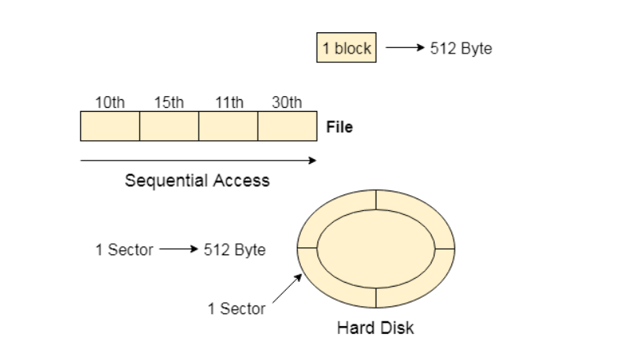
SEQUENTIAL ACCESS
Most of the operating systems access the file sequentially.
In other words, we can say that most of the files need to be accessed sequentially by the operating system.
In sequential access, the OS read the file word by word.
A pointer is maintained which initially points to the base address of the file. If the user wants to read first word of the file then the pointer provides that word to the user and increases its value by 1 word. This process continues till the end of the file.

Slide 29
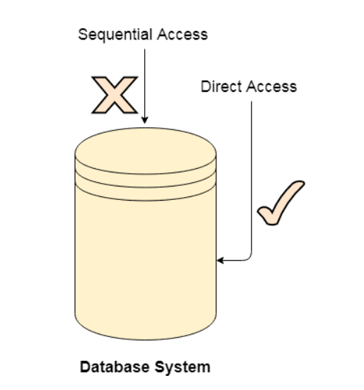
DIRECT ACCESS
The direct-access method is based on a disk model of a file, since disks allow random access to any file block.
For direct access, the file is viewed as a numbered sequence of blocks or records. Thus, we may read block 14, then read block 53, and then write block 7. There are no restrictions on the order of reading or writing for a direct-access file.

Slide 30
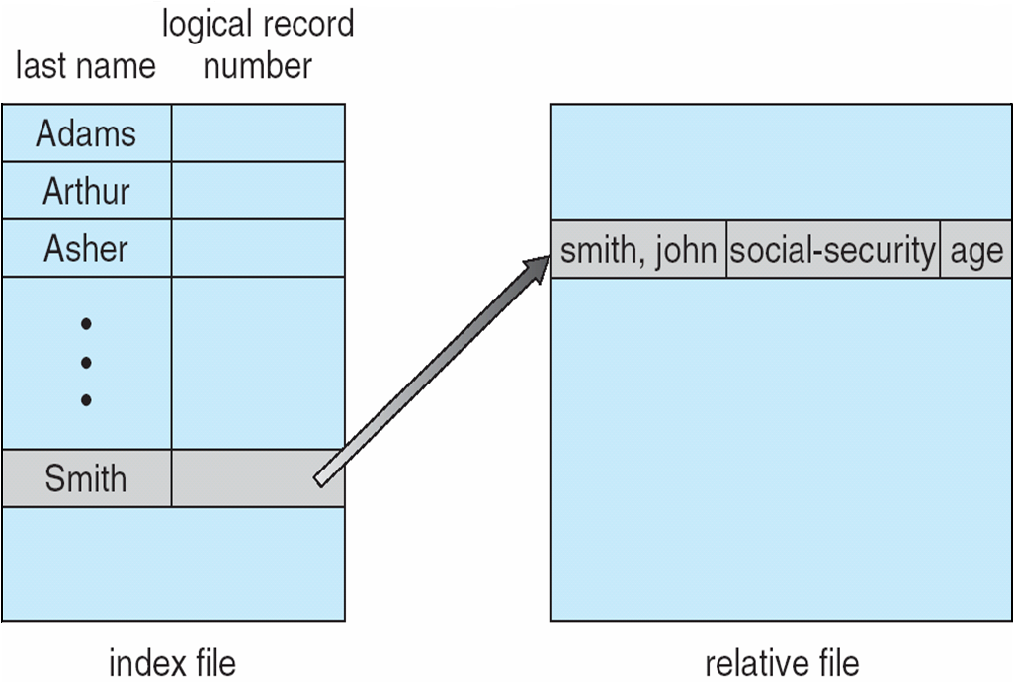
INDEX AND RELATIVE FILE ACCESS

Slide 31
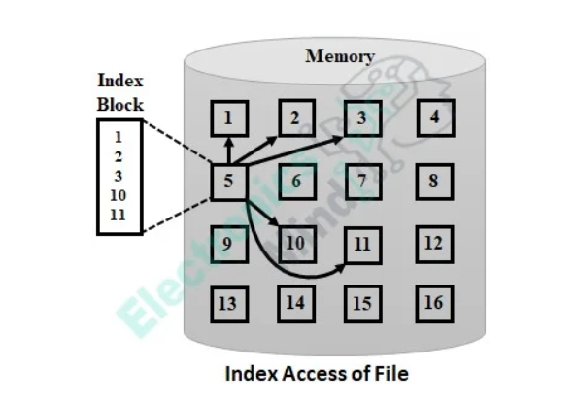
Indexed Access Method
This method is typically an advancement in the direct access method which is the consideration of index. A particular record is accessed by browsing through the index and the file is accessed directly with the use of pointers or addresses present in the index as shown below.

Slide 32
Sequential Access: read next
write next
reset
no read after last write
(rewrite)
Direct Access – file is fixed length logical records
read n
write n
position to n
read next
write next
rewrite n
n = relative block number
Relative block numbers allow OS to decide where file should be placed

Slide 33
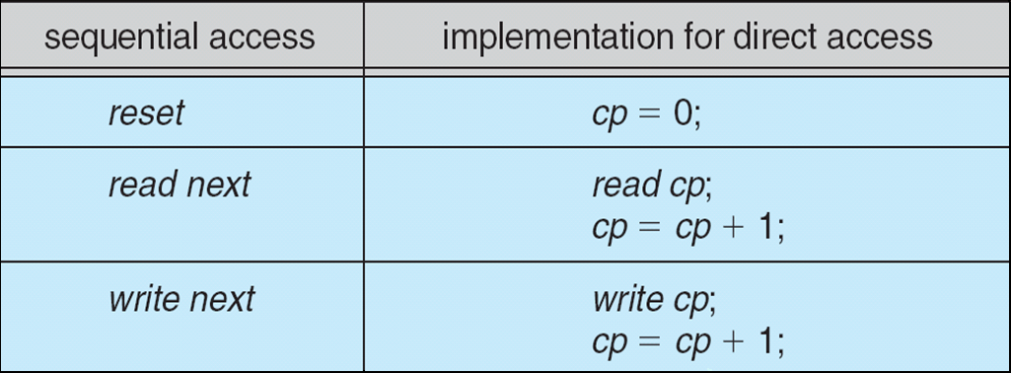
Simulation of Sequential Access on Direct-access File

Slide 34
Directory Structure
A collection of nodes containing information about all files
Directory
Files
F 1
F 2
F 3
F 4
F n
Both the directory structure and the files reside on disk

Slide 35
Disk Structure
Disk can be subdivided into partitions
Disks or partitions can be RAID protected against failure
Disk or partition can be used raw – without a file system, or formatted with a file system.
Partitions also known as minidisks, slices.
Entity-containing file system is known as a volume
Each volume containing a file system also tracks that file system’s info in device directory or volume table of contents
In addition to general-purpose file systems there are many special-purpose file systems, frequently all within the same operating system or computer

Slide 36
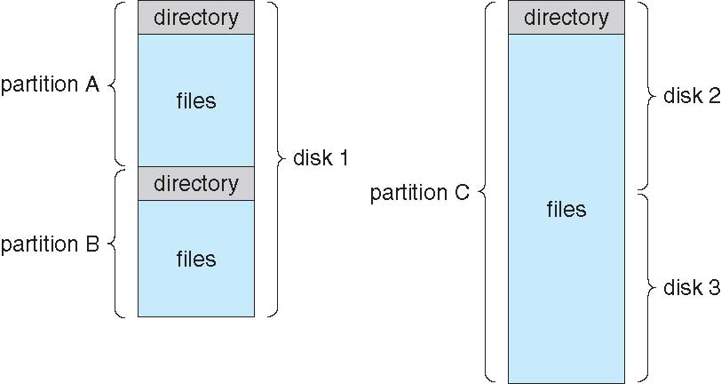
File-system Organization

Slide 37
Types of File Systems
We mostly talk of general-purpose file systems
But systems frequently have many file systems, some general- and some special- purpose
Consider Solaris has
tmpfs – memory-based volatile FS for fast, temporary I/O
objfs – interface into kernel memory to get kernel symbols for debugging
ctfs – contract file system for managing daemons
lofs – loopback file system allows one FS to be accessed in place of another
procfs – kernel interface to process structures
ufs, zfs – general purpose file systems

Slide 38
Operations Performed on Directory
Search for a file
Create a file
Delete a file
List a directory
Rename a file
Traverse the file system

Slide 39
Directory Organization
The directory is organized logically to obtain
Efficiency – locating a file quickly
Naming – convenient to users
Two users can have the same name for different files
The same file can have several different names
Grouping – a logical grouping of files by properties, (e.g., all Java programs, all games, …)

Slide 40
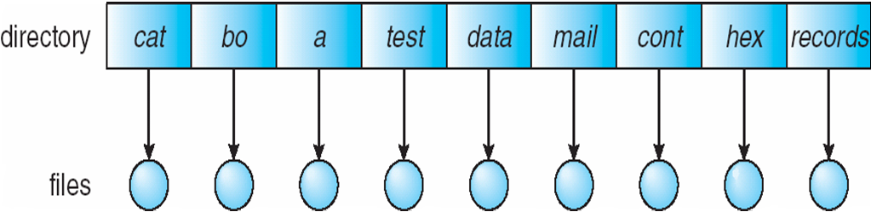
Single-Level Directory
A single directory for all users
Naming problem
Grouping problem

Slide 41
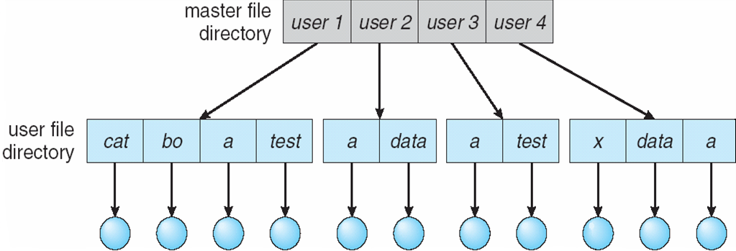
Two-Level Directory
Separate directory for each user
Path name
Can have the same file name for different user
Efficient searching
No grouping capability

Slide 42
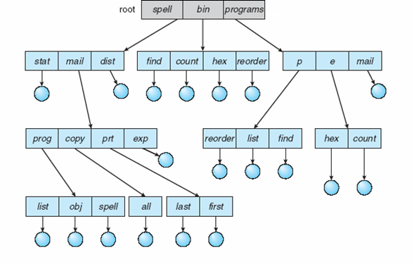
Tree-Structured Directories

Slide 43
Tree-Structured Directories (Cont.)
Efficient searching
Grouping Capability
Current directory (working directory)
cd /spell/mail/prog
type list

Slide 44
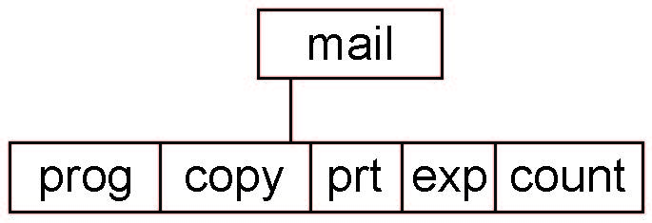
Tree-Structured Directories (Cont)
Absolute or relative path name
Creating a new file is done in current directory
Delete a file
rm <file-name>
Creating a new subdirectory is done in current directory
mkdir <dir-name>
Example: if in current directory /mail
mkdir count
Deleting “mail” ⇒ deleting the entire subtree rooted by “mail”

Slide 45
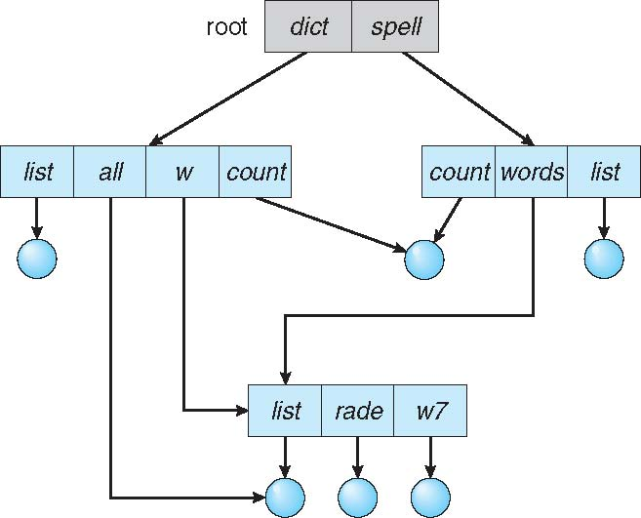
Acyclic-Graph Directories
Have shared subdirectories and files

Slide 46
Acyclic-Graph Directories (Cont.)
Two different names (aliasing)
If dict deletes list ⇒ dangling pointer
Solutions:
Back pointers, so we can delete all pointers Variable size records a problem
Back pointers using a daisy chain organization
Entry-hold-count solution
New directory entry type
Link – another name (pointer) to an existing file
Resolve the link – follow pointer to locate the file

Slide 47
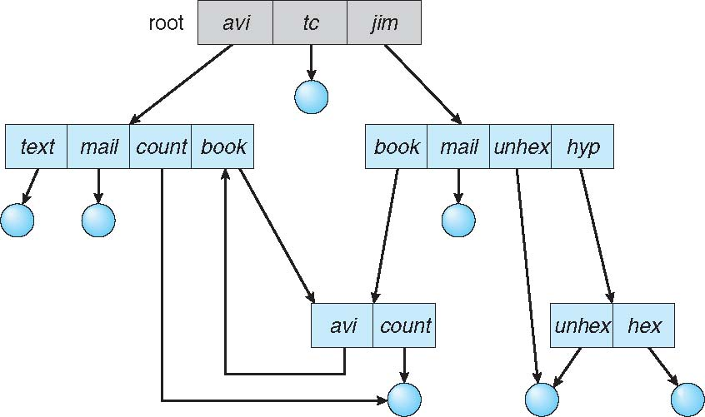
General Graph Directory

Slide 48
File System Mounting
A file system must be mounted before it can be accessed
A unmounted file system (i.e., Fig)is mounted at a mount point

Slide 49
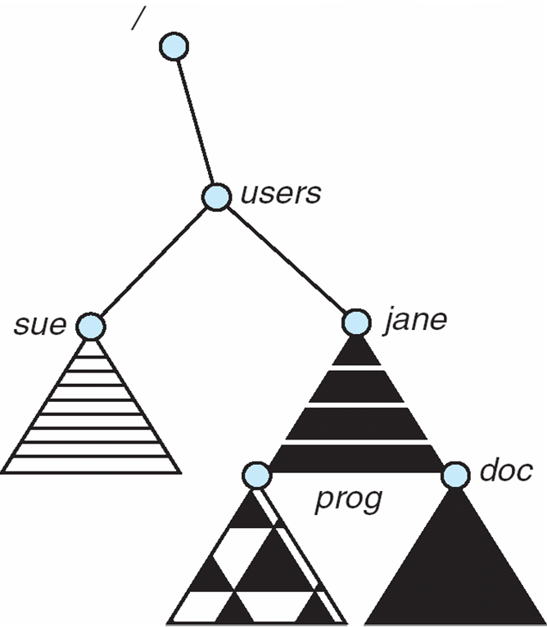
Mount Point

Slide 50
File Sharing
Sharing of files on multi-user systems is desirable
Sharing may be done through a protection scheme
On distributed systems, files may be shared across a network
Network File System (NFS) is a common distributed file-sharing method
If multi-user system
User IDs identify users, allowing permissions and protections to be per-user Group IDs allow users to be in groups, permitting group access rights
Owner of a file / directory
Group of a file / directory

Slide 51
File Sharing – Remote File Systems
Uses networking to allow file system access between systems
Manually via programs like FTP
Automatically, seamlessly using distributed file systems
Semi automatically via the world wide web
Client-server model allows clients to mount remote file systems from servers
Server can serve multiple clients
Client and user-on-client identification is insecure or complicated
NFS is standard UNIX client-server file sharing protocol
Standard operating system file calls are translated into remote calls

Slide 52
File Sharing – Failure Modes
All file systems have failure modes
For example corruption of directory structures or other non-user data, called metadata
Remote file systems add new failure modes, due to network failure, server failure
Recovery from failure can involve state information about status of each remote request
Stateless protocols such as NFS v3 include all information in each request, allowing easy recovery but less security

Slide 53
The Way To Think
FILE SYSTEM IMPLEMENTATION
There are two different aspects to implementing a file system
Data structures
What types of on-disk structures are utilized by the file system to organize its data and metadata?
Access methods
How does it map the calls made by a process as open(), read(), write(), etc.
Which structures are read during the execution of a particular system call?

Slide 54
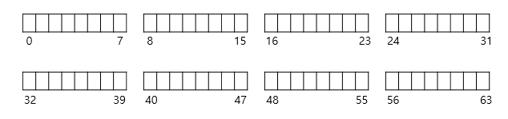
Overall Organization
Let’s develop the overall organization of the file system data structure.
Divide the disk into blocks.
Block size is 4 KB.
The blocks are addressed from 0 to N -1.

Slide 55
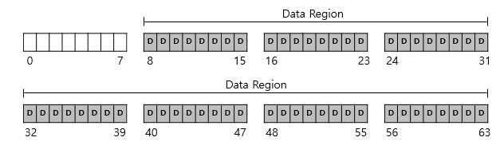
Data region in file system
Reserve data region to store user data
The file system has to track which data blocks comprise a file, its size, its owner, etc.

Slide 56
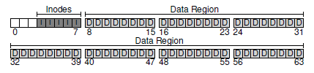
Inode table in the file system
Reserve some space for inode table
This holds an array of on-disk inodes.
Ex) inode tables : 3 ~ 7, inode size : 256 bytes
4-KB block can hold 16 inodes.
The file system contains 80 inodes. (maximum number of files)

Slide 57
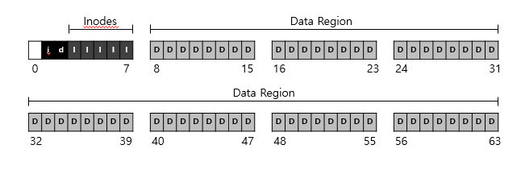
allocation structures
This is to track whether inodes or data blocks are free or allocated.
Use bitmap, each bit indicates free(0) or in-use(1)
data bitmap: for data region for data region
inode bitmap: for inode table

Slide 58
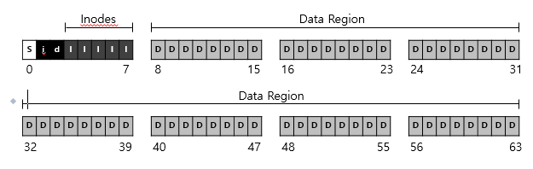
Superblock
Super block contains this information for particular file system
Ex) The number of inodes, begin location of inode table. etc
Thus, when mounting a file system, OS will read the superblock first, to initialize various information.

Slide 59
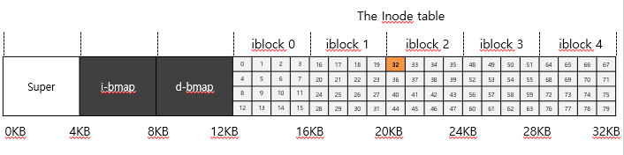
File Organization: The inode
Each inode is referred to by inode number.
by inode number, File system calculate where the inode is on the disk.
Ex) inode number: 32
Calculate the offset into the inode region (32 x sizeof(inode) (256 bytes) = 8192
Add start address of the inode table(12 KB) + inode region(8 KB) = 20 KB

Slide 60
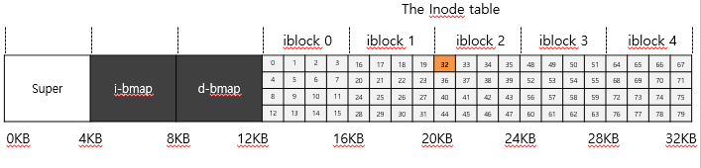
File Organization: The inode (Cont.)
Disk are not byte addressable, sector addressable.
Disk consist of a large number of addressable sectors, (512 bytes)
Ex) Fetch the block of inode (inode number: 32)
Sector address iaddr of the inode block:
blk : (inumber * sizeof(inode)) / blocksize
sector : (blk * blocksize) + inodeStratAddr ) /sectorsize

Slide 61
File Organization: The inode (Cont.)
inode have all of the information about a file
File type (regular file, directory, etc.),
Size, the number of blocks allocated to it.
Protection information(who ones the file, who can access, etc).
Time information.
Etc.

Slide 62
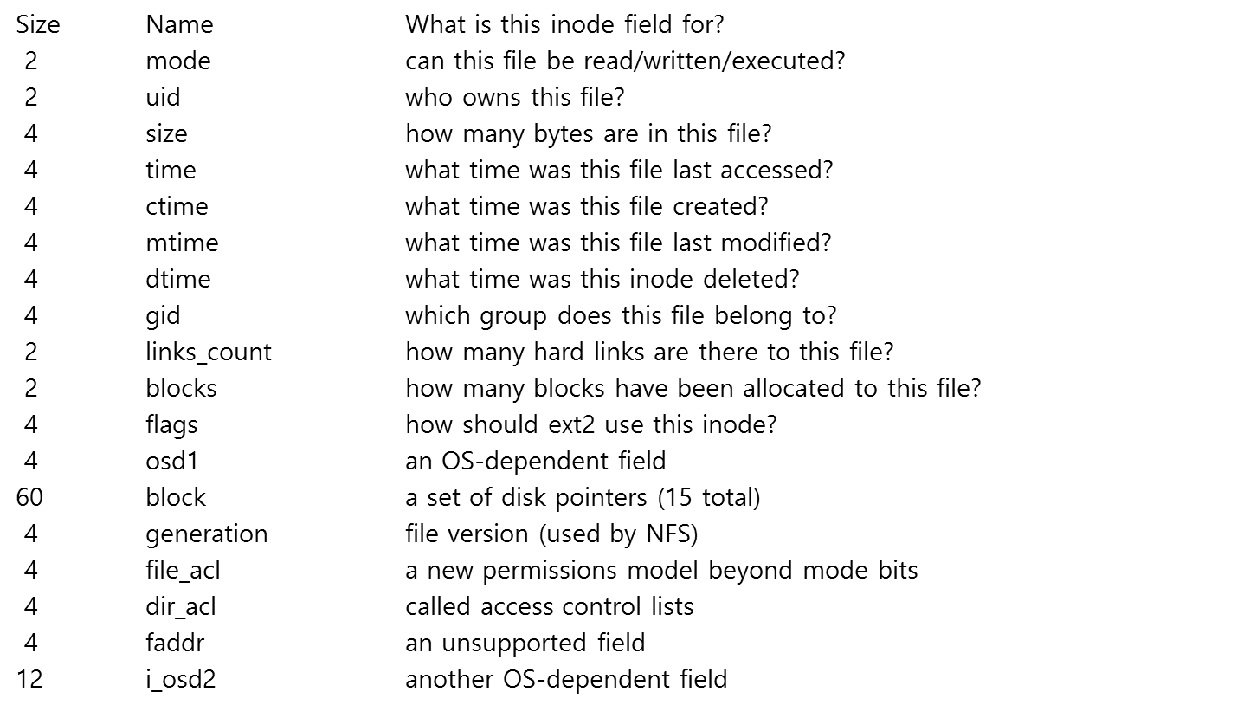
File Organization: The inode (Cont.)

Slide 63
The Multi-Level Index
To support bigger files, we use a multi-level index.
Indirect pointer points to a block that contains more pointers.
Inode have a fixed number of direct pointers (12) and a single indirect pointer.
If a file grows large enough, an indirect block is allocated, and the inode’s slot for an indirect pointer is set to point to it.
(12 + 1024) x 4 K or 4144 KB

Slide 64
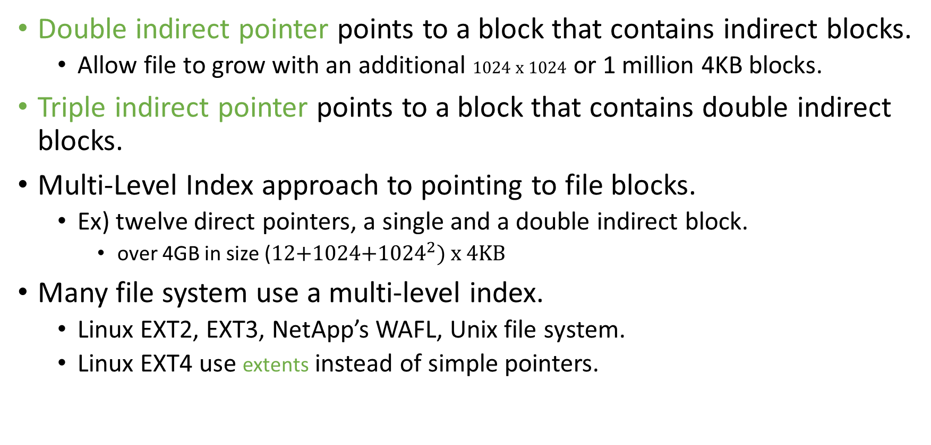
The Multi-Level Index (Cont.)

Slide 65
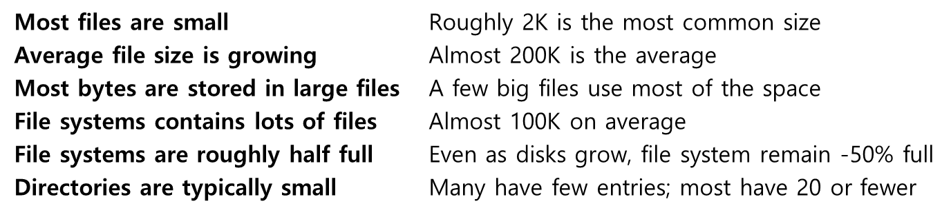
The Multi-Level Index (Cont.)
File System Measurement Summary

Slide 66
Directory Organization
Directory contains a list of (entry name, inode number) pairs.
Each directory has two extra files .”dot” for current directory and ..”dot-dot” for parent directory
For example, dir has three files (foo, bar, foobar)
inum | reclen | strlen | name
5 4 2 .
2 4 3 ..
12 4 4 foo
13 4 4 bar
24 8 7 foobar

Slide 67
Free Space Management
File system tracks which inode and data block are free or not.
To manage free space, we have two simple bitmaps.
When a file is newly created, it is allocated inode by searching the inode bitmap and updating the on-disk bitmap.
Pre-allocation policy is commonly used to allocate contiguous blocks.

Slide 68
Access Paths: Reading a File From Disk
Issue an open(“/foo/bar”, O_RDONLY),
Traverse the pathname and thus locate the desired inode.
Begin at the root of the file system (/)
In most Unix file systems, the root inode number is 2
Filesystem reads in the block that contains inode number 2.
Look inside of it to find a pointer to data blocks (contents of the root).
By reading in one or more directory data blocks, It will find the “foo” directory.
Traverse recursively the path name until the desired inode (“bar”)
Check final permissions, allocate a file descriptor for this process, and return the file descriptor to the user.

Slide 69
Access Paths: Reading a File From Disk (Cont.)
Issue read() to read from the file.
Read in the first block of the file, consulting the inode to find the location of such a block.
Update the inode with a new last accessed time.
Update in-memory open file table for file descriptor, the file offset.
When file is closed:
File descriptor should be deallocated, but for now, that is all the file system really needs to do. No dis I/Os take place.

Slide 70
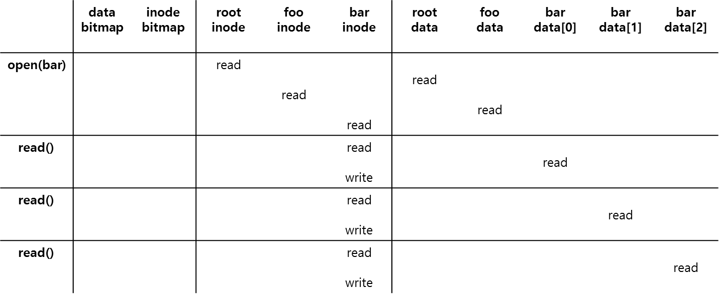
Access Paths: Reading a File From Disk (Cont.)
File Read Timeline (Time Increasing Downward)

Slide 71
Access Paths: Writing to Disk
Issue write() to update the file with new contents.
File may allocate a block (unless the block is being overwritten).
Need to update data block, and data bitmap.
It generates five I/Os:
one to read the data bitmap
one to write the bitmap (to reflect its new state to disk)
two more to read and then write the inode
one to write the actual block itself.
To create files, it also allocates space for the directory, causing high I/O traffic.

Slide 72
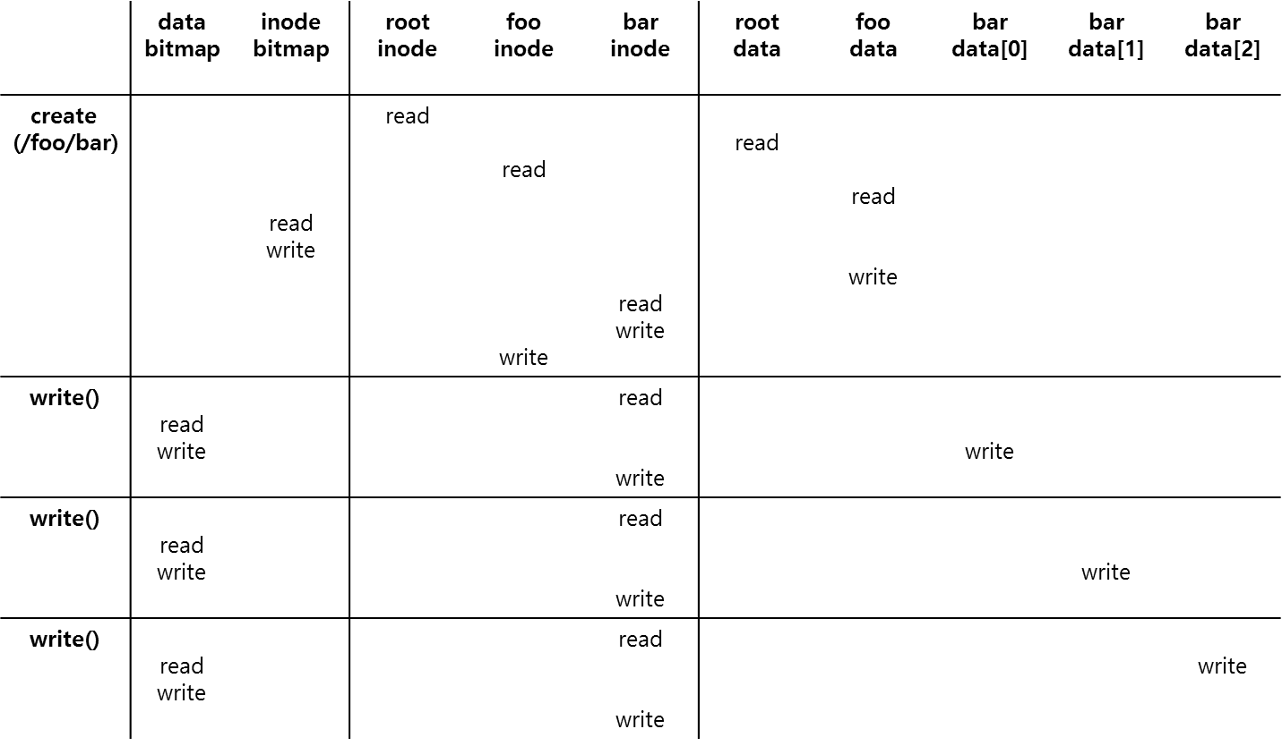
Access Paths: Writing to Disk (Cont.)
File Creation Timeline (Time Increasing Downward)

Slide 73
Caching and Buffering
Reading and writing files are expensive, incurring many I/Os.
For example, long pathname(/1/2/3/…./100/file.txt)
One to read the inode of the directory and at least one read its data.
perform hundreds of reads just to open the file.
To reduce I/O traffic, file systems aggressively use system memory(DRAM) to cache.
Early file systems use fixed-size cache to hold popular blocks.
Static partitioning of memory can be wasteful;
Modem systems use a dynamic partitioning approach, a unified page cache.
Read I/O can be avoided by large cache.

Slide 74
Caching and Buffering (Cont.)
Write traffic has to go to disk for persistence, Thus, cache does not reduce write I/Os.
File system uses write buffering for write performance benefits.
delaying writes (file system batch some updates into a smaller set of I/Os).
By buffering a number of writes in memory, the file system can then schedule the subsequent I/Os.
By avoiding writes
Some applications force flush data to disk by calling fsync() or direct I/O.

Slide 75
Protection
File owner/creator should be able to control:
what can be done
by whom
Types of access
Read
Write
Execute
Append
Delete
List

Slide 76
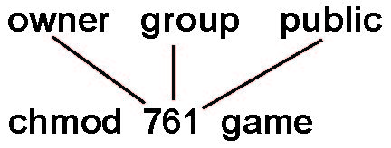
Access Lists and Groups
Mode of access: read, write, execute
Three classes of users on Unix / Linux
RWX
a) owner access 7 ⇒ 1 1 1 RWX
b) group access 6 ⇒ 1 1 0
RWX
c) public access 1 ⇒ 0 0 1
Ask manager to create a group (unique name), say G, and add some users to the group.
For a particular file (say game) or subdirectory, define an appropriate access.
Attach a group to a file chgrp G game

Slide 77
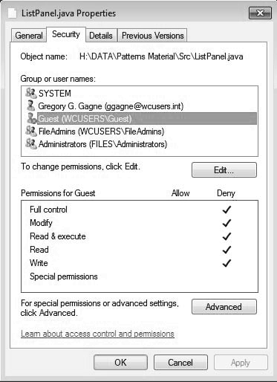
Windows 7 Access-Control List Management

Slide 78
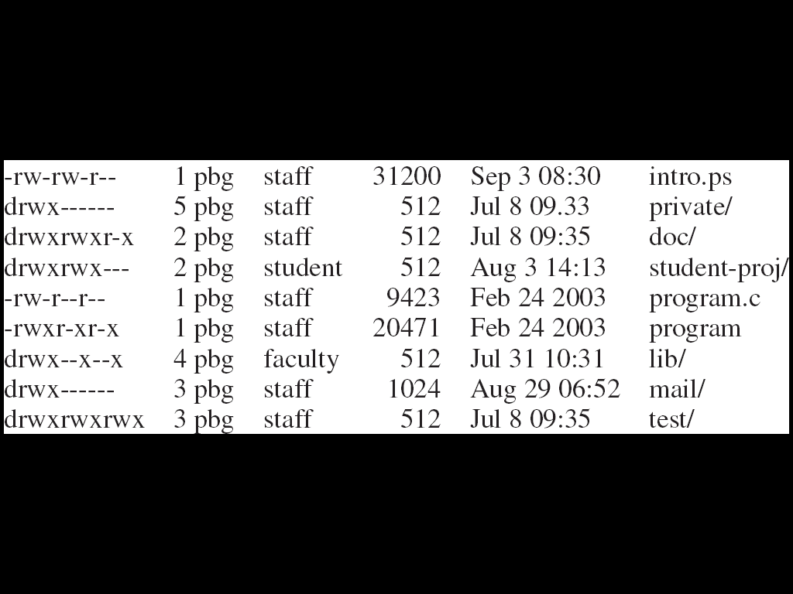
UNIX Directory Listing

Slide 79

THANK YOU
Team – Operating System

