Slide 1
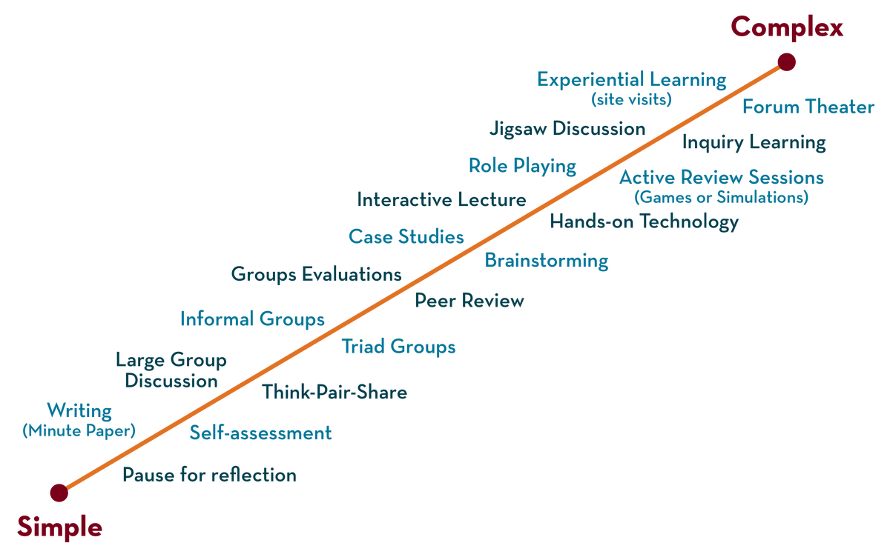
COURSE NAME: Operating Systems COURSE CODE: 23CS2104R/a
CO4
Session - 5
DATA INTEGRITY AND PROTECTION,
DISTRIBUTED SYSTEMS

Slide 2
AIM OF THE SESSION
To familiarize students with the basic concept of Data Integrity and Distributed Systems.
INSTRUCTIONAL OBJECTIVES
This Session is designed to:
Demonstrate what is meant by Data Integrity.
Demonstrate what is meant by Protection.
Describes the types of Protection Mechanisms.
Describe the Distributed Systems.
LEARNING OUTCOMES
At the end of this session, you should be able to:
Defines what Data Integrity.
Describe Distributed Systems.
Summarize the Role of Data Integrity and Protection.

Slide 3
Disk Failure Modes
The overall precision, completeness, and continuity of data is known as data integrity.
LSEs arise when a disk sector (or group of sectors) has been damaged in some way
For example, if the disk head touches the surface for some reason (a head crash,
A disk block becomes corrupt in a way not detectable by the disk itself)
Common and worthy of failures are the frequency of latent-sector errors(LSEs) and block corruption.
 | Cheap | Costly
LSEs | 9.40% | 1.40%
Corruption | 0.50% | 0.05%
Frequency of LSEs and Block Corruption

Slide 4
Disk Failure Modes (Cont.)
Frequency of latent-sector errors(LSEs)
Costly drives with more than one LSE are as likely to develop additional.
For most drives, annual error rate increases in year two
LSEs increase with disk size
Most disks with LSEs have less than 50
Disks with LSEs are more likely to develop additional LSEs
There exists a significant amount of spatial and temporal locality
Disk scrubbing is useful (most LSEs were found this way)

Slide 5
Disk Failure Modes (Cont.)
Block corruption:
Chance of corruption varies greatly across different drive models
Within the same drive class
Age effects are different across models
Workload and disk size have little impact on corruption
Most disks with corruption only have a few corruptions
Corruption is not independent with a disk or across disks in RAID
There exists spatial locality, and some temporal locality
There is a weak correlation with LSEs

Slide 6
Handling Latent Sector Errors
Latent sector errors are easily detected and handled.
Using redundancy mechanisms:
In a mirrored RAID or RAID-4 and RAID-5 system based on parity, the system should reconstruct the block from the other blocks in the parity group.

Slide 7
Detecting Corruption: The Checksum
How can a client tell that a block has gone bad?
Using Checksum mechanisms:
This is simply the result of a function that takes a chunk of data as input and computes a function over said data, producing a small summary of the contents of the data.

Slide 8
Common Checksum Functions (Cont.)
Different functions are used to compute checksums and vary in strength.
One simple checksum function that some use is based on exclusive or(XOR).
XOR is a reasonable checksum but has its limitations.
Two bits in the same position within each check summed unit changed the checksum will not detect the corruption.
365e c4cd ba14 8a92 ecef 2c3a 40be f666
If we view them in binary, we get the following:
0011 0110 0101 1110 1100 0100 1100 1101
1011 1010 0001 0100 1000 1010 1001 0010
1110 1100 1110 1111 0010 1100 0011 1010
0100 0000 1011 1110 1111 0110 0110 0110
It is easy to see what the resulting checksum will be:
0010 0000 0001 1011 1001 0100 0000 0011
The result, in hex, is 0x201b9403.

Slide 9
Common Checksum Functions (Cont.)
Addition Checksum
This approach has the advantage of being fast.
Compute 2’s complement addition over each chunk of the data
ignoring overflow
Fletcher Checksum
Compute two check bytes, s1 and s2.
Assuming a block D consists of bytes d1…dn; s1 is simply in turn is
s1 = s1 + di mod 255(compute overall di);
s2 = s2 + s1 mod 255(again over all di);
Cyclic redundancy check(CRC)
Treating D as a large binary number and dividing it by an agreed-upon value.
The remainder of this division is the value of the CRC.

Slide 10
Checksum Layout
The disk layout without checksum:
The disk layout with checksum:
Store the checksums packed into 512-byte blocks.
D0 | D1 | D2 | D3 | D4 | D5 | D6
D0 | D1 | D2 | D3 | D4
C[D0]
C[D1]
C[D2]
C[D3]
C[D4]
D0 | D1 | D2 | D3 | D4
C[D0]
C[D1]
C[D2]
C[D3]
C[D4]

Slide 11
Using Checksums
When reading a block D, the client reads its checksum from disk
Cs(D), stored checksum.
Computes the checksum over the retrieved block D
computed checksum Cc(D).
Compares the stored and computed checksums;
If they are equal (Cs(D) == Cc(D)), the data is in safe.
If they do not match (Cs(D) != Cc(D)), the data has changed since the time it was stored (since the stored checksum reflects the value of the data at that time).

Slide 12
A New Problem: Misdirected Writes
Modern disks have a couple of unusual failure modes that require different solutions.
Misdirected write arises in disk and RAID controllers which the data to disk correctly, except in the wrong location
D0
D1
D2
Disk 1
C[D0]
disk=1
C[D0]
disk=1
C[D0]
block=0
block=1
disk=1
block=2
D0
D1
D2
Disk 0
C[D0]
disk=1
C[D0]
disk=1
C[D0]
block=0
block=1
disk=1
block=2

Slide 13
One Last Problem: Lost Writes
some modern storage devices also have an issue known as a lost write, which occurs when the device informs the upper layer that a write has completed but in fact, it never is persisted; thus, what remains is the old contents of the block rather than the updated new contents.
There are several possible solutions:
One classic approach is to perform a write verify or read-after-write; by immediately reading back the data after a write
A system can ensure that the data indeed reached the disk surface.
This approach, however, is quite slow,.
Doubling the number of I/Os needed to complete a write.

Slide 14
Scrubbing
When do these checksums get checked?
Most data is rarely accessed and thus remains unchecked.
To remedy this problem, many systems utilize disk scrubbing.
By periodically reading through every block of the system
Checking whether checksums are still valid
Reduce the chances that all copies of certain data become corrupted

Slide 15
Overhead of Check summing
Two distinct kinds of overheads: space and time
Space overheads
Disk itself: A typical ratio might be an 8-byte checksum per 4KB data block, for a 0.19% on-disk space overhead.
Memory of the system: This overhead is short-lived and not much of a concern.
Time overheads
CPU must compute the checksum over each block
To reduce CPU overheads, combine data copying and checksumming into one streamlined activity.

Slide 16
Distributed Systems
A distributed system is a network that consists of autonomous computers that are connected using a distribution middleware.
Distribution Middleware help in sharing different resources and capabilities to provide users with a single and integrated coherent network.
Example
Client/server distributed system (Web browser connects to a web server).
Connecting to Google or Facebook.
Not just interacting with a single machine, however; behind the scenes, these complex services are built from a large collection (i.e., thousands) of machines, each of which cooperate to provide the particular service of the site.

Slide 17
Distributed Systems
Challenges
Complexity – Thousands of machines
Failure (machines, disks, networks, and software all fail from time to time)
Performance(reduce the number of messages to exchange)
Security
Communication

Slide 18
Communication
Unreliable Communication Layers
-UDP
Reliable Communication
- TCP/IP

Slide 19
Packet Loss
Packets are regularly lost, corrupted, or otherwise do not reach their destination.
During transmission, some bits get flipped due to electrical or other similar problems.
Network link or packet router or even the remote host, are damaged or otherwise not working correctly;
Network cables do accidentally get severed, at least sometimes.

Slide 20
User Datagram Protocol(UDP)
How to deal with packet loss in an unreliable communication layer?
A process uses the sockets API to create a communication endpoint;
Processes on other machines send UDP datagrams (a datagram is a fixed-sized message up to some max size)to the original process.
UDP includes a checksum to detect some forms of packet corruption.

Slide 21
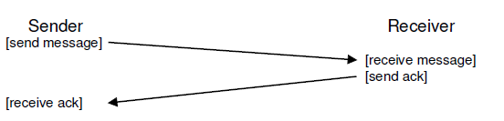
Transmission Control Protocol/ Internet Protocol (TCP/IP)
Techniques to handle packet loss
Acknowledgment, or ack for short.
The idea is simple: the sender sends a message to the receiver;
The receiver then sends a short message back to acknowledge its receipt
Message Plus Acknowledgment

Slide 22
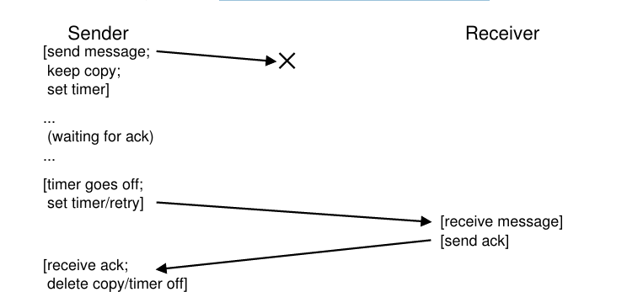
Dropped Request
Message Plus Acknowledgment: Dropped Request

Slide 23
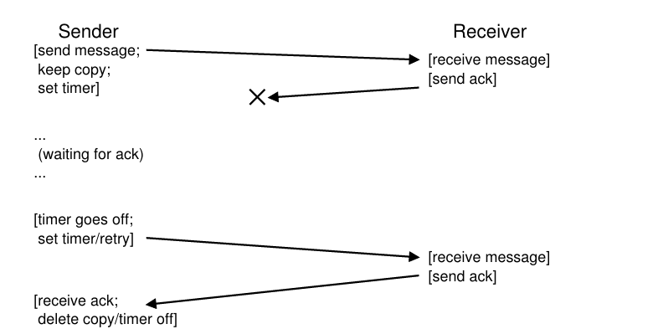
Dropped Reply
Message Plus Acknowledgment: Dropped Reply

Slide 24
Communication Abstractions
Distributed Shared Memory - distributed shared memory (DSM) systems enable processes on different machines to share. This abstraction turns a distributed computation into something that looks like a multi-threaded application; the only difference is that these threads run on different machines instead of different processors within the same machine a large, virtual address space
Remote Procedure Call (RPC) - Remote procedure call packages all have a simple goal: to make the process of executing code on a remote machine as simple and straightforward as calling a local function.

Slide 25
Distributed Shared Memory(DSM)
Systems enable processes on different machines to share a large, virtual address space.
When a page is accessed on one machine, two things can happen.
In the first (best) case, the page is already local on the machine, and thus the data is fetched quickly.
In the second case, the page is currently on some other machine. A page fault occurs, and the page fault handler sends a message to some other machine to fetch the page, install it in the page table of the requesting process, and continue execution.
This approach is not widely in use today for a number of reasons.

Slide 26
Distributed Shared Memory(DSM)
Problems
Failure
If a machine fails
what happens to the pages on that machine?
what if the data structures of the distributed computation are spread across the entire address space?
Performance.
Page faults
Fetches from remote machines.

Slide 27
Remote Procedure Call(RPC)
Simple goal: To make the process of executing code on a remote machine as simple as calling a local function.
To a client, a procedure call is made, and sometime later, the results are returned.
The server simply defines some routines that it wishes to export.
The rest of the magic is handled by the RPC system
Stub generator (sometimes called a protocol compiler), and
Run-time library.

Slide 28
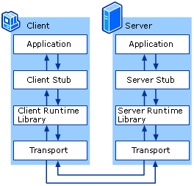
RPC

Slide 29
Functions in the Stub
Create a message buffer
Pack the needed information into the message buffer(marshaling of arguments or the serialization of the message)
Send the message to the destination RPC server
Wait for reply
Unpack return code and other arguments(unmarshaling or deserialization.)
Return to caller

Slide 30
Server actions
Unpack the message (un marshaling)
Call into the actual function
Package the results
Send the reply

Slide 31
Runtime Library
The run-time library handles Performance and Reliability issues
How to locate a remote service. (Problem of naming) - hostnames and port numbers
The client must know the hostname or IP address of the machine running the desired RPC service, as well as the port number it is using (a port number is just a way of identifying a particular communication activity taking place on a machine, allowing multiple communication channels at once).
Which transport-level protocol should RPC be built upon.
TCP/IP or UDP?

Slide 32
TCP/IP or UDP in RPC
In TCP/IP -
When the client sends an RPC request to the server, the server responds with an acknowledgment so that the caller knows the request was received.
Similarly, when the server sends the reply to the client, the client acks it so that the server knows it was received.
By building a request/response protocol (such as RPC) on top of a reliable communication layer, two “extra” messages are sent.
For this reason, many RPC packages are built on top of unreliable communication layers, such as UDP.
Doing so enables a more efficient RPC layer, but does add the responsibility of providing reliability to the RPC system.
The RPC layer achieves the desired level of responsibility by using timeout/retry and acknowledgments.

Slide 33

THANK YOU
Team – Operating System

