Slide 1

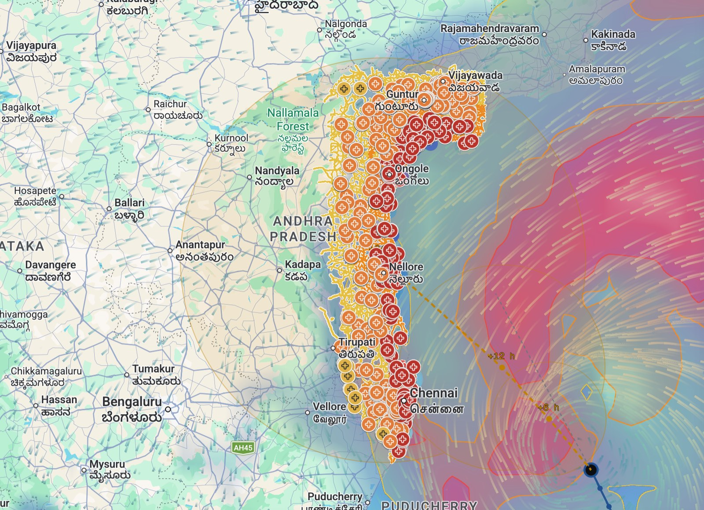

BUILD WITH AI: CODE FOR COMMUNITIES 2.0
SurgeSight
See a cyclone’s impact before it reaches the coast.
Problem Statement 05 · Track-Based Cyclone Impact & Infrastructure Vulnerability Forecaster
TEAM ECHO
Built with
Gemini
Earth Engine
Google Maps
Cloud Run
Charan · Vishal
Notes:
Hi, we are Team Echo: Charan and Vishal. Our project is SurgeSight: it lets district officials see a cyclone’s impact on schools, hospitals, power and roads before it reaches the coast. It is built on Gemini, Earth Engine, Google Maps and Cloud Run.

Slide 2







THE PROBLEM & THE CHALLENGE
Forecasts tell us where a cyclone will go. They don’t tell an officer what it will hit.
THE CHALLENGE
THE PROBLEM
Turn one cyclone forecast into answers every department can act on, before landfall:
IMD issues good cyclone forecasts. But before landfall, a District Collector and every department still work out by phone calls and spreadsheets what that track means for their schools, hospitals, power lines, roads and people.
Which schools and hospitals will be hit hardest, and why?
Which roads to a hospital could be cut off?
What changes if the track shifts 30 km north?
FORECAST
?
ACTION
What should Health do, and what should Electricity do?
The missing layer is consequence.
How do we warn people in Tamil, Telugu or Odia?
Team Echo · SurgeSight
2
Notes:
The problem: IMD’s forecasts are good, but they stop at the storm. Before landfall a District Collector and each department still have to work out, by phone and spreadsheet, what that track means for schools, hospitals, power, roads and people. The challenge is to turn one forecast into answers each department can act on: which facilities and why, which roads, what if the track shifts, what each department should do, and how to say it in the local language.

Slide 3





OUR SOLUTION
To solve it, we built SurgeSight: from one cyclone bulletin to approved action, in five steps.
1 Read
2 Score
3 Show
4 Advise
5 Approve
Gemini reads the IMD bulletin: text, PDF or photo
Every facility and main road is scored for wind, surge and rain
Alerted schools, hospitals and roads on the map, each with its reason
Gemini writes each department’s advisory in its own language
An officer approves, then alerts go out by email and phone
Gemini
Earth Engine
Google Maps
Gemini
Gmail · Firebase
Numbers come from our models. Words come from Gemini. Every number Gemini writes is checked against our data.
Team Echo · SurgeSight
3
Notes:
To solve it, we built SurgeSight. Five steps: Gemini reads the IMD bulletin. Our model scores every facility and main road for wind, surge and rain using Earth Engine data. The map shows the alerted schools, hospitals and roads, each with its reason. Gemini writes each department’s advisory in its own language. And an officer approves before anything is sent. Numbers come from our models, words from Gemini, and every number Gemini writes is checked.

Slide 4
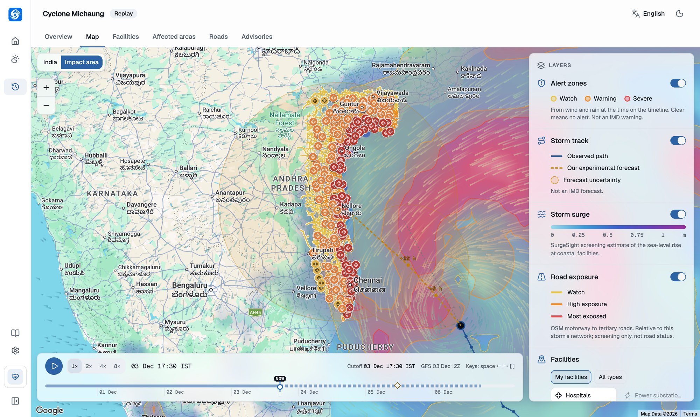



CASE STUDY
To study and test SurgeSight, we replayed Cyclone Michaung (December 2023) bulletin by bulletin.
Severe Cyclonic Storm Michaung crossed the Andhra Pradesh coast near Bapatla on 5 December 2023, after extreme rain flooded Chennai.
WHY WE CHOSE IT
Two states, two languages
Tamil Nadu and Andhra Pradesh, dense cities and long coast
Open data to check ourselves
IBTrACS track, NOAA GFS, NASA IMERG, Sentinel-2 floods
An honest replay
Each screen shows only what was known at that bulletin
4,214
critical facilities
33,930 km
main roads
10.5 M
people in priority area
7
departments
Our replay of Michaung on Google Maps at the 03 Dec 17:30 IST bulletin.
Team Echo · SurgeSight
4
Notes:
To study and test SurgeSight, we replayed a real storm: Cyclone Michaung, December 2023, which crossed the Andhra Pradesh coast near Bapatla after extreme rain flooded Chennai. We chose it because it spans two states and two languages, and because open data (IBTrACS, NOAA GFS, NASA IMERG and Sentinel-2) let us check our estimates against what really happened. The replay only shows what was known at each bulletin.

Slide 5
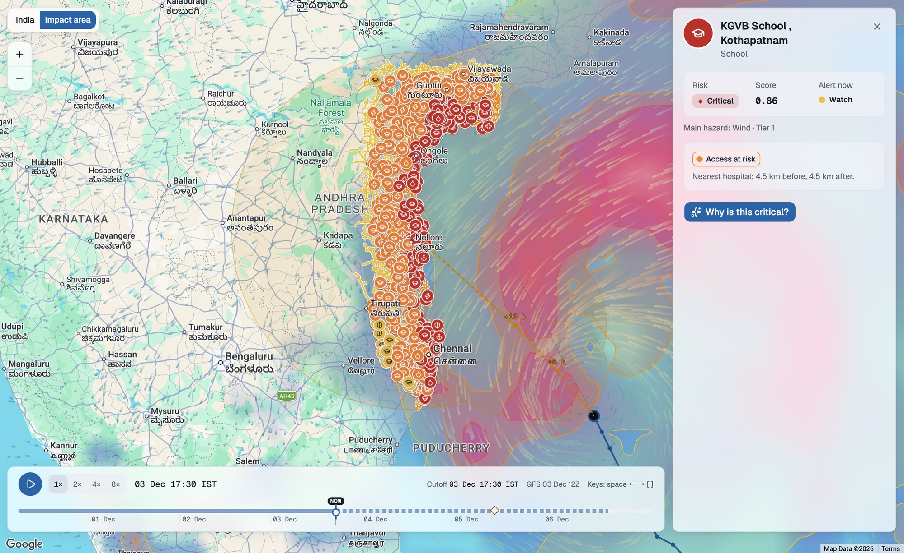




FEATURE 1 · THE IMPACT MAP
Every school, hospital and substation under the storm, on one map, coloured by risk.
4,214 facilities, 8 types
Schools, hospitals, substations, shelters, police, fire, water, harbours, from Low to Critical
Alert zones
Watch, warning and severe areas from wind and rain, moving with the storm
Track and forecast
Observed path, our experimental forecast and its uncertainty
Roads to check
33,930 km of main roads by exposure; hospitals whose access is cut off
Tap any facility (here KGVB School, Kothapatnam) to see why it was alerted.
Team Echo · SurgeSight
5
Notes:
Feature one is the impact map, built on Google Maps. Every school, hospital, substation, shelter, police and fire station, water works and fishing harbour under the storm is coloured from low to critical. Alert zones move with the storm, you see the observed track and our experimental forecast with its uncertainty, and the road layer shows which main roads to check. Tap any facility, here a school in Kothapatnam, and SurgeSight tells you why it was alerted.

Slide 6
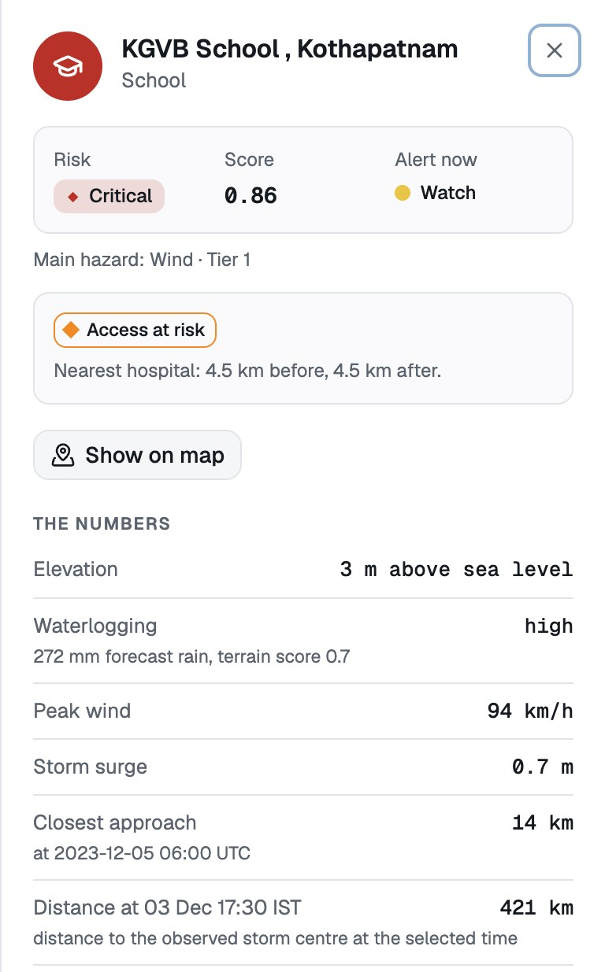
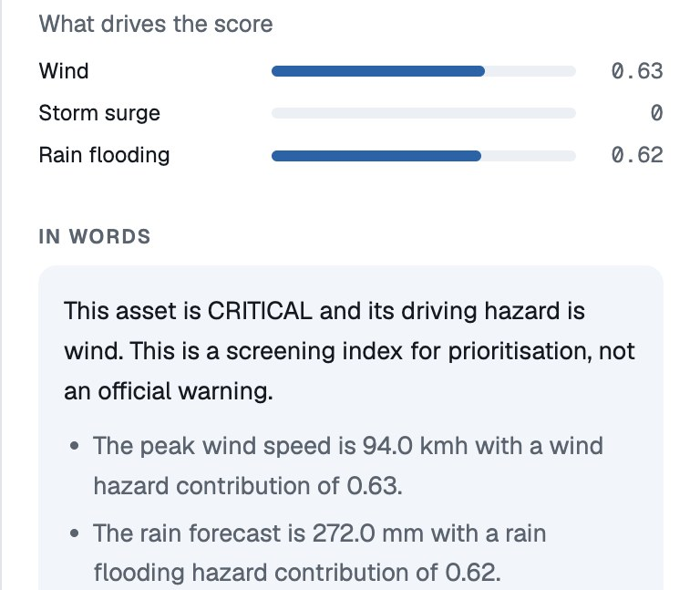

FEATURE 2 · WHY WAS IT ALERTED?
Every alert comes with its reason: the numbers first, then Gemini’s words.
1
2
1
The numbers
Our models and Earth Engine: 3 m above sea level, 272 mm of forecast rain, 94 km/h peak wind, 14 km from the track.
3
2
What drives the score
Wind 0.63 and rain flooding 0.62 make this school Critical, in the top priority tier.
3
In words, by Gemini
Road access too
A plain-language reason for the officer. Every number Gemini writes is checked against the table; any it cannot back up is removed.
Access at risk: the nearest hospital is 4.5 km away, and the main roads to it are exposed.
Team Echo · SurgeSight
6
Notes:
Feature two answers the question every officer asks: why was this alerted? For KGVB School in Kothapatnam, the panel shows the numbers first: 3 metres above sea level, 272 millimetres of forecast rain, 94 km/h peak wind, 14 km from the track. Then it shows what drives the score: wind and rain flooding, making it Critical. Then Gemini explains it in plain words, and every number it writes is checked against the table. It also flags that road access to the nearest hospital is at risk.

Slide 7






FEATURE 3 · GEMINI AT WORK
What Gemini does in SurgeSight.
Reads
Explains
Advises
Turns an IMD bulletin (text, PDF or photo) into a storm track.
Tells officers why each school or hospital was alerted, and what changes in a what-if.
Writes an action plan for each of 7 departments, from the ranked facilities and roads.
Speaks six languages
Reasons with tools
Searches
English, Hindi, Tamil, Telugu, Bengali and Odia, with audio from Cloud Text-to-Speech.
An agent team built with ADK picks from 29 tools to answer questions like “what if?”
Finds the latest bulletins and news with Google Search, with sources.
Gemini 3.7 Flash on Vertex AI · It never calculates the risk: our models do. A guard removes any number Gemini cannot back up.
Team Echo · SurgeSight
7
Notes:
Here is what Gemini does. It reads bulletins, even photos of them. It explains why each facility was alerted and what changes in a what-if. It writes an action plan for each department. It speaks six Indian languages, with audio. As an ADK agent team it picks from 29 tools to answer questions. And it searches for the latest bulletins with Google Search. What it never does is calculate the risk. Our models do that, and a guard removes any number Gemini cannot back up.

Slide 8
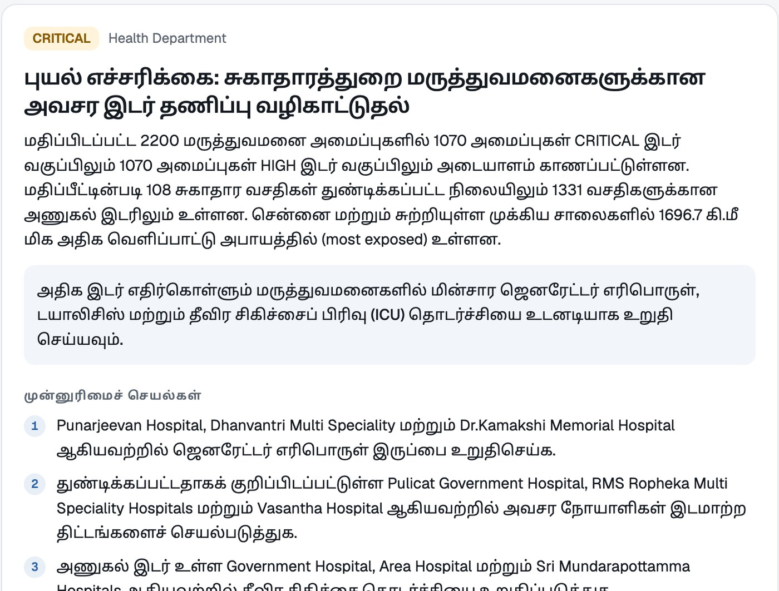




FEATURE 4 · ADVISORIES & ALERTS
Each department gets its own advisory, in its own language, sent only when a person approves.
Gemini drafts
7 departments × 6 languages
Audio + CAP 1.2 alert
Cloud Text-to-Speech · standard alert format
An officer approves
Nothing is sent automatically
Sent to the team
Gmail and phone push (Firebase)
Health Department advisory, written by Gemini in Tamil.
Team Echo · SurgeSight
8
Notes:
Feature four: every department gets its own advisory, written by Gemini from the ranked facilities and roads, in its own language. Here is the Health Department in Tamil. Each comes with audio from Cloud Text-to-Speech and a standard CAP 1.2 alert. Nothing is sent until an officer approves it; then it goes out by Gmail and phone push notification.

Slide 9
HOW IT WORKS
Our models compute the risk. Gemini explains it. Both are checked against real data.
DATA IN
RISK MODELS
GEMINI AGENTS
OUT
IMD bulletin
Wind · surge · rain flooding
Gemini 3.7 Flash + ADK
Map with reasons
Earth Engine · 10 datasets
Road exposure · hospital access
29 tools
Advisories · 6 languages
OpenStreetMap · 4,214 facilities
100-run ensemble · what-if
Number guard
Approved alerts
CHECKED AGAINST WHAT REALLY HAPPENED IN MICHAUNG
27.6 km
0.71
2×
average error of our 6-hour track forecast
match between forecast rain and NASA’s observed rain
satellites saw water twice as often on the roads we flagged
Team Echo · SurgeSight
9
Notes:
How it works: data comes in from the IMD bulletin, ten Earth Engine datasets and OpenStreetMap. Our risk models compute wind, surge and rain flooding, road exposure, hospital access, a 100-run ensemble and what-ifs. Gemini 3.7 Flash with the Agent Development Kit uses 29 tools to explain and advise, behind a number guard. And we checked it against what really happened: a 27.6 km average error on our 6-hour track forecast, forecast rain that matches NASA’s observed rain with a correlation of 0.71, and twice as much satellite-observed flooding on the roads we flagged.

Slide 10





BUILT ON GOOGLE
23 Google services, running on Cloud Run today.
AI
Gemini 3.7 Flash
Vertex AI
Gemini Live
Live on Cloud Run
Agent Development Kit
Search grounding
Text-to-Speech
Speech-to-Text
One container, asia-south1
MAPS & EARTH
Earth Engine
Maps JavaScript
Places
Routes
Scales to zero; scales out on a storm day
Geocoding
Weather
Weather refreshes itself
Cloud Scheduler runs a job every 3 hours
DATA
BigQuery GIS
Firestore
Cloud Storage
Keys stay secret
ALERTS
Gmail API
Firebase Messaging
Firebase Auth
Secret Manager and a dedicated service account
PLATFORM
Cloud Run
Cloud Scheduler
Secret Manager
A new state is a config file
Cloud Build
Artifact Registry
Same app, models and agents for any coast
Team Echo · SurgeSight
10
Notes:
SurgeSight uses 23 Google services: Gemini on Vertex AI with Gemini Live and the Agent Development Kit, Search grounding and Cloud speech; Earth Engine and the Maps Platform; BigQuery, Firestore and Cloud Storage; Gmail, Firebase Messaging and Auth; and Cloud Run, Scheduler, Secret Manager, Cloud Build and Artifact Registry. It runs today on Cloud Run in Mumbai, refreshes its weather every three hours by itself, and a new state needs only a configuration file.

Slide 11






WHAT’S NEXT
Next: from the control room to every coastal home.
SurgeSight for citizens
Cascading failures
Straight to every phone
“Am I at risk?” in my language, the nearest safe shelter, and a lower-risk route to it.
See which hospitals lose power or water when a substation or pumping station floods.
Send approved CAP alerts to NDMA’s SACHET platform for cell broadcast.
Voice for the last mile
Money before landfall
Learns from every storm
Village officers call in and ask Gemini Live in Tamil, Telugu or Odia.
Parametric triggers release relief funds before the storm hits, not weeks after.
Satellite flood maps after each event retune the model. Then floods and heatwaves too.
Team Echo · SurgeSight
11
Notes:
What’s next. A citizen app: “am I at risk?” in my language, the nearest safe shelter and a lower-risk route. Cascading failures: which hospitals lose power or water when a substation floods. Approved alerts sent to NDMA’s SACHET platform so they reach every phone. Voice for the last mile, so village officers can call in and ask Gemini Live in their language. Money before landfall through parametric triggers. And a model that learns from every storm through satellite flood maps, extending to floods and heatwaves.

Slide 12




WHY IT MATTERS
The right school, hospital and road protected first, before landfall.
District Collectors
A ranked list of what to protect first, with the reason for each.
Hospitals
Fuel, power and patient moves planned before the roads flood.
Power and water boards
Scan to try SurgeSight
Crews sent to the substations and pumps most at risk.
TEAM ECHO
People on the coast
Charan · Vishal
Warnings in their own language, from the officers they trust.
Live app
Demo video: [add link]
Code: [add link]
Michaung: 10.5 M people · 4,214 facilities · 7 departments · 6 languages
Screening, not forecasting · A person approves every alert
Team Echo · SurgeSight
12
Notes:
Why it matters. District Collectors get a ranked list of what to protect first, with a reason for each. Hospitals can plan fuel, power and patient moves before the roads flood. Power and water boards send crews to the assets most at risk. And people on the coast get warnings in their own language. SurgeSight does not replace IMD. It turns forecasts into action before landfall. Thank you. We are Team Echo.

