Slide 1


SurgeSight
See a cyclone’s impact before it reaches the coast.
TEAM ECHO
Charan · Vishal
BUILD WITH AI: CODE FOR COMMUNITIES 2.0 · PROBLEM STATEMENT 05
Notes:
Hi, we are Team Echo: Charan and Vishal. This is SurgeSight. It lets district officials see a cyclone’s impact on schools, hospitals, power and roads before it reaches the coast.

Slide 2

THE PROBLEM
Forecasts tell us where a cyclone will go.
Not what it will hit.
FORECAST
?
ACTION
Which school?
Which hospital?
Which road?
What if the track shifts?
THE CHALLENGE
Turn one cyclone forecast into answers every department can act on, in its own language, before landfall.
TEAM ECHO · SURGESIGHT
2
Notes:
IMD’s forecasts are good, but they stop at the storm. Before landfall a District Collector still has to work out, by phone and spreadsheet, which school, which hospital and which road will be hit, and what changes if the track shifts. The challenge is to turn one forecast into answers every department can act on, in its own language.

Slide 3
OUR SOLUTION
To solve it, we built SurgeSight. One bulletin in. Approved action out.
1
2
3
4
5
Read
Score
Show
Advise
Approve
Gemini
Earth Engine
Google Maps
Gemini
Gmail · Firebase
Gemini reads the IMD bulletin: text, PDF or photo
Every facility and main road scored for wind, surge and rain
Alerted schools, hospitals and roads, each with its reason
Each department’s advisory, in its own language
An officer approves, then alerts go out
Numbers come from our models. Words come from Gemini.
TEAM ECHO · SURGESIGHT
3
Notes:
To solve it, we built SurgeSight: Gemini reads the bulletin, our models score every facility and road with Earth Engine data, the map shows what was alerted and why, Gemini writes each department’s advisory, and an officer approves before anything is sent.

Slide 4
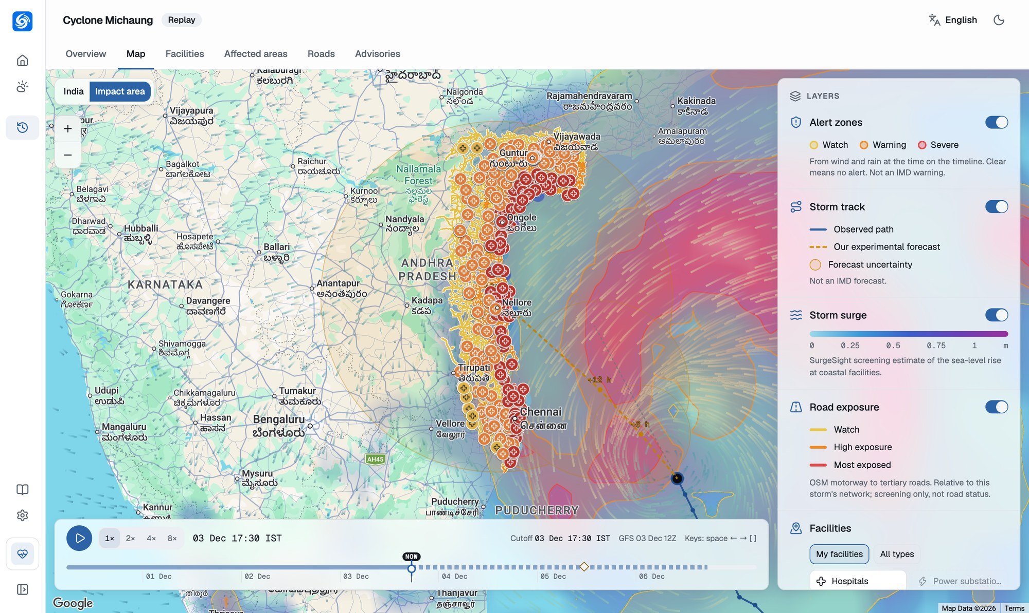
CASE STUDY
Cyclone Michaung
December 2023 · Tamil Nadu and Andhra Pradesh
To study and test SurgeSight, we replayed it bulletin by bulletin, and checked our estimates against open satellite and weather data.
4,214
33,930 km
critical facilities
main roads
10.5 M
7
people in the priority area
departments
Two states, two languages · open data to check ourselves · an honest replay
TEAM ECHO · SURGESIGHT
4
Notes:
To test SurgeSight we replayed Cyclone Michaung, December 2023, in Tamil Nadu and Andhra Pradesh. Under the storm: 4,214 critical facilities, nearly 34,000 km of main roads, 10.5 million people in the priority area, and seven departments that each needed a plan.

Slide 5
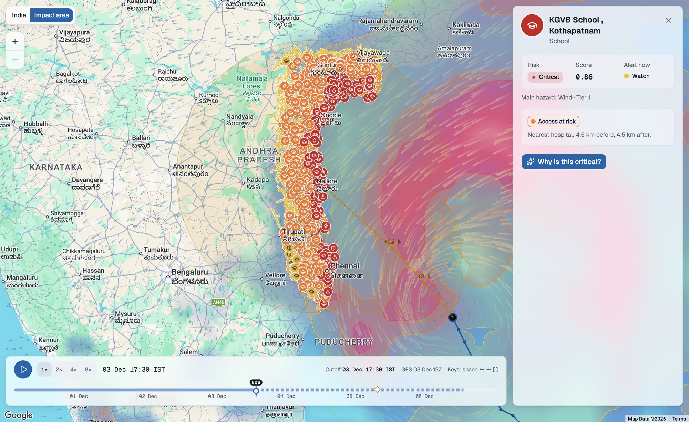




FEATURE 1 · THE IMPACT MAP
Every school, hospital and substation under the storm, coloured by risk.
4,214 facilities, 8 types
Coloured from Low to Critical
Alert zones
Watch, warning and severe, moving with the storm
Track and forecast
Observed path, our forecast and its uncertainty
Roads to check
Main roads by exposure, and cut-off hospitals
TEAM ECHO · SURGESIGHT
5
Notes:
Feature one, the impact map on Google Maps: every facility under the storm is coloured from low to critical, alert zones move with the storm, you see the observed track and our forecast with its uncertainty, and the road layer shows which roads to check.

Slide 6
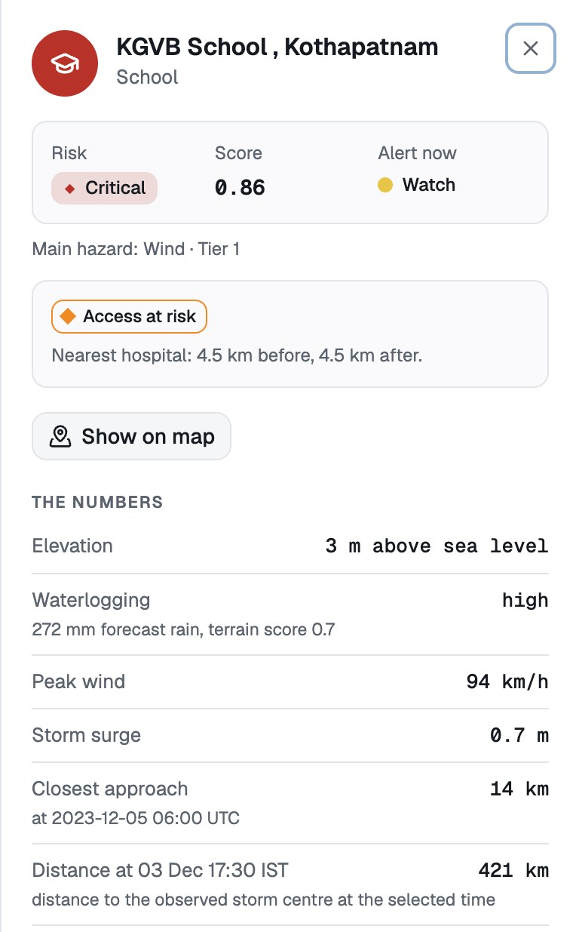
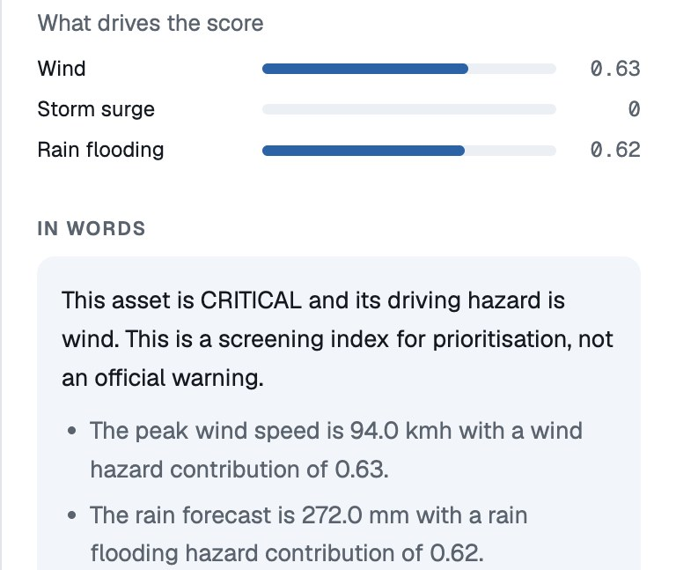

FEATURE 2 · WHY WAS IT ALERTED?
Every alert comes with its reason: the numbers first, then Gemini’s words.
1
2
1
The numbers
3 m above sea level, 272 mm of forecast rain, 94 km/h wind, 14 km from the track.
3
2
What drives it
Wind 0.63 and rain flooding 0.62 make this school Critical.
3
In words, by Gemini
Road access too
Plain language for the officer. Every number is checked against the table.
Access at risk: the nearest hospital is 4.5 km away, over exposed roads.
TEAM ECHO · SURGESIGHT
6
Notes:
Feature two answers why a facility was alerted. For KGVB School in Kothapatnam: the numbers first, then what drives the score, then Gemini’s plain-language reason, with every number checked against the table. It also flags that road access to the nearest hospital is at risk.

Slide 7







FEATURE 3 · GEMINI AT WORK
What Gemini does in SurgeSight.
Reads
Explains
Advises
Turns an IMD bulletin (text, PDF or photo) into a storm track.
Why each school or hospital was alerted, and what a what-if changes.
An action plan for each of 7 departments, from the ranked facilities and roads.
Speaks six languages
Reasons with tools
Searches
English, Hindi, Tamil, Telugu, Bengali and Odia, with audio.
An ADK agent team picks from 29 tools to answer “what if?”
The latest bulletins and news with Google Search, with sources.
Gemini 3.7 Flash on Vertex AI. It never calculates the risk. A guard removes any number it cannot back up.
TEAM ECHO · SURGESIGHT
7
Notes:
Gemini reads bulletins, explains why each facility was alerted, writes each department’s plan, speaks six Indian languages, reasons with 29 tools as an ADK agent team, and searches for the latest bulletins. It never calculates the risk; our models do.

Slide 8
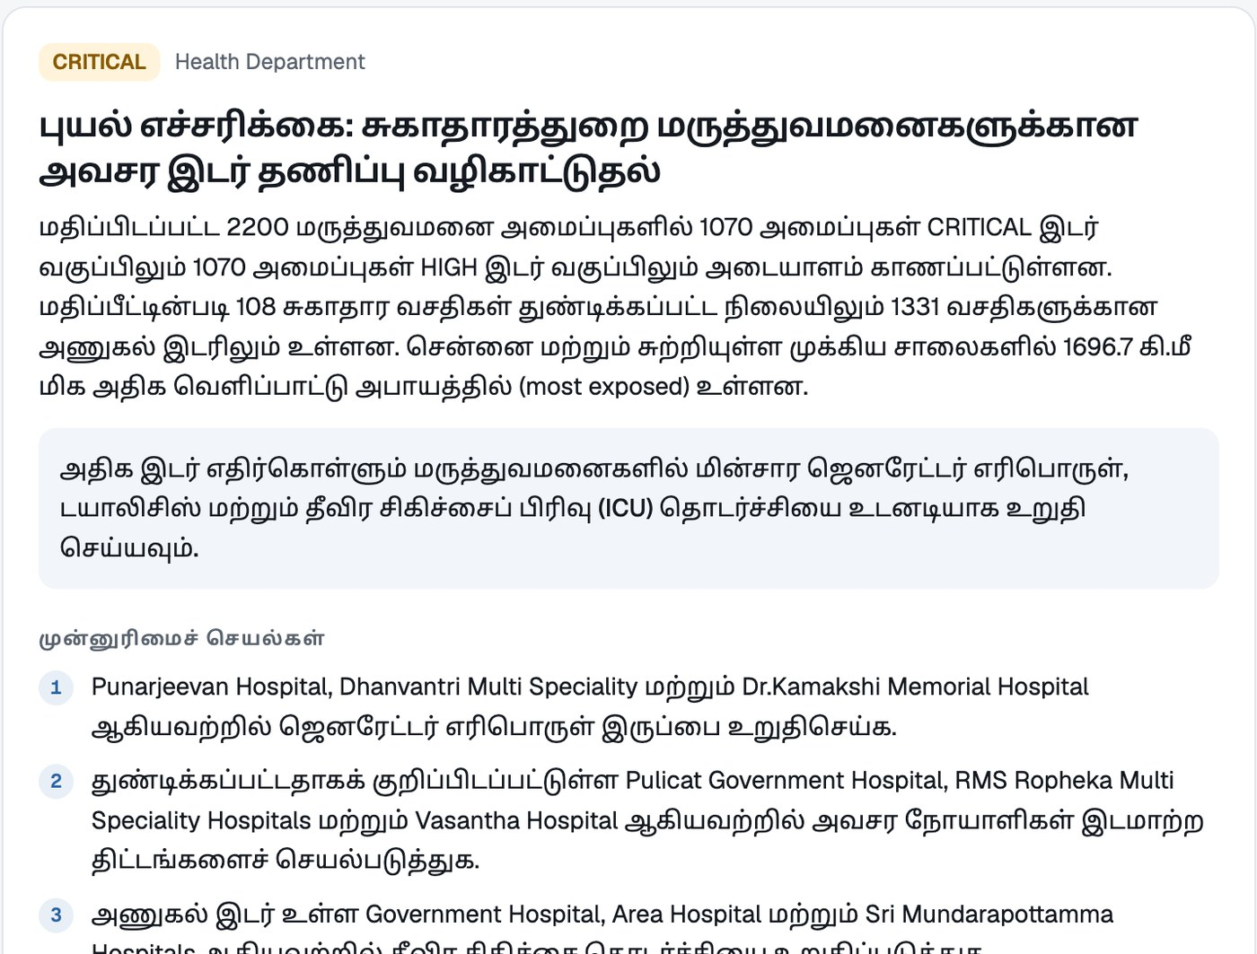




FEATURE 4 · ADVISORIES AND ALERTS
Each department gets its own advisory, in its own language.
Gemini drafts
7 departments × 6 languages
Audio and a CAP 1.2 alert
Cloud Text-to-Speech, standard alert format
An officer approves
Nothing is sent automatically
Sent to the team
Gmail and phone push (Firebase)
TEAM ECHO · SURGESIGHT
8
Notes:
Every department gets its own advisory, written by Gemini in its own language, here the Health Department in Tamil, with audio and a CAP 1.2 alert. Nothing is sent until an officer approves; then it goes out by Gmail and phone push.

Slide 9
HOW IT WORKS
Our models compute the risk. Gemini explains it.
Both are checked.
DATA IN
RISK MODELS
GEMINI AGENTS
OUT
IMD bulletin
Wind · surge · rain
Gemini 3.7 Flash + ADK
Map with reasons
Earth Engine · 10 datasets
Roads · hospital access
29 tools
Six languages
OpenStreetMap
Ensemble · what-if
Number guard
Approved alerts
CHECKED AGAINST WHAT REALLY HAPPENED
27.6 km
0.71
2×
average error of our 6-hour track forecast
match between forecast rain and NASA’s observed rain
satellites saw water twice as often on roads we flagged
TEAM ECHO · SURGESIGHT
9
Notes:
Data comes from the IMD bulletin, ten Earth Engine datasets and OpenStreetMap. Our models compute wind, surge, rain, roads, hospital access, the ensemble and what-ifs. Gemini with the Agent Development Kit explains and advises behind a number guard. Checked against Michaung: 27.6 km 6-hour track error, 0.71 rain correlation, and twice as much satellite-seen water on the roads we flagged.

Slide 10

23
Google services,
each with a real job.
AI
Gemini 3.7 Flash
Vertex AI
Gemini Live
Live on Cloud Run
Agent Development Kit
Search grounding
Text-to-Speech
Speech-to-Text
One container
MAPS & EARTH
Earth Engine
Maps JavaScript
Places
Routes
Geocoding
Scales to zero, scales out on a storm day
Weather
Refreshes itself
Cloud Scheduler job every 3 hours
DATA
BigQuery GIS
Firestore
Cloud Storage
Keys stay secret
ALERTS
Gmail API
Firebase Messaging
Firebase Auth
Secret Manager, dedicated service account
PLATFORM
Cloud Run
Cloud Scheduler
Secret Manager
Cloud Build
New state = config file
Same app, models and agents
Artifact Registry
TEAM ECHO · SURGESIGHT
10
Notes:
23 Google services, each with a real job: Gemini and Vertex AI with Gemini Live and the Agent Development Kit, Earth Engine and the Maps Platform, BigQuery, Firestore and Cloud Storage, Gmail and Firebase, and Cloud Run with Scheduler, Secret Manager, Cloud Build and Artifact Registry. It runs on Cloud Run today.

Slide 11
WHAT’S NEXT
From the control room to every coastal home.
A citizen app
Cascading failures
Every phone
“Am I at risk?” in my language, the nearest safe shelter and a lower-risk route.
Which hospitals lose power or water when a substation floods.
Approved alerts sent through NDMA’s SACHET platform for cell broadcast.
Voice for villages
Money before landfall
Learns every storm
Officers call in and ask Gemini Live in Tamil, Telugu or Odia.
Parametric triggers release relief funds before the storm hits.
Satellite flood maps retune the model after each event.
TEAM ECHO · SURGESIGHT
11
Notes:
Next: a citizen app, cascading-failure analysis, alerts to every phone through SACHET, voice for village officers with Gemini Live, parametric money before landfall, and a model that learns from every storm.

Slide 12





WHY IT MATTERS
Forecasts into action,
before landfall.
District Collectors
What to protect first, with the reason for each
Hospitals
Scan to try SurgeSight
Fuel, power and patient moves before roads flood
TEAM ECHO
Power and water boards
Charan · Vishal
Crews at the substations and pumps most at risk
Live app
Demo video: [add link]
Code: [add link]
People on the coast
Warnings in their own language
TEAM ECHO · SURGESIGHT
12
Notes:
Collectors know what to protect first and why. Hospitals plan fuel, power and patient moves before roads flood. Power and water boards send crews where the risk is highest. And people on the coast get warnings in their own language. SurgeSight does not replace IMD; it turns forecasts into action before landfall. Thank you. We are Team Echo.

