Slide 1
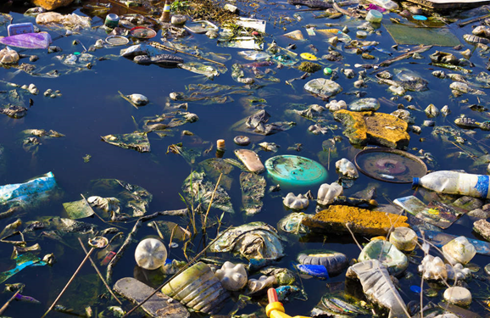
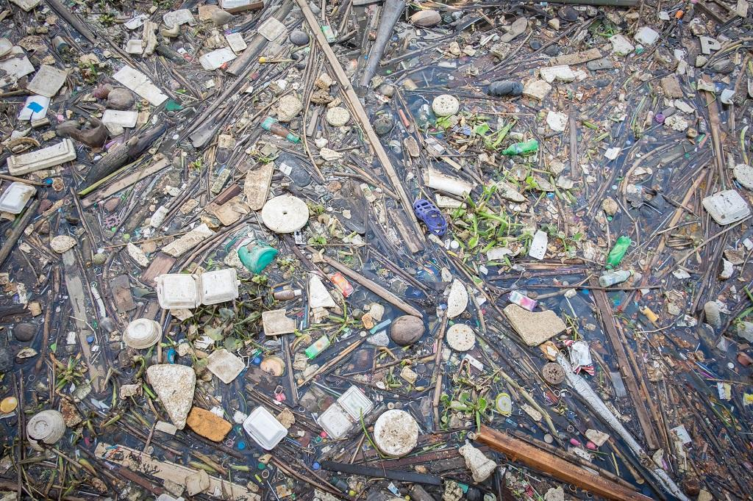
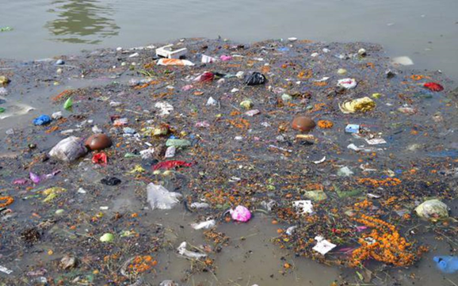
Problem STATEMENT
Just as much the society as been advanced ever since the invention of plastics our environment is at a rapid rate of degradation.
It is likely to be seen that rivers are like highways that transport 0.4–4 million metric tons of plastic from human inhabited land into the oceans.
Due to biomagnification, the waterbodies:
- lose most of its o2 levels and it loses the tendency to supports marine life
- when the water body is consumed, its prone to cancer, kidney problems mmmand birth defects.

Slide 2
WATERBOT

Slide 3
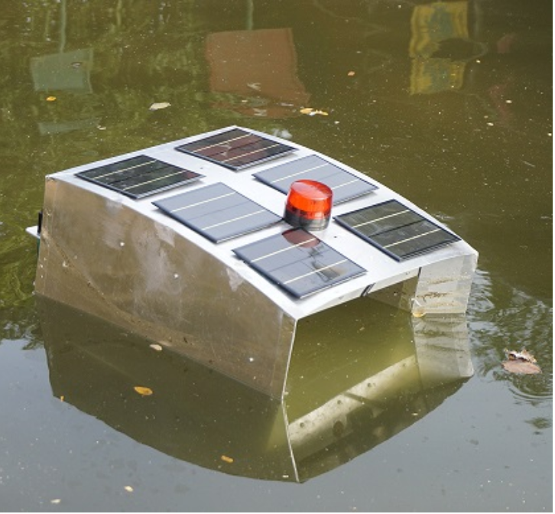
Idea/Approach Details
Our idea fundamentally includes of an unmanned water vehicle [UWV] which collects trash using AI-OPS and can be controlled remotely.
It can be powered by both solar panels and batteries thereby, making it more ECO-FRIENDLY and emission-free.
The vehicle also possesses the ability to analyze the water for pollutants and treat it accordingly.
Technology stack:
Lidar Sensor
Depth Sounder
P4 multispectral
RTK sensor

Slide 4
Idea/Approach Details
PROBLEM: Local water bodies such as lakes and canals are being heavily polluted with plastic and chemical wastes, this affects the ecosystem.
Use Cases:
Describe your Dependencies / Show stopper here
Our water bot picks up the floating debris, Shards of plastics and cleans up any alien aquatic matters (Algae, duck weed). Thereby allows penetration of sun rays in the lake which restores aquatic life.
Our UWV is a swimming laboratory which is equipped to [pH, salinity, dissolved oxygen, etc].
The UWV can also be equipped to treat the water body automatically with respect to analysis made from the water body.

Slide 5
Control flow
The raspberry pi is powered by a 5000mah power bank and connects to the device via specific mobile hotspot .
The thrusters are connected to their respective ESC. (What are those and why)
A 9g servo motor is placed to for control of ramp
Both the thrusters and the 9g servo ramp are powered by 5000 mah batteries
The sensors [Temperature and D.S.W] are placed at a respective positions for measurements.
All the components placed are connected to the arduino board for process
The Arduino is in turn connected to the lora comm module.
The lora comm from the bot is then connected to then connected to the module present in the laptop, ultimately establishes a pitch perfect connection and makes it possible to command the bot remotely.

Slide 6


Materials Required
Body :
- Kick boards
-mica board
-polysterene
-Mesh
Computing And communication:
-Raspberry PI module 4
32gigs micro SD card
Audriuno UNO
LORA communication Module
Movement of the bot:
-2X 10,000rpm BLDC motors
-2X ESC for BLDC motors
-2X 5000 mah batteries
-9g servo
-robot arm gripper
Power source:
5000mah powerbank
5000mah batteries X2
Sensors:
- Digital Temperature Sensor
Analog DSW Sensor
P4 multispectral
Infra red sensors
RTK sensors.

Slide 7
Cost of the waterbot:
The total cost of the waterbot sums up to
[50,000 – 1,00,000]– Indian Ruppes only

