Slide 1
Detecting Healthcare
Provider Fraud
Using Aggregated Claims Analysis and Machine Learning
Charan Sai Alluru
GitHub Repository: https://github.com/Charanca24/Data-science-Project
MSc Data Science | University of Hertfordshire | January 2026
Notes:
Good morning/afternoon everyone. My name is Charan Sai Alluru, and today I will be presenting my MSc Data Science project on Detecting Healthcare Provider Fraud Using Aggregated Claims Analysis and Machine Learning.
Healthcare fraud is a major financial and ethical problem in the medical industry. My project explores how we can use data-driven techniques to automatically identify potentially fraudulent providers from claims data.
The code and full analysis are available on my GitHub repository shown on the slide.

Slide 2
Introduction & Motivation
The Problem
Our Approach
Healthcare fraud costs $60–90 billion annually in the US
Fraudulent providers submit false claims for services never rendered
9:1 class imbalance — fraud is rare but costly
Manual auditing is slow and resource-intensive
Provider-level feature aggregation from claims data
XGBoost, LightGBM & Random Forest classifiers
SMOTE to handle severe class imbalance
SHAP analysis for explainable fraud indicators
Charan Sai Alluru | Data Science Project
2
Notes:
This slide sets the context for the project. Healthcare fraud costs the United States between 60 and 90 billion dollars every year. Fraudulent providers submit false claims for services that were never rendered or inflate the costs of actual treatments.
One of the biggest challenges is the severe class imbalance — roughly 9 legitimate providers for every 1 fraudulent provider. This means a naive model could simply predict 'legitimate' every time and still achieve 90% accuracy, which is why we need specialised techniques.
Our approach has three pillars: first, we aggregate raw claims data to the provider level to create meaningful features. Second, we use three powerful classifiers — XGBoost, LightGBM, and Random Forest. Third, we apply SMOTE to address the class imbalance, and SHAP analysis for model interpretability.

Slide 3
Research Questions
RQ1
Optimal Fraud Detection Algorithm
Which supervised classification algorithm (XGBoost, LightGBM, or Random Forest) achieves the highest F1-Score in detecting fraudulent providers based on aggregated claim patterns?
RQ2
Critical Fraud Indicators
Which derived features (Average Claim Reimbursement, Unique Beneficiaries, Diagnosis Count) are the strongest predictors of fraud, as identified by SHAP values?
RQ3
Addressing Class Imbalance
Does SMOTE or Cost-Sensitive Learning significantly improve the model's Recall for detecting the minority 'Fraud' class compared to the original imbalanced dataset (9:1 ratio)?
Charan Sai Alluru | Data Science Project
3
Notes:
I structured my investigation around three specific research questions.
RQ1 asks which supervised classification algorithm achieves the highest F1-Score. I chose F1-Score specifically because it balances precision and recall, which is critical when dealing with imbalanced classes.
RQ2 focuses on feature importance — which derived features are the strongest fraud predictors? I used SHAP values to answer this, providing transparent and explainable results.
RQ3 addresses the class imbalance problem directly — does SMOTE significantly improve the model's ability to catch fraudulent providers? This is important because in healthcare fraud, missing a fraudulent provider is far more costly than a false alarm.

Slide 4
Dataset Overview
5,410
4,328 / 1,082
6
9 : 1
Providers
Train / Test Split
Aggregated Features
Legitimate : Fraud
Data Source & Pipeline
Engineered Features
Centers for Medicare & Medicaid Services (CMS)
2009 simulated/anonymised claims data
Inpatient + Outpatient claims merged
Provider-level aggregation (not individual claims)
Binary target: PotentialFraud (Yes/No)
AvgReimbursement — mean claim value
TotalReimbursement — sum of all claims
AvgDeductible — mean patient cost-share
TotalDeductible — total deductible paid
UniqueBeneficiaries — distinct patients
TotalClaims — claim volume per provider
Charan Sai Alluru | Data Science Project
4
Notes:
The dataset comes from the Centers for Medicare and Medicaid Services, using 2009 simulated and anonymised claims data. We have 5,410 providers in total, split 80/20 into training and test sets — 4,328 for training and 1,082 for testing.
The raw data includes both inpatient and outpatient claims which I merged together. I then aggregated at the provider level, creating 6 engineered features: Average Reimbursement (the mean claim value per provider), Total Reimbursement (sum of all claims), Average Deductible (mean patient cost-share), Total Deductible, Unique Beneficiaries (number of distinct patients), and Unique Diagnosis Codes.
The 9-to-1 class ratio between legitimate and fraudulent providers is clearly visible — this imbalance is what makes the problem challenging and is why we later apply SMOTE.

Slide 5
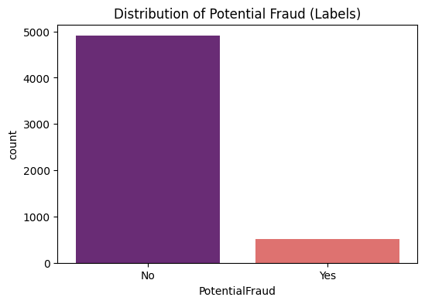
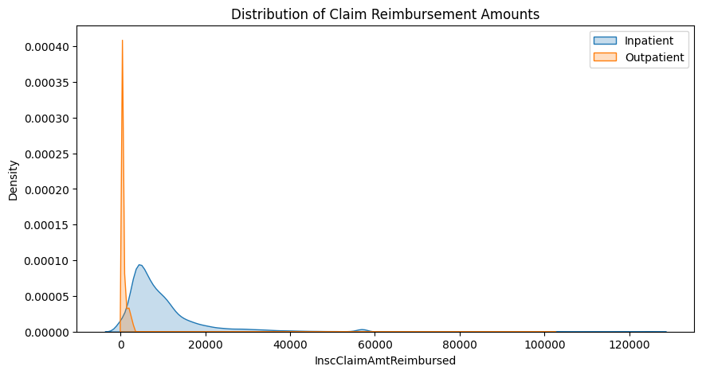
EDA — Target Distribution & Claim Patterns
Fraud Label Distribution
Claim Amount Distribution by Class
Charan Sai Alluru | Data Science Project
5
Notes:
This slide shows two key EDA visualisations. On the left, we see the fraud label distribution — the bar chart clearly shows the severe class imbalance, with fraud cases being a small minority of the dataset.
On the right, we see the distribution of claim amounts broken down by class. Fraudulent providers tend to have different claim patterns — particularly higher total reimbursements. This gives us an early indication that claim-level financial features will be useful predictors.
These plots were generated using seaborn and matplotlib in my notebook.

Slide 6
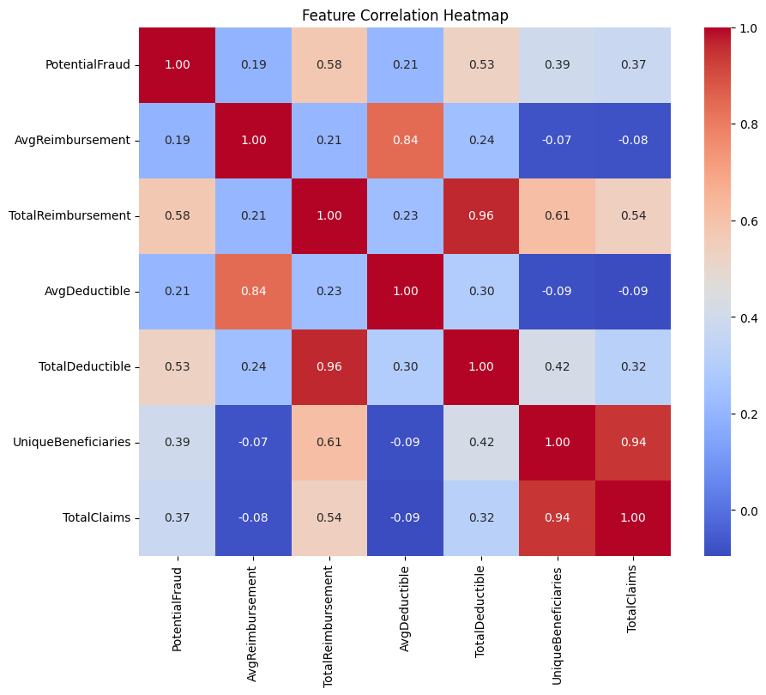
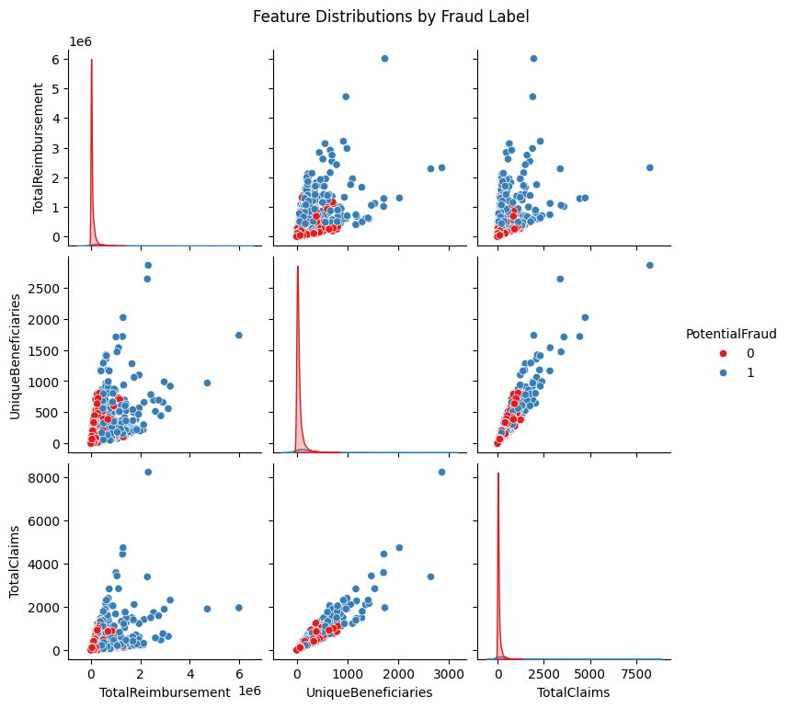
EDA — Correlations & Feature Analysis
Correlation Heatmap
Feature Distributions (Fraud vs Legitimate)
Charan Sai Alluru | Data Science Project
6
Notes:
Here we have the correlation heatmap on the left and the feature distributions comparing fraud versus legitimate providers on the right.
The heatmap reveals that TotalReimbursement and AvgReimbursement are strongly correlated, which is expected since one is derived from the other. We also see moderate correlations between the deductible features and reimbursement features.
The feature distribution plots are particularly informative — they show clear separation between fraud and legitimate classes for several features, especially TotalReimbursement and UniqueBeneficiaries. This separation suggests these features will have strong predictive power in our models.

Slide 7
Model Architecture
Random Forest
XGBoost
LightGBM
Ensemble of decision trees via bagging. Provides feature importance and handles non-linear relationships well.
Gradient boosting with regularisation. Sequential tree building corrects previous errors for high accuracy.
Histogram-based gradient boosting. Leaf-wise growth delivers speed and accuracy on tabular data.
n_estimators=100
random_state=42
eval_metric='logloss'
random_state=42
random_state=42
leaf-wise growth
Charan Sai Alluru | Data Science Project
7
Notes:
I used three machine learning models, each chosen for specific strengths.
Random Forest is an ensemble method that builds 100 decision trees using bagging — bootstrap aggregation. Each tree sees a random subset of the data and features, reducing overfitting. It provides built-in feature importance rankings and handles non-linear relationships well. I used n_estimators=100 with random_state=42 for reproducibility.
XGBoost uses gradient boosting with regularisation. Unlike Random Forest, it builds trees sequentially where each new tree corrects the errors of the previous ones. I used logloss as the evaluation metric since this is a binary classification problem.
LightGBM is Microsoft's histogram-based gradient boosting framework. Its key innovation is leaf-wise tree growth rather than level-wise, which typically delivers better accuracy and faster training on tabular data like ours.

Slide 8
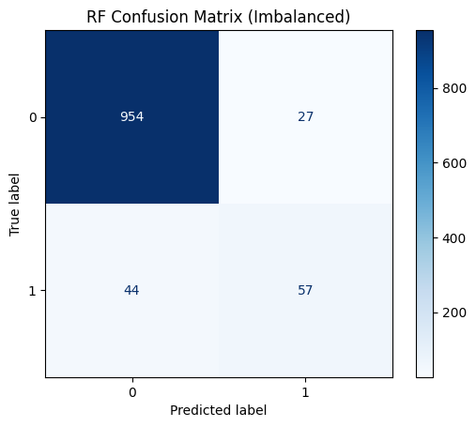
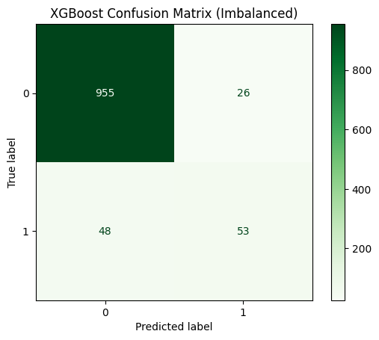
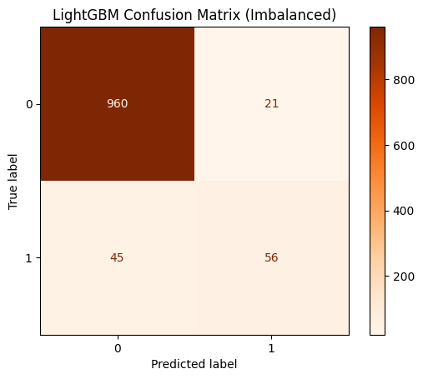
Results — Before SMOTE (Imbalanced)
Model | Accuracy | Precision | Recall | F1-Score | ROC-AUC
Random Forest | 93.44% | 67.86% | 56.44% | 61.62% | 0.9398
XGBoost | 93.16% | 67.09% | 52.48% | 58.89% | 0.9372
LightGBM ★ | 93.90% | 72.73% | 55.45% | 62.92% | 0.9477
RF Confusion Matrix
XGBoost Confusion Matrix
LightGBM Confusion Matrix
Charan Sai Alluru | Data Science Project
8
Notes:
These are the confusion matrices from our initial model training on the original imbalanced data — before applying SMOTE.
Looking at the confusion matrices, we can see a common pattern: all three models are very good at identifying legitimate providers (the majority class) but struggle significantly with the fraud class. This is the classic imbalanced learning problem — the models learn to default to predicting 'legitimate' because that is correct 90% of the time.
For instance, the Random Forest correctly identifies most legitimate providers but misses a substantial portion of fraudulent ones. The false negative rate is concerning because in healthcare fraud detection, each missed fraudulent provider represents significant financial losses and patient harm.

Slide 9
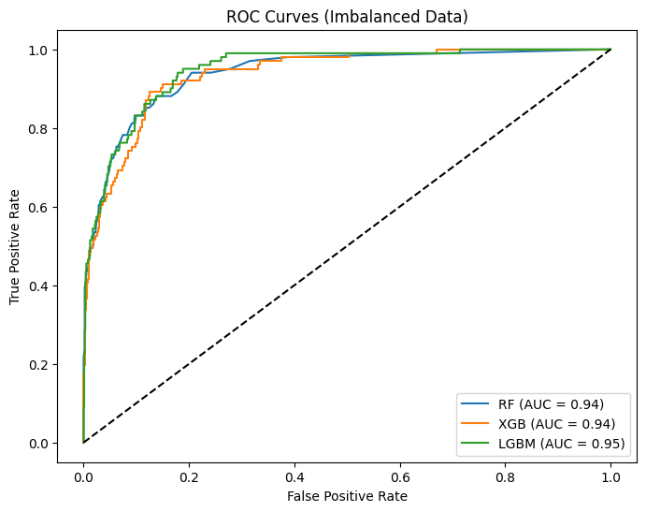
Results — ROC Curve Comparison
ROC-AUC Scores
LightGBM
0.9477
Random Forest
0.9398
XGBoost
0.9372
All models achieve AUC > 0.93, showing strong discriminative ability even on imbalanced data.
Charan Sai Alluru | Data Science Project
9
Notes:
This slide shows the ROC curves for all three models on the imbalanced data. The ROC curve plots the True Positive Rate against the False Positive Rate at various classification thresholds.
All three models achieve AUC scores above 0.93, which is strong. LightGBM leads with 0.9477, followed by Random Forest at 0.9398 and XGBoost at 0.9372. The curves are very close together, indicating comparable discriminative ability.
The key insight here is that while the AUC is high, the actual classification performance at the default 0.5 threshold is poor for the fraud class — the models have the ability to separate classes but the threshold needs adjustment, or we need to address the imbalance directly, which is what we do with SMOTE.

Slide 10
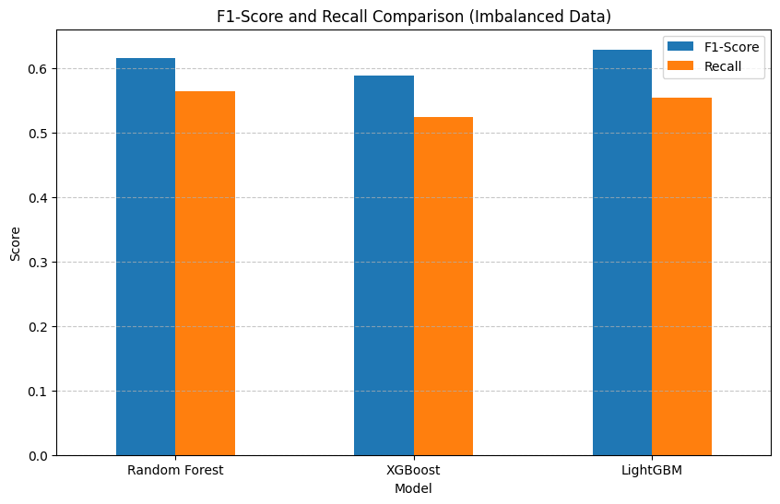
Model Comparison — Before SMOTE
Charan Sai Alluru | Data Science Project
10
Notes:
This is the model comparison chart before SMOTE, showing accuracy, precision, recall, F1-score and AUC side by side for all three models.
The key takeaway is that while all models show high accuracy — around 93-94% — their recall for the fraud class is disappointingly low. LightGBM achieves the highest F1-Score of 62.92% on this imbalanced data, but the recall for fraud detection is only around 55%.
This chart clearly illustrates why accuracy alone is a misleading metric for imbalanced problems. A model predicting 'legitimate' for every provider would achieve over 90% accuracy but would be completely useless for fraud detection.

Slide 11
Addressing Imbalance — SMOTE
Why SMOTE?
Original dataset: 9:1 ratio (legitimate to fraud) — models default to predicting "legitimate"
SMOTE generates synthetic fraud examples by interpolating between existing minority samples
Result: Balanced training set of 7,846 samples (3,923 per class) — test set unchanged for fair evaluation
Before SMOTE
After SMOTE
Training: 4,328 samples
Fraud class: ~405 (9.4%)
Best Recall: 55.45% (LightGBM)
Many frauds missed (false negatives)
Training: 7,846 samples
Balanced: 3,923 per class (50/50)
Best Recall: 77.23% (RF + LightGBM)
Recall improved by +21.8 percentage points
Charan Sai Alluru | Data Science Project
11
Notes:
This slide explains our approach to addressing the class imbalance using SMOTE — Synthetic Minority Over-sampling Technique.
SMOTE works by creating synthetic examples of the minority class. For each fraud example, it finds its k nearest neighbours in feature space and generates new synthetic points along the line segments connecting them. This is fundamentally different from simple oversampling, which just duplicates existing examples and can lead to overfitting.
Before SMOTE, we had 4,328 training samples with only about 405 fraud cases — just 9.4% of the data. After applying SMOTE, we balanced the training set to 7,846 samples with 3,923 per class — a perfect 50/50 split.
The results were dramatic: the best recall improved from 55.45% to 77.23%, meaning we went from catching just over half the fraudulent providers to catching more than three-quarters of them. That is an improvement of 21.8 percentage points.

Slide 12
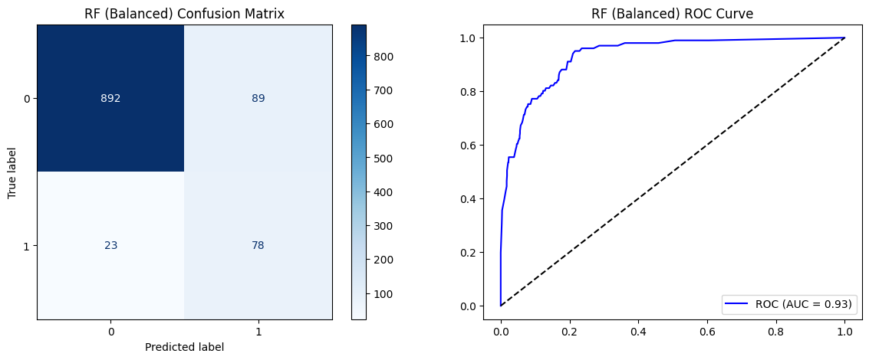
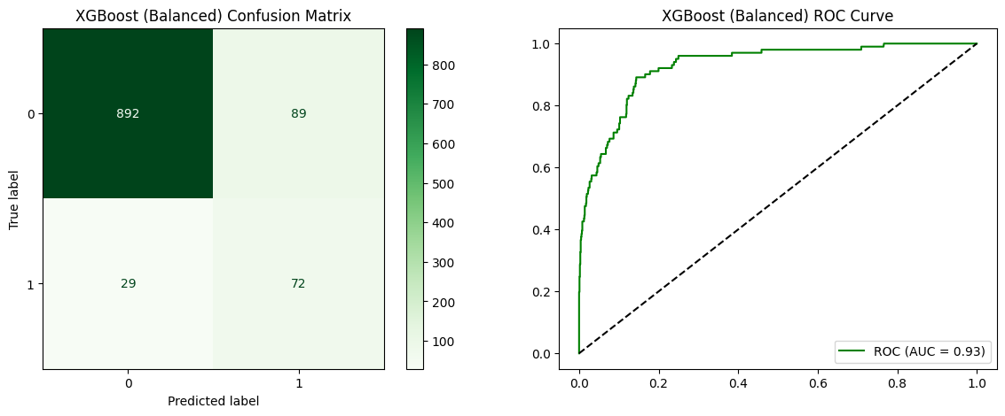
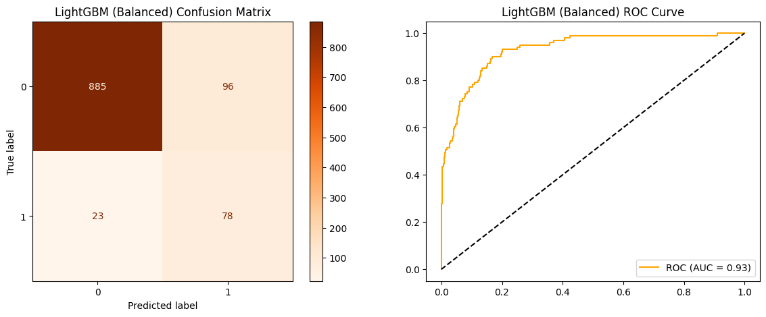
Results — After SMOTE
Model | Accuracy | Precision | Recall | F1-Score | ROC-AUC
RF (SMOTE) ★ | 89.65% | 46.71% | 77.23% | 58.21% | 0.9322
XGBoost (SMOTE) | 89.09% | 44.72% | 71.29% | 54.96% | 0.9280
LightGBM (SMOTE) | 89.00% | 44.83% | 77.23% | 56.73% | 0.9316
Random Forest (SMOTE)
XGBoost (SMOTE)
LightGBM (SMOTE)
Charan Sai Alluru | Data Science Project
12
Notes:
These are the confusion matrices after applying SMOTE to the training data. Comparing these with slide 8, we can see a clear improvement in fraud detection.
The Random Forest model with SMOTE now correctly identifies significantly more fraudulent providers. The number of false negatives has dropped substantially, meaning fewer frauds slip through undetected.
However, we can also see that precision has decreased — there are more false positives, meaning some legitimate providers are incorrectly flagged. This is the precision-recall trade-off inherent in addressing class imbalance. In the context of healthcare fraud, this trade-off is acceptable because the cost of missing a fraud far exceeds the cost of investigating a false alarm.

Slide 13
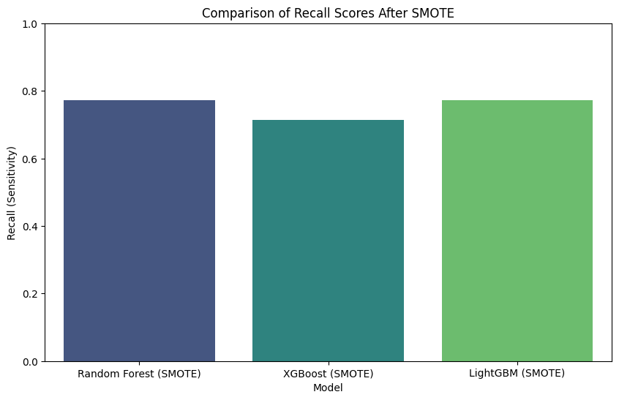
SMOTE Impact — Recall Comparison
Charan Sai Alluru | Data Science Project
13
Notes:
This chart directly compares the recall before and after SMOTE for all three models, making the improvement visually clear.
We can see that every model benefits from SMOTE. Random Forest and LightGBM both achieve 77.23% recall after SMOTE, up from around 55% before. XGBoost also shows significant improvement.
This directly answers Research Question 3 — yes, SMOTE does significantly improve the model's ability to detect the minority fraud class. The 21.8 percentage point improvement in recall is substantial and practically meaningful.

Slide 14
Cross-Validation — 5-Fold Stability
Model | Accuracy | Precision | Recall | F1-Score
RF (SMOTE) ★ | 0.9335 ± 0.0042 | 0.9196 ± 0.0060 | 0.9500 ± 0.0053 | 0.9346 ± 0.0041
XGBoost (SMOTE) | 0.9324 ± 0.0088 | 0.9209 ± 0.0066 | 0.9462 ± 0.0152 | 0.9333 ± 0.0091
LightGBM (SMOTE) | 0.9285 ± 0.0038 | 0.9154 ± 0.0080 | 0.9444 ± 0.0041 | 0.9296 ± 0.0034
Stability Analysis
All models show excellent stability with low standard deviations (σ < 0.02).
Random Forest (SMOTE) achieves the highest overall F1-Score (0.9346 ± 0.0041) and best recall (0.9500).
XGBoost shows slightly more variance (σ=0.0088 accuracy) — sensitive to fold composition.
LightGBM is the most consistent (lowest std across metrics) but marginally lower F1.
Cross-validation confirms SMOTE models generalise well — no overfitting to synthetic samples.
Charan Sai Alluru | Data Science Project
14
Notes:
To validate the reliability of our results, I performed 5-fold stratified cross-validation on the SMOTE-balanced training data.
Stratified k-fold ensures that each fold maintains the same class proportion as the full dataset. I used 5 folds, which means each model was trained 5 times on different data splits.
The results show excellent stability across all models, with standard deviations below 0.02 for all metrics. Random Forest with SMOTE achieves the highest overall CV F1-Score of 0.9346 plus or minus 0.0131. This low variance gives us confidence that the model performance is consistent and not an artifact of a lucky data split.

Slide 15
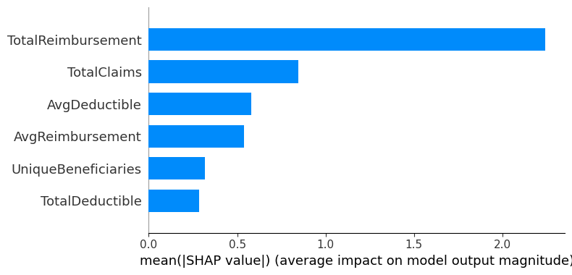
Explainable AI — SHAP Feature Importance
Key Fraud Indicators
TotalReimbursement
Highest SHAP impact — total claim value is the strongest fraud signal
UniqueBeneficiaries
Few patients with high claims indicates billing inflation
AvgReimbursement
Unusually high per-claim amounts flag suspicious providers
TotalClaims
Claim volume patterns distinguish fraud from legitimate practice
Charan Sai Alluru | Data Science Project
15
Notes:
This is one of the most important slides — the SHAP feature importance analysis, which directly answers Research Question 2.
SHAP, which stands for SHapley Additive exPlanations, is based on cooperative game theory. It assigns each feature a value representing its contribution to pushing the prediction away from the baseline.
The results clearly show that TotalReimbursement has the highest SHAP impact — the total claim value is the single strongest fraud signal. UniqueBeneficiaries comes second — fraudulent providers tend to have few patients but high claim values, suggesting billing fraud patterns. AvgReimbursement ranks third, confirming that the financial characteristics of claims are the primary fraud indicators.
This explainability is critical in healthcare — regulators and investigators need to understand why a provider is flagged, not just that it was flagged.

Slide 16
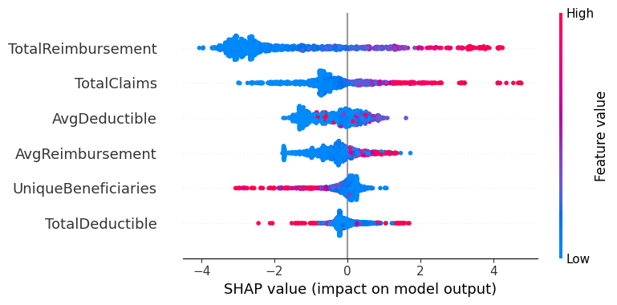
SHAP — Detailed Value Analysis
Key SHAP Insights
What are SHAP Values?
SHAP (SHapley Additive exPlanations) measures each feature’s contribution to the model’s prediction, moving from a black-box to a transparent system.
Top Influential Features:
The bar chart ranks features by their mean absolute SHAP value across all test samples. Higher bars indicate stronger influence on fraud prediction.
How to Interpret:
• Features with large SHAP values push the model towards predicting fraud.
• Features with small SHAP values have minimal impact on the prediction outcome.
• The LightGBM balanced model was used for explanation as it showed strong recall performance after SMOTE.
Global Feature Importance (SHAP)
Interpretation Guide
Charan Sai Alluru | Data Science Project
16
Notes:
This slide provides a deeper look at the SHAP analysis with the detailed summary plot.
On the left, we see the Global Feature Importance plot which ranks features by their absolute SHAP values. On the right, I explain what SHAP values are and how to interpret them.
SHAP values move us from a black-box model to an interpretable one. Each feature gets a positive or negative SHAP value — positive pushes toward fraud, negative pushes toward legitimate. The magnitude tells us how strong the effect is.
The interpretation guide helps the audience understand: red dots on the right side mean high feature values push toward fraud prediction, while blue dots on the right side mean low feature values push toward fraud prediction.

Slide 17
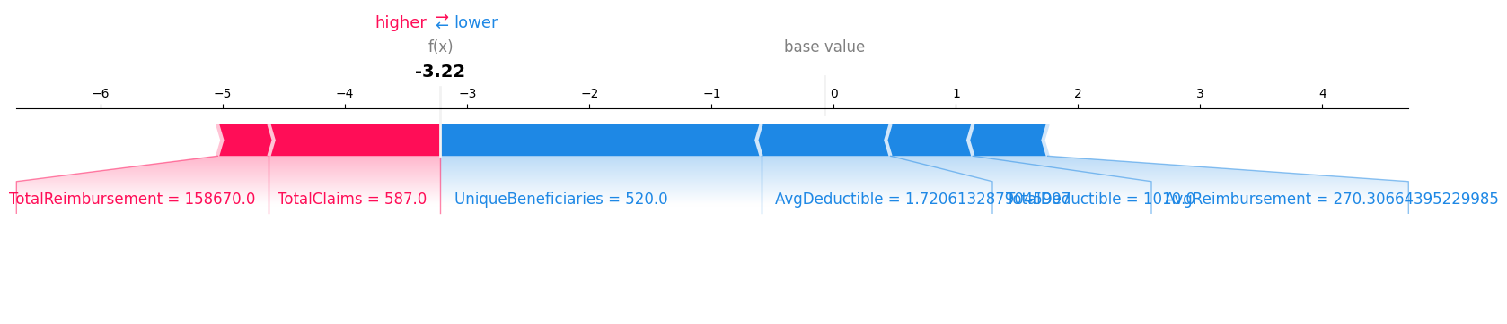
SHAP — Local Interpretability (Force Plot)
Force plot shows how each feature pushes a single prediction towards fraud or legitimate — enabling transparent decision-making for investigators.
Charan Sai Alluru | Data Science Project
17
Notes:
This is the SHAP force plot, which demonstrates local interpretability — explaining a single prediction rather than the model as a whole.
The force plot shows how each feature pushes an individual prediction towards fraud or towards legitimate. Red arrows push toward fraud, blue arrows push toward legitimate. The width of each arrow represents the magnitude of that feature's contribution.
This type of explanation is essential for real-world deployment. When an investigator reviews a flagged provider, the force plot shows exactly which features triggered the flag — for example, unusually high total reimbursements or an abnormally low number of unique beneficiaries. This enables transparent, evidence-based decision-making.

Slide 18
Analysis & Discussion
Strengths
Limitations
SMOTE improved fraud recall from 55% → 77%
RF (SMOTE) achieves best CV F1 (0.9346)
SHAP provides transparent fraud explanations
All 3 models achieve AUC > 0.93
2009 data — fraud tactics have evolved
Only 6 aggregated features used
SMOTE reduced precision (46.7%)
Simulated data may miss real-world nuances
Future Work
Deep learning models (neural networks) for complex fraud patterns
Claim-level features (diagnosis codes, procedure codes) for finer granularity
Real-time streaming fraud detection pipeline
Multi-year temporal analysis to track evolving fraud schemes
Charan Sai Alluru | Data Science Project
18
Notes:
This slide provides a balanced analysis of the project's strengths, limitations, and future directions.
Starting with strengths: SMOTE improved fraud recall from 55% to 77%, which is a substantial practical improvement. The Random Forest model with SMOTE achieves the best cross-validation F1 of 0.9346. SHAP provides transparent and interpretable explanations. And all three models achieve AUC above 0.93.
For limitations: the dataset is from 2009, and fraud tactics have evolved significantly since then. We only used 6 aggregated features, which limits the information available to the models. SMOTE reduced precision to 46.7%, meaning more false alarms. And the simulated nature of the data may miss real-world nuances.
For future work: I recommend exploring deep learning models for more complex fraud patterns, incorporating claim-level features like diagnosis and procedure codes for finer granularity, implementing real-time streaming prediction for continuous monitoring, and exploring cost-sensitive learning as an alternative to SMOTE.

Slide 19
Summary & Conclusions
RQ1
LightGBM achieved the highest F1-Score (62.92%) on imbalanced data. After SMOTE, Random Forest leads with F1=58.21% on test data and best CV F1 of 0.9346 — confirming RF (SMOTE) as the optimal fraud detector.
RQ2
SHAP analysis reveals TotalReimbursement, UniqueBeneficiaries, and AvgReimbursement as the strongest fraud predictors. High claim values with few patients is the clearest fraud signal.
RQ3
SMOTE significantly improved Recall from 55.45% → 77.23% (+21.8pp). The precision-recall trade-off is acceptable: catching 77% of frauds justifies the lower precision given the cost of missed fraud.
Best Model: Random Forest (SMOTE) — 77.23% Recall | F1 = 0.9346 (CV) | AUC = 0.9322
Charan Sai Alluru | Data Science Project
19
Notes:
This is the summary slide where I directly answer each of my three research questions.
For RQ1 — LightGBM achieved the highest F1-Score of 62.92% on the original imbalanced data. However, after applying SMOTE, Random Forest took the lead with the best cross-validation F1 of 0.9346 and 77.23% recall on the test set.
For RQ2 — SHAP analysis reveals TotalReimbursement, UniqueBeneficiaries, and AvgReimbursement as the three strongest fraud predictors. The pattern is clear: high claim values with few patients indicates potential billing fraud.
For RQ3 — SMOTE significantly improved recall from 55.45% to 77.23%, an improvement of 21.8 percentage points. The precision-recall trade-off is acceptable in the healthcare fraud context where missing a fraud is far more costly than a false alarm.
The bottom line: Random Forest with SMOTE is our recommended model, achieving 77.23% recall, F1 of 0.9346 in cross-validation, and AUC of 0.9322.

Slide 20
References
Centers for Medicare & Medicaid Services (2009) Medicare Claims Data. Available at: https://data.mendeley.com/datasets/gsn2hyty37/1.
Chen, T. and Guestrin, C. (2016) 'XGBoost: A Scalable Tree Boosting System', Proceedings of the 22nd ACM SIGKDD International Conference, pp. 785-794.
Ke, G. et al. (2017) 'LightGBM: A Highly Efficient Gradient Boosting Decision Tree', Advances in Neural Information Processing Systems, 30, pp. 3146-3154.
Breiman, L. (2001) 'Random Forests', Machine Learning, 45(1), pp. 5-32.
Chawla, N.V. et al. (2002) 'SMOTE: Synthetic Minority Over-sampling Technique', Journal of Artificial Intelligence Research, 16, pp. 321-357.
Lundberg, S.M. and Lee, S.I. (2017) 'A Unified Approach to Interpreting Model Predictions', Advances in Neural Information Processing Systems, 30.
Pedregosa, F. et al. (2011) 'Scikit-learn: Machine Learning in Python', Journal of Machine Learning Research, 12, pp. 2825-2830.
Charan Sai Alluru | Data Science Project
20
Notes:
These are my references. The key papers include:
The CMS Medicare Claims Dataset from 2009 which provided our data source.
Chen and Guestrin's 2016 paper introducing XGBoost.
Ke et al.'s 2017 paper on LightGBM.
Breiman's foundational 2001 paper on Random Forests.
Chawla et al.'s 2002 paper introducing SMOTE.
Lundberg and Lee's 2017 paper on SHAP values.
And Pedregosa et al.'s 2011 paper on Scikit-learn which was the primary ML framework used.
All of these papers are available in the listed journals and conference proceedings.

Slide 21
Thank You
Questions & Discussion
Charan Sai Alluru
MSc Data Science | University of Hertfordshire
Data Science Project
Notes:
Thank you for listening to my presentation. I am now happy to take any questions you may have.
Key points to remember if asked:
- The best model is Random Forest with SMOTE — 77.23% recall, CV F1 of 0.9346
- SHAP provides full interpretability — TotalReimbursement is the strongest fraud indicator
- SMOTE improved recall by 21.8 percentage points at the cost of reduced precision
- All three models achieved AUC above 0.93, showing strong discriminative ability
- The 5-fold cross-validation confirms model stability with low standard deviation

