Slide 1
CHANAKYA
“ I N A W O R L D O F C O N S T A N T T H R E A T , P R E C I S I O N A N D F O R E S I G H T B E C O M E T H E S O L D I E R’s S T R O N G E S T A L L I E S ”
MILITARY STRATEGIC DECISION SYSTEM
TEAM : TACTICIANS
THEME & DOMAIN : Student Innovation – Defence
( Hardware – Software Integration )
In a landscape dominated by AgriTech, MedTech, EdTech, and FinTech, we shine a light on a vital yet neglected
realm: national defense. Our project is dedicated to fortifying security and enhancing strategic capabilities, ensuring that our nation's safety remains at the forefront.

Slide 2

PROBLEM STATEMENT :
India's military stands tall as the 4th strongest in the world, a testament to the dedication and skill of its soldiers. This impressive ranking isn't just about numbers; it reflects the unwavering commitment of each soldier to safeguard the nation. Their strength lies not only in their advanced weaponry but also in their indomitable spirit and love for the motherland.
However, we must also address a crucial question: How can we protect our brave soldiers on the battlefield? In the chaos of war, military leaders face immense pressure to make split-second decisions that can mean the difference between victory and defeat, life and death. The fog of war can cloud even the sharpest minds, making it difficult to choose the best course of action. Even seasoned commanders, with years of experience under their belts, can find themselves struggling to make the right call when time is of the essence and lives hang in the balance. The lack of real-time intelligence on enemy positioning, safe zones, and optimal navigation routes severely hampers soldiers' ability to adapt to dynamic threats
The consequences of poor decisions in these high-stakes situations can be devastating, putting our valiant soldiers at unnecessary risk and jeopardizing entire missions. To address this critical issue, we must look towards innovation and technology to fill the gap in technological support not only endangers lives but also undermines mission success. By developing and implementing better tools and advanced systems, we can empower our military leaders to make more informed and effective decisions and strategies in the heat of battle. These improvements could range from enhanced communication systems to AI-powered strategic analysis tools. By embracing these advancements, we can not only keep our soldiers safer but also significantly boost the overall effectiveness of our military operations, ensuring that India remains a formidable force on the global stage.

Slide 3
EXISITING SOLUTIONS :
The Indian Army’s Integrated Battle Management System (IBMS), A Sophisticated platform designed to enhance battlefield coordination by linking soldiers, vehicles, and commanders in real-time. It excels at gathering data from various sensors for continuous monitoring, offering precise digital mapping, GPS-integrated live tracking, and rapid target acquisition. Its secure communication network keeps all units synchronized, improving operational coherence and response time. However, IBMS lacks advanced camouflage features and adaptive route optimization, which may limit flexibility and increase the risk of enemy detection in high-risk zones .
he DRDO’s Command, Control, Communications, Computers, and Intelligence (C4I) System is an advanced tool designed to help military operations by improving communication and decision-making on the battlefield. It gathers data from various sources to provide real-time information, helping commanders understand what’s happening. The system allows for communication ,accurate target tracking, making it easier for troops to respond quickly. However , it can be complicated to use, requiring a lot of training. It doesn’t have good features for camouflage or adapting to obstacles, which can make soldiers less stealthy and flexible in fast-changing combat situations.
Combined Limitations in Both of the Top Existing Solutions :
UAVs often lack effective camouflage, making them vulnerable to enemy detection and countermeasures.
Focus on mapping enemy positions but lack the dynamic adaptability to identify and mark safe zones or hiding points in real-time.
Primarily relay enemy locations through initial intelligence rather than dynamic and continuous tracking.
Provide strategic overviews but do not deliver adaptive, soldier-specific strategies for immediate field operations.
Current systems do not emphasize individual soldier pathfinding or dynamic route planning based on live data.

Slide 4
PROPOSED SOLUTION :
MILITARY STRATEGIC DECISION SYSTEM
Chanakya is a cutting-edge system designed to empower soldiers in the toughest environments. Leveraging the latest technology, it delivers real-time insights and strategic direction crucial for military success. By transforming raw data into actionable intelligence, Chanakya enables troops to make rapid, informed decisions in dynamic combat situations.
In an era where intelligence is power, Chanakya keeps soldiers a step ahead, turning uncertainty into clear, mission-critical guidance. From detecting hidden threats to navigating complex terrain, Chanakya equips soldiers with the knowledge and confidence needed to face any challenge head-on. This advanced system enhances troop effectiveness and safety, fostering a new standard of battlefield readiness and paving the way for mission success.
Key Solutions:
Real - Time Situational Awareness : Chanakya delivers the latest information about enemy movements and safe zones, helping soldiers make quick and informed decisions to stay safe on the battlefield.
Dynamic Strategy Formulation : The system leverages machine learning algorithms that learn and adapt strategies based on real-time battlefield conditions. This flexibility allows soldiers to adjust their plans quickly to respond to unexpected threats, also suggests a grenade attack when there is clustering of enemies , improving their chances of success.
Obstacle / Safe Point and Enemy Detection : Chanakya can identify obstacles / hiding spots and enemy movements in real-time, providing soldiers with vital information to plan safer routes and avoid dangerous areas, thereby enhancing their overall safety.
Covert (Secret) Surveillance : The system includes a specialized drone designed to mimic a bird, enabling it to gather critical information without being detected by the enemy. This stealth capability allows for discreet monitoring of the battlefield.
Direct Communication of Strategies : Chanakya not only generates effective strategies and paths but also via WebSocket audio communication , communicates them directly to the soldiers. This ensures that troops receive clear instructions on the best approaches to take, fostering coordinated and efficient actions during missions.
GPS Integration for Safety and Tracking of our allies : The system utilizes GPS technology to track the locations of friendly troops and enable real-time strategy communication. This ensures soldiers are aware of their teammates' positions, reducing the risk of accidental friendly fire and enhancing coordination. With instant updates delivered via WebSocket, soldiers can act swiftly and effectively in dynamic situations.

Slide 5



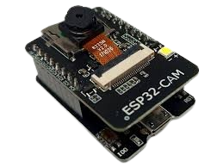
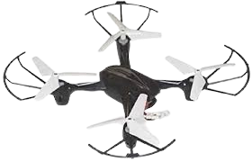





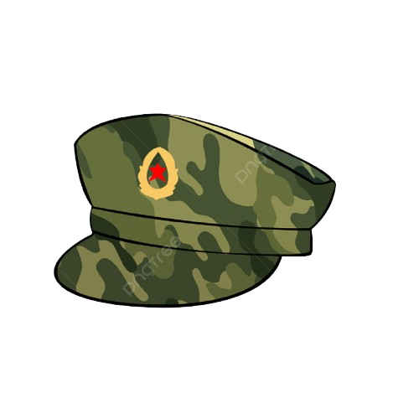





Tech Stack
System Architechture
Frontend
Custom Bird-Like Frame
Wi-Fi-enabled camera module for real-time video streaming and onboard image processing
Precise control of wing movement for realistic
bird-like motion.
For Interactive & Dynamic UI
Communication
Backend
All data is authorized and authenticated using OAuth and JWT (JSON Web Tokens).
Real – Time enemy
Detection using YOLO (ML Model)
Our Custom - Trained ML Model generates Dynamic - safest and shortest path to rescue hostages or to strategically surround enemy positions
Server Environment
NoSQL Database
TensorFlow Object (Safe Point ) Detection API
ML Model generates the best possible Hiding positions
GPS – tracking of
Our Allies
Locations
Authentication &
Authorization
Real time AI
Processing
Hostage
Hostage
Hardware
Drone Kit: Complete setup for assembling drone.
Frame: bird-like frame - mimic natural movements.
Servo Motors: enable precise wing movement.
ESP32-CAM (OpenCV): Real-time monitoring for
live surveillance and Tracking.
Allies will be promptly informed of the approved paths via WebSocket audio communication with the
software handler (Commander).
Battlefield
Software - Chanakya

Slide 6
BENEFITS :
MILITARY STRATEGIC DECISION SYSTEM
Enhanced Situational Awareness – Provides real-time intelligence to ensure soldiers have a clear understanding of threats and surroundings, prioritizing safety and strategic decision-making.
Precision Targeting & Pathfinding – Accurately locates targets and identifies optimal routes to hostages, focusing on efficiency and minimizing risks for both troops and hostages.
Real-Time Communication – Enables secure, swift communication between commanders and teams, allowing instant updates and approvals through WebSocket audio for rapid responsiveness.
Data-Driven Decision Support – Converts raw data into actionable insights, helping troops make informed, decisive moves in dynamic, high-stakes environments.
Improved Mission Success Rates – Empowers soldiers with technology that enhances coordination, situational awareness, and adaptability, maximizing overall mission effectiveness and safety.
Chanakya is more than a system; it’s a lifeline for those who serve. Built to protect, guide, and empower our soldiers, it ensures they have the knowledge and support needed to face the toughest challenges, safeguarding not only their lives but also the lives of those they defend. With Chanakya, we honor their bravery by giving them the tools to succeed and come home safely.

