Slide 1



Capstone Project – Tech Trend Analysis
Charanjeet Singh
8th April 2024

Slide 2

OUTLINE
Executive Summary
Introduction
Methodology
Results
Visualization – Charts
Dashboard
Discussion
Findings & Implications
Conclusion
Appendix

Slide 3

EXECUTIVE SUMMARY
Javascript maintains its top position in both the surverys followed by rise of Python to second position as desired language . Go and Kotlin takes the bottom 2 position replacing PHP and C++ as desired languages.
MySQL, PostgrestSQl and MS SQl Server dominates the current top positions however the desired databases data show interest in PostgrestSQL, MongoDB and Redis as highly desired.
JQuery the most used webframe currently might observe big shift downwards with the increasing popularity of React.js, View.js and Angular being part of Javascript.
The aggregated data says that out of 100% Respondents 93.5% were male and 6.5% Woman which explains there will be challenges in maintaining diversity in the development teams.

Slide 4

INTRODUCTION
We have 2 datasets from Stack Overflow Developer Survey 2019 which I will use to visualize and analyse the current usage, future trends of technologies and demographics patterns using various types of charts.
The Cognos Analytics Dashboard has 3 tabs - Current Technology Usage, Future Technology trend and Demographics.
Current Technology Trend tab shows the current usage of top 10 Languages, Databases, Platforms and Webframes used by respondents.
Future Technology trends tab visualizes the desired languages, databses, platforms and webframes.
Demographics tab has visuals of Gender, Countries, Age and Education level of the respondents.

Slide 5

METHODOLOGY
I have used survery data m5_survey_data_technologies_normalised.csv dataset to compare the data of Technology trends. This dataset contains the number of Respondents, LanguagesWorkedwith, LanguagesDesiredNextyear, DatabaseWorkedwith, DatabaseDesiredNextYear, PlatformWorkedWith, PlatformDesiredNextYear, WebframeWorkedWith, WebFrameDesiredNextYear.
To analyze the demographics of the respondents I have used another dataset m5_survey_data_demographics.csv. It contains details like Age, Gender, Country and EducationLevel.
There are more tables which can be used but as per to the project requirement I have limited my dashboards to only needed chats and visualizations.
The data is clean and ready for the use.

Slide 6
RESULTS
Top 10 Languages – To compare the top 10 Languages currently used and desired I have used Bar Graph using count of respondents and name of the languages with different colors assigned to each language.
Top 10 Databases - To compare the top 10 Databases used and desired I have used Column Bar chart with Number of respondents on Y axis and Name of the language on X Axis, bars are colored as per to the language.
To depict and show relationships between webframes and respondents I have used Word Map and Tree Map with addition of marker size as a dimension to allow for the size comparison.
To depict the demographics, I have used Pie chart for Gender distribution, Map chart for location of respondents, Line chart for age groups and stack bar chart to see the distribution of education levels in Men and woman.

Slide 7
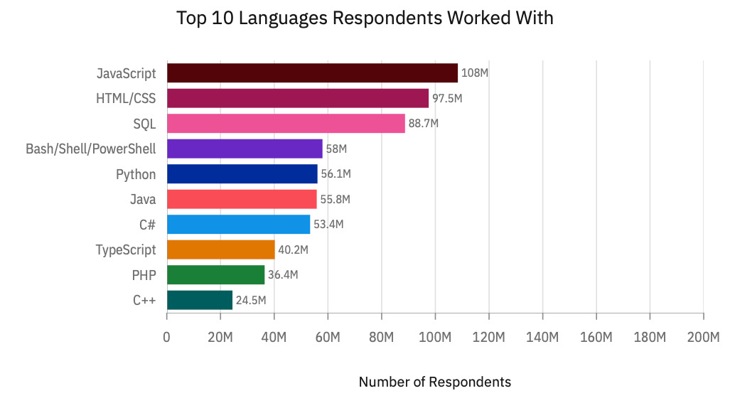
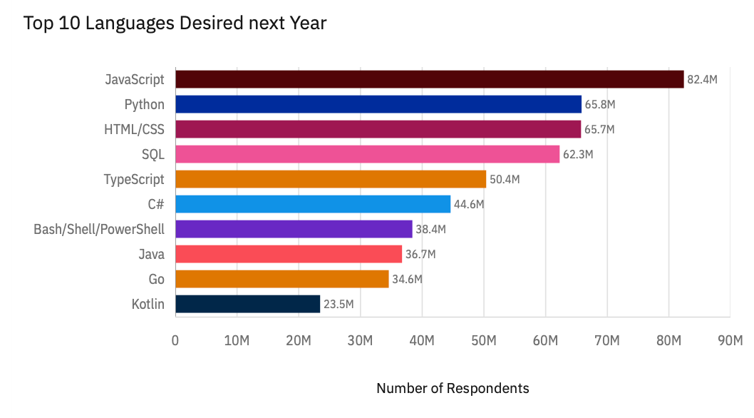
PROGRAMMING LANGUAGE TRENDS
Current Year
Next Year

Slide 8
PROGRAMMING LANGUAGE TRENDS - FINDINGS & IMPLICATIONS
Findings
Javascript maintains the top position in both current usage and desired language.
Python which in current usage is on the 5th position is the is second most desired language as observed in the Next Year chart.
PHP and C++ are the least used languages and are being replaced by Kotlin and Go as desired languages.
Implications
Projects based on Javascript will continue growing next year. There will be a strong demand of Developers who are proficient in Javascript which can lead to higher salary demands.
Pythons simple programming syntax makes it one of the strongly desired language, we can expect surge projects which has python in their stack and larger pool of people with such skills.
With the decline in PHP and C++ we can expect difficulty in finding people interested in work on such projects using these languages.

Slide 9
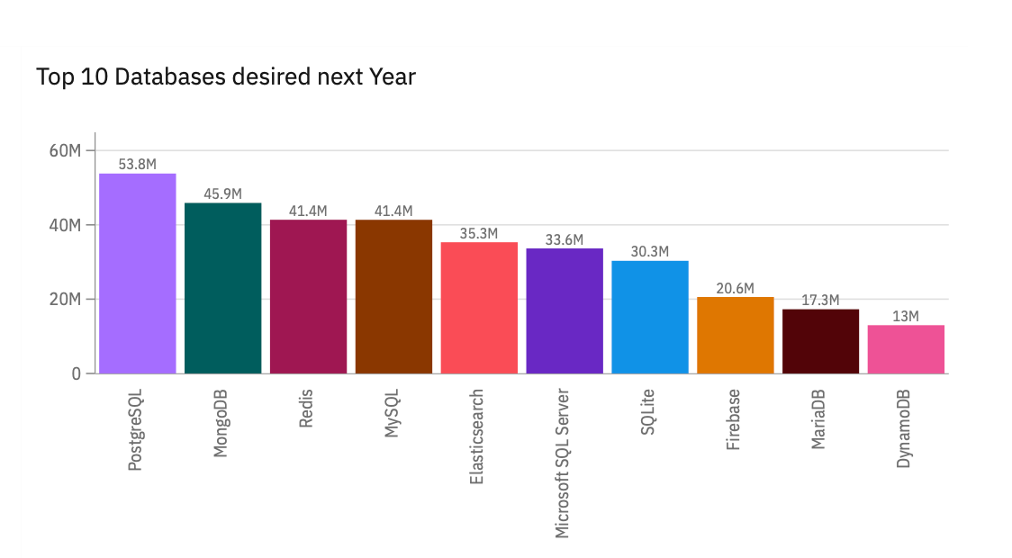
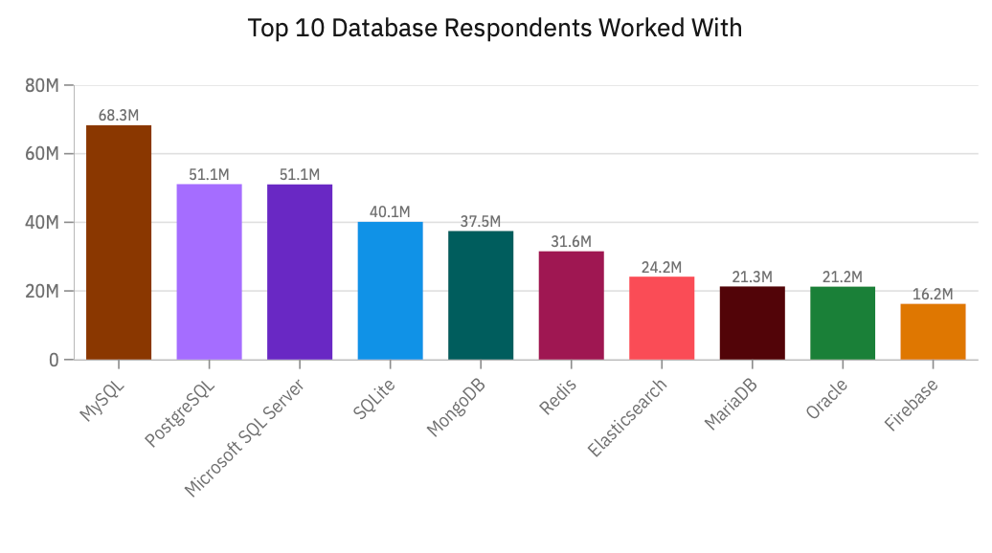
DATABASE TRENDS
Current Year
Next Year

Slide 10
DATABASE TRENDS - FINDINGS & IMPLICATIONS
Findings
MySQl is the most used databse currently however it slips to the 4th position in the desired databse chart.
PostgresSQL is the 2nd most used language and is the most desired databse.
Following Postgres, MongoDb and Redis replaces the 2nd and third spot
Implications
MySQl slipping from 1st to 4th position is alarming as it shows that repondents are losing interest in the databse which can impact hiring.
PostgresSQL is rising desire implies that more and more companies are using it and there are better tools and technologis available for integration with this database.
Similar is the case with MongoDb and Redis. As more and more integration is available, the cost of the database will also fall making them more accessible for the smaller companies.

Slide 11

DASHBOARD
https://github.com/CharanjeetI2D/IBM_Capstone_Project/blob/main/IBMDashboardAssignment.pdf

Slide 12
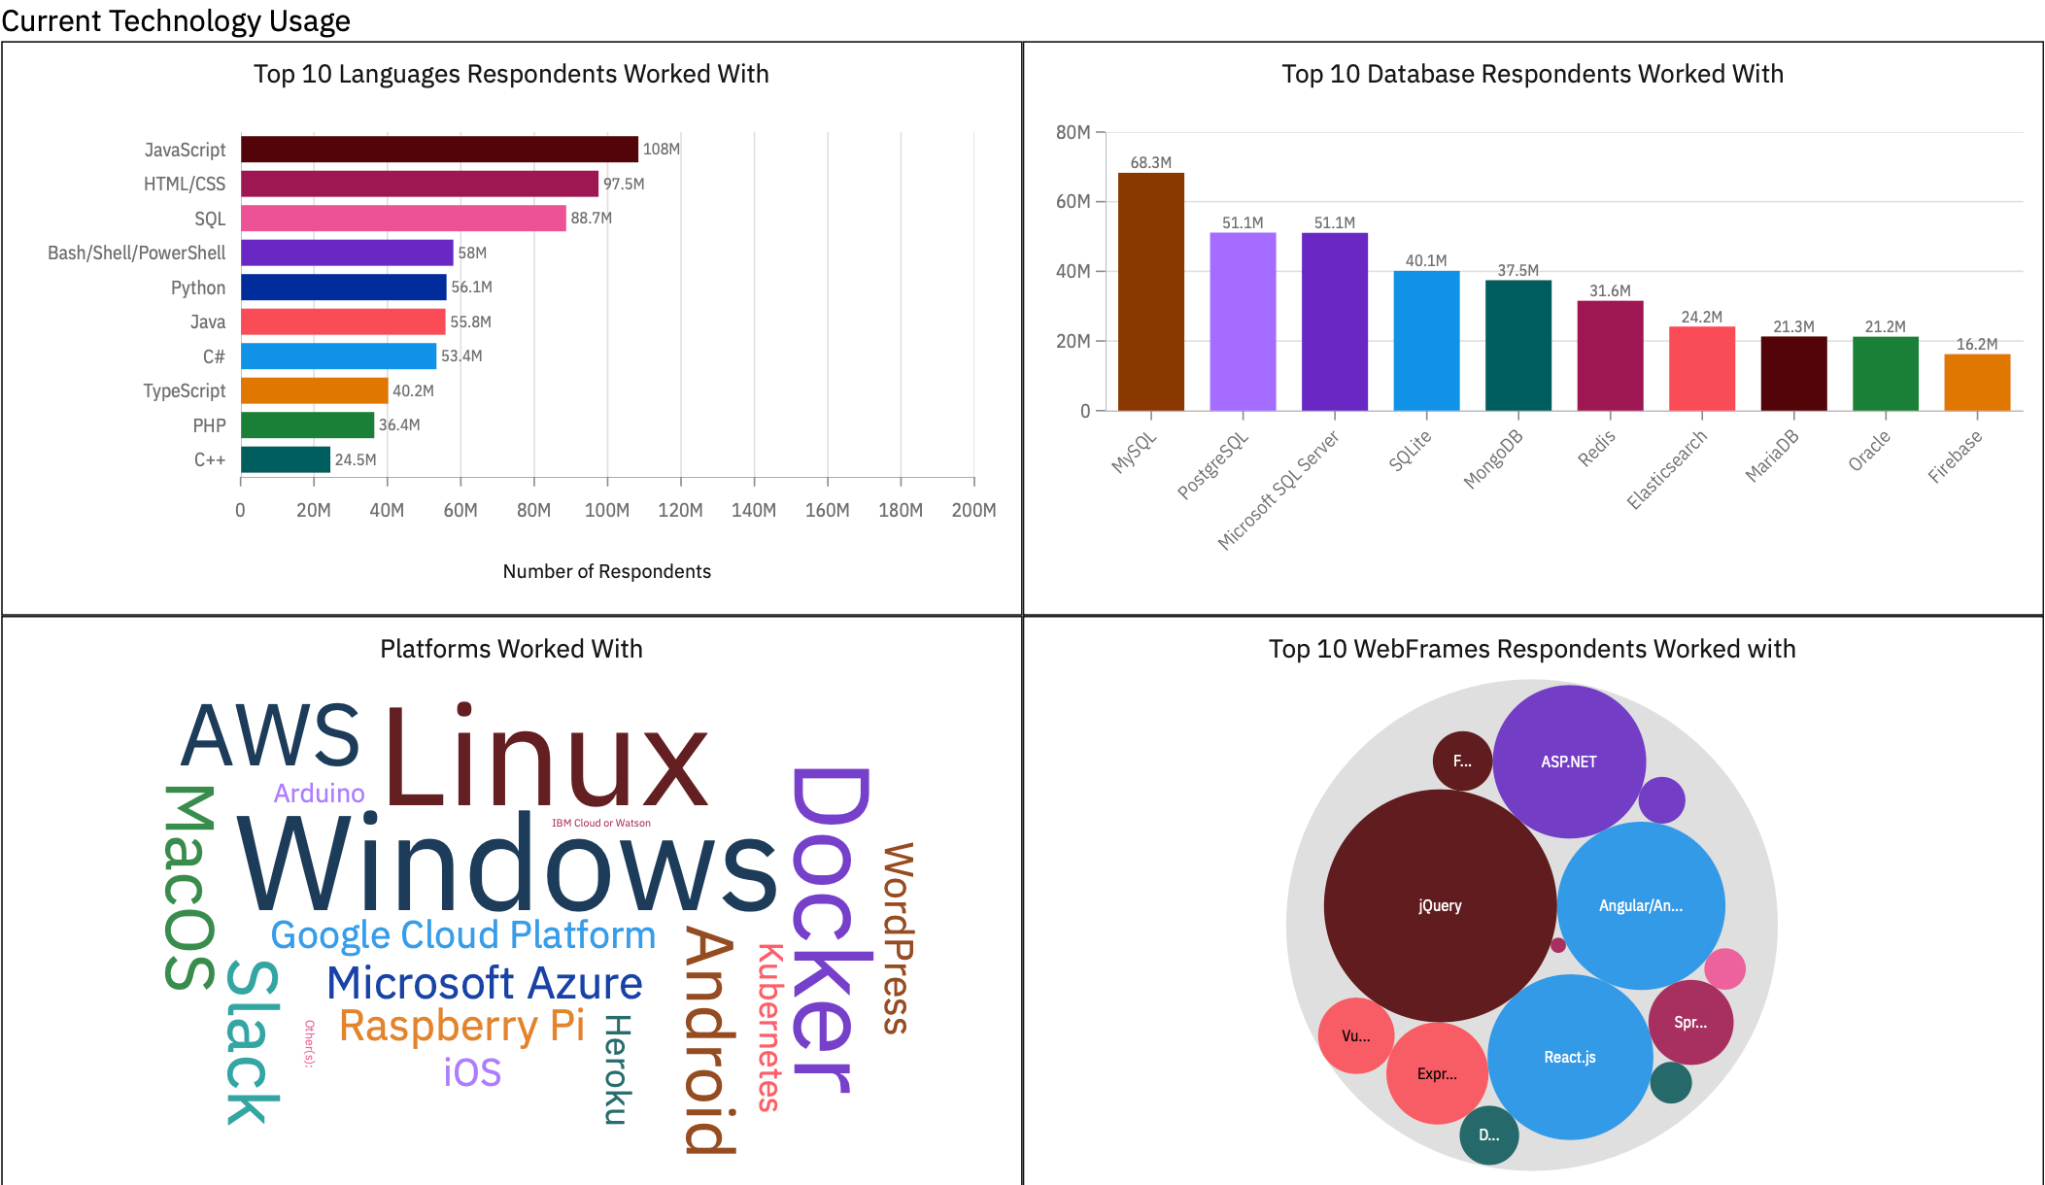
DASHBOARD TAB 1

Slide 13
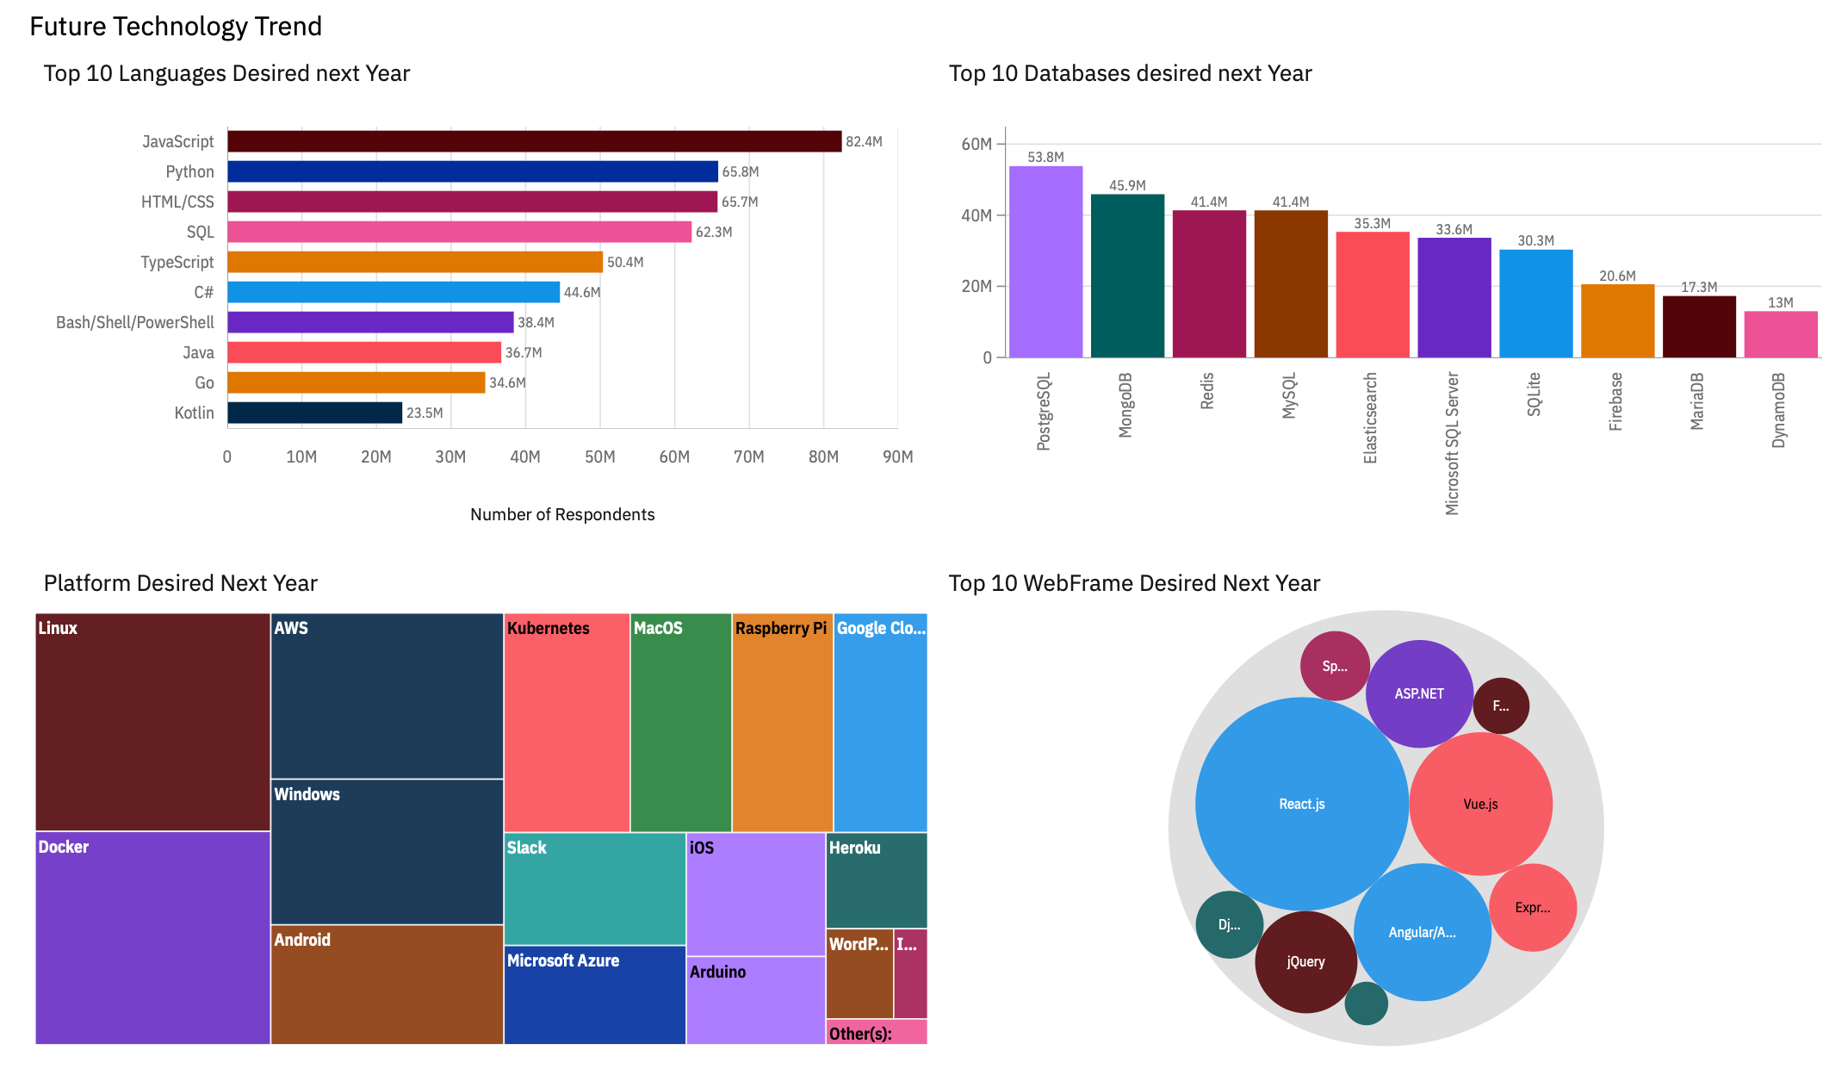
DASHBOARD TAB 2

Slide 14
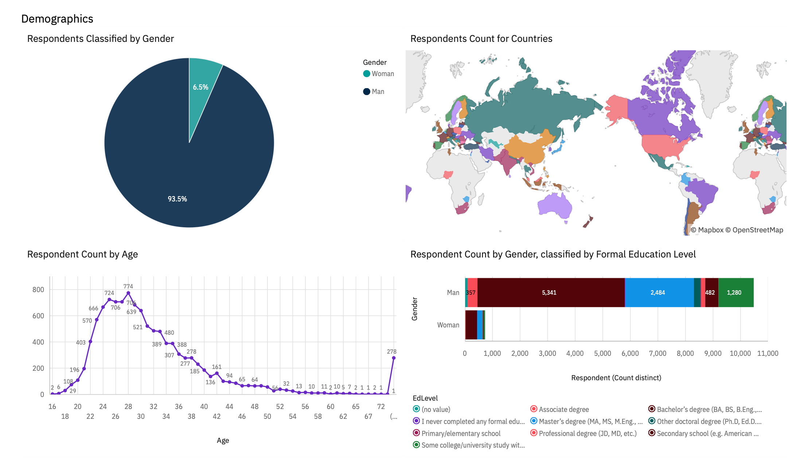
DASHBOARD TAB 3

Slide 15
DISCUSSION
Python will see a strong rise as it has one of the highest jump from 56M to 65M respondents interested in it.
PostgresSQL, MongoDB and Redis databases will become more accessible with reducing cost and increasing Integrations with other technologies and cloud.
Webframes like React.js, Vue.js and angular are on the rise along with continued support to Javascript.
There is a big difference in Men and Women respondents as per to the gender distribution pie chart.

Slide 16
OVERALL FINDINGS & IMPLICATIONS
Findings
Programming languages like Javascript, Python, HTML/CSS and SQL will continue to dominate the market with new features and updates, while languages like C++ and PHP continues to decline.
With more affordability and integrations PostgresSQL, MongoDb and Redis can see a sharp increase in usage.
With With just 6% of women in respondents its safe to assume that there is a big difference between availability if Men and Women developers in the market.
Implications
With JavaScript and Python rising there will be a larger talent pool available making it easier for companies to hire developers.
Companies can move from one database based on the new features, cost, integration and efficiency of Databses.
It will be difficult to maintain diversity in the teams in the current situation as there is a large difference in women and men developer as per to the survery.

Slide 17

CONCLUSION
Continue to expand teams on the Javascript projects and find more opportunities where Javascript can be leveraged along with the webframes like React, Vue and Angular.
Explore new databases as they become more cost effective and efficient with new technological advancements.
Due to less Women developers in the job market, avoid stricter criterias during evaluation and provide trainings for growth.

Slide 18

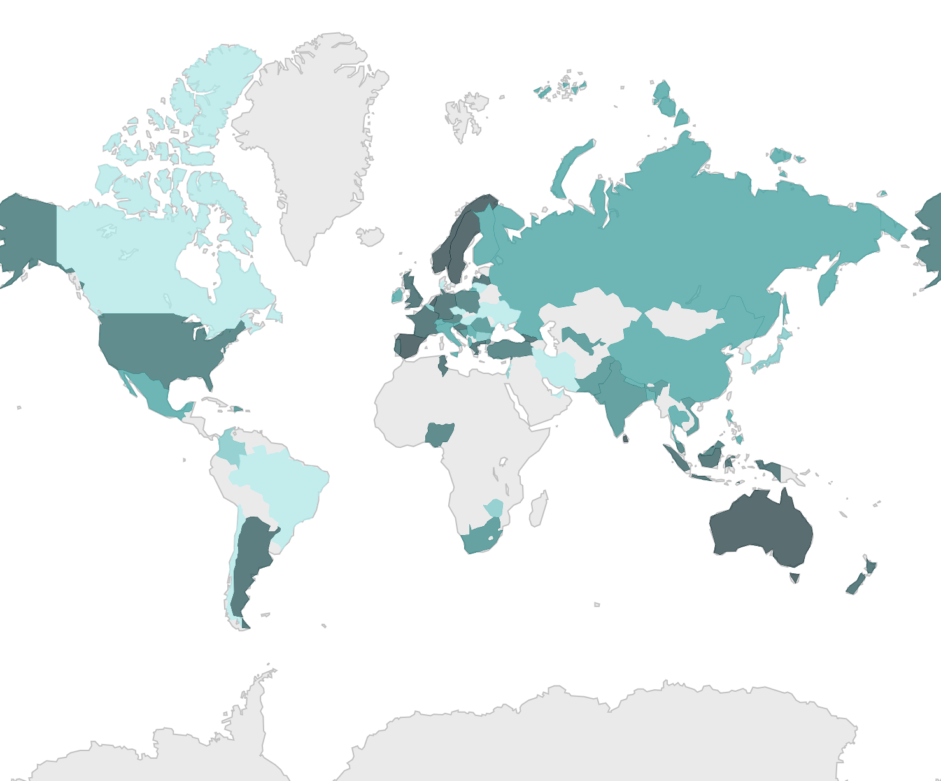
APPENDIX
Respondents as per to the country

Slide 19
JOB POSTINGS

Slide 20
POPULAR LANGUAGES

