Slide 1

Enhancing Aspect-Based Sentiment Analysis Using Self Attention and Gated Convolutional Networks Authors - Jian Yang and Juan Yang Published year- December 24,2020
Name: Sai Charan Kalikota ID: 700755456

Slide 2
Motivation
Traditional sentiment analysis a straightforward technique to classify the text into positive, negative and neutral and typical sentiment analysis has limitations. Traditional sentiment analysis fails to capture sentiments towards understanding individual features negations and complex context in the text. The motivation behind this study is to explore detailed and nuanced insights in the text using more advanced techniques like Aspect-Based Sentiment Analysis to gain comprehensive sentiment understanding.

Slide 3
Problem statement
The focus of this research is on addressing the challenges of traditional sentiment analysis by implementing Aspect-Based Sentiment Analysis, which involves identifying specific aspects of the text and also deals with cross-domain sentiment analysis, where traditional sentiment analysis methods fail to generalise data from various domains.

Slide 4
Objectives
The main objectives of the project are:
The primary goal of the project is to design and implement the ABSA(Aspect-Based Sentiment Analysis) model which extracts the sentiments at the aspect level. The whole project is divided into two sub tasks ACSA (Aspect Category Sentiment Analysis)task and ATSA(Aspect Term Sentiment Analysis).
The project aims to integrate self-attention mechanism to ABSA model which allows to focus on semantic relationships and long-range dependencies in a sequence .
The other objective of the project is to incorporate Gated Convolutional Networks which captures the local patterns and dependencies

Slide 5

Contributions-I
To address the issues of cross-domain sentiment analysis, the project introduces numerous novel methods, including aspect-based sentiment analysis, sentiment-aware word embeddings, and transfer learning techniques.
In the past, a time serial algorithm is implemented using Long Short-Term Memory (LSTM) or Recurrent Neural Network (RNN), which requires longer training time and has more complex architecture. Furthermore, many earlier models are unable of learning the internal structure elements of sentences successfully. In this project aspect-category sentiment analysis (ACSA) and aspect-term sentiment analysis (ATSA) are implemented to extract the aspects of the sentiments of the sequence.

Slide 6
Contributions-II
Sentence structure plays a crucial role in Aspect-Based Sentiment Analysis. ambiguous or complex sentence structures may make it challenging for the model to accurately pinpoint the aspects, leading to potential errors in sentiment analysis. To avoid this problem self-attention algorithm and gating mechanisms are incorporated. Using self-attention mechanism we extract the structural features of the data and by CNN we extract the general features of the data in the end we combine to make a final classification.

Slide 7

Critical Analysis
THE DOCUMENT SUCCESSFULLY OUTLINES THE IMPORTANCE AND RELEVANCE OF ABSA IN CONTEMPORARY SENTIMENT ANALYSIS TASKS. IT PROVIDES A DETAILED ACCOUNT OF THE VARIOUS METHODOLOGIES EMPLOYED IN ABSA, EFFECTIVELY BRIDGING THE GAP BETWEEN THEORETICAL CONCEPTS AND PRACTICAL APPLICATIONS. HOWEVER, THE PAPER COULD BENEFIT FROM A MORE CRITICAL EXAMINATION OF THE LIMITATIONS AND POTENTIAL BIASES INHERENT IN ABSA MODELS. FOR INSTANCE, THE DISCUSSION ON THE CHALLENGES COULD BE EXPANDED TO INCLUDE MORE EXAMPLES OF HOW CULTURAL AND LINGUISTIC DIFFERENCES IMPACT THE PERFORMANCE OF ABSA SYSTEMS. ADDITIONALLY, WHILE THE DOCUMENT TOUCHES UPON THE EVALUATION METRICS FOR ABSA, A MORE DETAILED COMPARISON OF DIFFERENT MODELS USING THESE METRICS WOULD ENHANCE THE READER'S UNDERSTANDING OF THEIR RELATIVE STRENGTHS AND WEAKNESSES.

Slide 8
Results
For the experimental analysis SemEval dataset is used. For ACSA (Aspect Category Sentiment Analysis)task, we use restaurant dataset of SemEval 2016 , and for the ATSA(Aspect Term Sentiment Analysis) task, we use the original restaurant and laptop datasets of SemEval 2014.
In the experimental analysis we used following parameters.
A 300-dimension pre-trained GloVe vectors for the initialization of word embeddings
self-attention, the head number is set to 1 for test and dropout rate to 0.5 to prevent over fitting

Slide 9
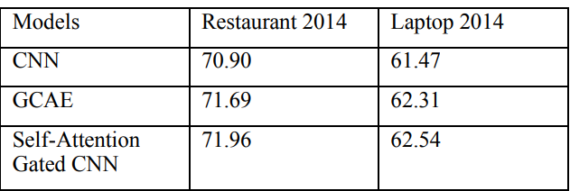
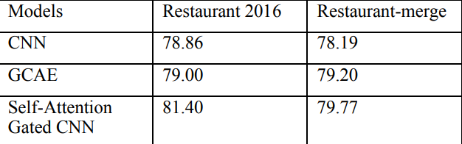
Results
FIG.1.AVERAGE ACCURACY OF MODELS FOR ATSA IN 10
EXPERIMENTS
FIG.2.AVERAGE ACCURACY OF MODELS FOR ACSA IN 10
EXPERIMENTS

Slide 10
Results
Experiments shows that the new model based on gating mechanism, combined with convolutional neural networks (CNN) and self-attention mechanism has improvement on both ACSA and ATSA tasks, which proves the effectiveness of this model.

Slide 11
References
[1].K. Bayraktar, U. Yavanoglu and A. Ozbilen, "A Rule-Based Holistic Approach for Turkish Aspect-Based Sentiment Analysis," 2019 IEEE International Conference on Big Data (Big Data), Los Angeles, CA, USA, 2019, pp. 2154-2158, doi: 10.1109/BigData47090.2019.9005473.
[2].J. Ma, X. Cai, D. Wei, H. Cao, J. Liu and X. Zhuang, "Aspect-Based Attention LSTM for Aspect-Level Sentiment Analysis," 2021 3rd World Symposium on Artificial Intelligence (WSAI), Guangzhou, China, 2021, pp. 46-50, doi: 10.1109/WSAI51899.2021.9486323.
[3].W. L. Kay Khine and N. T. Thwet Aung, "Multi-Aspect Attention Model for Aspect-based Sentiment Classification Using Deep Learning," 2020 International Conference on Advanced Information Technologies (ICAIT), Yangon, Myanmar, 2020, pp. 206-211, doi: 10.1109/ICAIT51105.2020.9261803.

