Slide 1

SMART IRRIGATION

Slide 2
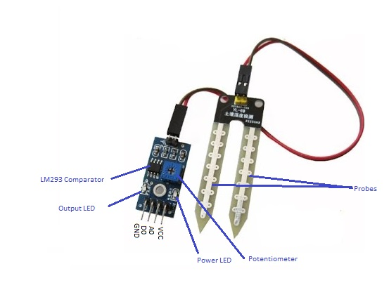
SOIL MOSITURE SENSOR

Slide 3
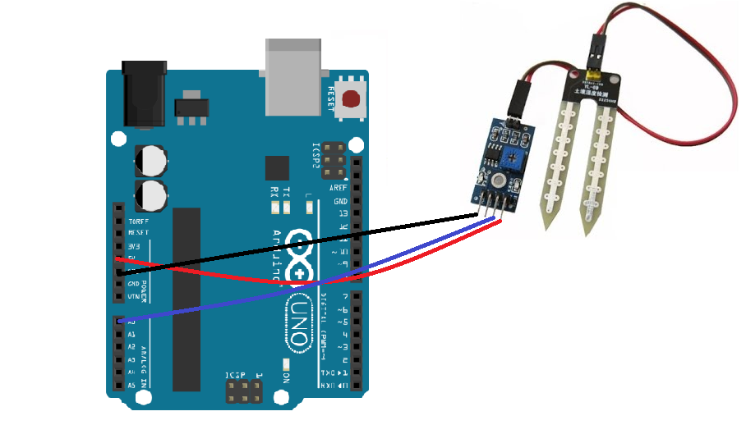

Slide 4
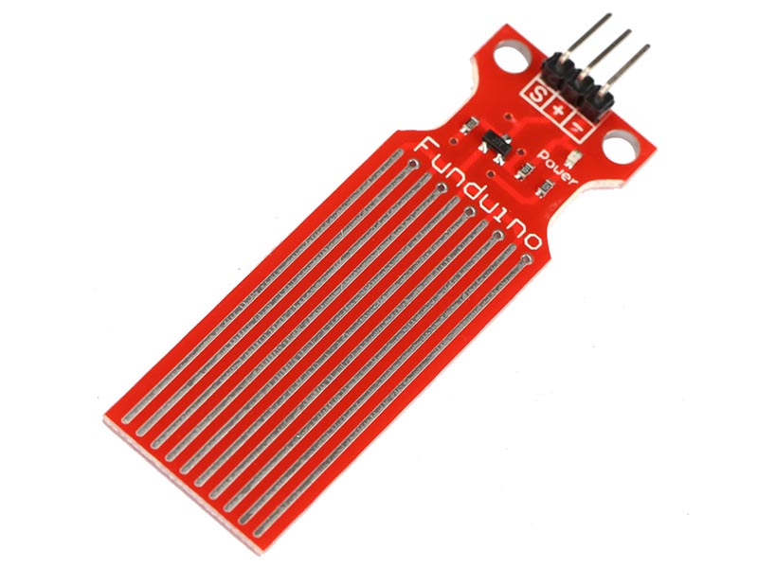
WATER LEVEL DETECTOR

Slide 5
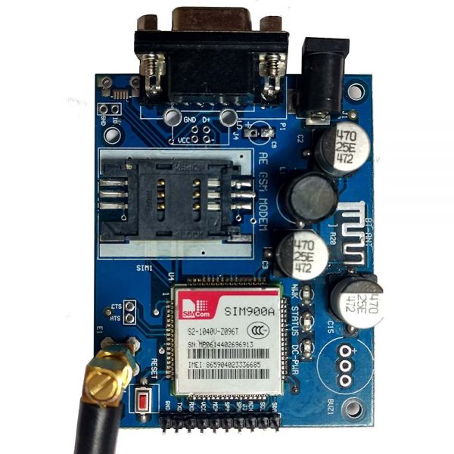
GSM MODULE

Slide 6
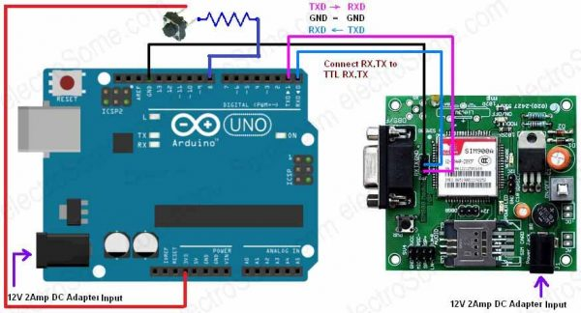

Slide 7
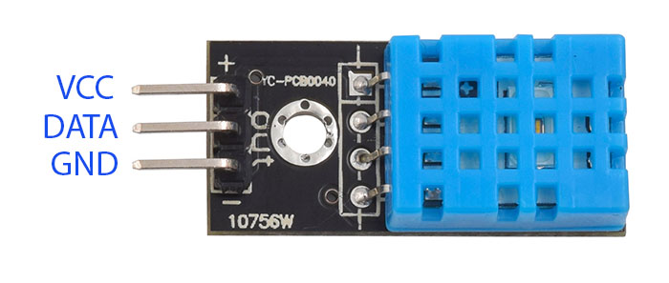
DHT11 SENSOR

Slide 8
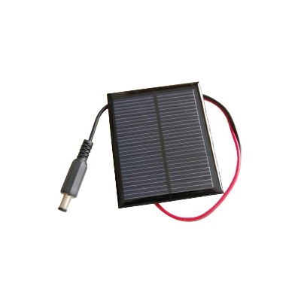
SOLAR PANEL

Slide 9
