Slide 1
Project proposal
Computer Vision
Autonomous Patrol Simulator
PROTOTYPE STATUS
Working GUI and navigation pipeline
6 headless tests passed
Real-footage evaluation proposed
From a camera frame to an explainable
simulated navigation decision
Software-only educational system • 3 October 2026
COMPUTER VISION AUTONOMOUS PATROL SIMULATOR
1

Slide 2
Problem and project question
The problem
Our question
Object detection identifies what appears in an image. It does not, by itself, show which route is less risky or explain a navigation command.
How can monocular detections, image geometry, and transparent risk rules produce stable simulated decisions?
Goal: make every step from object box to steering recommendation visible and testable.
COMPUTER VISION AUTONOMOUS PATROL SIMULATOR
2

Slide 3
Project objectives and scope
01
Detect and track
Selected people, vehicles, bicycles, buses, trucks, and chairs.
02
Understand scene layout
Zones, projected corridor, approximate proximity, and apparent approach.
03
Recommend an action
Compare left and right risk; choose straight, turn, or stop.
04
Explain and evaluate
Show the reason in the GUI; replay scenes and inspect failures.
Scope: desktop simulation only; no motors, measured depth, or safety claim.
COMPUTER VISION AUTONOMOUS PATROL SIMULATOR
3

Slide 4
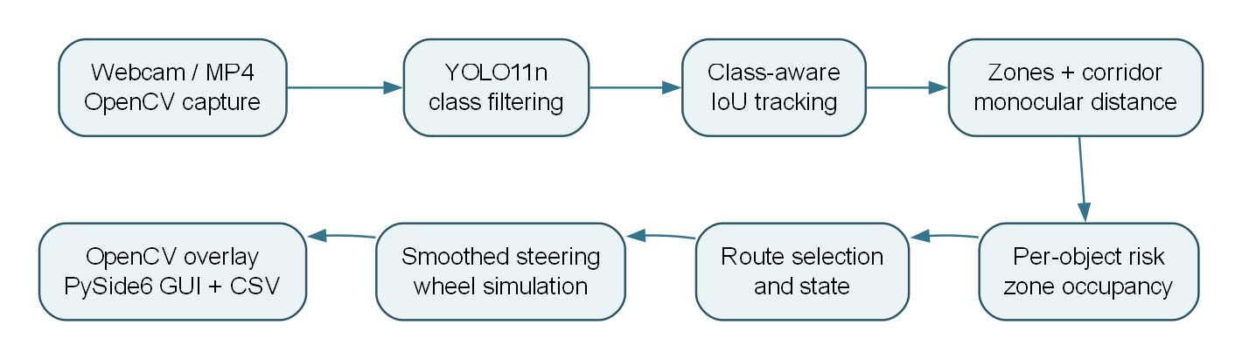
How the system works
Frame → objects → tracking → geometry → risk → route choice → steering and wheel simulation
The dashboard displays the frame, estimated proximity, corridor risks, selected action, and reason.
COMPUTER VISION AUTONOMOUS PATROL SIMULATOR
4

Slide 5
Computer vision contribution
Perception
Spatial reasoning
YOLO11n returns classes, confidence, and bounding boxes. IoU matching assigns track IDs and box-area trends suggest approach.
Box centers select image zones. Box height gives an approximate distance; a center corridor and lower-frame position add risk.
Scene risk
Explainability
Risk combines proximity, size, class, confidence, location, and approach. Zone risks are combined for each side.
The GUI shows the primary threat, its estimated distance and risk, left/right corridor totals, and the selected action.
Distance and risk are heuristics, not calibrated physical measurements.
COMPUTER VISION AUTONOMOUS PATROL SIMULATOR
5

Slide 6
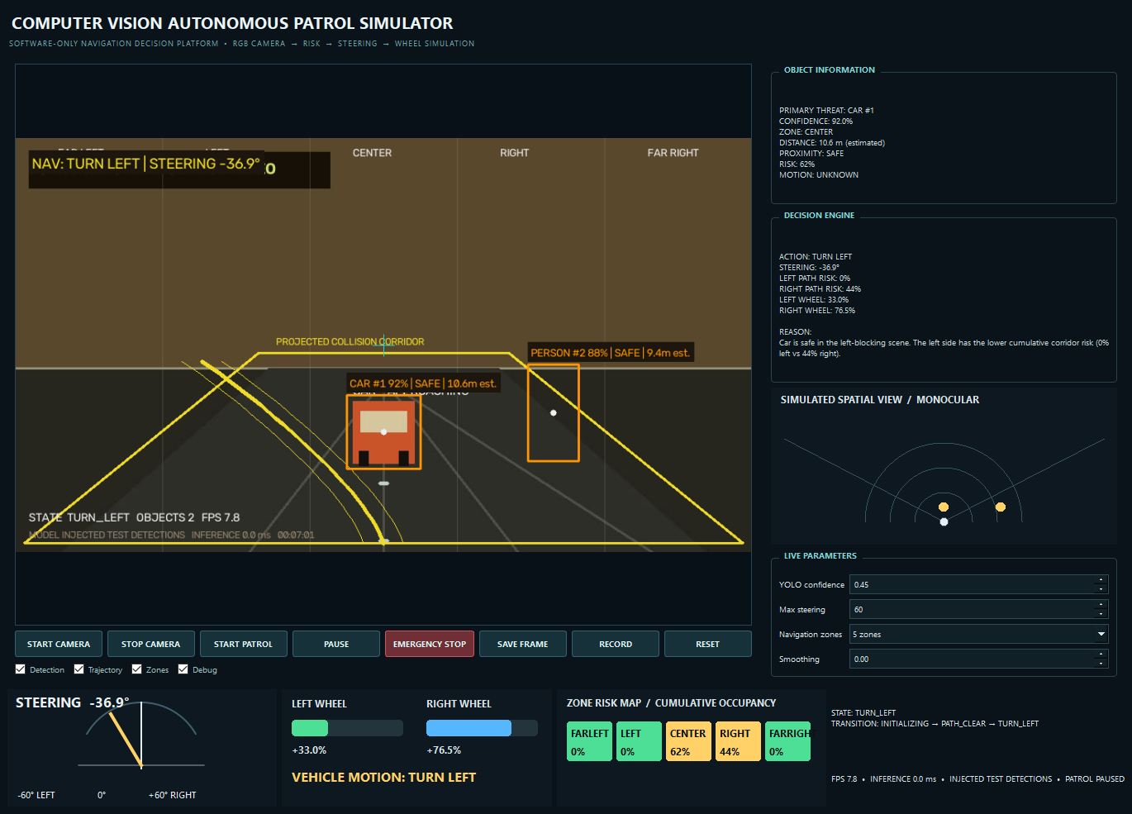
Current prototype demonstration
CONTROLLED TURN SCENE
A center car and a right-side person raise risk on the right. The simulator selects TURN LEFT, with the left wheel slower than the right.
Figure provenance
Real GUI capture with injected test boxes over synthetic video; not a YOLO accuracy result.
COMPUTER VISION AUTONOMOUS PATROL SIMULATOR
6

Slide 7
Validation and next steps
Evidence already available
Proposed evaluation
Working webcam/video dashboard.
Six navigation tests passed.
Controlled clear, turn, and stop screenshots.
YOLO model loaded on CPU.
Use real footage with configured classes.
Record detection and tracking behavior.
Measure FPS and inference time.
Resolve pause, stop-delay, and corridor-display inconsistencies.
Outcome: a reproducible teaching and research demonstration with clearly reported limits.
COMPUTER VISION AUTONOMOUS PATROL SIMULATOR
7

