Slide 1
Superstore Sales & Profit Analysis using Power BI
By
N. Sri Charan

Slide 2
Objective
Purpose of the Analysis:
Understand sales and profit patterns
Gain actionable business insights from visual data
Identify best-performing segments, regions, and categories

Slide 3
Tools & Process
Power BI for dashboard creation and analysis
Excel for initial date formatting
Steps involved:
Data Cleaning (date format issues)
Chart Creation
Insight Extraction
Dashboard Design

Slide 4
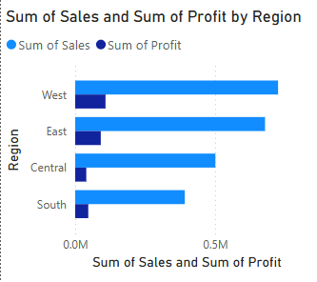
Sales & Profit by Region
"West and East regions lead in both sales and profit. Central shows decent sales but lower profit, indicating a potential margin issue."

Slide 5
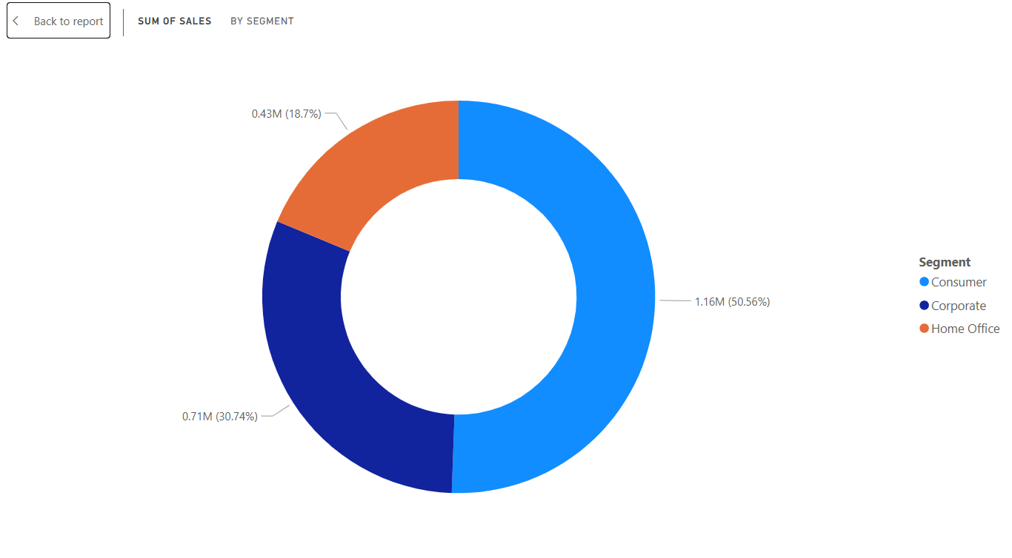
Sales by Segment
"Consumer segment dominates sales, accounting for more than half of all revenue."

Slide 6
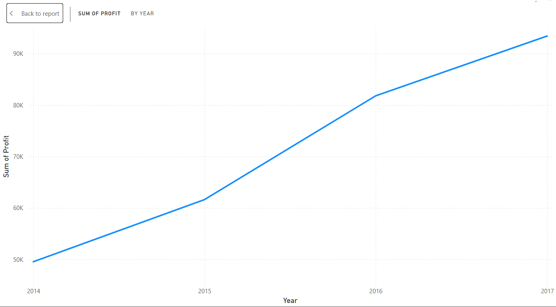
Profit Trend by Year
"Profit shows a steady upward trend from 2014 to 2017, with a sharp rise in 2016."

Slide 7
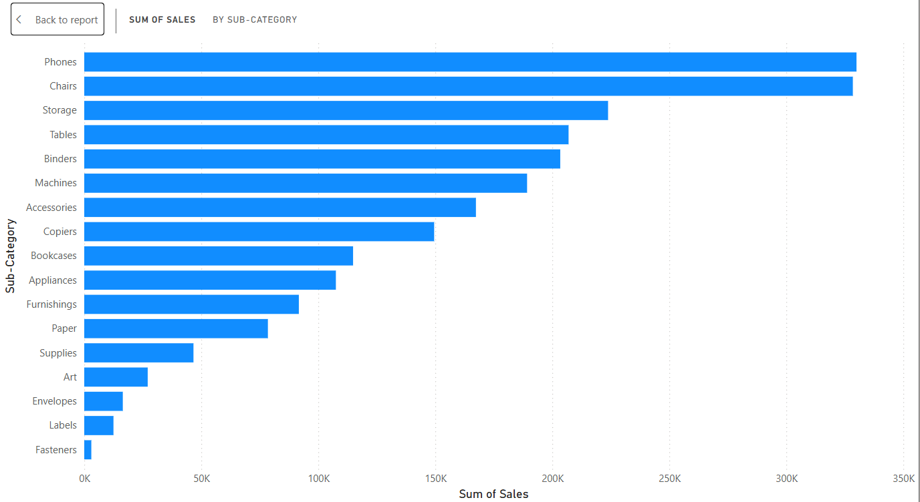
Sales by Sub-Category
Tracking and understanding your income sources and spending habits

Slide 8
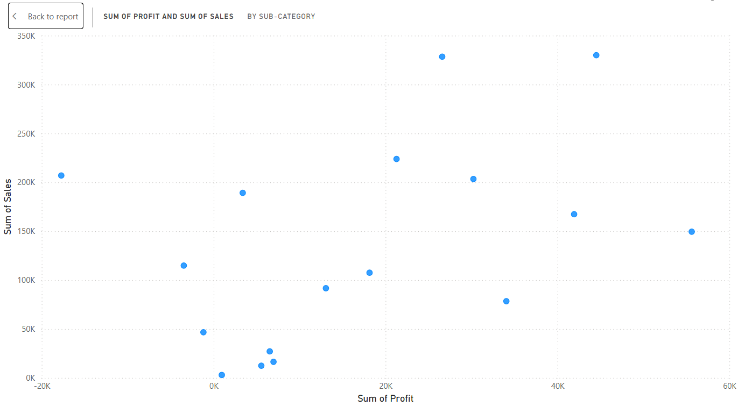
Profit vs Sales by Sub-Category
"Phones and Copiers generate both high sales and high profit. Tables show high sales but low profit."

Slide 9
Summary & Storyboard
01
Steady profit growth from 2014–2017
02
Phones and Chairs generated the highest sales
03
West and East regions are high performers
04
Consumer segment drives the highest revenue

Slide 10
Thank You

