Slide 1
Data Cleaning steps
1. Clean column names 2. Fix structural errors 3. Remove empty rows 4. Remove or identify constant data 5. Remove or identify duplicates 6. Find outliers
7. Impute Missing Data
Notes:
Did not find empty rows , or duplicates for both datasets.

Slide 2
Data Cleaning |Clinical data
Participant ID 2 (possibly) and weight of 23.wo is an error. Changed weight to NA
Replaced 999/99999/999999 to NA throughout the dataset
Changed prefer not to answer responses for sex and gender to NA
Created BMI variables from height and weight to further filter out unusual responses in the future
Participation_information_complete had 2 response for yes
Notes:
- Many 999 (unknown) and some 99999/999999 values for height and weight
And BMI variables could be useful for regression
Changed binary variables to factor in R

Slide 3
Data Cleaning |Clinical data
Duplicates within dx_other_dis_text, need to merge some responses
dx_schizo had only values of 1
Mental health responses changed to 0 based on mentalhealth_screen (decreased NAs by 83% for each)
clinical_data %>% mutate(across(dx_anx:dx_tics, ~ ifelse(is.na(.) & menthealth_screen == 0, 0,.)))
2136 distinct participants (no duplicate ids)
1503 families
Notes:
Made sure data class represents the type of variable ( weight is numeric, was text before)
No empty rows
No duplicate rows (check if repeated participants)
This is an example of cleaning with domain knowledge

Slide 4
Data Exploration| Clinical data
Outlier for age at enrollment at -16.02 for female participant 11856
Outliers for height and weight, some numbers seem impossible.
Potential outliers for t-scores in dataset
Notes:
-Data exploration is about asking questions
Why are participants missing values
When are missing values, what date ? etc
- Also made a function to capture all outliers
-Could ask a physician about the outliers or other expert

Slide 5
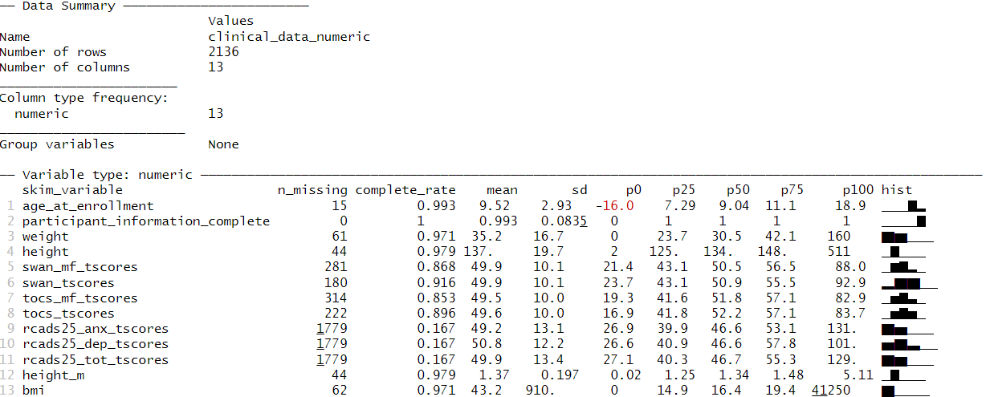
Notes:
-Seems like some kind of scaling factor and constant being added to tscores

Slide 6
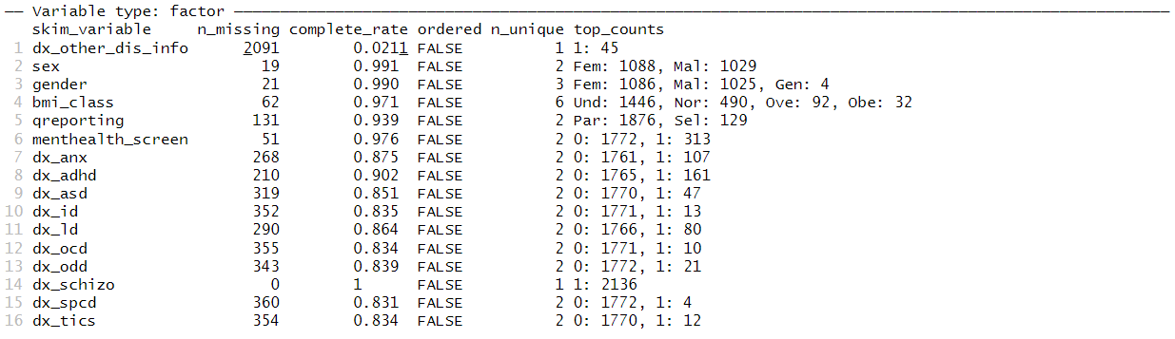
Notes:
Mainly parents filled out questionnaire (recall bias ?)
- Cleaned mental health questions, except dx_schizo

Slide 7
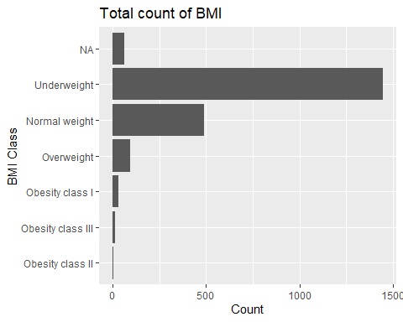
Data Exploration| Clinical data|
Notes:
Participants are primarily underweight
- Further would see how big the families are in the dataset

Slide 8
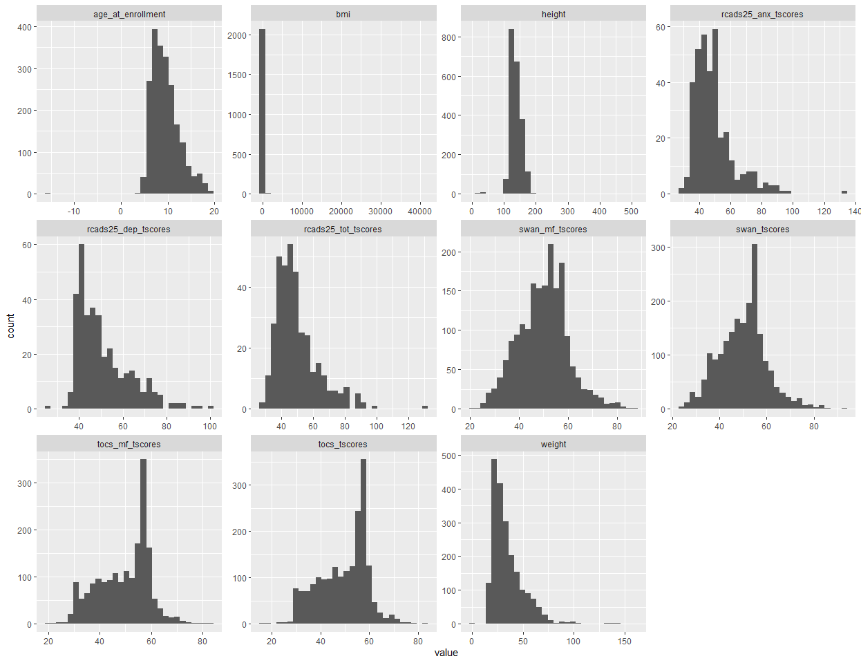
Histograms of all continuous variables in clinical dataset
Notes:
T = ((X - μ) / σ) * 10 + 50
Knowing the distribution can help in small samples

Slide 9
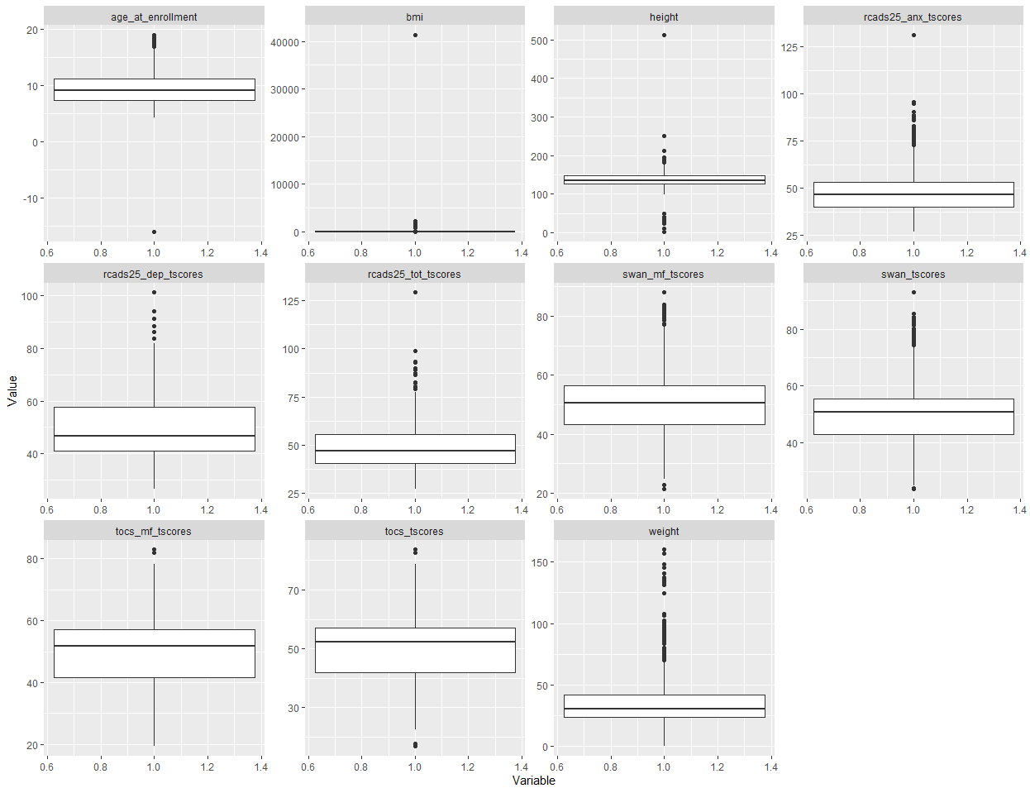
Notes:
- Min: The lowest score, excluding outliers (shown at the end of the left whisker).
Min: Q1 – 1.5 * IQR
Max: Q3 + 1.5 * IQR
- Could have boxplots for different levels of sex

Slide 10
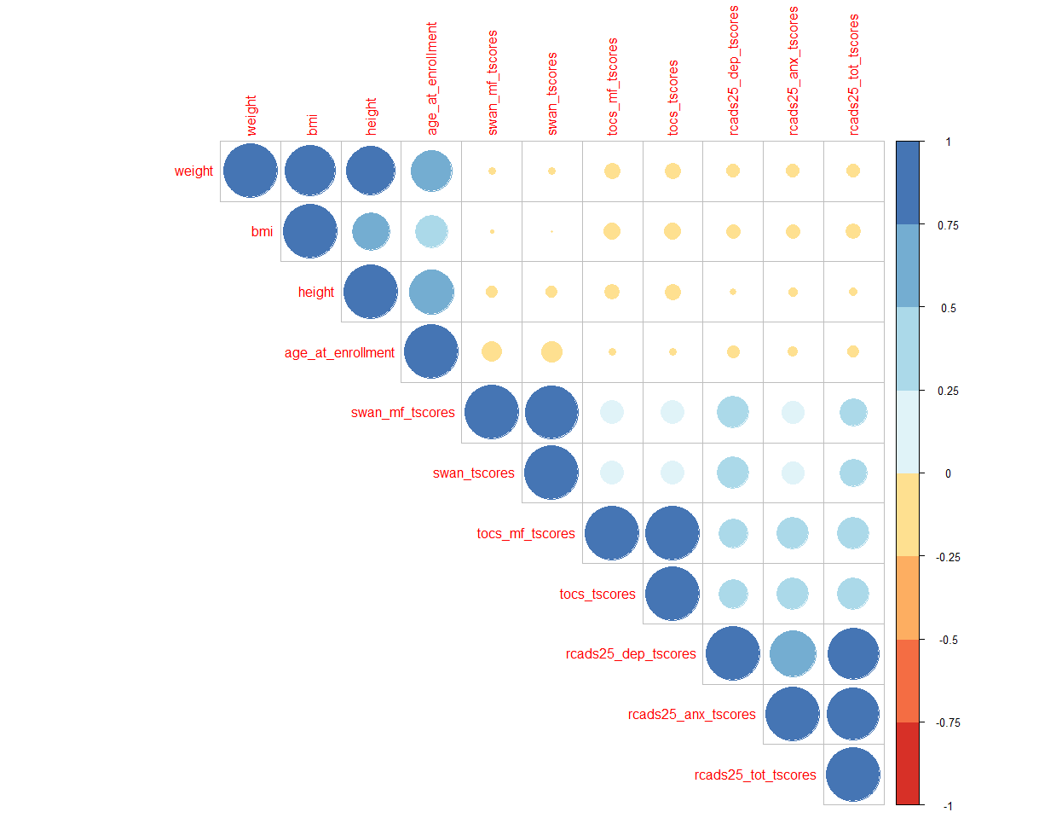
Notes:
Can see from the plot that some t-scores are highly correlated to each other as well.
BMI is obviously going to be highly correlated with height and weight

Slide 11
month | year | total
Feb | 2020 | 661
Dec | 2019 | 611
Jan | 2020 | 598
Nov | 2019 | 130
March | 2020 | 119
NA | NA | 15
Feb | 2004 | 1
Feb | 2015 | 1
Notes:
When did participant most enroll
Useful to check if other models could be use like times series

Slide 12
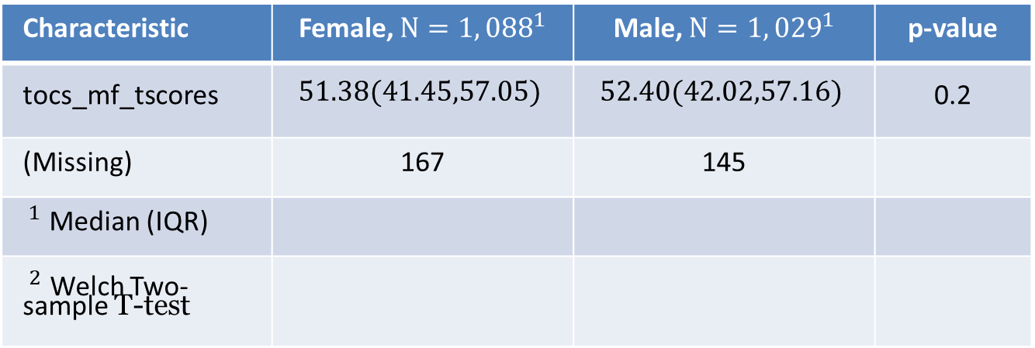
Can use tests for other types of variables
A continuous variable and a categorical variable t-test or anova
Correlation between two categorical variables, chi- squared test
Characteristic | Female, $N=1,{088}^{1}$ | Male, $N=1,{029}^{1}$ | p-value
tocs_mf_tscores | $$51.38(41.45,57.05)$$ | $$52.40(42.02,57.16)$$ | 0.2
(Missing) | 167 | 145
$^{1}$ Median (IQR)
$^{2}$ Welch Two- sample T-test
Notes:
No difference in mean between males and females, thus you could say no association
Should have shown the mean here too

Slide 13
Data Cleaning |Genetic data
participant ID 10194W is an error, changed ID to 10194
449 distinct participants (no duplicate ids)
No empty rows
no duplicate rows

Slide 14
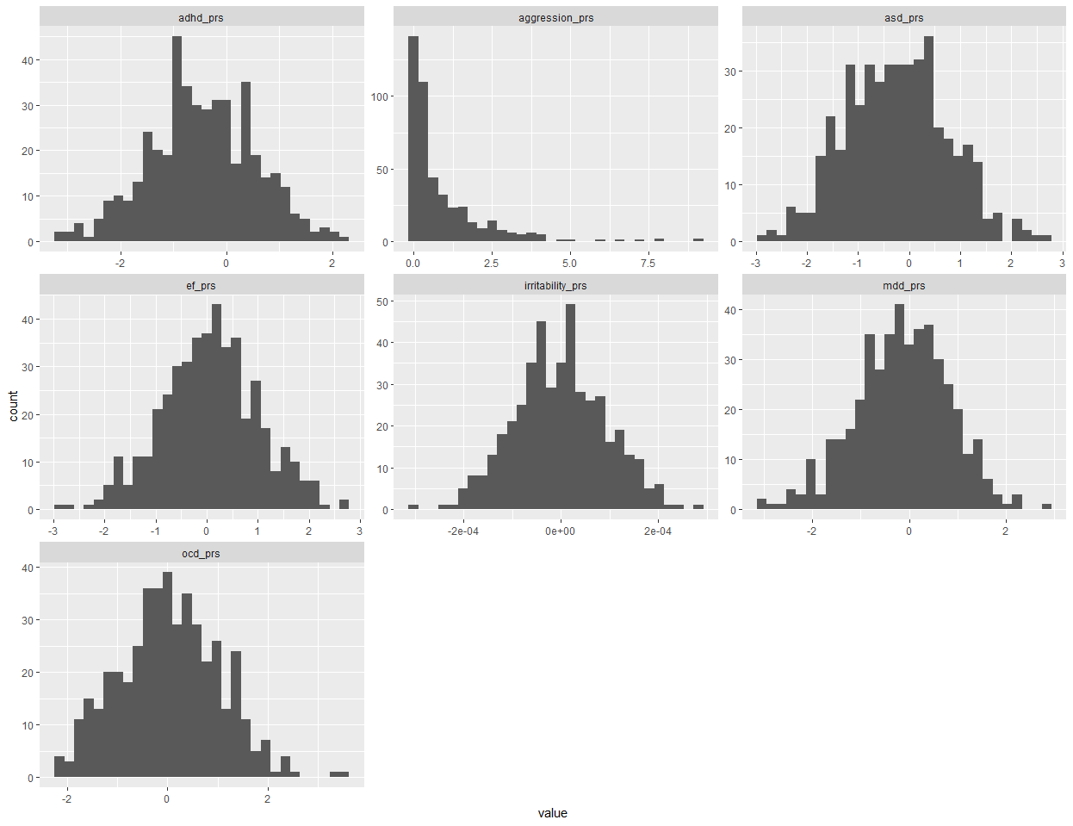
Notes:
- Normally distributed
- Aggression_prs right skewed, possible outliers

Slide 15
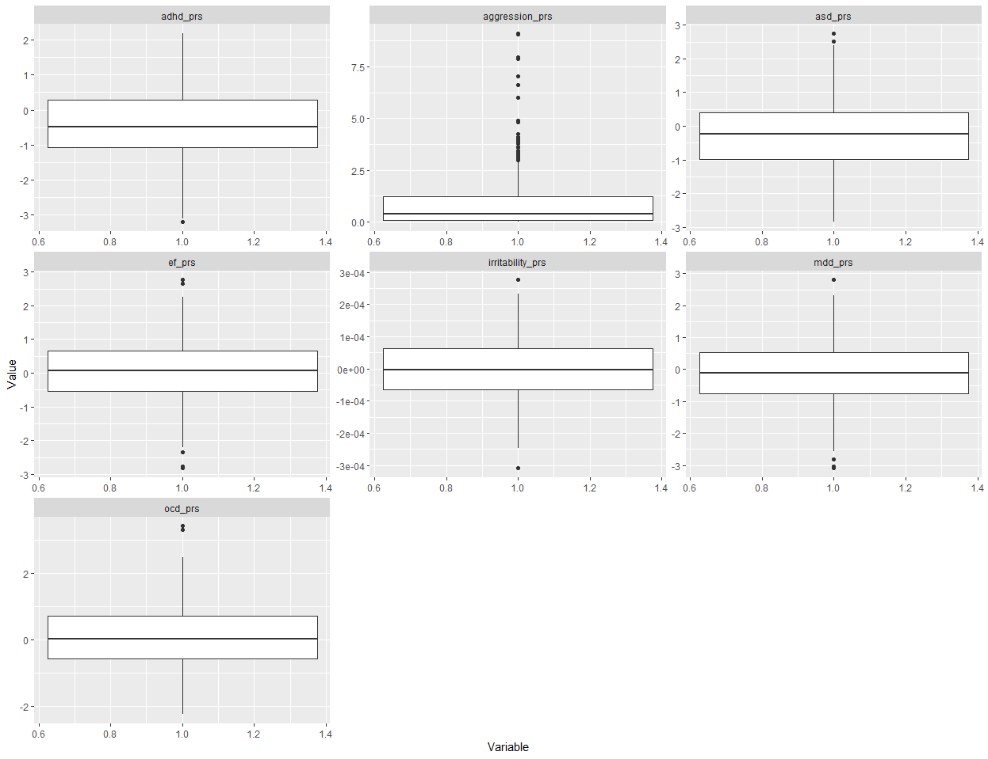

Slide 16
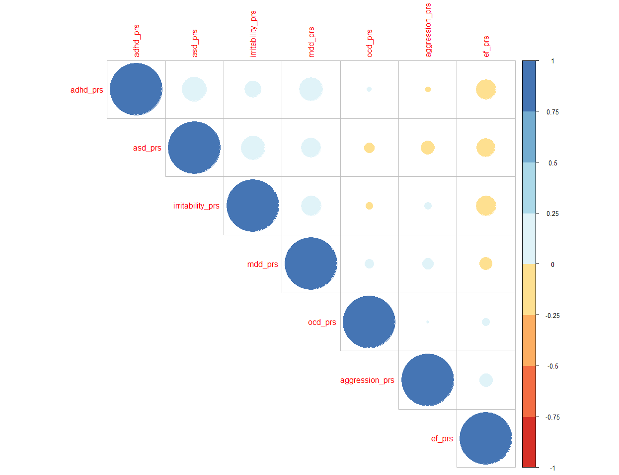
Data Exploration |Genetic Data

Slide 17
Data Merging
Did a inner join to avoid missing values
Missing Completely at Random (MCAR): - Missing data has no relation to any observed or unobserved variables
-(mean, median or most frequent)
Missing at Random (MAR):
- Missingness of one feature can be explained by other variables.
Missing Not at Random (MNAR):
Example: Individuals not reporting their income due to privacy concerns.
Collect more data or ask domain expert
If imputing check the distribution before and after using plots like histograms
Notes:
- Imputing values is complicated and require domain knowledge
- Can introduce bias of imputation is not done correctly

Slide 18
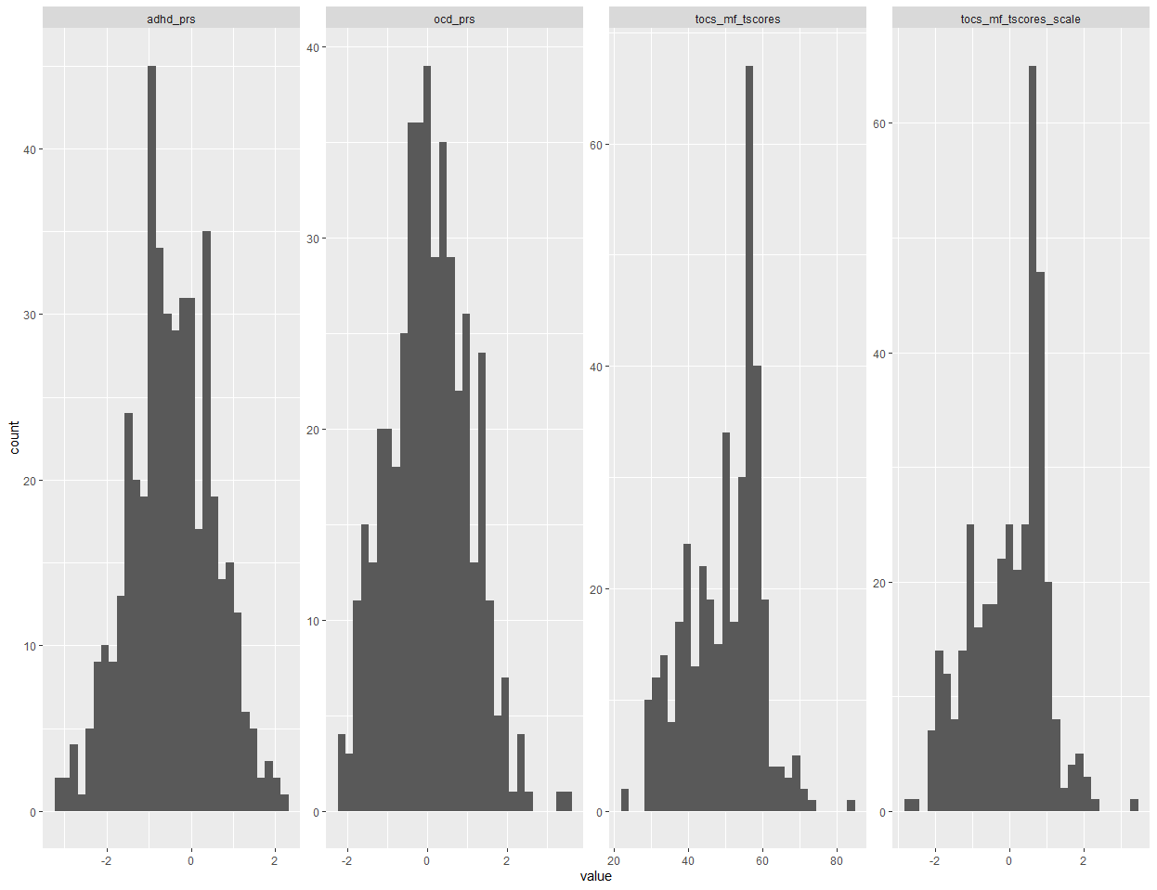
Linear regression

Slide 19
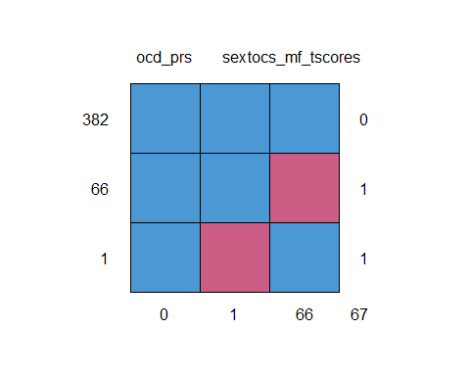
Linear regression
Notes:
look at row patterns for missing data
left are row totals for the amount of time pattern appears
Right is how many missing values in each pattern (row)
Bottom are column total for total amount of missing observations for each variable

Slide 20
Linear regression
Call:
lm(formula = tocs_mf_tscores ~ sex + ocd_prs, data = df)
Residuals:
Min 1Q Median 3Q Max
-28.139 -7.652 2.085 7.444 33.640
Coefficients:
Estimate Std. Error t value Pr(>|t|)
(Intercept) 50.2963 0.6869 73.222 <2e-16 ***
sexMale -1.0060 1.0267 -0.980 0.328
ocd_prs -0.3067 0.5211 -0.589 0.556
---
Signif. codes: 0 ‘***’ 0.001 ‘**’ 0.01 ‘*’ 0.05 ‘.’ 0.1 ‘ ’ 1
Residual standard error: 9.977 on 379 degrees of freedom
(67 observations deleted due to missingness)
Multiple R-squared: 0.00348, Adjusted R-squared: -0.001779
F-statistic: 0.6618 on 2 and 379 DF, p-value: 0.5165
Notes:
A one standard deviation increase in ocd_prs leads to a 0.031 decrease tocs_mf_tscores.-
Being a Males results in 1.01 decrease in tocs_mf_tscores.
(Intercept): outcome for female, ocd_prs=0 (no change in s.d)
p-values high, providing weak evidence against the null hypothesis that coefficients are zero
Multiple R-squared: proportion of variation of tocs_mf_tscores accounted for by our model
Too high can mean oversaturation, model will not be useful for other data
F-Statistic: Testing if all coefficients are zero
Residual standard deviation: provides how well the model predicts tocs_mf_tscores values (badly)
Coefficient std.error: Precision of estimate

Slide 21
Standardized Linear regression
Call:
lm(formula = scale(tocs_mf_tscores) ~ sex + ocd_prs, data = df)
Residuals:
Min 1Q Median 3Q Max
-2.8260 -0.7684 0.2094 0.7476 3.3784
Coefficients:
Estimate Std. Error t value Pr(>|t|)
(Intercept) 0.04722 0.06898 0.684 0.494
sexMale -0.10103 0.10311 -0.980 0.328
ocd_prs -0.03080 0.05233 -0.589 0.556
Residual standard error: 1.002 on 379 degrees of freedom
(67 observations deleted due to missingness)
Multiple R-squared: 0.00348, Adjusted R-squared: -0.001779
F-statistic: 0.6618 on 2 and 379 DF, p-value: 0.5165
Notes:
Intercept here is almost zero
A one standard deviation ocd_prs leads to a 0.03080 standard deviation decrease tocs_mf_tscores.
- Being a Males results in 0.10103 decrease in standard deviation of tocs_mf_tscores.
Being a Female results in 0.10103 decrease in standard deviation of tocs_mf_tscores.

Slide 22
Linear regression assumptions
Linear relationship: There exists a linear relationship between the independent variable, x, and the dependent variable, y.
Independence: The residuals are independent. In particular, there is no correlation between consecutive residuals in time series data.
Homoscedasticity: The residuals have constant variance.
Normality: The residuals of the model should be normally distributed.
No Multicollinearity: None of the predictor variables are highly correlated with each other.
Notes:
Hierarchical structure is an example of non independence.
Use a Linear Mixed model in this case
For a categorical predictor, the linearity assumption is always true.
Multicollinearity because of matrix has to be invertible.

Slide 23
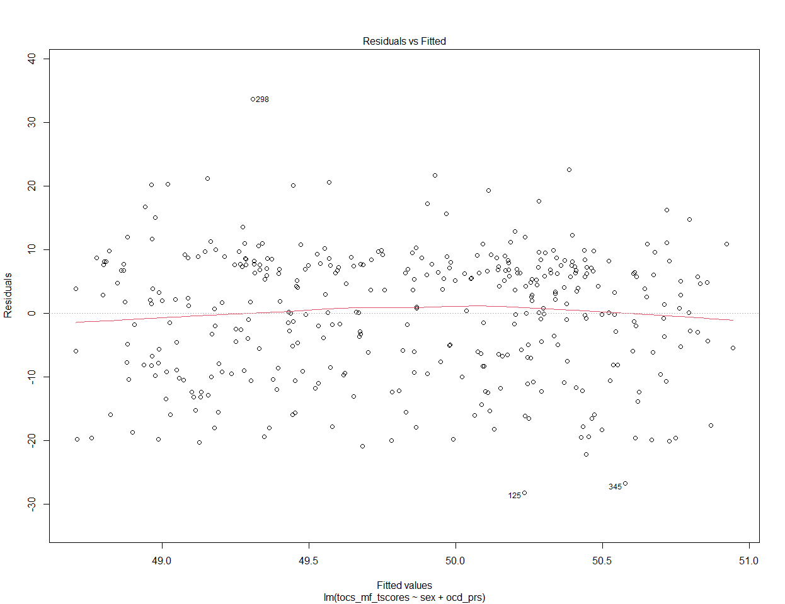
Notes:
- Linearity Assumption
The residual plot will shows no pattern.

Slide 24
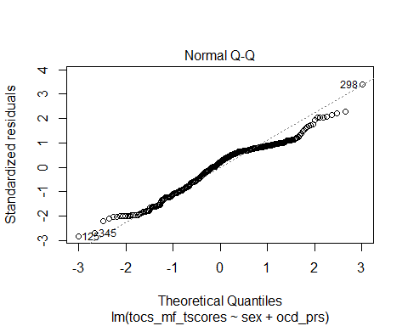
Notes:
-Should be a straight line
-points should be on the dashed line
- Approx normal

Slide 25
## ## Shapiro-Wilk normality test ## ## data: student_resid ## W = 0.96639, p-value = 1.079e-07
Notes:
-The p-value is less < 0.05, the residuals are not normally distributed.
- Could try Box-Cox transformations for negative values.
Reasonably large sample size and graph looks good, could look at outliers.
In my experience as long as the other assumptions hold it should be fine, assuming not a major departure from normality.

Slide 26
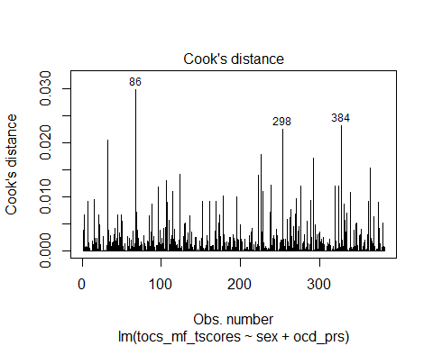
Influential values
Notes:
Can see influential points that effect the regression estimates the most
Such a value is associated with a large residual.

Slide 27
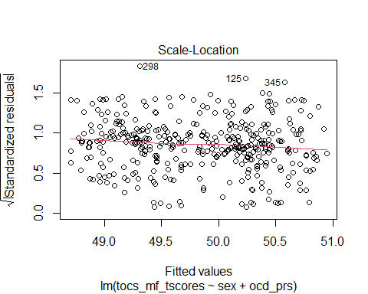
Notes:
For Homoscedasticity Assumption (constant variance)
- Residuals are spread equally along the ranges of predictors.
- Horizontal line with equally spread points.
- In this is the case we can assume Homogeneity of variance

Slide 28
## lag Autocorrelation D-W Statistic p-value ## 1 -0.03512361 2.066691 0.518 ## Alternative hypothesis: rho != 0
Notes:
# durbin watson test
- p-value > 0.05, so the errors are not autocorrelated.
We have not violated the independence assumption.
If we did could hint to us to use Linear Mixed Model with family as random effect

Slide 29
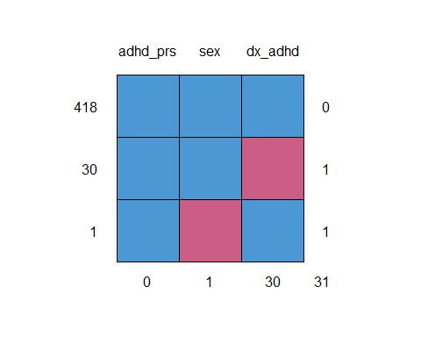
Logistic Regression
Notes:
Response missing 30 times (dx_adhd)
Sex missing once
ADHD_prs not missing

Slide 30
Logistic Regression
## ## Female Male ## 0 218 166 ## 1 10 24
## ## Call: ## glm(formula = dx_adhd ~ sex + adhd_prs, family = binomial, data = df) ## ## Deviance Residuals: ## Min 1Q Median 3Q Max ## -0.6188 -0.5058 -0.3164 -0.2895 2.6107 ## ## Coefficients: ## Estimate Std. Error z value Pr(>|z|) ## (Intercept) -3.1526 0.3383 -9.319 < 2e-16 *** ## sexMale 1.1361 0.3907 2.908 0.00364 ** ## adhd_prs -0.1441 0.1787 -0.807 0.41982 ## --- ## Signif. codes: 0 '***' 0.001 '**' 0.01 '*' 0.05 '.' 0.1 ' ' 1 ## ## (Dispersion parameter for binomial family taken to be 1) ## ## Null deviance: 235.78 on 417 degrees of freedom ## Residual deviance: 225.58 on 415 degrees of freedom ## (31 observations deleted due to missingness) ## AIC: 231.58 ## ## Number of Fisher Scoring iterations: 5
## (Intercept) sexMale adhd_prs ## 0.04273873 3.11456092 0.86576097
Notes:
-Males have a 3.11 increased odds having ADHD over females
-Intercept is a often called a constant term
- Called Adjusted ORs
- A one standard deviation increase in adhd_prs has 0.87 odds (decreased) of having ADHD.
- For rare diseases, can be approx. close to RR
- Null deviance: How well the model with no predictors is fitted
- Residual deviance: Probability fitted vs Observed error with predictors

Slide 31
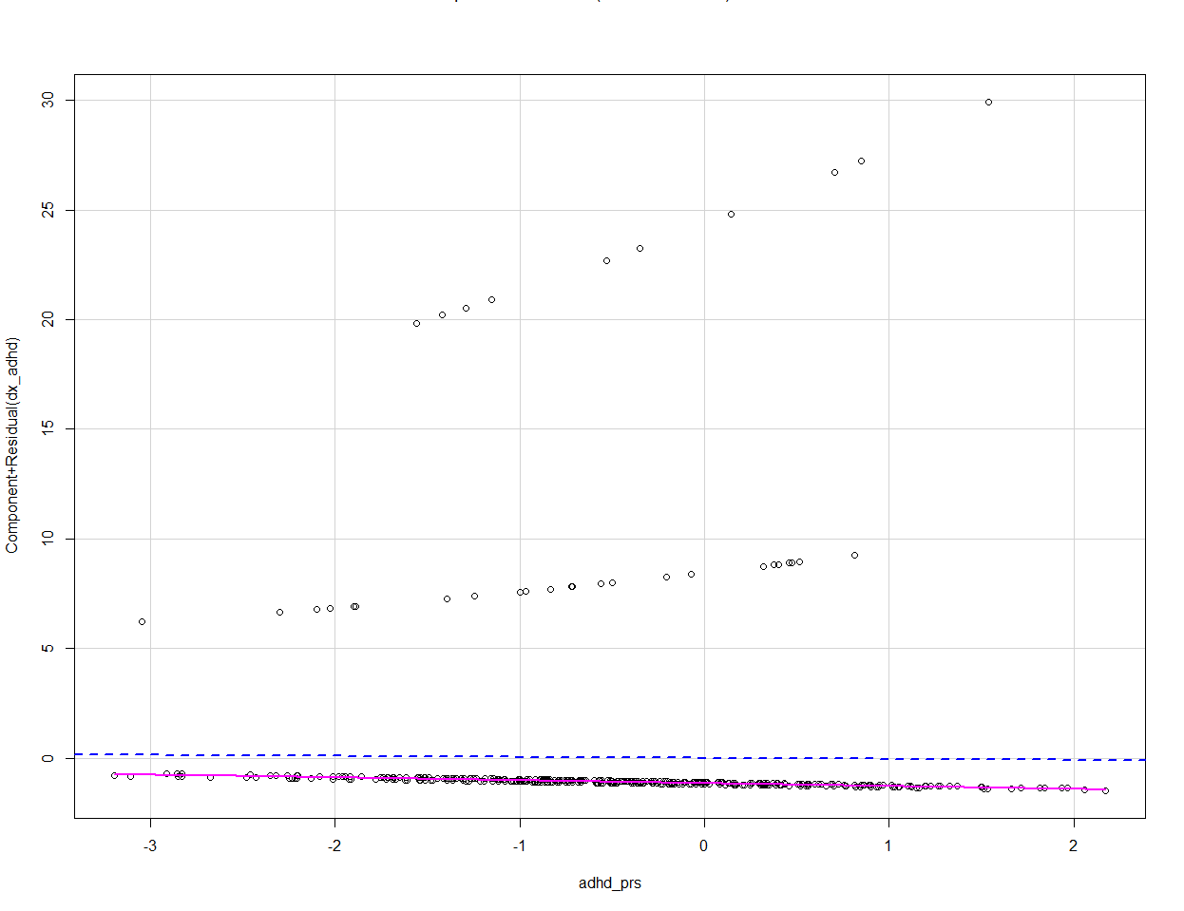
Logistic regression assumptions
Linearity in the logit of the response logit(p) = log(p/(1-p)) and the continuous predictors.
The observations should not be repeated measurements or matched data. (Use another logistic model for this).
Absence of Multicollinearity
Notes:
A partial residual plot essentially attempts to model the residuals of one predictor against the dependent variable.
Red line that is a linear fit of the points, and a blue smoothed conditional mean line
A significant difference between the residual line and the component line indicates that the predictor does not have a linear relationship
Only one continuous variable so no multicollinearity

Slide 32
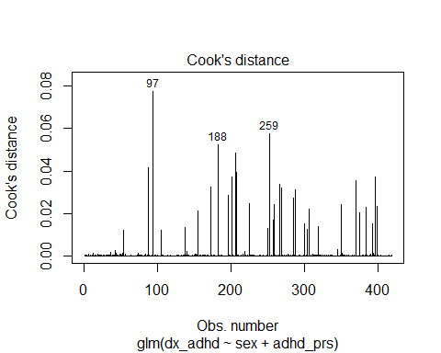

Slide 33
Some texts for reference
Applied logistic regression- Hosmer, David W.Lemeshow, Stanley Sturdivant, Rodney X
Applied Regression- John D. Fox Harvey Sanford Weisberg
Made with R markdown (powerpoint output)

