Slide 1
Knowledge Graph Completion
with R-GCN and CompGCN
Link prediction on ogbl-biokg with a PySpark pipeline on a Kaggle T4
Charan Ponaganti
M Charan
Lalit Deshmane
240150024
240150018
240150044
Big Data course project · November 2026
Notes:
[Charan Ponaganti] ~0:30
Introduce the team and the one-line goal: predict missing links in a large biomedical knowledge graph, using Spark for the data side and graph neural networks for the learning side, all within a free Kaggle T4 GPU.

Slide 2
Roadmap
1 · Problem & data
2 · Models & training
3 · Results & lessons
• What KG completion is
• Why it is a Big Data problem
• ogbl-biokg
• PySpark ETL & scaling
• DistMult, R-GCN, CompGCN
• Fitting GNNs on a 16 GB T4
• Training recipe
• Two evaluation protocols
• Main results (OGB + candidates)
• Ablations & error analysis
• Engineering lessons
• Conclusion & limitations
Charan Ponaganti
M Charan
Lalit Deshmane
≈ 6 minutes per speaker · ~18 min total + Q&A
Speaker: Charan Ponaganti
2
Notes:
[Charan Ponaganti]
~0:45
Walk through the three parts and who presents each. Total ~18 minutes plus Q&A.

Slide 3
The problem: completing a knowledge graph
• Knowledge graph: facts stored as triples (head, relation, tail).
• Problem: real KGs are incomplete; many true links are missing.
• Task: given (h, r, ?) or (?, r, t), rank all entities so the true one is near the top.
• Metrics: MRR (mean reciprocal rank) and Hits@1/3/10.
• Our goal: compare GNN encoders (R-GCN, CompGCN) against shallow embeddings on a real, large KG.
Example query (biomedical)
targets
Drug A
Protein P
treats
associated
Disease D
?
Query: (Protein P, associated, ?) → rank all 93k entities
Speaker: Charan Ponaganti
3
Notes:
[Charan Ponaganti]
~1:15
A KG is a set of (head, relation, tail) facts. Real KGs are incomplete. Link prediction ranks every candidate entity for a query like (aspirin, treats, ?). We rank in both directions: missing tail and missing head. Metrics are MRR and Hits@k: how high the true answer lands in the ranked list.

Slide 4
Why this is a Big Data problem
Dataset | Entities | Relations | Train triples | Fits T4 GNN?
ogbl-biokg | 93,773 | 51 | 4.76M | Yes (sampled)
ogbl-wikikg2 | 2.50M | 535 | 16.1M | No
Wikidata5M | 4.59M | 822 | 20.6M | No
FB15k-237 | 14,541 | 237 | 272k | Yes (too small)
Constraint 1 · Spark
• Cleaning, statistics, indexing, filter tables in PySpark
• Not a hidden pandas step
Decision: train on ogbl-biokg with neighbor-sampled mini-batches; keep Wikidata5M as a Spark-only subset option.
Constraint 2 · Kaggle T4
• 16 GB VRAM · ~30 GB RAM
• 12-hour session limit
• Full-batch GNN on millions of entities does not fit
Speaker: Charan Ponaganti
4
Notes:
[Charan Ponaganti]
~1:15
Two constraints shaped every decision. First, the course requires Spark for the heavy data work. Second, we only have a Kaggle T4: 16 GB VRAM, ~30 GB RAM, 12-hour sessions. Wikidata5M and wikikg2 have millions of entities; full-graph GNN training on them does not fit. ogbl-biokg is the largest OGB KG that does, with an official evaluator.

Slide 5
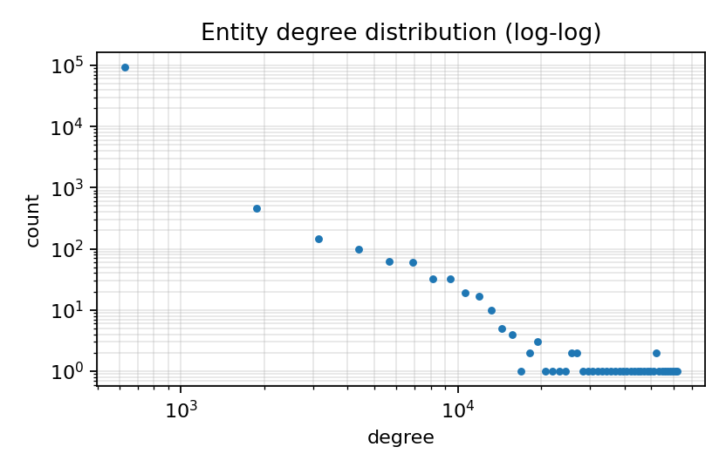
Dataset: ogbl-biokg
93,773
51
entities
relations
4.76M
22
train triples
median degree
62,733
5
max degree
entity types
Heavy-tailed degrees → hubs make full 2-hop expansion unsafe on a GPU
Speaker: Charan Ponaganti
5
Notes:
[Charan Ponaganti]
~1:00
Numbers here all come from Spark aggregations. The degree distribution is very heavy-tailed: median 22 but a max of 62,733. That tail is why we cannot naively expand two-hop neighborhoods: one hub would blow up GPU memory. Every relation is many-to-many under the Bordes threshold, which matters later in error analysis.

Slide 6
PySpark pipeline
Ingest
Clean
Profile
Index
Filter keys
Hand-off
explicit (h,r,t)
schema
nulls, duplicates,
self-loops
degrees, relation
categories
dense IDs +
inverse edges
int64 key per
true triple
tensors →
spark.stop()
• Config: local[*], Arrow on, Kryo serializer, 12 GB driver, 8 shuffle partitions.
• Inverse edges: (t, r + |R|, h) → 102 message-passing relation types.
• Filtered ranking: Spark builds one int64 key per true triple; the GPU does a sorted search.
• Memory safety: Spark is stopped before any GPU training starts.
Speaker: Charan Ponaganti
6
Notes:
[Charan Ponaganti]
~1:15
Spark runs in local[*] mode with Arrow and Kryo, 12 GB driver. Stages: ingest with an explicit schema, clean duplicates and self-loops, profile degrees and relation types, build dense IDs and inverse edges for message passing, and build an int64 key for every true triple so filtered ranking can run on the GPU. Then spark.stop() frees RAM before training.

Slide 7
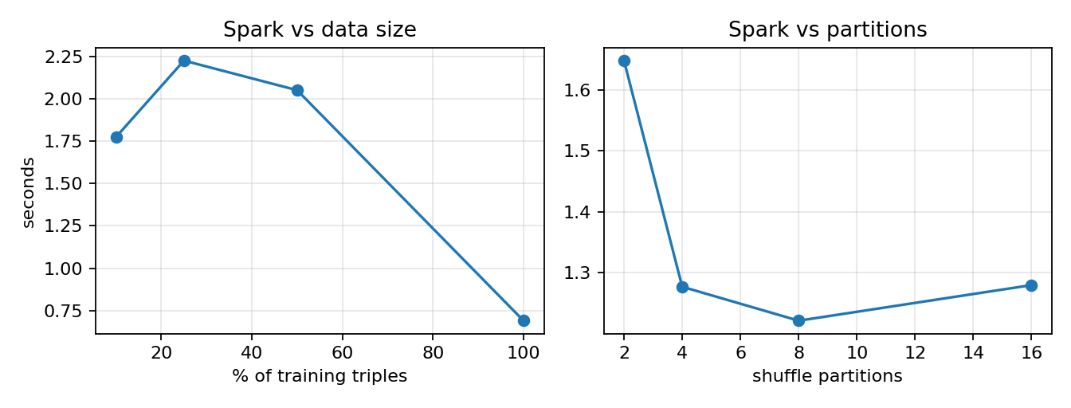
Spark scalability
Setting | Seconds
10% data | 1.77
25% data | 2.22
50% data | 2.05
100% data | 0.69
2 partitions | 1.65
4 partitions | 1.28
8 partitions | 1.22
16 partitions | 1.28
• All of ETL profiling on 4.76M triples runs in ≈ 1–2 s on one node.
• 100% is fastest because it is cached; not super-linear scaling.
• Partitions 2→16 are flat: a single node saturates quickly.
Speaker: Charan Ponaganti
7
Notes:
[Charan Ponaganti]
~1:00
We timed count + degree + relation frequency on 10 to 100 percent of the data and on 2 to 16 partitions. Everything finishes in about two seconds. The 100 percent point is fastest only because that DataFrame was already cached; we report that honestly. Partition count is flat because one node saturates quickly. Hand over to M Charan.

Slide 8
Models we compare
DistMult (decoder)
R-GCN encoder
CompGCN encoder
• score(h, r, t) = Σ hₖ · rₖ · tₖ
• Shared decoder for all GNNs
• Also a shallow baseline
• Per-relation weight Wᵣ + self-loop
• Basis decomposition: Wᵣ = Σ aᵣᵦ Vᵦ
• 8 bases shared by 102 relations
• 2 layers, dim 128
• Message = W · φ(neighbor, relation)
• sub: h − r
• mult: h ⊙ r
• corr: h ⋆ r (FFT)
• Relations updated each layer
Extra shallow baselines (same budget): TransE (−‖h + r − t‖₁) and ComplEx (complex bilinear)
Speaker: M Charan
8
Notes:
[M Charan]
~1:30
The decoder is DistMult for every GNN, so differences come from the encoder. R-GCN uses relation-specific weights with basis decomposition so 102 relation types share 8 bases. CompGCN puts the relation inside the message using a composition: subtraction, multiplication, or circular correlation. As extra baselines we trained shallow TransE and ComplEx with the same budget.

Slide 9
Making GNNs fit on a 16 GB T4
Query entity
Sample 2-hop
fanout [10, 10]
GNN on
subgraph
+ residual
base embedding
DistMult score vs
candidate table
• Query-side encoding: only the query gets message passing; candidates come from model.ent.
• Residual: GNN output + base embedding keeps queries and candidates in one space.
• Neighbor sampling: bounded cost even around 62k-degree hubs.
• Mixed precision for speed; CompGCN composition kept in float32.
• OOM fallback: halve batch and fanout, retry.
• Fail-soft: each model saved separately; resume after Kaggle restarts.
Speaker: M Charan
9
Notes:
[M Charan]
~1:30
Encoding all 94k entities with message passing every step does not fit. So we encode only the query entity: sample up to 10 neighbors per hop for two hops, run the GNN on that small subgraph, and add the base entity vector as a residual. Candidates are scored from the global embedding table. Mixed precision for speed; CompGCN composition is forced to float32 because half-precision FFT broke correlation. OOM halves batch and fanout.

Slide 10
Training recipe
• Bidirectional: each step trains (h, r, ?) and (?, r, t).
• Matched budget: all 7 models get identical epochs, steps, and negatives.
• Type-aware negatives: corrupt a drug with another drug, not a random protein.
• Self-adversarial loss: harder negatives get more weight (RotatE-style).
• Early stopping: on validation MRR, patience 5; keep the best checkpoint.
Setting | Value
Epochs × steps | 12 × 600
Negatives / batch | 16 / 512
Embedding dim | 128
Layers / R-GCN bases | 2 / 8
Fanout | [10, 10]
Optimizer | Adam 1e-3, clip 1.0
Wall clock (all) | 1.75 h on T4
Speaker: M Charan
10
Notes:
[M Charan]
~1:15
Every step trains both directions: predict the tail from the head and the head from the tail. All seven models get the same budget, 12 epochs of 600 steps with 16 negatives, so the comparison is fair. Negatives are type-aware: a drug is replaced by another drug. Self-adversarial weighting from RotatE focuses the loss on hard negatives.

Slide 11
Two evaluation protocols
Filtered candidates (ours)
Official OGB evaluator
• True entity vs 500 random entities
• Other true answers masked via Spark keys
• Head + tail, 15,000 test triples
• Fast; used for validation each epoch
• OGB's type-constrained negatives
• All 162,870 test triples, head + tail
• Comparable to published numbers
• Main metric in the report
Lesson learned: OGB negatives are aligned to OGB's test order. Spark reorders rows,
so an early version paired the wrong negatives. We now evaluate OGB on the original order.
Speaker: M Charan
11
Notes:
[M Charan]
~1:15
We report two views. The candidate protocol ranks the answer among 500 random entities, filtering other true answers using the Spark keys. The official OGB evaluator uses OGB's own type-constrained negatives over 162,870 test triples; that is the number to compare with the literature. One lesson: OGB negatives are row-aligned with OGB's test order, and Spark reorders rows, so we evaluate OGB on the original order. Hand over to Lalit.

Slide 12
Main result: official OGB evaluator
162,870 test triples
Model | MRR | H@1 | H@3 | H@10
DistMult | 0.325 | 0.224 | 0.364 | 0.526
R-GCN | 0.547 | 0.434 | 0.606 | 0.768
CompGCN-sub | 0.578 | 0.464 | 0.641 | 0.799
CompGCN-mult | 0.620 | 0.505 | 0.691 | 0.835
CompGCN-corr | 0.004 | 0.000 | 0.000 | 0.000
TransE | 0.270 | 0.165 | 0.305 | 0.490
ComplEx | 0.250 | 0.168 | 0.278 | 0.410
CompGCN-mult > CompGCN-sub > R-GCN > TransE/ComplEx > DistMult
Speaker: Lalit Deshmane
12
Notes:
[Lalit Deshmane]
~1:30
This is the headline table. CompGCN with multiplication is best on every metric: MRR 0.620, Hits@10 0.835. CompGCN-sub is close behind at 0.578, then R-GCN at 0.547. DistMult is 0.325; TransE/ComplEx sit around 0.25–0.27. CompGCN-corr failed to learn. Message passing clearly helps under type-constrained negatives.

Slide 13
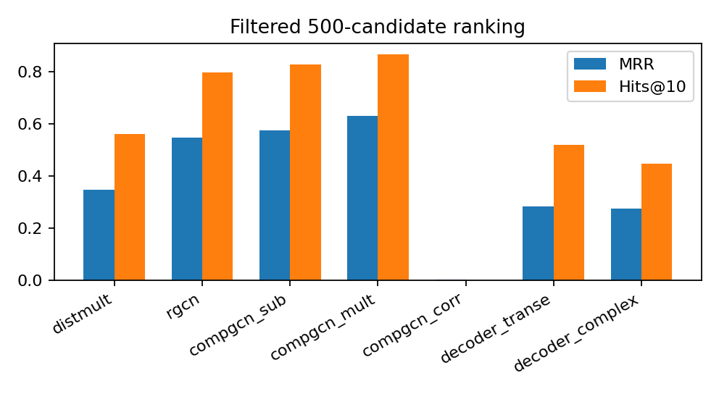
Second protocol agrees
15,000 test triples · 500 candidates
Model | MRR | H@10 | MR
DistMult | 0.348 | 0.562 | 63.4
R-GCN | 0.549 | 0.798 | 13.5
CompGCN-sub | 0.576 | 0.828 | 11.6
CompGCN-mult | 0.631 | 0.867 | 9.5
CompGCN-corr | 0.002 | 0.000 | 485.1
TransE | 0.285 | 0.519 | 56.5
ComplEx | 0.275 | 0.448 | 110.6
• Same ranking as OGB; numbers higher because random negatives are easier.
• Matched budget removed the earlier "DistMult wins" artifact.
Speaker: Lalit Deshmane
13
Notes:
[Lalit Deshmane]
~1:00
Under the 500-candidate protocol the ranking is the same: CompGCN-mult on top with MRR 0.631 and Hits@10 0.867. Absolute numbers are higher because random candidates are easier than OGB's type-constrained ones. In an earlier run with an unequal budget DistMult looked best here; with a matched budget that disappears.

Slide 14
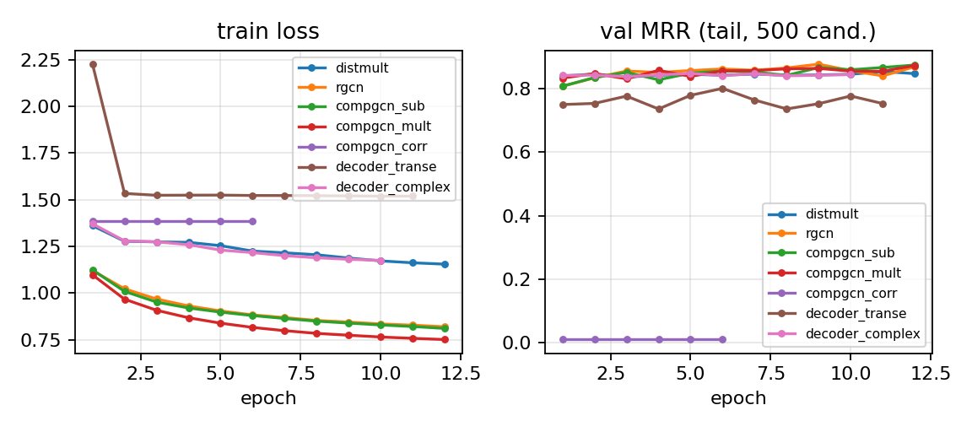
Training dynamics
• Lowest loss: CompGCN-mult, then CompGCN-sub and R-GCN; TransE plateaus highest.
• CompGCN-corr collapses after epoch 1 even in float32; early-stopped at epoch 6 (all others run 12).
Speaker: Lalit Deshmane
14
Notes:
[Lalit Deshmane]
~1:00
Left: loss. CompGCN-mult reaches the lowest loss, then CompGCN-sub and R-GCN. TransE plateaus highest. Right: validation MRR on 500 random candidates. CompGCN-corr starts near 0.2, collapses to almost zero, and early stopping ends it at epoch 6. All other models run the full 12 epochs.

Slide 15
R-GCN ablations
6 epochs × 300 steps
Setting | MRR | H@1 | H@10 | MR
Base (dim 128, 2 layers, 8 bases, 16 neg) | 0.411 | 0.291 | 0.655 | 32.5
1 layer | 0.449 | 0.323 | 0.701 | 26.7
8 negatives | 0.332 | 0.213 | 0.582 | 48.5
4 bases | 0.395 | 0.270 | 0.644 | 34.0
dim 64 | 0.436 | 0.316 | 0.679 | 28.7
Takeaways
• 1 layer strongest
• 8 negatives hurts most
• dim 64 still competitive
• Depth 1 > depth 2 here
Speaker: Lalit Deshmane
15
Notes:
[Lalit Deshmane]
~1:00
Half-length runs of R-GCN: 6 epochs of 300 steps. One layer is strongest; eight negatives hurts most; dim 64 stays close to base. Depth 1 beats depth 2 at this shorter budget.

Slide 16
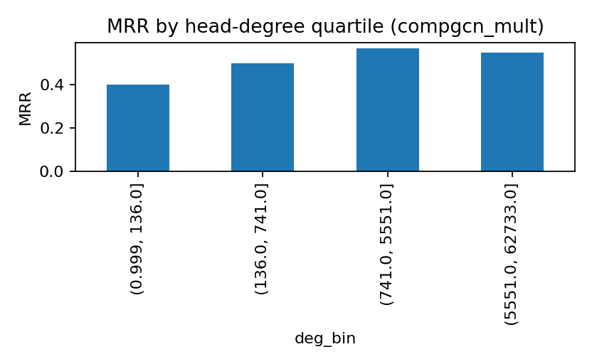
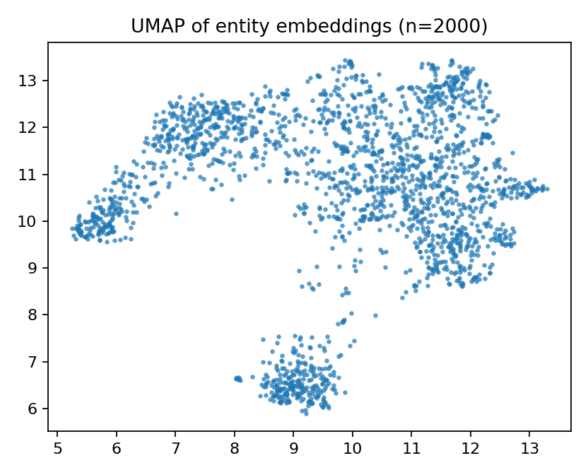
Error analysis: rare entities are hard
• By degree (CompGCN-mult): MRR 0.40 for the rarest quartile vs peak 0.57.
• By relation type: all 51 relations are N–N, so that breakdown is uninformative.
Speaker: Lalit Deshmane
16
Notes:
[Lalit Deshmane]
~1:15
All relations are many-to-many, so a relation-category breakdown has only one bar. Degree is the informative slice: for CompGCN-mult, the rarest quartile gets MRR 0.40, while the peak mid/high bin reaches 0.57. Sparse entities have little neighborhood for the GNN to use. The embedding projection on the right shows loose clusters by entity type.

Slide 17
Engineering lessons
OGB misalignment
Half-precision FFT
Spark reordered test rows; OGB negatives are row-aligned. Fixed by evaluating on the original order.
CompGCN-corr broke under AMP. Composition now runs in float32.
Kernel deaths (RAM)
CUDA 13 installs
Per-row negative sampling made millions of tiny tensors. Vectorized by type.
Compiling torch-scatter killed the kernel. Binary wheels only, else skip.
Speaker: Lalit Deshmane
17
Notes:
[Lalit Deshmane]
~1:15
Four real bugs we hit and fixed. Each is a general lesson for running graph learning on shared notebooks: check alignment of external negatives, watch numerical precision, avoid per-row Python loops in samplers, and never compile CUDA extensions on Kaggle.

Slide 18
Conclusion, limitations, future work
Conclusions
Limitations
Future work
• Spark ETL on 4.76M triples in seconds
• Sampled GNNs fit a 16 GB T4
• CompGCN-mult best: OGB MRR 0.620
• GNNs ≫ shallow baselines at equal budget
• Below published long-schedule SOTA
• Candidates not GNN-encoded
• CompGCN-corr unstable
• Spark on a single node
• Encode both query and candidate
• ConvE decoder on the same encoder
• Longer schedule / stabilize corr
• Multi-node Spark; Wikidata5M training
Speaker: Lalit Deshmane
18
Notes:
[Lalit Deshmane]
~1:15
Summarize: Spark handles the data, sampled GNNs handle learning on a T4, and CompGCN-mult wins on both protocols under a fair budget. Be upfront about limits: our numbers are below long-schedule leaderboard results, candidates are not GNN-encoded, and Spark ran on one node. Then invite questions.

Slide 19
Thank you · Questions?
Code, notebook, results and report:
github.com/Charanponaganti/Knowledge-Graph-Completion-with-R-GCN-CompGCN
Charan Ponaganti · M Charan · Lalit Deshmane
Notes:
[All] Q&A. Likely questions: why not Wikidata5M (memory), why DistMult decoder (assignment + isolates encoder), why corr fails (numerical/optimization; reported honestly), why two protocols (OGB is comparable; candidates are fast for validation), what Spark adds (relational ETL + filter keys).

