Slide 1
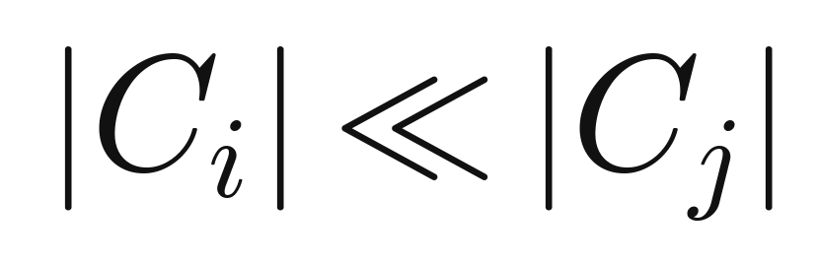
1. Introduction — The Class Imbalance Problem
Why rare events break standard classifiers, and why synthetic oversampling matters
PROBLEM SETTING
COMMON FIXES
A dataset is imbalanced when one class has far fewer examples than another:
Cost-sensitive learning (needs costs + algorithm changes)
Undersample majority (can throw away useful data)
Duplicate minority (easy overfitting)
Synthetic oversampling (SMOTE family) — most practical
WHAT THIS PAPER FIXES
The majority class dominates training; minority recall drops
This hurts high-stakes tasks: fraud, disease, system failure
Collecting more minority data is often impossible
SMOTE needs a neighbour count K and fills only a line
Near-neighbour copies can overfit minority clusters
Synthetics can spill into majority space
Need a parameter-free method with safer, more diverse samples
SMOTEFUNA | Tarawneh et al. | IEEE Access, 2020
1 / 5

Slide 2
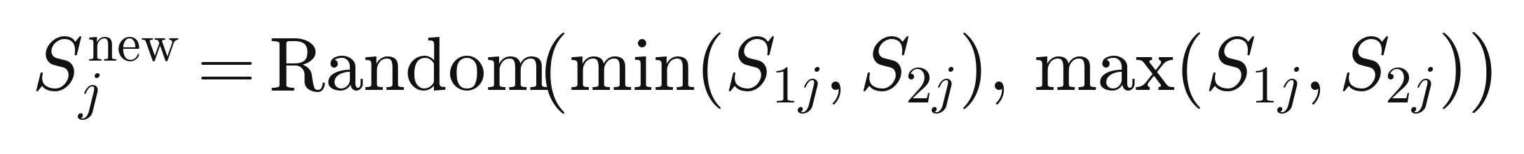
2. Proposed Idea — Furthest-Neighbour Sampling
Create synthetics inside a cuboid between a minority seed and its furthest neighbour
CORE IDEA
SMOTE
Pick a random minority point S1
Find its furthest minority neighbour S2
The box spanning S1 and S2 is the potential space
Each feature of the new point is drawn inside that box:
Uses k nearest neighbours
Requires choosing K
Line interpolation only
SMOTEFUNA
SMOTE walks along a line; SMOTEFUNA fills a volume
Larger space means more diverse synthetics, less near-copy overfitting
Uses furthest neighbour
No K to tune
Fills a cuboid region
SMOTEFUNA | Tarawneh et al. | IEEE Access, 2020
2 / 5

Slide 3
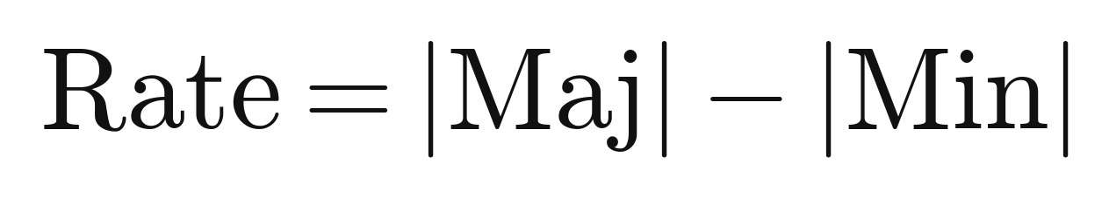
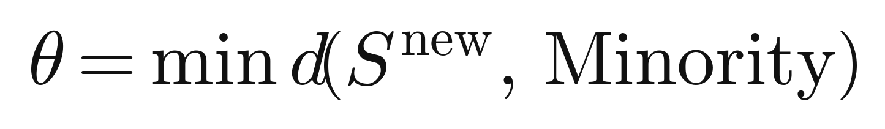
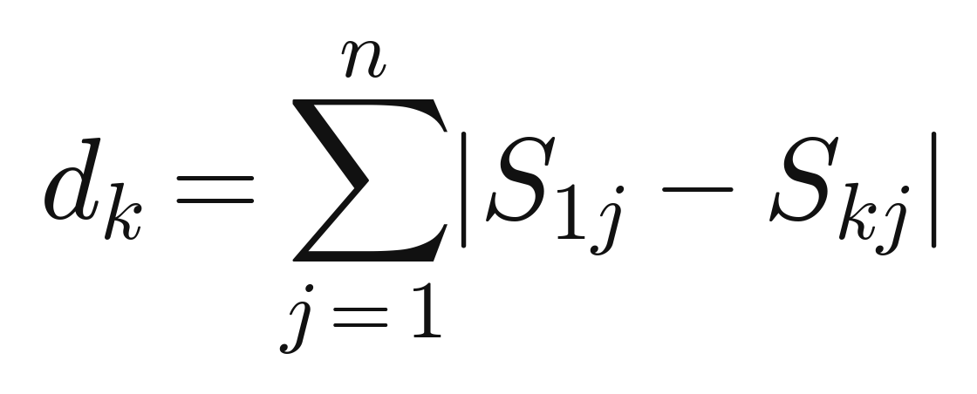
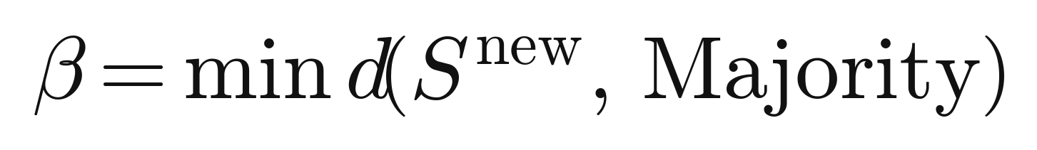
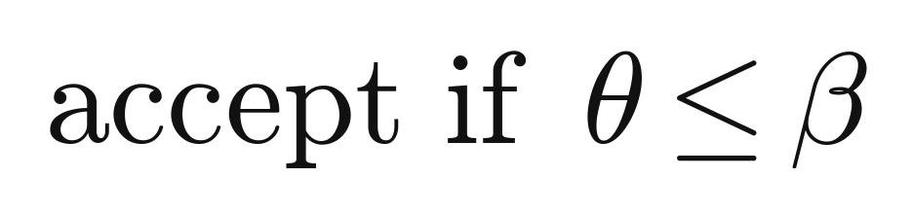
3. Proposed Architecture — Algorithm Pipeline
Five steps from imbalanced data to a balanced training set
1
Split
2
Seed
3
Sample
4
Filter
5
Merge
Separate minority
and majority
Pick S1; find
furthest S2
Draw features
in the cuboid
Keep if nearer
to minority
Add synthetics;
shuffle if needed
SAMPLING FORMULAS
SAFETY CHECK
How many synthetics
Distance to nearest minority
Manhattan distance
Distance to nearest majority
New feature inside the cuboid
Keep only if nearer to minority
SMOTEFUNA | Tarawneh et al. | IEEE Access, 2020
3 / 5

Slide 4
4. Results — Empirical Evaluation
33 datasets, two classifiers, ROC and precision-recall, Wilcoxon significance tests
SETUP
FINDINGS
STATISTICS
33 binary imbalanced datasets (PROMISE and KEEL)
Different sizes, features, and imbalance ratios
All features kept; z-score standardized
Classifiers: Naive Bayes and SVM
5-fold cross-validation, repeated 30 times
Report mean and standard deviation of AUC and AUPR
Compared to: original data, SMOTE, ADASYN, SWIM
Most wins on AUC and AUPR for both classifiers
ROC and PR curves improve over the original data
Competitive with or better than SMOTE, ADASYN, and SWIM
Large AUPR gains on hard cases (example: D10 with Naive Bayes)
Minority coverage looks more complete than SMOTE in figures
Wilcoxon signed-rank across all 33 datasets
Paired against SMOTE, ADASYN, SWIM, and original
Checked for both AUC and AUPR
All paired tests significant (p less than 0.05)
Effect sizes mostly large
Positive ranks dominate — wins favor SMOTEFUNA
SMOTEFUNA | Tarawneh et al. | IEEE Access, 2020
4 / 5

Slide 5
5. Conclusion, Limitations and Future Work
What works, where it can fail, and what to do next
CONCLUSION
LIMITATIONS
FUTURE WORK
SMOTEFUNA is a parameter-free oversampler
Furthest-neighbour cuboid plus a safety filter
On 33 datasets with Naive Bayes and SVM it generally beats SMOTE, ADASYN, and SWIM
Stronger ROC / PR and AUC / AUPR overall
Easier to use in practice because there is no K
Isolated minority outliers can pull the cuboid away from the true boundary
Synthetic points then drift toward that outlier
Performance still depends on distance in overlapping regions
Study covers binary classification only
Not yet tested on multi-class, nominal, or very large data
Remove outliers before sampling
Try outlier-robust distances
Compare against more methods
Extend to multi-class imbalance
Support nominal features
Scale to large datasets
SMOTEFUNA | Tarawneh et al. | IEEE Access, 2020
5 / 5

