Slide 1

Homely
Civil Construction Mobile Application

Slide 2
Introduction
Homely is Online contractor hiring application.
It allows users to compare different service providers and to choose one according to their budget and needs.
The app allows users to publish requirements, budgets and availability dates online.
Contractors can view advertisements, respond with interest, and find deals.

Slide 3
Features
User can find a civil Contractor as per their interest and user can post the Work as per the requirement. communicate with Contractor and assign project to contractor. According the receive the application its accept or reject.
Contractor can see the post work. Its bidding the project and Communicate to user via Chat.
Admin has all access over whole application. Admin can delete, edit or post a Work. And he can also delete User And Contractor.

Slide 4
Why we choose this Technologies?
Android Studio(Core java): As we have to develop a mobile application therefore we thought that android in core java will be the better choice as a team
Firebase Authentication: Authenticate the User use firebase Email and Password Authentication system.its be authenticate via email id and reset the password via email id link.
Firebase realtime database: Firebase is a open source platform with a real-time database storage. That is why we decided to use firebase.

Slide 5
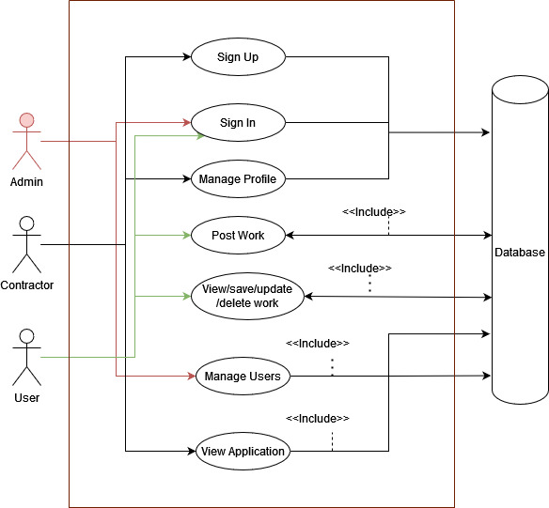
Use Case Diagram

Slide 6
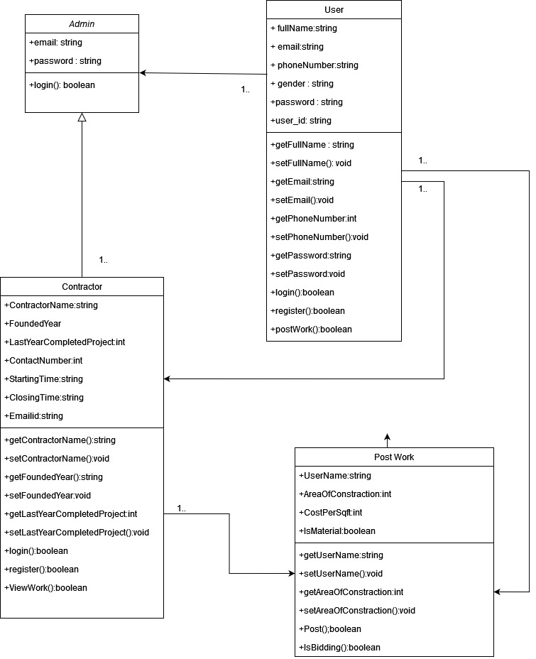
Class Diagram

Slide 7
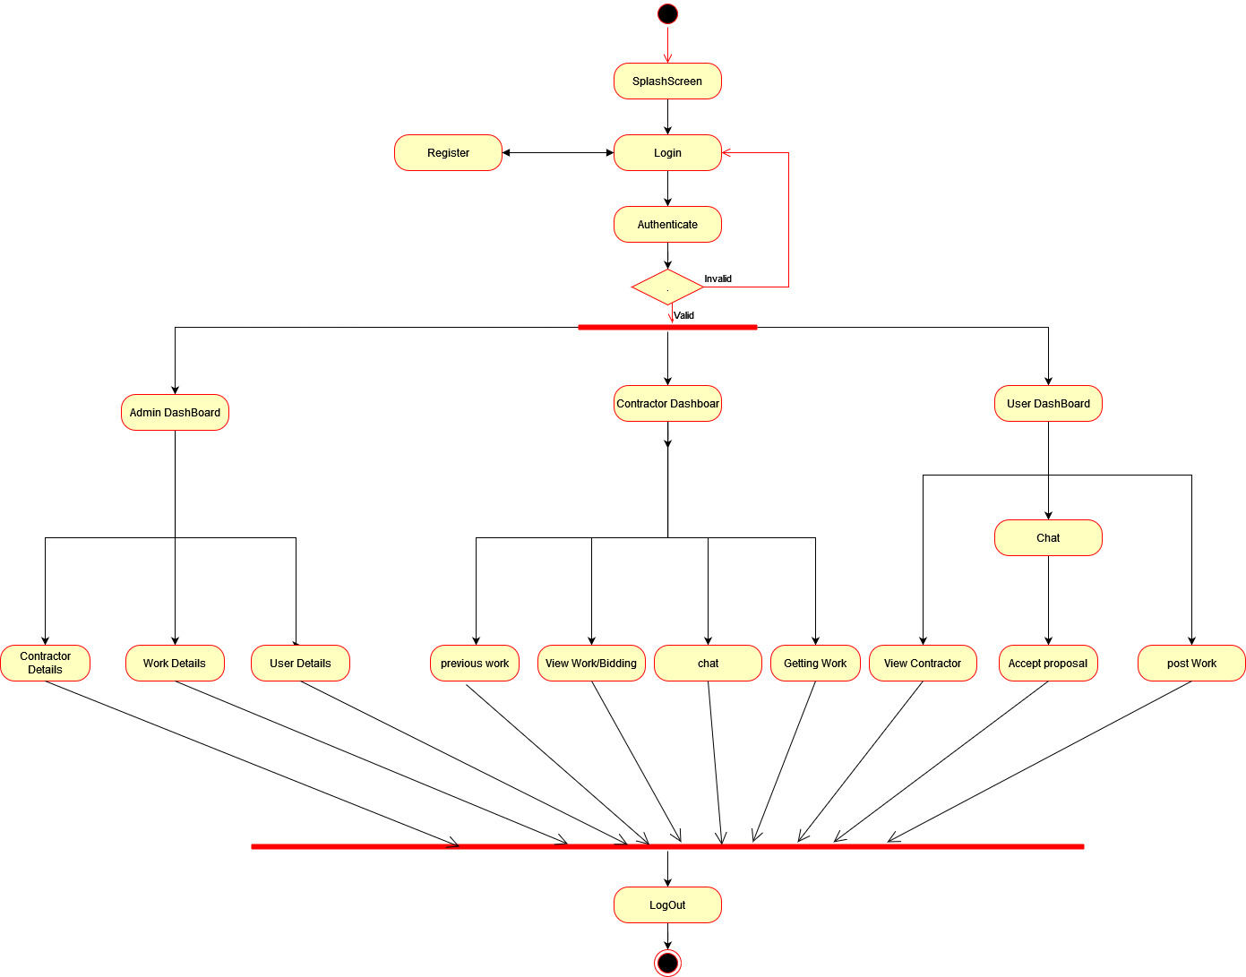
Activity Diagram

Slide 8
Github
https://github.com/Mananprajapati1/Homely

Slide 9

Team
Charanpreet Singh – (2091713)
Manan Ashvinbhai Prajapati

Slide 10
Work of Team Members
Charanpreet Singh – Lead of the Project. Mostly work on Documentation part decide the technology and User Stories.
Manan Ashvinbhai Prajapati – Setup the GitHub Repo. Draw the Use Case Diagram And Activity Diagram.

Slide 11


