Slide 1
Foodies Spot With Data Science
Batch No. : B9 Project Guide :
H Prijwal Reddy 21N31A0583 MR. MANOJ KUMAR
G Sai Charan Reddy 21N31A0579
J Harshith Kumar 21N31A0589

Slide 2
Introduction :
Efficient market management is essential for streamlining operations and enhancing customer satisfaction in today’s competitive landscape. This system leverages modern web technologies like React.js and Firebase to simplify market operations, providing real-time inventory tracking, seamless order processing, and personalized user experiences. For administrators, it offers advanced tools for managing sales, tracking trends, and generating reports, ensuring data-driven decision-making. With its responsive design and secure authentication, the system transforms traditionalmarket operations into a more efficient and customer-focused process.

Slide 3
Abstract :
Foodie Spot is a modern web application designed to streamline food ordering and management in cafeterias. Built with React.js and Firebase, it offers a seamless user experience with real-time inventory updates, personalized order history, and secure authentication. For administrators, it provides tools for managing orders, analyzing sales, and generating reports using Recharts and JSPDF. With its responsive design and data-driven insights, Foodie Spot simplifies cafeteria operations, catering to both user convenience and management efficiency.

Slide 4
Existing and Proposed System :
Existing System :
Proposed System :
Relies heavily on manual processes or outdated
software.
Lacks real-time inventory updates, leading to
inefficient stock management.
Limited functionality customer personalization,
such as order history or recommendations.
4.Operational delays due to poor integration and
slow processes.
Real-time stock updates for accurate inventory
management.
Seamless user experience with responsive design
and order history.
Advanced sales analytics with Recharts and
PDF reports via JSPDF.
Secure Firebase authentication for efficient
operations.

Slide 5
Literature Survey
Foodie Spot is an innovative web application built with React.js and Firebase, designed to streamline food ordering and cafeteria management. It provides users with a seamless experience, offering real-time inventory updates, secure authentication, and personalized order history to improve user engagement. For administrators, the application includes tools to manage orders, track sales, and generate detailed reports using Recharts for data visualization and JSPDF for PDF reports. The app’s responsive design ensures it functions smoothly across various devices, making it accessible and convenient for all users. By integrating these features, **Foodie Spot** enhances cafeteria operations, improves user satisfaction, and helps administrators make data-driven decisions for more efficient management.

Slide 6
Software requirements:
1. Operating System: Windows 10 or higher / macOS / Linux (Ubuntu or similar)
2. Web Browser: Google Chrome, Mozilla Firefox, Safari, or Microsoft Edge (latest versions)
3. Development Tools:
Code Editor: Visual Studio Code, Sublime Text, or IntelliJ IDEA
4. Backend & Database:
Node.js (for backend development with React.js)
Firebase (for real-time database, authentication, and hosting)
MongoDB (alternative if using a different database setup)
5. Libraries & Frameworks:
React.js (for front-end development)
Firebase SDK (for Firebase integration)
Recharts (for data visualization)
JSPDF (for PDF report generation)

Slide 7
Hardware requirements:
Processor : Intel Core i5 or higher / AMD Ryzen 5 or higher (for better performance, especially when handling large datasets and model training).
RAM : Minimum 8 GB (16 GB or higher recommended for faster processing of large datasets and complex model training).
Storage : At least 256 GB SSD (Solid State Drive) or HDD, with SSD recommended for faster data access and storage .Additional space for datasets, model artifacts, and logs (~10-20 GB).
GPU (optional but recommended) : A dedicated GPU such as NVIDIA GTX 1050 Ti or higher (for faster model training, especially if dealing with large datasets or deep learning models).
Internet Connection : Required for downloading libraries, dependencies, and datasets if necessary.

Slide 8
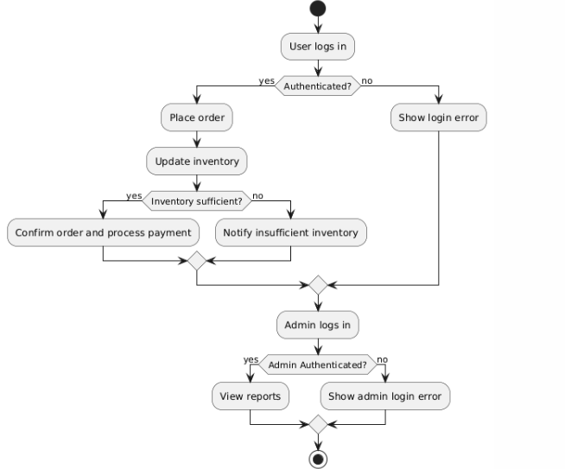
System Design:

Slide 9
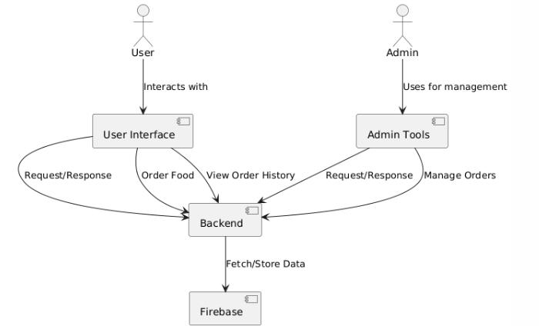
Architecture Diagram:

Slide 10
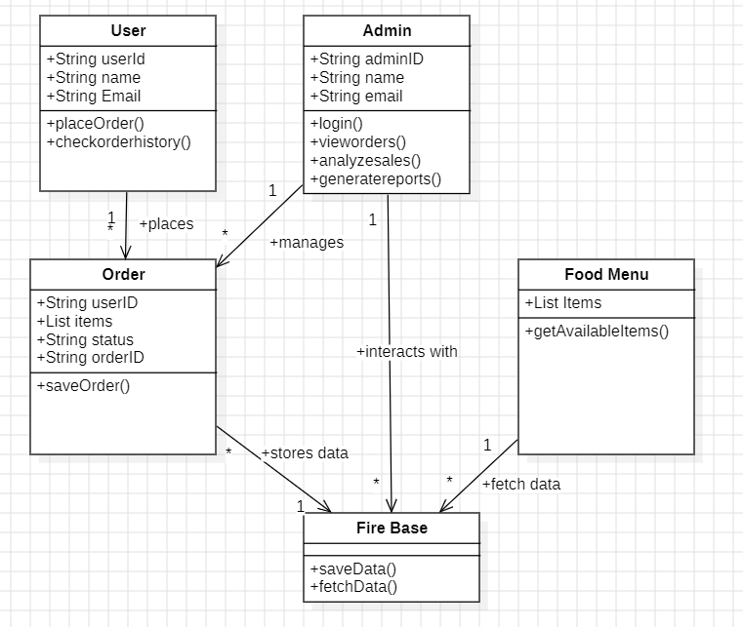
Class Diagram:

Slide 11
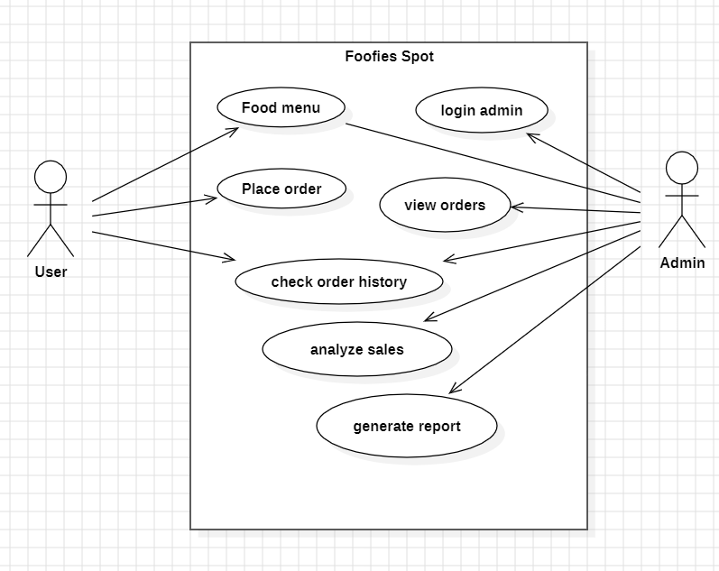
Use Case Diagram:

Slide 12
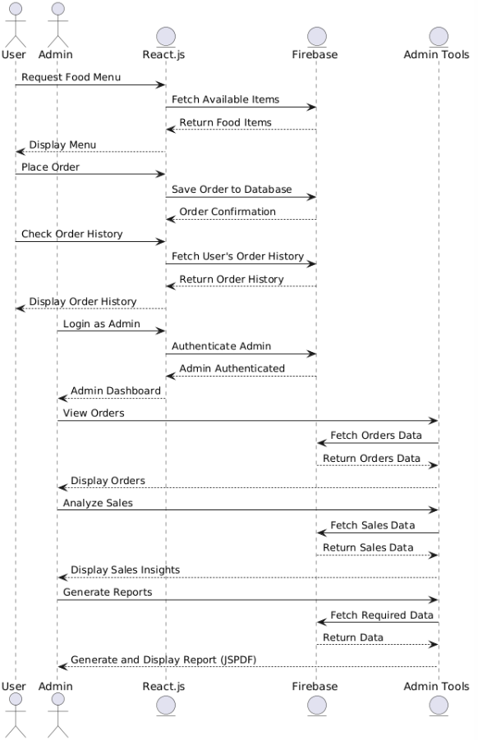
Sequence Diagram:

Slide 13
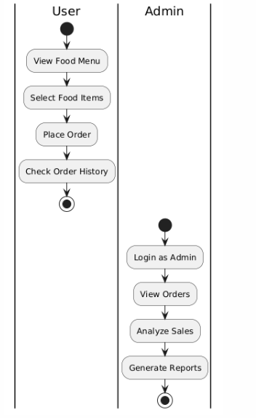
Activity Diagram:

Slide 14
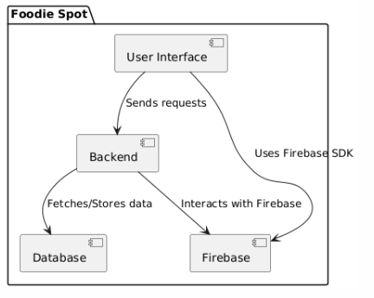
Component Diagram:

Slide 15
Module(s) Specifications
Module 1: User Interaction
This module manages user login, registration, and profile management. It ensures a personalized dashboard with easy navigation through menus, order history, and saved preferences, enhancing user experience.
Module 2: Order Placement
Handles the entire process of browsing food items, customizing orders, adding them to the cart, and securely processing payments. It confirms the order and updates the inventory once the order is placed.
Module 3: Reporting and Analytics
Provides admins with tools to generate sales reports, track inventory, and analyze customer behavior. It helps optimize menu offerings and improve operational efficiency through data-driven insights.
Module 4: Notifications and Updates
Ensures timely communication by sending order status updates, promotional offers, inventory alerts, and admin notifications. It keeps users and administrators informed about relevant events and changes.

Slide 16
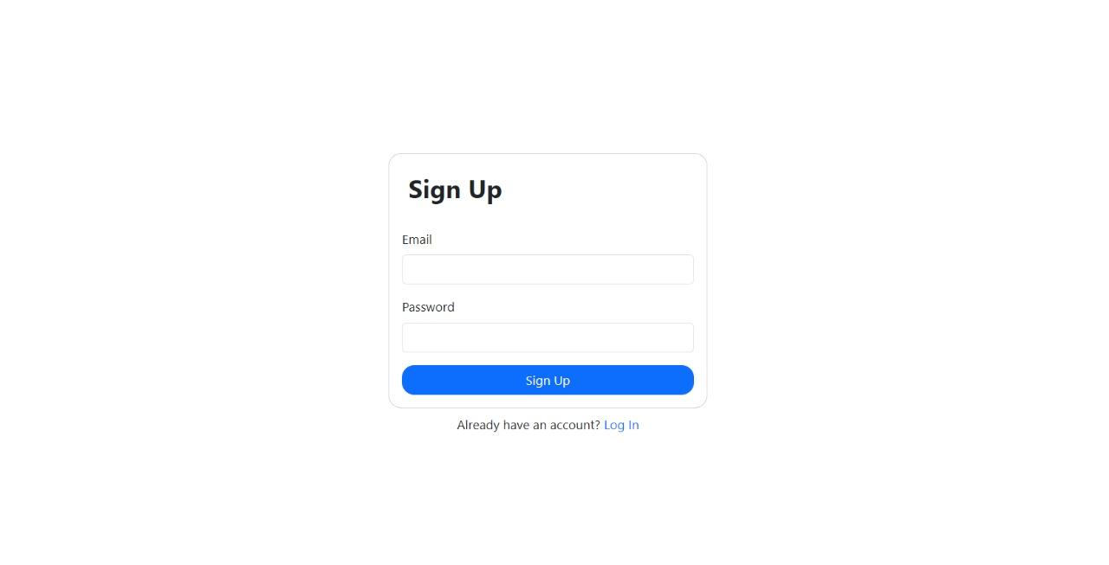
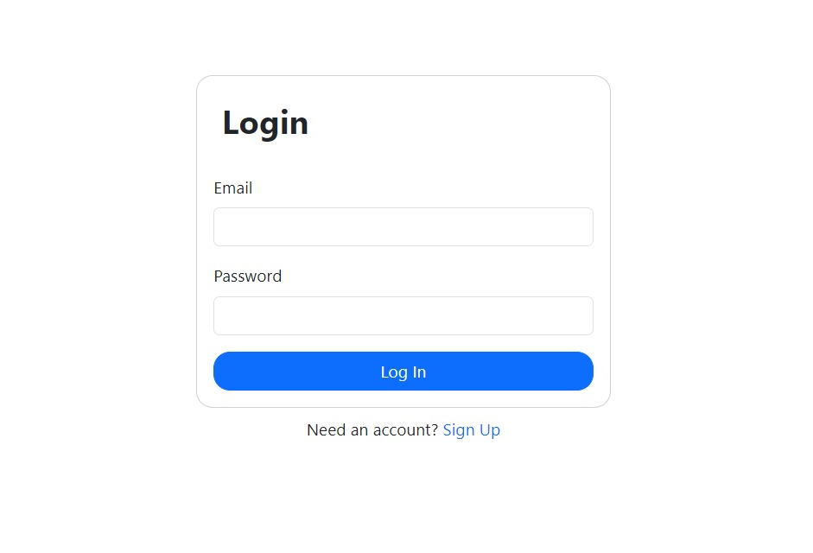
Output Screen:
Sign Up page
Login Page

Slide 17
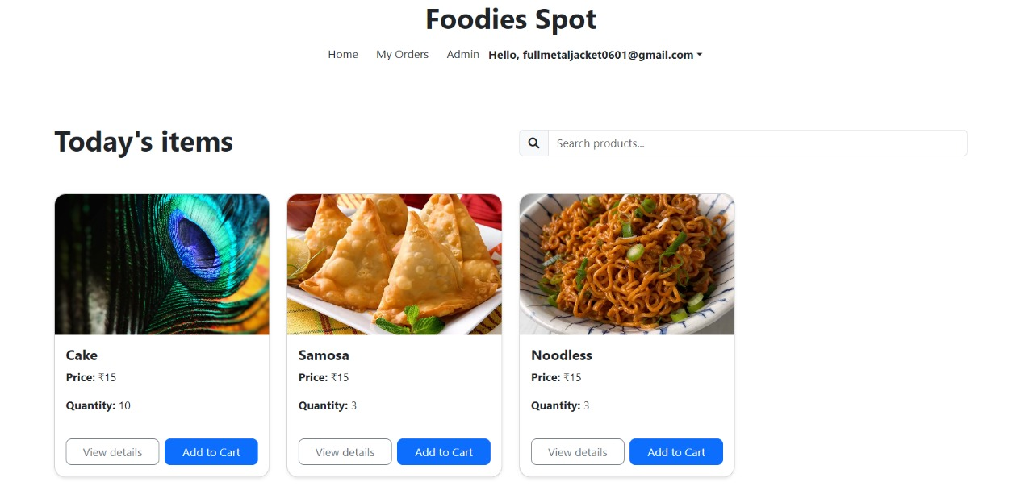
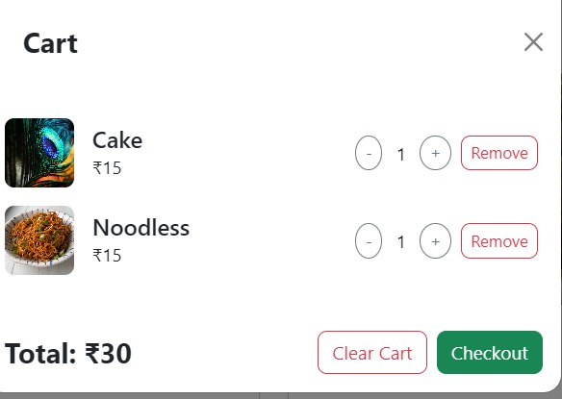
Output Screen:
Landing Page
Cart

Slide 18
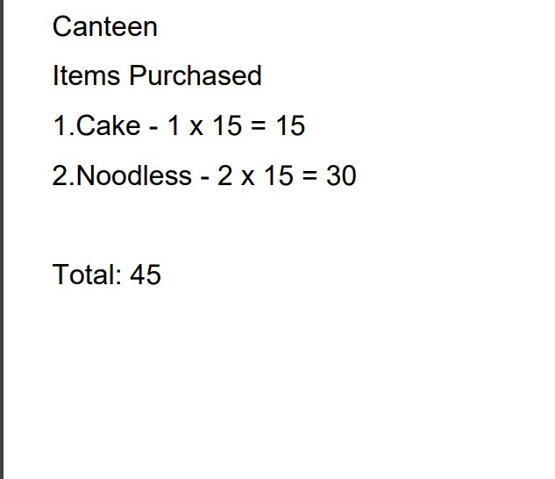
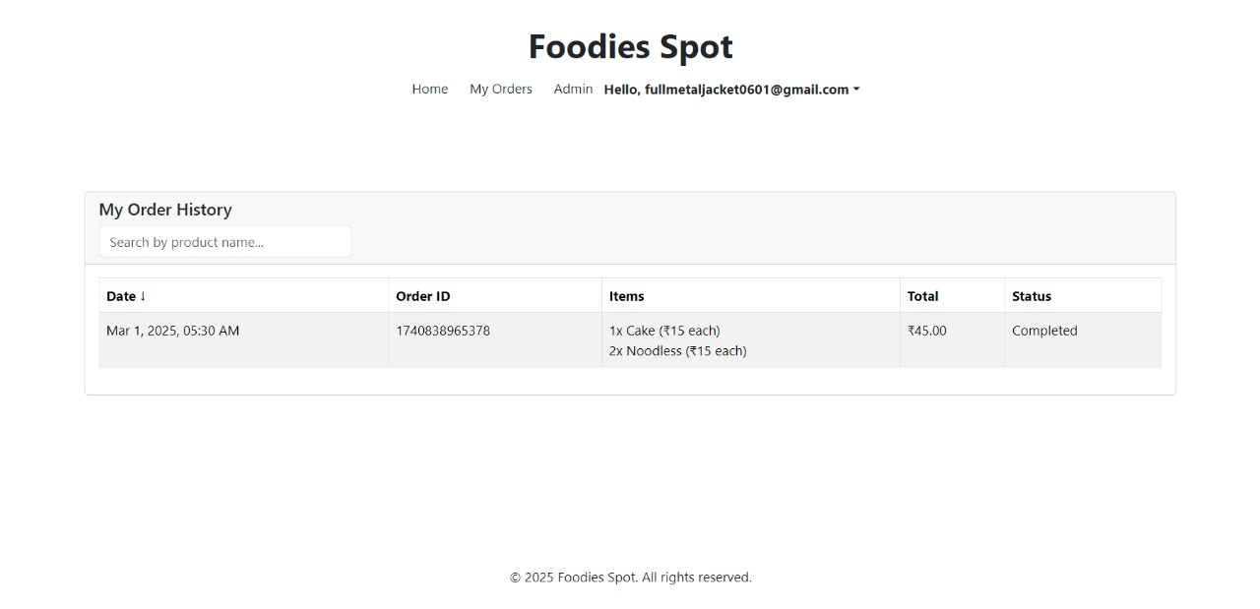
Output Screen:
Bill pdf
Orders Page

Slide 19
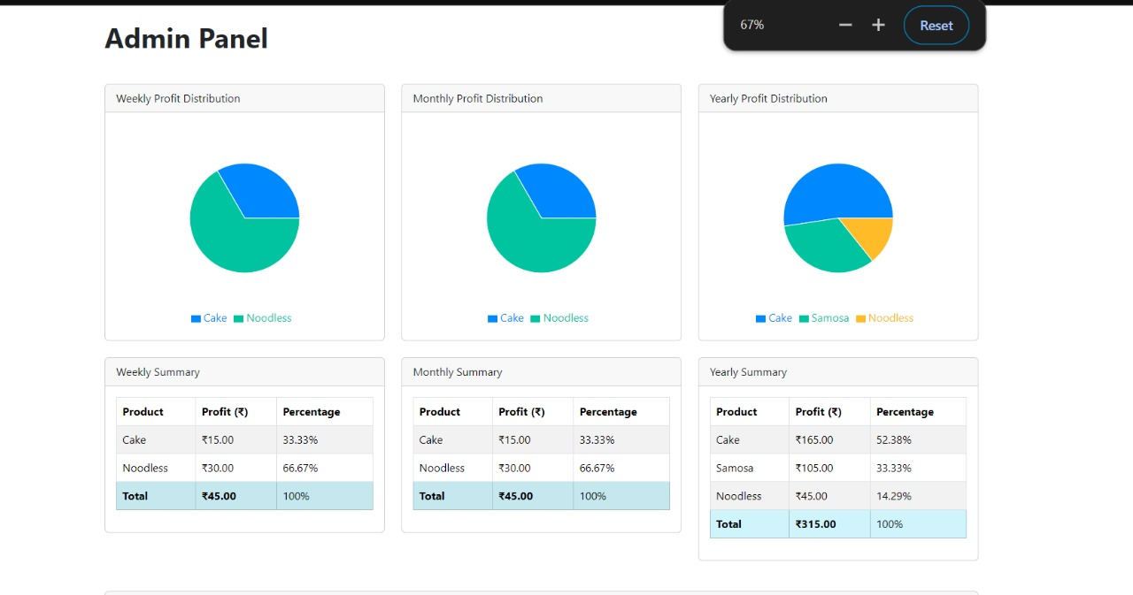
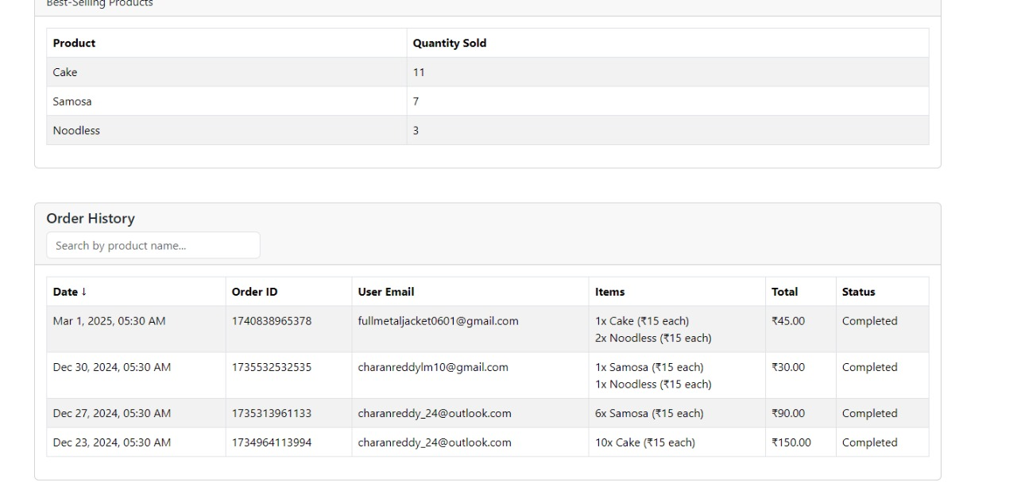
Output Screen:
Admin panel

Slide 20
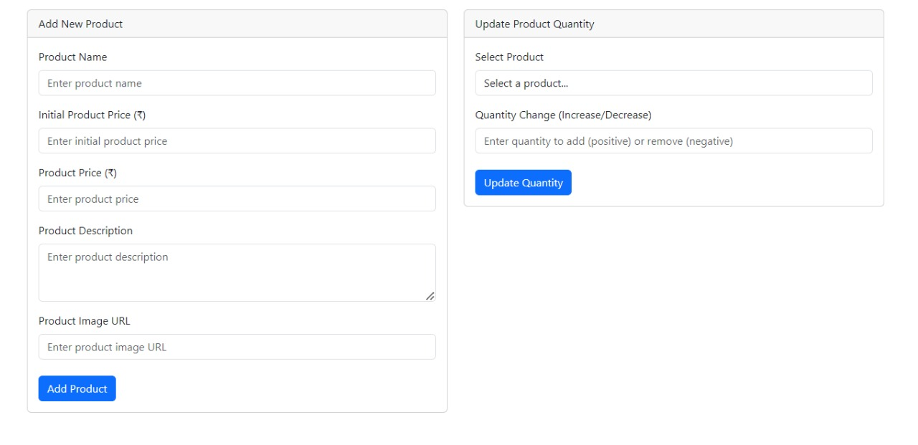
Output Screen:
Inventory Manager

Slide 21
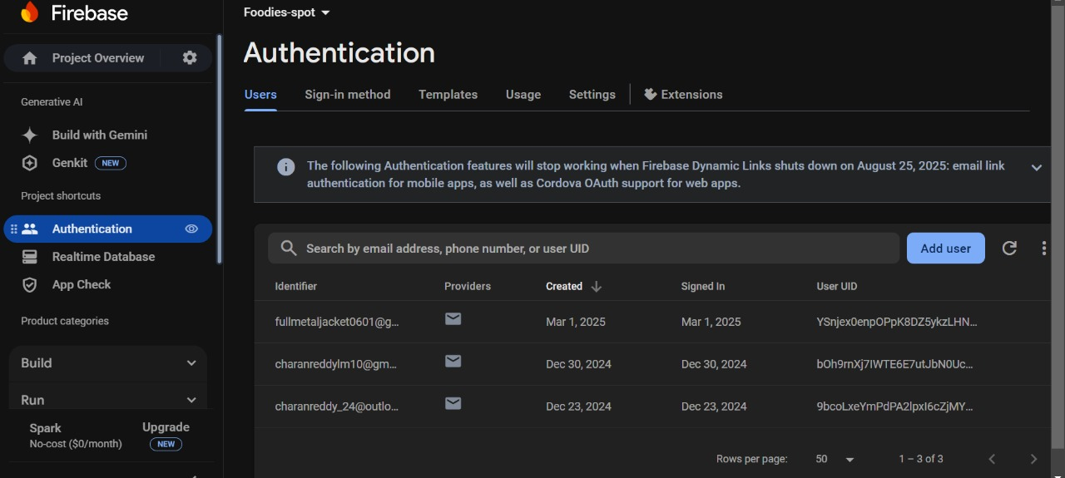
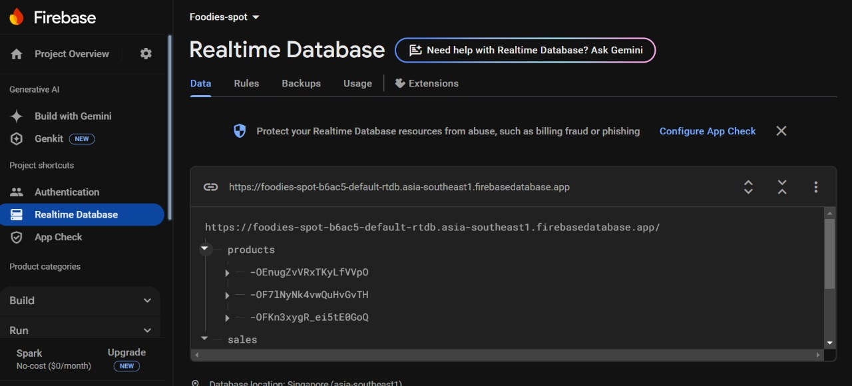
Output Screen:
User Authenticator
Real Time DataBase

Slide 22
Conclusion:
The Foodie Spot application is designed to streamline cafeteria operations and enhance the user experience. With robust modules for user interaction, order placement, reporting and analytics, and notifications, the system offers a seamless and efficient solution for both customers and administrators. Users can easily browse the menu, customize orders, and make secure payments, while administrators gain valuable insights into sales trends, inventory management, and customer preferences. By integrating real-time updates and personalized features, Foodie Spot optimizes cafeteria management and improves operational efficiency, creating a win-win scenario for both customers and staff.

Slide 23
Future Scope:
AI-Driven Recommendations: Implement machine learning algorithms to recommend food items
based on user preferences, past orders, and seasonal trends, enhancing the personalization aspect.
Real-Time Order Tracking: Allow users to track their orders in real-time, providing updates on the
order’s progress from kitchen to delivery.
Loyalty Programs: Introduce reward systems and loyalty programs where users can earn points for
each order, which can be redeemed for discounts or free meals.
Advanced Analytics for Admins: Expand the reporting features by integrating predictive analytics to forecast trends consumption, optimize inventory, and automate restocking based on usage patterns.
Integration with IoT: Incorporate smart kitchen devices to monitor food preparation in real-time,
ensuring freshness and quality, while also optimizing kitchen workflows.
Multi-location Support: Scale the platform to support multiple cafeteria locations, allowing users to
order from different outlets and admins to manage operations across locations seamlessly.

Slide 24
THANK YOU ☺

