Slide 1
SMART COMPETENCY DIAGNOSTIC AND CANDIDATE PROFILE SCORE CALCULATOR
CSE7101- Capstone Project
Batch Number: CSE_207
Under the Supervision of,
Ms. Jeevitha V K
Assistant Professor
School of Computer Science and Engineering
Presidency University
Roll Number | Student Name
20221CSE0235 20221CSE0289 20221CSE0279 | Aduri Sai Charan Reddy Mithaeghar Mohammad Arif Thotamsetty Sai Sreekar
Name of the Program: B-tech,Computer Science And Engineering
Name of the HoD: Dr.Asif Mohammed
Name of the Program Project Coordinator: Dr.Jayavadivel Ravi
Name of the School Project Coordinators: Dr. Sampath A K , Dr. Geetha A

Slide 2
Problem Statement Number: 278
Organization: Presidency University
Category : Software
Problem Description : A smart, AI-powered employment platform that helps job seekers by assessing their skills, identifying gaps, and recommending suitable jobs and training programs. Through a competency test, the system provides personalized career paths, adaptive learning recommendations, real-time job market insights, and verified skill certifications—making job hunting and upskilling more efficient and tailored to each individual.

Slide 3
Problem Statement
Most existing employment portals only list job openings without providing personalized insights into a candidate’s true competencies or skill gaps. As a result, job seekers often apply for roles blindly, while recruiters spend extra time evaluating suitability beyond resumes. Training resources are available, but they are rarely tailored to individual needs, leading to wasted effort. There is a need for a smart, AI-powered platform that can assess competencies, calculate a unified profile score, identify skill gaps, and recommend both suitable jobs and targeted training programs — all in one place.

Slide 4
Objectives:
Evaluate candidates smartly
Generate an overall competency score
Identify skill gaps
Recommend the right jobs
Suggest targeted training
Provide real-time market insights

Slide 5
Background and Related Work for title Selection
Traditional job portals
Skill assessments are fragmented
Recruiters face inefficiencies
Candidates lack clarity
Industry demand for data-driven hiring
AI-powered unified scoring systems

Slide 6
Analysis of Problem Statement
Technology Stack Components:
Frontend – React.js
Backend – Node.js+Express
Database – MongoDB
AI/ML Framework - PyTorch / Scikit-learn
Authentication – JWT Tokens
Visualization - Chart.js/D3.js

Slide 7
Innovation
Unified Multi-Skill Assessment
Adaptive Smart Scoring Model
Gamified Assessment Experience
Role & Reduced Evaluation
Instant Insights & Feedback

Slide 8
Github Link
Github Link
https://github.com/Charanreddy7673/SMART-COMPETENCY-DIAGNOSTIC-AND-CANDIDATE-PROFILE-SCORE-CALCULATOR

Slide 9
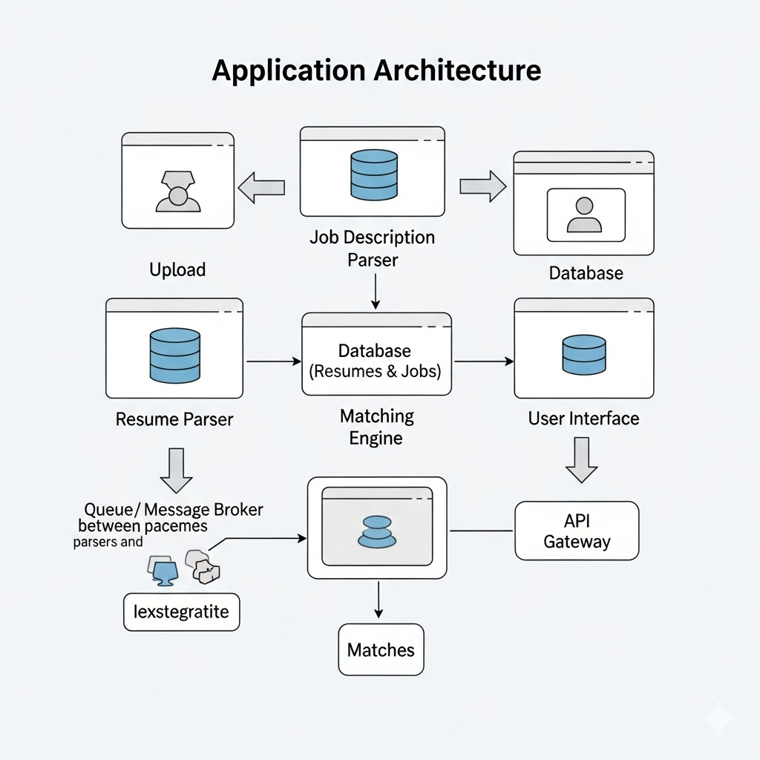
Architecture

Slide 10
Analysis of Problem Statement (contd...)
Software Requirements:
Operating System - Windows 10/11 or Linux (Ubuntu)
Development Environment - VS Code
Backend - Node.js
Frontend - React.js
Database - MongoDB
AI/ML Libraries - PyTorch / Scikit-learn
API Services - REST APIs / GraphQL

Slide 11
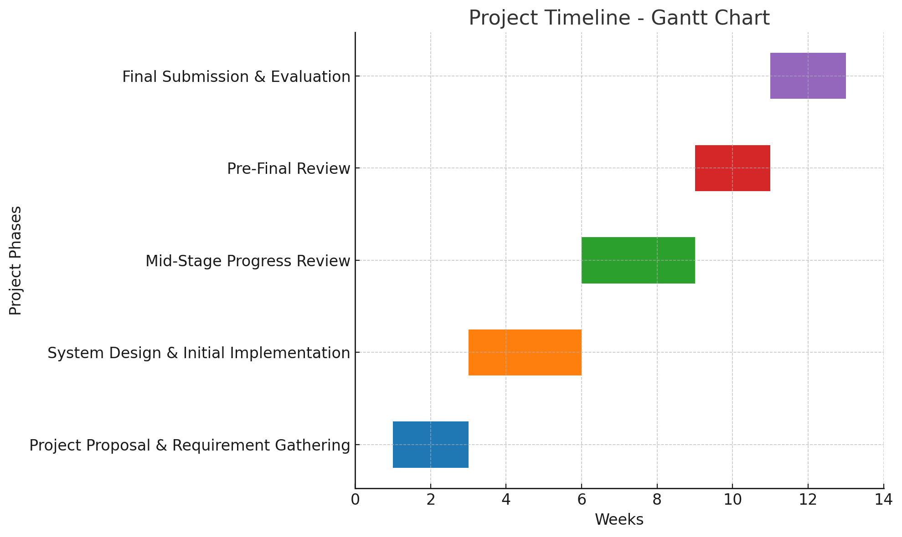
Timeline of the Project (Gantt Chart)

Slide 12
References (IEEE Paper format)
[1] Z. Zheng, Z. Qiu, X. Hu, L. Wu, H. Zhu, and H. Xiong, “Generative Job Recommendations with Large Language Model,” arXiv preprint, 2023.
https://doi.org/10.1109/ICSSS49621.2020.9202046
[2] X. Han, C. Zhu, X. Hu, C. Qin, X. Zhao, and H. Zhu, “Adapting Job Recommendations to User Preference Drift with Behavioral‐Semantic Fusion Learning,”
https://doi.org/10.1016/j.chb.2023.107713
3] S. A. Alsaif, M. S. Hidri, H. A. Eleraky, I. Ferjani, and R. Amami, “Learning-Based Matched Representation System for Job Recommendation,”
https://doi.org/10.26668/businessreview/2023.v8i6.2089

Slide 13


