Slide 1
Smart Traffic Management System for Urban Congestion
CSE7302- University Project
Review-5
Batch Number: CSE_154
Roll Number | Student Name
Under the Supervision of
Dr. Jothish C
Associate Professor
School of Computer Science and Engineering
Presidency University
20221CSE0235 | Aduri Sai Charan Reddy
20221CSE0289 | Mithaeghar Mohammad Arif
20221CSE0279 | Thotamsetty Sai Sreekar
Name of the Program: CSE-Computer Science and Engineering
Name of the HOD: Dr. Asif Mohammed
Name of the Program Project Coordinator: Dr. Jayavadivel Ravi
Name of the School Project Coordinators: Dr. Sampath A K , Dr. Geetha A

Slide 2
Content
Problem Statement
Analysis of Problem Statement
Abstract
Literature Survey
Objectives
Existing Methods
Drawbacks
Analysis and Design
Proposed method & Feasibility Study
Architecture Diagram
Modules
Hardware and software details
Working Screenshot
Git hub Link
Timeline of the Project
References

Slide 3
Problem Statement
Traffic congestion in urban areas is increasing rapidly.
Manual traffic control systems are inefficient and cannot handle real-time traffic variations.
Parking management is also not optimized, leading to wasted time and fuel.
There is a need for an intelligent system to predict congestion and manage traffic efficiently.

Slide 4
Analysis of problem Statement
Urban traffic is dynamic and changes frequently.
Traditional systems lack real-time decision-making capabilities.
Parking space detection is not automated in most areas.
Emergency vehicles often get delayed due to poor traffic control.
A smart AI-based system can solve these issues effectively.

Slide 5
Abstract
This project proposes an AI-based traffic and parking management system.
It uses machine learning to predict traffic congestion and computer vision to detect parking availability.
The system provides real-time updates and optimizes traffic signals.
It helps reduce congestion, improve vehicle movement, and support emergency routing.

Slide 6
Literature Survey
Many existing studies use AI for traffic prediction.
Machine learning models like Random Forest are widely used for prediction tasks.
Computer vision is used for vehicle and parking detection.
However, most systems focus only on one feature and lack integration.
This project combines multiple technologies into one system.

Slide 7
Objectives
Develop a traffic congestion prediction system using AI
Implement smart parking detection using computer vision
Improve traffic signal control
Provide real-time updates to users
Support emergency vehicle prioritization

Slide 8
Existing Methods
Manual traffic signal systems
Fixed-time traffic lights
Basic traffic monitoring systems
Manual parking management
Rule-based traffic systems

Slide 9
Drawbacks of existing methods
No real-time decision making
High traffic congestion during peak hours
Manual parking causes delays
No emergency vehicle prioritization
Inefficient use of road infrastructure

Slide 10
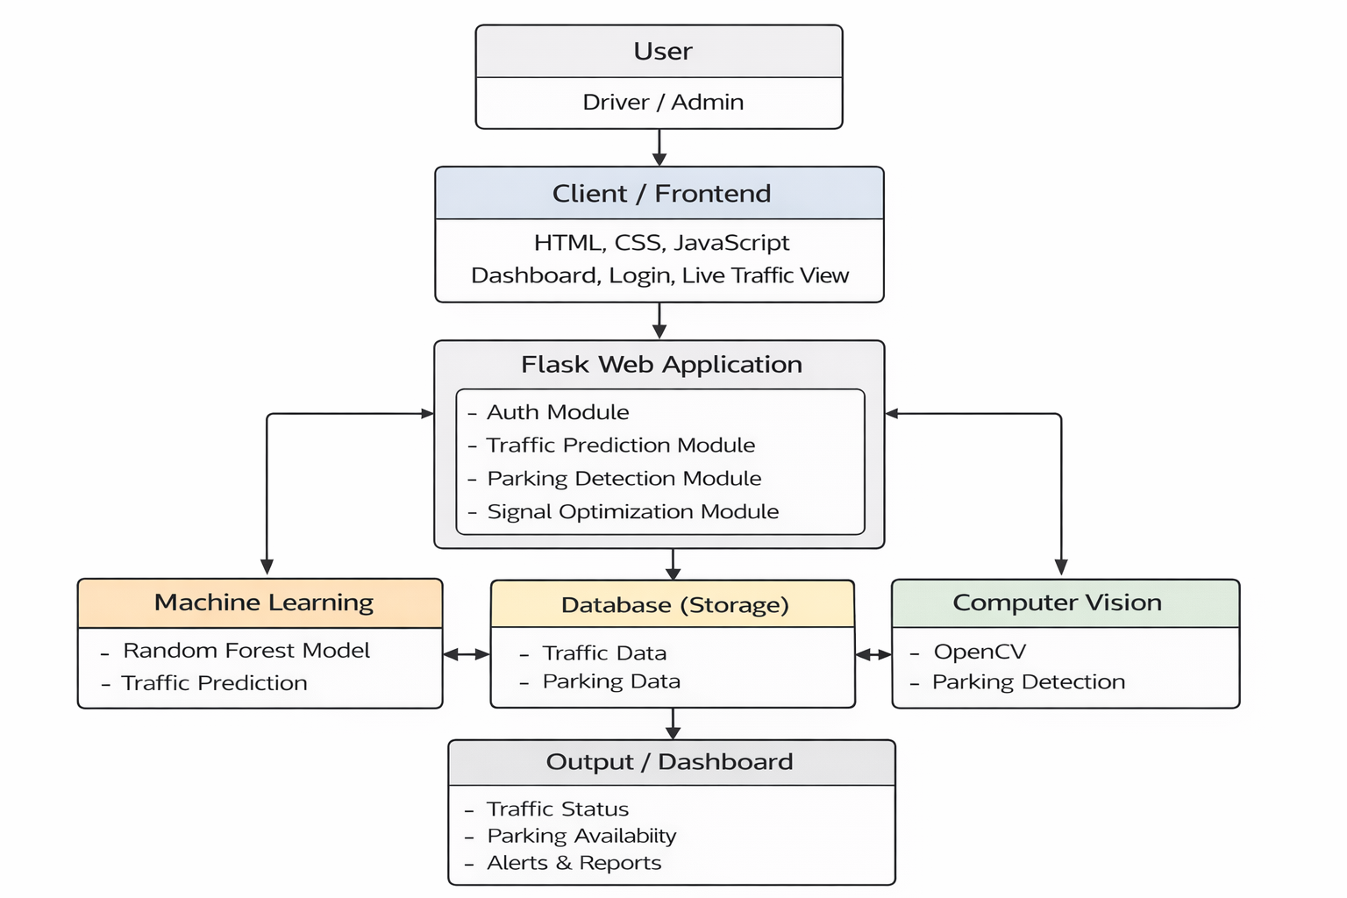
Analysis and Design
Block Diagram:

Slide 11
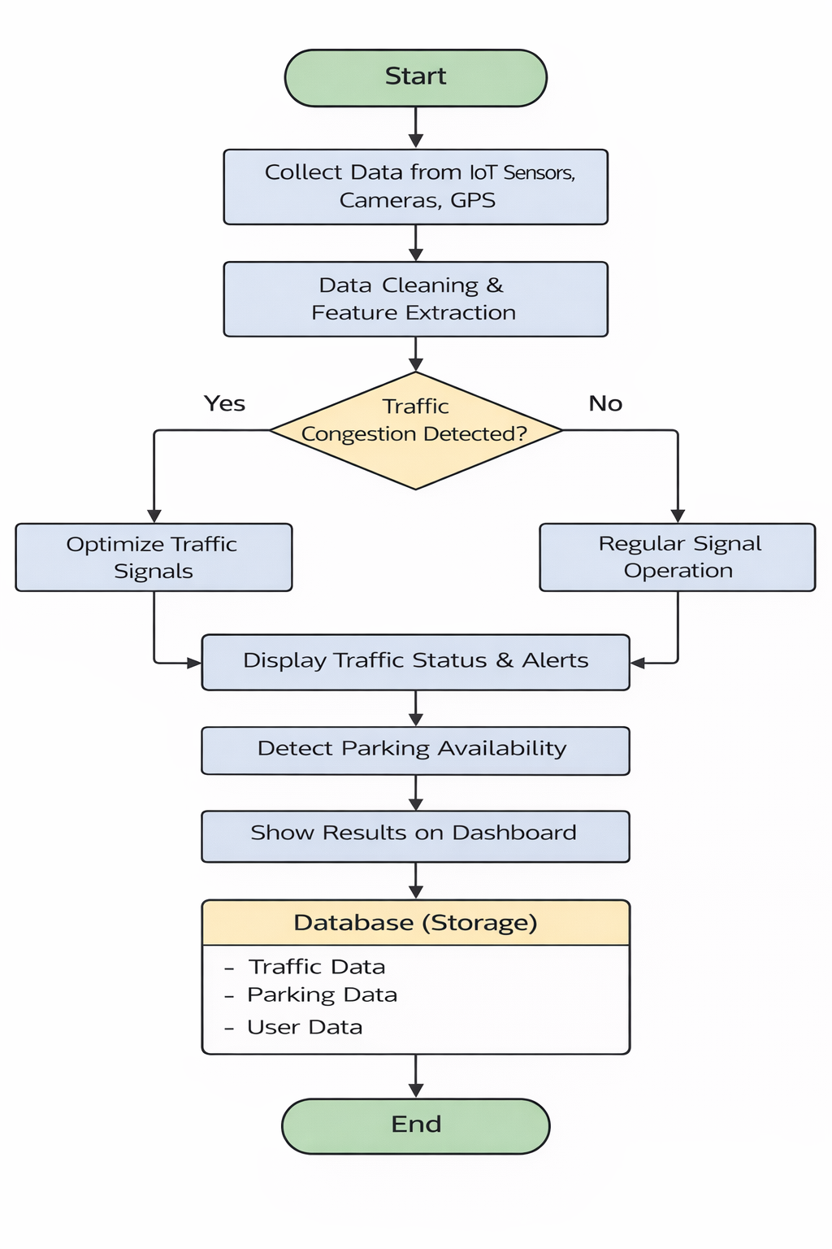
Analysis and Design
System flow chart:

Slide 12
Proposed method & Feasibility Study
Proposed Method
Use AI for traffic prediction Use computer vision for parking detection Optimize signals dynamically Provide dashboard for monitoring
Feasibility Study
Technically feasible using Python and ML Easy to use interface Cost-effective solution Can be scaled for smart cities

Slide 13
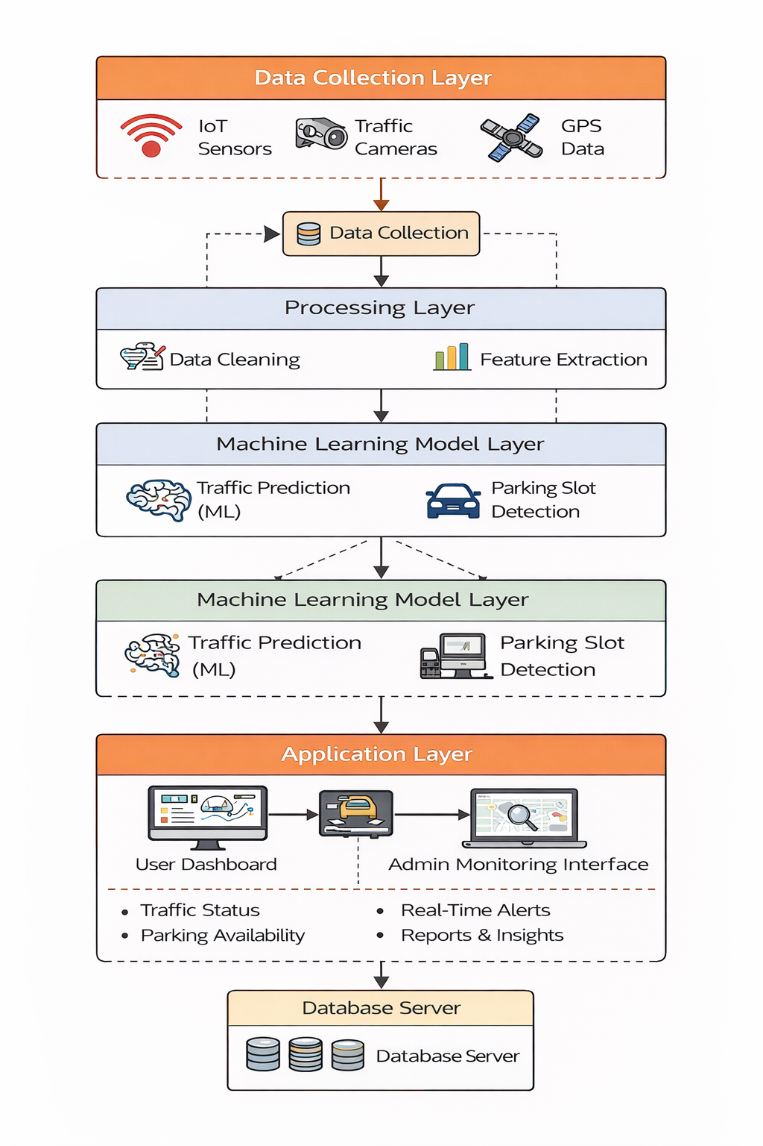
Architecture Diagram

Slide 14
Modules
Authentication Module
Login and user management
Traffic Prediction Module
Predict congestion using ML
Parking Detection Module
Detect available parking slots
Signal Optimization Module
Adjust traffic signals
Dashboard Module
Display results and analytics

Slide 15
Hardware and Software details
Hardware
Computer/Laptop Minimum 4GB RAM Camera (optional for parking detection)
Software
Python Flask OpenCV Scikit-learn HTML, CSS, JavaScript VS Code, GitHub

Slide 16
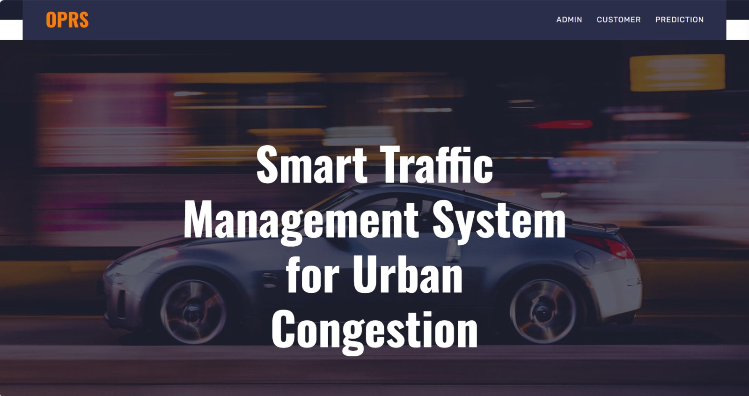
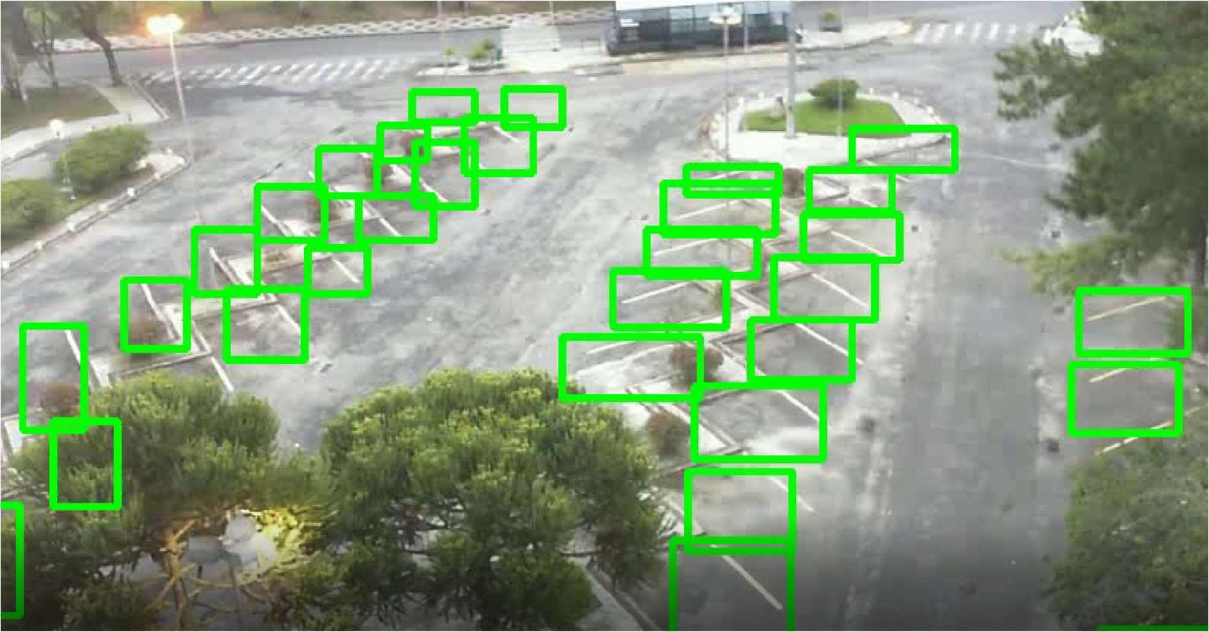
Working Screenshots
Fig. 1. The main landing page providing navigation to parking and traffic prediction features.
Fig. 2. Page showing output of the parking vacancy prediction model with slot availability.

Slide 17

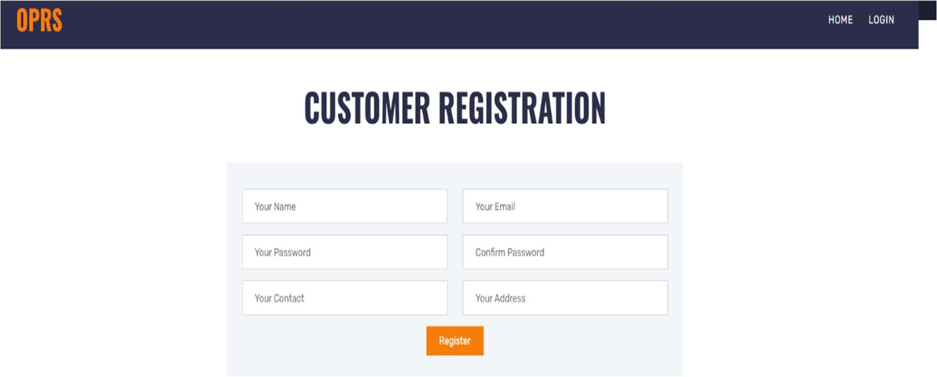
Screenshots
Fig. 3. Secure login interface for administrators to access management functionalities.
Fig. 4. User login interface to access parking and traffic prediction services.

Slide 18
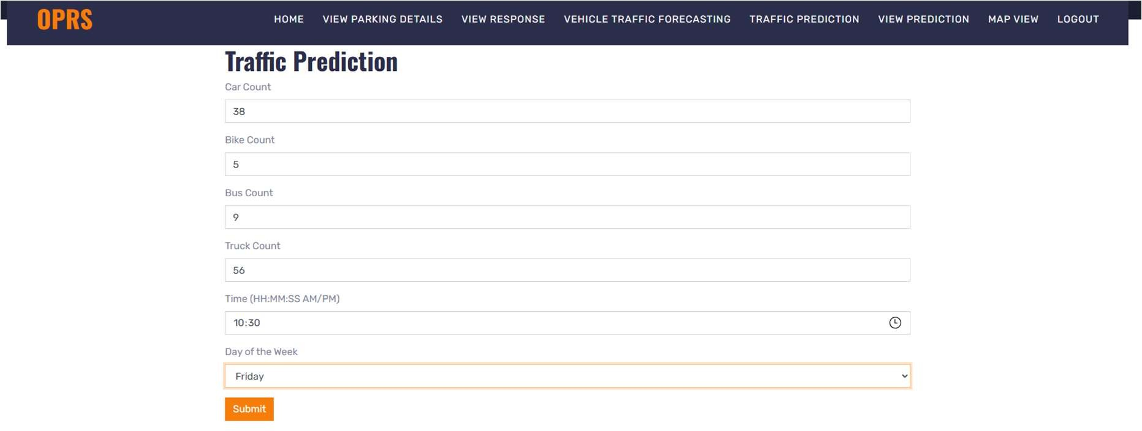
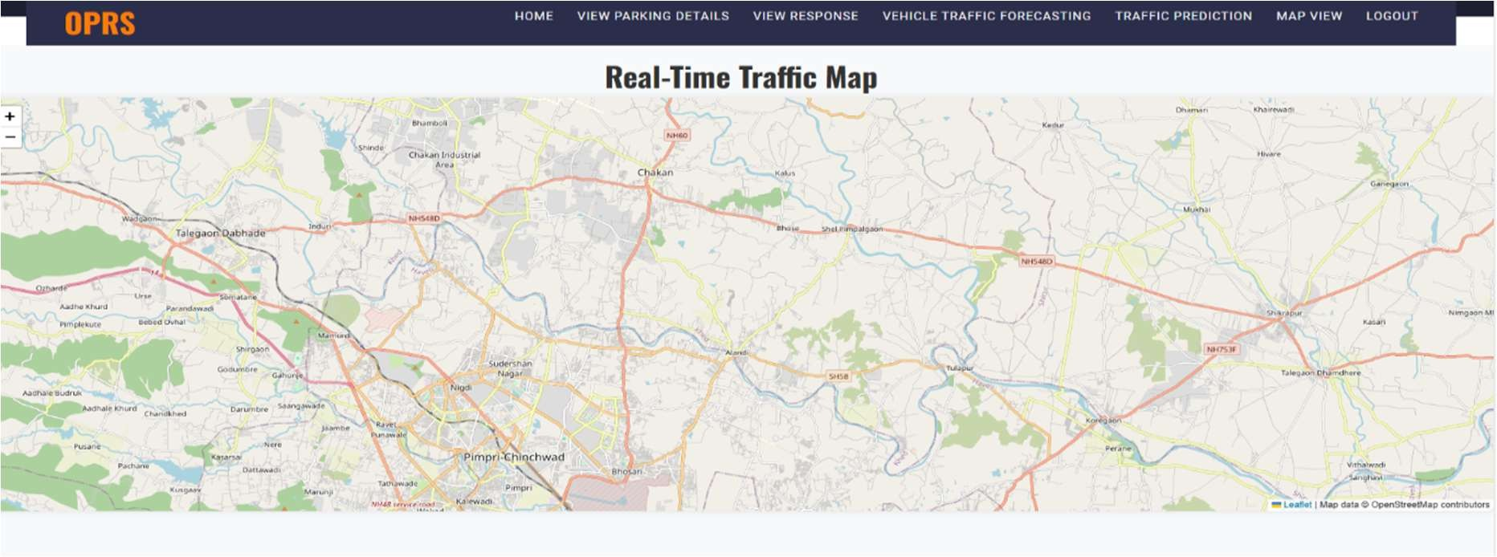
Screenshots
Fig. 5. Visual representation of estimated vehicle flow on different routes.
Fig. 6. Interactive map showing parking locations and real-time traffic data.

Slide 19
Timeline of the Project (Gantt Chart)
Gantt Chart
Phase | Week 1 | Week 2 | Week 3 | Week 4 | Week 5 | Week 6 | Week 7 | Week 8
1. Requirement Gathering & Analysis | ██████ | ██████
2. Design (UI/UX & Architecture) |  | ██████ | ██████
3. Development (Frontend & Backend) |  |  | ██████ | ██████ | ██████
4. Testing & Debugging |  |  |  |  | ██████ | ██████
5. Deployment & Documentation |  |  |  |  |  |  | ██████ | ██████

Slide 20
References (IEEE Paper format)
[1] Al-Heety, O.S., Zakaria, Z., Abu-Khadrah, A., Ismail, M., Shakir, M.M., Alani, S. and Alsariera, H., 2026. Traffic jam control with emergency conscious and reinforcement learning-based non-dominated sorting genetic algorithm. IEEE Access.
[2] Goswami, A. and Kadao, A.K., 2025. Indian metro congestion reduction using smart traffic management systems. Next Generation Smart Systems, pp.1022–1031.
[3] Xu, Y. and Li, Y., 2025. A multi-source data fusion framework of risk field and traffic congestion prediction in real-time urban environments. IEEE Access, vol. 13.
[4] Prathiba, S.B., Krishnamoorthy, S.R., Kannan, K.S., Selvaraj, A.K., Ranganayakulu, D., Fang, K. and Gadekallu, T.R., 2025. Digital twin-powered traffic and power grid optimization system in 6G-driven smart cities in real-time. IEEE Internet of Things Journal.
[5] Wairagade, A., Ugale, K. and Waghmare, R., 2025. Urban congestion reduction using AI-powered smart traffic management system. International Journal of Scientific Research and Engineering Trends, 11(2).
[6] Naramdeo, K., Madake, S., Patil, J. and Patil, P., 2025. Smart traffic management system in urban environment. Journal of Novel Research and Innovative Development, 3(6).
[7] Laanaoui, M.D., Lachgar, M., Mohamed, H., Hamid, H., Villar, S.G. and Ashraf, I., 2024. SETEC: Enhancing urban traffic management using real-time load balancing and anomaly detection. IEEE Access, vol. 12.

Slide 21
References (IEEE Paper format)
[8] Bhat, C.R., Raghunath, K.M.K., Kumar, V.V., Kannan, V.A., Mahesh, T.R., Manikandan, K. and Krishnamoorthy, N., 2024. Redefining urban traffic dynamics using TCN-FL based traffic prediction and control measures. IEEE Access, vol. 12.
[9] Fadila, J.N., Wahab, N.H.A., Alshammari, A., Aqarni, A., Al-Dhaqm, A. and Aziz, N., 2024. Fourth industrial revolution smart urban traffic management at scale: A comprehensive review. IEEE Access, vol. 12.
[10] Wang, C., Ma, X., Jia, L., Lai, Z., Yang, Z., Yan, H. and Zhao, J., 2024. CPS architecture development for urban roadway intersections based on MBSE. Journal of Intelligent and Connected Vehicles, 7(3), pp.190–204.
[11] Xu, H., Berres, A., Yoginath, S.B., Sorensen, H., Nugent, P.J., Severino, J., Tennille, S.A., Moore, A., Jones, W. and Sanyal, J., 2023. Smart mobility in the cloud: Digital twin for situational awareness and cyber-physical control in real-time. IEEE Transactions on Intelligent Transportation Systems, 24(3), pp.3145–3160.
[12] Jin, J., Rong, D., Pang, Y., Ye, P., Ji, Q., Wang, X., Wang, G. and Wang, F.Y., 2022. An agent-based traffic recommendation system: Urban traffic management strategy revisiting and revising. IEEE Transactions on Systems, Man, and Cybernetics: Systems, 52(11), pp.7289–7301.
[13] Oliveira, L.F.P., Manera, L.T. and Luz, P.D.G., 2021. Smart traffic light control system with real-time observation. IEEE Internet of Things Journal, 8(5), pp.3384–3393.
[14] Nagapragna, H. and Joshi, S.S., 2017. Smart traffic management system. Sapthagiri College of Engineering, Bangalore.
[15] Lanke, N. and Koul, S., 2013. Smart traffic management system. International Journal of Computer Applications, 75(7), pp.19–22.

Slide 22


