Slide 1
BUILDING MODERN CLOUD: USING DOCKER, KUBERNETES & GOOGLE CLOUD PLATFORM
DEPARTMENT OF COMPUTER SCIENCE
CHANNABASAVESHWARA INSTITUTE OF TECHNOLOGY, GUBBI
PRESENTED BY :
CHARAN S
1CG16CS021
UNDER GUIDANCE OF :
DHARANESH KUMAR M L
ASST. PROFESSOR

Slide 2
TABLE OF CONTENTS
01
02
03
INTRODUCTION
RELATED WORK
EXISTING SYSTEM
04
PROBLEM STATEMENT
05
PROPOSED SYSTEM
06
EXPERIMENTAL RESULTS
07
CONCLUSION

Slide 3
01
INTRODUCTION

Slide 4
WHAT IS CLOUD..???
Cloud computing is the on-demand delivery of IT resources over the Internet with pay-as-you-go pricing. Instead of buying, owning, and maintaining physical data centers and servers, you can access technology services, such as computing power, storage, and databases, on an as-needed basis from a cloud provider like Amazon Web Services (AWS).

Slide 5
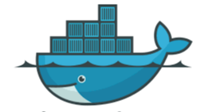
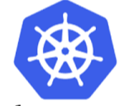
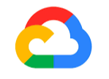
DOCKER, KUBERNETES AND GOOGLE CLOUD
DOCKER
KUBERNETES
GOOGLE CLOUD
Docker is an open source software platform to create, deploy and manage virtualized application containers on a common operating system (OS), with an ecosystem of allied tools
Kubernetes is a portable, extensible, open-source platform for managing containerized workloads and services, that facilitates both declarative configuration and automation. It has a large, rapidly growing ecosystem. Kubernetes services, support, and tools are widely available.
Google Cloud is a suite of Cloud Computing services offered by Google. The platform provides various services like compute, storage, networking, Big Data, and many more that run on the same infrastructure that Google uses internally for its end users like Google Search and YouTube.

Slide 6

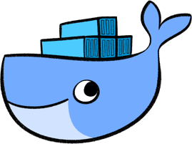
CONTAINER
Containers are an executable unit of software in which application code is packaged, along with its libraries and dependencies, in common ways so that it can be run anywhere, whether it be on desktop, traditional IT, or the cloud.

Slide 7
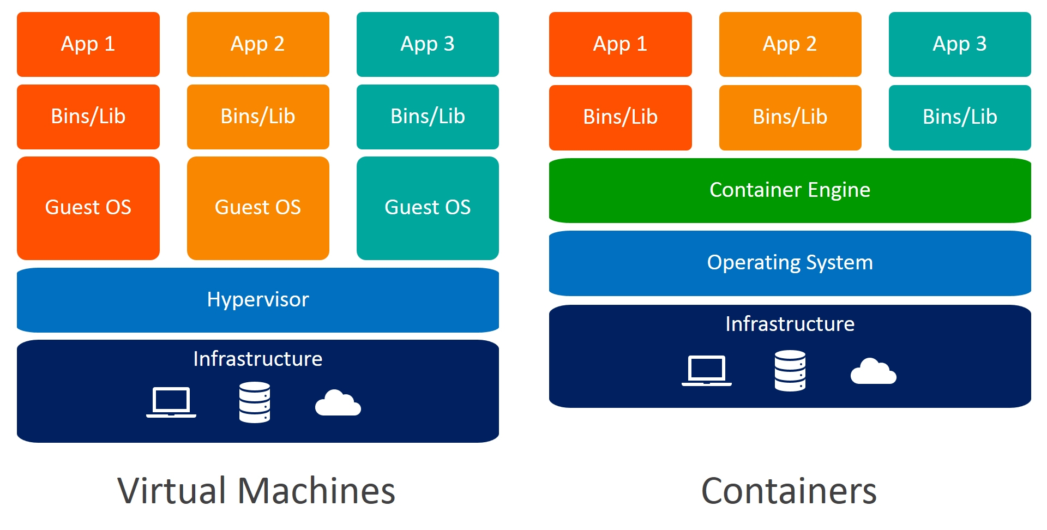

Slide 8
02
RELATED WORK

Slide 9
Docker provides the ability to package and run an application in a loosely isolated environment called a container. The isolation and security allow you to run many containers simultaneously on a given host. Containers are lightweight because they don’t need the extra load of a hypervisor, but run directly within the host machine’s kernel. This means you can run more containers on a given hardware combination than if you were using virtual machines. You can even run Docker containers within host machines that are actually virtual machines !

Slide 10
03
EXISTING SYSTEM

Slide 11
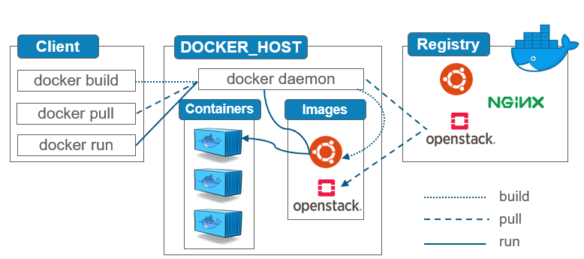
DOCKER ARCHITECTURE

Slide 12
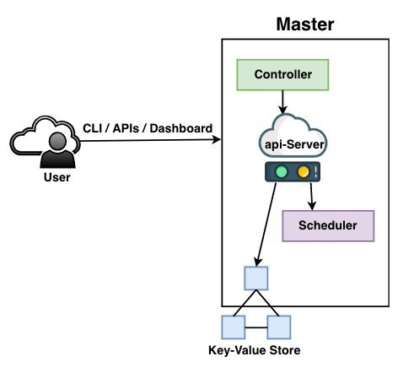
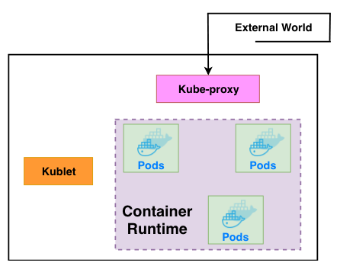
KUBERNETES ARCHITECTURE

Slide 13
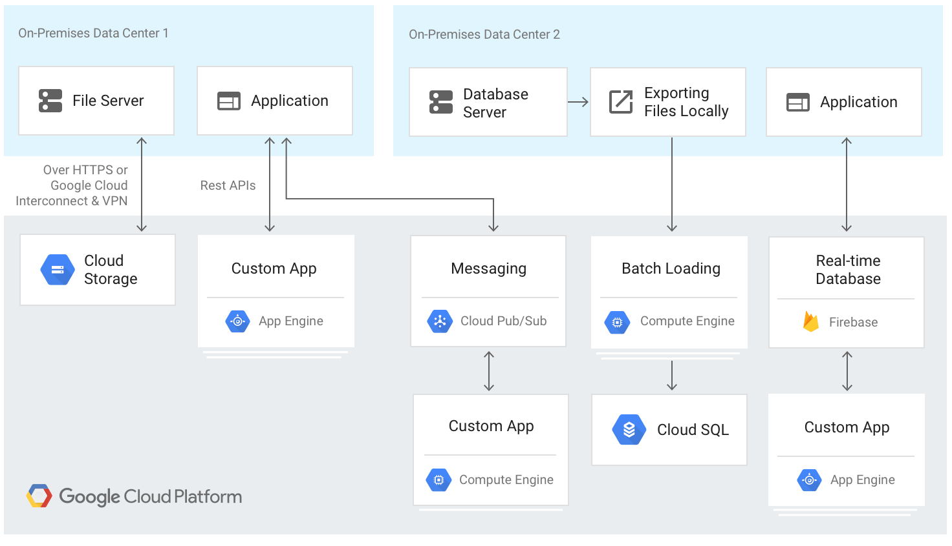
GOOGLE CLOUD ARCHITECTURE (HYBRID)

Slide 14
04
PROBLEM STATEMENT

Slide 15
The most important issues
which need to be
addressed from the cloud
service providers view
are data privacy and
vendor-lock-in. Cloud
Computing has also
provided a new platform
for data storage as a
service.

Slide 16
05
PROPOSED SYSTEM

Slide 17
To develop and build a modern cloud infrastructure or devops implementation than both Docker and Kubernetes have revolutionized the era of software development and operations.
Although both are different, they unify the process of development and integration, it is now possible to build any architecture by using these technologies

Slide 18
06
EXPERIMENTAL RESULT

Slide 19
Usage of Kubernetes
1.For deployment and monitoring option .
2.For fast and reliable response times.
3.Deploying a big cluster.
4.Developing and managing large number of containers.

Slide 20
USAGE OF DOCKER
1) Docker creates virtual containers. Its container management tool can consistently run software as long as system exits .
2) With the use of Docker we can use single VM and can run many containers above that. It uses much less memory.
3) Container is a part of operating system that is responsible running a software. That makes the process faster

Slide 21
07
CONCLUSION

Slide 22
1. Docker and Kubernetes work at different levels.
2. The Docker technology make use of the of the Linux kernel and the different and various features of Linux, because in Linux operating system the entire system is been separated from the other running applications, which makes the process or working of the Docker faster and accurate.
3. The major advantage of using Kubernetes is orchestrating between many applications. It is
also very useful for scaling many applications at very less time. By using this we can save our cost and time.

Slide 23
THANKS!
DOES ANYONE HAVE ANY QUESTIONS?

