Slide 1

Introduction to Ansible

Slide 2
Why Ansible ???
No Agent
Idempotent
Declarative Not Procedural
Tiny Learning Curve

Slide 3
Ansible Use Cases
Provisioning
Configuration Management
App Deployment
Continuous Delivery
Security & Compliance
Orchestration

Slide 4
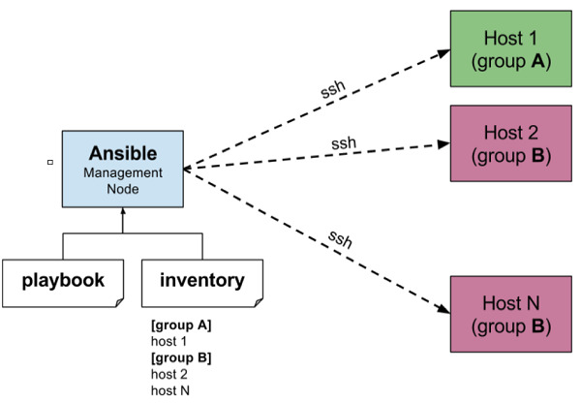
Architecture of Ansible

Slide 5
Playbook
Playbooks are simple YAML files. These files are descriptions of the desired state of your systems
Playbook contains Plays.
Plays contain tasks.
tasks call modules.

Slide 6
Installing Ansible
sudo dnf -y install https://dl.fedoraproject.org/pub/epel/epel-release-latest-8.noarch.rpm
sudo dnf install --enablerepo epel-playground ansible

Slide 7
EXAMPLE OF ANSIBLE
Create yaml file
---
hosts: localhost
sudo:yes
tasks:
- name : install apache
yum name=httpd state=latest
- name: start apache
service:
name:httpd
state: started
Run the file
ansible-playbook play.yaml

Slide 8

Companies that are using Ansible

Slide 9
THANKYOU

