Slide 1
Intelligent MultiDoc QnA Platform Using LangChain
TEAM MEMBERS
CHARAN VIGNESH N R – 312320205021
RAKESH K - 312320205114
PROJECT MENTOR
Mr. RADHAKRISHNAN K R

Slide 2
ABSTRACT
LangChain: Innovative technology for efficient multi-document question-answering and contextual understanding.
Advanced NLP: Cutting-edge natural language processing techniques for text comprehension and analysis.
Document Embeddings: Extract meaningful content from diverse documents for enhanced understanding.
Transformer Models: Utilize transformer-based models to generate rich vector representations for contextual comprehension.

Slide 3
OBJECTIVES
Efficient Processing: Efficient processing focuses on developing a system that can rapidly process and index various document formats, ensuring smooth question-answering across multiple documents.
Natural Interaction: Natural Interaction refers to the implementation of advanced NLP techniques, allowing users to interact effortlessly and intuitively with the platform using natural language queries.
Contextual Understanding: Contextual Understanding involves the utilization of document embeddings and transformer-based models to achieve a comprehensive grasp of document content, thereby enhancing the accuracy of generated answers.
Versatile Answering: Versatile Answering capability is achieved by enabling the platform to adeptly handle a wide range of question types, highlighting its intelligence and adaptability in providing precise responses.

Slide 4
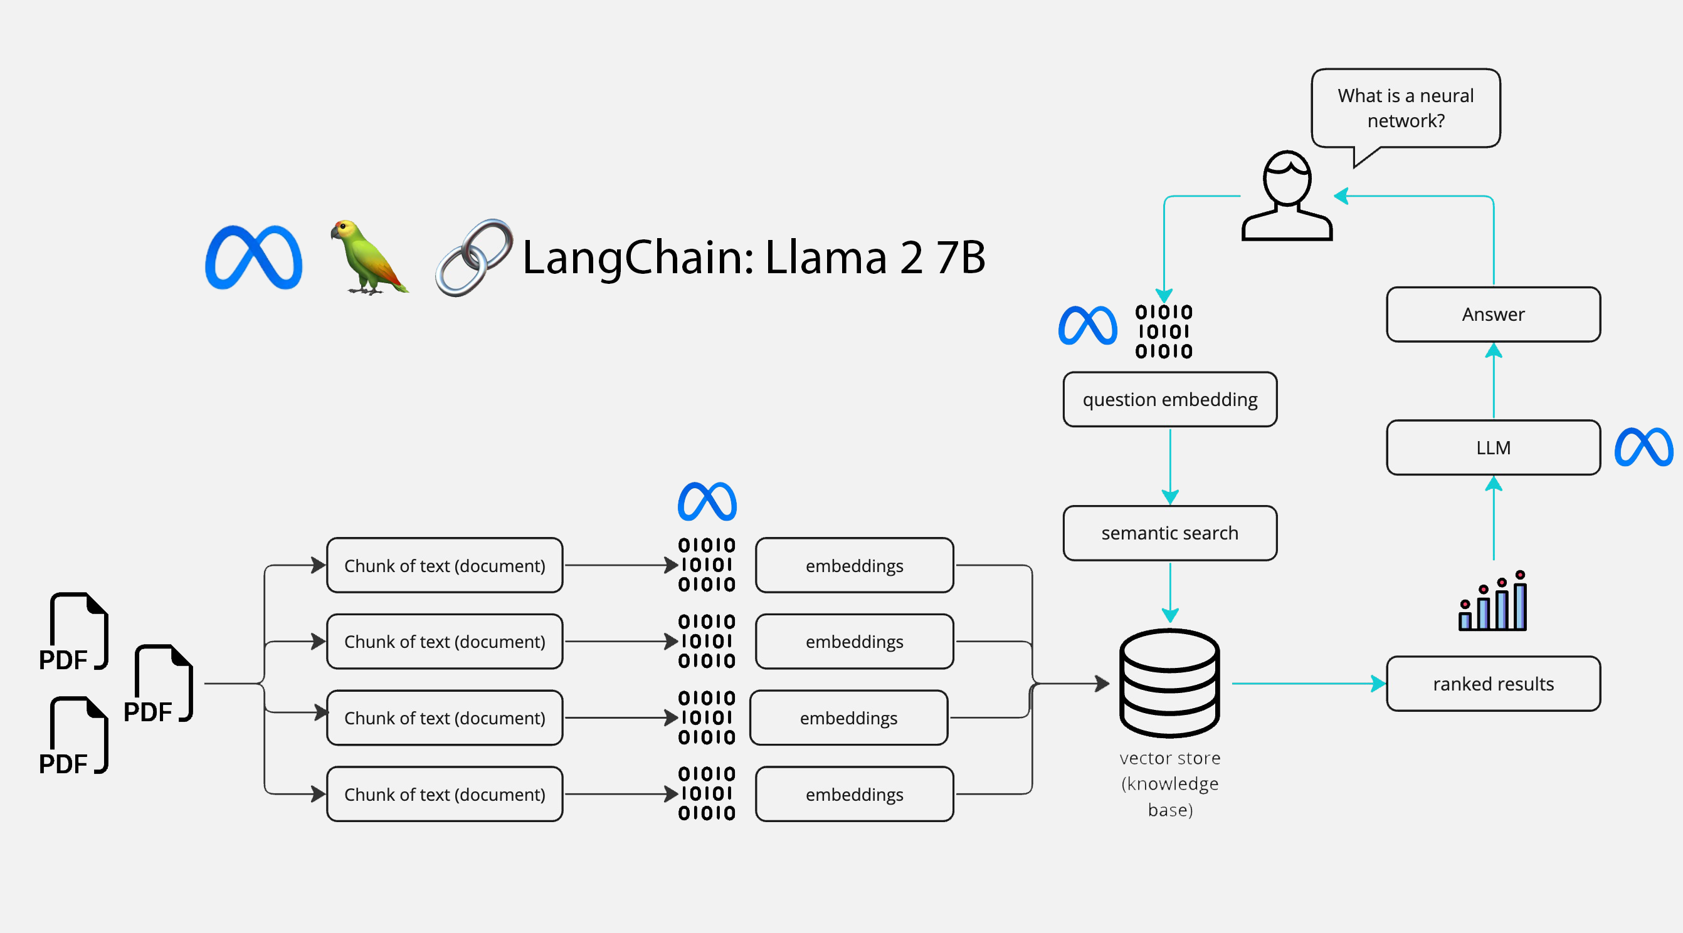
INTRODUCTION

Slide 5
INTRODUCTION
Efficient Document Processing
Precise Question-Answering
User-Centric Design
Versatile Applications
Transformative Potential

Slide 6
LITERATURE REVIEWS
AUTHOR | YEAR | PRINCIPLE | PROS AND CONS
Xiang Dong and Lijia Zeng | 2021 | The algorithm utilizes AI for query optimization and leverages edge computing to efficiently manage and preserve Chinese heritage art in a classic art database. | PROS Efficient Knowledge Extraction Deep Contextual Understanding Natural Interaction CONS Data Dependency Maintenance and Updates
Michael L. Rupley, Jr. Indiana University at South Bend | 2022 | This paper introduces query processing and optimization's importance in a DBMS, emphasizing efficient results for all users, using a car and driver database example to illustrate key concepts and relationships. | PROS Improved Performance Complex Analysis Resource Utilization CONS Complex Implementation Maintenance Overhead Inaccurate Optimization

Slide 7
LITERATURE REVIEW
AUTHOR | YEAR | PRINCIPLE | PROS AND CONS
Ryan Marcus , Parimarjan Negi , Hongzi Mao , Chi Zhang, Mohammad Alizadeh , Tim Kraska, Olga Papaemmanouil1 , Nesime Tatbul Brandeis University MIT Intel Labs | 2020 | The algorithm Neo utilizes machine learning to enhance cardinality estimation and search strategies, aiming for commercial-level performance and efficient open-source database optimizer development. | PROS Reduced Development Time Holistic Optimization Adaptive Learning CONS Complex Implementation Data Dependency Lack of Guarantees
Liwei Yan, Bo Bai, Member, IEEE, Wei Chen, Senior Member, IEEE, and Dapeng Oliver Wu, Fellow, IEEE | 2017 | This study addresses Chinese New Word Extraction (NWE) for financial concepts using dynamic features, introducing Source Diversity-Significance of Principal Patterns (SDSPP). SVM classification and iterative refinement yield improved precision (from 83.2% to 89.8%) and recall (from 80.8% to 88.9%) | PROS Improved Precision and Recall Contextual Insight Enhanced Performance CONS Complex Implementation Resource Intensity
Abdul Wahab Qurashi (abdul.qurashi@hud.ac.uk) and Anju P. Johnson (a.johnson@hud.ac.uk) | 2023 | This research leverages NLP and machine learning to automate railway safety document analysis within Enterprise Architecture, utilizing word embeddings and neural networks for context understanding and similarity assessment. | PROS Risk Mitigation Resource Savings Efficiency Enhancement CONS Complex Implementation Data Quality Dependency

Slide 8
AUTHOR | YEAR | PRINCIPLE | PROS AND CONS
Ahmad Amin; Toqir A. Rana; Natash Ali Mian; Muhammad Waseem Iqbal; Abbas Khalid; Tahir Alyas | 2019 | The algorithm employs unsupervised techniques, utilizing keyphrase extraction, to predict topics in Urdu documents, facilitating organization, summarization, and title assignment, particularly addressing challenges posed by evolving online news and the complexity of the Urdu language. | PROS Efficient Information Retrieval Automated Title Assignment Broad Applicability CONS Semantic Complexity Resource Intensity
Louis R Pasquale, MD Department of Ophthalmology Icahn School of Medicine at Mount Sinai | 2023 | This analysis utilizes search-engine query patterns, specifically search queries, to predict regional COVID-19 outbreaks early, offering real-time insights into health-seeking behavior at a population level and enhancing traditional outbreak detection methods. | PROS Real-Time Insights Supplemental Forecasting Predictive Value CONS Historical Inaccuracies Bias and Privacy Concerns
Stella Biderman Hailey Schoelkopf Quentin Anthony Herbie Bradley Kyle O’Brien Eric Hallahan Mohammad Aflah Khan Shivanshu Purohit USVSN Sai Prashanth Edward Raff Aviya Skowron Lintang Sutawika Oskar van der Wal | 2020 | Pythia is a suite designed to analyze large language models' behavior across training and scaling, addressing the need for understanding their performance in various domains, including NLP, and bridging the gap caused by the absence of suitable model suites for research. | PROS State-of-the-Art Performance Innovative Applications Scalability Insights CONS Limited Understanding Data and Bias Challenges

Slide 9
REFERENCES
Research on Query Optimization of Classic Art Database Based on Artificial Intelligence and Edge Computing - Xiang Dong and Lijia Zeng - 2021
Introduction to Query Processing and Optimization - Michael L. Rupley, Jr. Indiana University at South Bend - 2022
Neo: A Learned Query Optimizer - Ryan Marcus , Parimarjan Negi , Hongzi Mao , Chi Zhang, Mohammad Alizadeh, Tim Kraska, Olga Papaemmanouil1, Nesime Tatbul Brandeis University MIT Intel Labs - 2020
New Word Extraction From Chinese Financial Documents - Liwei Yan, Bo Bai, Member, IEEE, Wei Chen, Senior Member, IEEE, and Dapeng Oliver Wu, Fellow, IEEE - 2017
New Avenues for Automated Railway Safety Information Processing in Enterprise Architecture: An NLP Approach - Abdul Wahab Qurashi and Anju P. Johnson - 2023
A Novel Unsupervised Approach for Topic Prediction Using Keyphrase Extraction for Urdu Documents - Ahmad Amin; Toqir A. Rana; Natash Ali Mian; Muhammad Waseem Iqbal; Abbas Khalid; Tahir Alyas - 2019
Analysis of Search-Engine Query Patterns - Louis R Pasquale, MD Department of Ophthalmology Icahn School of Medicine at Mount Sinai - 2023
Pythia: A Suite for Analyzing Large Language Models Across Training and Scaling - Stella Biderman Hailey Schoelkopf Quentin Anthony Herbie Bradley Kyle O’Brien Eric Hallahan Mohammad Aflah Khan Shivanshu Purohit USVSN Sai Prashanth Edward Raff Aviya Skowron Lintang Sutawika Oskar van der Wal – 2020

Slide 10
SUMMARY
MultiDoc Capability: The platform excels in processing multiple documents, expanding the knowledge base through LangChain technology.
Advanced NLP: It uses transformer-based models to comprehend context deeply, generating accurate responses from text chunks.
Versatile Question Types: The platform handles diverse queries, adapting to factual and reasoning-based questions across domains.
Efficient Similarity Matching: Optimized similarity matching identifies relevant text chunks swiftly, leading to precise answers.
User-Friendly Interface: A web-based interface simplifies loading documents, asking questions, and receiving instant, accurate responses.
Impactful Applications: From research to legal analysis, the platform enhances decision-making and productivity with contextual answers.

Slide 11
THANK YOU

