Slide 1
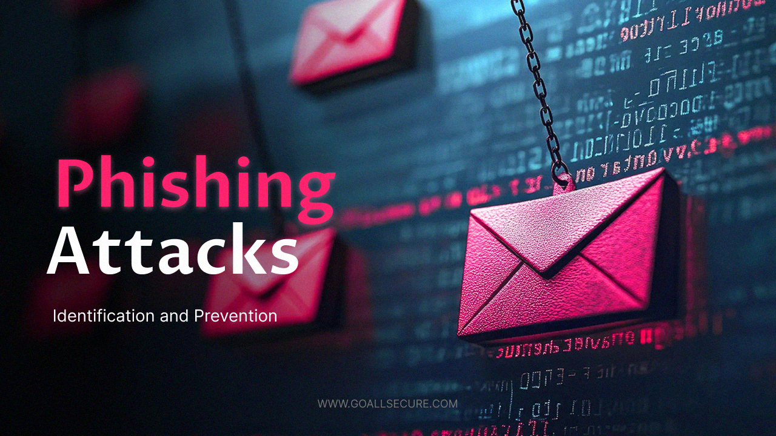

Slide 2
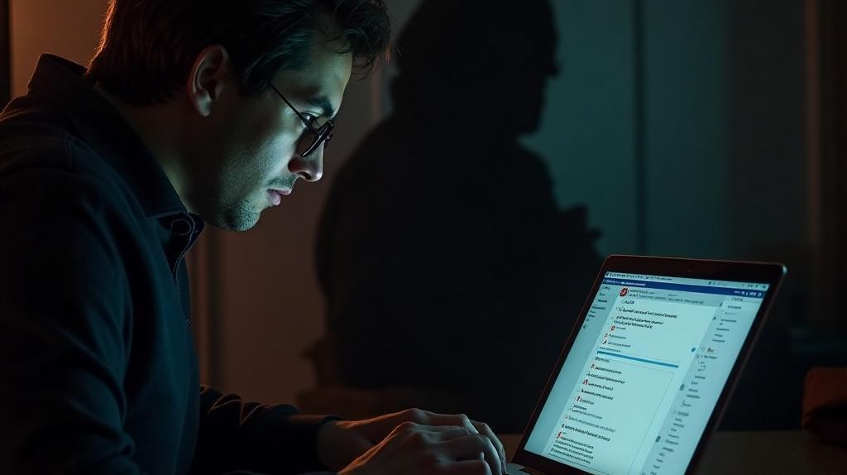
Don’t Take the Bait: Recognizing and Avoiding Phishing Attacks
Presented by Charbel Rizk
@CodeAlpha Internship

Slide 3

Introduction
Phishing attacks are prevalent threats targeting individuals and organizations, aiming to deceive them into revealing sensitive information. This presentation will provide insights into understanding phishing, its objectives, and tactics used by cybercriminals.

Slide 4
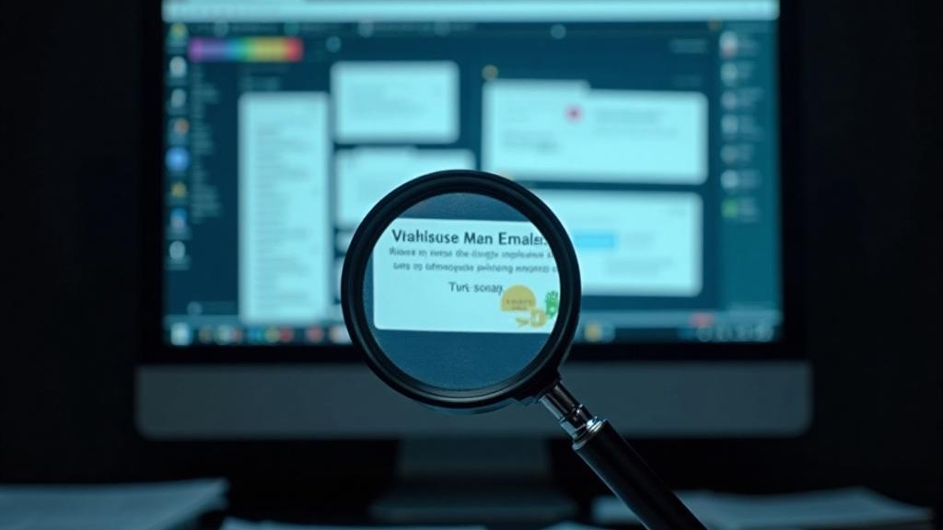
01
Phishing Overview

Slide 5
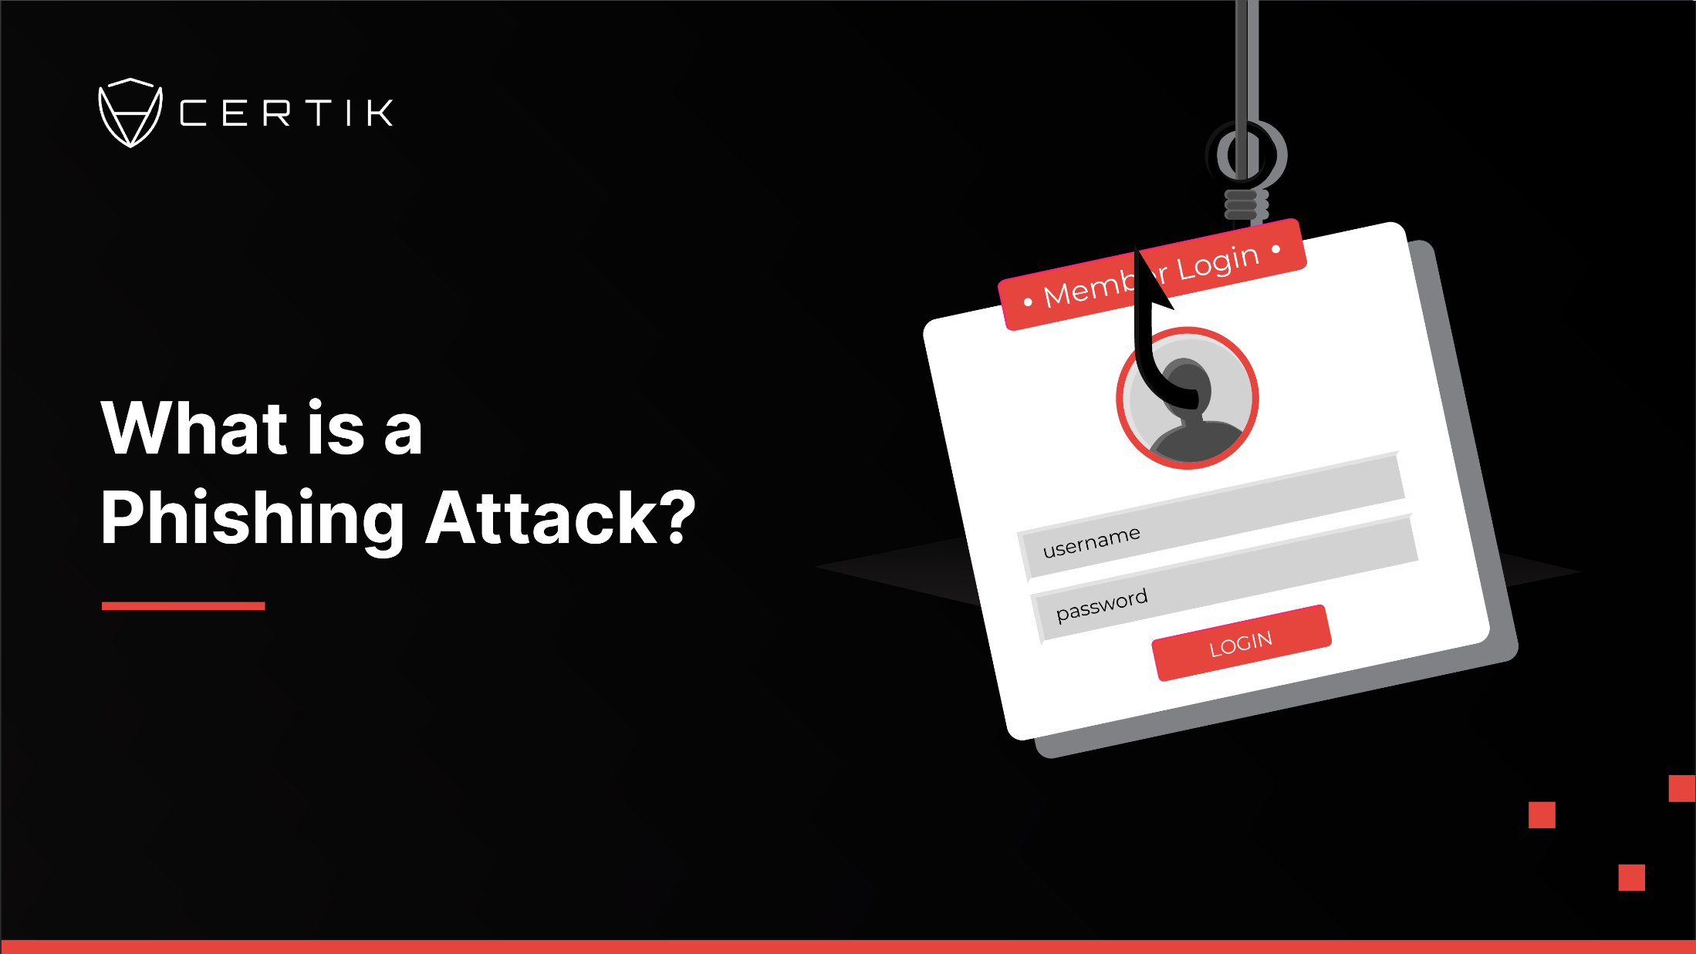

Slide 6
Definition of Phishing
Phishing is a cybercrime that involves tricking individuals into providing sensitive data, such as usernames, passwords, credit card details, and other personal information. Attackers often impersonate trustworthy sources, making their fraudulent messages appear legitimate to the target.

Slide 7

Goals of Phishing Attacks
The primary objective of phishing attacks is to gain unauthorized access to confidential information. This can include theft of financial credentials, identity fraud, or malware installation. By capturing sensitive data, attackers can exploit this information for malicious purposes, often with severe repercussions for victims.

Slide 8
Real-Life Examples of Phishing
One notable example of a phishing attack is the Google Docs incident in 2017. In this event, users received emails that appeared to be invites to collaborate on a Google Docs document. Clicking the link led to a fake authentication page where users unwittingly provided access to their Google accounts. This attack rapidly spread, impacting numerous workplaces and academic institutions before it was contained.

Slide 9

Phishing Tactics
02

Slide 10
Common Types of Phishing
Phishing attacks encompass various forms, including:
Email Phishing: Fraudulent emails masquerading as reputable sources such as banks or service
providers.
Spear Phishing: Highly targeted attacks personalized to specific individuals, often
utilizing information gleaned from social media.
Smishing: Phishing attempts conducted through SMS messages, often containing malicious links.
Vishing: Voice phishing, where attackers use phone calls to lure victims into divulging private information.

Slide 11
Signs of Phishing Emails
Identifying phishing emails can be challenging, but certain indicators can help:
Urgent or threatening language is often employed to provoke quick responses.
Misspelled URLs or email addresses may reveal the sender's illegitimacy.
Unexpected attachments or links can contain malware.
Generic greetings, such as "Dear Customer," may signal a lack of personalization and authenticity.

Slide 12

Protection Strategies Against Phishing
To safeguard against phishing attacks, consider implementing these strategies:
Avoid clicking on suspicious links in emails. Always verify the source before taking action.
Hover over URLs to reveal their true destination, ensuring they match the intended site.
Utilize multi-factor authentication (MFA) to add an extra layer of security.
Report any suspicious messages to your IT or security department to assist in protecting others.

Slide 13
Conclusion
Awareness is key to combating phishing attacks. By understanding what phishing is, recognizing common tactics, and implementing robust protection strategies, individuals and organizations can significantly reduce their risk of falling victim to these cyber threats. Stay informed and vigilant to protect your sensitive information.

Slide 14
Thank you!
Presented by Charbel Rizk
@CodeAlpha Internship

