Slide 1

CSUN ECE UAV Project Top Three Claws 01/30/26
By: ECE UAV Team

Slide 2
Table of Contents:
Design Requirements-(disclaimer based on the density of our payloads, we’d have to upscale these designs)
Top Three Choices
Pros and Cons for each
Material list and Cost
Vote and Pick

Slide 3
Efficiency==Light weight: score(20)
Since the competition requires the drone to be at and or under 40lb this is one of the heavier weighted scores cause it’s that important.

Slide 4
compatible with razz pie: score(13)
If the part is incompatible with our current built in razz pie computer, then the design was scored appropriately.

Slide 5
compatible with Linux: score(13)
This is one of the few requirements that directly relays on a previses requirement. So, it scales with “compatible with razz pie.”

Slide 6
Simplistic: score(20)
Our group is focusing on simplicity cause finding the claw design is half the battle, we also need to attach it to the current drone set up. Hence simplicity is key for success.

Slide 7
Latch Designs: score(1)
While it may be nice if the claw incorporated some type of latch design, i.e. affixing a rotational component to a surface, it’s not necessary.

Slide 8
Pure System Mechanic Denominations: each score(1)
Pure systems of Mechanics the easiest systems to model and incorporate, but they don’t incorporate cross denominational advantages that make Hybrid systems more useful. They’d also be at a higher cost of integration since these systems are often design for very specific roles.

Slide 9
Hybrid System Mechanic Denominations: each score(15)
Hybrid Systems offer a wide range of utility an application. This is because it allows for energy translators to be incorporated between the systems i.e turning EMF ➔ Translator(DC motor) ➔ Rotational Mechanical Torque.

Slide 10
Top Three Winers of the Criteria Matrix
Criteria Matrix | Nominal Scores | Robot Claw with servo for Arduino/Raspberry Pi/Microbit DIY | CPX Drone Claw | Granular Jamming Grippers
Efficiency==Light weight: | 20 | 15 | 20 | 20
compatible with razz pie: | 13 | 13 | 13 | 13
compatible with Linux: | 13 | 13 | 13 | 13
Simplistic: | 20 | 20 | 20 | 20
Latch Designs: | 1 | 1 | 0 | 1
Pure System Mechanic Denominations: | 3 | 2 | 2 | 3
Hybrid System Mechanic Denominations: | 45 | 10 | 10 | 25
Total Scoring: | 100 | 74 | 78 | 95
//////////////////// | //////////////////////// | /////////////////////// | ////////// | ///////////////////

Slide 11
Robot Claw with Metal Servo for Arduino/Raspberry Pi/Microbit DIY score(74)
Pros: This design comes with its own motor type and explicitly sates the desired compatibility listed in the Criteria Matrix. In addition, all part files for 3-d printing and documentation of specs are included as well insuring fast assembly and easy integration with our current drone design.
Cons: The design in practice however seems to have a hard time dealing with surface friction, creating lots of extra resistance to the mechanical action of opening and closing. We’d need to test possible customizations if necessary to reduce friction between the moving parts.
Reff(1)

Slide 12
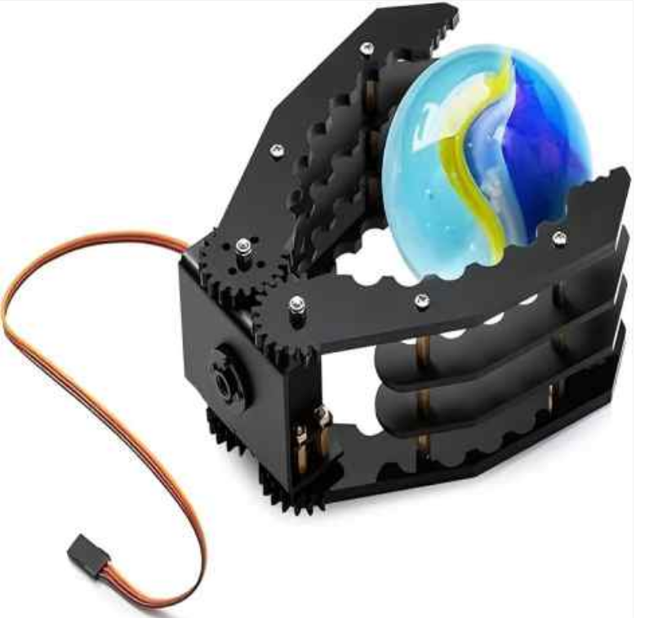
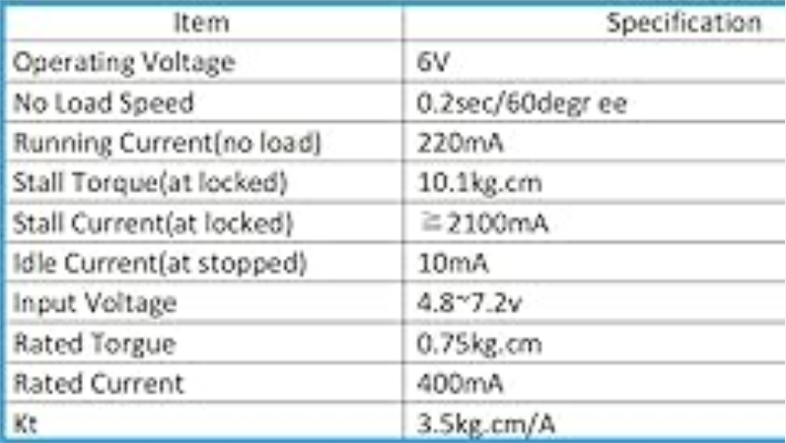

Material List and Approximate Cost

Slide 13
CPX Drone Claw score(78)
Pros: This design comes with a complete bill of materials and a very detailed step by step instruction manual to not only set up the drone claw but even includes a copy of the circuit diagram, code instructions used, and Fusion 360 CAD files along with a stated loading capacity of 2 lb or (990 g).
Cons: The setup is less straight forward and would require a longer assembly time. Additionally, we’d have to rewrite the code into python cause the instructions used a different coding language. Also, the loading capacity is fixed so if we wanted to increase the force load capacity, we’d have to make modifications and additional test runs.
Reff(2)

Slide 14
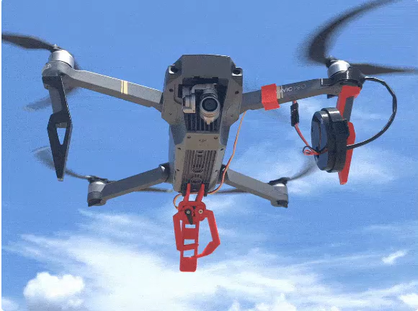
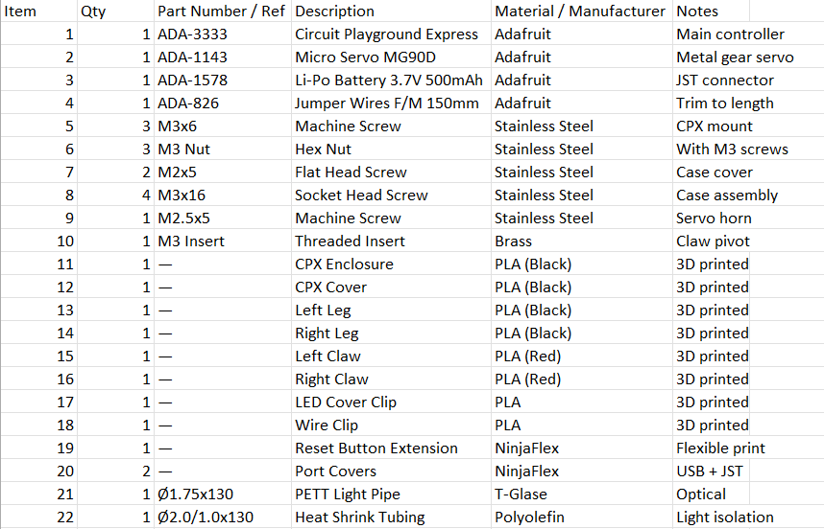

Material List and Approximate Cost

Slide 15
Granular Jamming Grippers score(95)
Pros: The Granular Jamming Gripper is a type of pneumatic system that incorporates a rubber gripper that uses pressure to grab, drop, and throw elements. The gripper has a grip force of about 0.661 lb or (330 g) and because of its uniform surface the grip is uniform to the deformation on impact. Also, the device is very space efficient for a Hybrid system. All specs and documentation are included.
Cons: The grip force is less than half the CPX drone, so you’d be sacrificing extra carrying capacity. Another area to consider is the device is sold in parts to the price steeply varies. Also, this device is a hybrid systems with three separate mechanic systems.
Reff(3)

Slide 16
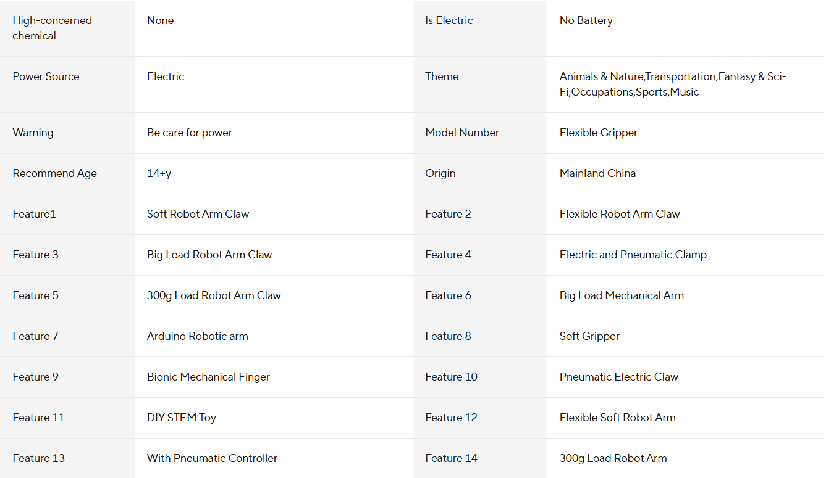
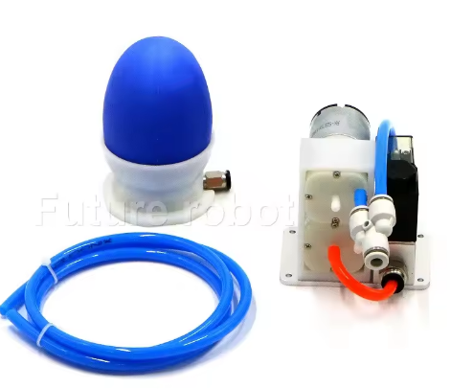

Material List and Approximate Cost

Slide 17

Discuses Among Yourself and Vote
Keep in mind our 3 elements are:
A 3.93701in by 3.93701 in by 3.93701 in cube~1kg
A Spherical bean bag with r= 1.25984 in~130g
A 7.5 in by 7.5 in by 6.7 in collapseable bucket~1to2 kg

Slide 18
Resources:
https://cokoino.com/products/robot-claw-with-metal-servo-for-arduino-raspberry-pi-microbit-diy (1)
https://learn.adafruit.com/drone-claw/overview (2)
https://www.aliexpress.us/item/3256808139902221.html?src=google&pdp_npi=4%40dis%21USD%2169.50%2163.93%21%21%21%21%21%40%2112000044612948606%21ppc%21%21%21&gatewayAdapt=glo2usa#nav-description (3)

