Slide 1


Prepared by - Charchil Singh
Brain Tumour Classification (MRI)
School of emerging science and technology ,
Gujarat University

Slide 2
Abstract
Brain tumour detection and classification is that the most troublesome and tedious task within the space of medicative image getting ready.
MRI (Magnetic Resonance Imaging) may be a medicative procedure, typically adopted by the medical specialist for illustration of inner structure of the build with no surgery.
MRI provides long information concerning the human delicate tissue, that helps within the conclusion of brain tumour. Precise segmentation of MRI image is basic for the conclusion of brain tumour by laptop supported clinical device.
This project is concentrated towards the look of Associate in Nursing best and additional correct approach for the detection of neoplasm from brain magnetic resonance imaging scans and if it confirms the presence of tumour then it's focused on evaluating its stage, i.e., benign or malignant(glioma , meningioma, pituitary )

Slide 3
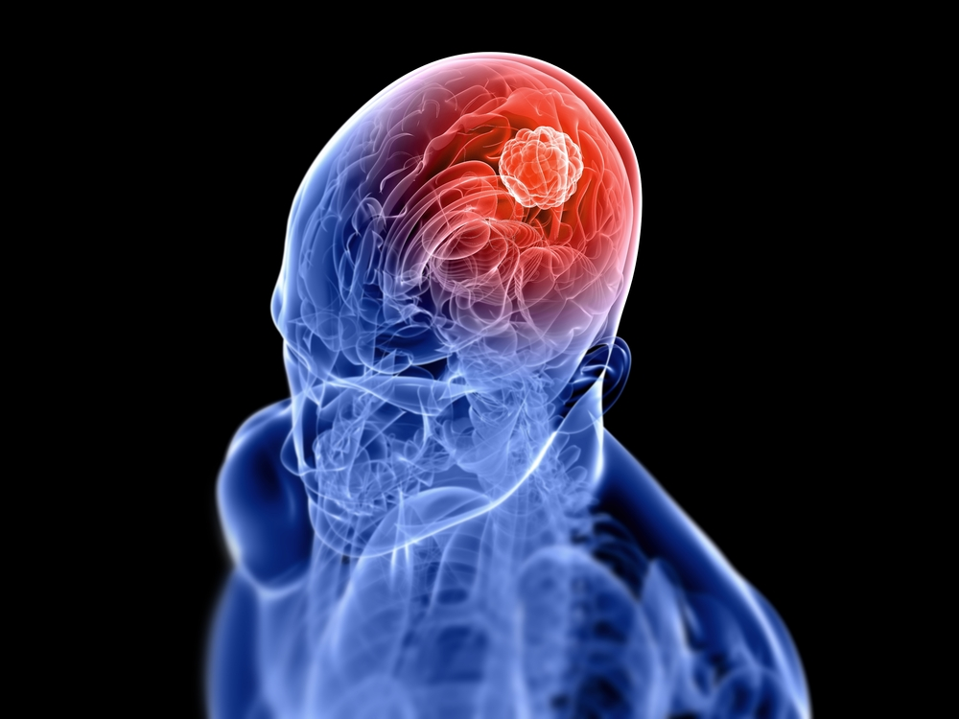
What is a brain tumor?
A brain tumor is a mass or growth of abnormal cells in your brain. Many different types of brain tumors exist. Some brain tumors are noncancerous (benign), and some brain tumors are cancerous (malignant).

Slide 4
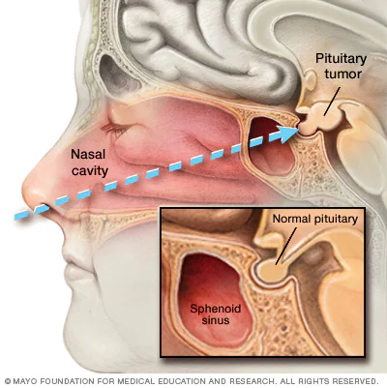
Types of Brain Tumor
1) Pituitary Tumors
This type of tumor occurs in the anterior body of the pituitary gland. This is a pea-sized gland that is located behind the bridge of your nose. It produces hormones that help to regulate the functions of the other endocrine glands. Pituitary tumors can affect the function of the pituitary gland in two different ways:
Increasing the production of regulatory hormones
Reducing the production of regulatory hormones

Slide 5
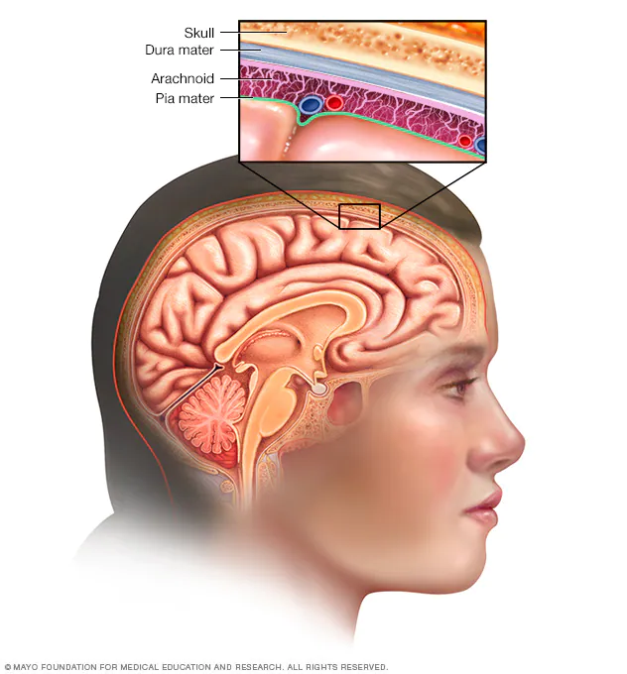
2) Meningioma Tumors
A meningioma is a tumor that arises from the meninges the membranes that surround the brain and spinal cord. Although not technically a brain tumor, it is included in this category because it may compress or squeeze the adjacent brain, nerves and vessels. Meningioma is the most common type of tumor that forms in the head.

Slide 6
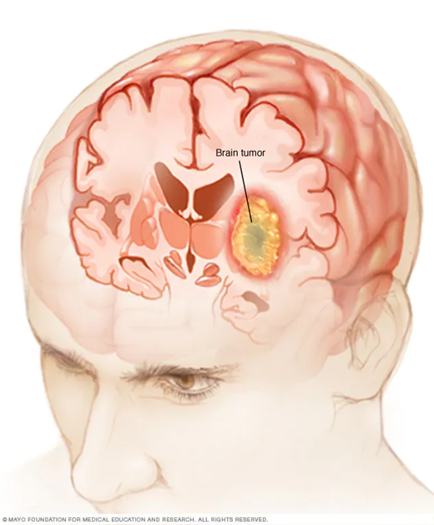
3) Glioma Tumors
A type of tumour that occurs in the brain and spinal cord.
Gliomas can occur in the brain and in various locations in the nervous system, including the brain stem and spinal column.
Different types of gliomas cause different symptoms. Some include headaches, seizures, irritability, vomiting, visual difficulties and weakness or numbness of the extremities.
Treatments include surgery, radiation therapy, chemotherapy and targeted molecular therapy.

Slide 7
How does AI-ML helps in Brain tumor classification ?
The classification of tumor in unstructured data set such as brain MRI images and its analysis as become an important part of the diagnosis of cancer at an early stage. The correct diagnosis is a very crucial and critical step and depends on the expertise of doctors and radiologists.
The deep learning models are getting a lot of popularity in the detection of tumors because its accuracy.
In this project, we have used deep learning algorithms for detection of tumors in Magnetic Resonance Imaging (MRI) image. In the proposed architecture, firstly, the convolution neural network (CNN) algorithm was designed from scratch using Keras library; secondly, the architecture of CNN was tuned by adjusting hyper parameter and increasing number of layers,

Slide 8
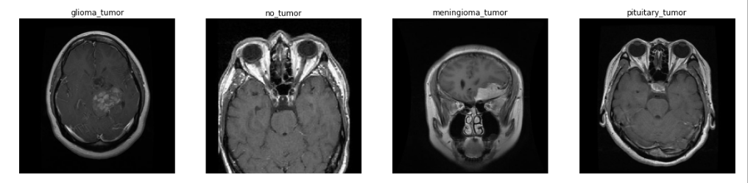
Workflow
Loading Image Labels
Data Division and augmentation
Insert Brain MRI image dataset
Extraction of images
Pre processing
Training (88%)
Testing (12%)
Deep Training Network
Network Output
Tumor Classification

Slide 9
DATA COLLECTION
The dataset has been collected from Kaggle. The original dataset is available at Kaggle which is provided from a Kaggle user named SATRAJ .
The dataset consist of 3264 MRI images of Brain at different angles.
These images are resized into 224x224 pixels so that they can be readily used with many pre-trained deep learning models.
The images in this dataset contains different types of tumor

Slide 10
DISTRIBUTION OF DATASET
Here the data distribution is given
395 images contain no tumor
827 images contain pituitary tumor
826 images contain glioma tumor
822 images contain meningioma tumor

Slide 11
Sample MRI images of brain form each type

Slide 12
Methodology
The classification modeling is done by designing deep learning CNN architecture and transfer learning mechanism.
A convolutional neural network (CNN ) is a network architecture for deep learning which learns directly from data, eliminating the need for manual feature extraction.
CNNs are particularly useful for finding patterns in images to recognize objects, faces, and scenes. They can also be quite effective for classifying non-image data such as audio, time series, and signal data.

Slide 13
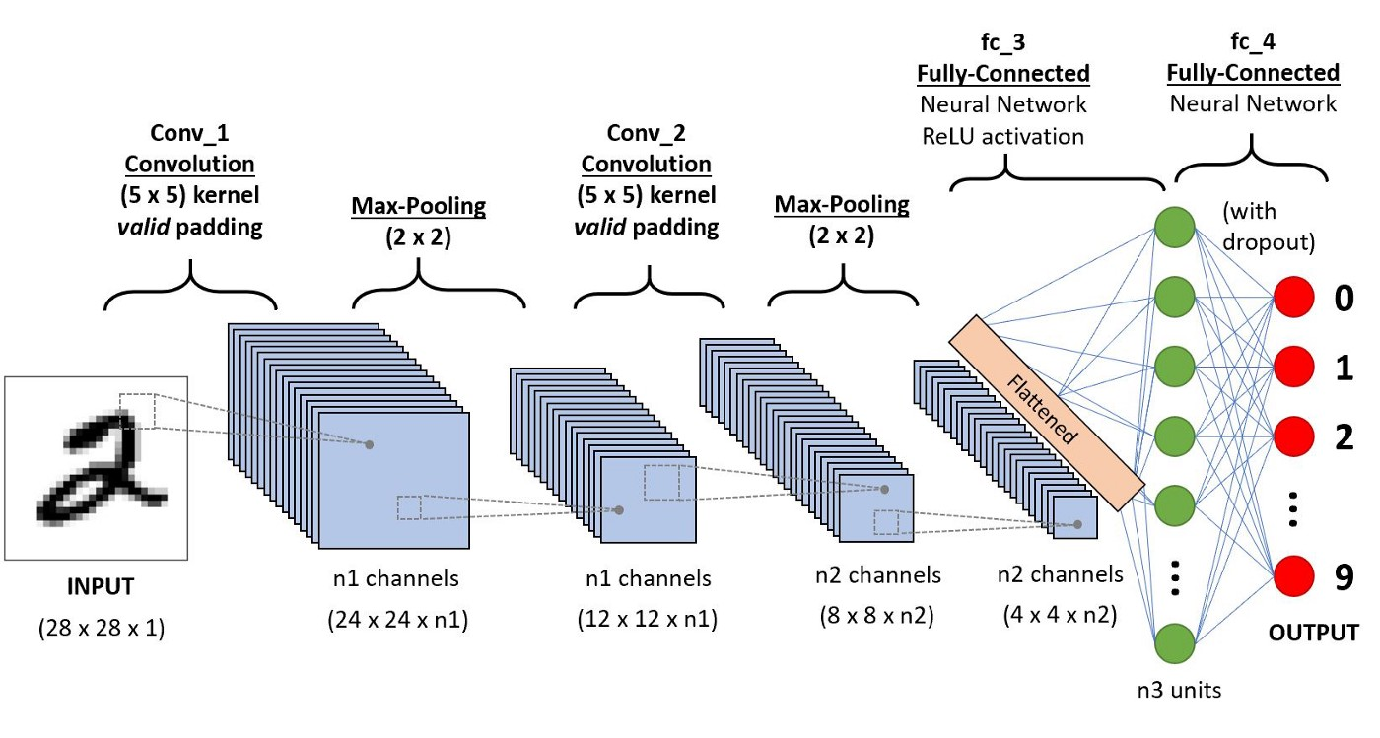
Workflow of CNN

Slide 14
Transfer Learning
To improve performance of the deep learning model, the transfer learning technique can be used.
In transfer learning pre-trained models are used to build model instead of designing them from scratch.
Here we have used EffiecientNet architecture weights for training the model.
EffiecientNet is a convolutional neural network architecture and scaling method that uniformly scales all dimensions of depth/width/resolution using a compound coefficient

Slide 15
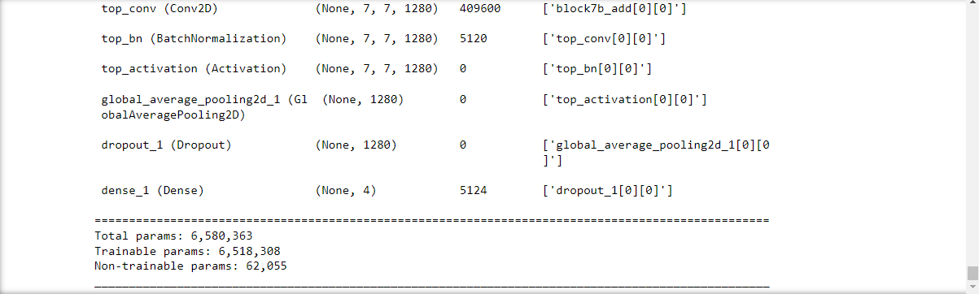
The picture above shows number of parameters of EfficientNetB1 model and layers used for training the sample size using transfer learning mechanism

Slide 16
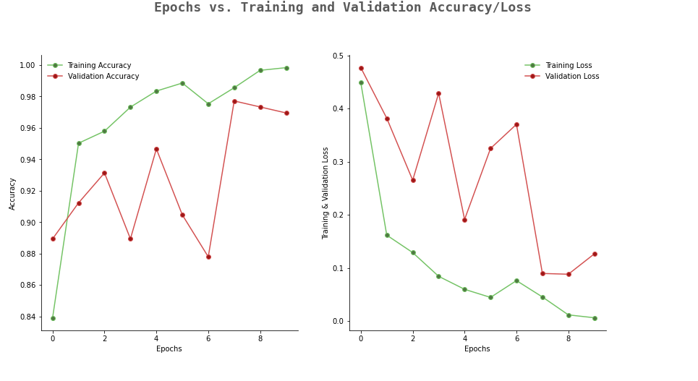
Results

Slide 17
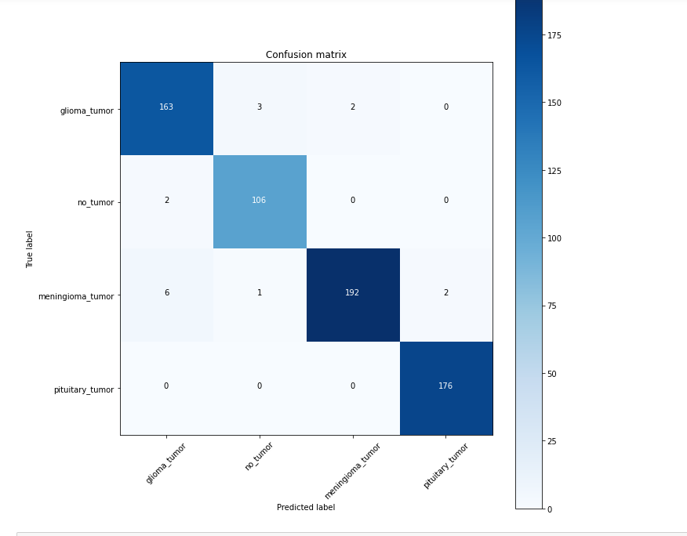
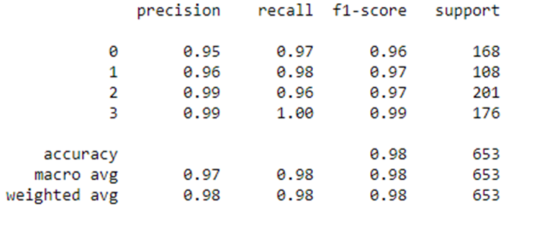
Model Evalution

Slide 18
Conclusion
In this project, we have proposed different styles of CNN architectures and compared their performance for brain tumor classification.
First we started with very simple architecture and recorded its accuracy and then the model is tuned by adjusting hyper parameter and increasing number of filters and layers.
The results show that adjustment of hyper parameters increases the accuracy of CNN model. Further model accuracy was increased by using EffecientNet .
The use of transfer learning mechanism shows significant improvement in accuracy and F1 score of tumor classification model.

Slide 19
References
https://www.kaggle.com/datasets/sartajbhuvaji/brain-tumor-classification-mri
https://towardsdatascience.com/a-comprehensive-guide-to-convolutional-neural-networks-the-eli5-way-3bd2b1164a53
https://paperswithcode.com/method/efficientnet#:~:text=EfficientNet%20is%20a%20convolutional%20neural,resolution%20using%20a%20compound%20coefficient.
https://braininformatics.springeropen.com/articles/10.1007/s40708-017-0075-5
https://youtu.be/-a7IMhEi4_w

Slide 20
THANK YOU

