Slide 1

Convolutional-Recurrent Architectures
Classify images from the ArtGAN based on Style, Artist, Genre, and other attributes.

Slide 2
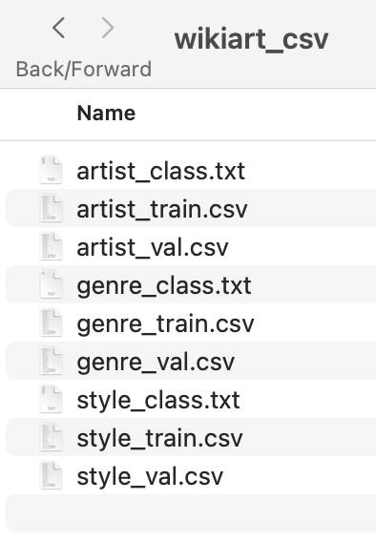
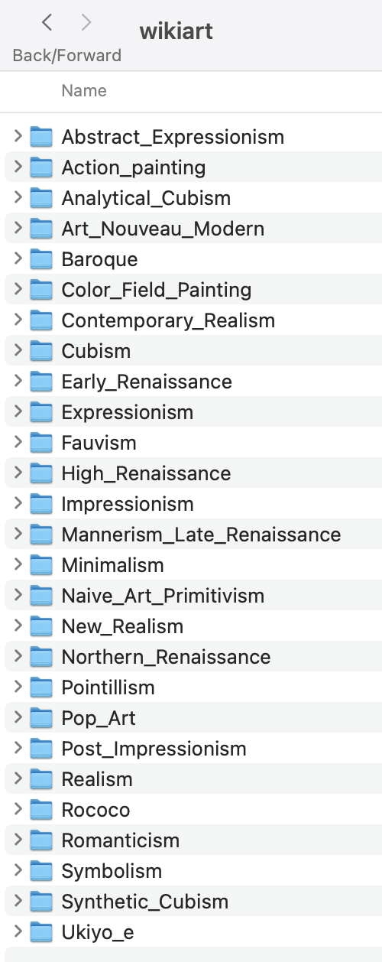
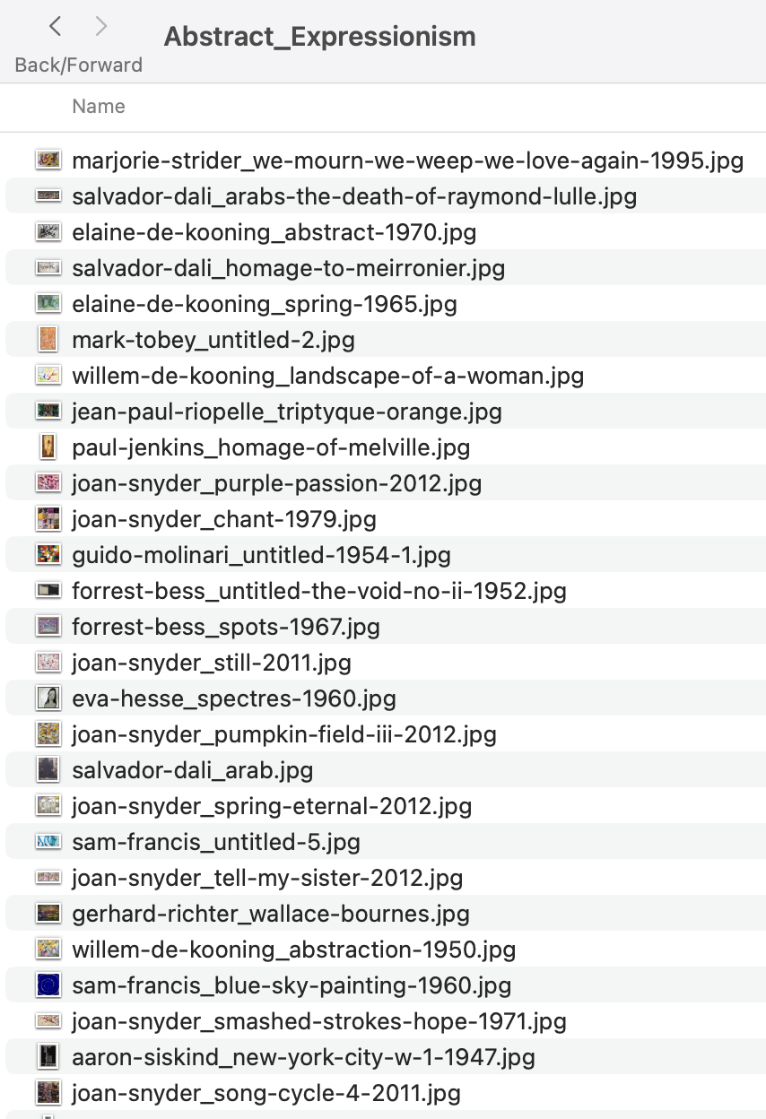
Load and Prepare the Data
Load the CSV files that contain the image paths and labels.
Preprocess the images, resizing them to the desired shape and normalizing the pixel values to a range between 0 and 1.

Slide 3
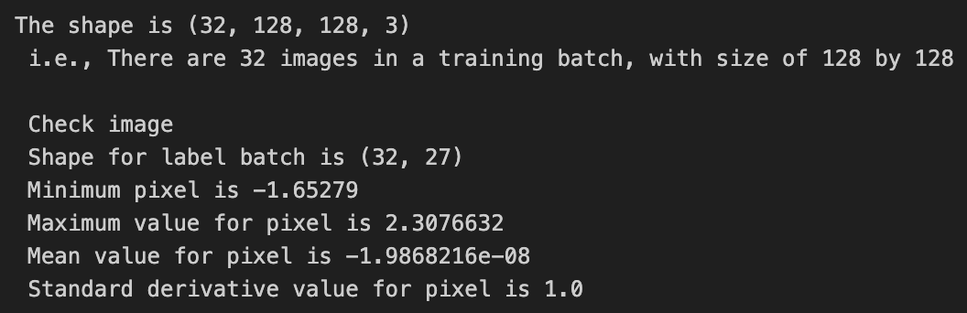
Data Generator
Since the task is working with large datasets, a custom
ImageLabelGenerator is created.

Slide 4
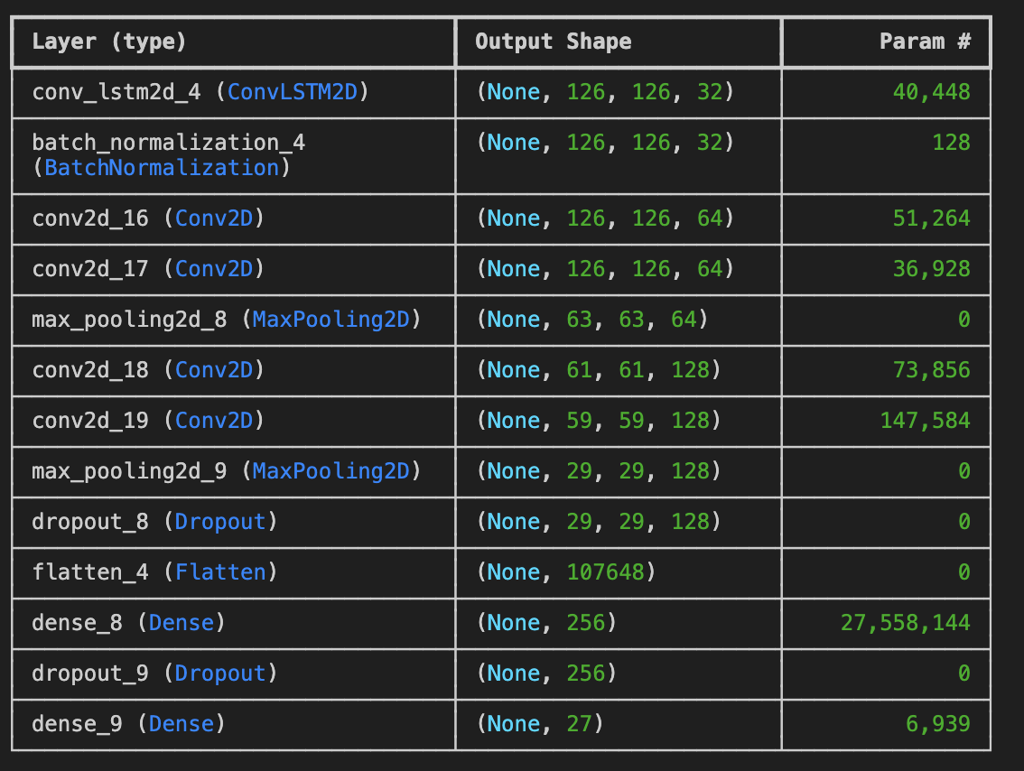
Build the Model
Use a combination of CNNs for extracting features from the images and LSTM layers for processing the sequential information in the data.

Slide 5
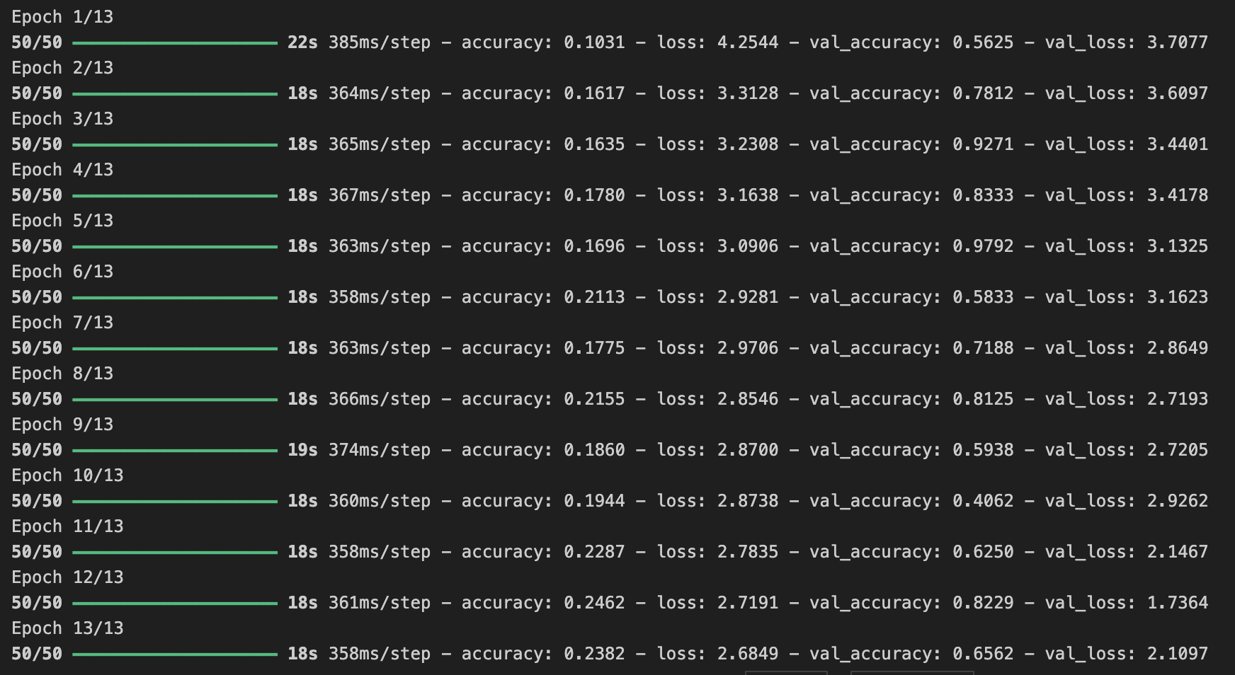
Train the Model
Train the model using the fit method, providing the training data generator and setting parameters like batch size and number of epochs.

Slide 6
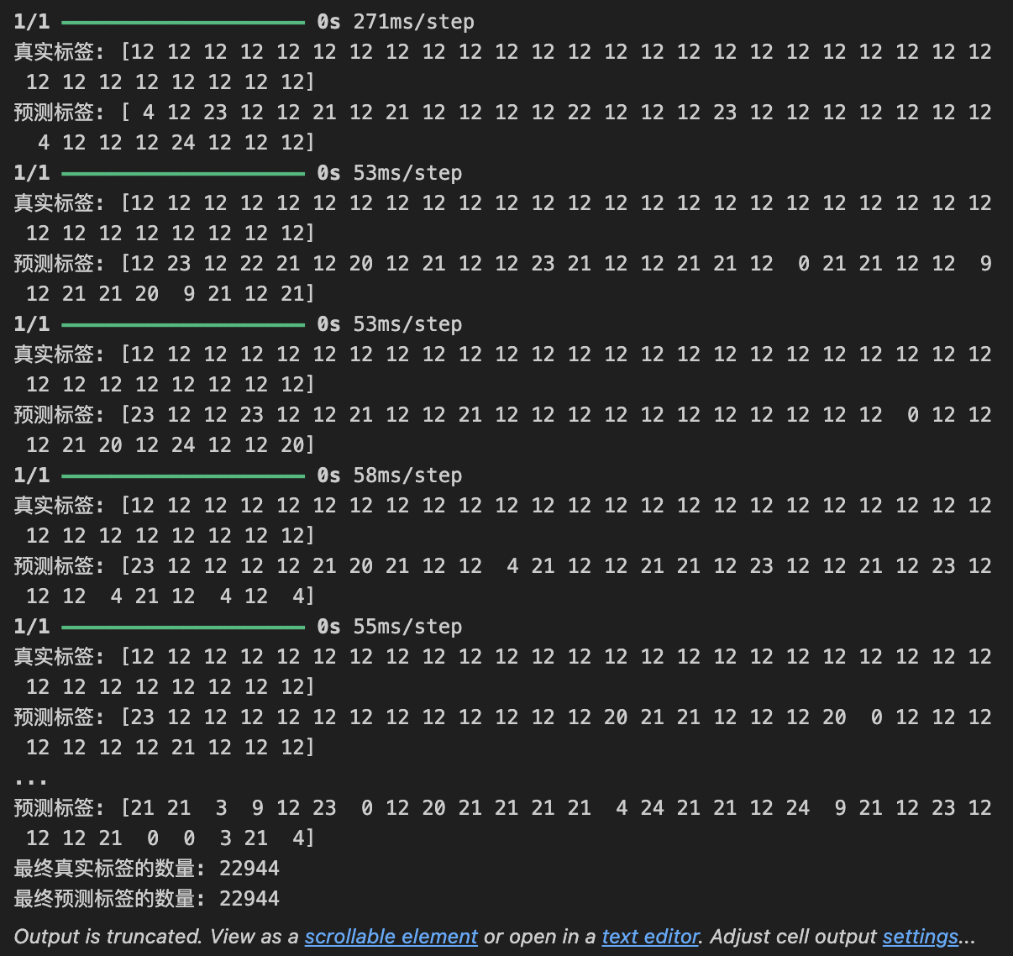
Make Predictions
Once the model is trained, used it to make predictions on new images or evaluate its performance on the validation set.

Slide 7
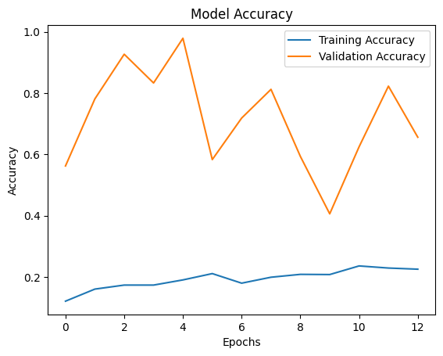
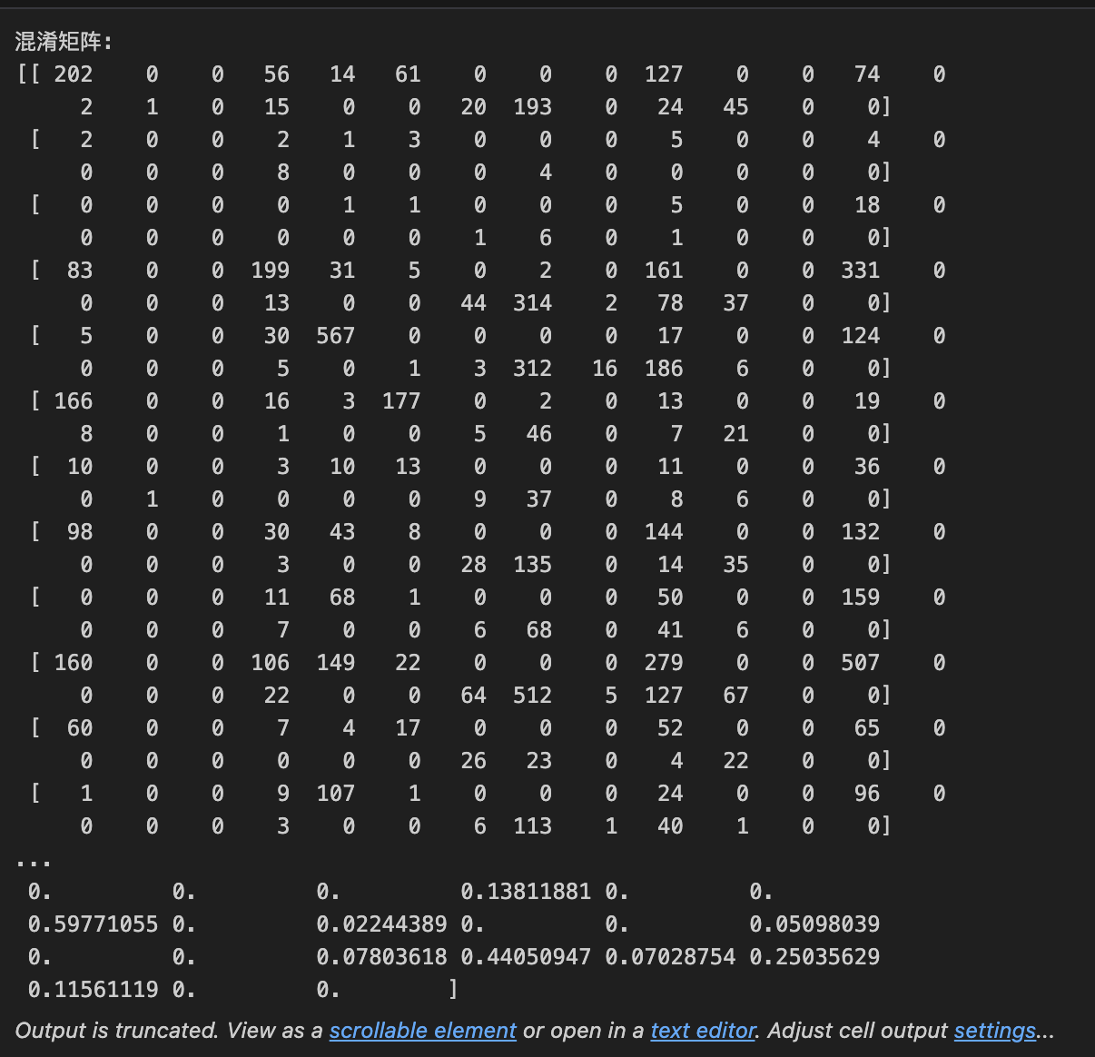
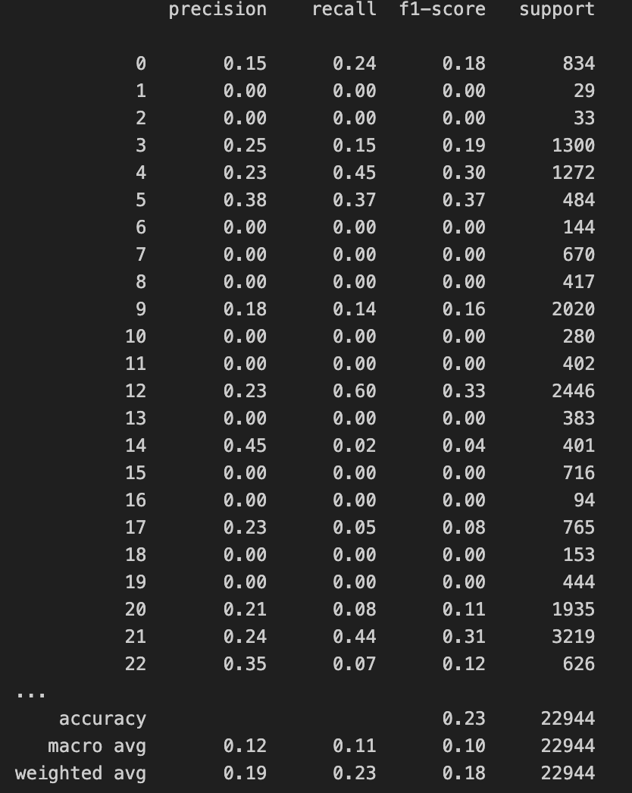
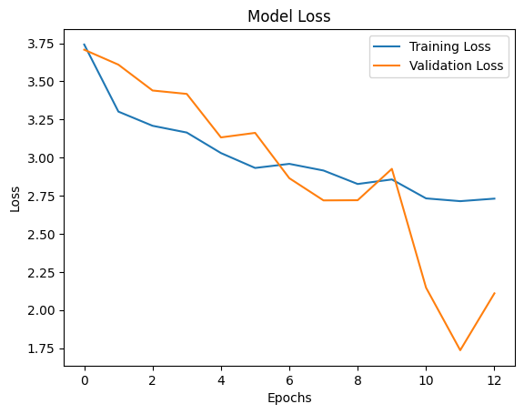
Evaluating the Model
To assess the performance of the model, used metrics like accuracy and loss, confusion matrices.

Slide 8
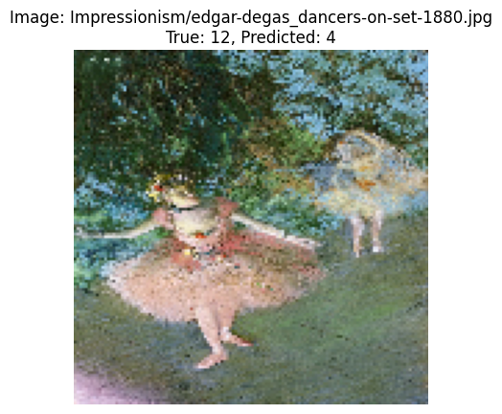
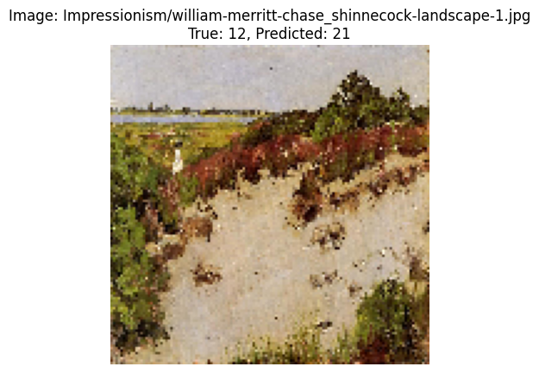
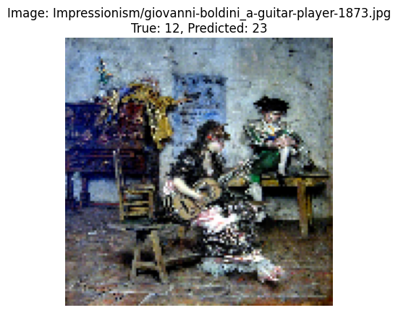
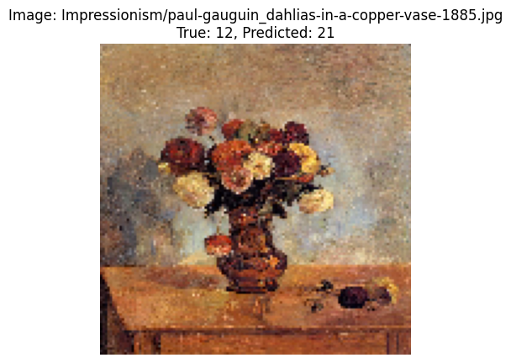
Extract Features
After training the model, you can extract features from intermediate layers (such as conv2d_3) to analyze how the model is learning or to use these features in other tasks (like clustering or further analysis).

