Slide 1

HTML Report Generation of Required Standard Cells using .lib File
Under the guidance of Pine Training Academy
Team:
Kajal Pathak Nikhil Jain
Sarosh
Project Buddy:
Vashu Yadav

Slide 2
Content | Slide Number
Introduction | 3
Elements of Project | 5
Flow of Information | 10
Application of Project | 14
Debugging | 15
Code | 17
Outputs | 23
INDEX

Slide 3
PROJECT INTRODUCTION
Here we lay out the basic of our project

Slide 4
Introduction to the Project
Standard Cell Libraries Information are required by almost all the Designers for Chip Design. Standard cell libraries contain primitive cells required for digital design, those particular cell contain the information of capacitance, rise time, fall time, delay table etc.
In standard cell library file there are many type of cells are present having different drive strength, which contain timing and power information which is necessary for the designer to fix the timing checks. Reading the particular information of cell which is important for designer is complex or time consuming as this file contain lots of information, so our Aim to make this project is reduce the complexity in reading the file, reduced time in searching the cell, in searching the particular information of cell etc.
And we are putting these information in HTML table to read easily and then this file will be sent through the email.

Slide 5
ELEMENTS OF THE PROJECT
Here we describe the important elements of out project

Slide 6
Main elements that have been used in this project are:
.lib files
BASH
Major Commands Used like AWK, EGREP
MSMTP Protocol
HTML

Slide 7
.lib Files
.lib stands for Liberty Timing Files
It is a timing model that contains cell delays, transition, setup and hold time requirements.
It is is an ASCII representation of timing and power parameters associated with any cells in a particular technology node.
These files are provided by gate library vendor or the foundry if they support gate library.
These files are generated by software like Virtuoso and can be accessed by the user in any text editor.

Slide 8
Bash / GNU Bash
Bash is the Bourne Again SHell.
It is an sh-compatible shell that incorporates useful features from the Korn shell (ksh) and C shell (csh).
The improvements offered by Bash include:
Command line editing
Unlimited size command history
Job Control
Shell Functions and Aliases
Indexed arrays of unlimited size

Slide 9
Major Commands Used
Most frequently used major commands in our script are:
AWK
EGREP
SED
AWK Command is used for generating formatted reports.
EGREP Command is used for extracting regular expressions from a text file.
SED Command is a stream editor it can perform functions like substitution, deletion and printing.

Slide 10
MSMTP
In the default mode, it transmits a mail to an SMTP server which takes care of further delivery.
We use msmtp in our project for mailing the tabulated report to any specified mailing address.
A benefit of using msmtp is that we can send mail directly from our terminal
We use commands mail and sendmail for sending email from terminal.

Slide 11
HTML
HTML is a standard markup language for creating webpages.
It stands for Hyper Text Markup Language and is used to describe the structure of a webpage.
We use HTML to generate a tabulated format of the report.
We use <table> tag for generating table, <tr> & <tc> for defining table row and column and <th> for defining the heading.

Slide 12
FLOW OF INFORMATION
Here we describe the flow of information in our project from .lib files to e-mail

Slide 13
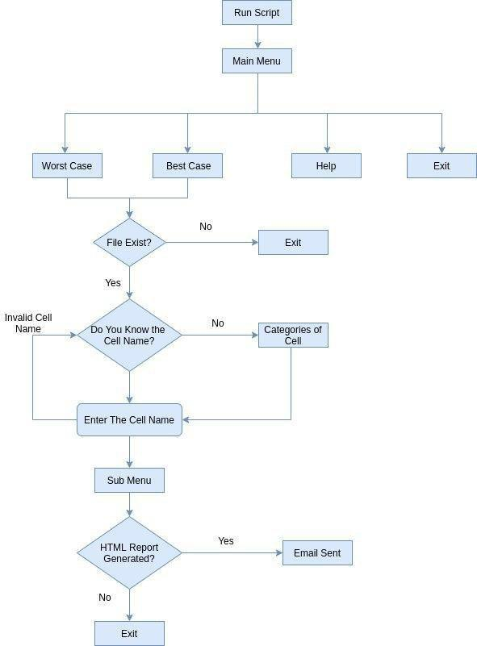

Slide 14
Applications of Our Project
To obtain the starting, ending and the total working time of the user on the script.
To obtain the minimum and maximum values of the timing and power of the selected standard cell from the lookup table in an instant.
Enables the user to obtain the specifications of the desired Standard cell without opening and searching the file each and every time.
To generate the HTML report in the background while working on the shell.
To send the tabular HTML data in the body of email.
To send work report form terminal via email.

Slide 15
DEBUGGING
We came across multiple problems while working on this projects, here we highlight some of those bugs with solutions

Slide 16
Problem we Faced
To fetch the timing information for minimum and maximum values from the lookup table.
Categorization of 477 standard cell into 12 categories.
HTML Report Generation through the bash script in background, simultaneously.
To show HTML report in email body so that recipient don't need to open the file.
We also fixed the problem of exit with or without the Email option.

Slide 17
Code
Our shell script and HTML codes are as follows

Slide 18
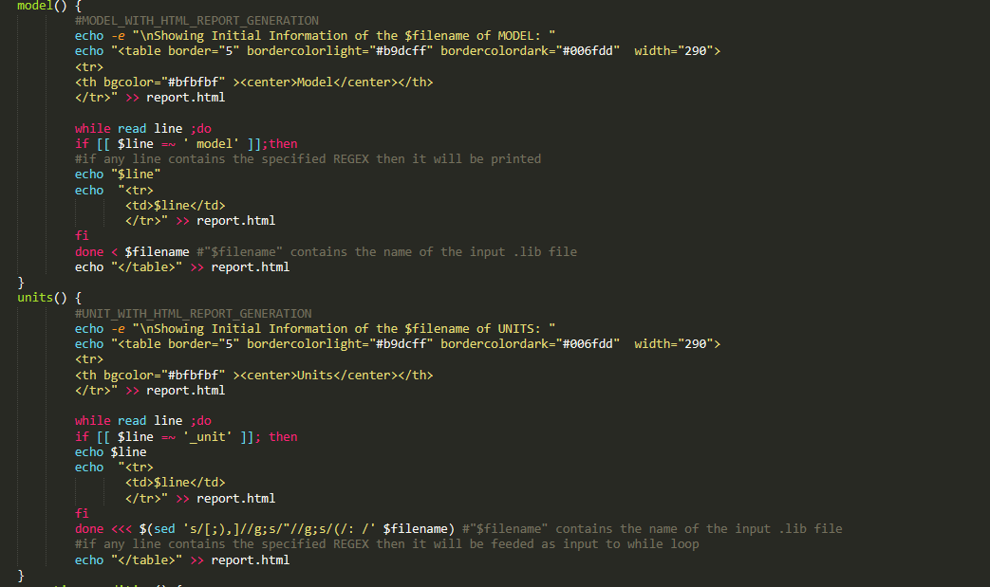
SHELL SCRIPT
Code to print Model
and Units from the .lib file
Which is common for all
Standard cell .

Slide 19
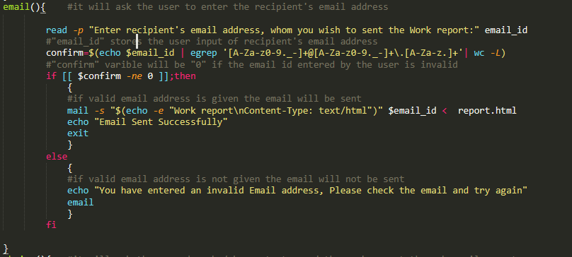
Code for Sending Email

Slide 20
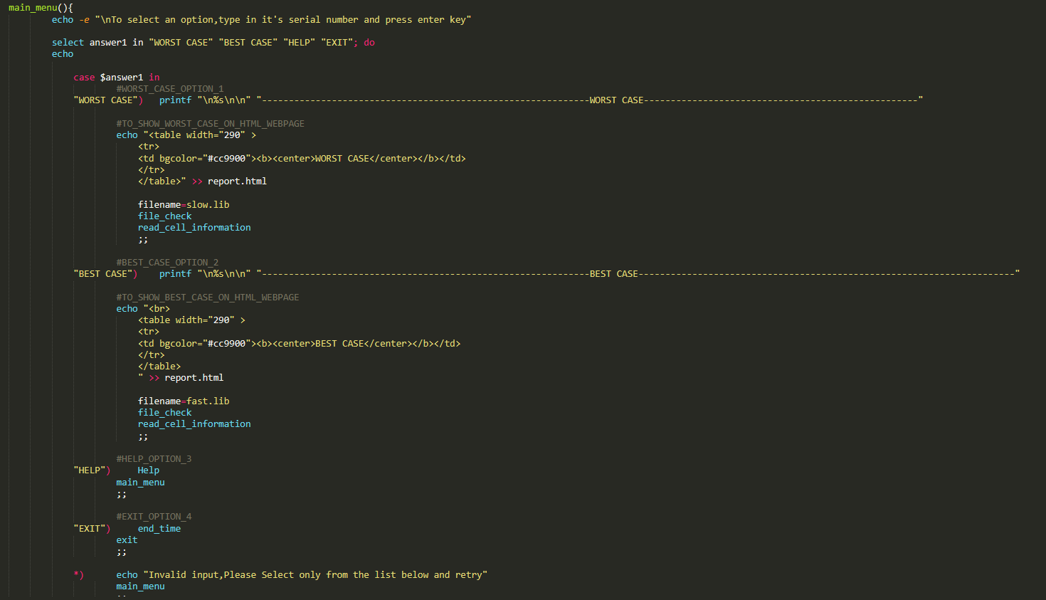
Code for Main Menu

Slide 21
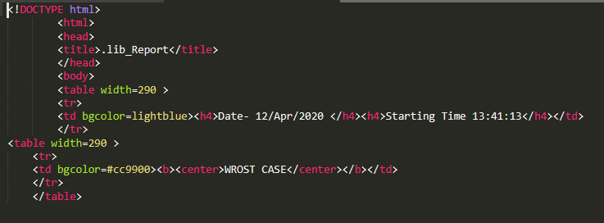
HTML Report

Slide 22
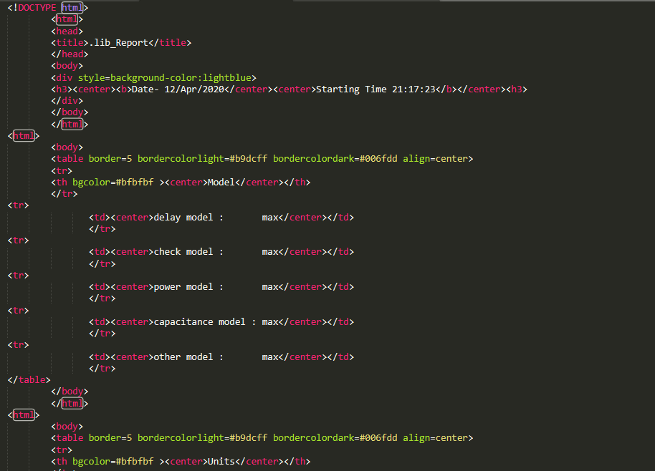
HTML code of report generated at the end

Slide 23
OUTPUTS
Here are the outputs of script in terminal and the tabulated email

Slide 24
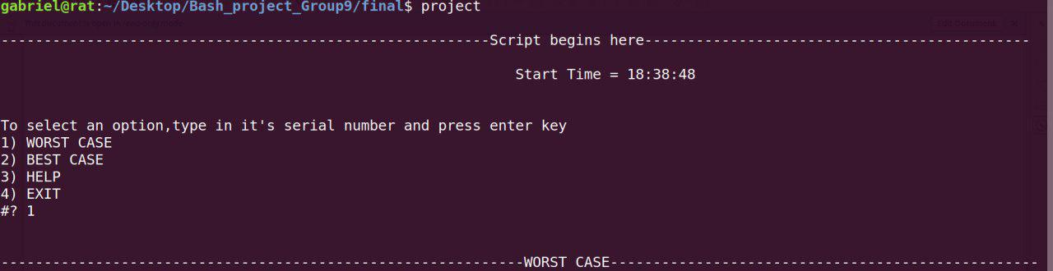
SCRIPT OUTPUT
We highlight our script output frame by frame.
This is the main menu.

Slide 25
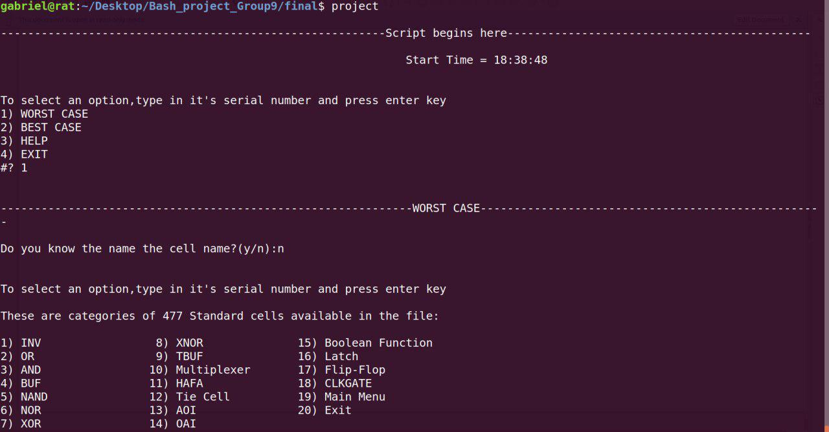
Worst Case Option Selected

Slide 26
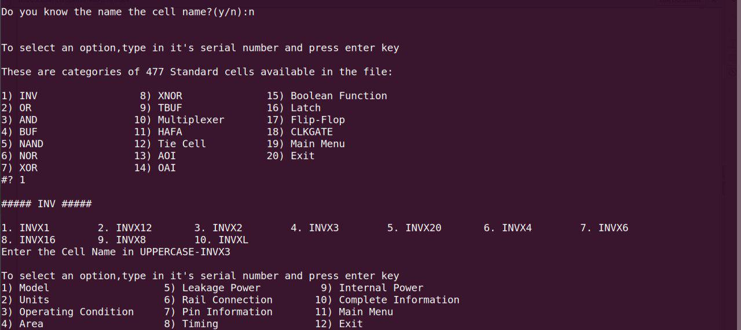
Selecting Standard Cell Type : INV

Slide 27
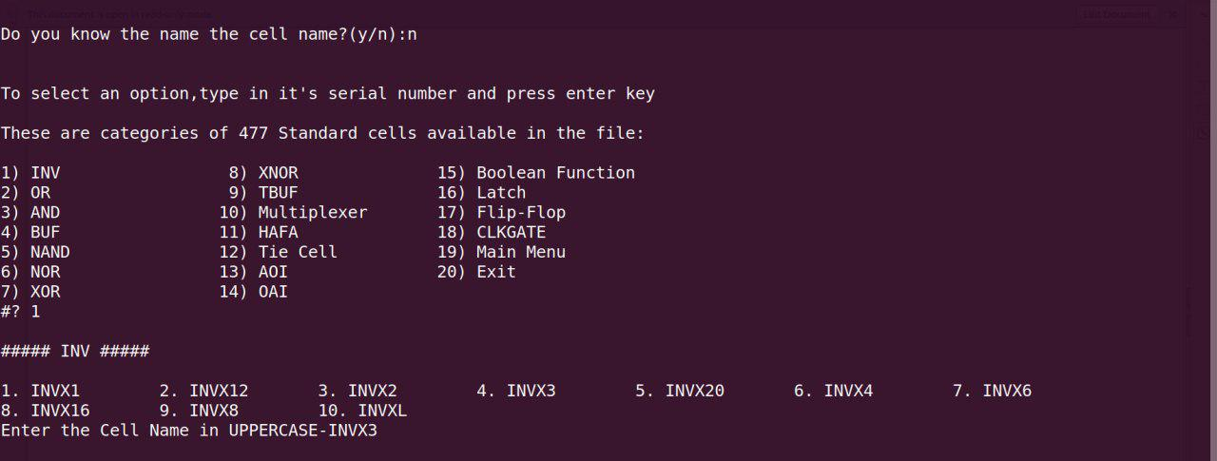
Selecting Cell Name with the particular drive strength from the available list

Slide 28
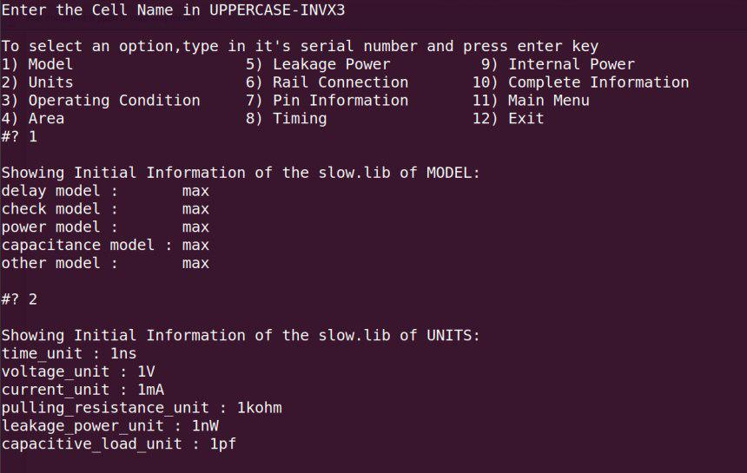
Displaying Initial Information of Model and Units

Slide 29
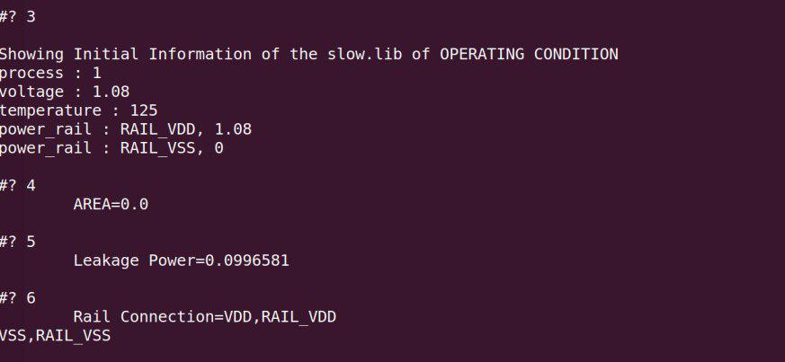
Displaying Initial Information of Operating Condition

Slide 30
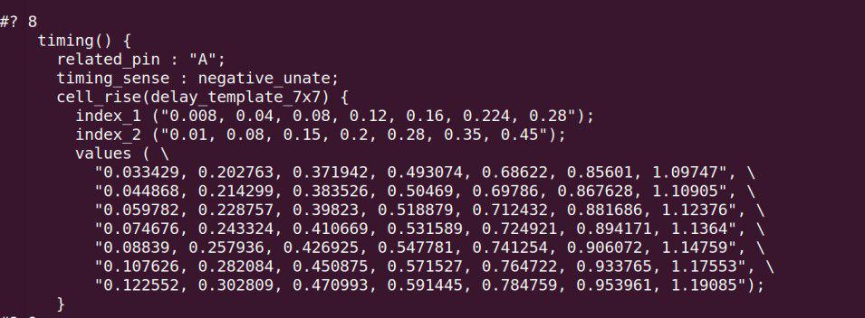
Displaying Timing of Cells

Slide 31
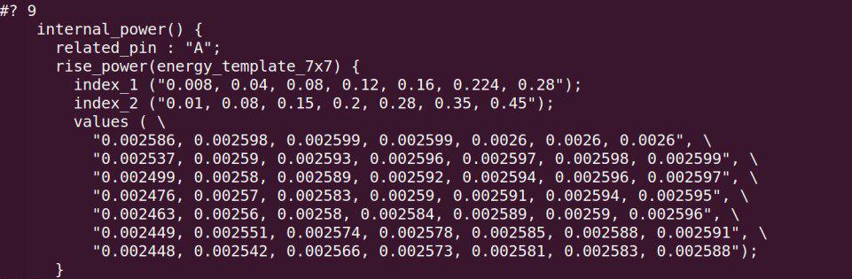
Displaying Internal Power

Slide 32
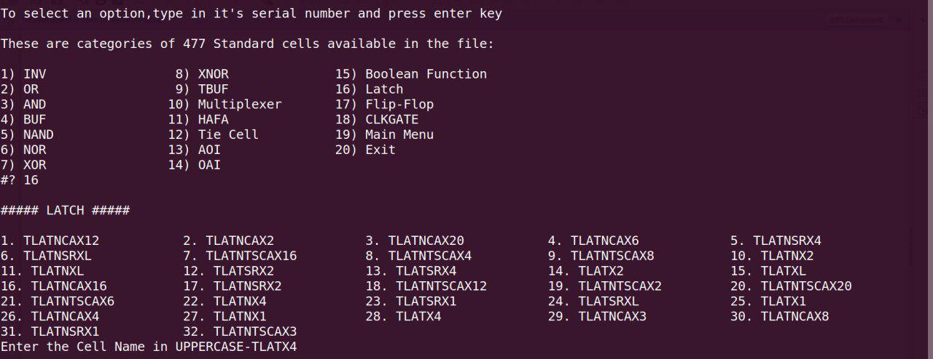
Selecting Standard Cell Type : LATCH

Slide 33
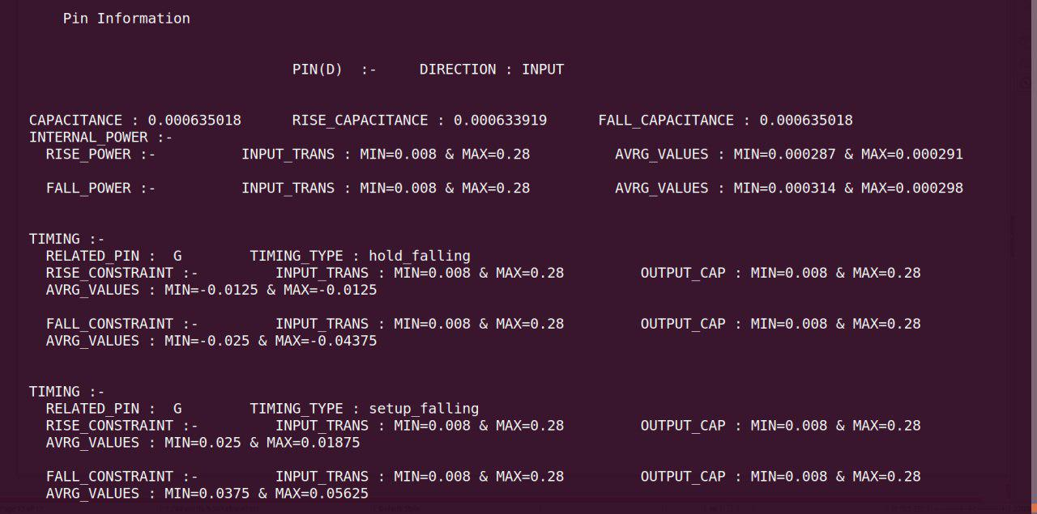
Displaying Pin Information

Slide 34
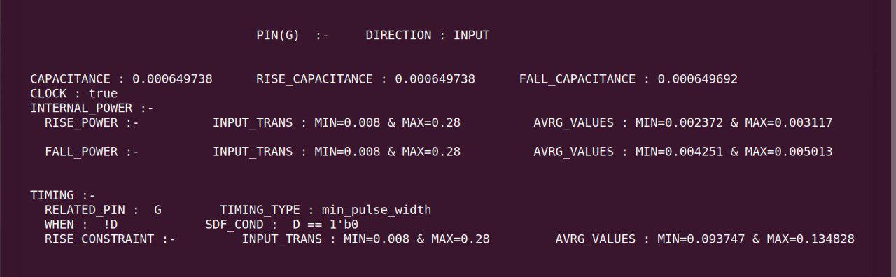
Displaying Pin Information

Slide 35
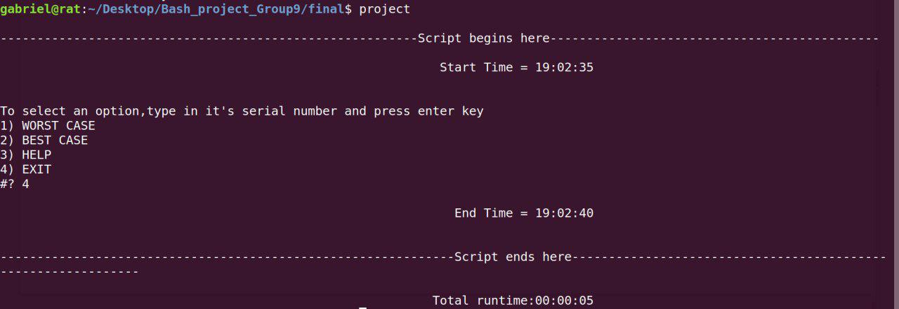
Displaying Total Runtime

Slide 36
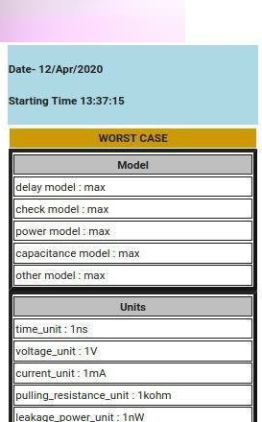
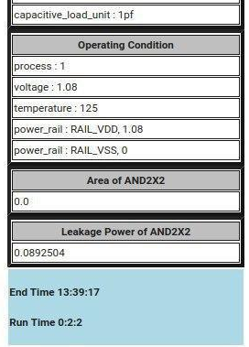
HTML OUTPUT
Here’s the tabulated HTML Output in E-Mail.

Slide 37
Team:
Kajal Pathak Nikhil Jain Sarosh
Project Buddy:
Vashu Yadav
THANK YOU

