Slide 1
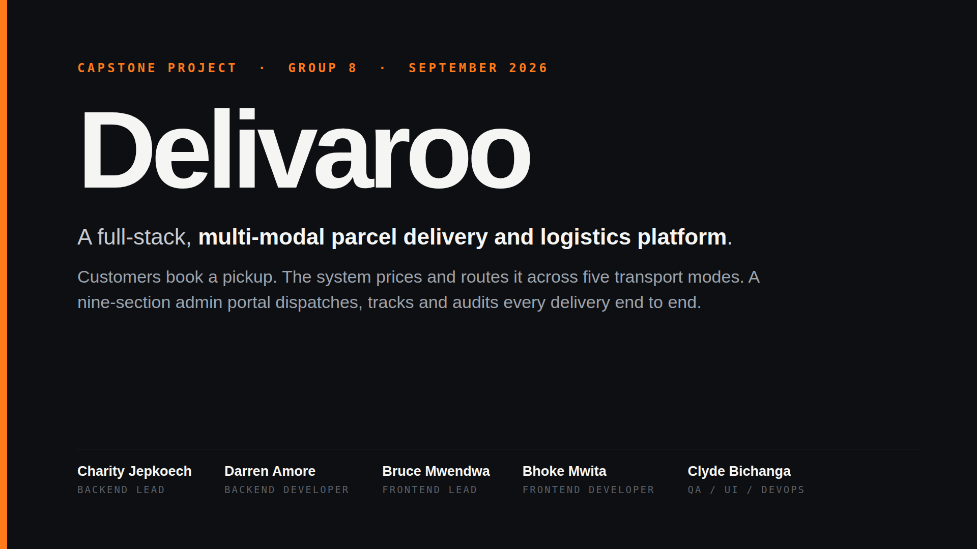
Notes:
Good morning. We're Group 8, and this is Delivaroo — a parcel delivery platform we built over three weeks. The short version: a customer says where a parcel is going and what it is, and the system computes a real driving route, prices that route across five different transport modes, assigns a courier, and streams live tracking until it's delivered. Behind that there's a nine-section operations portal that dispatches and audits everything. I'll walk through the problem first, then the architecture, and spend most of the time on the engineering decisions we'd defend in a review.

Slide 2
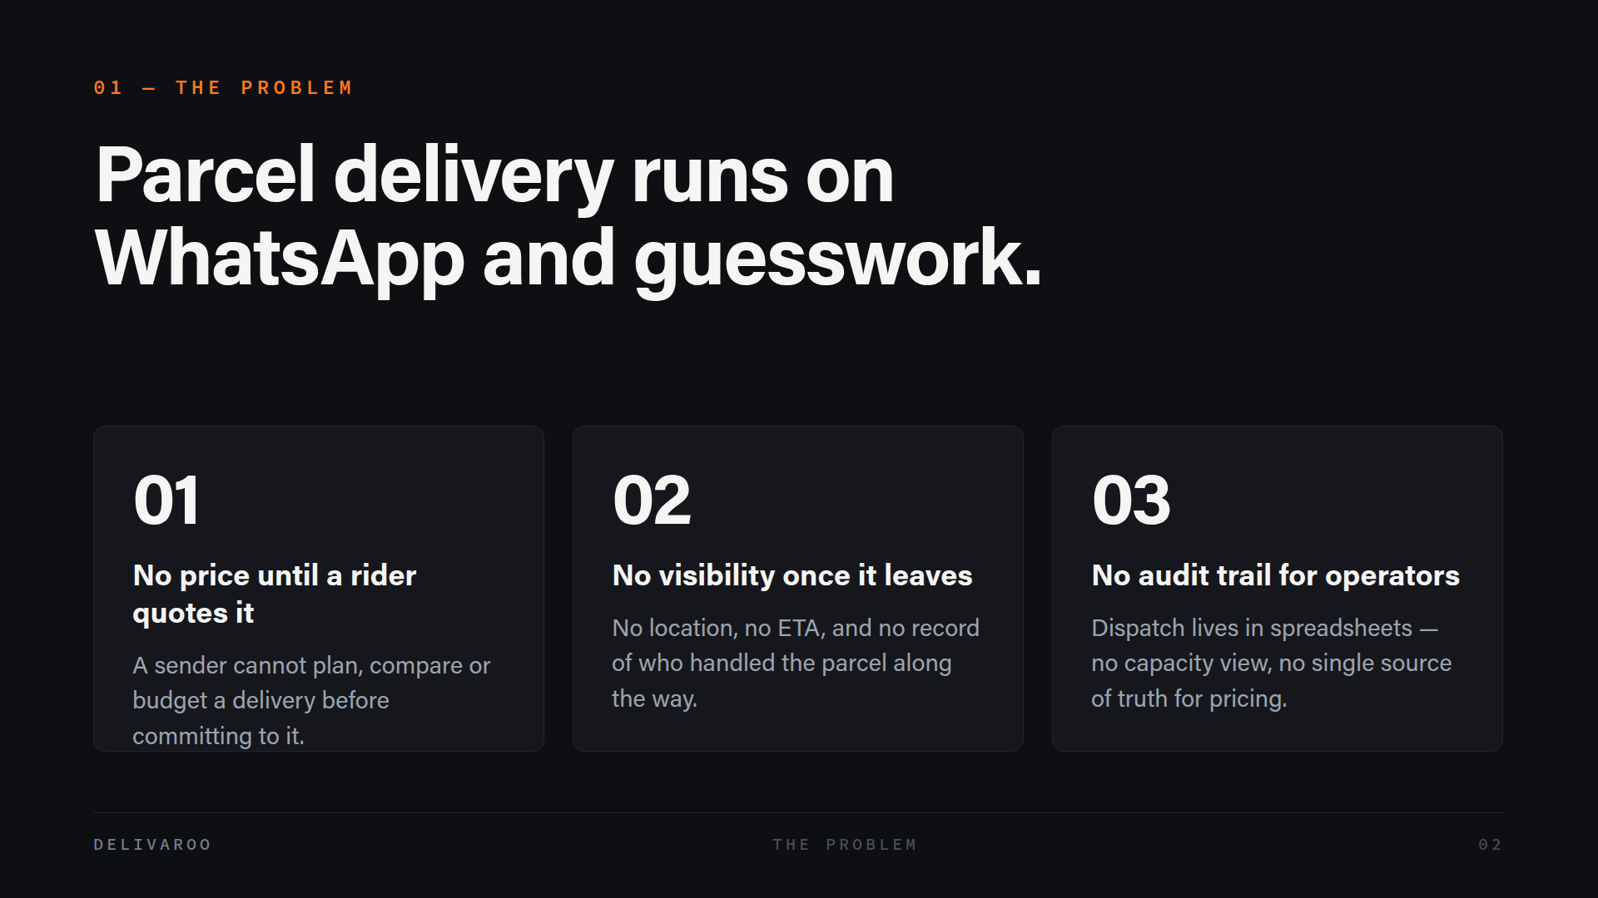
Notes:
Parcel delivery in Kenyan cities is fragmented and opaque, and it's opaque on both sides of the transaction. If you're sending something, you don't know what it costs until a rider quotes you, you can't see where it is once it's gone, and there's no record of who touched it. If you're running the operation, it's worse — dispatch happens on WhatsApp and spreadsheets, so there's no audit trail, no view of what capacity you have, and no single place where pricing is decided. Those are three different problems, but they all come from the same missing thing: a system of record. That's what we built.

Slide 3
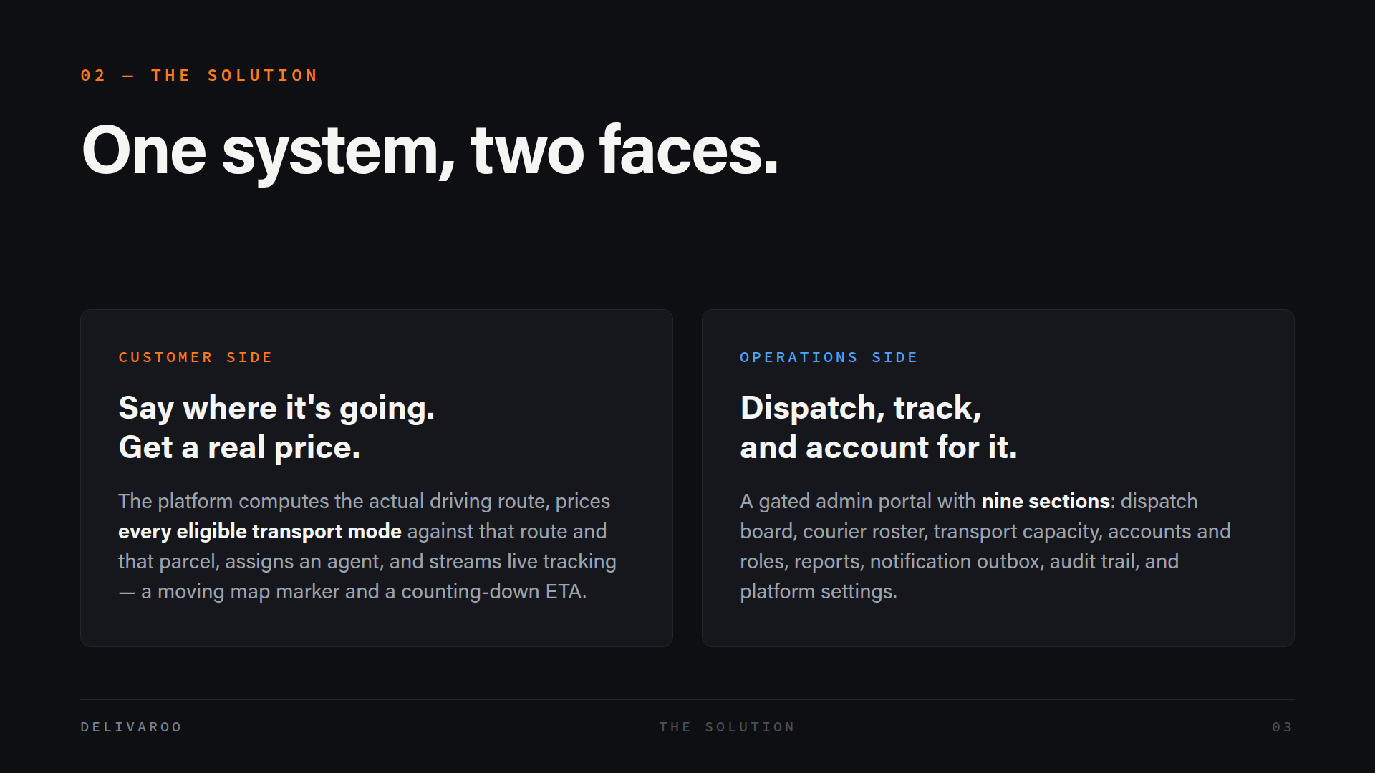
Notes:
Delivaroo is one system presenting two quite different faces. On the customer side, you describe the parcel and where it's going, and the platform does the work — it computes the real driving route, prices every mode that's actually eligible for that route and that parcel, finds you an agent, and then tracks it live. On the operations side, there's a gated portal with nine sections that handles dispatch, the courier roster, capacity, accounts, reporting and the audit trail. The important thing is that these aren't two applications — they're one data model with two views and a permission layer between them. Let me show you the customer journey first.

Slide 4
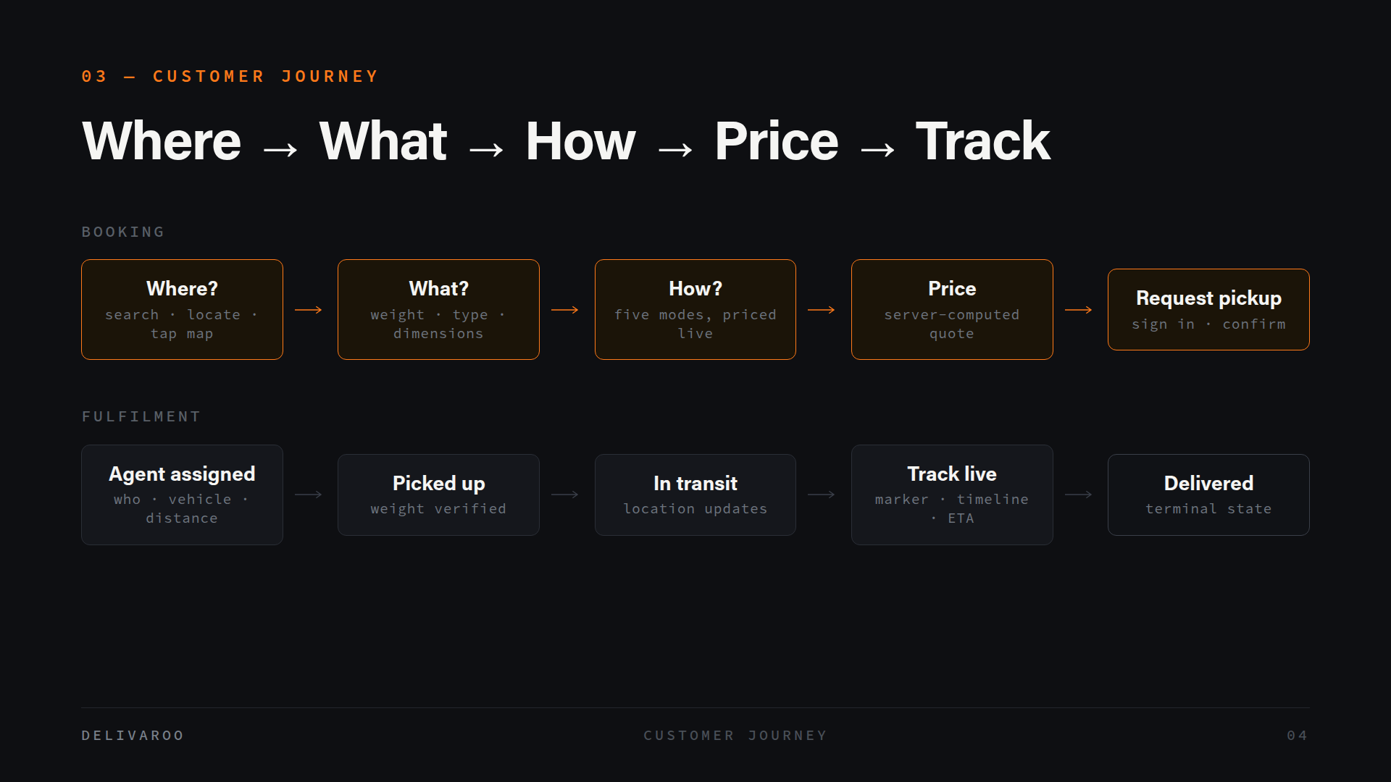
Notes:
The journey splits cleanly into booking and fulfilment. In booking, you pick pickup and destination — by type-ahead search, by "use my location", or by tapping the map — and the route, distance and duration draw themselves. Then you declare the parcel, and then you choose how it travels: four or five cards, priced live against this specific route and this specific parcel. Then you request pickup and confirm. Fulfilment is the half you watch rather than drive: an agent is assigned, the parcel is picked up and weighed, and from there you get a moving marker, a seven-stage timeline and a countdown that advances with the clock. Every one of those pricing cards is computed server-side — I'll come back to why that matters.

Slide 5
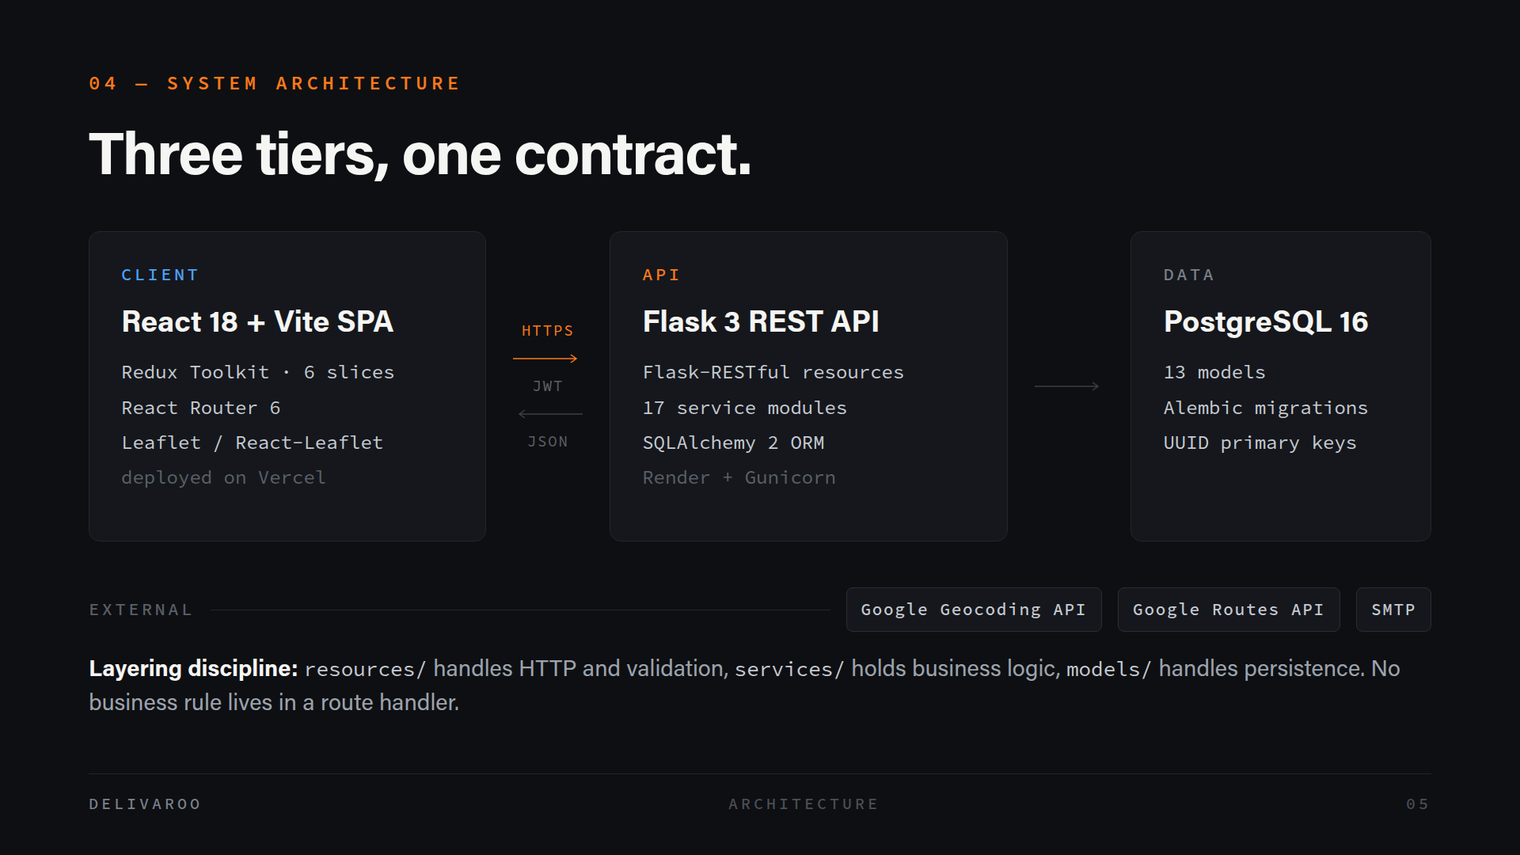
Notes:
Architecturally this is a conventional three-tier application, and we kept it conventional on purpose. A React single-page app talks over HTTPS to a Flask REST API using JWTs, and the API owns a PostgreSQL database. Google's Geocoding and Routes APIs and an SMTP server sit at the edge, reached only by the backend. The part I'd point at is the layering rule at the bottom: resources handle HTTP and validation, services hold business logic, models handle persistence — and no business rule is allowed to live in a route handler. That's what makes the logic testable without an HTTP request, and it's why we could expose the same service under two different route aliases without duplicating anything.

Slide 6
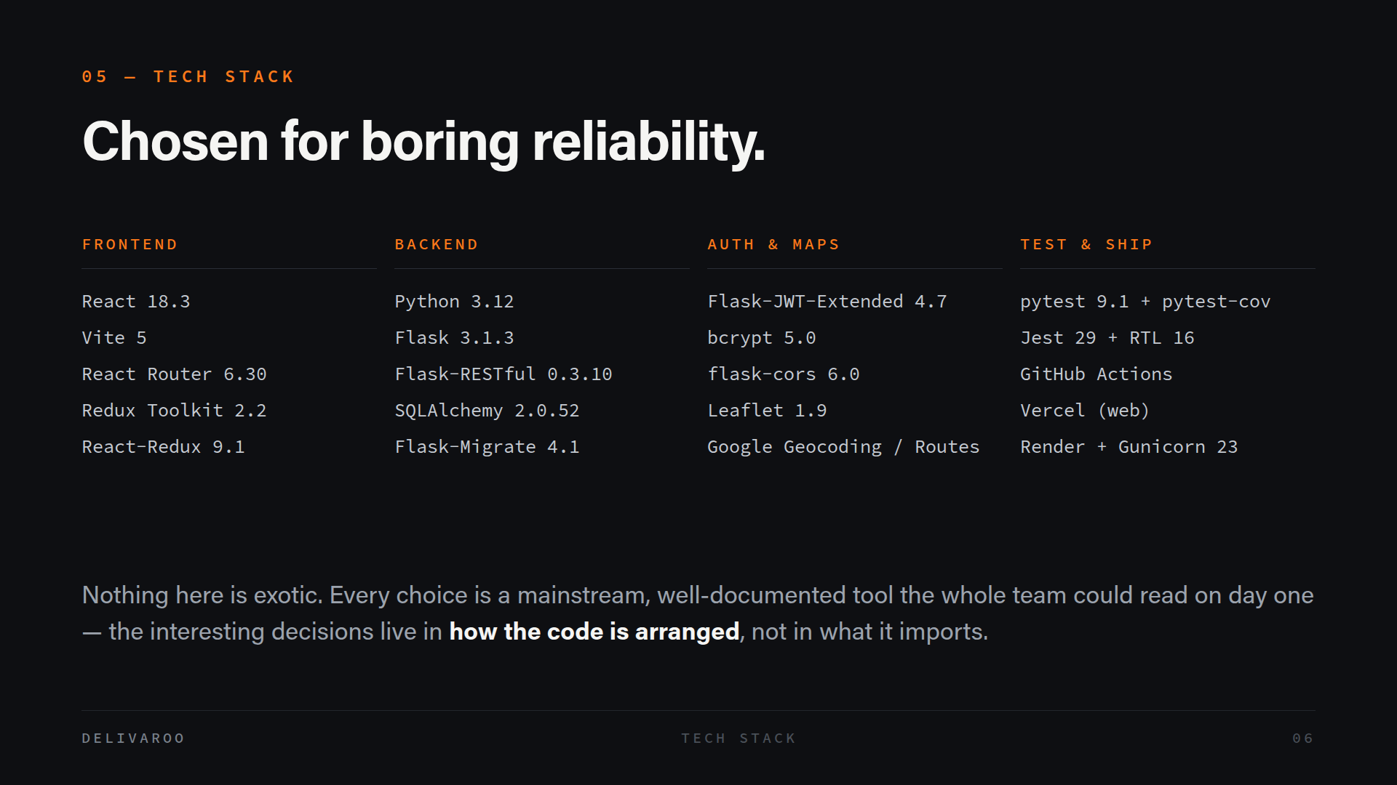
Notes:
Here's the stack grouped by layer. React, Vite and Redux Toolkit on the front; Flask, Flask-RESTful and SQLAlchemy on the back; JWT and bcrypt for auth; Leaflet in the browser with Google's Geocoding and Routes APIs called server-side. Testing is pytest on one side and Jest with React Testing Library on the other, and it ships through GitHub Actions to Vercel and Render. I want to be honest that none of this is exotic — that was deliberate. We picked mainstream tools that five people could all read on day one, and we spent our thinking budget on how the code is arranged instead. That's what the rest of the deck is about.

Slide 7
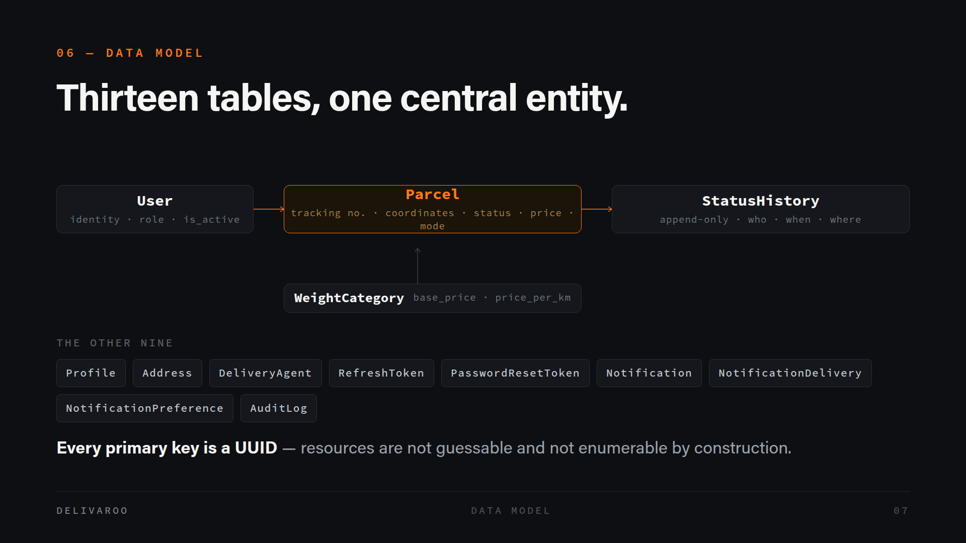
Notes:
There are thirteen tables, but four of them carry the story. A User owns Parcels; Parcel is the central entity holding the tracking number, the coordinates, status, price and transport mode; and every status change appends a row to StatusHistory with who changed it, when, where and why. WeightCategory holds the tariff bands that pricing reads. The other nine handle profiles, addresses, couriers, tokens, notifications and audit. One detail worth flagging: every primary key is a UUID, not an auto-incrementing integer. That means you can't guess a resource ID and you can't enumerate the table by counting upward — it's a security property you get from a schema decision.

Slide 8
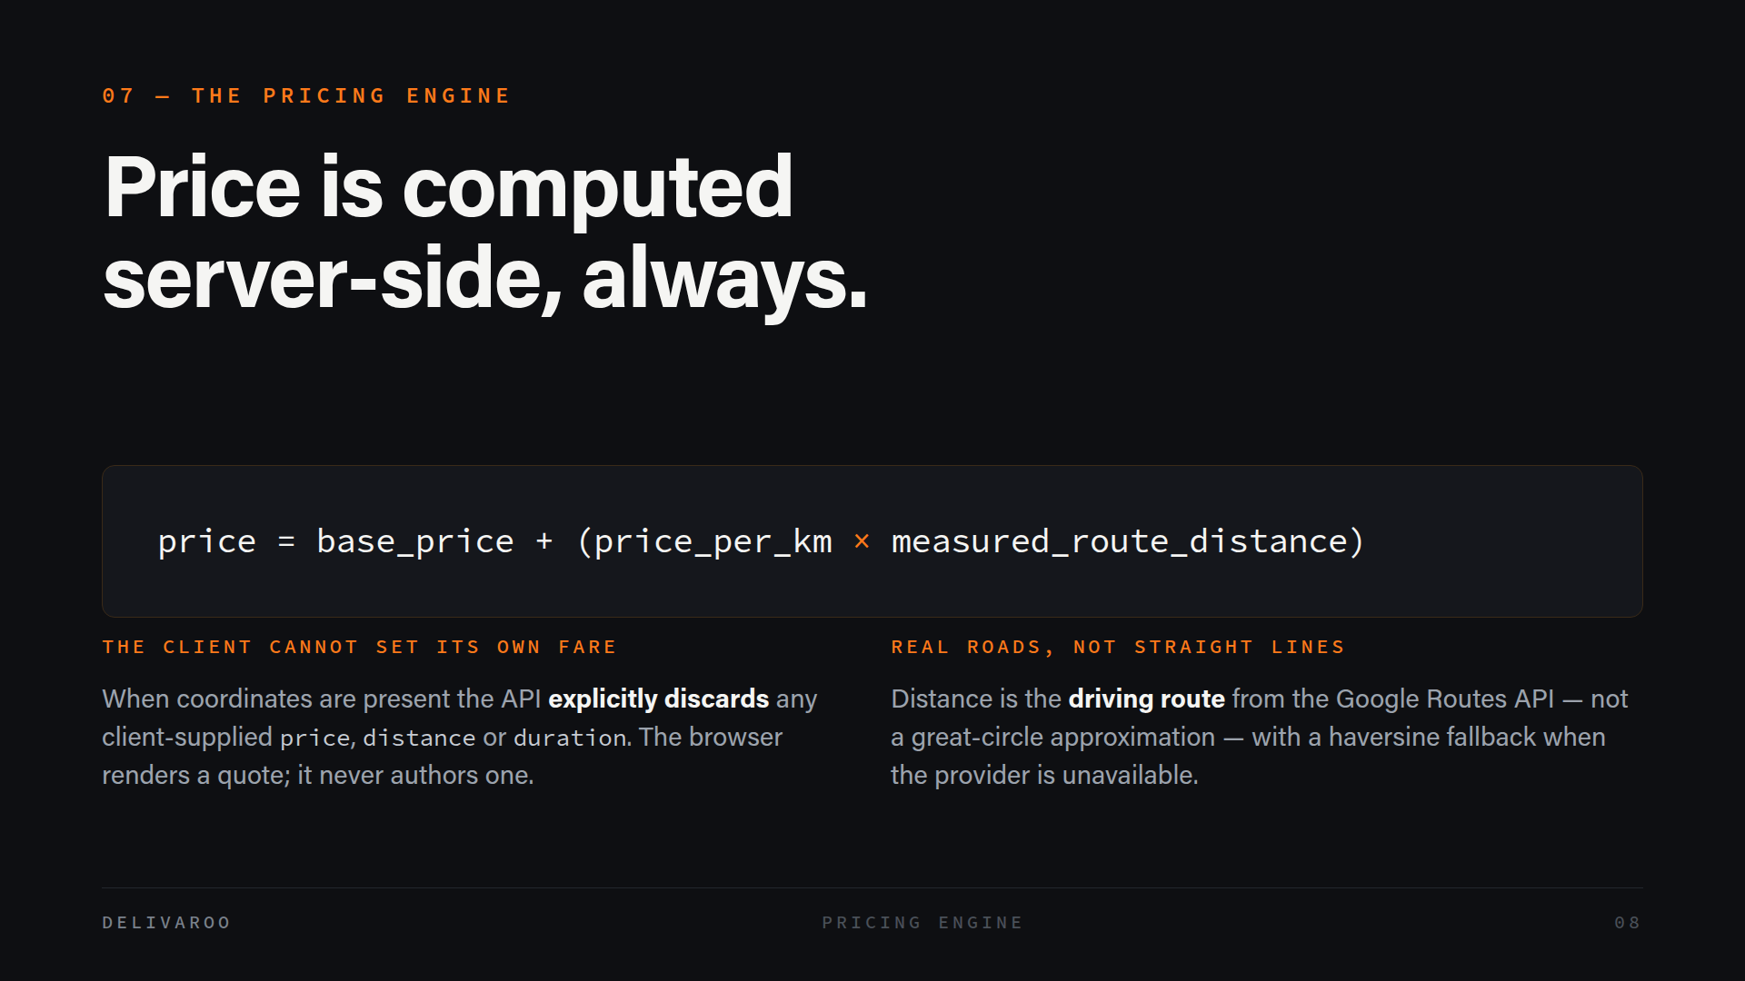
Notes:
This is the claim I'd most want to defend. Price is always computed on the server. The formula itself is simple — a base price plus a per-kilometre rate times the measured distance — but two things make it trustworthy. First, when the request carries coordinates, the API explicitly throws away any price, distance or duration the client sent. The browser renders a quote; it never authors one. If we trusted the client here, anyone with developer tools could post their own fare. Second, the distance is a real driving route from Google's Routes API, not a straight line between two points, because a straight line badly underprices anything that has to go around a lake or through a city. There's a haversine fallback if the provider is down.

Slide 9
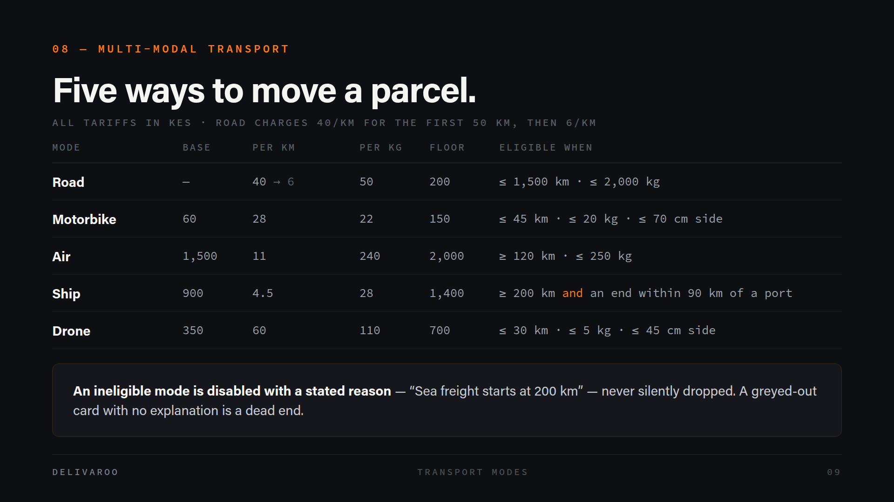
Notes:
Five transport modes, each with its own tariff and its own eligibility rules. Road is the default; motorbike is cheap but capped at 45 kilometres and 20 kilos; air has a high base but a low per-kilometre rate, so it wins on long hauls; ship is cheapest per kilometre but needs both ends near a port; drone is fast and expensive with tight weight and size limits. The rule I want to highlight is at the bottom. When a mode doesn't qualify, we don't hide the card — we disable it and say why. "Sea freight starts at 200 kilometres" tells the customer something. A greyed-out card with no explanation is a dead end, so we made the reason part of the data model rather than an afterthought in the UI.

Slide 10
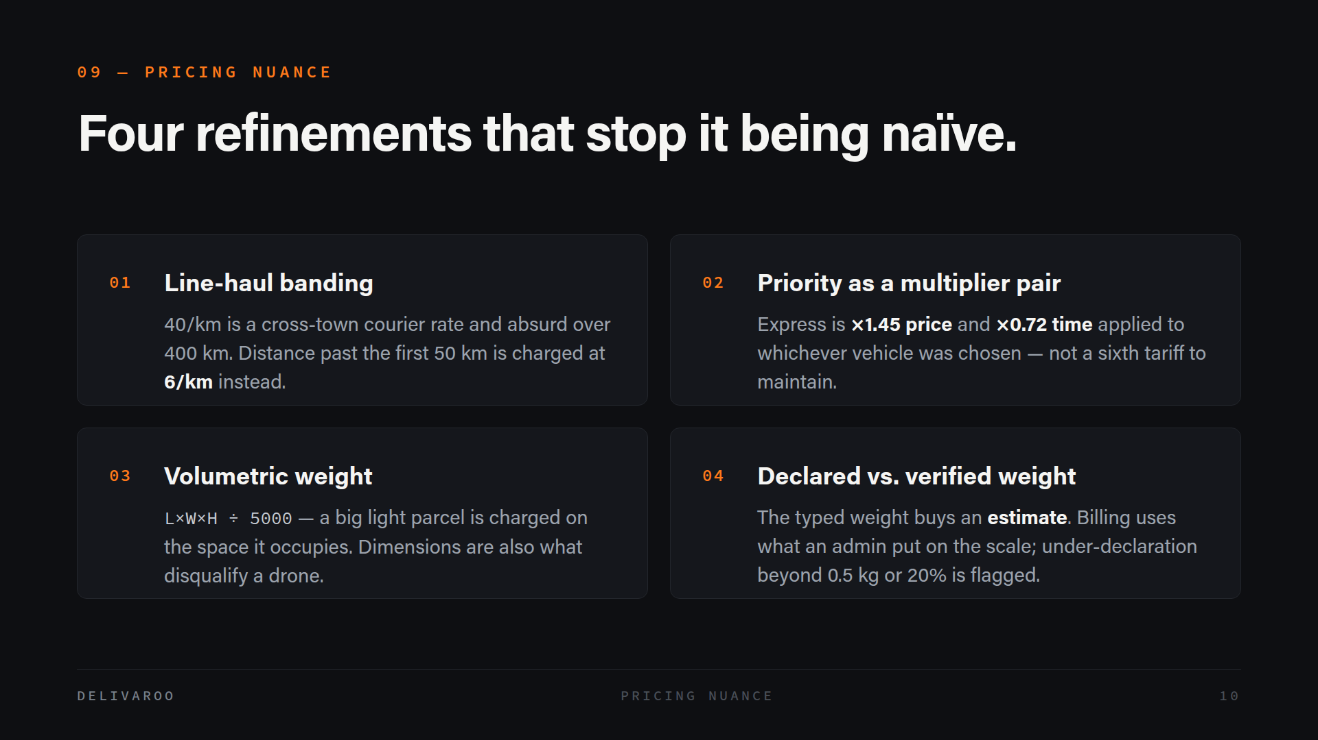
Notes:
A flat rate per kilometre falls apart quickly, so there are four refinements. Line-haul banding: forty shillings a kilometre is a sensible cross-town courier rate and completely absurd over four hundred kilometres, so anything past the first fifty is charged at six. Priority is a multiplier pair rather than a separate tariff — express is 1.45 times the price and 0.72 times the duration, applied to whatever vehicle you picked, so we don't maintain ten tariffs instead of five. Volumetric weight means a large light parcel is charged for the space it occupies. And the weight you type only buys an estimate — the billable figure is what an admin actually weighed, with under-declaration past a tolerance flagged to operations.

Slide 11
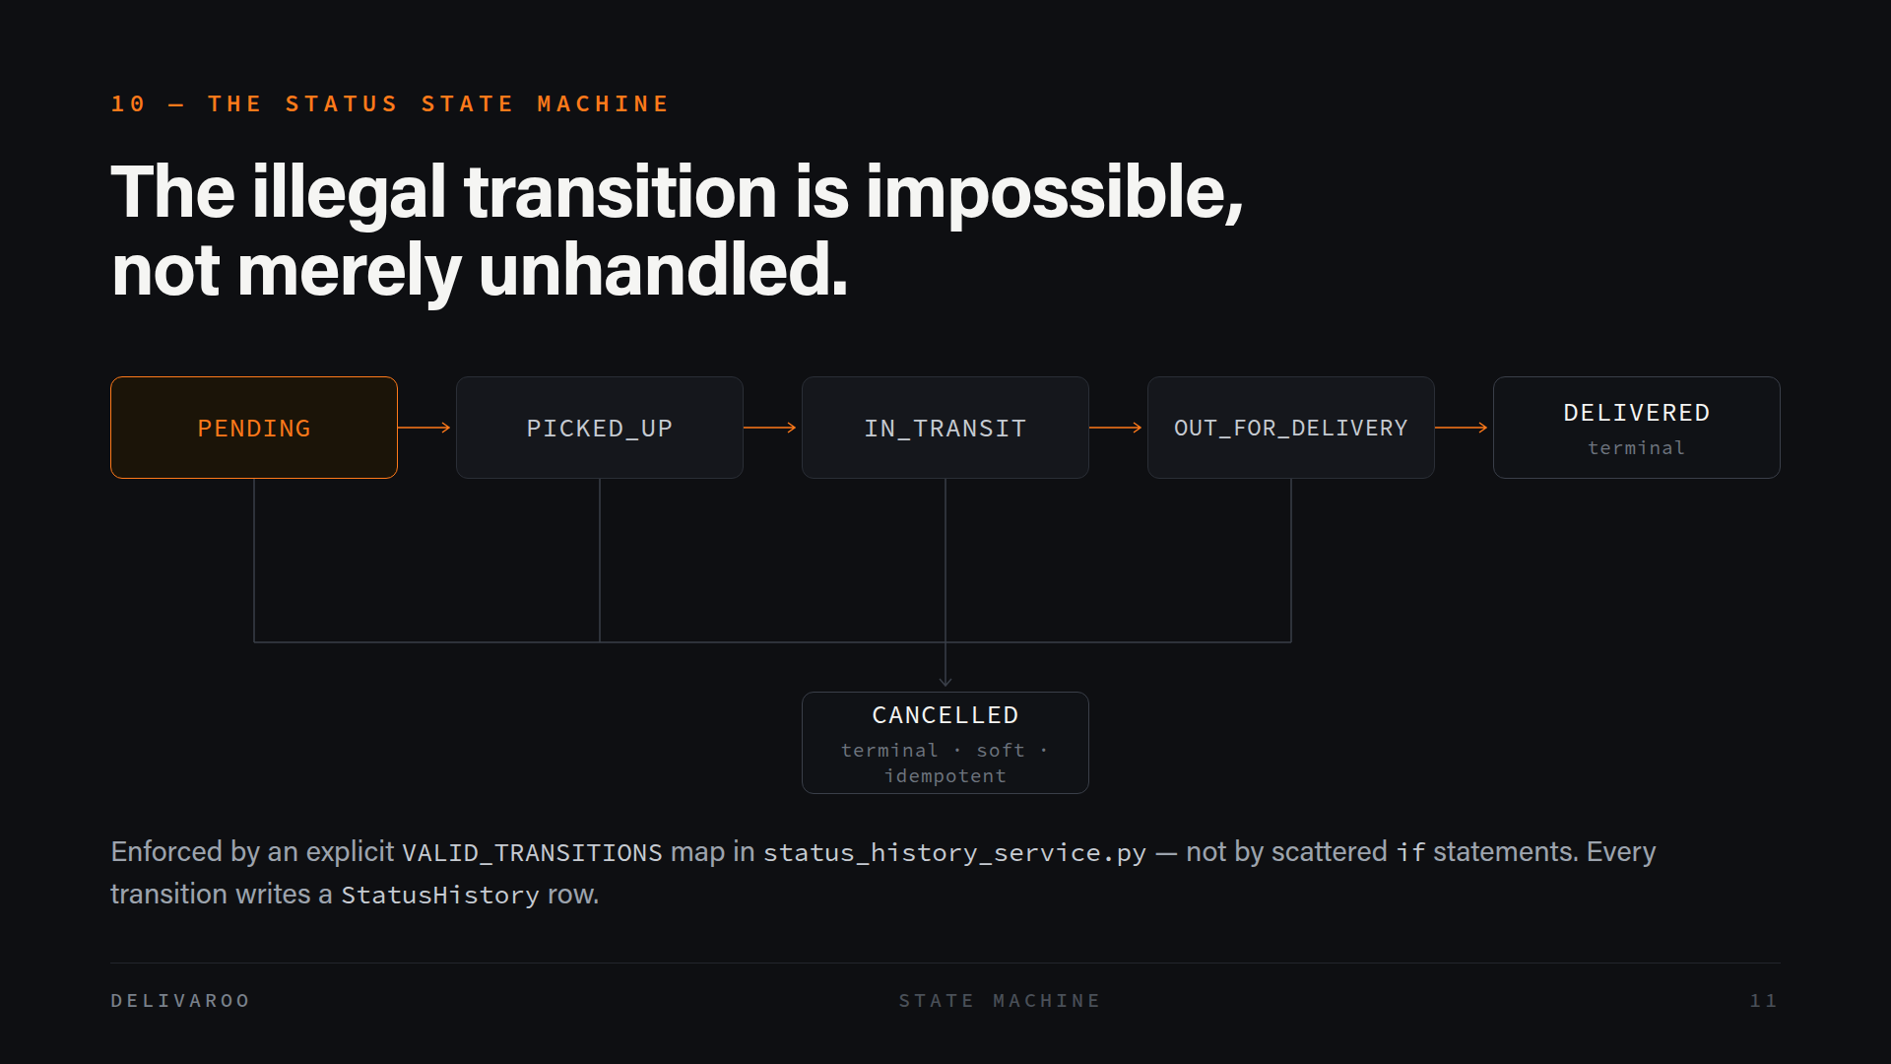
Notes:
A parcel moves through five states, and any of the first four can be cancelled. Delivered and cancelled are terminal — they have zero outgoing transitions. What matters is how that's enforced. There's a single explicit VALID_TRANSITIONS map in the status history service, so an illegal move isn't something we forgot to handle — it's something the code has no path to express. Scattered if-statements would have given us the same behaviour on a good day and a bug on a bad one. Two more details: every transition appends a StatusHistory row, so the audit trail is a side effect of the design rather than extra work; and cancellation is soft and idempotent, so cancelling twice returns 200 and operational history is never destroyed.

Slide 12
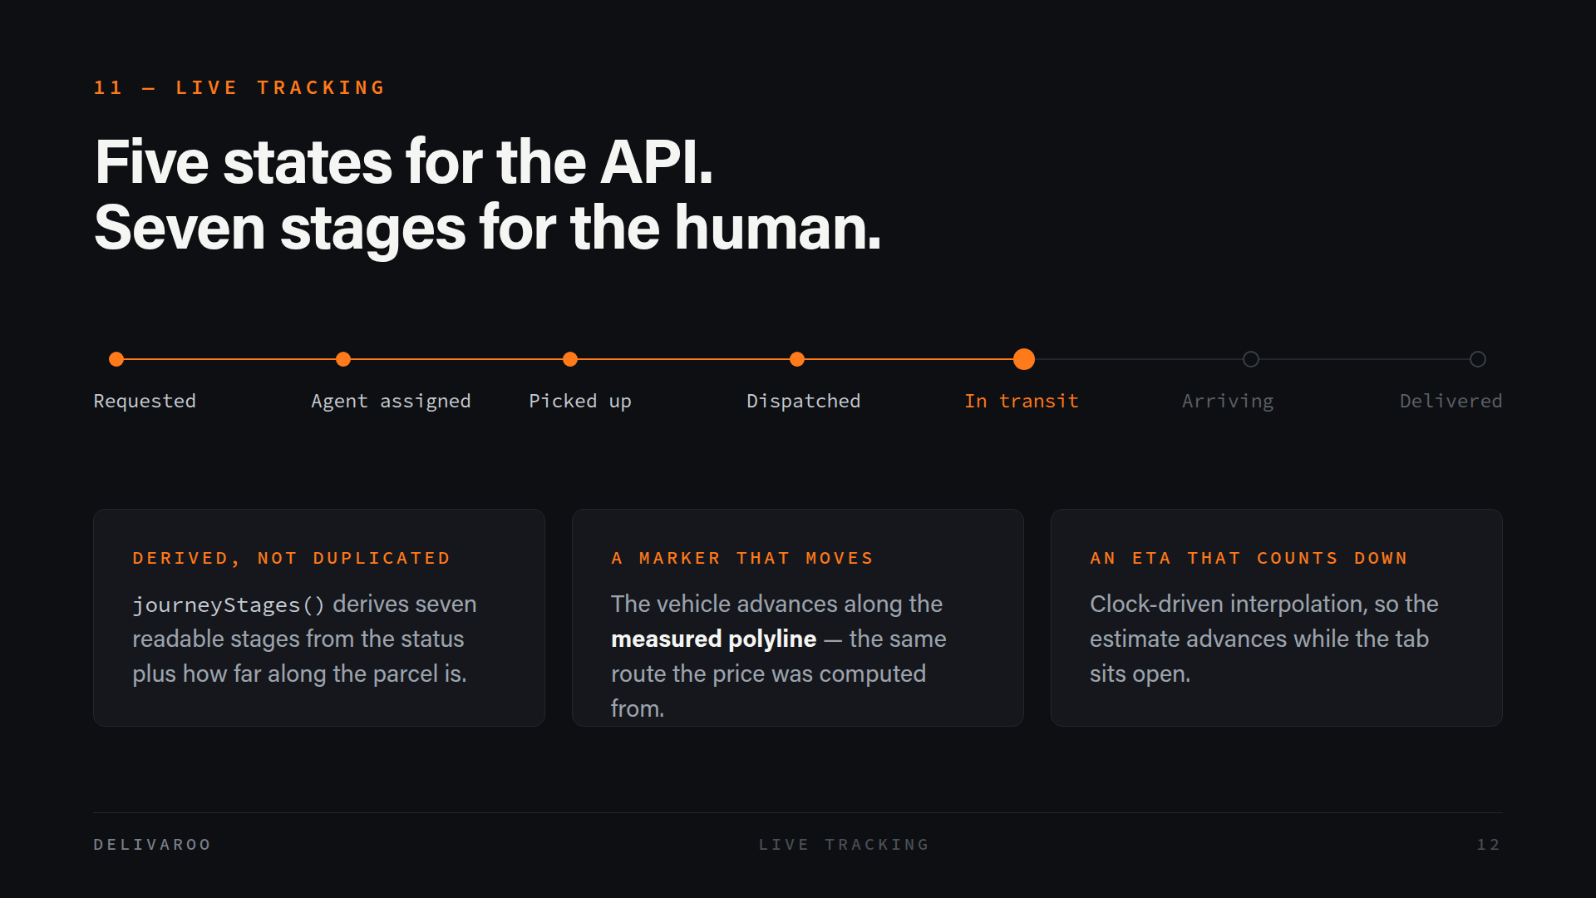
Notes:
The backend has five canonical states, but five states make a poor progress bar — "in transit" covers most of the journey and tells the customer nothing. So the frontend derives seven human-facing stages from the status plus how far through the route the parcel is. The key word is derived. We didn't add a second status column that could disagree with the first; there's one vocabulary for the API and one for the human, and the second is computed from the first. Alongside that, the map marker moves along the same measured polyline the price was calculated from, and the ETA counts down with the clock. I'll be upfront now: this is interpolation, not GPS telemetry — I'll come back to that in limitations.

Slide 13
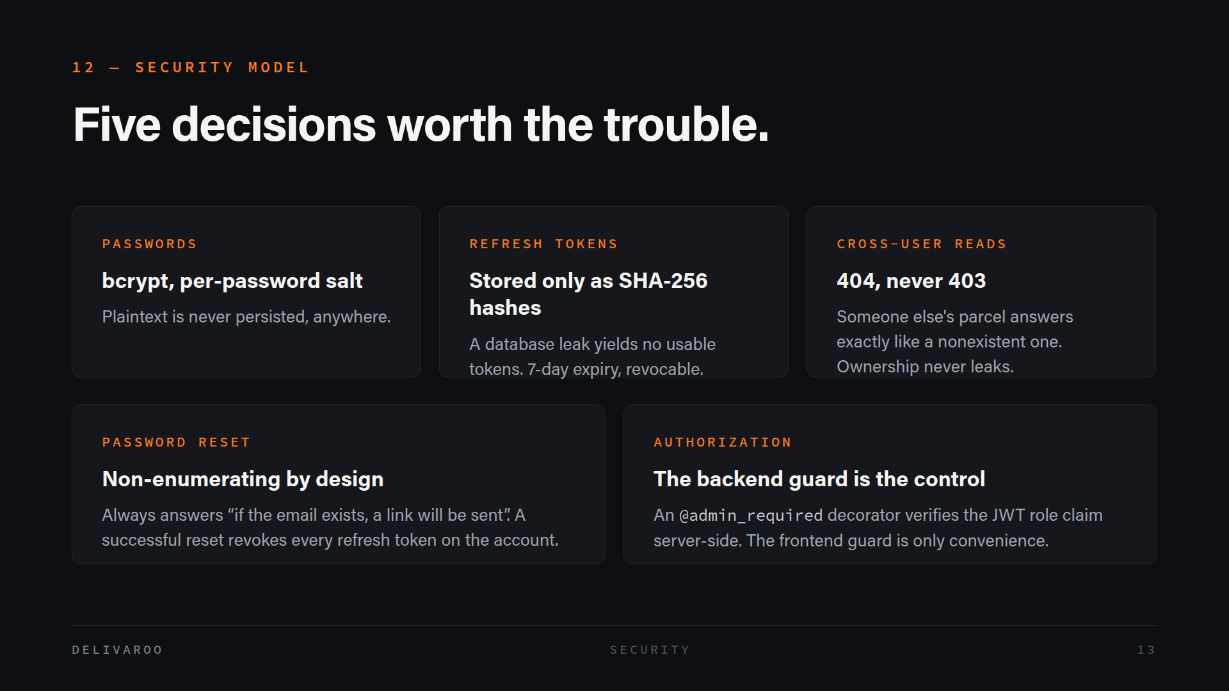
Notes:
Five security decisions. Passwords are bcrypt-hashed with a per-password salt. Refresh tokens are opaque and stored only as SHA-256 hashes, so a database leak doesn't hand an attacker working tokens — same reasoning as password hashing, applied consistently. Cross-user reads return 404 rather than 403, because 403 confirms the resource exists and belongs to someone; a 404 is indistinguishable from a parcel that was never created. Password reset always says "if the email exists, a link will be sent", so you can't use it to discover who has an account, and a successful reset revokes every refresh token. And authorization is enforced by a decorator that checks the JWT role claim server-side — the frontend guard is convenience, the backend guard is the control.

Slide 14
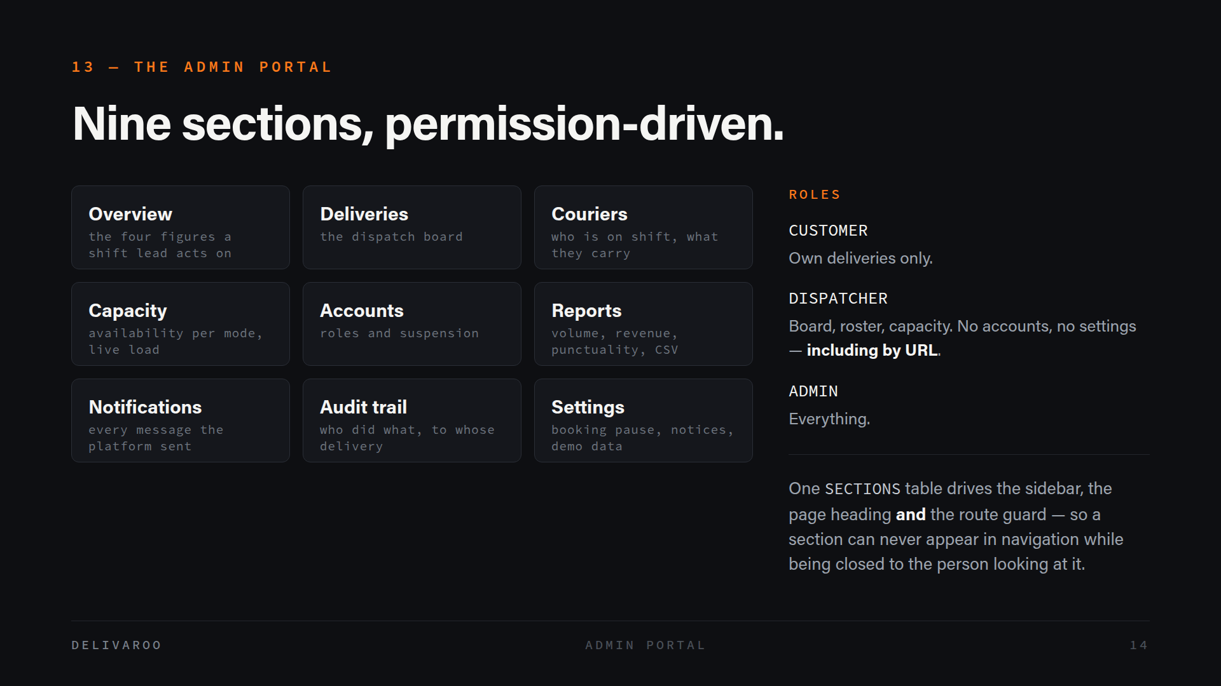
Notes:
The operations portal has nine sections, from the dispatch board through to the audit trail and platform settings. Three roles: customers see only their own deliveries, dispatchers get the board, roster and capacity but not accounts or settings — and that holds even if they type the URL directly — and admins get everything. The design decision here is that it's permission-driven rather than screen-driven. A single SECTIONS table drives the sidebar, the page heading and the route guard together, which means a section physically cannot appear in someone's navigation while being closed to them. Those three things can't drift apart because they're the same data. And admin actions are live — change a status and the customer's tracking tab updates without a reload.

Slide 15
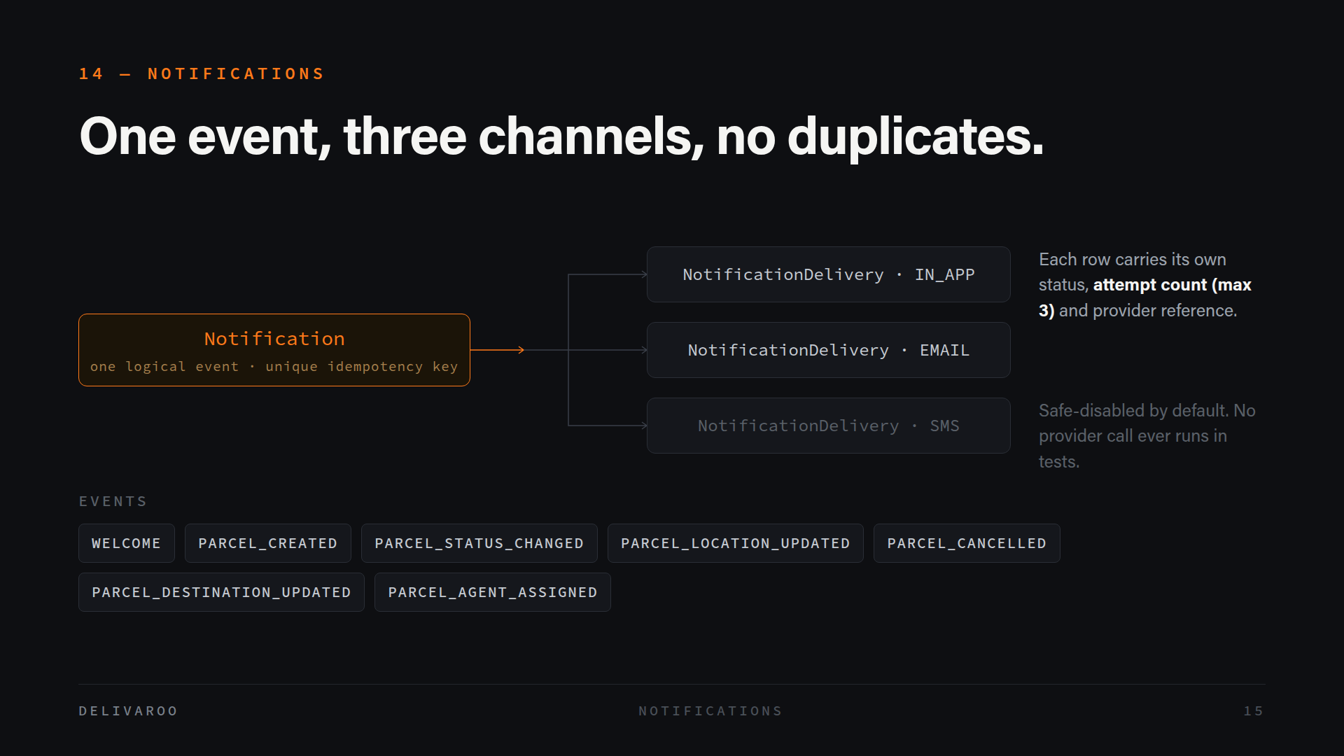
Notes:
Notifications fan out. One logical event — a parcel was created, a status changed, an agent was assigned — becomes one Notification row, which then produces a separate delivery record per channel: in-app, email and SMS. Each delivery tracks its own status, its own attempt count capped at three, and a provider reference, so a failed email doesn't mark the whole event failed. The idempotency key is a unique column, which means the same event physically cannot notify twice — that's a database constraint doing the work rather than application logic hoping. Users control their channels through a preferences table. SMS is scaffolded but safe-disabled: it needs an explicit flag and a configured provider, and no real provider call ever runs in tests.

Slide 16
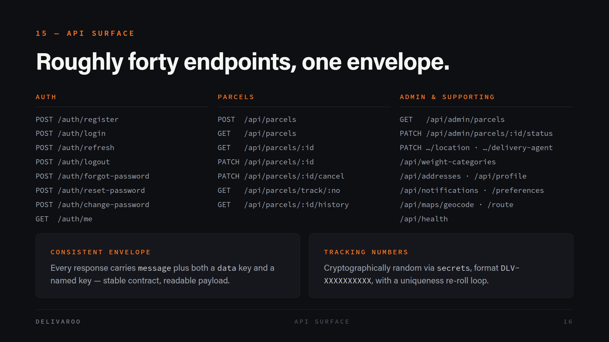
Notes:
About forty endpoints in four families: auth, parcels, admin, and supporting services like addresses, notifications and maps. Two things are worth calling out. Every response uses the same envelope — a human-readable message plus both a generic data key and a named key like "parcel" or "parcels" — so client code has a stable contract to bind to without the payload becoming unreadable, and errors always return a message written for the end user rather than a stack trace. And tracking numbers are generated with Python's secrets module in a DLV-plus-ten-characters format, with a re-roll loop on collision. Sequential tracking numbers would let anyone enumerate every parcel on the platform.

Slide 17
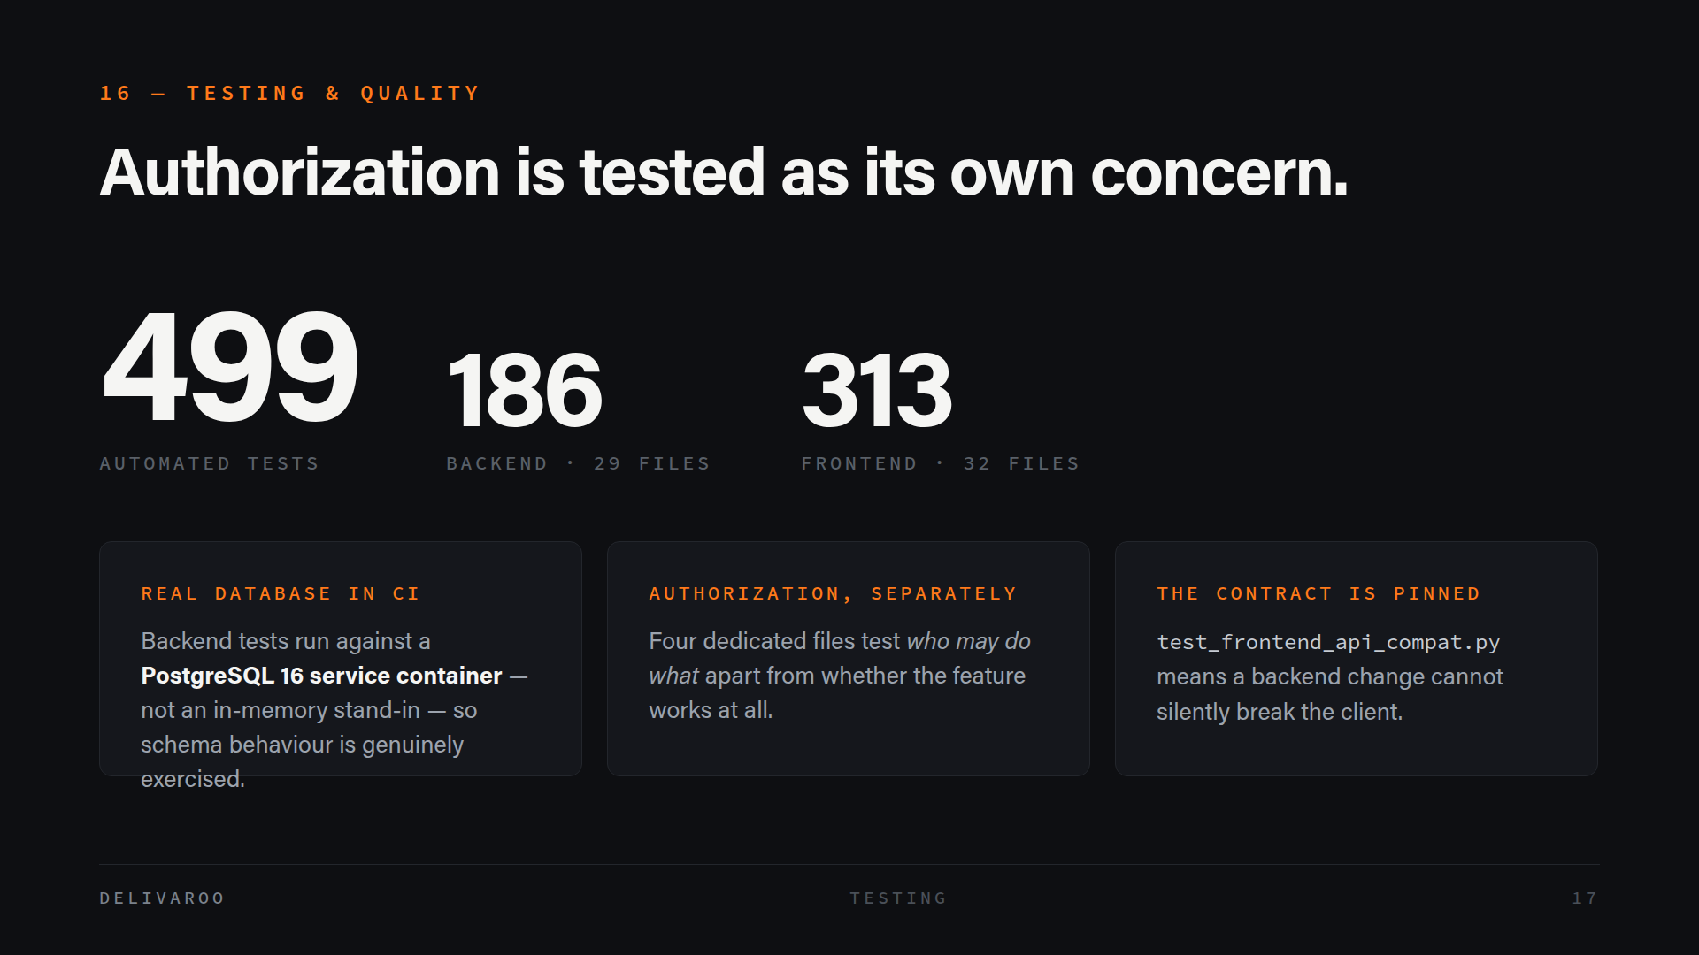
Notes:
Roughly 499 automated tests — 186 backend functions across 29 files, and about 313 frontend cases across 32. But the count matters less than the shape. Backend tests run against a real PostgreSQL service container in CI rather than SQLite in memory, so constraints, cascades and migrations are actually exercised instead of approximated. Authorization has its own dedicated test files, separate from the functional ones, because "does this work" and "who is allowed to do this" are different questions and the second is the one that bites you. And there are contract tests pinning the shapes the frontend expects, so a backend rename can't silently break the client — it fails in CI instead of in the demo.

Slide 18
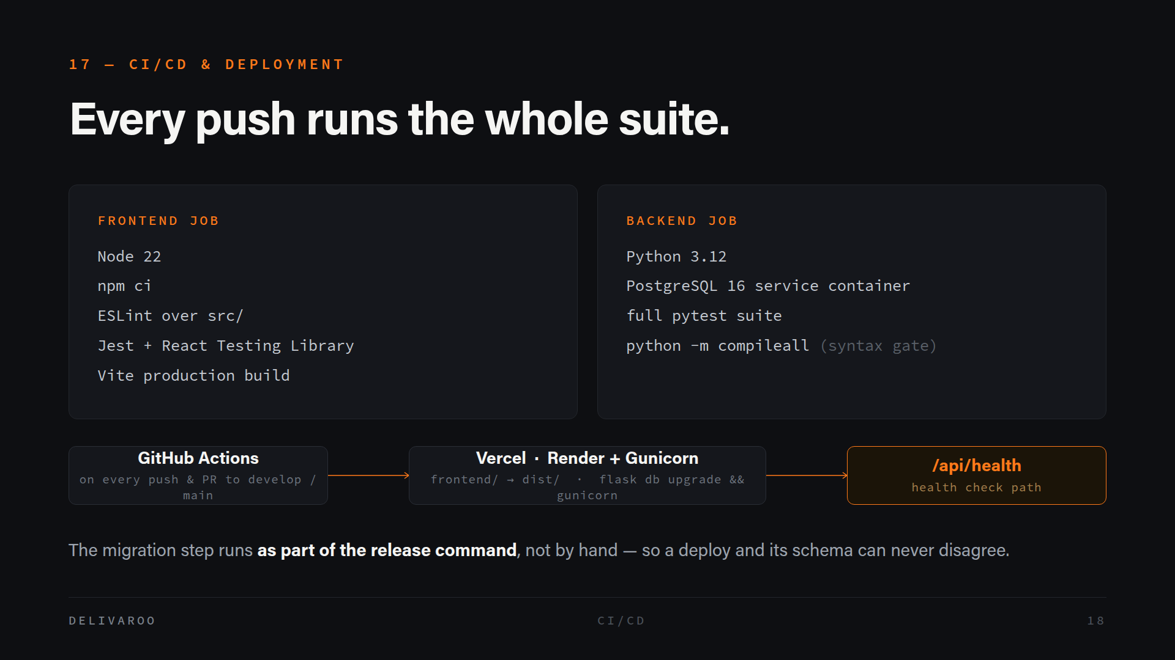
Notes:
GitHub Actions runs two jobs on every push and every pull request into develop or main. The frontend job installs cleanly, lints, runs Jest, and does a real production build — so a build failure is caught in CI rather than at deploy time. The backend job spins up a PostgreSQL 16 service container, runs the full pytest suite, and finishes with compileall as a cheap syntax gate. Deployment is Vercel for the frontend and Render with Gunicorn for the API, with /api/health as the health check path. The detail I like: the migration runs as part of the release command, so a deployed build and its database schema can never disagree with each other.

Slide 19
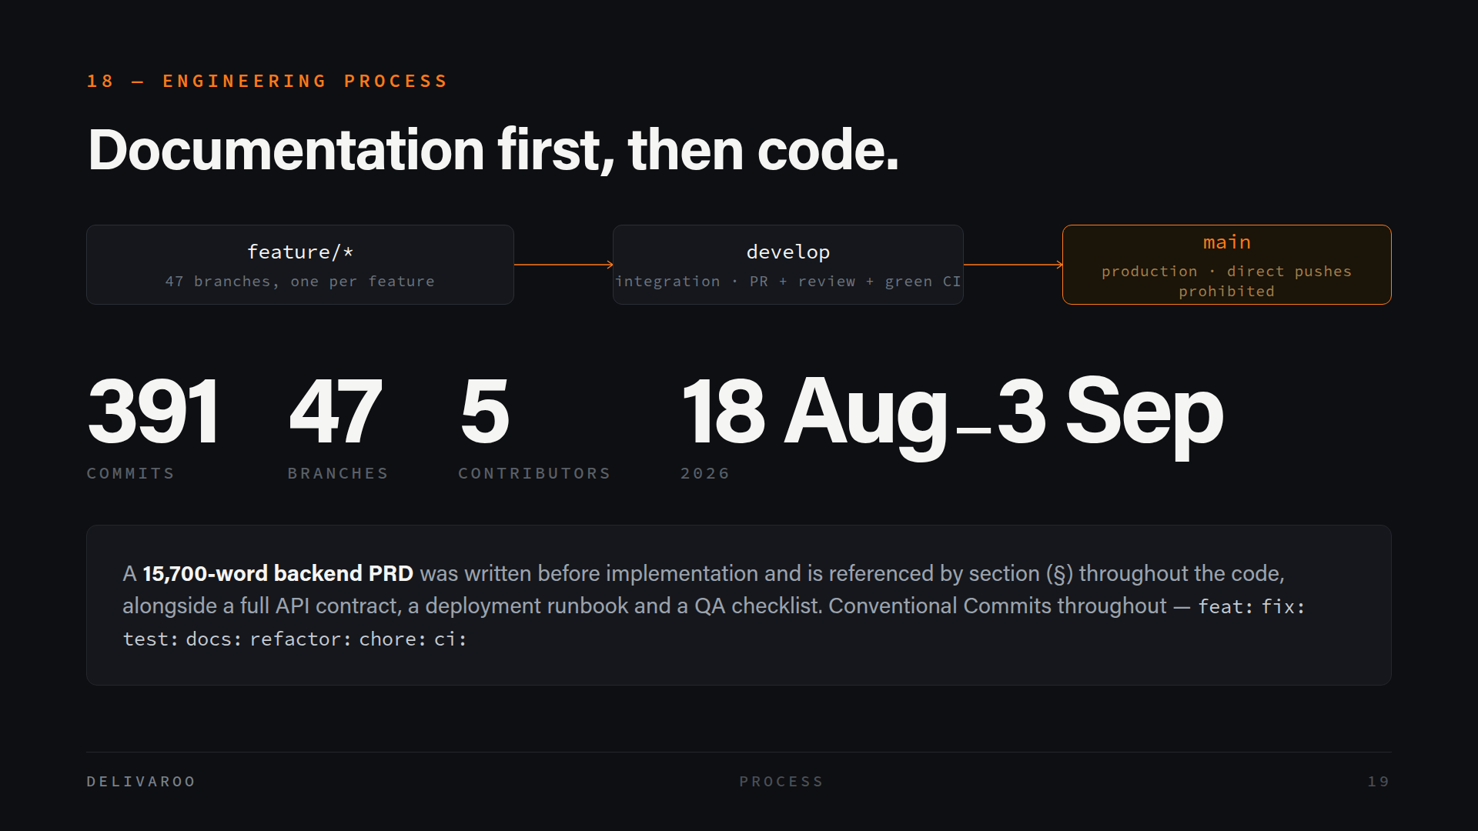
Notes:
We ran a three-tier Git flow: feature branches merge into develop by pull request with review and green CI, and develop merges into main. Direct pushes to main are prohibited. That produced 391 commits across 47 feature branches from five contributors between the 18th of August and the 3rd of September. The part I'd underline is documentation-first. A 15,700-word backend requirements document was written before the implementation and is referenced by section number throughout the code, so when you're reading a service you can find the requirement it satisfies. Alongside it there's an API contract, a deployment runbook and a QA checklist. That's what let five people work in parallel without constantly colliding.

Slide 20
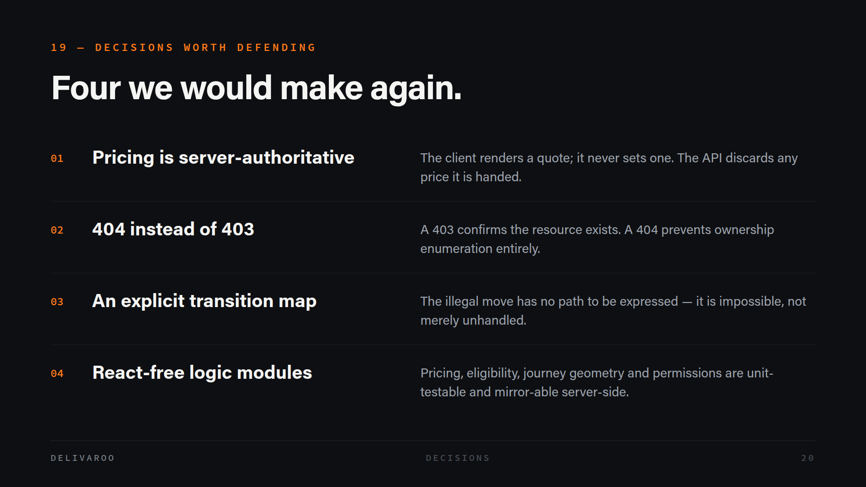
Notes:
If you take four things from this talk, take these. Pricing is server-authoritative — the client renders a quote and never sets one, so nobody sets their own fare with developer tools. Cross-user reads return 404 rather than 403, because a 403 confirms the thing exists and belongs to someone, which is itself a leak. The status machine uses an explicit transition map, so an illegal move isn't merely unhandled — the code has no way to express it. And the frontend's core logic — pricing, transport eligibility, journey geometry, permissions — lives in modules that import neither React nor Leaflet, which means we can unit-test them directly and mirror them server-side without a rewrite.

Slide 21
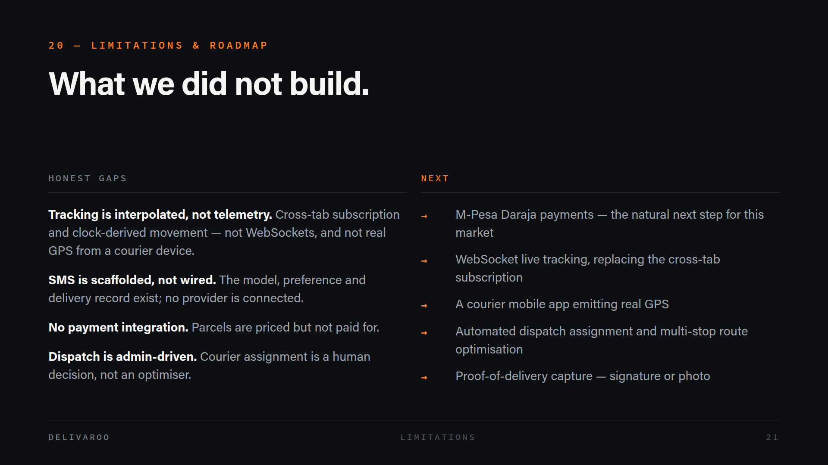
Notes:
I want to be straight about the gaps, because a demo can hide them. Live tracking looks real, but it's a cross-tab subscription plus clock-driven interpolation along a known route — there are no WebSockets and no GPS coming off a courier's phone. SMS has the model, the preference and the delivery record, but no provider is connected, so it's scaffolding. There's no payment integration at all. And courier assignment is a human decision rather than an optimiser. The roadmap follows directly from that list: M-Pesa through the Daraja API is the obvious first step for this market, then WebSockets, then a courier app with real GPS, then automated dispatch and proof-of-delivery capture.

Slide 22
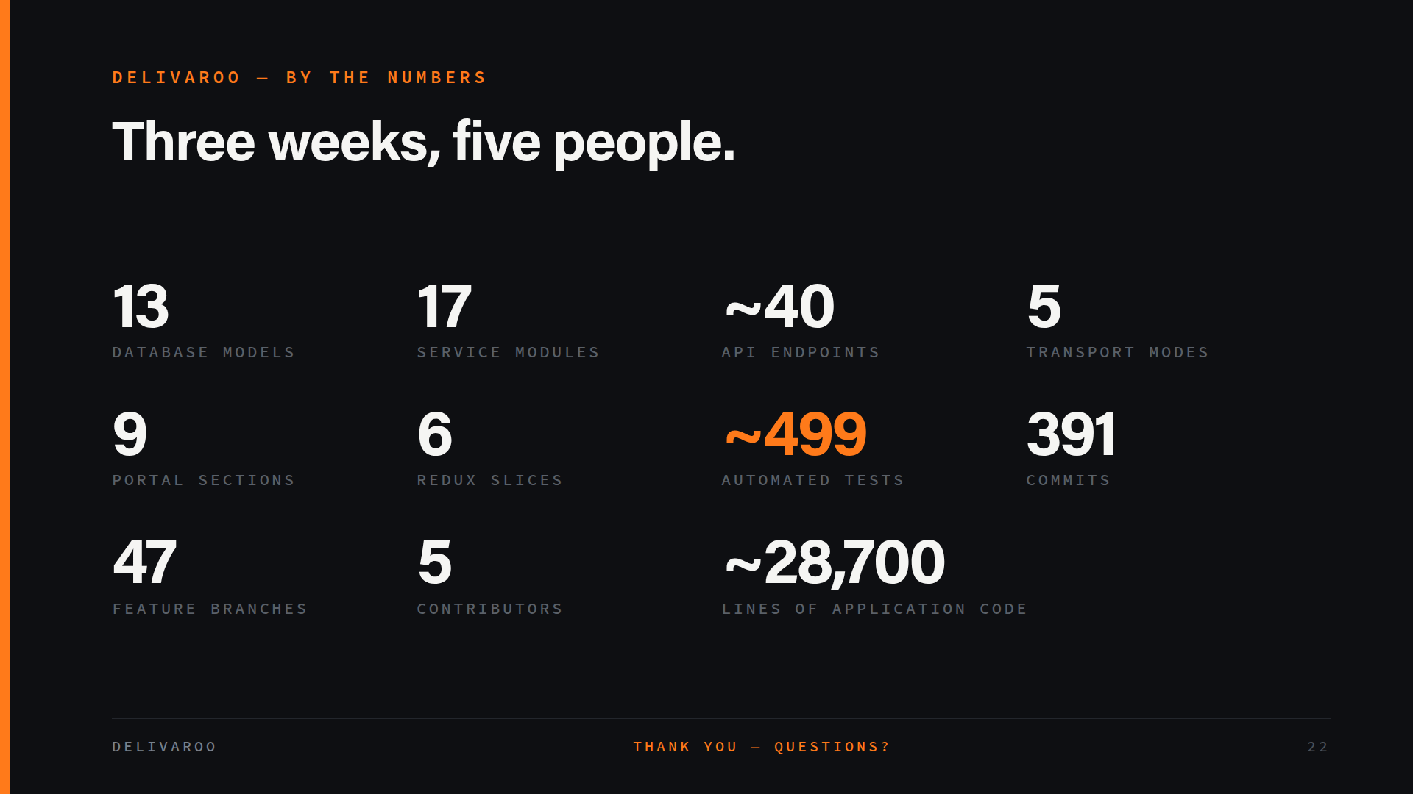
Notes:
To close, the shape of the thing: 13 models, 17 service modules, about 40 endpoints, 5 transport modes, a 9-section portal, 6 Redux slices, roughly 499 automated tests, 391 commits across 47 feature branches from 5 contributors, and about 28,700 lines of application code — built in three weeks. The number I'm proudest of isn't the line count, it's the test count relative to it, because that's what let us keep changing the pricing engine and the state machine in the last week without breaking the demo. Thank you — we're happy to take questions, and we can go live in the app or into any part of the codebase you'd like to see.

