Slide 1

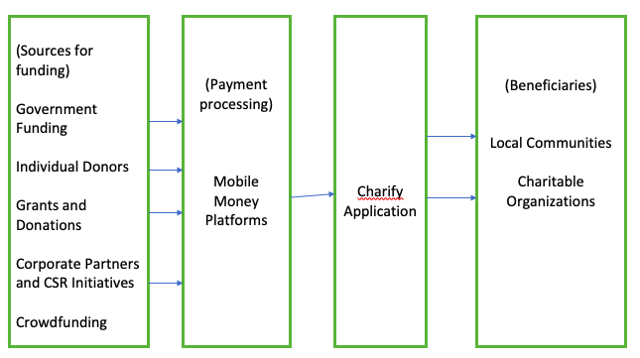
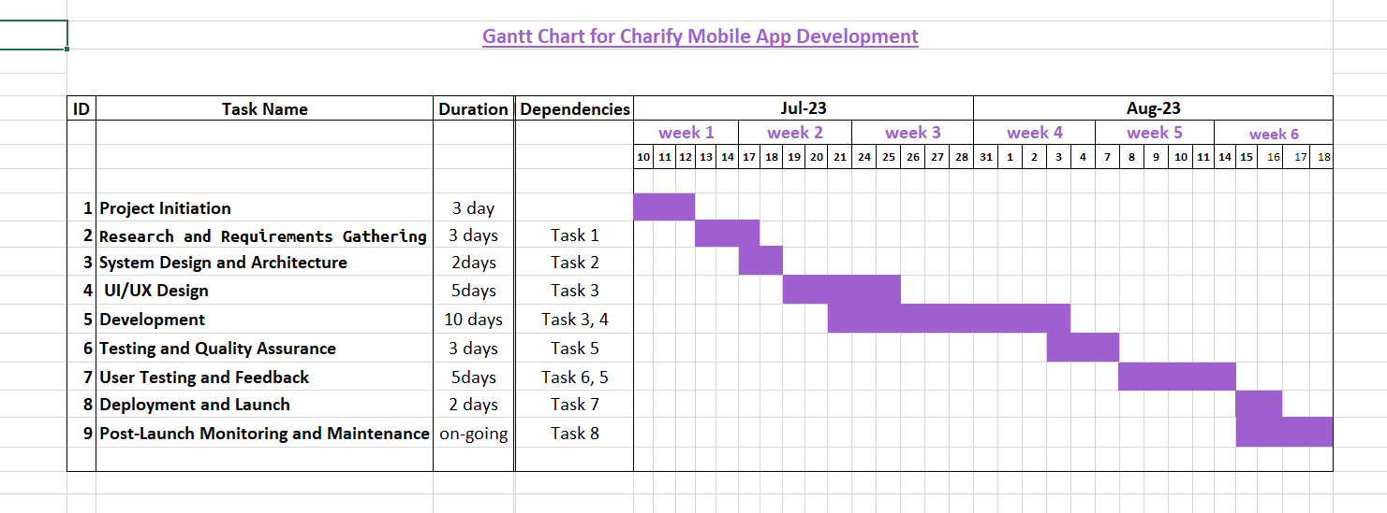
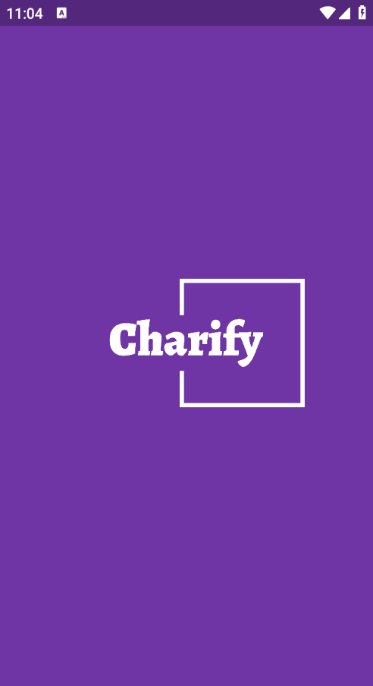
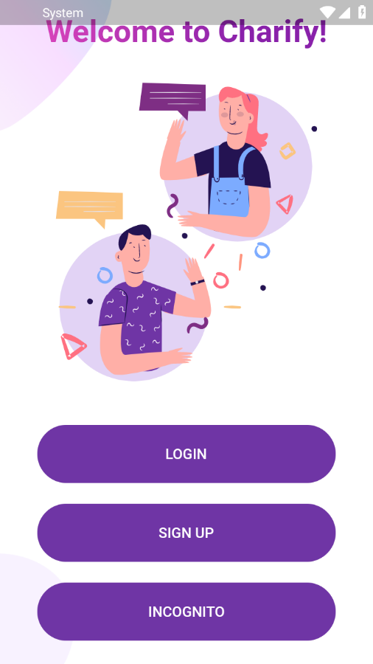
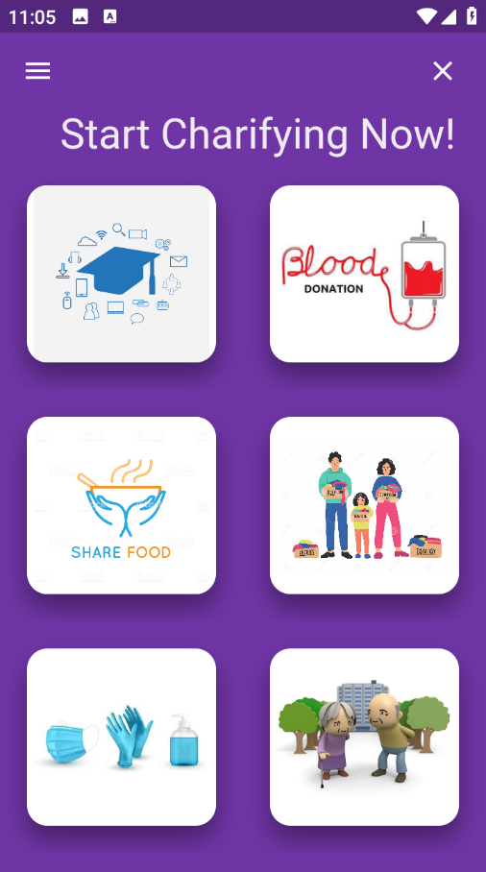
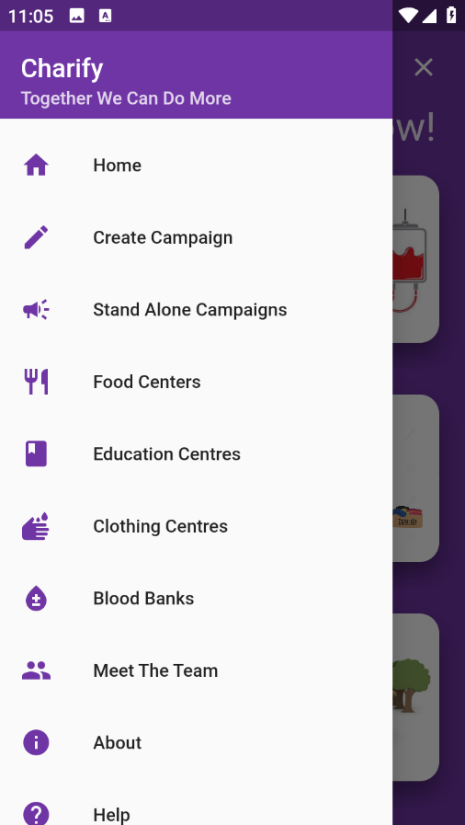
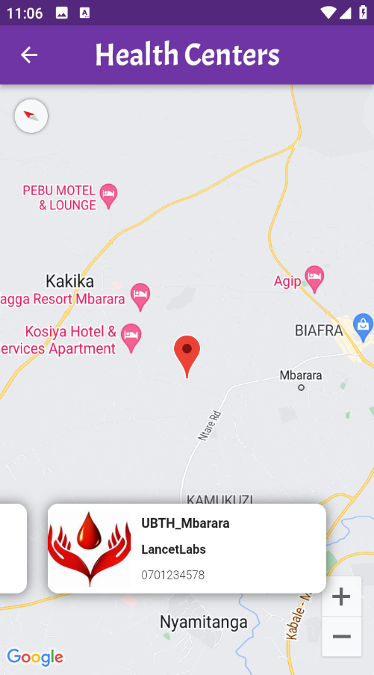
Charify App
RONALD ATUHAIRE | EDWARD KABOGGOZA| GEORGE SSEMAGANDA
Problem
Project Design
Results
Ugandan charities and individuals struggle with technology barriers, inadequate platforms, and location visibility, hindering effective fundraising and impactful campaigns. People affected by the project include charitable organizations, local communities, mobile money platforms and donors.
Project Objectives
Improve engagement with donors through effective use of digital marketing and story telling techniques.
Establish transparent reporting mechanisms to showcase how donations are utilized and the progress achieved by charitable projects.
Create user-friendly online donation platforms and mobile based systems.
Results
Project Requirements
Step 1
Step 2
Login to access Charify main menu
Step 3
Select Charify to donate to
Step 4
Confirm donation to a selected Charify
Sign up to access Charify services
User-Friendly Donation Platform: Create a mobile and web-based platform for making donations.
User Profiles and Donor Management: Allow users to create profiles and track their donations and engagement.
Transport Reporting: Develop a dashboard for organizations to report on project and fund utilization.
Mobile Money integration: Integrate with popular mobile money platforms for seamless payment processing.
Flash screen
Welcome screen
Home Page
Main Drawer
Google Maps
Conclusion
Brief summary of what you discovered based on results
Indicate and explain whether or not the data supports your hypothesis
Target Users
Future Work
Charitable Organizations
Create campaigns and enhance visibility for their projects.
Corporate Partners and CSR initiatives
Contribute financially, provide resources and participate in community development projects.
Mobile Money Platforms
Process payments being made for the different campaigns.
Expand Payment Methods: Continuously update and expand the platform's payment methods to accommodate emerging preferred payment options in Uganda.
Regional Scaling: We consider scaling the platform to address challenges faced by charitable organizations and individuals in the neighboring countries.
Blockchain for Transparency: Implement blockchain technology to enhance transparency and accountability in fund utilization and project progress.
Localized Content and Languages: Expand multilingual support to include additional local languages.
Machine Learning and AI Integration: Integrate machine learning algorithms to provide personalized recommendations to donors, suggest impactful campaign strategies and analyze trends in donor behavior.
Ability to start a campaign by the users not only by the admins.
Planning to use Mango DB
References
GoFundMe https://www.gofundme.com/en-gb
Flutter documentation https://docs.flutter.dev/
Momo API https://momodeveloper.mtn.com/api-documentation
REST API-hosting/PaaS https:// render.com
Flutter wave documentation https://developer.flutterwave.com/
Fire base documentation https://firebase.google.com/docs
Dart documentation https://dart.dev/guides
Fire store documentation https://firebase.google.com/
Notes:
To change this poster, replace our sample content with your own. Or, if you'd rather start from a clean slate, press the New Slide button on the Home tab to insert a new page. Now enter your text and pictures in the empty placeholders. If you need more placeholders for titles, subtitles or body text, copy any of the existing placeholders, then drag the new one into place.

