Slide 1
OSA Project

Slide 2
Target
Office Supply Application
Improvement Testing Process
Frontend Framework
Learn Agile

Slide 3

Agile Manifesto

Slide 4
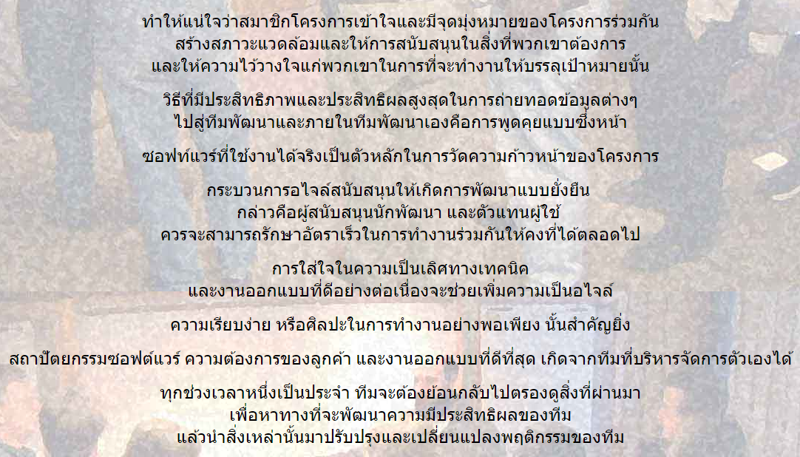
Agile Manifesto

Slide 5



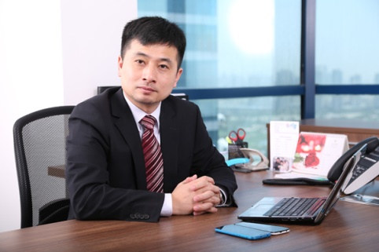


OSA Operation Flow
1
2
Request
Approve
3
FIC No.
Manager
Office Supply App.
4
Receipt
& FIC No.
Verify
Account

Slide 6





Layer of Application
Presentation
App Service
Database

Slide 7





Development Process

Slide 8
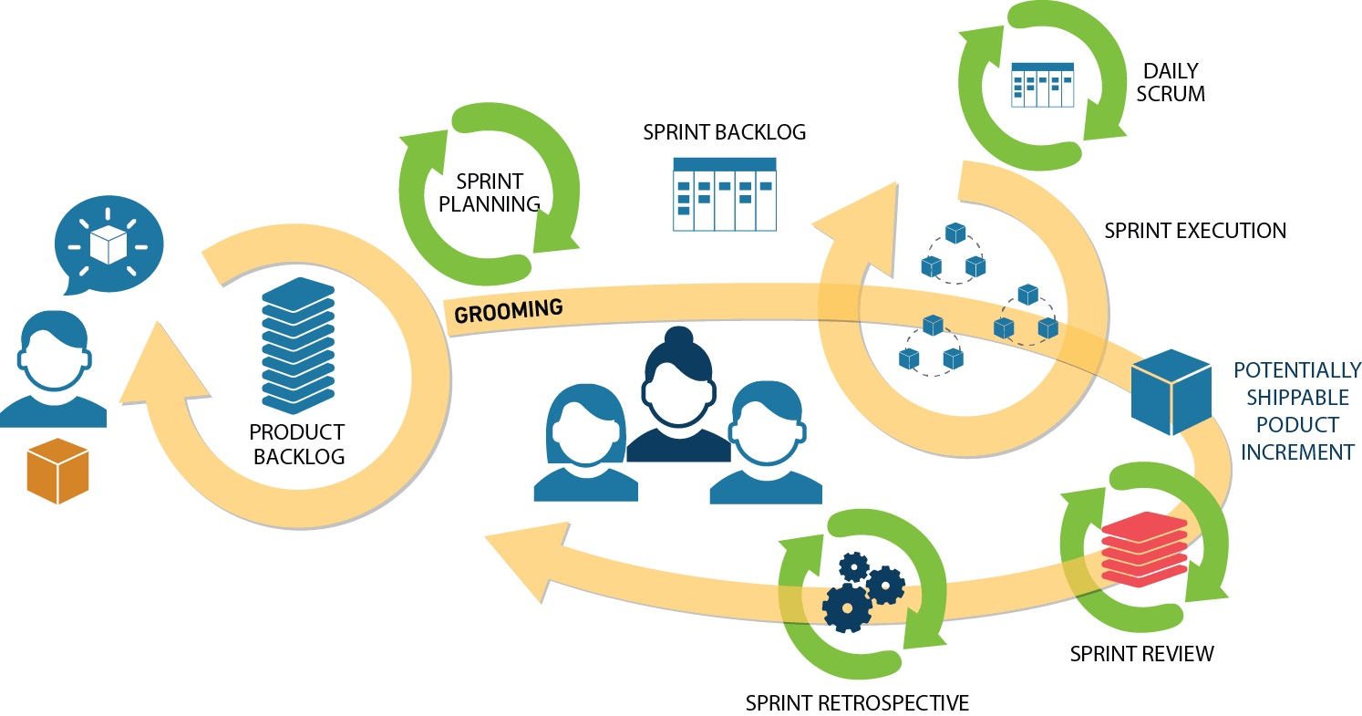
SCRUM

Slide 9
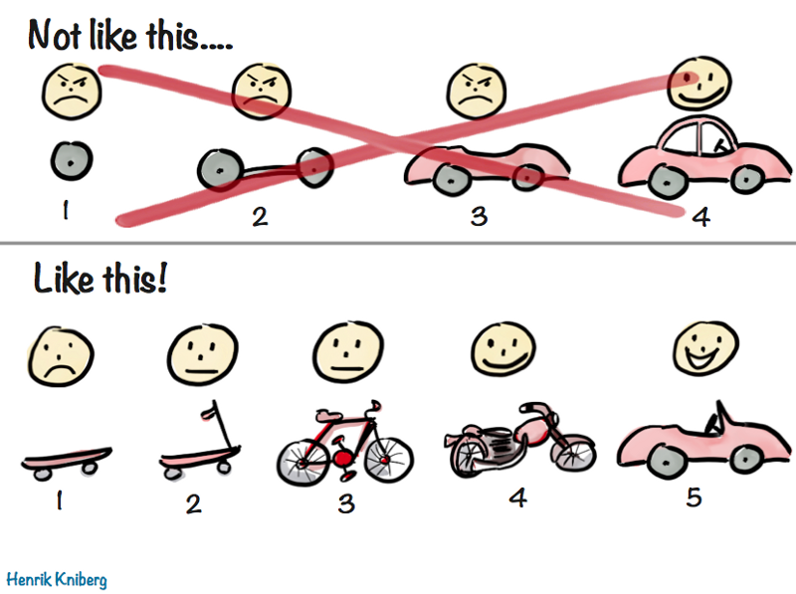
Sprint

Slide 10
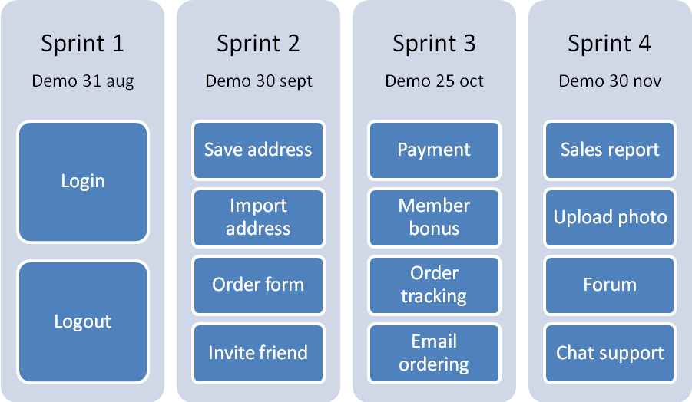
SCRUM Sprint

Slide 11
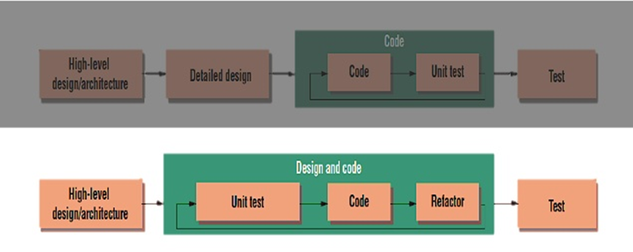
Test Driven Development

Slide 12

Automation Test
http://robotframework.org
http://robotframework.org/Selenium2Library/Selenium2Library.html
http://www.swtestacademy.com/getting-started-robotframework/

Slide 13
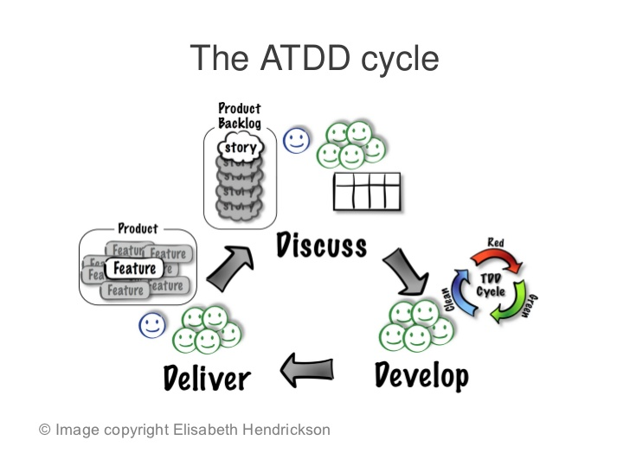
Acceptance Test Driven Development

Slide 14
Work Philosophy
รู้สึก
นึก
คิด
ทำ

Slide 15
To be continue…

