Slide 1
Rails Framework

Slide 2

Go to desktop

Slide 3
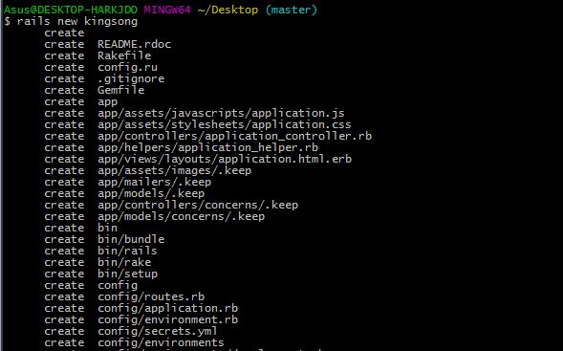
rails new kingsong

Slide 4
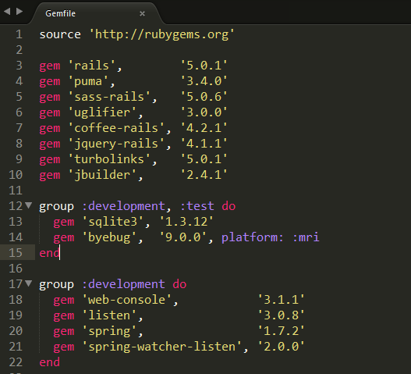
แก้ไข Gemfile

Slide 5
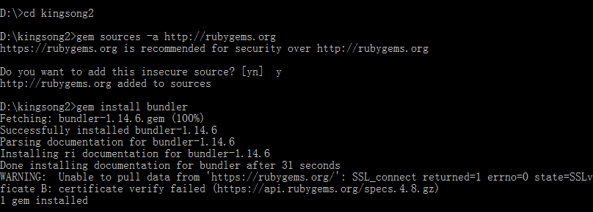
1. cd kingsong2
2. gem sources –a http://rubygems.org
3. answer y
4. gem install bundler

Slide 6
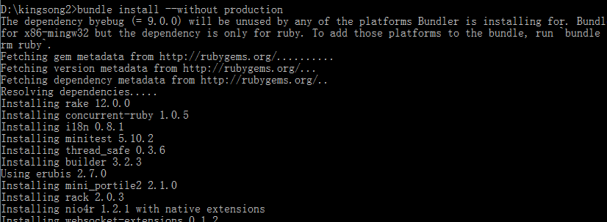
bundle install --without production

Slide 7
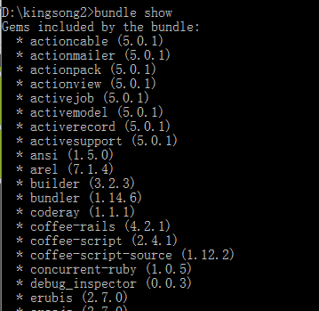
bundle show

Slide 8
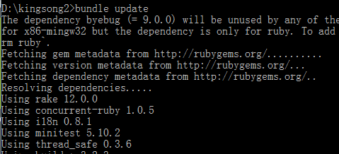
bundle update

Slide 9
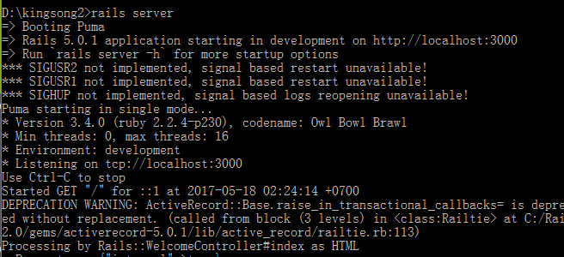
run rails server

Slide 10

open localhost:3000 will see welcome rails

Slide 11
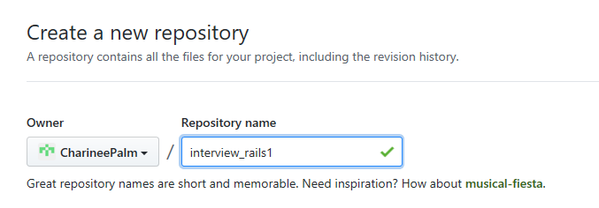
create repo at github

Slide 12

git config --global user.name "your username“ git config --global user.email "your email"

Slide 13
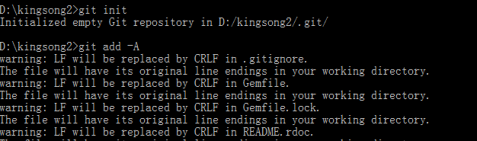
git init git add –A

Slide 14
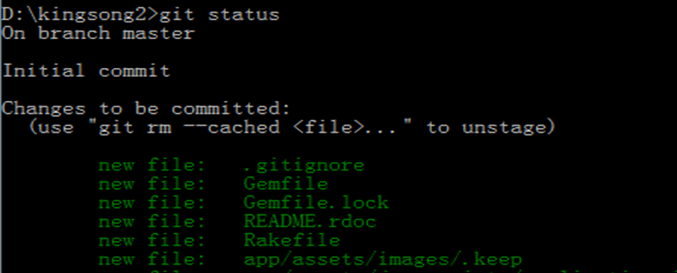
git status

Slide 15
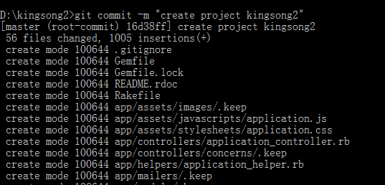
git commit –m “create project kingsong”

Slide 16
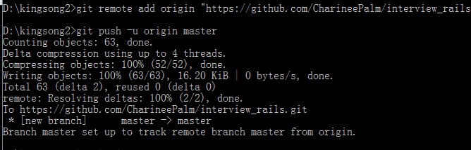
git remote add origin “git repo” git push -u origin master

Slide 17
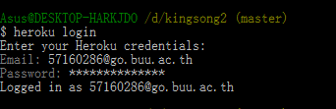
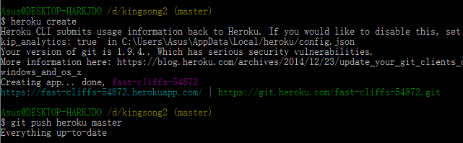
heroku login
heroku create git push heroku master

Slide 18
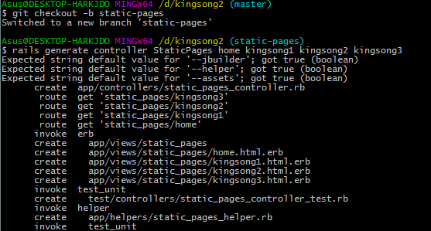
git checkout -b static-pages

Slide 19
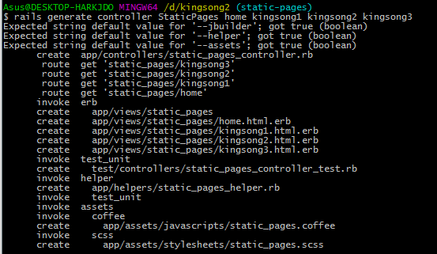
rails generate controller StaticPages home kingsong1 kingsong2 kingsong3

Slide 20
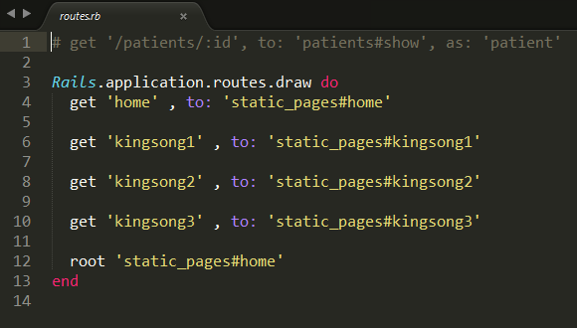
edit config/routes

Slide 21
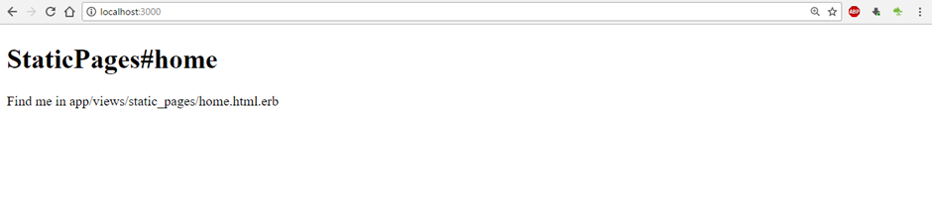
localhost:3000
Edit app/views/static_pages/home.html.erb
Edit app/views/static_pages/kingsong1.html.erb
Edit app/views/static_pages/ kingsong2.html.erb
Edit app/views/static_pages/ kingsong3.html.erb

Slide 22
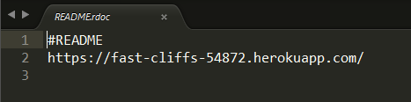
Edit Readme
git add –A
git commit -m "Finish static pages"
git checkout master
git merge static-pages
git push
git push heroku

Slide 23

git checkout –b presentation create powerpoint

Slide 24
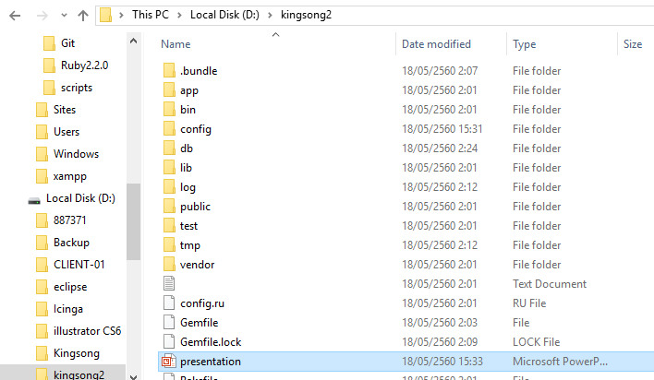
edit powerpoint and save as presentation.ppt
git add –A
git commit -m "Finish presentation"
git checkout master
git merge presentation
git push

