Slide 1


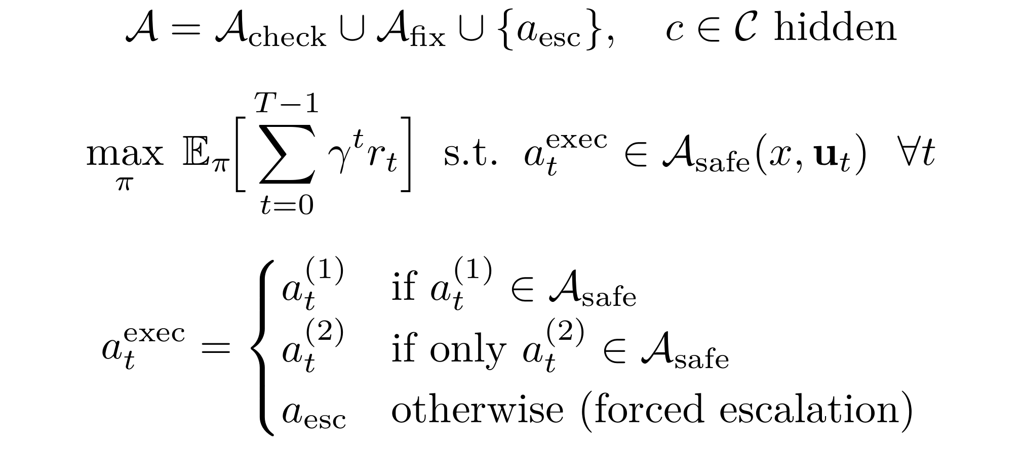
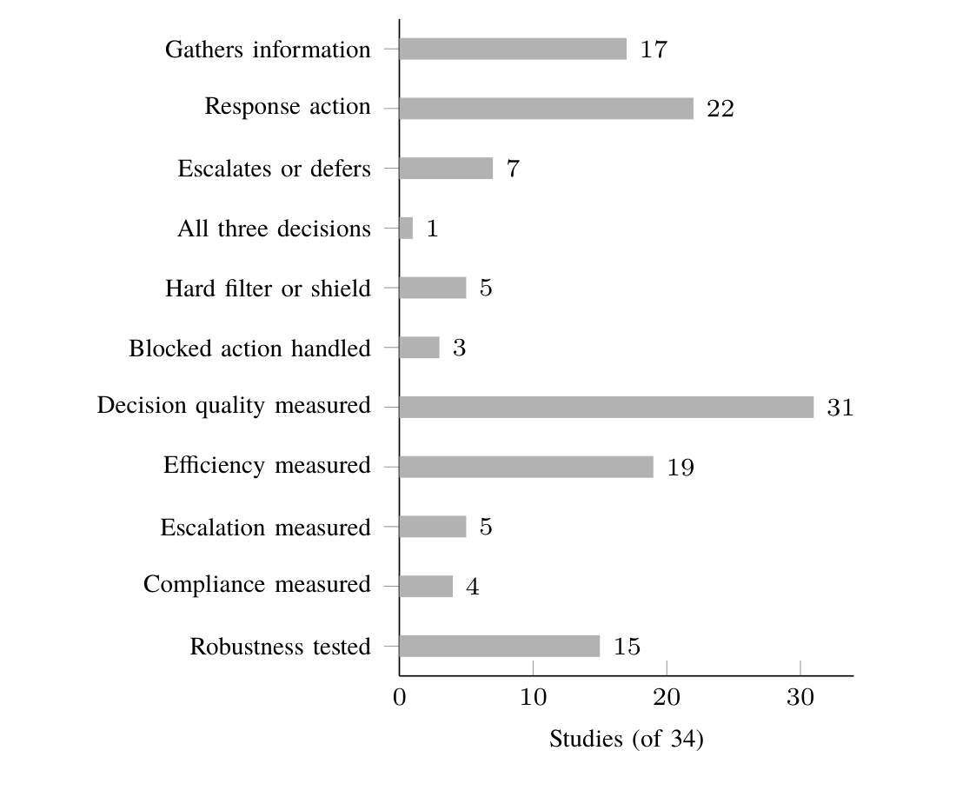
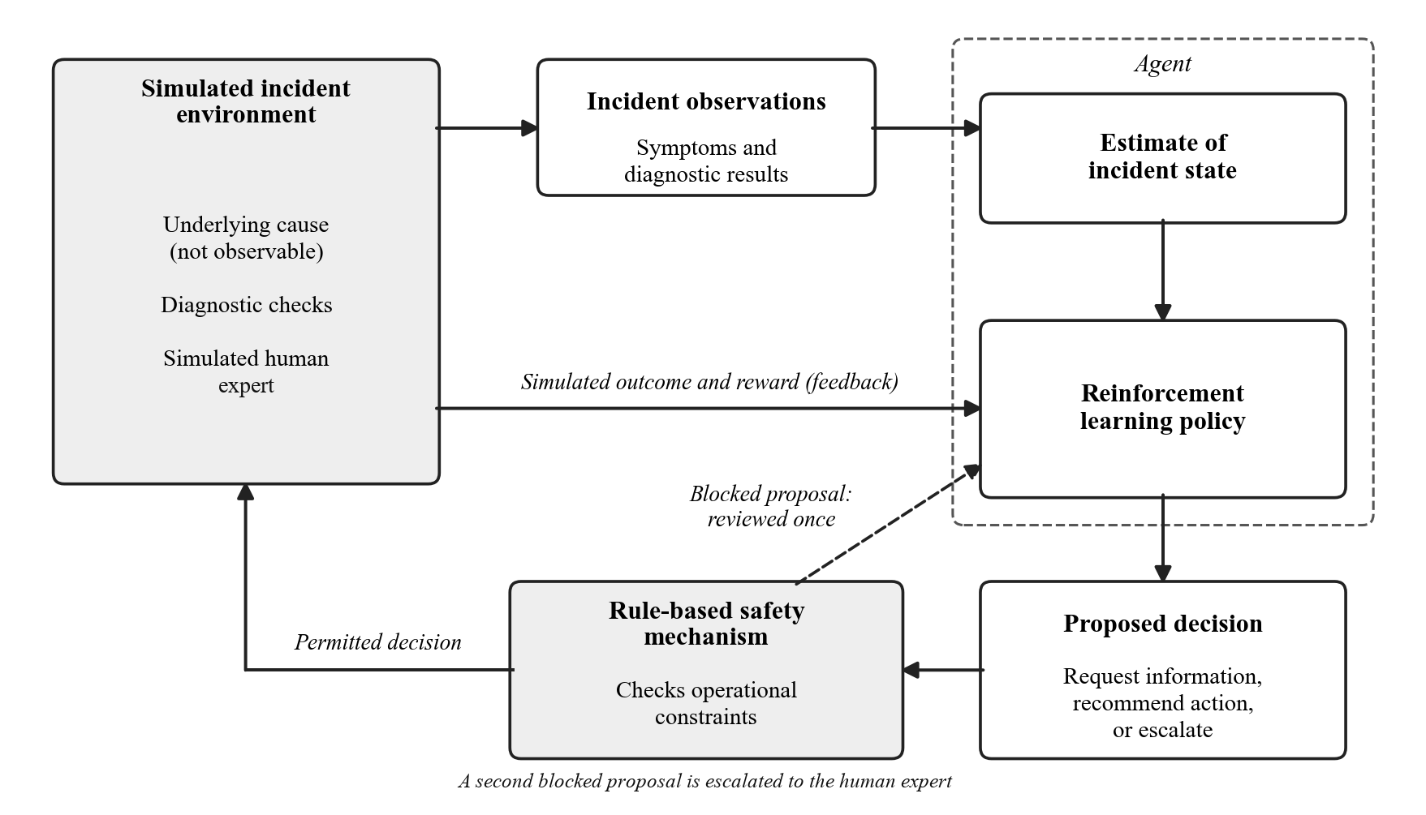
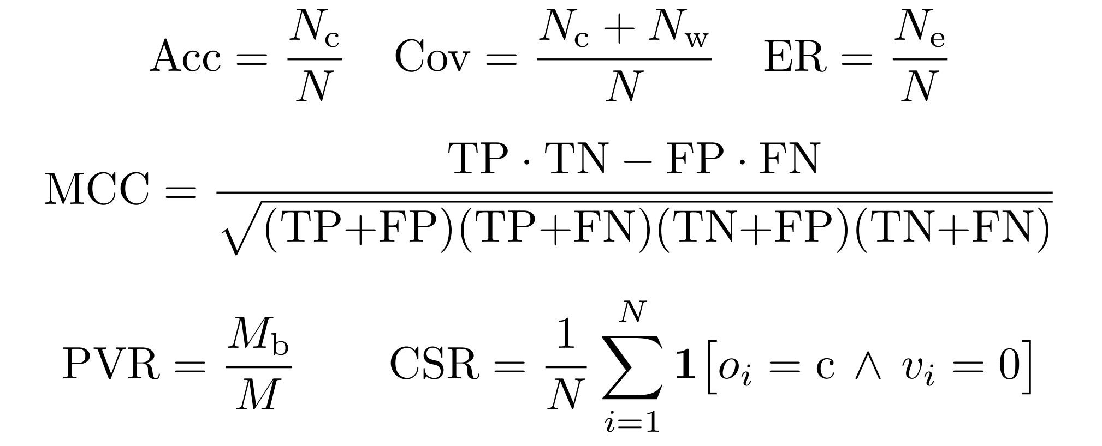
Investigate, Recommend or Escalate: A Rule-Constrained Reinforcement
Learning Agent for IT Incident Triage under Ambiguous Evidence
OPOL CHARIS | S24B23/003 | B29654 | BSc Computer Science
Uganda Christian University | Department of Computing & Technology | Faculty of Engineering, Design & Technology
1. Introduction
3. Problem Statement
7. Methodology
9. Hypotheses & Expected Results
When an IT incident is reported, staff must act before they know its cause: investigate further, apply a likely fix, or pass the incident to someone better placed. The first evidence, an error in the logs or a user's ticket, is often incomplete, unreliable or consistent with several causes.
Most AI tools for IT operations treat triage as a single prediction from the ticket. They cannot ask for more evidence, cannot say that they are unsure, and do not check their suggestions against the organisation's operating rules.
This project designs and evaluates a reinforcement learning agent that learns when to investigate, recommend a permitted fix or escalate.
In the reviewed literature, no evaluated agent for IT service incidents learns when to investigate, when to recommend a fix that the operational rules permit, and when to hand the incident to a person.
The agent is built with the Directorate of University ICT Services (UIS) at Uganda Christian University.
Problem: triage of one incident is a partially observable decision problem (POMDP). The cause is hidden; the agent must maximise expected return while every action carried out is permitted by the rules.
H1: the agent resolves more incidents correctly than the simple baselines, at no higher cost than the scripted checklist. Criteria: a difference of at least 0.05 with non-overlapping 95% intervals.
H2: the agent with the rule mechanism achieves a higher compliant success rate than the unconstrained and penalty-only agents. (Zero executed violations is verified, not tested.)
H3: more missing evidence brings more escalation, not more checks; less reliable evidence brings more checks and fewer fixes; more overlap brings more checks and more escalation.
Prototype: a working simulator, rule mechanism, baselines and trained agents, with a dashboard that replays each incident step by step.
4. Objectives
Build: a simulator from about 15 causes, 20 checks and 10 rules elicited from UIS, with controllable ambiguity.
Train: a deep Q-network that requests checks, recommends permitted fixes or escalates, under a rule mechanism.
Evaluate: against six baselines on decision quality, cost, escalation and compliance, across ambiguity levels.
Objective under the rule constraint, and the two-proposal mechanism
2. Research Gap
Data: a scenario model elicited from UIS staff: causes, checks with effort costs, and rules. No personal data are used.
Environment: a Gymnasium simulation of one incident per episode, with missing, unreliable and overlapping evidence each controlled.
Agent: a deep Q-network (two hidden layers of 128 units) over 36 actions; PPO as a secondary learner.
A systematic review reported following PRISMA 2020 (Scopus, ACM Digital Library, IEEE Xplore) included 34 studies of reinforcement learning for IT and security incidents. Each part of the planned agent appears somewhere, but not together:
10. Next Steps
5. Research Questions
Elicit the scenario model with UIS staff in the week of 26 October 2026, and freeze it after staff review of sample incidents.
Build and test the simulator and rule mechanism, train the agents, run the four experiments, and report the results with a working prototype by 29 November 2026.
RQ1: How can ambiguous UIS incidents be simulated with controllable missing, unreliable and overlapping evidence?
RQ2: How well can an agent learn when to investigate, recommend a permitted fix or escalate, and do the findings hold with PPO?
RQ3: How does the two-proposal rule mechanism affect compliant success and decisions, against no mechanism or a penalty only?
RQ4: How does the agent compare with the baselines as the evidence becomes more ambiguous?
8. Evaluation Plan
Six baselines, same incidents, ten random seeds:
11. National & Global Alignment
Policy | Checks | Fix | Escalate | Rules | Learns
Proposed agent | ✓ | ✓ | ✓ | ✓ | ✓
Initial-symptom | – | ✓ | – | ✓ | –
Scripted checklist | ✓ | ✓ | – | ✓ | –
Always-escalate | – | – | ✓ | ✓ | –
Confidence threshold | ✓ | ✓ | ✓ | ✓ | –
Unconstrained agent | ✓ | ✓ | ✓ | – | ✓
Penalty-only agent | ✓ | ✓ | ✓ | Penalty | ✓
AI & Robotics track: deep reinforcement learning, decision-making under uncertainty and safe RL.
SDG 9: reliable, rule-governed automation of the digital services that infrastructure depends on; local research capability (Target 9.5).
NDP IV: supports the Digital Transformation Programme through reliable delivery of digital services and local AI skills.
Vision 2040: locally developed AI expertise, with ICT as a foundation of national transformation.
6. Conceptual Framework
Studies (of 34) containing each element
Alert-triage agents hand cases over, but none recommends a repair or checks it against rules.
Rule-mechanism studies enforce rules but never learn when to hand over, and disagree on the cost.
Only 3 studies say what happens to a blocked action; none lets the agent propose again.
No reviewed study measures how investigating, acting and escalating change as ambiguity rises.
12. Contacts & Key References
Key measures, where Nc, Nw and Ne count correct, wrong and escalated incidents
Email: charisopol@gmail.com
Phone: 0765821211
Experiments: baselines, rule mechanism, ablations, robustness; mean of ten seeds with 95% bootstrap intervals.
[1] Z. Chen et al., "Towards intelligent incident management: Why we need it and how we make it," ESEC/FSE, 2020.
[2] M. Alshiekh et al., "Safe reinforcement learning via shielding," AAAI, 2018.
The agent proposes; the rule mechanism permits, returns or escalates

