Slide 1


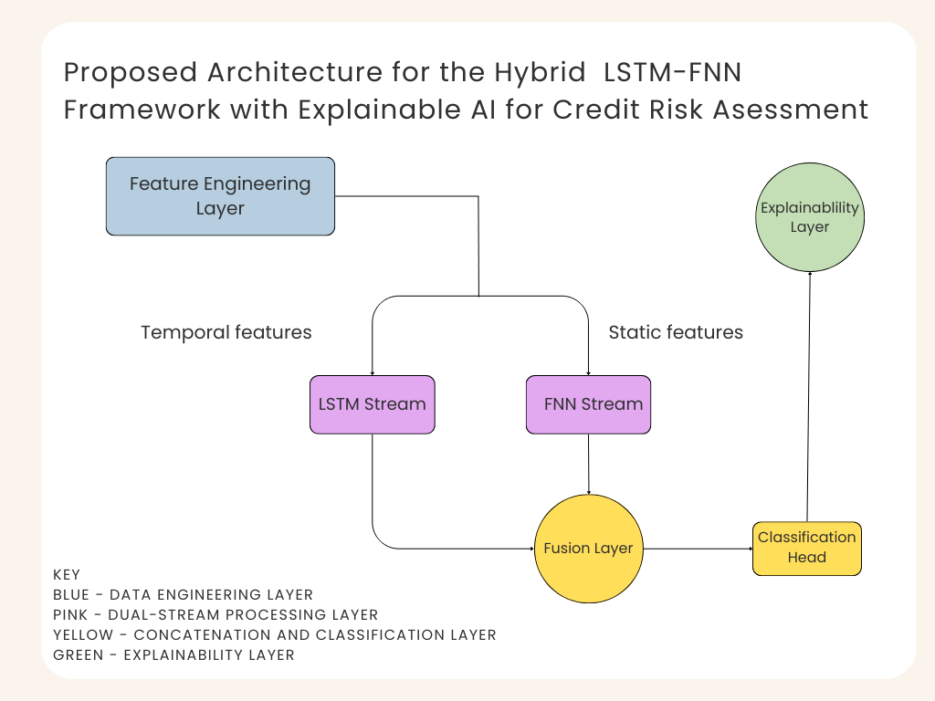
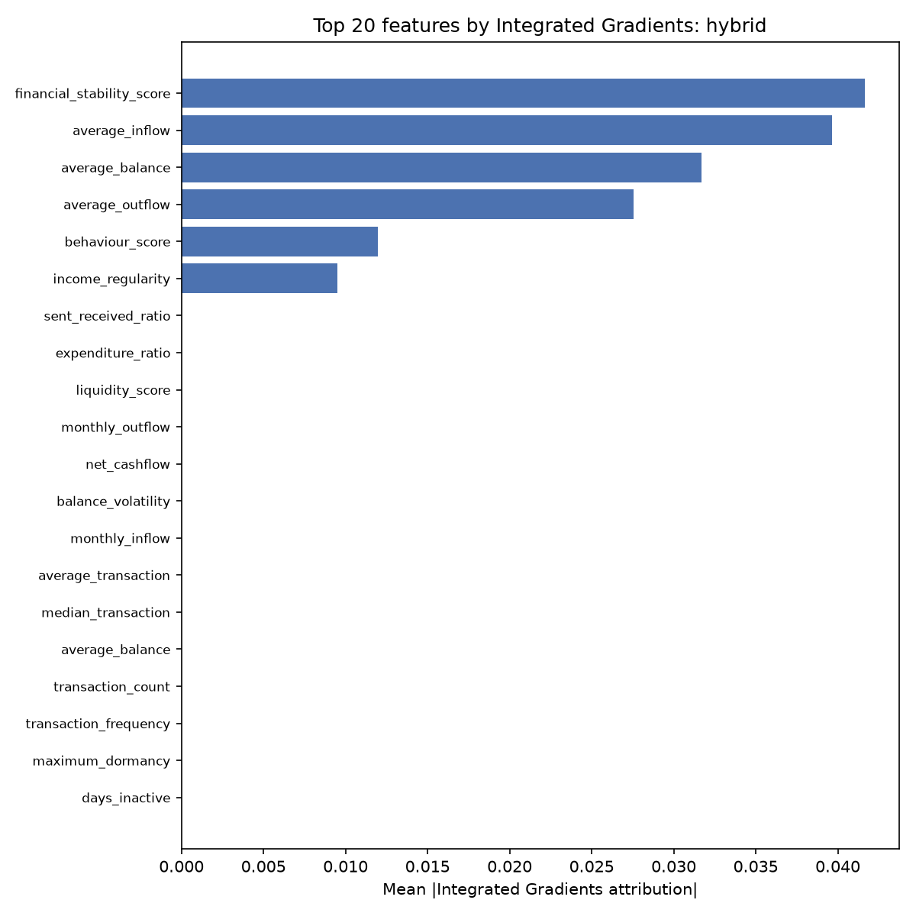
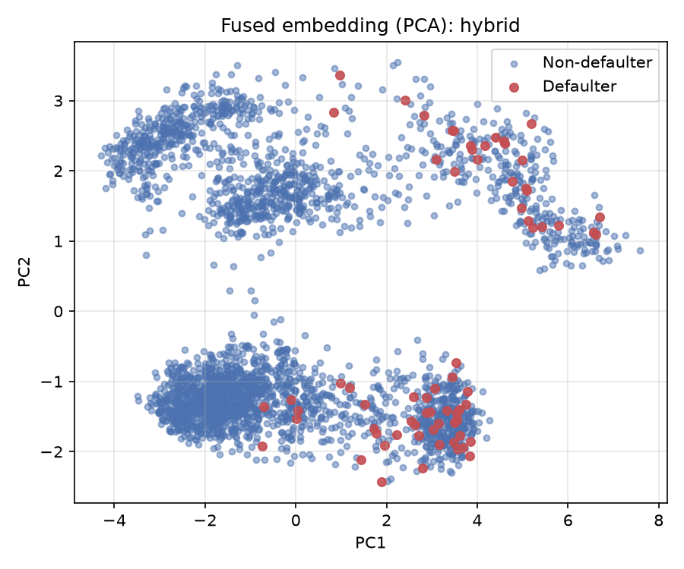
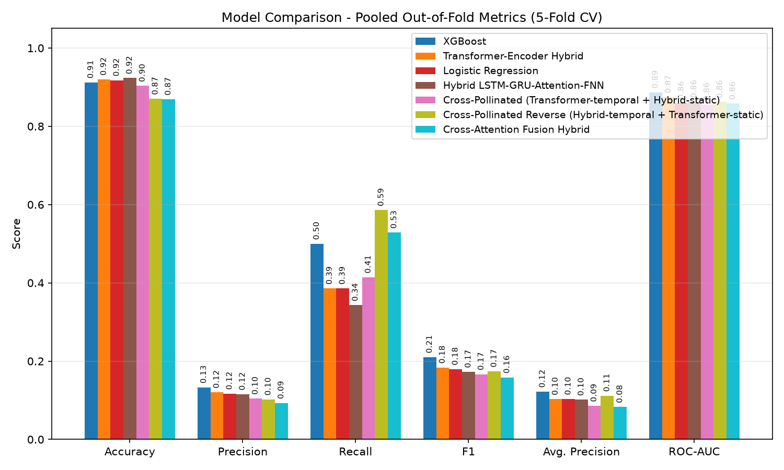
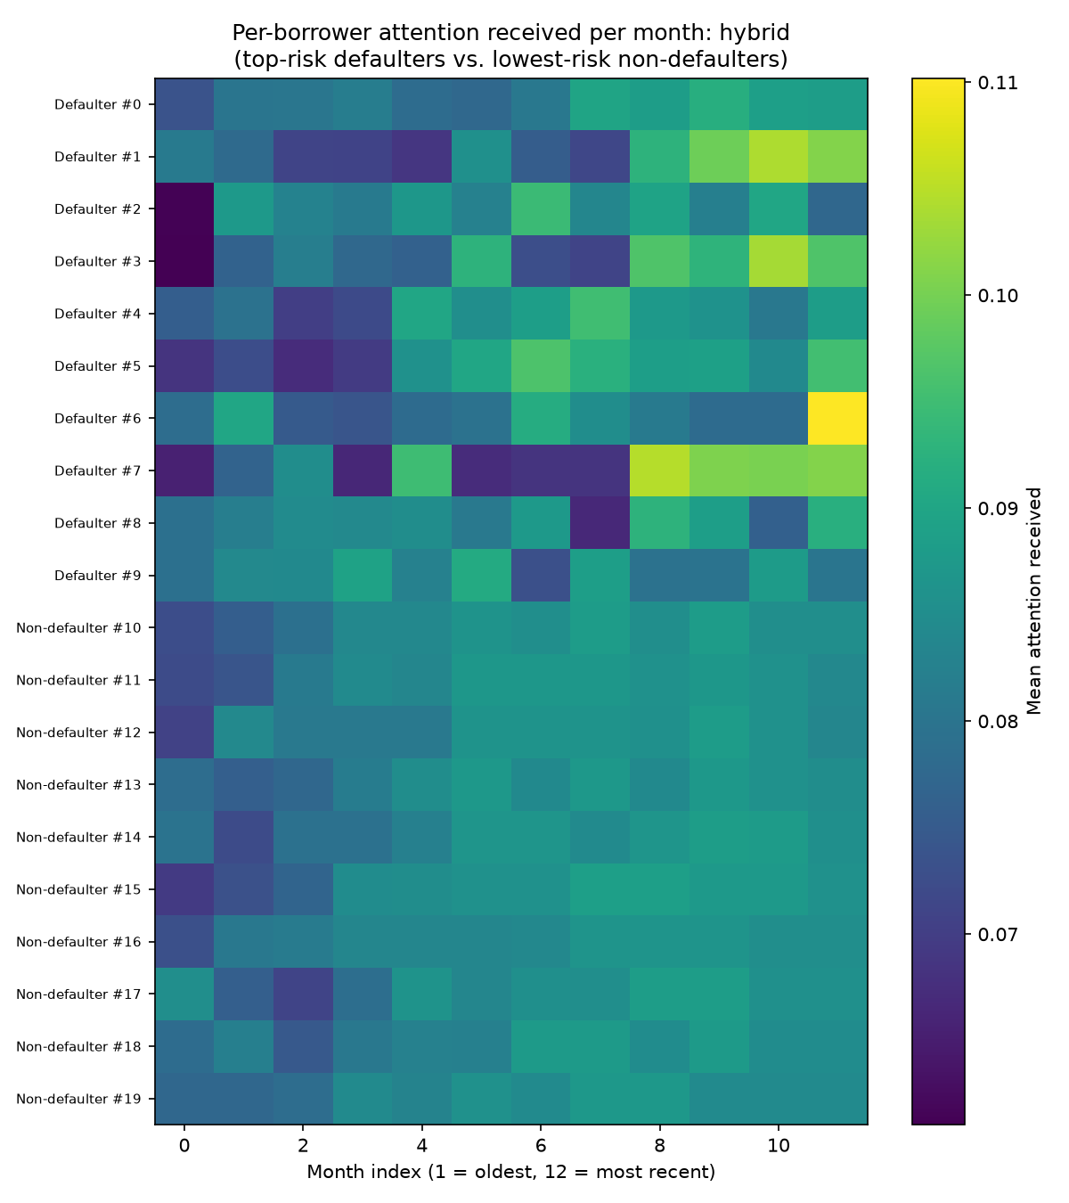
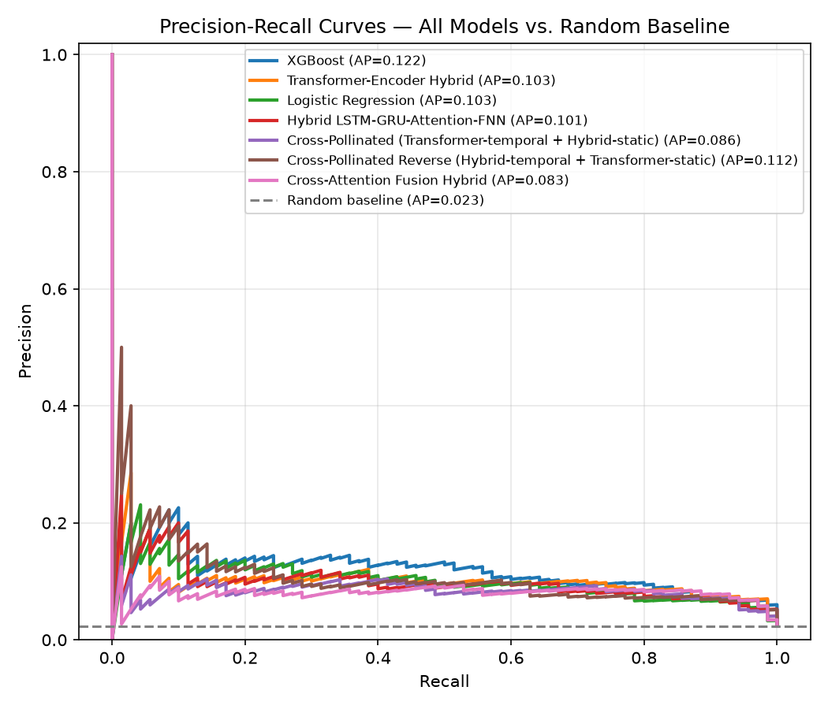
Hybrid LSTM-FNN Framework with Localised Feature Engineering and
Explainable AI for Credit Risk Assessment in Ugandan Micro-Finance Institutions
OPOL CHARIS | S24B23/003 | B29654 | BSCS
Uganda Christian University | Department of Computing & Technology | Faculty of Engineering, Design & Technology
Introduction
Introduction
System Architecture
Results
Areas of Improvement: Interpretability
Uganda's microfinance sector is the primary credit access point for the unbanked, yet it lacks a credit risk system that is accurate, locally calibrated, and explainable. The Bank of Uganda's 2024/2025 Integrated Annual Report notes the banking sector's NPL ratio has declined to roughly 3.7%, while Tier II and III MFIs continue to struggle with high default rates driven by informal borrower data.
Existing deep learning credit models are either unexplainable "black boxes" or trained on Western datasets blind to Uganda's informal economy, agricultural income cycles, mobile money behaviour, and seasonal school-fees patterns.
This project builds and evaluates a Hybrid LSTM-FNN framework with localised feature engineering and a post-hoc explainability layer, trained and benchmarked on 3,000 real Ugandan MFI borrower records.
Pooled out-of-fold metrics, 5-fold CV, on 3,000 borrowers (all models):
Moved beyond SHAP to Integrated Gradients (IG) — per-feature, per-month attributions for every borrower, showing exactly what the model “looks at” when predicting default risk.
Added and benchmarked two new architectures: a Transformer-Encoder Hybrid (self-attention over the 12-month sequence) and a Cross-Attention Fusion Hybrid (temporal & static streams attend to each other directly).
Model | Accuracy | Precision | Recall | F1 | Avg. Precision | ROC-AUC
XGBoost | 91.23% | 13.31% | 50.00% | 0.210 | 0.122 | 0.887
Transformer-Encoder Hybrid | 92.00% | 12.05% | 38.57% | 0.184 | 0.103 | 0.875
Logistic Regression | 91.77% | 11.69% | 38.57% | 0.179 | 0.103 | 0.859
Cross-Pollinated Reverse | 87.03% | 10.22% | 58.57% | 0.174 | 0.112 | 0.862
Hybrid LSTM-Attention-FNN | 92.33% | 11.54% | 34.29% | 0.173 | 0.102 | 0.863
Cross-Pollinated | 90.33% | 10.43% | 41.43% | 0.167 | 0.086 | 0.856
Cross-Attention Fusion Hybrid | 86.90% | 9.32% | 52.86% | 0.159 | 0.083 | 0.858
Problem Statement and Objectives
Implementation
Pooled out-of-fold metrics across all nine model configurations
IG feature importance (Hybrid model)
PCA of fused embedding space
Problem Statement: Uganda's MFI sector lacks a credit risk framework that is accurate, locally calibrated, and explainable. Traditional statistical models miss nonlinear patterns in mobile money data; deep learning models are accurate but operate as black boxes; and most published models are trained on Western datasets, blind to Uganda's informal economy.
As a result, creditworthy smallholder farmers, informal traders, and rural women are denied credit, not because of genuine default risk, but because no framework exists to fairly assess their informal income patterns.
Data: 3,000 synthetic borrower records mobile money transaction histories, and UBOS agricultural calendar data, 70 confirmed defaulters (2.33% base rate).
Features: 47 features engineered into temporal inputs (12 months of transaction behaviour) and static borrower profiles, including composite scores, financial_stability_score, behaviour_score, income_regularity, plus seasonal flags.
Model: dual-stream Hybrid LSTM-Attention + FNN. The temporal stream processes 12 months of transaction behaviour sequentially with an attention mechanism; the FNN stream processes fixed borrower attributes in parallel; both are concatenated and passed to a classification head.
Benchmarking: 5-fold cross-validation with pooled out-of-fold evaluation against Logistic Regression, XGBoost, a Vanilla LSTM, a Transformer-Encoder Hybrid, and a Cross-Attention Fusion Hybrid.
Imbalance handling sweep: class-weighting (0.5×–1.5×) and SMOTE oversampling (0.3–0.5 ratio) tested across every model family.
Explainability: Integrated Gradients computed per borrower, feature, and month, extended from the originally planned SHAP layer for compatibility with the sequential LSTM/Transformer streams.
IG confirms the localisation hypothesis: financial_stability_score, average_inflow, average_balance, average_outflow, behaviour_score and income_regularity drive almost all attributions in both the Hybrid and Transformer models.
Unexpected finding: discrete seasonal flags (harvest, dry season, school-fees, Christmas) contributed ~zero attribution — the composite scores already absorb their signal. Future work should fold seasonality directly into the composite scores rather than as separate dummy flags.
Problem Statement & Objectives
Implementation
All eight model configurations exceeded the ROC-AUC ≥ 0.80 objective (0.836–0.889) therefore localised features carry real predictive signal.
Hybrid LSTM-FNN had the highest accuracy.
Challenges
Objectives
The single biggest challenge was severe class imbalance: only 70 of 3,000 borrowers (2.33%) defaulted. Every model therefore reached deceptively high accuracy (91–93%) simply by predicting “no default” most of the time, while precision stayed low (0.09–0.23), most flagged high-risk borrowers were false alarms.
Attention-by-month heatmaps show defaulting borrowers draw sharply higher attention in specific months versus non-defaulters, whose attention stays flat across the year — evidence the network is learning a meaningful risk signal, not memorising noise. This is echoed in the fused-embedding PCA above, where defaulters and non-defaulters form partially separable clusters.
Engineer localised features from mobile money transactions, UBOS agricultural calendars, and behavioural / financial-stability scores.
Design and train a Hybrid LSTM-FNN architecture (plus Transformer and cross-attention variants) benchmarked against Logistic Regression, XGBoost and vanilla LSTM baselines.
Achieve ROC-AUC ≥ 0.80, which was ACHIEVED (0.836–0.889 across all eight model configurations on 3,000 borrowers).
Implement a post-hoc explainability layer validated against known financial-behaviour drivers which was ACHIEVED and extended from SHAP to Integrated Gradients for the sequential architecture.
47
5-fold
8
Precision-recall curves, all models vs. random baseline
Conclusions & Next Steps
Per-borrower attention received, by month (Hybrid)
Engineered features per borrower
Cross-validation, pooled out-of-fold
Model configurations benchmarked
Other information
Deep learning's underperformance in Ugandan MFIs stems mainly from severe class imbalance and lack of localisation/explainability, not model complexity, a resolvable combination, not a fundamental limit.
Next: formalise data-sharing with more Tier II/III MFI partners to grow the defaulter sample beyond n=70; deploy a threshold/SMOTE-tuned model behind the IG explainability layer in a loan-officer user study; fold seasonal signal into composite scores.
Contacts
Email: charisopol@gmail.com Phone: 0765821211
Key References
1. J. Huang, J. Chai, and S. Cho, “Deep learning in finance and banking: A literature review and classification.”
2. M. A. Rafi, S. M. I. Shaboj, M. K. Miah, I. Rasul, M. R. Islam, and A. Ahmed, “Explainable AI for credit risk assessment: A data-driven approach to transparent lending decisions.”
Alignment with National & Global Agenda
AI & Robotics Specialisation: applies deep learning, neural architecture design, and attention-based explainability.
SDG 8 — Decent Work & Economic Growth: enables MFIs to responsibly extend credit to the informal sector.
SDG 9 — Industry, Innovation & Infrastructure: delivers locally-built AI infrastructure for Uganda's financial sector.
NDP IV & Uganda Vision 2040: supports the 100% financial-inclusion target by 2029/30.
Accuracy alone is unusable here.
Precision-recall curves show every model well above the random baseline (AP 0.023) but rarely above 0.20–0.25 precision at usable recall.
Lesson: the F1 ≥ 0.75 target set at proposal stage was unrealistic for a ~2% base rate, average precision and lift-over-random are more honest benchmarks going forward.
Additional Information

